Slide 1
Respiratory System
Dr Archna Ghildiyal
Associate Professor
Department of Physiology
KGMU

Slide 2
Lecture:10
Contents
Applied-Terminology
Hypoxia

Slide 3
Learning Objectives
Definition of Terms
Cyanosis: Types & Features
Abnormal Breathing
Hypoxia: Types & Physiology

Slide 4
Applied Terms
Apnea: Temperary cessation of respiration
Dyspnea: Difficulty in breathing
Hyperpnea: Abnormal increase in depth and
rate of respiration
Hypercapnoea / Hypercarbia: Increased concentration of CO₂ in blood

Slide 5
Cyanosis
-Physical sign
Bluish discoloration of the skin and mucous membranes
-Due to lack of oxygen in the blood
Associated with cold temperatures, Lung diseases, Heart failure

Slide 6
Cyanosis
Central
Inadequate oxygenation,↓po2 of inspired gas
Heart / Lung disease
Extremities warm & pulsatile
Peripheral blood flow –rapid
Tachycardia
Pulse pressure increased
Peripheral
Blood flow reduced at periphery(vasoconstriction)
Cyanosis due to long stasis time (stagnant hypoxia)
Extremities-cold & blue
Peripheral pulses difficult to detect

Slide 7
Respiratory Acidosis:
Acidosis resulting
from reduced gas exchange in lungs (as in
Emphysema or Pneumonia)
Excess carbon dioxide combines with water to form carbonic acid which
increases the acidity of the blood

Slide 8
Respiratory Alkalosis
A state due to excess loss of CO₂
from body, usually as a
result of hyperventilation
(Anxiety ,Pain, Fever)

Slide 9
Contd…
Bronchial Asthma
Emphysema
Pleurisy
Pulmonary- Fibrosis
-Tuberculosis
-Edema

Slide 10
Abnormal Breathing Pattern
Cheyne-Stokes Breathing
-Periods of apnea punctuated by periods of hyperpnea
-Type of periodic breathing
Occurs in:
Brain stem disease affecting respiratory centers

Slide 11
Kussmaul Breathing
Abnormally deep, very rapid sighing respiration
Characteristic of Diabetic ketoacidosis (Metabolic Acidosis)

Slide 12
Hypoxia
Inadequate oxygen supply to the cells and tissues of the body

Slide 13
Hypoxia-Types
According to cause:
Hypoxic
Anaemic
Stagnant
Histoxic

Slide 14
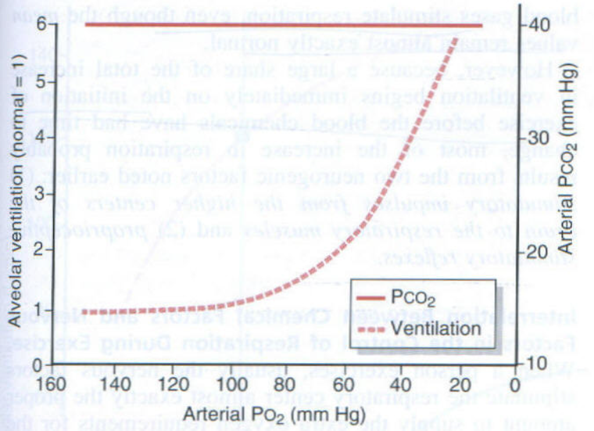

Slide 15
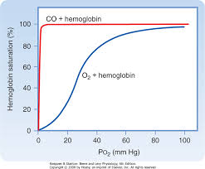
Affinity of CO>O₂

Slide 16
Causes of Hypoxia
1. Inadequate oxygenation of blood in Lungs
-Decreased PO₂ of inspired air(High altitude)
-Hypoventilation
2. Pulmonary disease
-Impaired diffusion
-Ventilation-perfusion mismatches
3. Venous-to-arterial shunt
-Congenital heart disease, Tetralogy of Fallot

Slide 17
Contd…
4. Inadequate O₂ transport to tissues by blood
- Anemia or abnormal Hemoglobin
-Circulatory Deficiency
5. Inadequate tissue capability of using O₂
-Poisoning of cellular oxidation enzymes
-Diminished cellular metabolic capacity for using O₂ (Toxicity)

Slide 18
Effects of Hypoxia
Less Severe:
-Depressed mental activity , sometimes coma
-Reduced work capacity of muscles
Severe: Death

Slide 19
Treatment: O₂ Therapy
Useful :In Hypoxia due to atmosphere (100% effective), Hypoventilation, Impaired alveolar membrane diffusion
Less Useful: In Anaemia, Abnormal Hb, Circulatory deficiency
Not Useful: If Impaired O₂ utilization by tissues (Histotoxic Hypoxia)

Slide 20
References
Guyton & Hall.Text book of Medical Physiology
Ganong’s Review of Medical Physiology
Berne & Levy Physiology
http://meded.ucsd.edu/ifp/jwest/resp_phys/student_files.html

Slide 21
Question:1
In arterial blood, decreased pCO₂, decreased H⁺ and increased pO₂ causes:
A) Hyperventilation
B) Hypoventilation
C) Hypercapnea
D) Hypoxia

Slide 22
Question:2
Severe Hypoxia may produce:
Hypertension
Hypotension
BP fall followed by BP rise
No change

Slide 23
Question:3
Hyperventilation causes:
A) Respiratory acidosis
B) Respiratory alkalosis
C) Metabolic alkalosis
D) Metabolic acidosis

Slide 24
Question:4
Cheyne-stokes breathing is characterized by:
A) Continuous Hyperpnea
B) Increased sensitivity of respiratory centre
C) Fluctuating pO₂ and stable pCo₂
D)Periods of apnea inturrpted by periods of hyperpnea

Slide 25
Question:5
Inability of the tissue to use Oxygen results in which type of Hypoxia?
A) Hypoxic
B) Stagnant
C) Histotoxic
D) Anaemic

Slide 26
Answers
1-B
2-B
3-B
4-D
5-C

