Slide 1
Potential Across The Cell Membrane By Dr. Vani Gupta

Slide 2
“Polarity” of the membrane
Different permeability
Pumps
Protein channels
inside
(in mM)
14
140
0.5
10⁻⁴
(pH 7.2)
10
5-15
2
75
40
outside
(in mM)
142
4
1-2
1-2
(pH 7.4)
28
110
1
4
5
Na⁺
K⁺
Mg²⁺
Ca²⁺
H⁺
HCO₃⁻
Cl⁻
SO₄²⁻
PO₃⁻
protein

Slide 3
The Resting Potential in cells are normally more negative inside than outside. This varies from -9mV to -100mV. This is just the opposite of osmolarity.
Excitable tissues of nerves and muscles cells have higher potentials than other cells (epithelial cells and connective tissue cells).
Dead cells do not have membrane potentials.

Slide 4
The membrane potential is due to the sodium ions found in the extracellular matrix and the potassium ions found in the intracellular matrix

Slide 5
Membrane potentials are due to the diffusion of ions down their concentration gradients, the electric charge of the ion, and any membrane pumps for that ion.
Influx is the net movement of ions into the cell from the ECF.
Efflux is the net movement of ions out of the cell to the ECF.
Flux (the movement of charges) is always measured in millivolts (mV).

Slide 6
Is the membrane permeable to it?
Does it have a concentration gradient?
If the answer is yes to both questions, then the species will diffuse (Which way? Down it’s gradient)

Slide 7
Inside of cell is more negative:
Proteins are abundant inside cell, and are negatively charged at your normal pH.
Na+/K+ ATPase -Two K are pulled in while 3 Na go out., so net loss of one positive charge (net loss of positive charges~ 4mV)
potassium leak -integral proteins. Potassium leaves by leak channels, contributing to negativity. Memb. are 100 time more permeable to K.

Slide 8
Nerve cells-70 mV
Heart cells – 90 mV
some are - 50-60 mV.

Slide 9
Electricity
- - - - - - -
+
+
+
+
+
Current: the flow of charge
Voltage: separation of opposite charges (mV)
Voltage
Voltage difference
Potential difference
Potential
Resistance: opposition to charge movement (friction)
Conductance: allowing a charge to move (permeability)
-
+
What are the charged things that run through our body fluids? Electrolytes!
ions: Na+ K+ Cl- Ca++

Slide 10
When dealing with things that are charged ….
Is the membrane permeable to it?
Is there a chemical gradient for it?
Things tend to move from high to low concentration
Is there an electrical gradient for it?
Things tend to move to regions of opposite charge
- - - - - - -
+
+
+
+
+
+
-
Sometimes, the chemical gradient is favors one ion to go in one direction, and the electrical gradient favors it to go in the other direction. The stronger pull will win.
= Na+

Slide 11
So, we have a battle: diffusion of a chemical gradient and the diffusion of the charges (Electrical potential )
+
−
−
−
−
−
−
−
−
−
−
−
−
−
−
−
−
−
−
−
−
−
−
−
−
+
−
−
When will the negatively charged molecules stop entering the cell?
−
−
−
−
−
−
−
−
−
−
−
−
−
−
−
−
−
−
−
−
−
−
−
−
−
−
−
−
The Nernst potential (equilibrium potential) is the theoretical intracellular electrical potential that would be equal in magnitude but opposite in direction to the concentration force.
In other words: when does the attraction between opposite charges oppose the diffusion of a chemical gradient?
Notes:
In this case we’re changing the electrical potential across the membrane and see what happens to the concn gradient of the ion. In reality, the concentration gradient is changed various cellular processes which determines the Nernst potential.

Slide 12
When the electrical and chemical gradient is equally powerful (in opposite directions)- Nernst potential: No net gain or loss. Cells with resting membrane potential are at - 70mV. They are not at their resting K potential. If more K channels are open , there will be more movement of K out of the cell, and the potential will get closer to-94 mV (at which time, the cell will reach equilibrium, and the cell will die; but the body does not let it get that far).

Slide 13
The electrical potential that counters net diffusion of K⁺ is called the K⁺ equilibrium potential (E_{K}).
The equilibrium potential of K is - 94 mV
So, if the membrane were permeable only to K+, mV would be -94 mV (cell death from equilibrium

Slide 14
Simplest Case Scenario:
inside
outside
If a membrane were permeable to only K⁺ then…
K⁺
K⁺
The electrical potential that counters net diffusion of K⁺ is called the K⁺ equilibrium potential (E_{K}).
So, if the membrane were permeable only to K+, Vm would be -94 mV

Slide 15
Simplest Case Scenario:
inside
outside
If a membrane were permeable to only Na⁺ then…
Na⁺
Na⁺ would diffuse down its concentration gradient until potential across the membrane countered diffusion.
Na⁺
The electrical potential that counters net diffusion of Na⁺ is called the Na⁺ equilibrium potential (E_{Na}).
So, if the membrane were permeable only to Na⁺, mV would be +61 mV

Slide 16
Nernst Equation
Vm = RT/ZF In (X)o / (x)I
Vm= Voltage Equlibrium
R= Gas Constant
T = Temprature
Z= Charge
F= Faraday Constant
X0= Concentration of the ion out side
Xi= Concentration of the ion inside

Slide 17
Membrane Potential: Goldman Equation
P = permeability
at rest: P_{K}: P_{Na}: P_{Cl} = 1.0 : 0.04 : 0.45
Net potential movement for all ions
known V_{m}:Can predict direction of movement of any ion ~

Slide 18
Resting Membrane Potential
Na⁺
Cl⁻
outside
K⁺
+
+
+
+
+
+
+
+
+
+
+
+
+
+
+
+
+
+
+
+
+
+
Membrane
-
-
-
-
-
-
-
-
-
-
-
-
-
-
-
-
-
-
-
-
-
-
inside
A⁻
K⁺
Na⁺
Cl⁻

Slide 19
At resting membrane potential, cell voltage is at - 70 mV.
Since potassium’s chemical equilibrium is - 94, potassium’s chemical equilibrium is not met yet.
That means that it will WANT to flow out of the cell.
But the difference between the voltage of where it is (-70) and where it wants to be (- 94), is only 24 mV.
This is not a very strong difference.
Since sodium’s chemical equilibrium is + 61 mV, sodium’s chemical equilibrium is not met yet.
That means that it will WANT to flow into of the cell.
The difference between the voltage of where it is (- 70) and where it wants to be (+ 61), is 131 mV.
This is a much stronger difference, compared to potassium. Therefore, the ion with the strongest driving force is sodium because its equilibrium potential is much different from the resting membrane potential.
the sodium driving force instead of potassium.

Slide 20
Example: If K_{o} = 5 mM and K_{i} = 140 mM
E_{K} = -61 log(140/4)
E_{K} = -61 log(35)
E_{K} = -94 mV

Slide 21
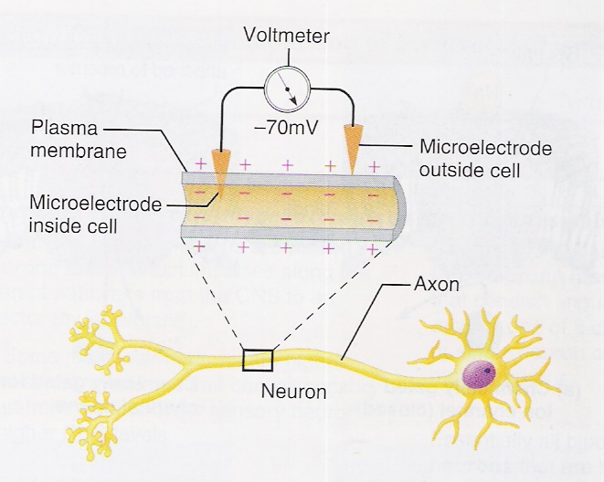
How the Resting Membrane Potential is Measured

Slide 22
Why is Vm so close to E_{K}?
Ans. The membrane is far more permeable to K+ than Na+.
Normal conditions
E_{K} -94
Vm -74
E_{Na}+61
0
mV
20 mV
135 mV
The resting membrane potential is closest to the equilibrium potential for the ion with the highest permeability!
What is the net driving force on K⁺ ions?
What is the net driving force on Na⁺ ions?
Which way do the ions diffuse?
What effect does increasing Na⁺ or K⁺
permeability (or extracellular concn) have on Vm?
Notes:
Each ion diffuse in the direction that will bring the membrane potential toward its Eq potential.
Increasing extracellular K from 4 to 6 mM, will cause EqK to change from -94 to -83.
Increasing extracellular Na from 142 to 162 increases EqNa from 61 to 65. Decreasing
Extracellular Na from 142 to 122 decreases EqNa from 65 to 57. But the main point is that changing
the EqNa has little effect because the membrane is relatively impermeable to Na compared to K.

Slide 23
Definitions:
There is a potential difference (pd) across the cell membrane
(-70 mV) is called the “Resting Membrane Potential”
Because a charge is present (it is not zero), we say the membrane is “polarized”

Slide 24
If it becomes less negative, it is called depolarization (happens when sodium is entering the cell).
If it becomes more negative than - 70, it is hyperpolarization. (happens when K leaves the cell)
In either case, when you go back towards - 70, it is repolarization.
Threshold is the point at which the first voltage-regulated sodium channel opens.

Slide 25
The membrane potential (how negative or positive is) is a number that is a reflection of the ion with the greatest permeability.
If our cells are - 70 mV, it’s because they are most permeable to K. Therefore, K will diffuse out its concentration gradient, taking its positive charges with it, leaving the inside of the cell more negative.
if the cell was more permeable to Na? Sodium would diffuse down its concentration gradient to the inside of the cell, taking its positive charges with it, making the inside of the cell more positive.

Slide 26
If you want more electrical current, open the sodium channels first (instead of the potassium channels). When sodium conductance (permeability) invreases, sodium can move down its electrical gradient as well as its chemical gradient.
Sodium’s equilibrium potential (+61), will make inside of the cell very positive, which is the opposite of the resting membrane potential
(-70). The reversal of the membrane potential is called the ACTION POTENTIAL.

Slide 27
But you cannot let sodium continue on into the cell until it reaches equilibrium, or the cell will not be able to metabolize, and it will die.
To prevent too much sodium from entering the cell, you have to open the K channel to allow K to diffuse out by its chemical and electrical gradients. This is called the dance of the gates.
During an action potential, the sodium gate opens first, the potassium gate opens second.
Something needs to push K back into the cell and Na out: Na-K ATPase (the mother protein, or housekeeping protein).
During action or resting potential, Na-K ATPase is active all the time, constantly trying to reestablish the gradients.

Slide 28
Excitable cells (neurons and muscles) are those that want this large electrical current to use for work.
They have proteins that are sodium channels. Not all cells have these proteins. All cells have the genes to make these proteins, but only the excitable cells EXPRESS these genes, and actually make the proteins that fuse with the cell membrane and form a sodium channel.
Muscle cells use the electrical force to contract, and neurons use it to excite the neurons touching them.

Slide 29
Cells that can experience a momentary change in membrane voltage are “excitable” cells
That temporary change in voltage is due to a momentary change in permeability
The membrane, for only a moment, becomes more permeable to Na⁺ than to K⁺
an Action Potential-it is a reversal of the membrane potential!
Cell becomes positive inside!!!

Slide 30
What keeps the ion gradients from running down? The sodium/potassium ATPase
inside
outside
K⁺
Na⁺
Na+
ATP
K+
3 Na⁺
2 K⁺
ADP
Remember: sodium is pumped out of the cell, potassium is pumped in...
Integral membrane protein found in all cells which “pumps” (against their gradients across the membrane) Na and K.
Fueled by ATP
ATP ADP + Pi + energy
This pump is electrogenic, it contributes slightly to RMP

Slide 31
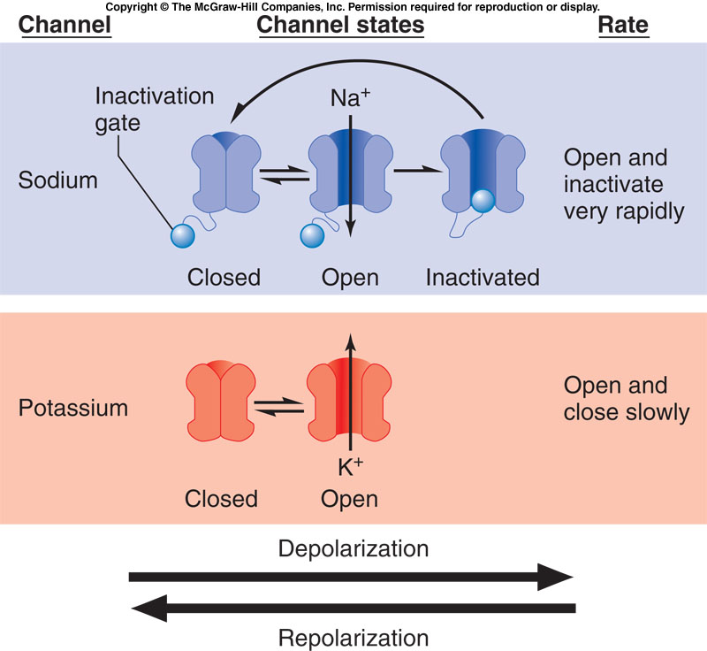
Sodium channels have 2 gates, a normal voltage (activation) gate (which is closed at rest) and an inactivation gate (which is open at rest). The rapid opening of the voltage gate lets Na⁺ rush in and depolarizes the cell. This is immediately followed by closing of the inactivation gate which stops the Na⁺ influx. At the same time the K⁺ gate opens letting K⁺ efflux (repolarization).
Widmaier, et al., 2006

Slide 32
Hodgekin and Huxley put one of these neurons in an isosmotic solution and inserted four wires along the axon, distal to the hillock. The first wire was attached to an instrument that can inject a positive charge into the cell (increasing its membrane potential). The next three wires (R1, R2, R3) received the signal and measured the resulting charge.

Slide 33
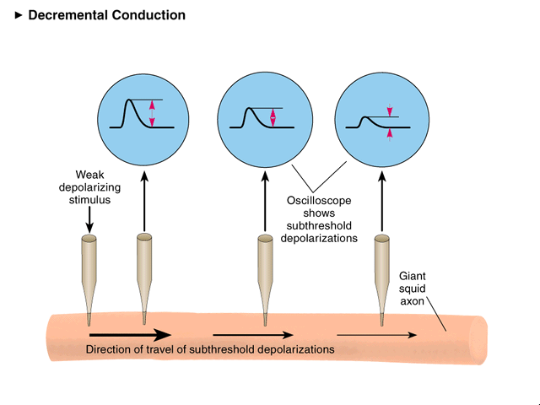
First try: a small depolarizing stimulus (-65 mV)
+40 -
+30 -
+20 -
+10 -
0 -
-10 -
Voltage (mV)
-20 -
-30 -
-40 -
-50 -
-60 -
-70 -
time
Stim Elec
REC 1
REC 2
REC 3
++++
++
+
+++

Slide 34
Next try: a slightly larger depolarizing stimulus (-60 mV)
+40 -
+30 -
+20 -
+10 -
0 -
-10 -
Voltage (mV)
-20 -
-30 -
-40 -
-50 -
-60 -
-70 -
time
Stim Elec
REC 1
REC 2
REC 3
++++++
++++++
+++
++

Slide 35
Next try: a slightly larger depolarizing stimulus (-55 mV)
+40 -
Action Potentials
+30 -
+20 -
+10 -
0 -
Local Potentials
-10 -
Voltage (mV)
-20 -
-30 -
RMP
-40 -
-50 -
-60 -
-70 -
time
Stim Elec
REC 1
REC 2
REC 3
+++++++++
+++++++++
+++++++++
+++++++++

Slide 36
Can we get even larger Action Potentials?
Try an even larger depolarizing stimulus (-50 mV)
+40 -
Action Potentials
+30 -
+20 -
+10 -
0 -
Local Potentials
-10 -
Voltage (mV)
-20 -
-30 -
RMP
-40 -
-50 -
-60 -
-70 -
time
Stim Elec
REC 1
REC 2
REC 3
- - - - -

Slide 37
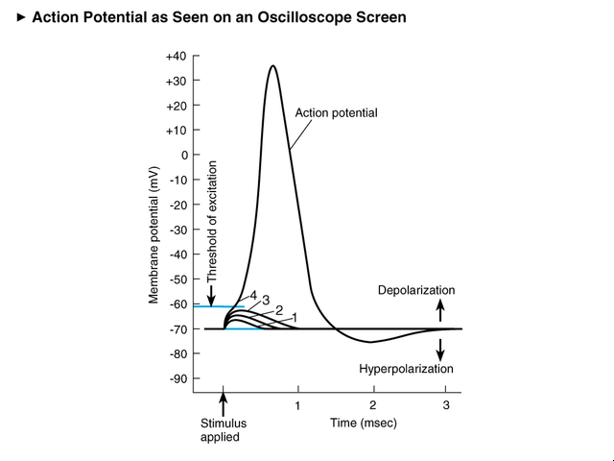
Definition:
Threshold voltage is the minimum voltage needed to trigger an AP. to open voltage operated channels
Note the timeframe for one AP

Slide 38
Parts to an action potential:
Upstroke: Na is more permeable, cell becomes less negative
Downstroke: K permeability is greater, cell returns toward negative, repolarization.
Hyperpolarization: Dips below line

Slide 39
Compare LP to AP
Local Potentials
Generally, they reflect shape, size of voltage stimulus (similar to stimulus pulse)
They are graded in size (ie. bigger stimuli give bigger depolarizations)
They “die out” (voltage grows smaller) as they move from site of stimulation (resistance!)
Action Potentials
They don’t reflect the shape, size of the stimulus, rather they are uniform in size, shape; always identical
They are “all-or-none” (ie. either you trigger an AP if you reach threshold – or if subthreshold, you don’t get an AP – get local potential.)
They do not diminish in size no matter how far from the stimulus; regenerate anew at each point along the axon

Slide 40
As sodium channels open, it is recorded on a machine as an upstroke.
The peak of the curve shows that Na channels are deactivated, so K channels open, recorded on the machine as a downstroke.
Na- Channel have three gated properties, like a stop light: red, yellow, green. If a light is green, you are conducted through intersection. When the light is yellow, you should slow down and not go through the intersection. Likewise, in the middle position, the sodium voltage channel prohibits further sodium from crossing the channel.

Slide 41
Yellow lights do not turn green. It has to turn red first. There are 2 amino acid lids (gates); an external and internal gate. Together, they are shaped like a ball and chain. When the voltage becomes positives, the AA’s change their charge, and their ball and chain will rock over and cover up the channel. This state (yellow light) means inactivation. The amino acids have to change their charge to move back out of the way (red light), meaning deactivation. Then the channel can become active again. It is a safely mechanism, insuring that another neuron cannot fire another action pot before it is ready to receive one.

Slide 42
When the gated channel is yellow, it is in absolute refractory period. This means that it cannot go from yellow to green. When enough channels are deactivated (red light), they can open again. Then neuron can fire again. if you need neurons to fire quickly, you need greater stimulus.

Slide 43
Sodium channels have 2 gates, a normal voltage (activation) gate (which is closed at rest) and an inactivation gate (which is open at rest). The rapid opening of the voltage gate lets Na⁺ rush in and depolarizes the cell. This is immediately followed by closing of the inactivation gate which stops the Na⁺ influx. At the same time the K⁺ gate opens letting K⁺ efflux (repolarization).
Widmaier, et al., 2006

Slide 44
Gated Ion Channels
Allow simple diffusion
Can open and close
Are selective
VGC (Voltage-gated channels): Open/close depending on the voltage across the membrane
Na+ VGC, K+ VGC, Ca++VGC
Located on the axon, at hillock and beyond
LGC (Ligand-gated channels): are not dependent on membrane potential but binding
of ligands (e.g. neurotransmitters)
Neurotransmitter receptors
Located on dendrites and cell body, above hillock
in
out
Na⁺ and other ions
Na⁺

Slide 45
The occurrence of action potentials means the gated channels are open. When they are open, ATP is not used, it is simple diffusion. But resting membrane potential requires ATP to keep it at steady state. Homeostasis (steady state) requires a lot of energy (ATP). Homeostasis is the opposite of equilibrium. If the cell voltage reaches - 94, it is at equilibrium, no driving force is present, cell death.

Slide 46
Properties of action potentials
Action potentials:
are all-or-none events
threshold voltage (usually 15 mV positive to resting potential)
+60
0
mV
threshold
are initiated by depolarization
action potentials can be induced in nerve and muscle by extrinsic (percutaneous) stimulation
have constant amplitude
APs do not summate - information is coded by frequency not amplitude.
-70
Stimulus
75
Myelinated
(cat)
have constant conduction velocity
True for given fiber. Fibers with large diameter conduct faster than small fibers. As a general rule:
50
Velocity (m/s)
non-myelinated
(squid)
25
myelinated fiber diameter (in mm) x 4.5 = velocity in m/s.
Square root of unmyelinated fiber diameter = velocity in m/s
0
0
3
6
9
12
15
0
400
800
Fiber diameter (μm)

Slide 47
The AP - membrane permeability
+61
E_{Na}
During the upstroke of an action potential:
Na permeability increases
due to opening of Na⁺ channels
memb. potential approaches E_{Na}
0
downstroke
upstroke
(mV)
resting potential
During the downstroke of an action potential:
Na permeability decreases
due to inactivation of Na⁺ channels
-90
E_{K}
1 ms
Membrane
hyperpolarized
K permeability increases
due to opening of K⁺ channels
mem. potential approaches E_{K}
Na⁺ channels
After hyperpolarization of membrane following an action potential:
K⁺ channels
Number of open channels
not always seen!
There is increased K⁺ conductance
due to delayed closure of K⁺ channels
Copyright © 2006 by Elsevier, Inc.

Slide 48
Saltatory Conduction
AP’s only occur at the nodes (Na
channels concentrated here!)
increased velocity
energy conservation
Figure 5-17; Guyton & Hall

Slide 49
Multiple Sclerosis
Patients have a difficult time describing their symptoms. Patients may present with paresthesias of a hand that resolves, followed in a couple of months by weakness in a leg or visual disturbances. Patients frequently do not bring these complaints to their doctors because they resolve. Eventually, the resolution of the neurologic deficits is incomplete or their occurrence is too frequent, and the diagnostic dilemma begins.
- MS is an immune-mediated inflammatory demyelinating disease of the CNS -
- About 1 person per 1000 in US is thought to have the disease - The female-to-male ratio is 2:1 - whites of northern European descent have the highest incidence
http://www.emedicine.com/pmr/topic82.htm
Copyright © 2006 by Elsevier, Inc.

Slide 50
Q.1 Inside the cell are more negative because of-
Slow Na Channel
Na-K ATPase
Leaky K channel
Fast K channel.
Notes:
Ans-c

Slide 51
Q.2 Resting Membrane potential is –
a). Equal to Nernst Equilibrium for K⁺
^{b).} Equal to Nernst Equilibrium for Na⁺
c). Much more near to Nernst Equilibrium for K⁺
^{d).} Much more near to Nernst Equilibrium for Na⁺
Notes:
Ans-c

Slide 52
Q.3) Resting membrane potential for Cardiac Cell Is-
a). -60 mv
b). -90 mv
c). -80 mv
d).-70 mv.
Notes:
Ans-b

Slide 53
Q.4. The depolarization of a cell membrane is due to-
a). Entry of more K⁺
^{b).} Entry of more Na⁺
^{c).} Entry of more Ca⁺⁺
^{d).} Entry of more Cl⁻
Notes:
Ans-b

Slide 54
q.5. Cell death occurs when membrane potential for K⁺ became equal to-
a). Nernst equilibrium potential for Na.
b). Nernst equilibrium potential for K.
c). Nernst equilibrium potential for Ca.
d). Nernst equilibrium potential for Cl.
Notes:
Ans-b

Slide 55
Q.6. ATP is required
a). Opening of Na+ channel
b). Closing of Na+ Channel
c). Maintenance of steady state of membrane potential.
d). Opening of K+ channel.
Notes:
Ans-c

Slide 56
Q.7. During Hyper polarization –
a). Increase permeability of K+
b). Decrease permeability of K+
c). Increase permeability of Na+
d). Decrease permeability of Na+
Notes:
Ans-a

Slide 57
Q.8. Action potential travel through –
a). Nodes of Ranveir
b). Over the myelin sheath.
c). Under the myelin sheath.
d). Across the cell membrane of mylinated nerve.
Notes:
Ans-a

Slide 58
Q.9. Conductance of nerve impulse is faster at-
a). Mylinated nerve
b). Non mylinated nerve
c). Thin nerve
d). Thick Nerve
Notes:
Ans-a

Slide 59
Q.10. Nernst equilibrium for Na+ is
a). - 61 mv
b). –94 mv.
c).+94 mv
d). + 61mV.
Notes:
Ans-a

Slide 60
Q-11.Why are neuronal cells and muscle cells able to change their membrane potential?
a). They have gene for Na-K ATPase protein.
b). They have expressible gene for Na-K ATPase.
c). They have high permeability for K
d). They have high permeability for Na.
Notes:
Ans-b

Slide 61
Q.12 Action potential only travels on node of ranveir because-
a). Nodes of ranveir are unmylenated.
b). Na-K ATPase are more concentrated at nodes of ranveir.
C). Na-K ATPase are only present at nodes of ranveir.
d). Conductance of K is high at Nodes of ranveir>
Notes:
Ans-c

Slide 62
Q.13 Threshold voltage is define as-
a). Voltage at which Na-K ATPase starts opening.
b). Voltage at which Action Potential starts .
C). Voltage at which depolarization starts .
d). Voltage at which nerve became excitable.
Notes:
Ans-b

Slide 63
Q.14 Action potential have-
a). Property of summation
b). Constant amplitude
c). Variable amplitude
d). Can not propogate.
Notes:
Ans-b

Slide 64
Q-15 Na- K ATPase have-
a). Activated and deactivated stage
b). Activated , Inactivate and deactivated stage.
c). Allows only Na to Pass.
d). Need energy during open
Notes:
Ans-b

Slide 65
Q-16- Which of the fallowing experiment shows that AP develop when potential reaches to thresh hold potential-
a). Goldman
b). Godbin Galbin
c). Hodgkin Huxley
d). Nernst Huxley.
Notes:
Ans-c

