Slide 1
MICROANATOMY OF GINGIVA
Gingiva consists of two parts :
Epithelium (stratified squamous epithelium)
Connective tissue.

Slide 2
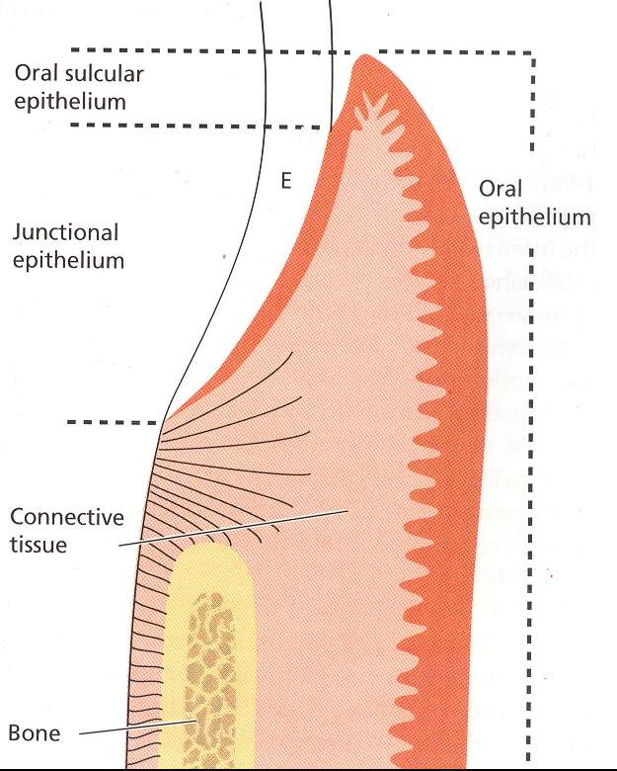
GINGIVAL EPITHELIUM
can be divided into :
Oral / outer Epithelium - faces the oral cavity
Sulcular Epithelium – faces the tooth without being in contact with it.
Junctional Epithelium - provides the contact between the tooth and gingiva.

Slide 3
General Aspects Of Gingival Epithelium
Principal cell type of gingival epithelium is:
Keratinocyte
Non-keratinocytes
Langerhan cells
Merkel cells
Melanocytes
Inflammatory cells

Slide 4
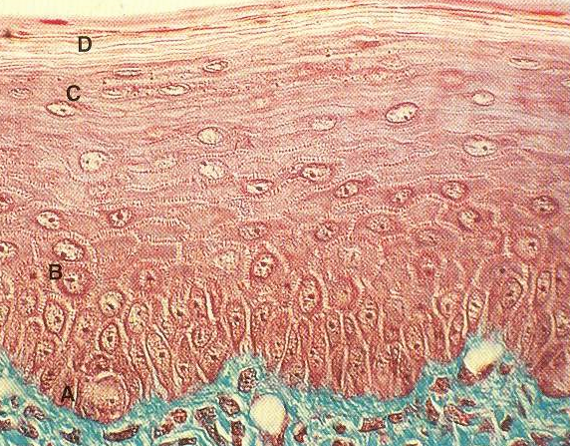
Distinct layers or strata of epithelium:
A. Stratum Basale
B. Startum Spinosum
C. Stratum Granulosum
D. Stratum Corneum

Slide 5
FUNCTIONS OF GINGIVAL EPITHELIUM
To protect the deep structures.
Selective interchange with oral environment

Slide 6
Different types of epithelial surface layers
Orthokeratinization
Complete keratinization process
Superficial horny layer similar to that of skin
No nuclei in the str. Corneum
Well defined str. Granulosum with keratohyaline granules
15%

Slide 7
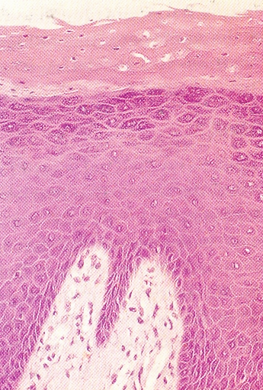
Parakeratinization
Pyknotic nuclei in Str. Corneum
Keratohyaline granules are disperse not giving rise to str. Granulosum
75%

Slide 8
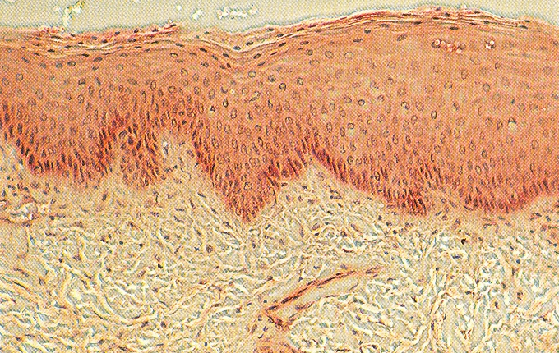
Non keratinization
Superficial cells have viable nuclei
No str. Corneum and no str. Granulosum
10%

Slide 9
Main protein in gingival epithelium
KERATIN
composed of
Different polypeptide subunit
characterized by
Their molecular wt
Iso-electric point

Slide 10
Nonkeratin proteins
Keratolinin
Involucrin
Filaggrin

Slide 11
Corneocytes
Contains bundles of keratin tonofilaments in matrix of filaggrin.
Surrounded by envelop under the cell membrane.

Slide 12
In electron microscopy- reveals that keratinocytes are interconnected by-
Desmosomes
2. Tight junctions (zonae occludens)

Slide 13
Nonkeratinocytes
MELANOCYTES-
1. Are dendritic cells
2. Located in basal and spinus layer
3. Synthesize melanin in the organells called Premelanosomes/ Melanosomes

Slide 14
LANGERHANS CELL
1. Dendritic cells -suprabasal layers.
2. Belong to Mononuclear phagocyte system
3. Act as antigen presenting cells (APC)
4. Contain g-specific granules (Birbeck’s granules) which are rod or flask shaped granules.
5. Marked ATPase activity.

Slide 15
MERKEL CELL
1. Located in deeper layer of epithelium
2. Tactile perceptors
3. Free nerve endings.

Slide 16
BASAL LAMINA
Epithelium is joined by underlying connective tissue by a basal lamina.
Thickness– 300-400 A*
Lying 400 A* below epithelial basal layer.

Slide 17
thank you

Slide 18
1. The epithelium of gingiva is:
(a)Simple squamous epithelium
(b)Stratified squamous epithelium
(c)Stratified columner epithelium
(d)Stratifiedcuboidal epithelium

Slide 19
2. Main protein of gingival epithelium is:
(a) Keratolinin
(b) Keratin
(c) Involucrin
(d) Filaggrin

