Slide 1
MULTIPLE CHOICE QUESTIONS- MECHANICAL PLAQUE CONTROL

Slide 2
Q1: THE RECOMMENDED METHOD OF BRUSHING IN MOST PATIENTS IS:
FONES METHOD
ROLL METHOD
BASS METHOD
SCRUB METHOD

Slide 3
Q2: RECOMMENDED BRUSHING TIMS IS:
30 SEC
60 SEC
90 SEC
120 SEC

Slide 4
Q3: CHARTER METHOD HAS BRUSHING MOVEMENT IN:
VIBRATORY MOTION
ROTATORY MOTION
HORIZONTAL MOTION
VERTICAL MOTION

Slide 5
Q4: THE METHOD SUITED FOR CHILDREN ARE:
BASS METHOD
CHARTER METHOD
FONES METHOD
STILLMAN METHOD

Slide 6
Q5: THE EXPERIMENTAL GINGIVITIS WAS DONE WITH NO ORAL HYGIENE MEASURES IN:
21 DAYS
14DAYS
7 DAYS
3 DAYS

Slide 7
LECTURE II

Slide 8
Q6: THE DETERGENT USED IN DENTIFRICE IS:
BAKING SODA
SODIUM LAURYL SULPHATE
SODIUM MONOPHOSPHATE
SILICA OXIDE

Slide 9
Q7: THE AMOUNT OF PERMISSIBLE FLOURIDE IN A DENTIFRICE ARE:
120 MG
260 MG
360 MG
290 MG

Slide 10
Q8: POWERED TOOTHBRUSHES ARE EFFECTIVE IN:
NORMAL PATIENTS
HANDICAPPED PATIENTS
PATIENTS WITH GOOD MOTOR SKILLS
NONE OF THE ABOVE

Slide 11
Q9: DEGREE OF ABRASIVE ACTION DEPENDS ON:
SIZE OF THE ABRASIVE PARTICLES
HARDNESS OF TOOTHBRUSH BRISTLES
BRUSHING PRESSURE
ALL OF THE ABOVE

Slide 12
Q10:USE OF WATER INSTEAD OF HUMECTANT LEADS TO :
CAKING OF THE TOOTHPASTE
SHORT SHELF LIFE
BOTH OF THE ABOVE
NONE OF THE ABOVE

Slide 13
LECTURE III

Slide 14
Q11: DENTAL FLOSS IS EFFECTIVE IN :
TYPE I EMBRASURE
TYPE II EMBRASURE
TYPE III EMBRASURE
TYPE IV EMBRASURE

Slide 15
Q12: TYPE III EMBRASURE IS:
PAPILLA COMPLETELY FILLING THE INTERDENTAL AREA
PAPILLA SLIGHTLY FILLING THE INTERDENTAL AREA
PAPILLA TOTALLY MISSING
NO RELATION TO INTERDENTAL PAPILLA

Slide 16
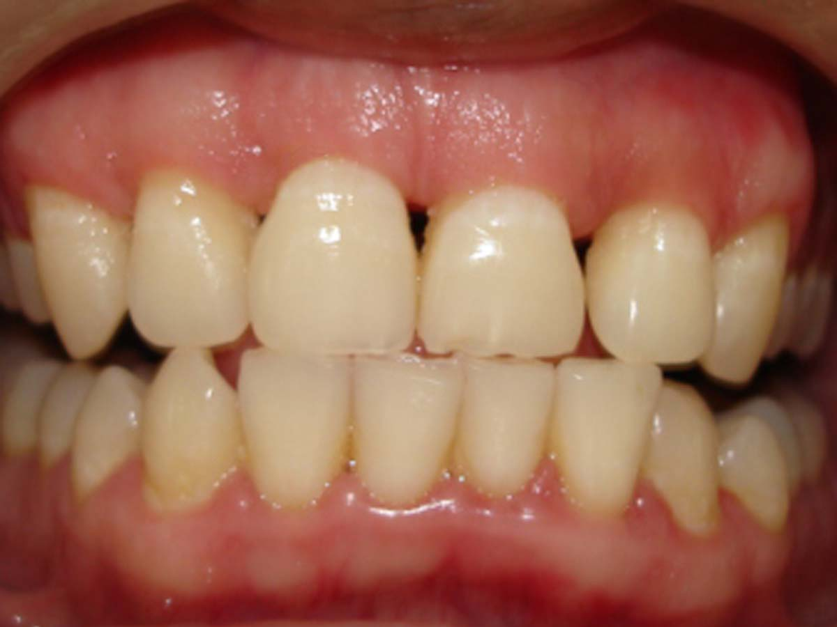
Q13: INTERDENTAL SPACE IN CENTRAL INCISORS OF MAXILLARY TEETH DEPICT :
TYPE I EMBRASURE
TYPE II EMBRASURE
TYPE III EMBRASURE
TYPE IV EMBRASURE

Slide 17
Q14: INTERDENTAL SPACE IN INCISORS OF MANDIBULAR TEETH DEPICT :
TYPE I EMBRASURE
TYPE II EMBRASURE
TYPE III EMBRASURE
TYPE IV EMBRASURE

Slide 18
Q 15: THE METHOD OF PLAQUE REMOVAL IN TEETH WITH ROOT CONCAVITIES IS:
DENTAL FLOSS
WOODEN TIP
TOOTH BRUSH
INTERDENTAL BRUSH

