Slide 1
Implants and Instruments

Slide 2
What does the examiner expect…?
Ability to identify
Ability to categorize
Method to use
Related surgical procedures

Slide 3
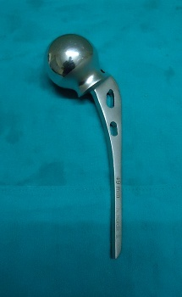
AUSTIN MOORE PROSTHESIS
UNIPOLAR
FENESTRATINS FOR BONE GRAFT
USED IN HEMIREPLACEMENT OF HIP JOINT

Slide 4
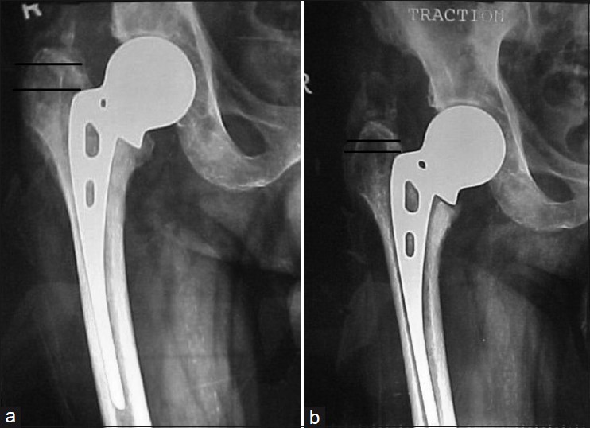

Slide 5
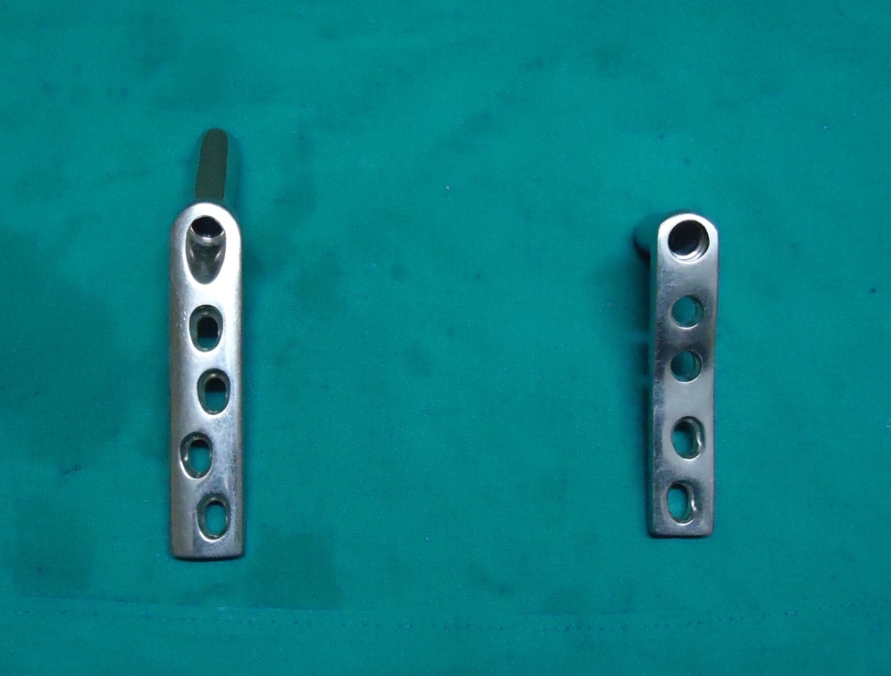
DHS
USED TO FIX INTERTROCHANTERIC HIP FRACTURES

Slide 7
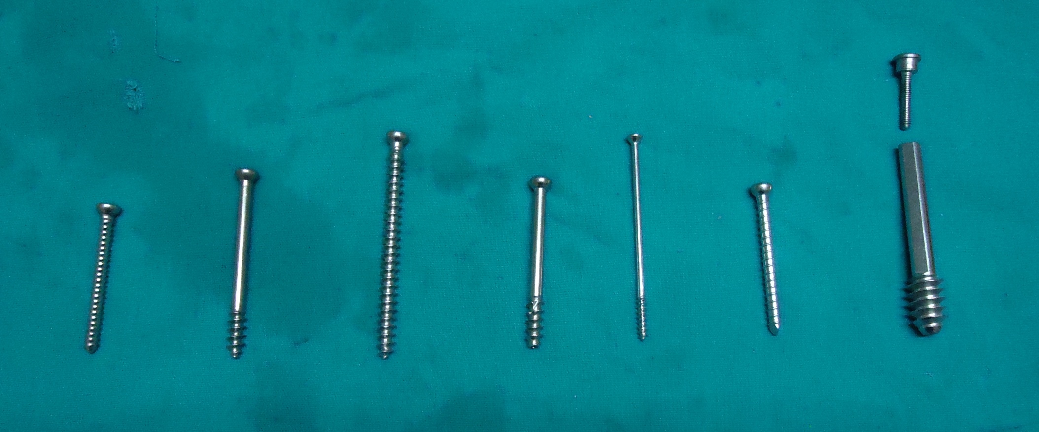
SCREWS
CORTICAL SCREW
PARTIALLY THREADED CANCELLO-US SCREW
FULLY THREADED CANCELLO-US SCREW
PARTIALLY THREADED CANCELLO-US CANNULATEDSCREW
MALLEOLAR SCREW
INTERLOCKING BOLT
RICHARD SCREW

Slide 10
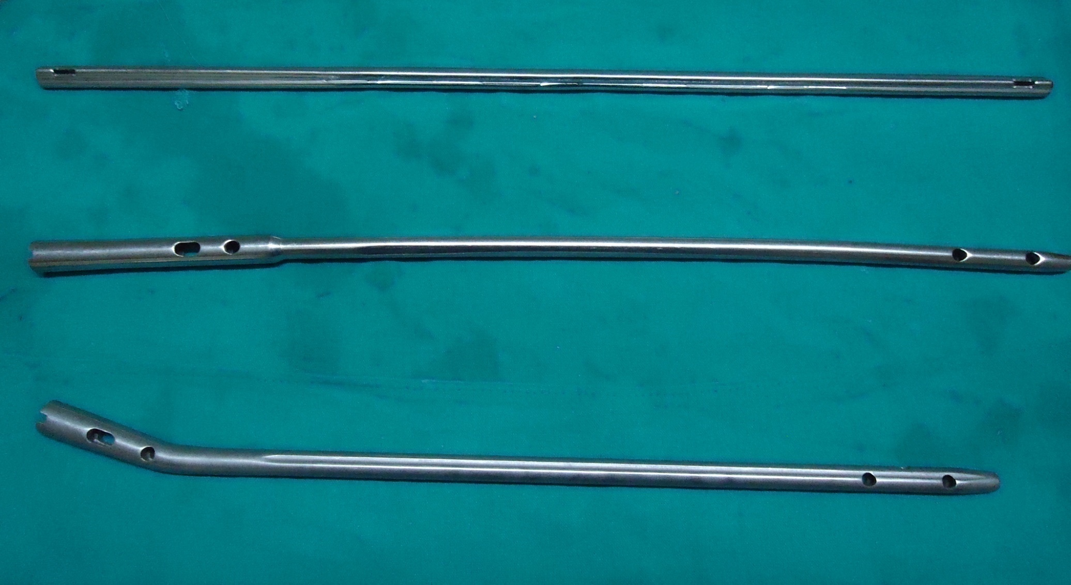
K-NAIL, FIN, TIN

Slide 13
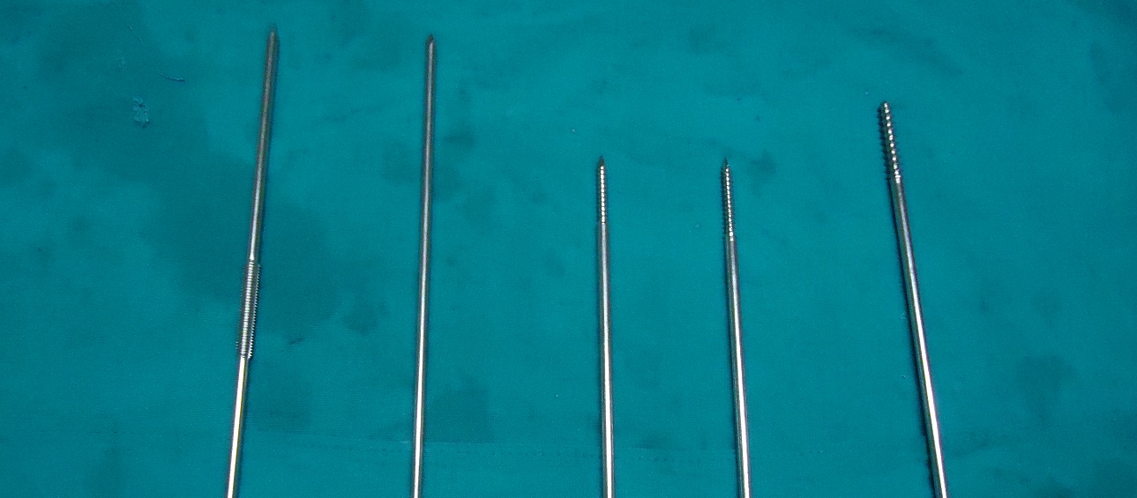
DENHEM PIN
K WIRE
SHANZ PIN
CORTICAL
SHANZ PIN
CANCELLOUS

Slide 14
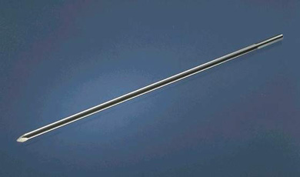

Slide 15
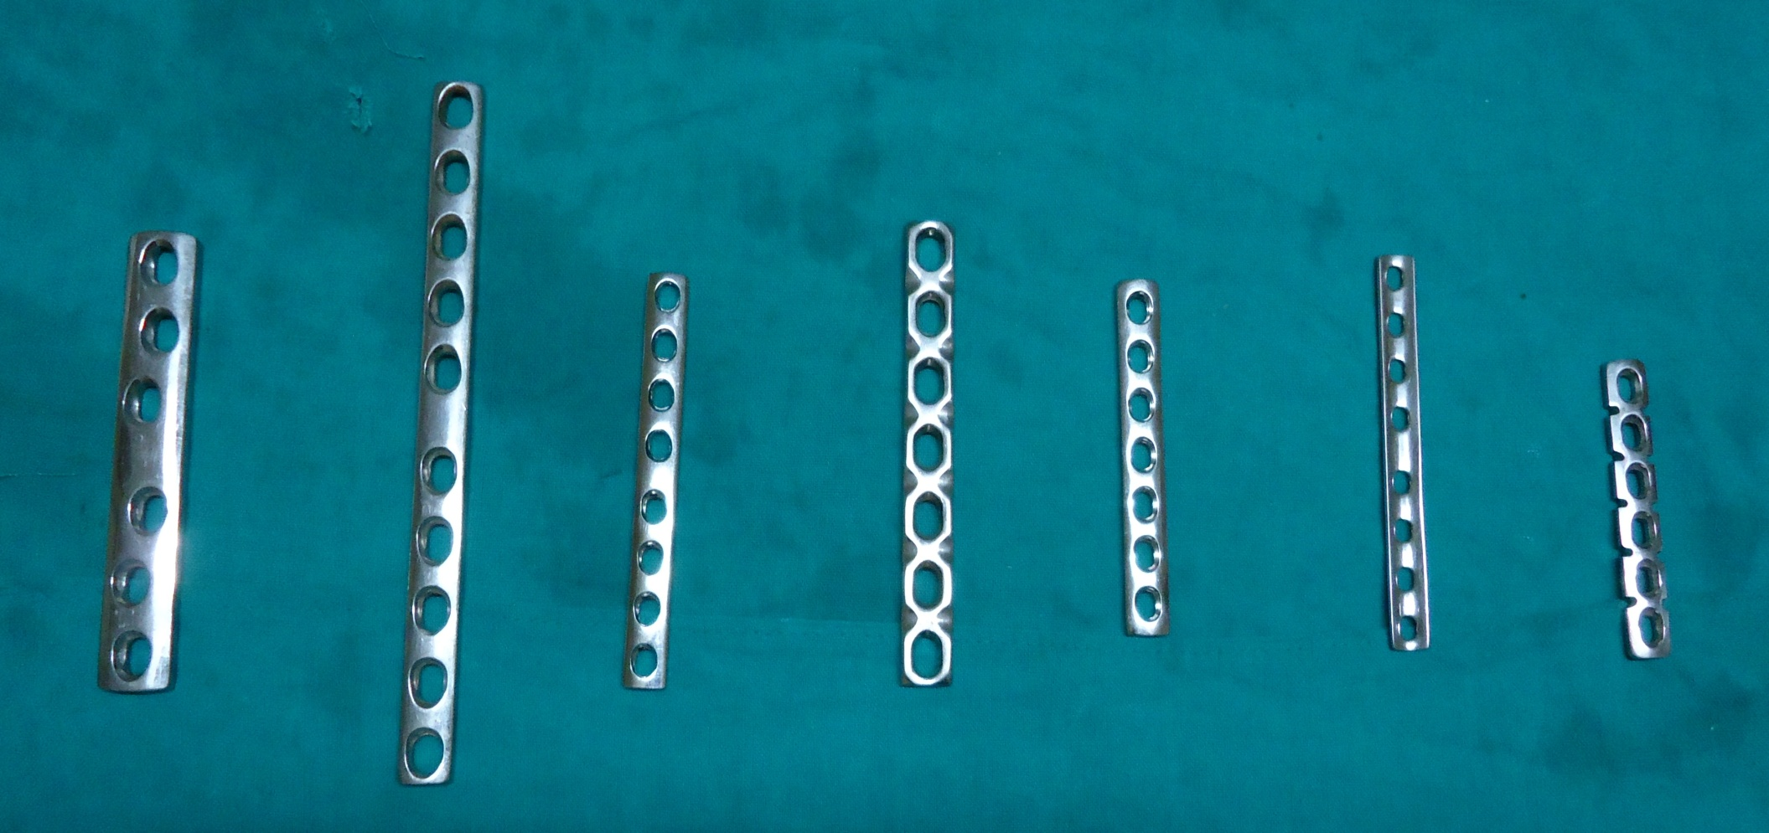
PLATES
BROAD
DCP
NARROW
DCP
SMALL
DCP
LC DCP
INFERIOR
SURFACE
LC DCP
SUPERIOR
SURFACE
1/3 RD
TUBULAR
DCP
RECON
DCP

Slide 17
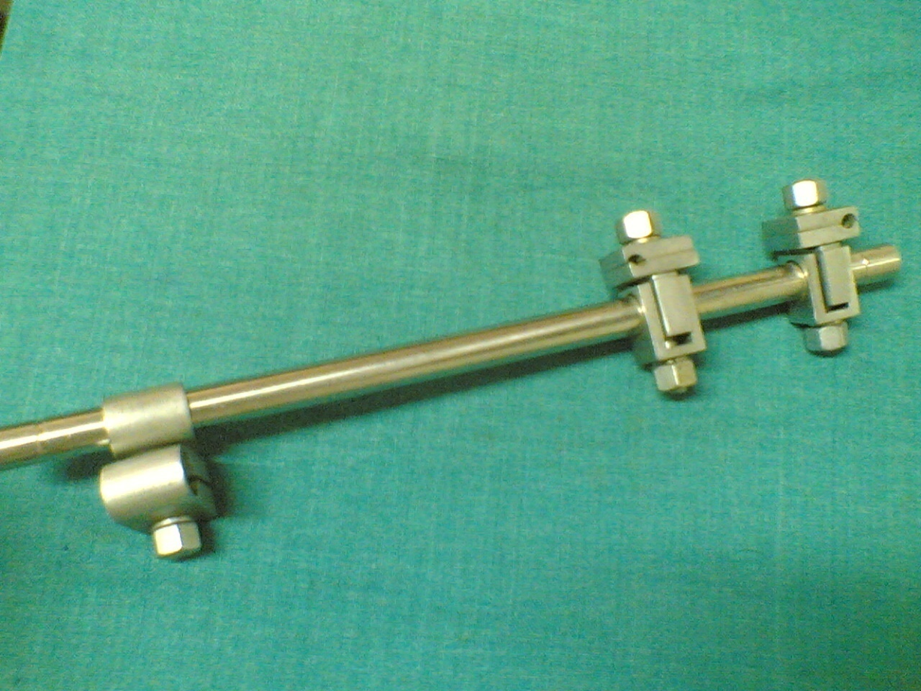
EXTERNAL FIXATOR TUBULAR ROD AND UNIVERSAL CLAMP

Slide 19
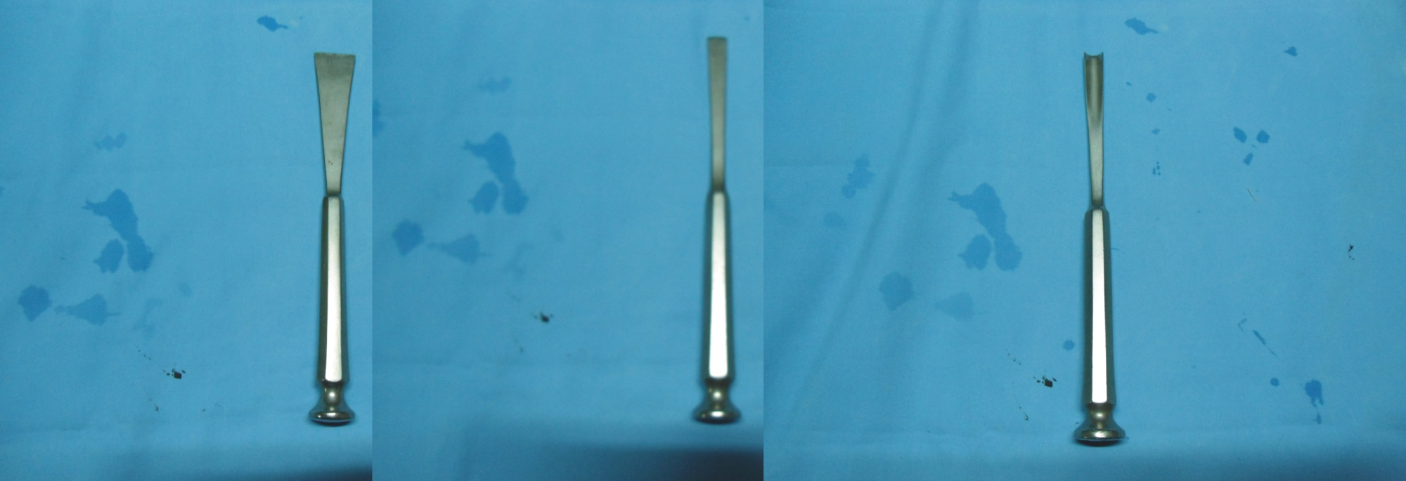
OSTEOTOME
BONE CHISEL
BONE GOUGE
BOTH EDGES BEVELLED
USED TO CUT BONE: PERFORM OSTEOTOMIES
ONLY ONE EDGE IS BEVELLED
USED TO REMOVE PROTRUDING BONE
CONCAVE BLADED CHISEL
USED TO CUT ON ROUND BONES OR TO MAKE ROUND HOLES IN A BONE

Slide 20
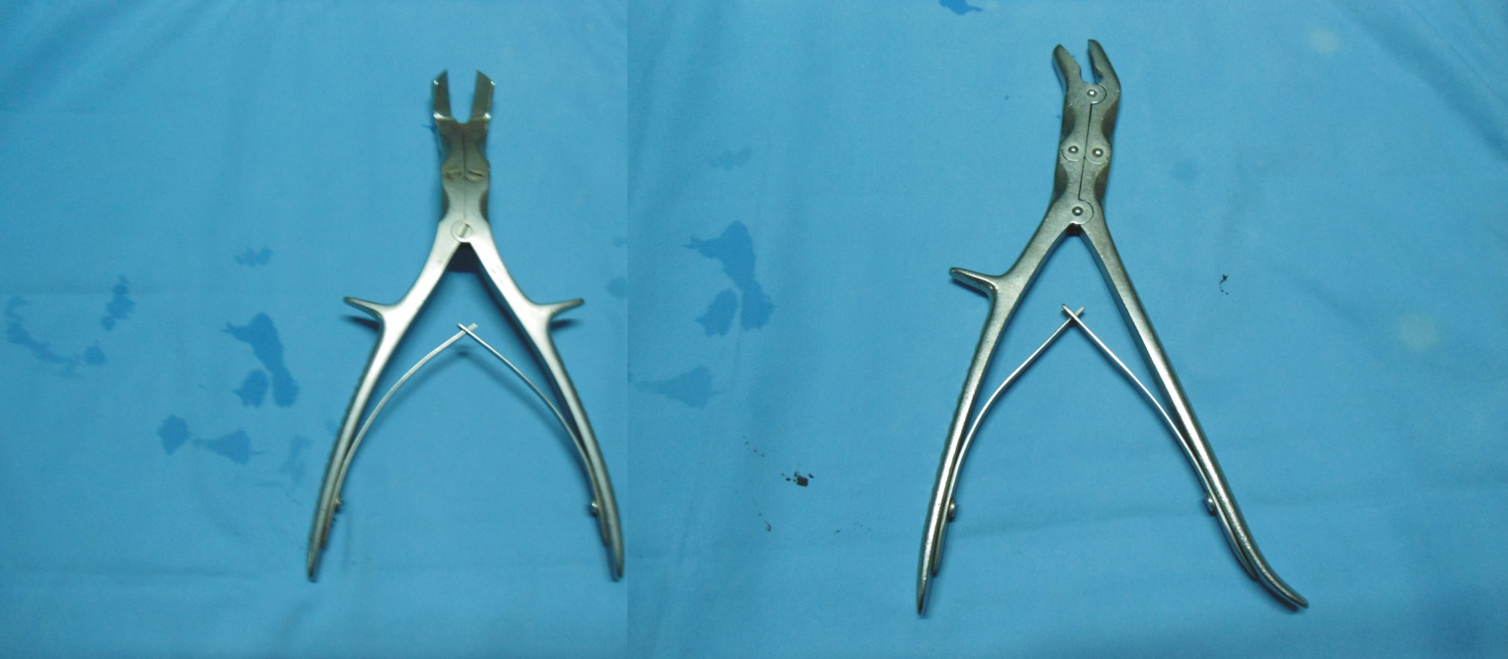
DOUBLE ACTION BONE CUTTER
STRAIGHT/CURVED
SINGLE STRAIGHT CUTTING EDGE
USED TO CUT BONE INTO SMALL PIECES
DOUBLE ACTION BONE NIBBLER
STRAIGHT/CURVED
MOUTH SHAPED CUTTING EDGE
USED TO NIBBLE BONE

Slide 22
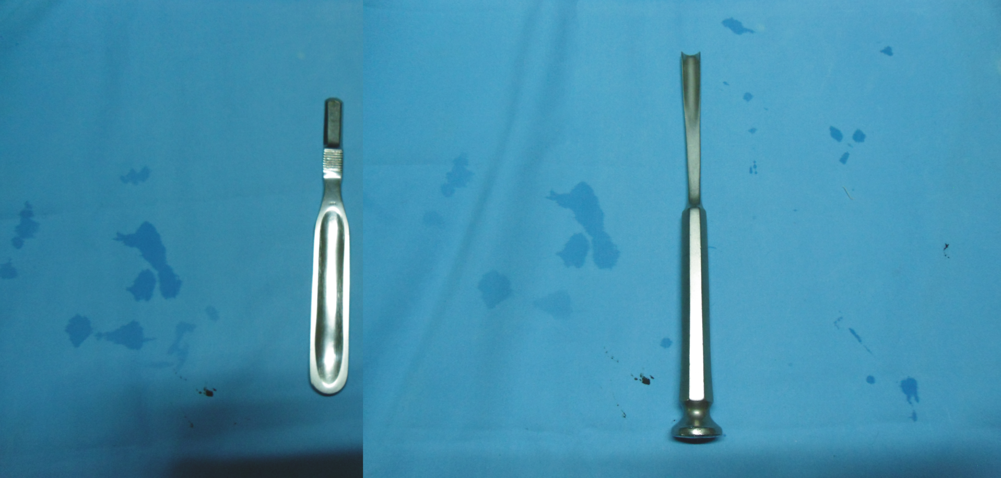
PERIOSTEUM ELEVATOR
USED TO LIFT UP PERIOSTEUM
SUBPERIOSTEAL PLANE HAS NO NV BUNDLE: SAFE FOR SURGEON
BONE GOUGE
CONCAVE BLADED CHISTLE
USED FOR CUTTING A ROUND BONE OR MAKING A ROUND HOLE IN BONE

Slide 23
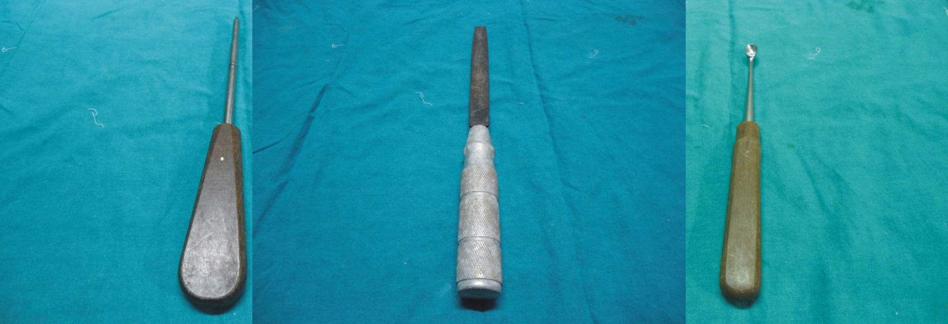
SCREW DRIVER
BONE FILER
BONE CURETTE
USED TO TIGHTEN THE SCREWS
USED TO SMOOTHEN THE POINTED MARGIN OF FRACTURE END
USED TO CLEAN THE CAVITIES IN THE BONE AND ALSO THE FRACTURE ENDS

Slide 24
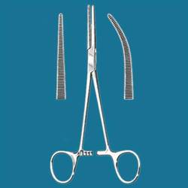
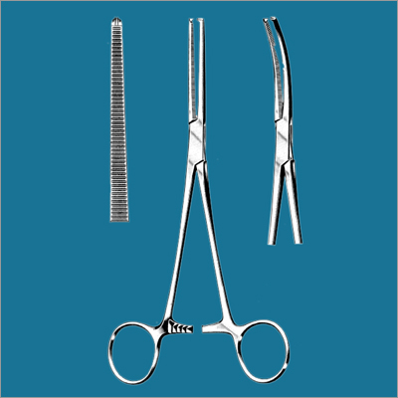
ARTERY FORCEPS
USED FOR GRASPING, COMPRESSING, AND HOLDING THE END OF AN ARTERY DURING LIGATION. GENERALLY SELF-LOCKING, ITS HANDLES ARE SCISSORLIKE. ALSO CALLED HEMOSTATIC FORCEPS.
KOCHER FORCEPS
A TWO-BLADED INSTRUMENT WITH A HANDLE FOR COMPRESSING OR GRASPING TISSUES IN SURGICAL OPERATIONS, AND FOR HANDLING STERILE DRESSINGS, ETC.

Slide 26
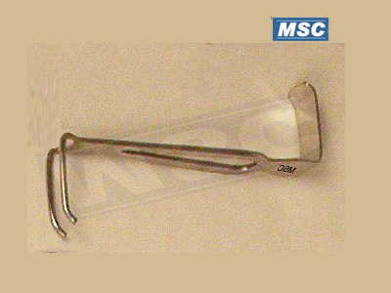
CZERNY RETRACTOR

Slide 27
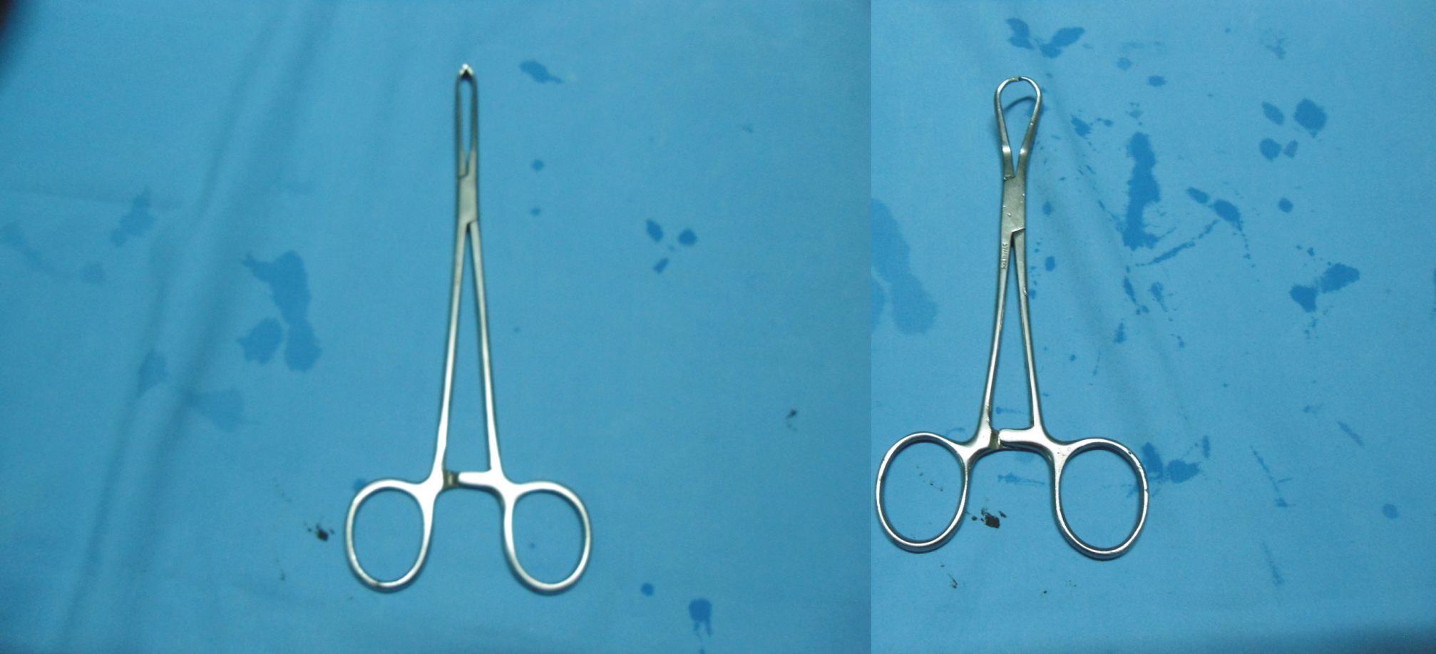
ALLIS FORCEPS

Slide 28
MALLET
T- HANDLE
HAND DRILL

Slide 29
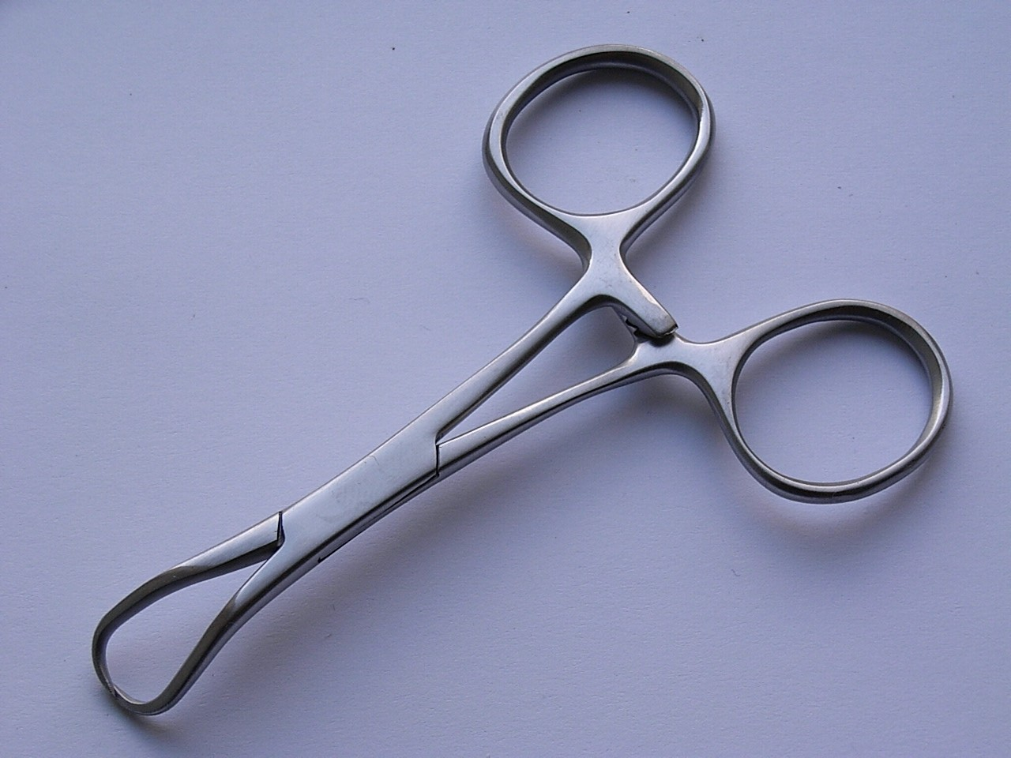
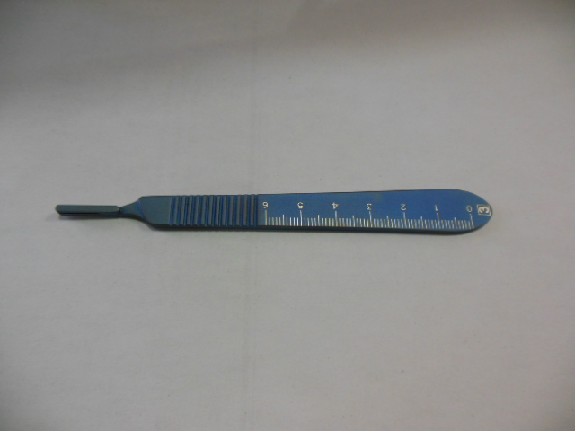
TOWEL CIP
BP HANDLE
BARD PARKER HANDLE

