Slide 1
Echocardiographic Evaluation Of Prosthetic Cardiac Valves
Thanks …………
Dr Gaurav Kumar Chaudhary MD,DM( Cardiology)
Assistant Professor
Department of Cardiology
King George Medical University ,Lucknow
a
Cardiology Department K.G.M.U

Slide 2
Outline
Learning Points in Presentation
When we should asses Prosthetic valve function ?
What are parameters that need to be assessed?
How should we assess?
ECHO images of assessment of patients with prosthetic valve
Cardiology Department K.G.M.U

Slide 3
Timing of assessment of prosthetic valve
An echocardiographic examination performed 6 weeks to 3 months after valve implantation
It allows for an assessment of the effects and results of surgery
Serves as a baseline for comparison should complications or deterioration occur later
2014 AHA/ACC Guideline for the Management of Patients With Valvular Heart Disease A Report of the American College of Cardiology/American Heart Association Task Force on Practice Guidelines
Cardiology Department K.G.M.U

Slide 4
Timing of assessment of prosthetic valve
Asymptomatic uncomplicated patient is usually seen at 1–year intervals for a cardiac history and physical examination
No further echocardiographic testing is required after the initial postoperative evaluation in patients with mechanical valves
Who are stable
Who have no symptoms
No clinical evidence of prosthetic valve or ventricular dysfunction or dysfunction of other heart valves.
2014 AHA/ACC Guideline for the Management of Patients With Valvular Heart Disease A Report of the American College of Cardiology/American Heart Association Task Force on Practice Guidelines
Cardiology Department K.G.M.U

Slide 5
Timing of assessment of prosthetic valve
Cardiology Department K.G.M.U
2014 AHA/ACC Guideline for the Management of Patients With Valvular Heart Disease A Report of the American College of Cardiology/American Heart Association Task Force on Practice Guidelines

Slide 6
Imaging of valve
Motion of leaflets or occluder
Presence of calcification on the leaflets
Any abnormal densities on the various components of the prosthesis
Valve sewing ring integrity and motion
Recommendations for Evaluation of Prosthetic Valves With Echocardiography and Doppler Ultrasound, JASE 2009
Cardiology Department K.G.M.U

Slide 7
Doppler Study of Prosthetic valve
Contour of jet velocity signal
Peak velocity and gradient
Mean pressure gradient
VTI of the jet
DVI
Pressure half time in MV and TV
EOA
Presence, location and severity of regurgitation
Recommendations for Evaluation of Prosthetic Valves With Echocardiography and Doppler Ultrasound, JASE 2009
Cardiology Department K.G.M.U

Slide 8
Case 1
Case 1
27 yr female ,Post MVR (SJM ) 1 yr back
Cardiology Department K.G.M.U

Slide 9
Cardiology Department K.G.M.U
Leaflet excursion normal

Slide 10
OC,CC Sharp
Cardiology Department K.G.M.U

Slide 11
PG/MG= 3.5/2.2 mm Hg
Cardiology Department K.G.M.U

Slide 12
MVA =3.6 cm2
Cardiology Department K.G.M.U

Slide 13
Recommendations for Evaluation of Prosthetic Valves With Echocardiography and Doppler Ultrasound, JASE 2009
Cardiology Department K.G.M.U

Slide 14
Case 2
Case 2
35 yr male Post DVR (MVR+AVR ) , SJM ,August 2014
Cardiology Department K.G.M.U

Slide 15
Normal leaflet excursion ,posterior leaflet ?Calcification/Pannus
Cardiology Department K.G.M.U

Slide 16
Normal leaflet excursion with acoustic shadowing
Cardiology Department K.G.M.U

Slide 17
Pannus versus Thrombus
Fibrous pannus, is usually annular in location
Pannus formation is more frequent on aortic than on mitral prostheses
On mitral prosthetic valves, they most often occur on the atrial side of the prosthesis
Typically presenting as a very dense immobile echo, pannus are typically seen in patients with
Normal anticoagulation profile
Subacute or chronic symptoms
Cardiology Department K.G.M.U

Slide 18
Pannus versus Thrombus
Cardiology Department K.G.M.U

Slide 19
Pannus formation
Cardiology Department K.G.M.U

Slide 20
Cardiology Department K.G.M.U

Slide 21
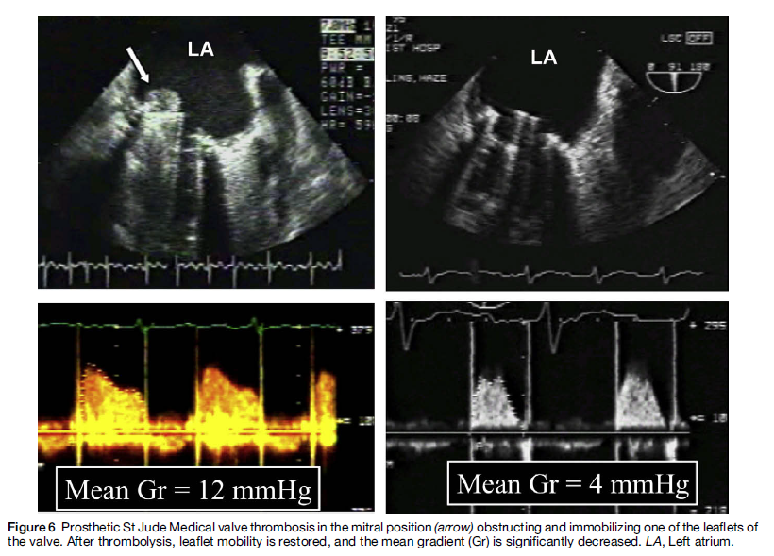
Thrombus on prosthetic valve
Cardiology Department K.G.M.U

Slide 22
Mild paravalvular leak
Cardiology Department K.G.M.U

Slide 23
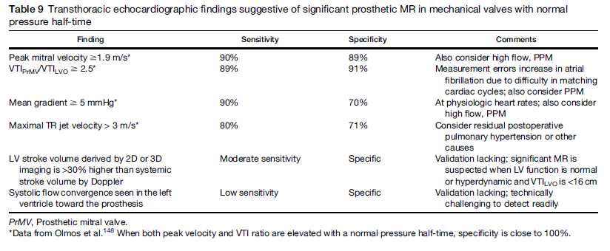
Recommendations for Evaluation of Prosthetic Valves With Echocardiography and Doppler Ultrasound, JASE 2009
Cardiology Department K.G.M.U

Slide 24
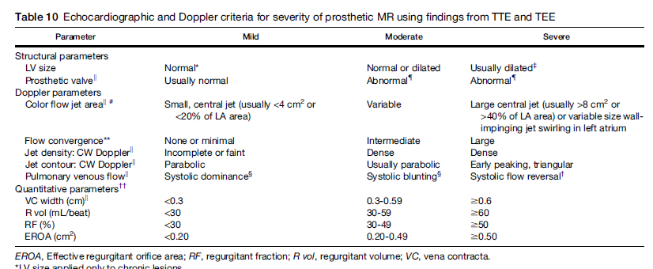
Cardiology Department K.G.M.U

Slide 25
Cardiology Department K.G.M.U

Slide 26
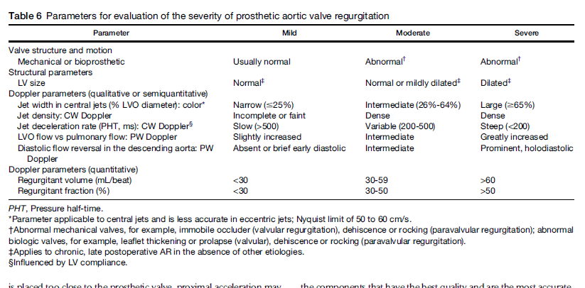
Recommendations for Evaluation of Prosthetic Valves With Echocardiography and Doppler Ultrasound, JASE 2009
Cardiology Department K.G.M.U

Slide 27
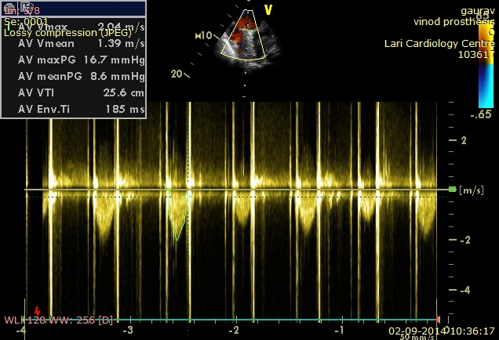
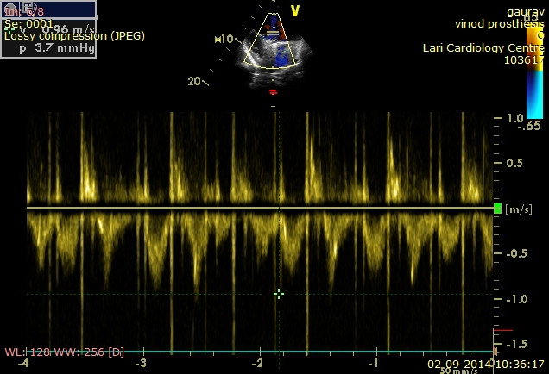
Velocity at prosthetic valve level 2m/s
Velocity at LVOT level 1m/s
DVI =1/2=.5

Slide 28
DVI (Doppler velocity index)
DVI (Doppler velocity index )
DVI is a dimensionless ratio of the proximal velocity in the LVO tract to that of flow velocity through the prosthesis:
DVI = VLVO/VPrAV
Normal prosthetic valve function
Mean DVI, 0.39; range - 0.28-0.55
A DVI < 0.25 is highly suggestive of significant valve obstruction
Cardiology Department K.G.M.U

Slide 29
Recommendations for Evaluation of Prosthetic Valves With Echocardiography and Doppler Ultrasound, JASE 2009
Cardiology Department K.G.M.U

Slide 30
Case 3
Case 3
30 yr female ,post MVR (SJM )
Cardiology Department K.G.M.U

Slide 31
Leaflet excursion normal
Cardiology Department K.G.M.U

Slide 32
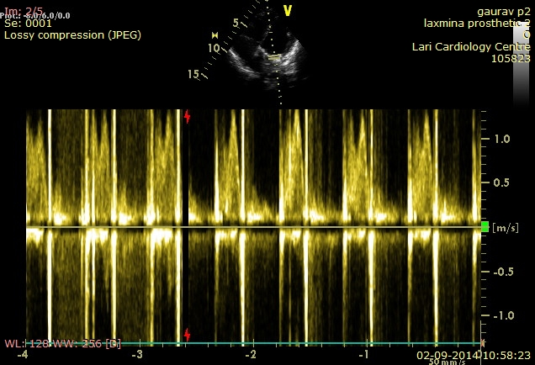
OC,CC Sharp
Cardiology Department K.G.M.U

Slide 33
Trivial paravalvular leakage
Cardiology Department K.G.M.U

Slide 34
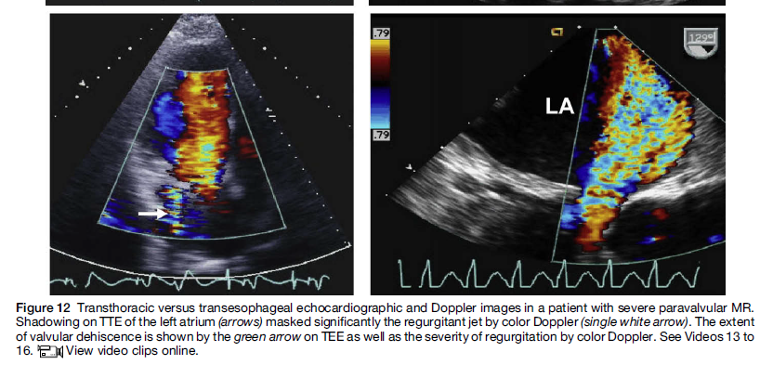
TTE Can be deceptive sometimes !!!!!
Cardiology Department K.G.M.U

Slide 35
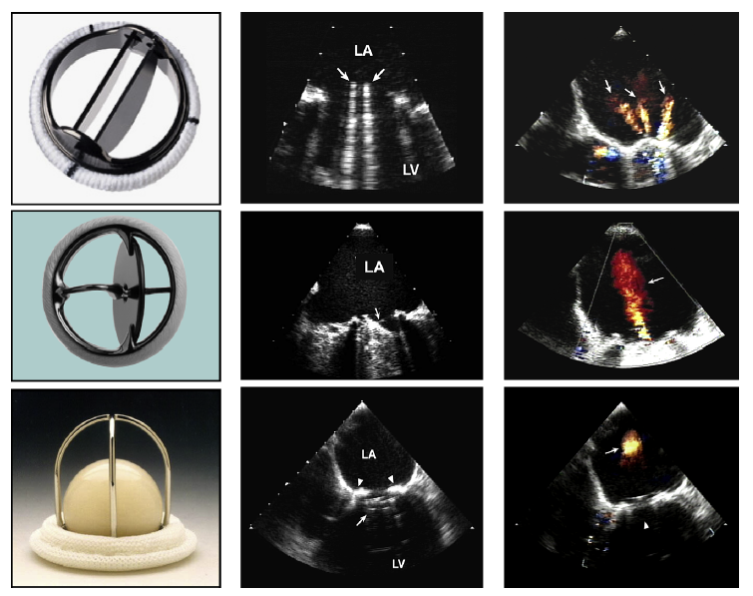
Cardiology Department K.G.M.U

Slide 36
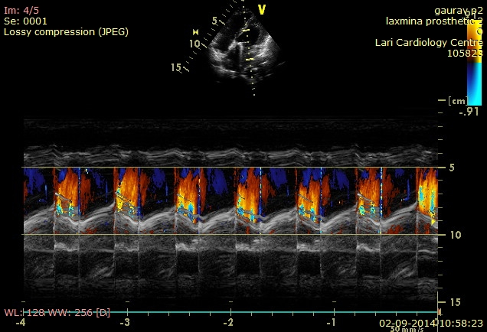
Cardiology Department K.G.M.U

Slide 37
Prosthetic valve stenosis/regurgitation …..
2014 AHA/ACC Guideline for the Management of Patients With Valvular Heart Disease A Report of the American College of Cardiology/American Heart Association Task Force on Practice Guidelines
Cardiology Department K.G.M.U

Slide 38
Case 4
Case 4
35 yr male ,Post MVR (TTK 29 Chitra ) in oct 2008
Cardiology Department K.G.M.U

Slide 39
Single Tilting disc excursion normal
Cardiology Department K.G.M.U

Slide 40
Cardiology Department K.G.M.U

Slide 41
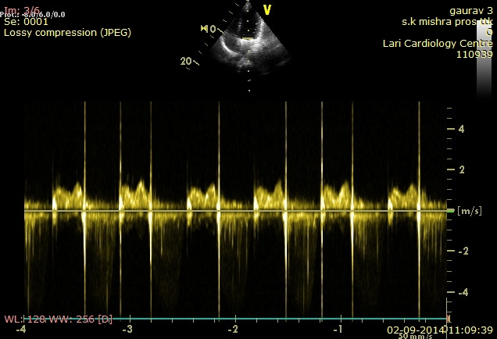
Cardiology Department K.G.M.U

Slide 42
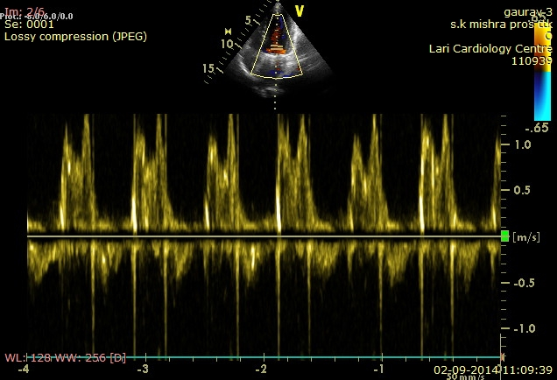
Cardiology Department K.G.M.U

Slide 43
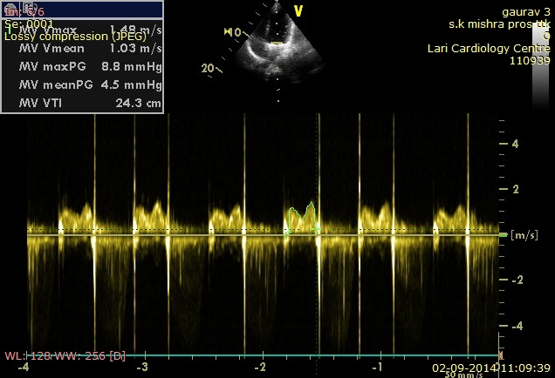
Cardiology Department K.G.M.U

Slide 44
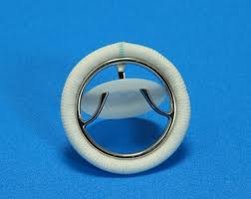
TTK chitra valve
Tilting disc valve
Metallic housing (cobalt based wrought alloy)
Circular disc high molecular weight polyethylene
Polyester suture ring
Hemodynamically comparable to other mechanical valves
Valve related complications are similar
Cardiology Department K.G.M.U

Slide 45
Case 5
Case 5
65 yr male Post CABG (LIMA –LAD,SVG-RCA) + AVR ( 21 A –SJM ) in may 2014
Cardiology Department K.G.M.U

Slide 46
Well preserved LVEF
Cardiology Department K.G.M.U

Slide 47
Trivial AR, No significant gradient across Prosthetic valve

Slide 48
Patient-prosthesis mismatch (PPM)
It is Nonstructural dysfunction, a composite category that includes any abnormality that results in stenosis or regurgitation of the operated valve that is not intrinsic to the valve itself, exclusive of thrombosis and infection
This includes inappropriate sizing, which is called valve prosthesis–patient mismatch (VP-PM)
When the effective prosthetic valve area, after insertion into the patient less than that of a normal valve
Patients with aortic PHV have obstruction to left ventricular outflow (similar to aortic stenosis), and patients with mitral PHV have obstruction to left atrial emptying (similar to mitral stenosis)
Cardiology Department K.G.M.U

Slide 49
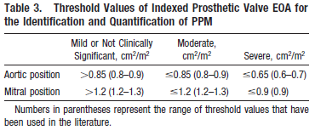
Patient-prosthesis mismatch (PPM)
Cardiology Department K.G.M.U

Slide 50
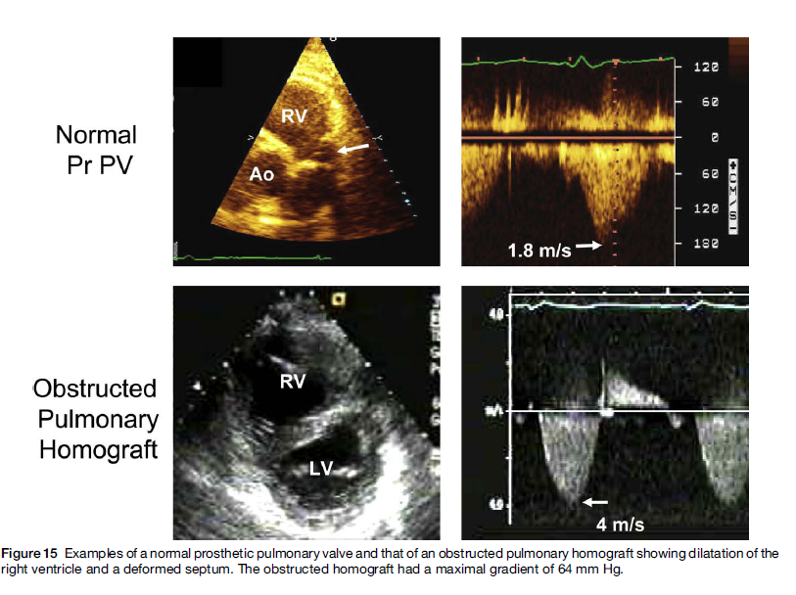
Bioprosthesis evalvation
Cardiology Department K.G.M.U

Slide 51
Recommendations for Evaluation of Prosthetic Valves With Echocardiography and Doppler Ultrasound, JASE 2009
Cardiology Department K.G.M.U

Slide 52
Thank you

