Slide 1
ANATOMY OF CORONARY SINUS AND CLINICAL APPLICATION
Dr Gaurav Chaudhary
MD,DM Cardiology
Assistant Professsor
Department of Cardiology

Slide 2
VENOUS DRAINAGE OF HEART
Coronary sinus
Anterior cardiac vein
Thebesian vein

Slide 3
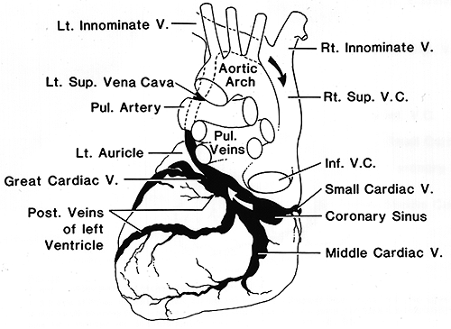

Slide 4
60 % of venous blood of heart drains into right atrium via coronary sinus .
40 % remaining blood drains via anterior cardiac vein

Slide 5
Coronary sinus conveys blood from left coronary territory .
Anterior cardiac vein drains most of blood from right coronary artery

Slide 6
CORONARY SINUS
Great cardiac vein
Oblique vein of left atrium [ vein of marshall ]
Posterior vein of LV
Middle cardiac vein
Small cardiac vein

Slide 7
Coronary Venous System
CORONARY SINUS TRIBUTARIES

Slide 8
Great cardiac vein - anterior interventricular sulcus
Oblique vein of LA - post surface of LA
Post .vein of LV - runs on diaphragmatic surface
Middle cardiac vein - posterior IV groove .
Small cardiac vein - accompanies RCA

Slide 9
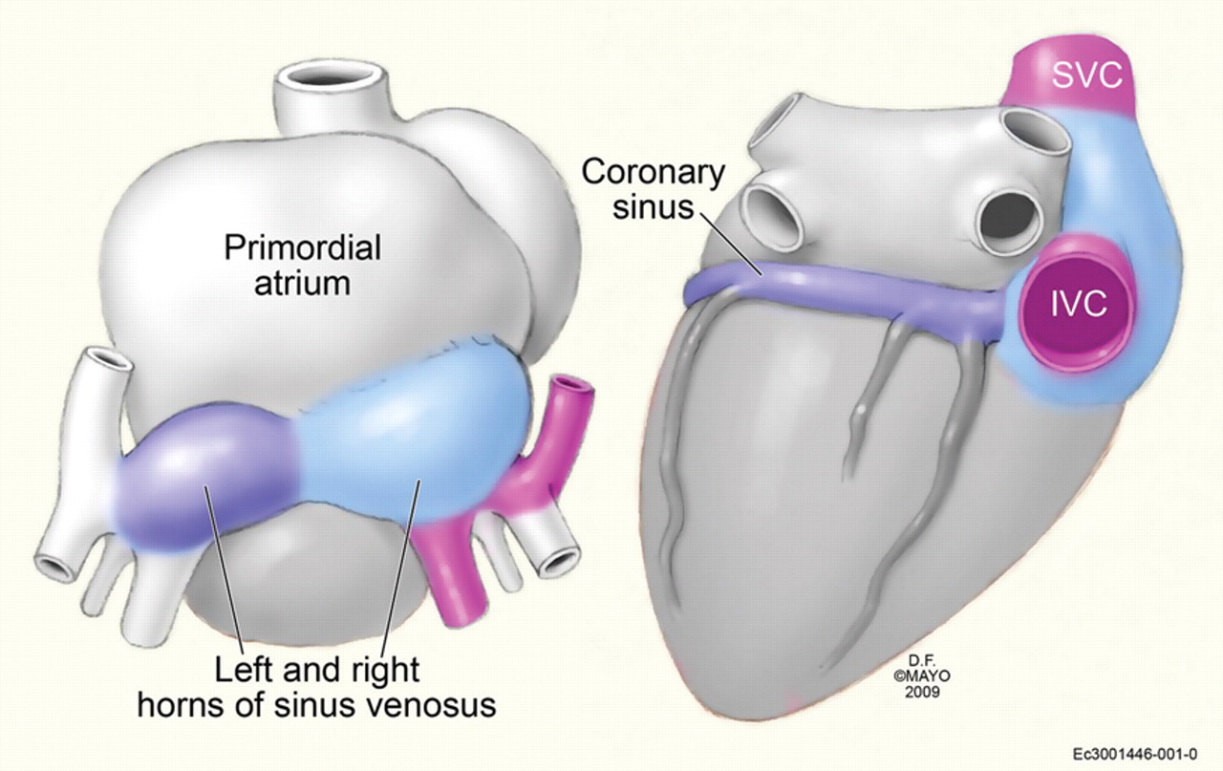
Developmental anatomy of the coronary sinus (CS) (26 weeks)—the right horn of the sinus venosus remains as the venous portion of the right atrium between the vena cava (light blue).
H
Notes:
Developmental anatomy of the coronary sinus (CS) (26 weeks)—the right horn of the sinus venosus remains as the venous portion of the right atrium between the vena cava (light blue). The left horn of the sinus venosus remains in adult life as the CS and portion of the great cardiac vein (dark blue).

Slide 10
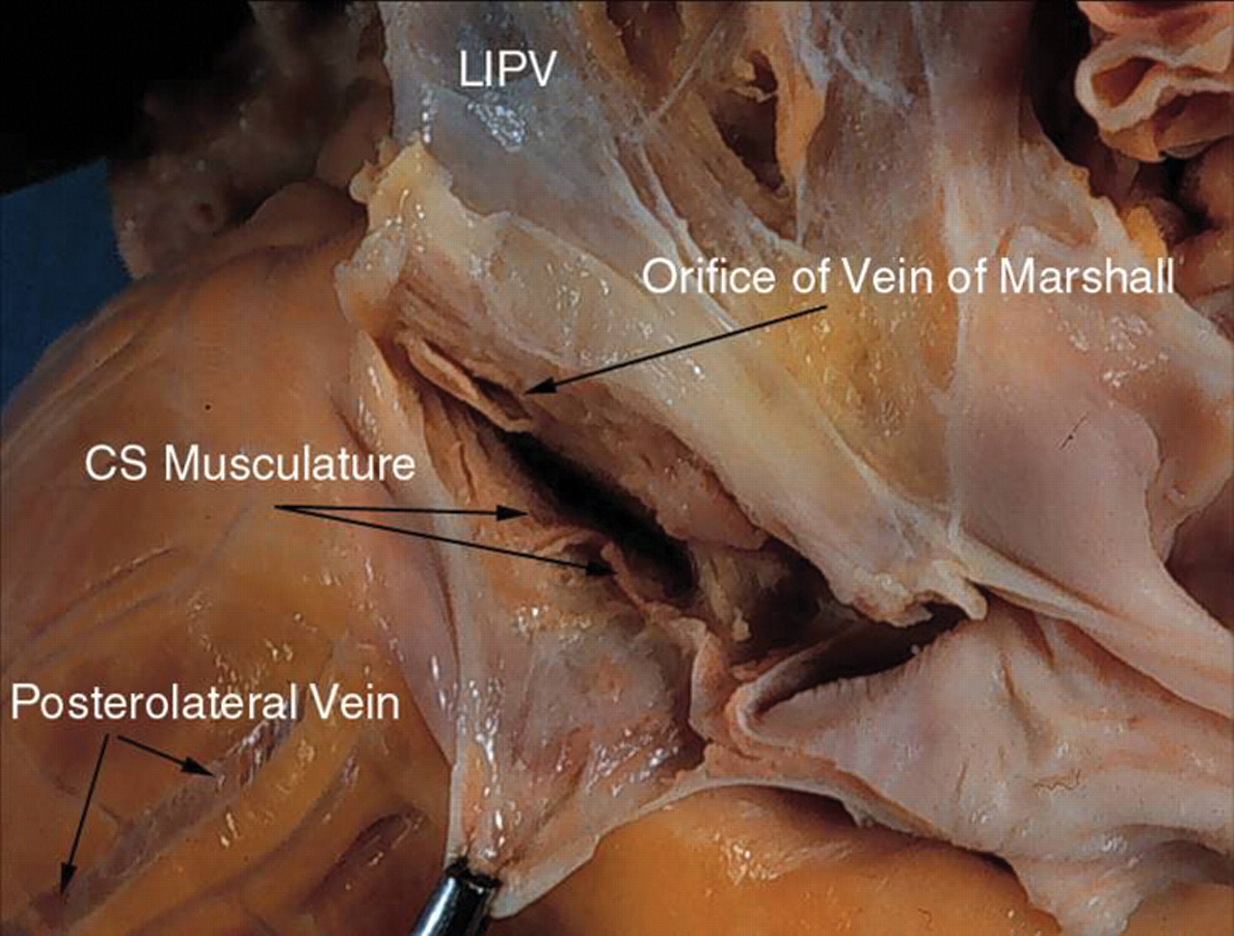
The CS has been dissected open along its long axis, CS musculature is seen in the proximal portion of the CS up to the orifice of the vein of Marshall. In this patient multiple posterior and posterolateral veins are also seen draining into the CS.
Notes:
The CS has been dissected open along its long axis, CS musculature is seen in the proximal portion of the CS up to the orifice of the vein of Marshall. In this patient multiple posterior and posterolateral veins are also seen draining into the CS.

Slide 11
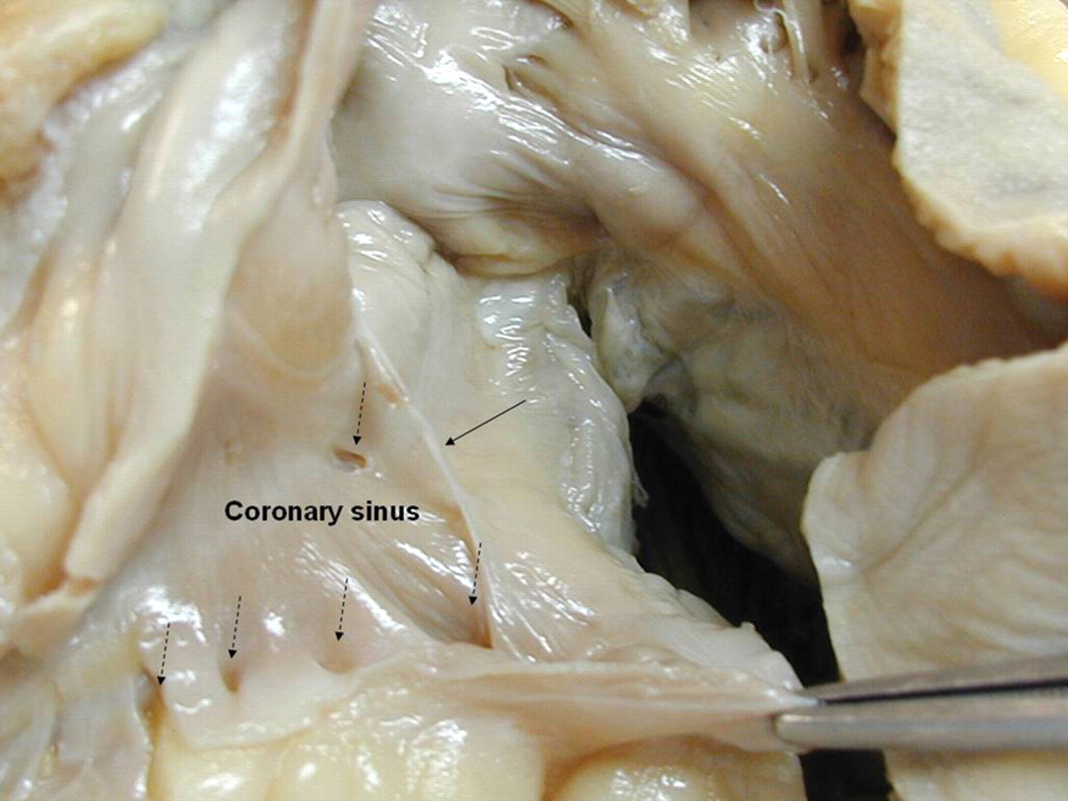
The CS has been dissected open along its long axis
Notes:
The CS has been dissected open along its long axis. Note the multiple ostia of various ventricular veins (hatched arrows). A remnant of the Thebesian valve that partly covers the ostium of the middle cardiac vein (MCV) is seen (arrow).

Slide 12
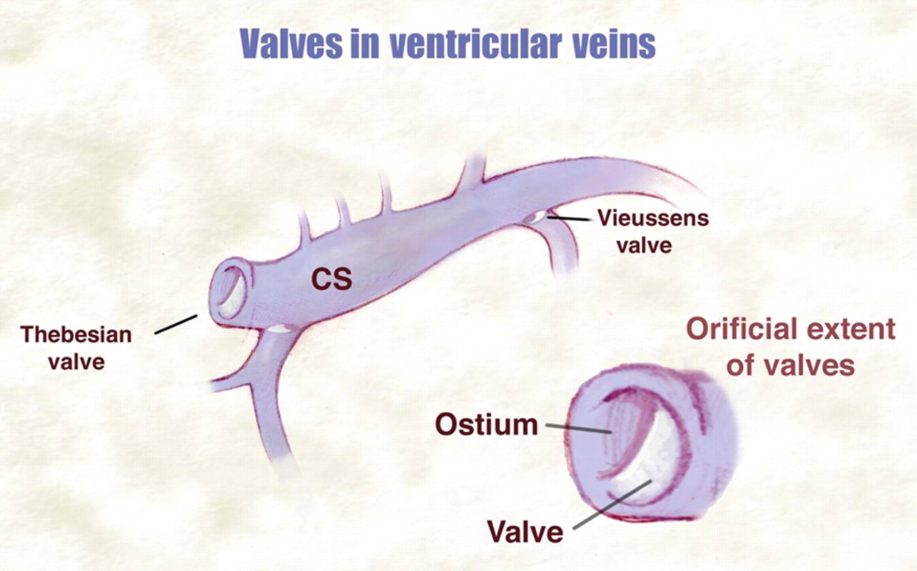
Notes:
Valves can be found in the CS at various locations. Most common are at the ostium of the CS (Thebesian valve) and at the ostium of the postural lateral vein at the junction of the Great Cardiac vein and CS (Vieussen's valve). These valves cover various extents of the area of the orifice.

Slide 13
2-D ECHOCARDIOGRAPHIC IMAGING OF CORONARY SINUS

Slide 14
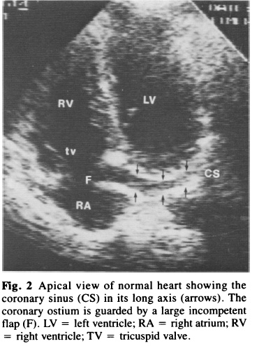
CORONARY SINUS -2D ECHO

Slide 15
ANAMOLIES OF CORONARY SINUS
Absent thebesian valve .
Membranous thebesian valve .
Absent tributaries of coronary sinus .
Obstucted coronary sinus ostia
Dilated coronary sinus

Slide 16
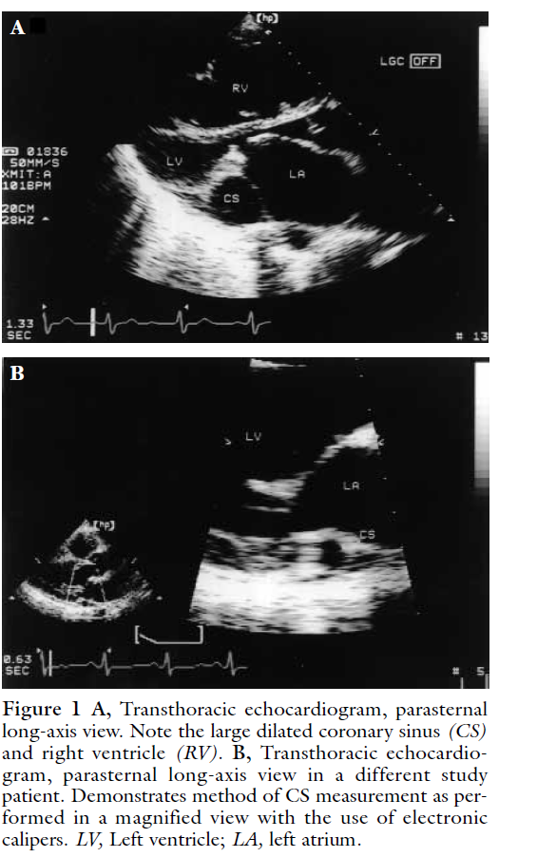

Slide 17
DILATED CORONARY SINUS

Slide 18
ABNORMAL CORONARY SINUS DRAINAGE

Slide 19
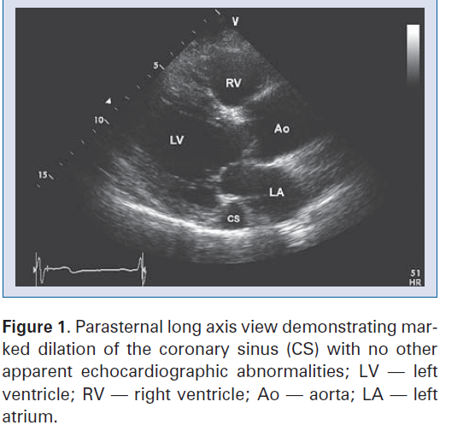

Slide 20
PERSISTENT LSVC

Slide 21
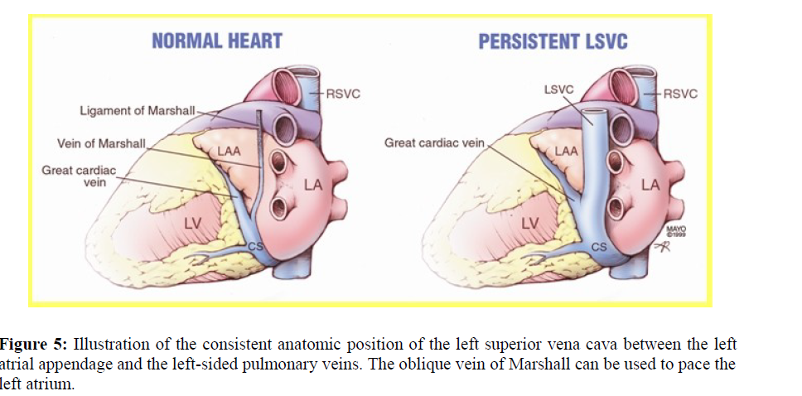

Slide 22
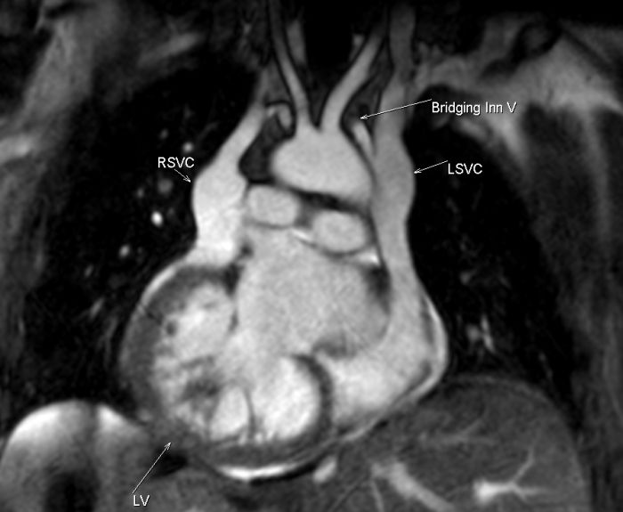

Slide 23
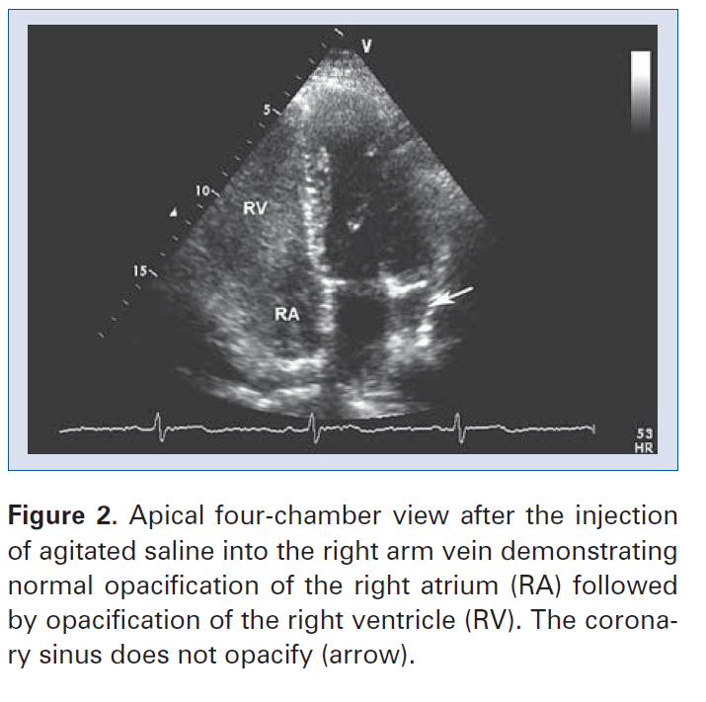

Slide 24
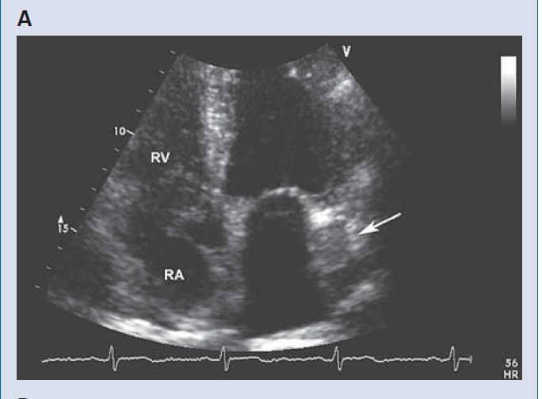

Slide 25
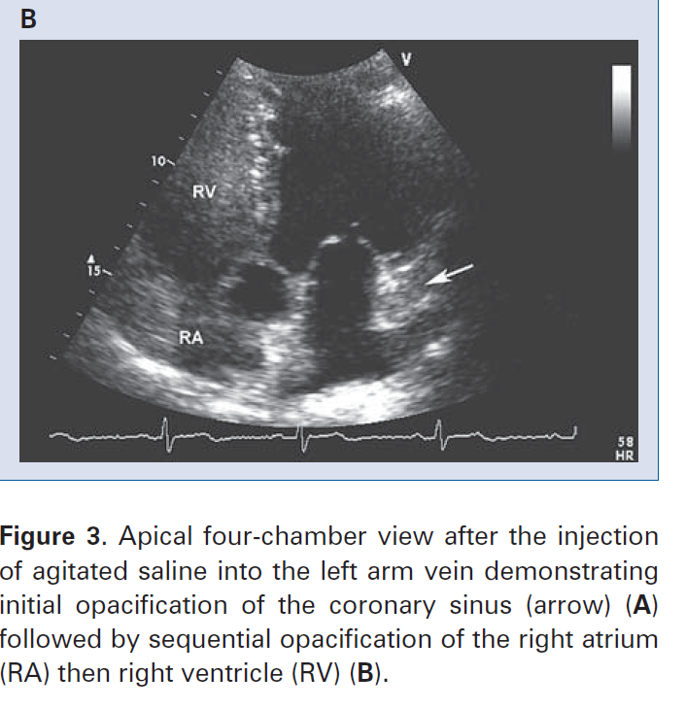

Slide 26
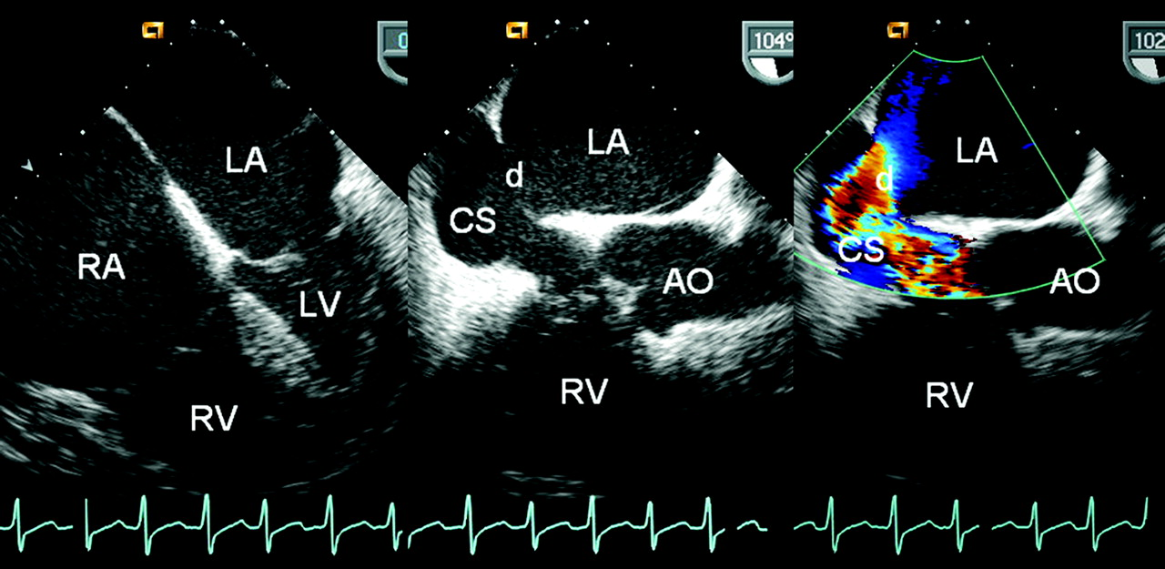
Figure 1. Transesophageal echocardiography revealed both atrial and right ventricular enlargement (left), a defect of the partial coronary sinus (middle), and shunt of the left atrium to the dilated coronary sinus (right) at the near longitudinal plane.
Huang X Circulation 2007;116:e373-e373
Copyright © American Heart Association
Notes:
Figure 1. Transesophageal echocardiography revealed both atrial and right ventricular enlargement (left), a defect of the partial coronary sinus (middle), and shunt of the left atrium to the dilated coronary sinus (right) at the near longitudinal plane. AO indicates aorta; CS, coronary sinus; d, coronary sinus defect; LA, left atrium; LV, left ventricle; RA, right atrium; and RV, right ventricle.

Slide 27
FLOUROSCOPIC IMAGING OF CORONARY SINUS

Slide 28
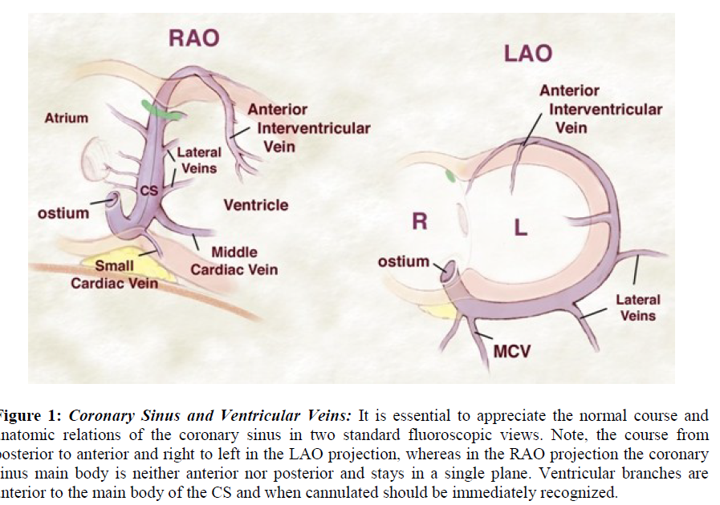
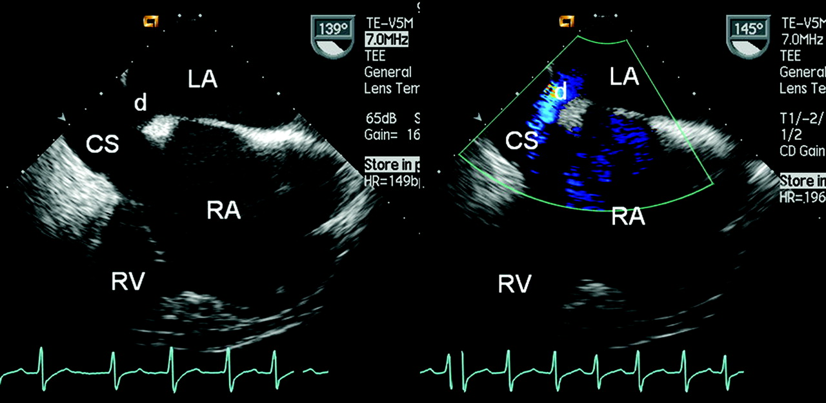
Figure 2. A partial coronary sinus defect beyond the range of the interatrial septum and an intact flap valve of the oval fossa with its muscular rims were revealed simultaneously at ≈140° section by transesophageal echocardiography (left).
Huang X Circulation 2007;116:e373-e373
Copyright © American Heart Association
Notes:
Figure 2. A partial coronary sinus defect beyond the range of the interatrial septum and an intact flap valve of the oval fossa with its muscular rims were revealed simultaneously at ≈140° section by transesophageal echocardiography (left). The shunt of the left atrium to the dilated coronary sinus was confirmed by the color Doppler flow image (right). Abbreviations as in Figure 1.

Slide 29
AP Venogram

Slide 30
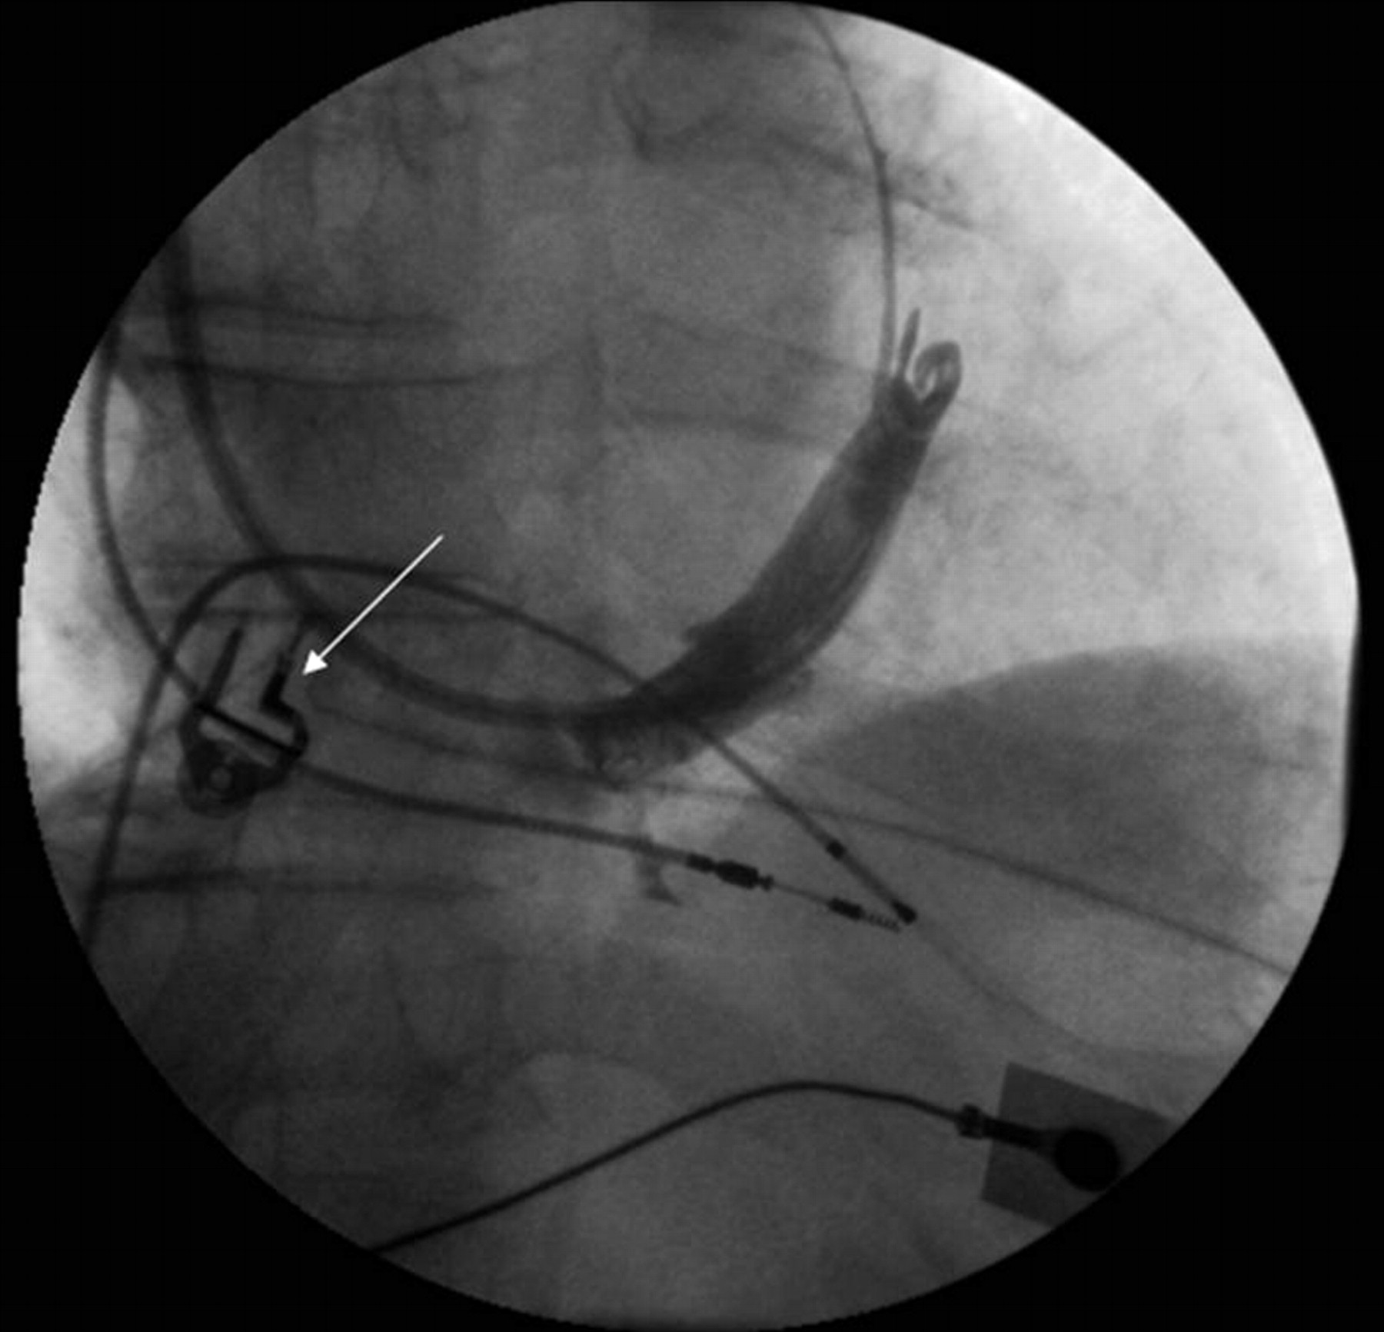
The MCV is a very consistent tributary of the CS present in nearly all hearts.
Notes:
The MCV is a very consistent tributary of the CS present in nearly all hearts. In our study of 219 hearts the MCV was found in its usual location in the posterior interventricular sulcus draining to the ostium of the CS in 98% of these cases. Rarely, in 2.8%, the MCV has a separate ostium into the right atrium and in 18% of the cases the vein receives an immediate tributary from a posterior or posterolateral vein.

Slide 31
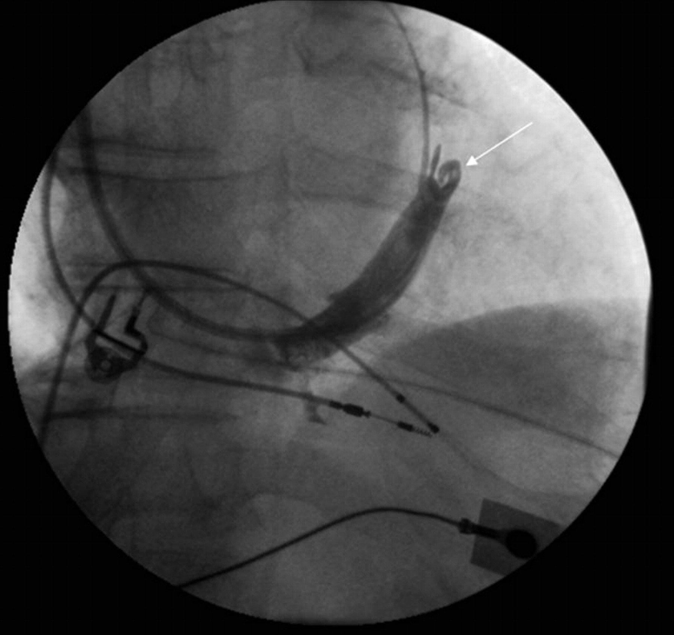
Coronary venous angiogram in the left anterior oblique (LAO) projection showing a near occlusive valve (arrow) in the region of the posterolateral vein (Vieussen's valve).
Notes:
Coronary venous angiogram in the left anterior oblique (LAO) projection showing a near occlusive valve (arrow) in the region of the posterolateral vein (Vieussen's valve).

Slide 32
CT ANGIO IMAGING OF CORONARY SINUS

Slide 33
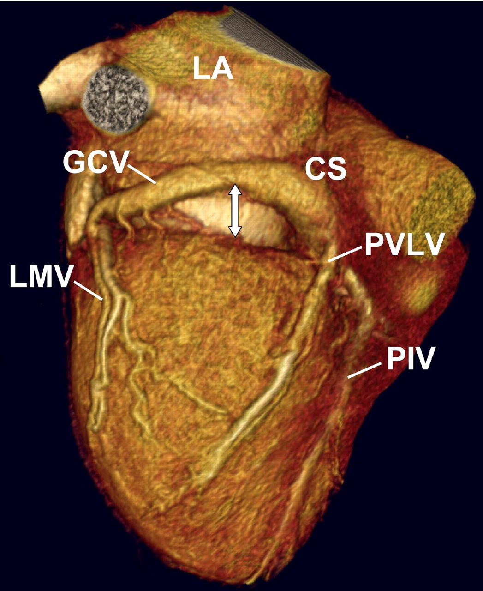
Coronary Venous Anatomy and Relation Between Coronary Sinus and Mitral Annulus
Tops, L. F. et al. J Am Coll Cardiol Img 2008;1:94-106
Copyright ©2008 American College of Cardiology Foundation. Restrictions may apply.

Slide 34
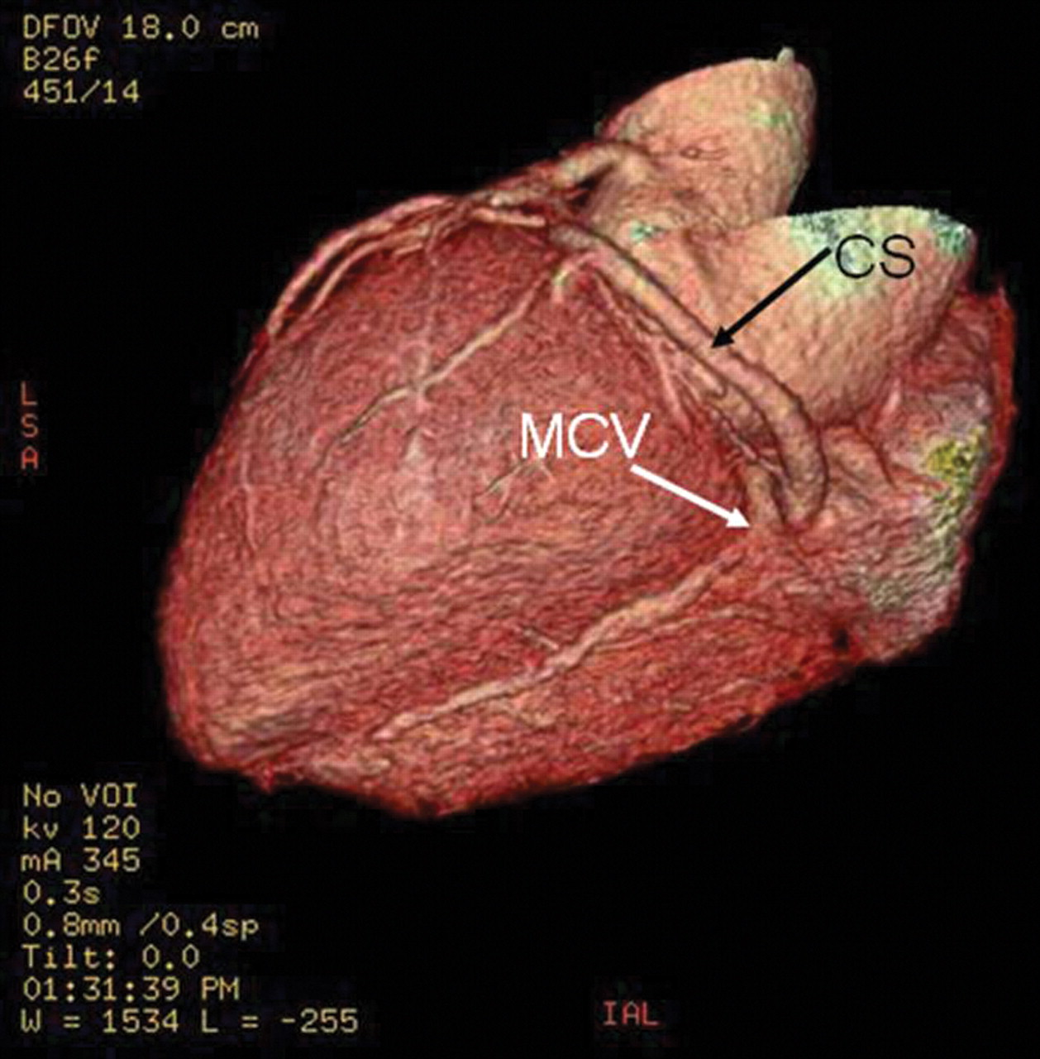
Reconstructed computed tomography image showing the coronary veins
Notes:
Reconstructed computed tomography image showing the coronary veins. Note the complex origin of the MCV close to the ostium of the CS. In this patient there is a paucity of venous drainage of the posterolateral wall.

Slide 35
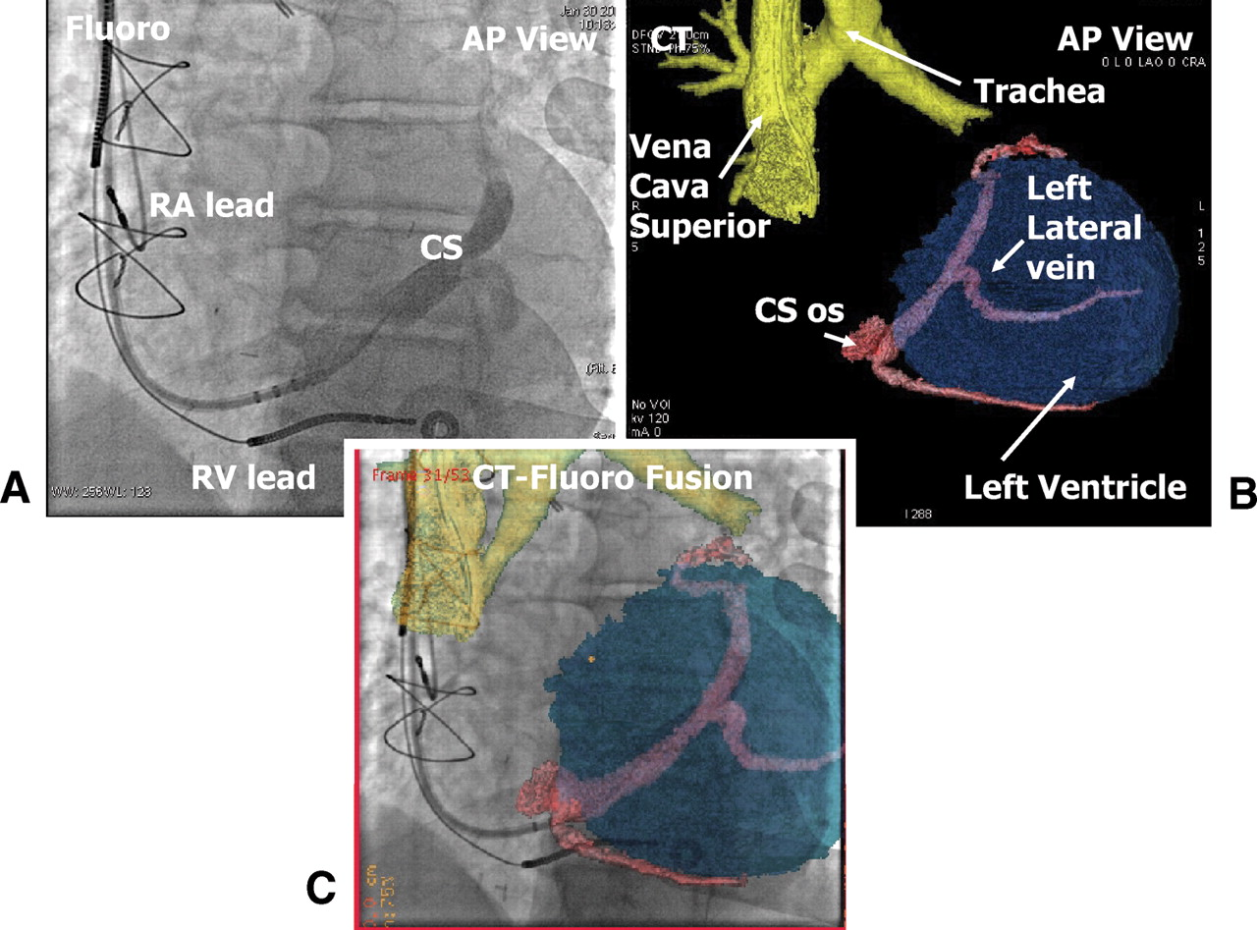
Notes:
Case no. 15. (A) X-ray antero-posterior view during CS angiography; (B) CT reconstruction of CS and its branches, trachea and the two main bronchi, superior vena cava, and left ventricle; (C) fusion image of X-ray with CT reconstruction. RA, right atrium; RV, right ventricle; LA, left atrium; LV, left ventricle; CS, coronary sinus; VCS, vena cava superior.

Slide 36
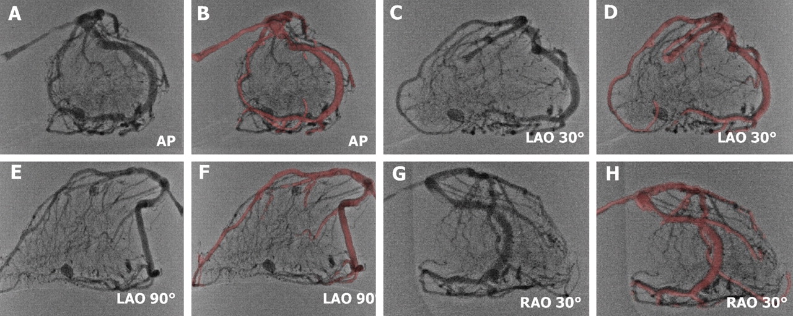
X-ray view of the phantom and fusion of CT reconstruction.
Notes:
X-ray view of the phantom and fusion of CT reconstruction. (A–B) Antero-posterior (AP) view. (C–D) Left anterior oblique (LAO) 90° view. (E–F) Left anterior oblique (LAO) 30° view. (G–H) Right anterior oblique (RAO) 30° view.

Slide 37
Coronary sinus diverticulum
Should be suspected in patient having WPW syndrome ,refractory to ablation
Angiography reveals coronary diverticulum Associated with refractory posteroseptal pathway

Slide 38
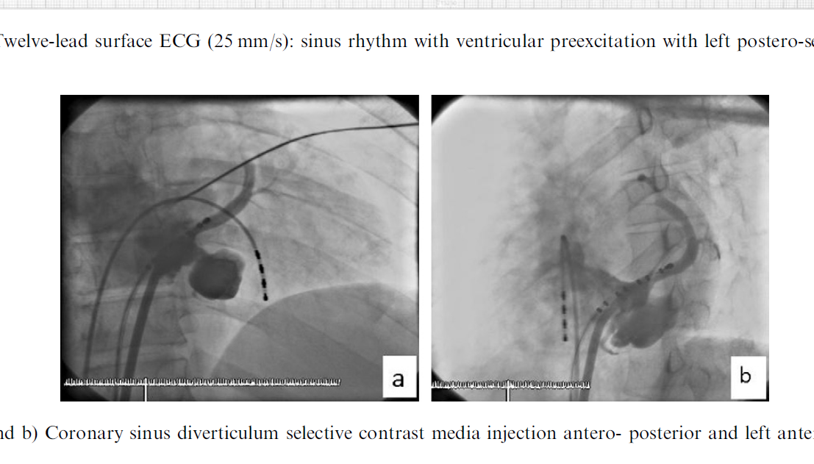

Slide 39
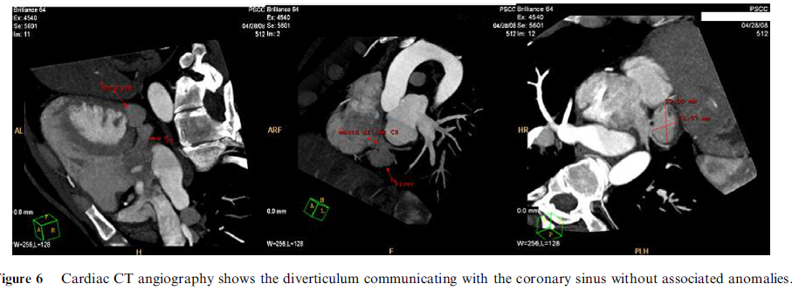

Slide 40
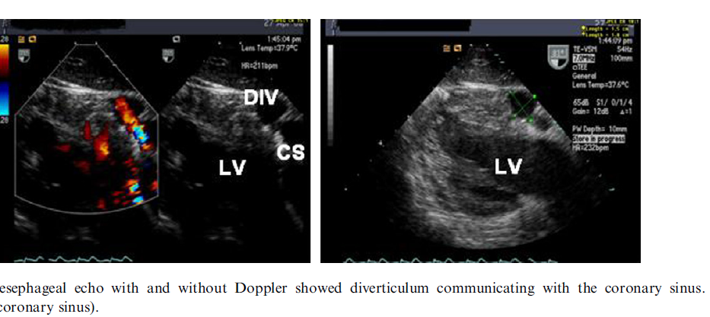

Slide 41
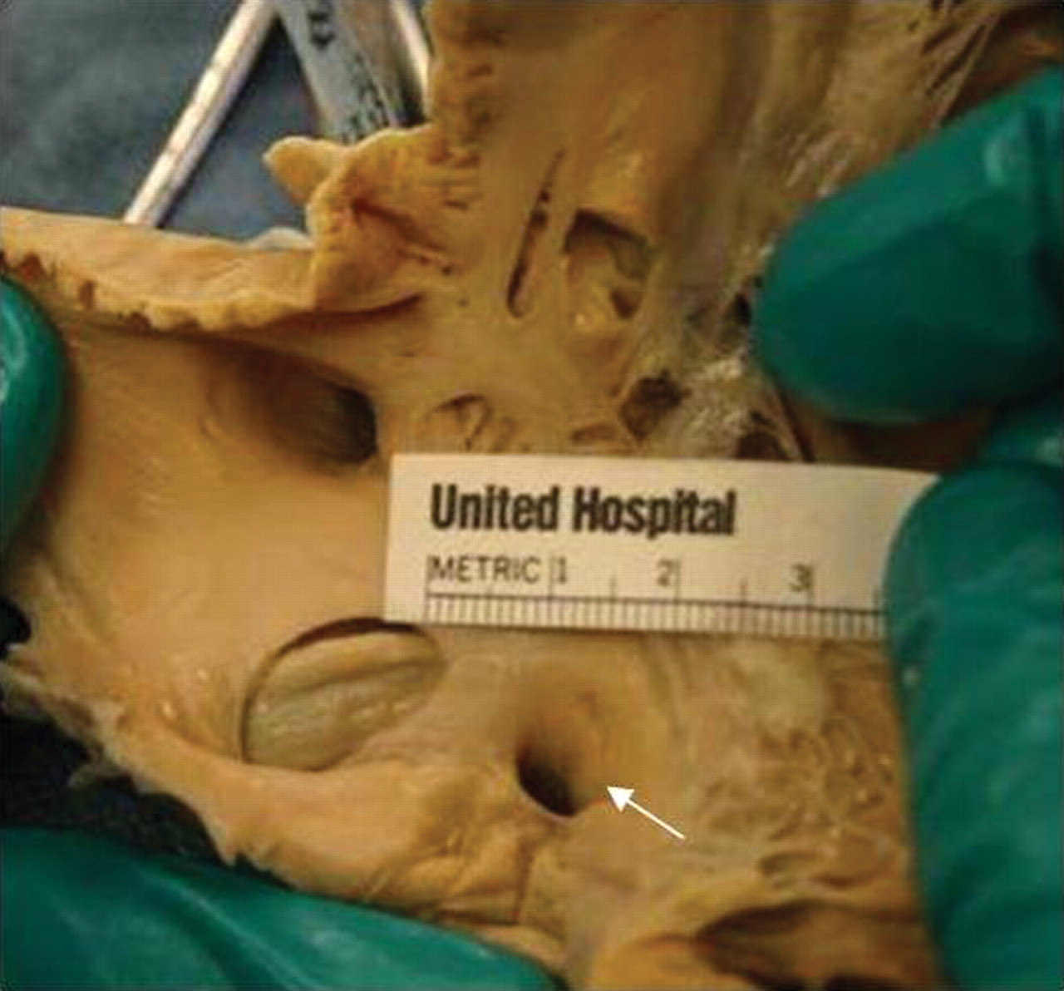
Autopsy heart specimen depicting an absent Thebesian valve.
Notes:
Autopsy heart specimen depicting an absent Thebesian valve. The lateral right atrium and lateral right ventricle have been cut open, displaying the septal leaflet of the tricuspid valve, the CS ostium (white arrow), and the fossa ovalis. Similar to this specimen, a Thebesian valve was absent in 20 of the 75 heart specimens in our study.

Slide 42
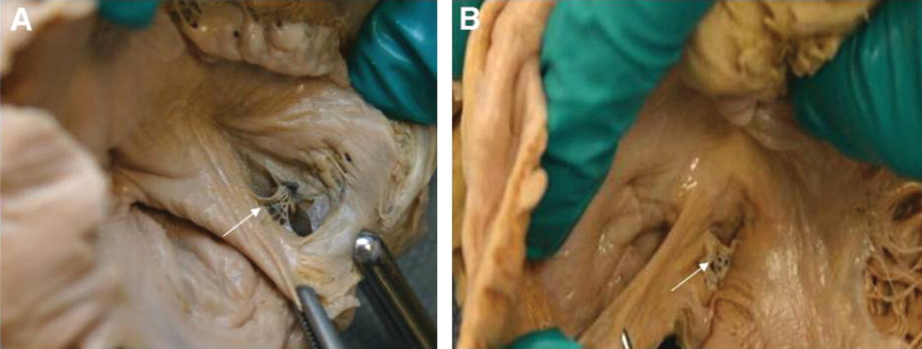
Examples of membranous Thebesian valves with fenestrations.
Notes:
Examples of membranous Thebesian valves with fenestrations. Two autopsy heart specimens are shown in which the right atrium and right ventricle are cut open along the direction of blood flow. (A) A ‘band-like’ Thebesian valve (white arrow) that is attached from 9 o'clock to 7 o'clock and from 1 o'clock to 4 o'clock of the ostial margin of the CS. The cranial and caudal aspect of the CS ostium is devoid of any valve attachment. (B) A ‘crescentic’ Thebesian valve (white arrow) with attachments along the entire margins of the CS ostium except at the cranial most aspect. The valves shown in (A and B) are thin and fenestrated, and likely should not impede the passage of a catheter through the ostium.

Slide 43
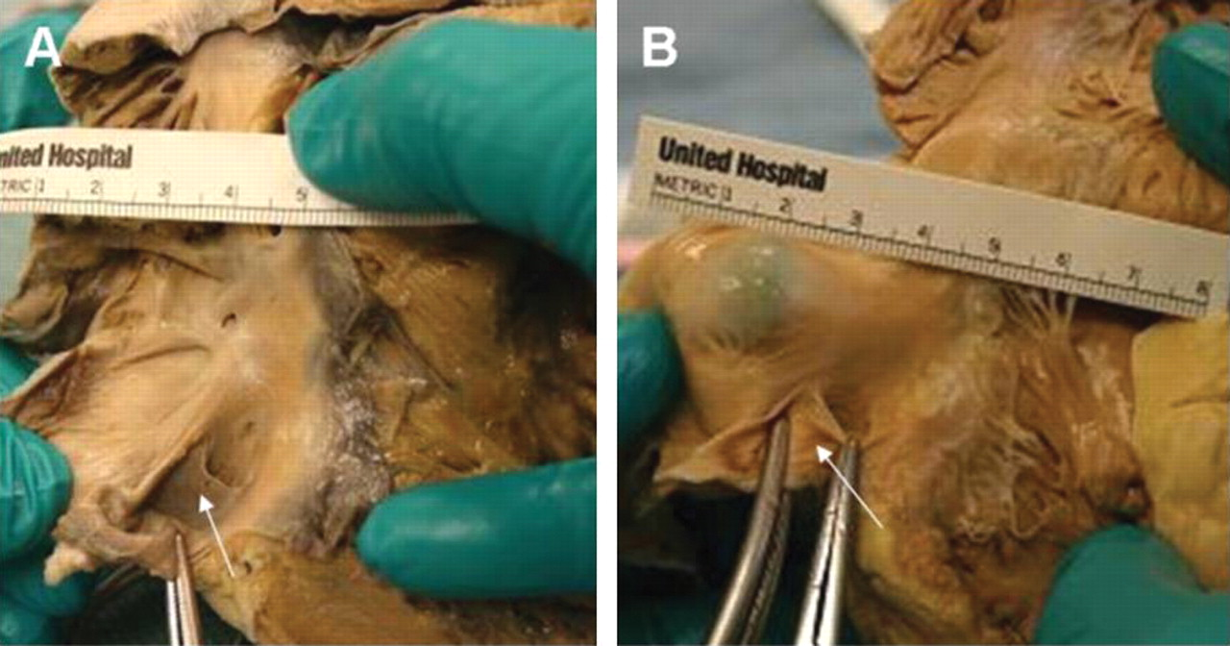
Examples of Thebesian valves that are fibromuscular, non-fenestrated, and occlusive.
Notes:
Examples of Thebesian valves that are fibromuscular, non-fenestrated, and occlusive. Two autopsy heart specimens are shown in which the right atrium and right ventricle are cut open along the direction of blood flow. (A) A non-fenestrated Thebesian valve (white arrow) that is fibromuscular and is seen to occlude ∼80% of the ostium except for the cranial most aspect of the ostium. (B) A muscular, non-fenestrated Thebesian valve (white arrow) that occludes the entire CS ostium. To appreciate the CS ostium, the non-attached cranial most aspect of the valve has to be grasped with the forceps and peeled back. (A and B) Examples of Thebesian valves that potentially would interfere with CS cannulation (seen in 12/75—16% hearts).

