Slide 1
Nervous Tissue

Slide 2
Objectives
Intoduction
Morphology of a Neuron
Types of Neuron
Neuroglia
Myelinated and unmyelinated Axons
Peripheral Nerve
Sensory and motor Ganglia

Slide 3
Cellular Components of the Nervous System
Neurons
Glia
(support cells)
Notes:
Wheater’s Functional Histology; 5th edition, 2006, Young, Lowe, Stevens and Heath; Churchill Livingstone Elsevier, Fig 7.4d
Nervous tissue is the third of the four basic tissue types. Neurons have many cytoplasmic processes, and are best appreciated with special stains that employ heavy metal impregnation. These classic neuronal stains were developed by the pioneers of neuroanatomy: Ramon y Cajal and Golgi. Both neurons and supporting glia arise from the embryonic neuroectoderm.

Slide 4
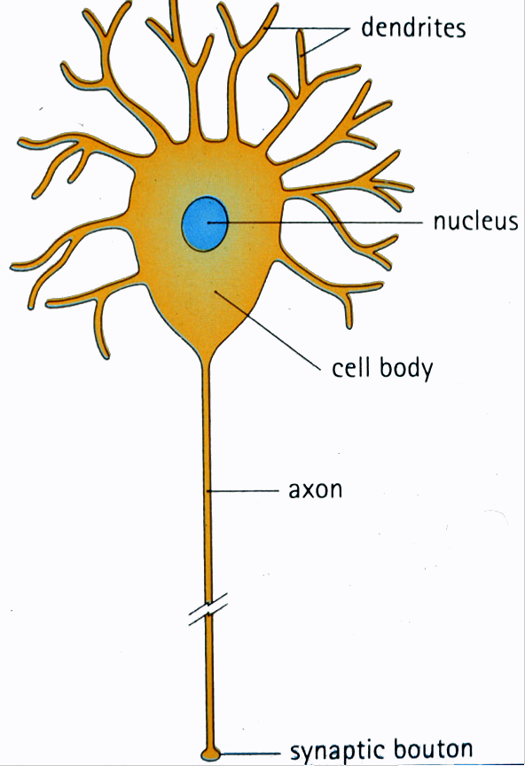
Generic neuron
Large cell body (aka soma or perikaryon)
Large, euchromatic nucleus (and usually a prominent nucleolus)
Extensive cytoplasmic extensions:
Dendrite(s): single or multiple extensions specialized for receiving input
Axon: single, large extension specialized for conveying output (in humans, can be up to 1.5m in length)
Notes:
Human Histology, 2nd edition, Stevens and Lowe, Mosby; Fig. 6-1

Slide 5
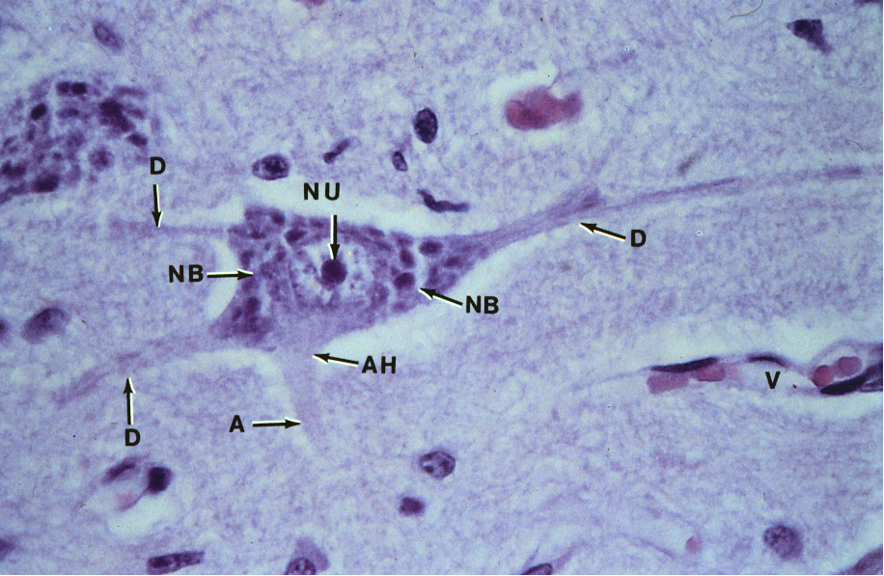
Motor neuron with Nissl bodies
D
NU
N
D
NB
NB
AH
V
D
A
A-axon D-dendrite N-nucleus NB-Nissl body
AH-axon hillock V-blood vessel NU-nucleolus
Notes:
Color Atlas of Basic Histology; 1993; Berman; Appelton and Lange; Fig 6-4

Slide 6
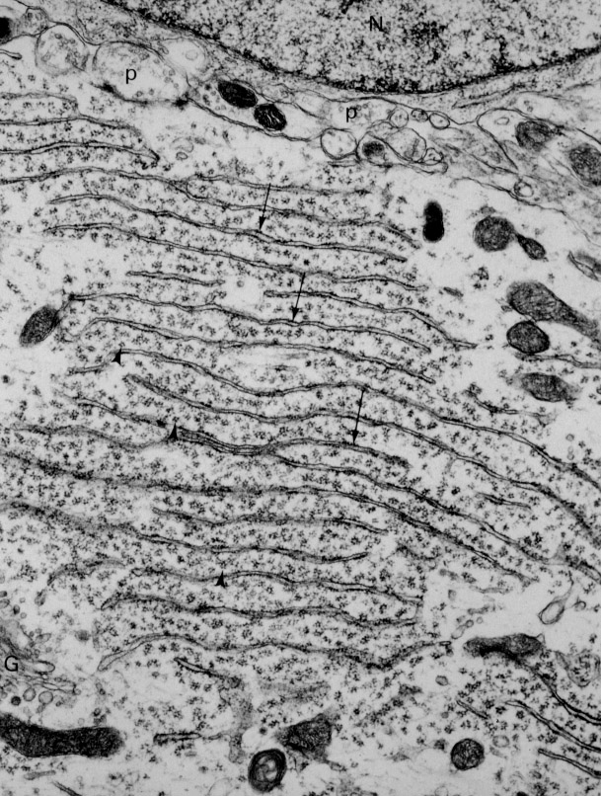
Nissl substance is rough endoplasmic reticulum
Notes:
Cell and Tissue Ultrastructure – A Functional Perspective; 1993; Cross and Mercer, Freeman and Co.; Page 127

Slide 7
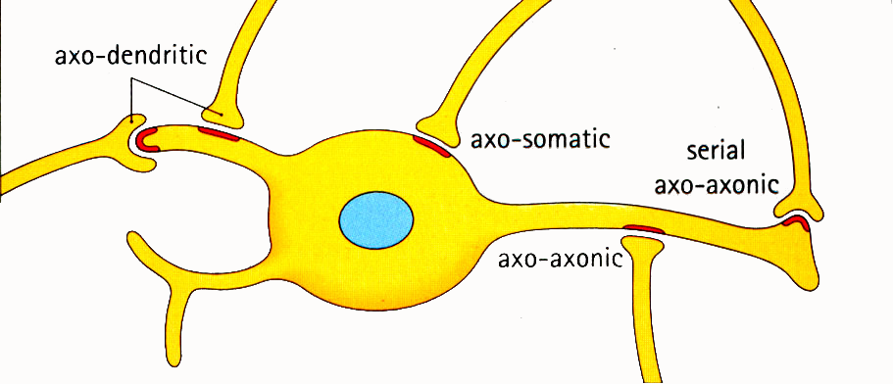
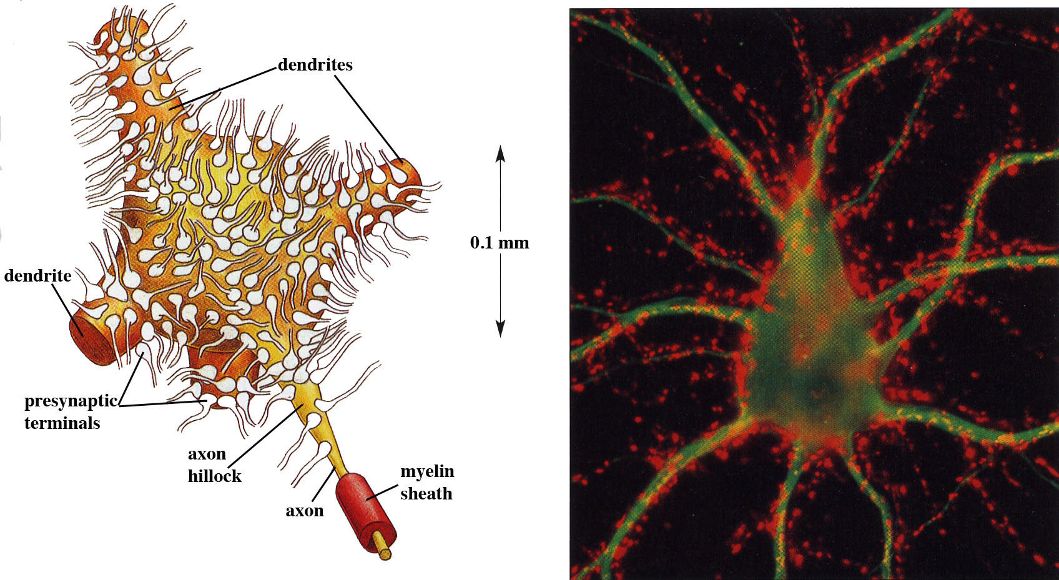
Synapses can form between many different parts of neurons and between a neuron and a non-neuronal cell, e.g., a muscle or a secretory cell.
A single neuron can receive activating or inhibiting inputs from thousands of synaptic connections.
Motor neuron cell body in the spinal cord
Notes:
Human Histology, 2nd edition, Stevens and Lowe, Mosby ; Fig 6.7
and
The Molecular Biology of the Cell by B. Alberts et al., 4th edition, 2002, Garland Science
Fig. 11-38 A motor neuron in the spinal cord. Panel B courtesy of Olaf Mundigl and Pietro de Camilli

Slide 8
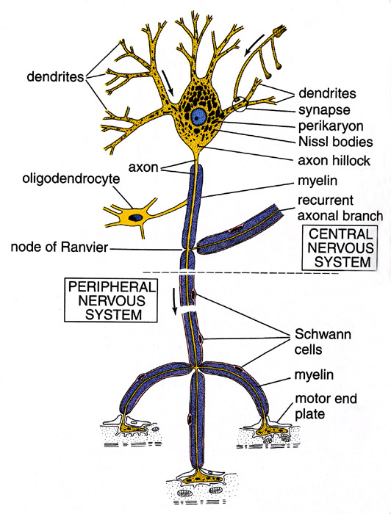
Conduction velocity in the axon is enhanced by myelination axons in the CNS are myelinated by oligodendrocytes axons in the PNS are myelinated by Schwann cells
Notes:
Diagram from Kelley, Kaye and Pawlina, "Histology, a Text and Atlas," 4th ed., page 284. Neuron-Ross4-284.tif.

Slide 9
Myelinated Nerve Fiber
The increased lipid content of the myelin sheath provides electrical insulation for the underlying axon.
Myelin Sheath
Notes:
Wheater’s Functional Histology; 5th edition, Young, Lowe, Stevens and Heath; Churchill Livingstone, Fig. 7.6
A, axon; S, Schwann cell nucleus.
Demyelinating diseases result in decreased or lost ability to transmit electrical signals along nerve fibers. Guillain-Barre syndrome is the most common life-treatening disease of PNS. It is characterized by inflammatory response around nerve fibers (accumulation of plasma cells, lymphocytes, macrophages around and within nerves, consistent with a T-cell mediated immune response against myelin. Can be triggered by a respiratory or gastrointestinal viral infection, but the etiology is not known. The symptoms include tingling or crawling sensation, ascending weakness or paralysis, loss of muscle coordination and loss of cutaneous sensation.

Slide 10
Each Schwann cell myelinates a single internode
Internode length can be up to 1.5 mm in the largest nerve fibers
Notes:
A single Schwann cell produces a single segment of myelin sheath along an individual nerve fiber. In contrast, each myelinating glial cell in the central nervous system, called oligodendrocytes, can myelinate up to 50 individual axons.

Slide 11
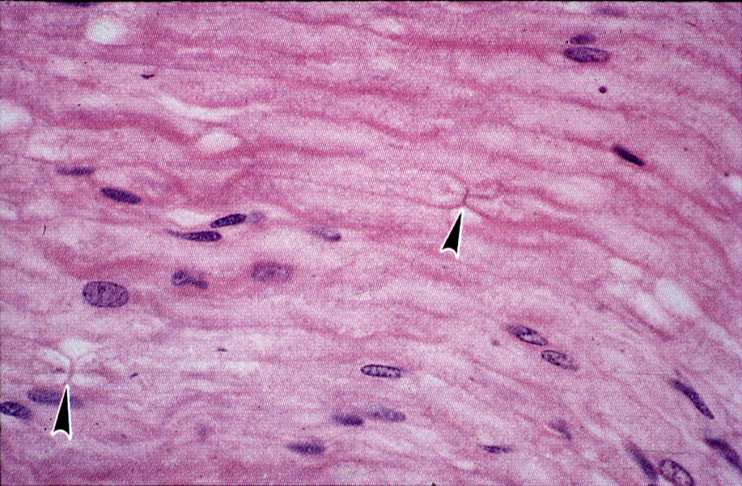
Nodes of Ranvier in a longitudinal nerve section
Notes:
Color Atlas of Histology; 1992; Erlandsen and Magney; Mosby Book; Fig. 9-13

Slide 12
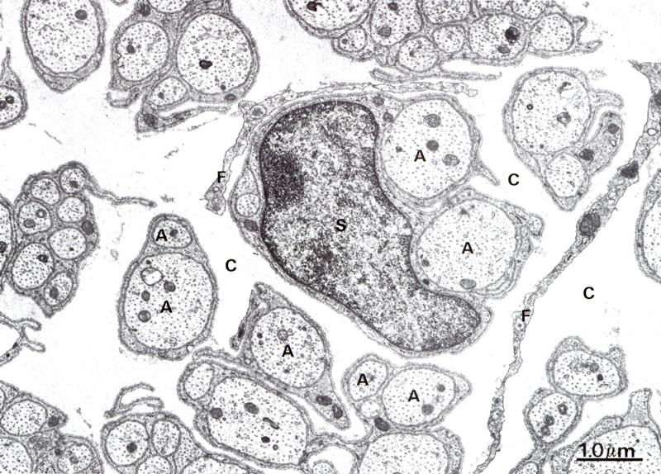
Small diameter nerve fibers are non-myelinated
Notes:
Wheater’s Functional Histology; 5th edition, 2006, Young, Lowe, Stevens and Heath; Churchill Livingstone Elsevier; Fig 7.5b
S, Schwann cell; F, fibroblast; A, axon; C, connective tissue (endoneurium). Unmyelinated (or non-myelinated) fibers include autonomic nerve fibers and sensory fibers carrying pain inputs. Each Schwann cell can enwrap several fibers.

Slide 13
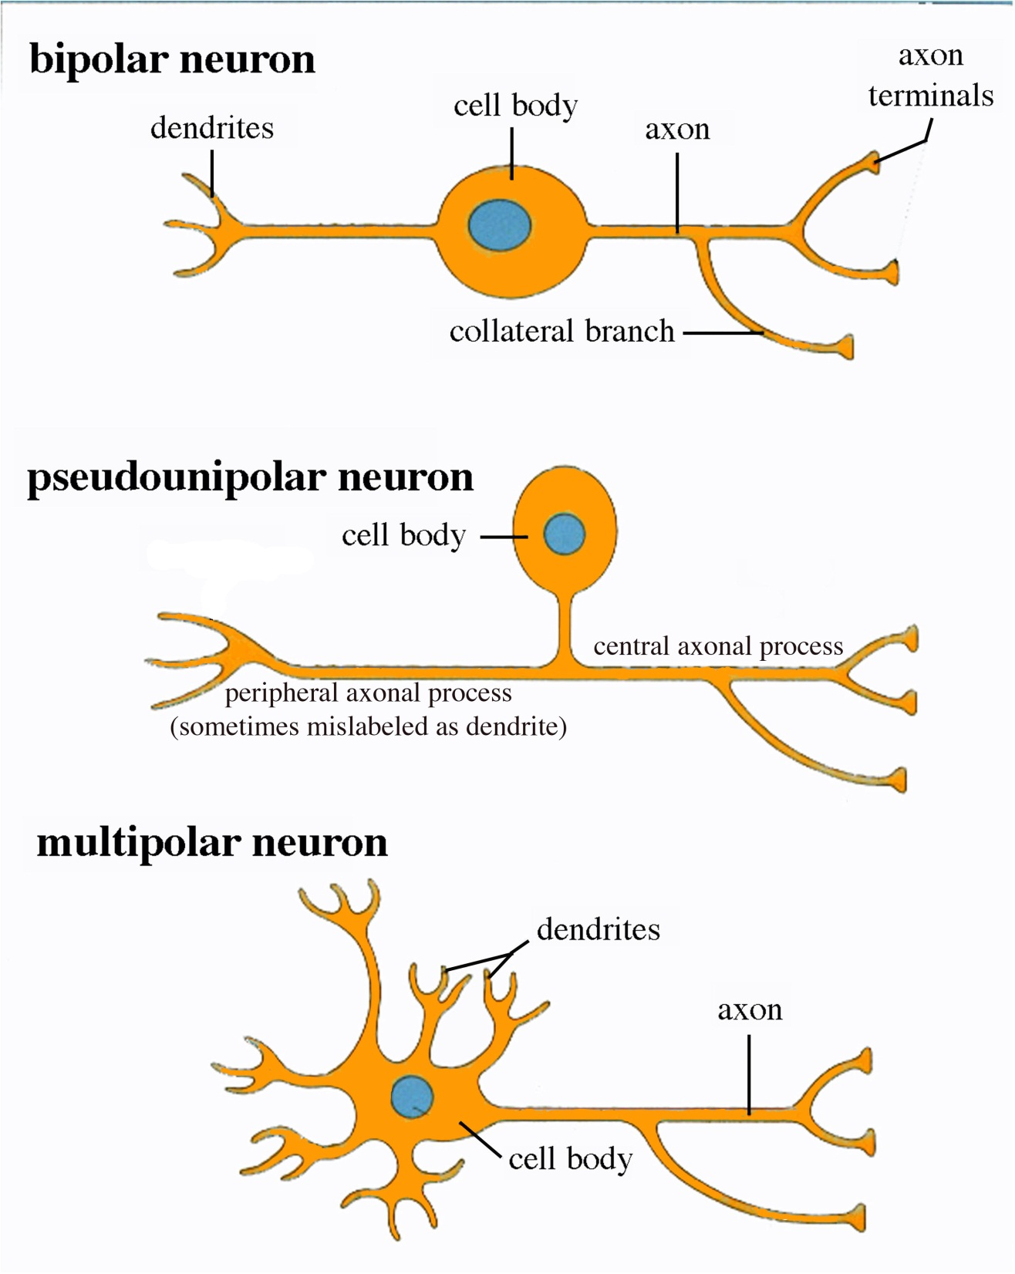
Three different basic types of neuronal structure
Notes:
Human Histology, 2nd edition, Stevens and Lowe, Mosby ; Fig.6.3

Slide 14
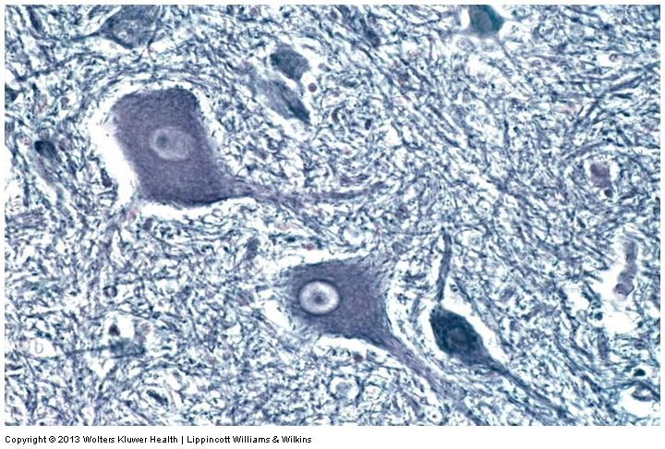
Multipolar neurons

Slide 15
Multipolar neurons

Slide 16
Neurons and Neuroglia

Slide 17
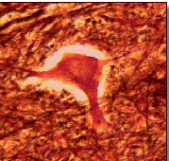
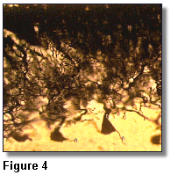
Nerve cell body surrounded by Neuropil
Purkinje cells of the Cerebellum (Golgi Stain)

Slide 18
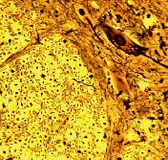
Spinal cord stained with silver

Slide 19
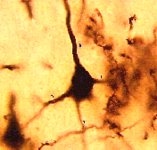
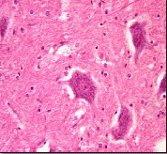
Pyramidal cell from Cerebral Cortex (Golgi Stain)
Section of Spinal cord

Slide 20
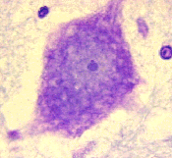
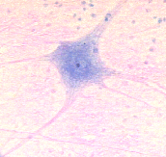
Cell body of Motor Neuron from spinal cord
Nerve cell body from Spinal cord

Slide 21
Multipolar neurons

Slide 22
Unipolar Neurons

Slide 23
Unipolar neurons

Slide 24
Myelinated axons

Slide 25
Spinal cord and Dorsal Root Ganglion
Dorsal median sulcus
Dorsal horn
(Lateral horn) if present
Ventral horn
Ventral median fissure
Dorsal root ganglion (DRG)

Slide 26
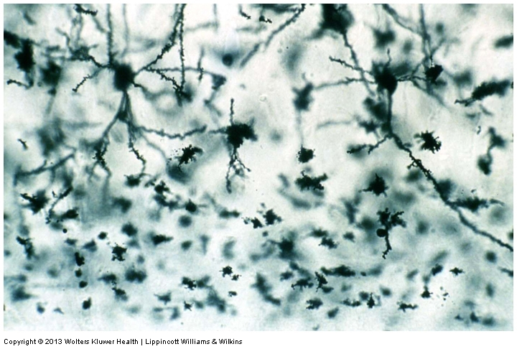
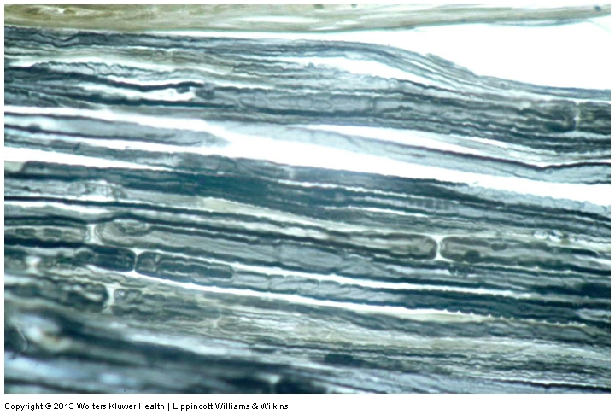
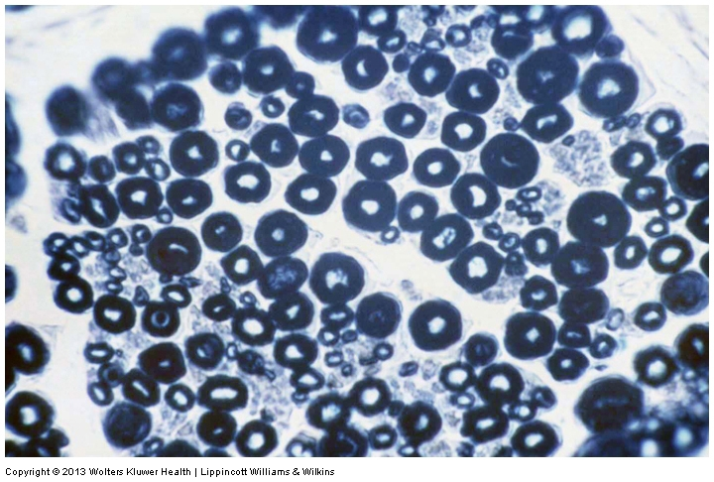
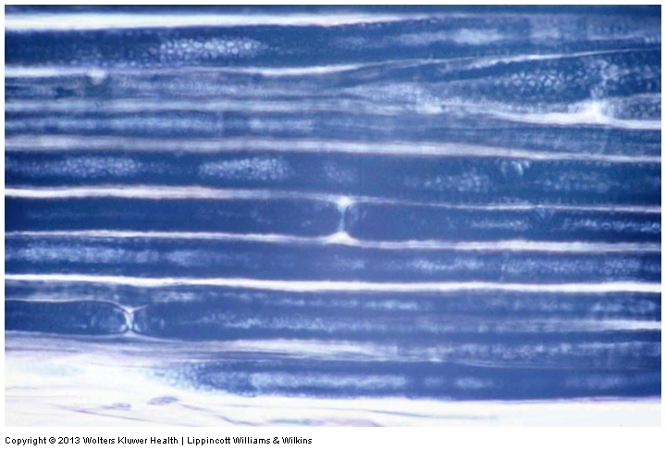
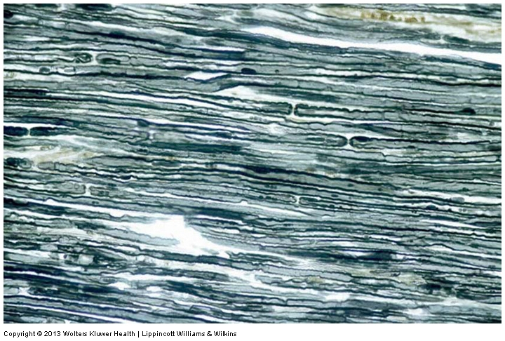
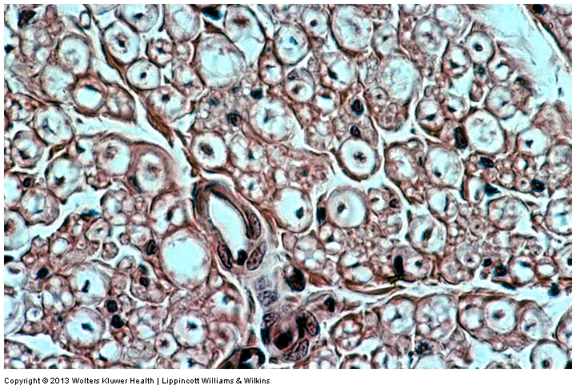
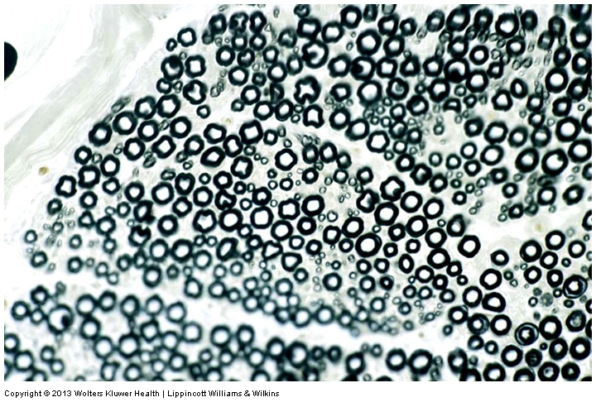
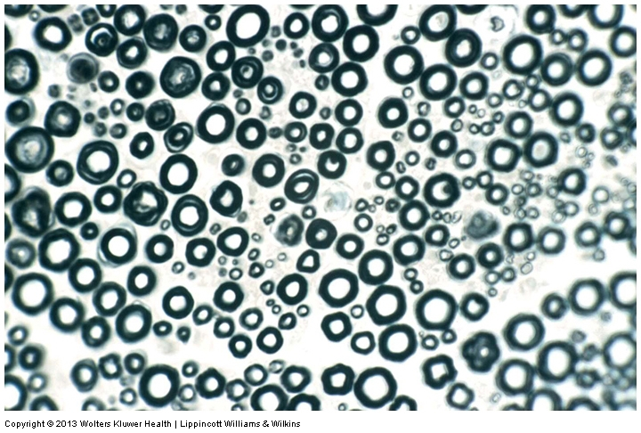
Myelinated Axons

Slide 27
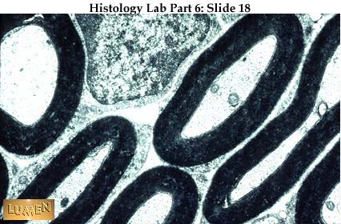
EM picture of Myelinated Axons

Slide 28
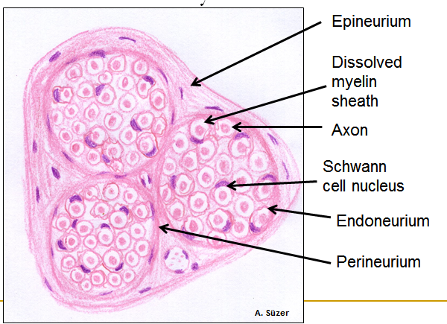
Peripheral Nerve

Slide 29
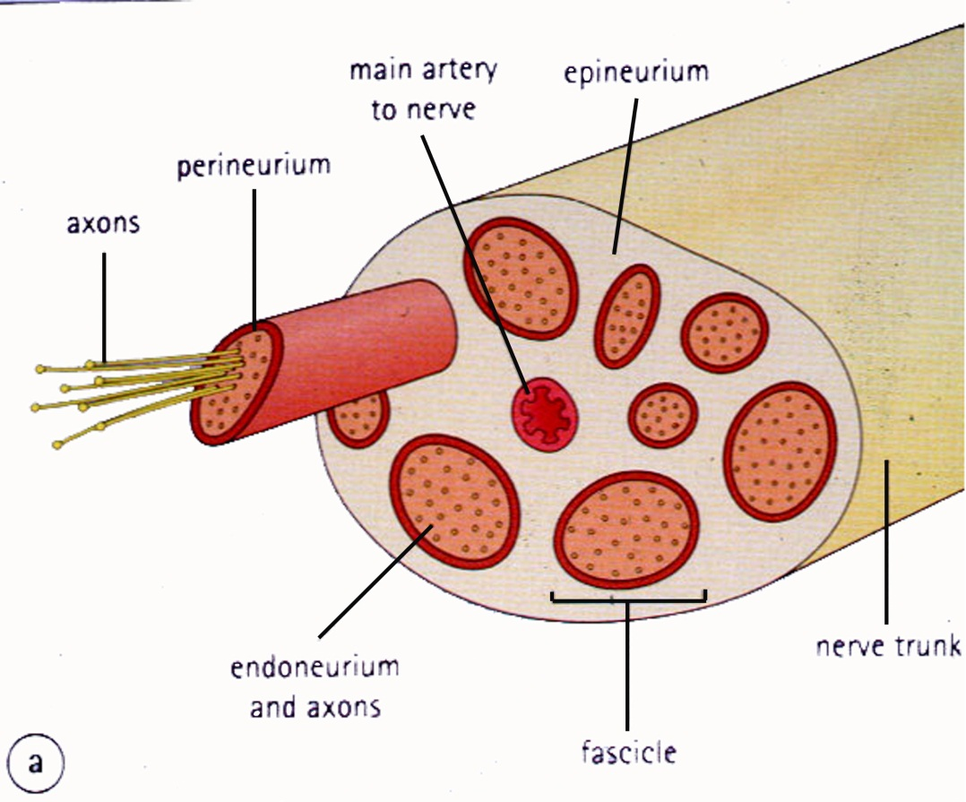
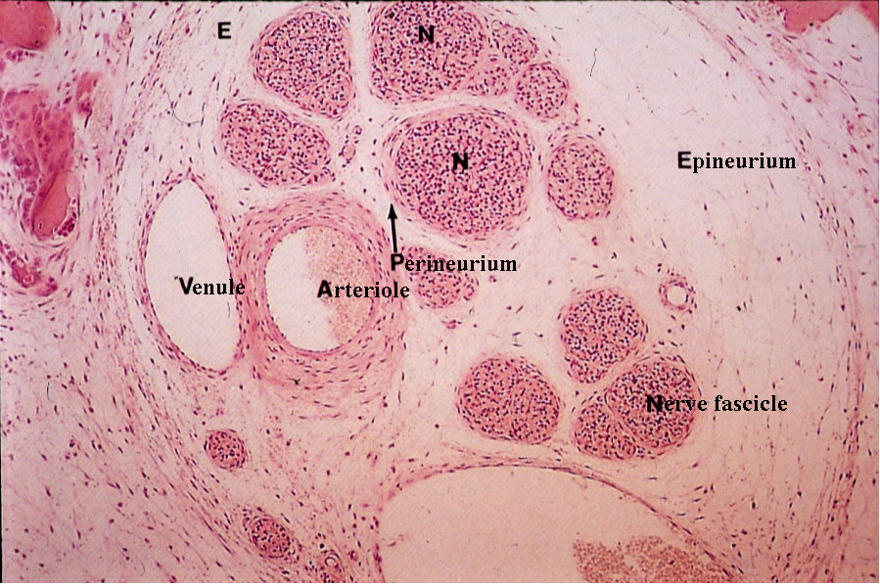
Connective tissue layers found in nerves: endoneurium surrounds axons, perineurium axon fascicles and epineurium the entire nerve
Notes:
Human Histology, 2nd edition, Stevens and Lowe, Mosby ; Fig. 6.20

Slide 30
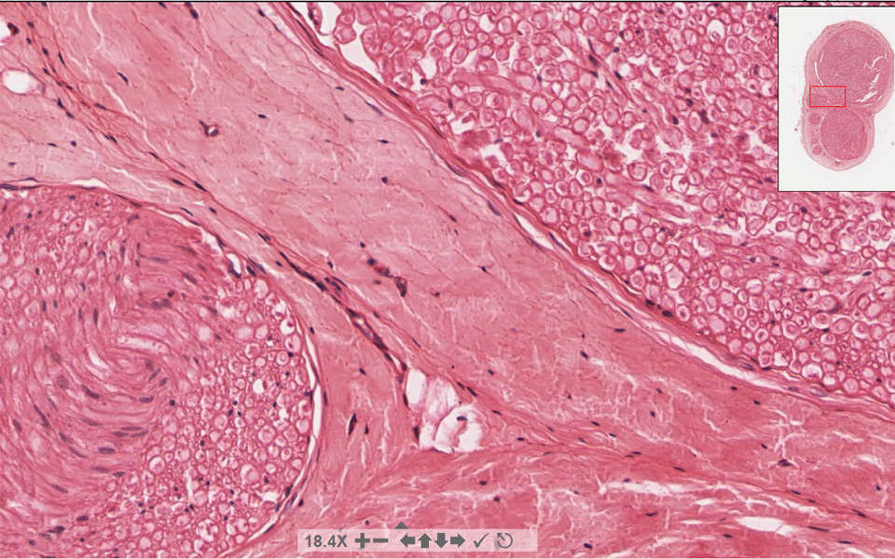
Connective tissue layers in a peripheral nerve. Tight junctions between perineurium cells form a important isolating barrier.
Epineurium
Perineurium
Notes:
Basic Histology – Text & Atlas; 10th edition, 2003; Junqueira and Carneiro, Lange McGraw-Hill; Fig 9-34
Endoneurium surrounds individual axons (nerve fibers) within a fascicle, perineurium surrounds bundles (fascicles) of nerve fibers, epineurium surrounds fascicles and forms a denser sheath around the entire nerve.
Perineurial cells are derived from fibroblasts.

Slide 31
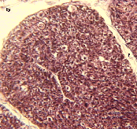
Myleinated Nerve

Slide 32
Myelinated Axons

Slide 33
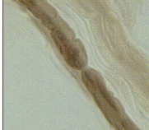
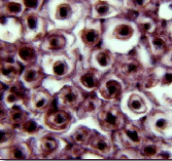
Nervous tissue in PNS
Teased myelinated nerve fibre stained with osmium tetraoxide
Myelinated Nerve stained with silver

Slide 34
Neuroglial cells
Supporting, Non-neuronal cells
Much smaller than the neurons
10 times more numerous than neurons
4 types: Astrocytes(Fibrous and Protoplasmic), oligodendroctes, microglial cells

Slide 35
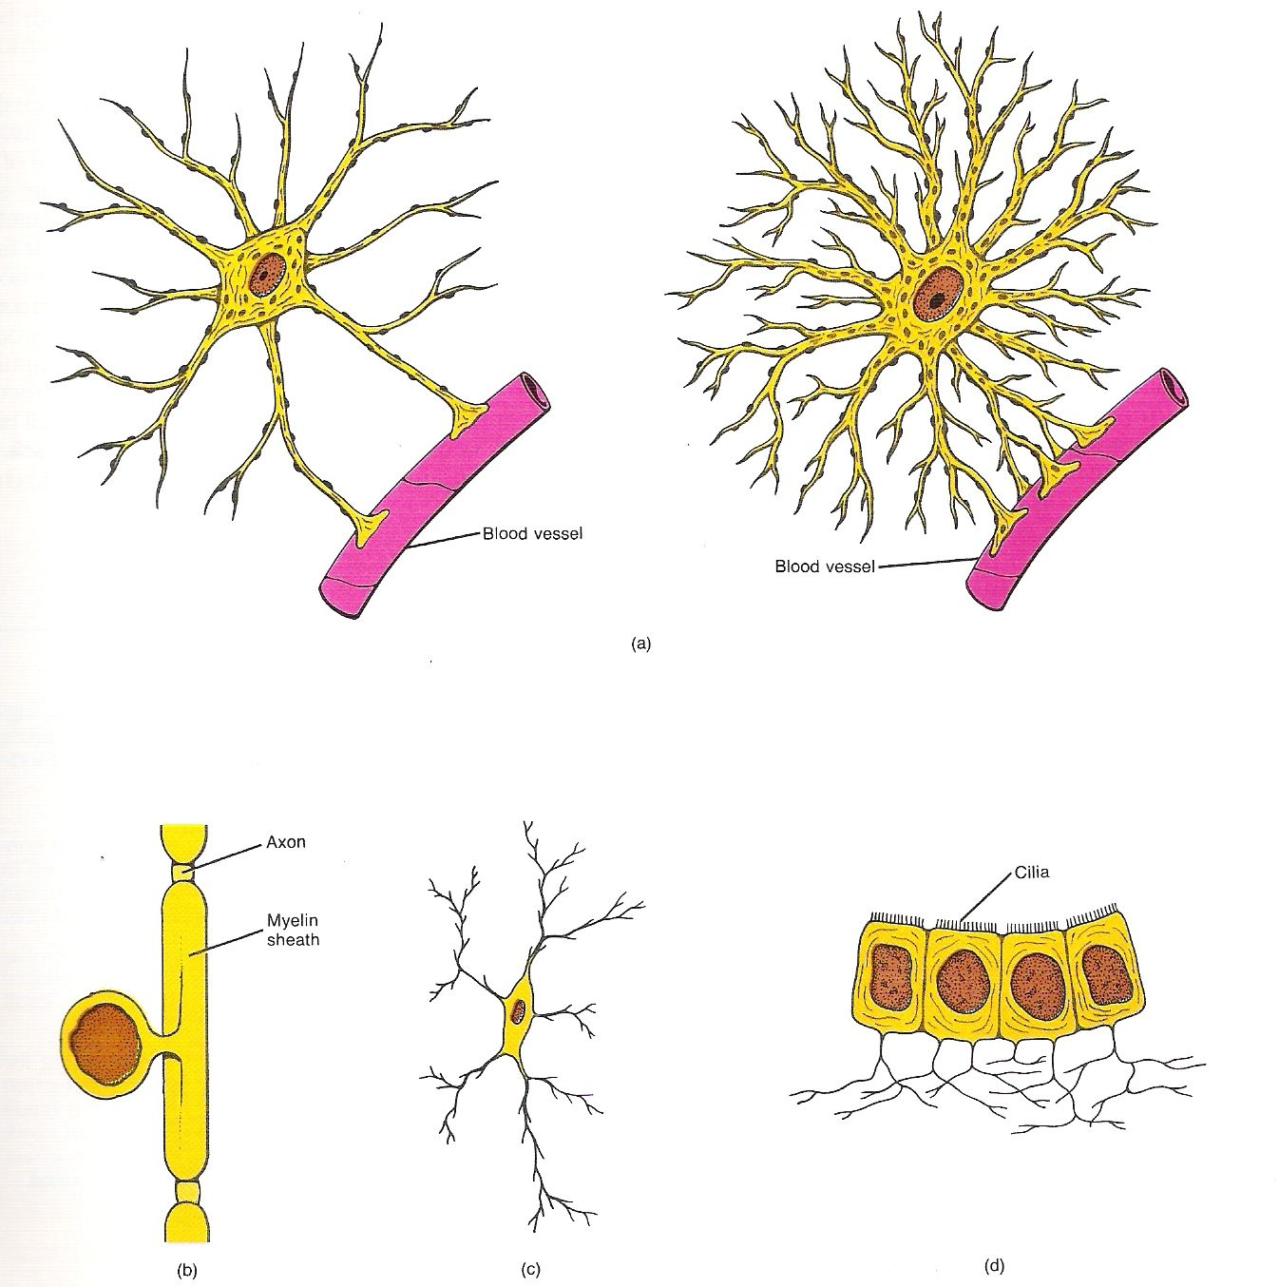

Slide 36
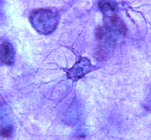
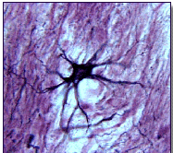
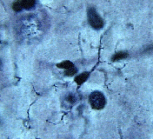
Neuroglial cells
Oligodendrocyte
Fibrous Astrocyte
Microglial cells

Slide 37
Astrocytes

Slide 38
Astrocytes
Many short thick processes.
Predominantly seen in gray matter.
Function:Supportive, Nutritive, Repair, barrier to diffusion of toxic substances

Slide 39
Ganglia
Sensory Ganglia
Example:Spinal Ganglion
Large, rounded Pseudounipolar cells
Nucleus is centrally placed
Found in groups
Well defined Satellite cells present.
Motor ganglia
Known as Autonomic or Sympathetic ganglia.
Small angular multipolar Neurons
Nucleus eccentrically placed
Found Scattered
Poorly defined satellite cells prsent

Slide 40
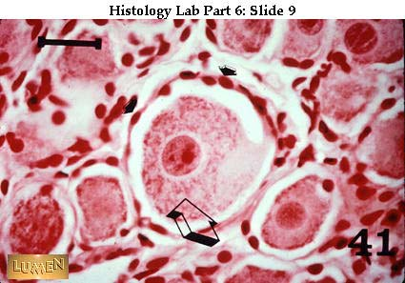
Spinal Ganglion

Slide 41
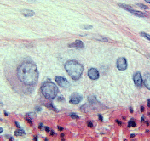
Autonomic Ganglia

Slide 42
MCQ
Pseudounipolar cells are found in the following ganglion:
1. Spinal
2.Spiral
3.Sympathetic
4.Parasympathetic

Slide 43
MCQ
The connective tissue sheath around a nerve is called
1.Endoneurium
2.Perineurium
3.Epineurium
4.Neurilemma

Slide 44
MCQ
Section of the sympathetic ganglion can be identified by the presence of
1.Large Pseudo-unipolar neurons
2. Small multiple neurons
3. Bipolar Neurons
4.Well dveloped satellite cells

Slide 45
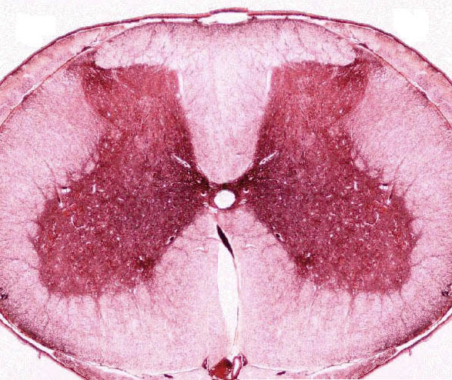
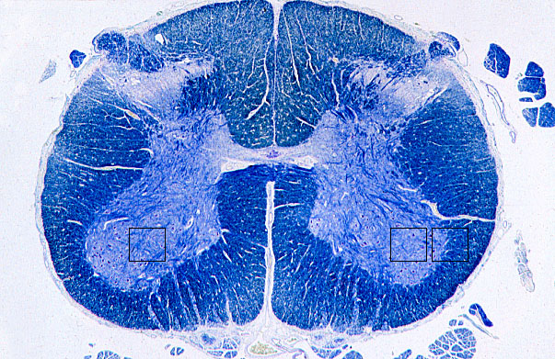
Spinal cord

Slide 46
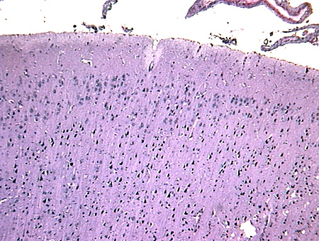
Cerebrum

Slide 47
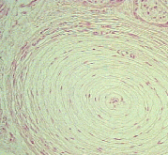
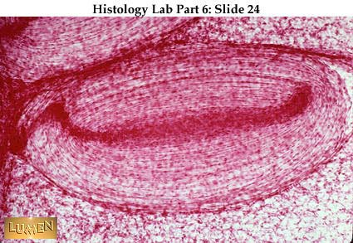
Pacinian Corpuscle

Slide 48
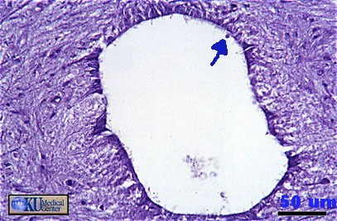
Central Canal of Spinal Cord

Slide 49
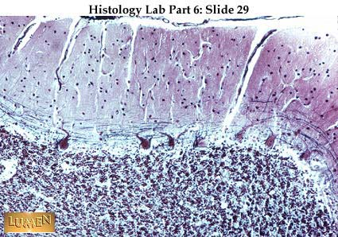
Cerebellum

Slide 50
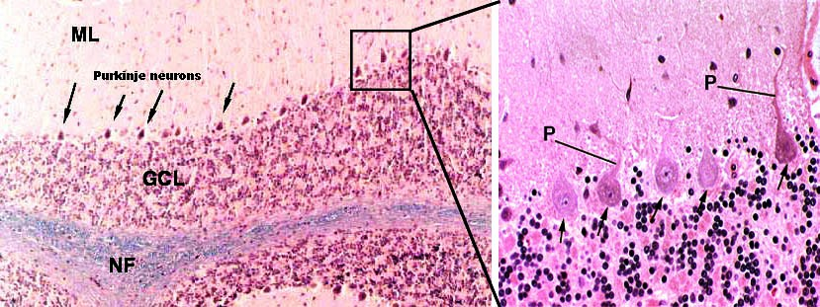

Slide 51
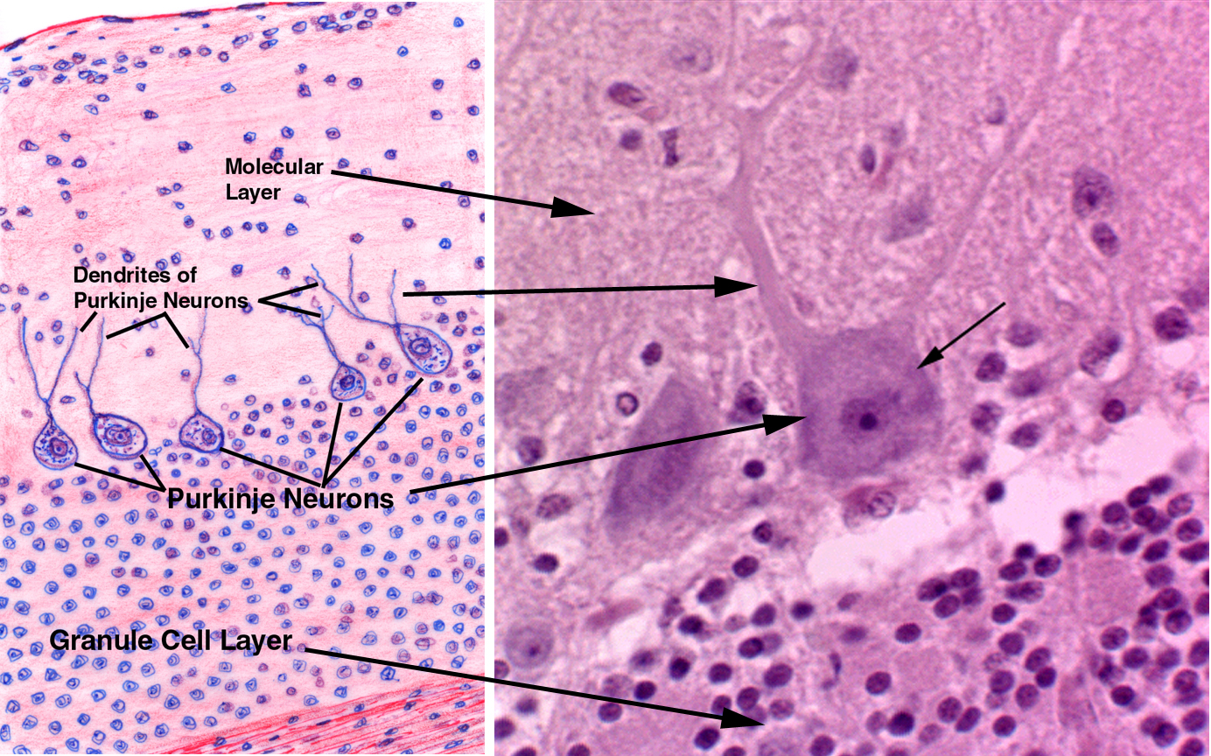

Slide 52
