Slide 1
PHARMACODYNAMICS
DR NARENDRA KUMAR

Slide 2
Pharmacodynamics is the study of the biochemical and physiological effects of drugs and their mechanisms of action.
Simply stated, pharmacodynamics refers to the effects of a drug on the body.

Slide 3
Two state receptor model
A receptor may exist in two interchangeable states, active (Ra) & inactive (Ri) which are in equilibrium.
Binding of drug shift this equilibrium in either direction.

Slide 4
Ligand- any molecule which attaches selectively to particular receptors.
Affinity -The strength of the reversible interaction between a drug and its receptor, as measured by the dissociation constant, is defined as the affinity of one for the other.
Intrinsic activity – capacity to induce a functional change in the receptor.
Specificity - A drug that interacts with a single type of receptor that is expressed on only a limited number of differentiated cells will exhibit high specificity.

Slide 5
Agonists
Drugs that bind to physiological receptors and mimic the regulatory effects of the endogenous signaling compounds are termed agonists.
If the drug binds to the same recognition site as the endogenous agonist (the primary or orthosteric site on the receptor) the drug is said to be a primary agonist.
Allosteric agonists bind to a different region on the receptor referred to as an allosteric site.

Slide 7
Antagonist
Drugs that block or reduce the action of an agonist are termed antagonists.
Antagonism most commonly results from competition with an agonist for the same or overlapping site on the receptor (a syntopic interaction)
Physical antagonist binds to the drug and prevents its absorption like charcoal binds to alkaloids and prevents their absorption.
Chemical antagonist combines with a substance chemically like chelating agents binds with the metals.
Physiological antagonist produces an action opposite to a substance but by binding to the different receptors e.g. adrenaline is a physiological antagonist of histamine because adrenaline causes bronchodilatation by binding to β2 receptors, which is opposite to bronchoconstriction caused by histamine through H1 receptors.
Pharmacological antagonists produce no effect , shows no intrinsic activity.

Slide 8
Partial agonists -Agents that are only partly as effective as agonists regardless of the concentration employed.
Inverse agonists -Many receptors exhibit some constitutive activity in the absence of a regulatory ligand; drugs that stabilize such receptors in an inactive conformation are termed inverse agonists (produce effect opposite to that of agonist).

Slide 11
Efficacy
A maximal effect (Emax) an agonist can produce.
It can be measured with a graded dose-response curve only.

Slide 12
POTENCY
The amount of the drug needed to produce a given effect.
potency is determined by the affinity of the receptor for the drug.
The dose causing 50% from the maximal effect (EC50) can be obtained from graded dose-response curve.
In quantal dose response curve, ED50, TD50 and LD50 are potency variables.

Slide 16
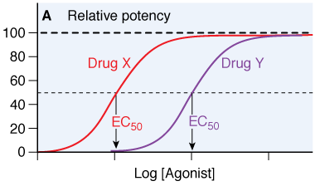

Slide 17
Repeated administration of a drug results in diminished effect “Tolerance”.
Tachyphylaxis: is a type of tolerance which occurs very rapidly.
Desensitization: decreased response to the agonist after its repeated injection in small doses.
May be due to
1- Masking or internalization of the receptors.
2- Loss of receptors (down regulation)- decreased synthesis or increased destruction.
3- Exhaustion of mediators (depletion of catecholamine).

Slide 20
PHYSIOLOGICAL RECEPTORS
GPCR
Ion channels
Transmembrane enzymes
Transmembrane, non-enzymes
Nuclear receptors
Intracellular enzymes

Slide 21
Cellular Pathways Activated by Physiological Receptors
Signal Transduction Pathways
Physiological receptors have at least two major functions, ligand binding and message propagation (i.e., signaling).
Two functional domains within the receptor:
-ligand-binding domain and
-effector domain.
The regulatory actions of a receptor may be exerted directly on its cellular target(s), on effector protein(s), or may be conveyed by intermediary cellular signaling molecules called transducers.

Slide 23
Receptors with intrinsic ion channel
Ligand gated ion channels.
No intervention of G-protein or second messenger.
Response is fastest (in milliseconds).
e.g. GABAA, 5HT3, NMDA

Slide 24
voltage-activated Na⁺ channel with the pore in the open and closed state.

Slide 28
Structure of the nicotinic acetylcholine receptor (a typical ligand-gated ion channel. The five receptor subunits (α2, β, γ, δ) form a cluster surrounding a central transmembrane pore.

Slide 29
Ligand-gated nicotinic acetylcholine receptor expressed in the skeletal muscle neuromuscular junction. The pore is made up of five subunits, each with a large extracellular domain and four transmembrane helices. The helix that lines the pore is shown in blue.

Slide 30
PHYSIOLOGICAL RECEPTOR
STRUCTURAL FAMILY | FUNCTIONAL FAMILY | PHYSIOLOGICAL LIGANDS | EFFECTORS AND TRANSDUCERS | EXAMPLE DRUGS
GPCR | β Adrenergic receptors | NE, Epi, DA | G_{s} ; AC | Dobutamine
 | Muscarinic cholinergic receptors | ACh | G_{i} and G_{q}; AC, ion channels, PLC | Atropine
 | Eicosanoid receptors | Prostaglandins, leukotrienes, thromboxanes | G_{s}, G_{i} and G_{q} proteins | Misoprostol, montelukast

Slide 31
G Proteins
GPCRs a family of heterotrimeric GTP-binding regulatory proteins termed G proteins.
G proteins are signal transducers that convey the information that agonist is bound to the receptor from the receptor to one or more effector proteins.
The G protein heterotrimer is composed of a guanine nucleotide-binding α subunit, which confers specific recognition to both receptors and effectors, and an associated dimer of β and ϒ subunits.
G–protein-regulated effectors include enzymes such as
-adenylyl cyclase,
-phospholipase C,
-cyclic GMP phosphodiesterase (PDE6),
-membrane ion channels selective for Ca²⁺ and K⁺.

Slide 32
G Protein–Coupled Receptors (GCPRs)
GPCRs span the plasma membrane as a bundle of seven alfa-helices.
Extracellular binding site for ligand.
Cytosolic binding site for transducer G-protein.

Slide 35
The subunits fall into four families (G_{s}, G_{i}, G_{q}, and G_{12/13}).
The G_{s} α-subunit uniformly activates adenylyl cyclase;
the G_{i} α-subunit can inhibit certain isoforms of adenylyl cyclase;
the G_{q} α-subunit activates all forms of phospholipase C;
and the G_{12/13} α-subunits couple to guanine nucleotide exchange factors (GEFs), such as p115RhoGEF for the small GTP-binding proteins Rho and Rac.

Slide 36
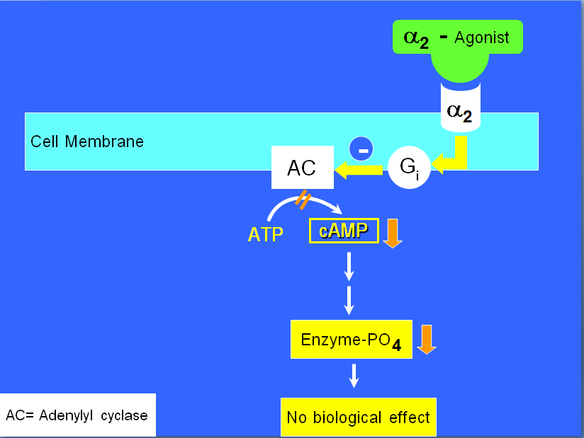

Slide 37
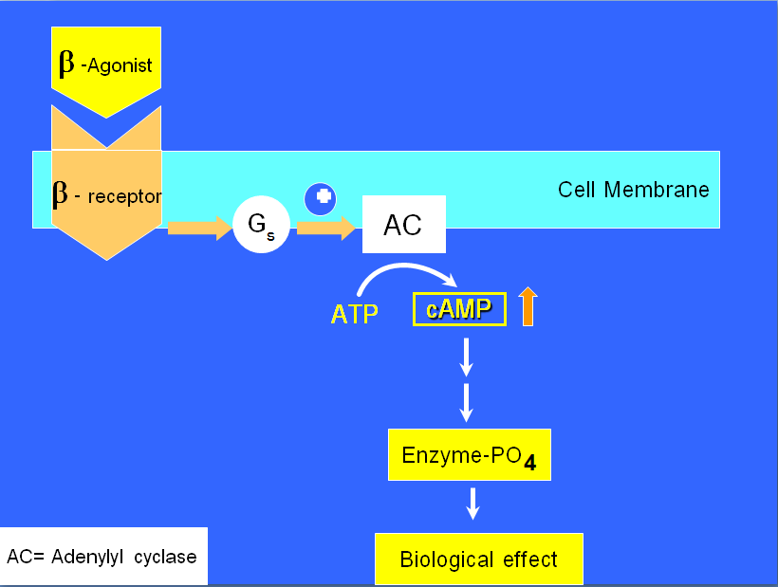

Slide 38
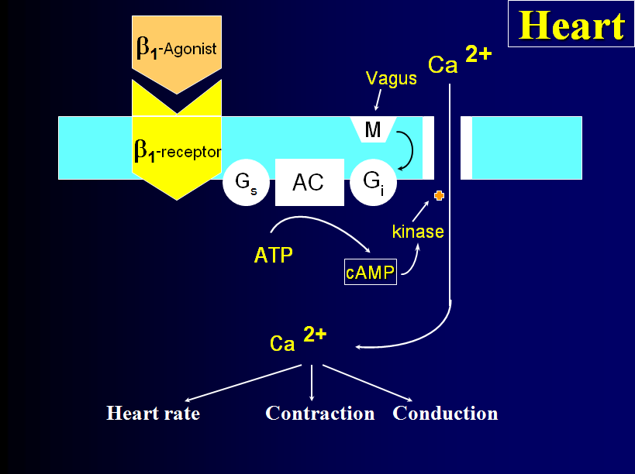

Slide 39
Adenylyl cyclase-cAMP pathway
↑ cAMP (2nd messenger)
PKA phosphorylation
Various functions
-↑ heart contraction
-Smooth mus relaxation
-Glycogenolysis
-lipolysis

Slide 40
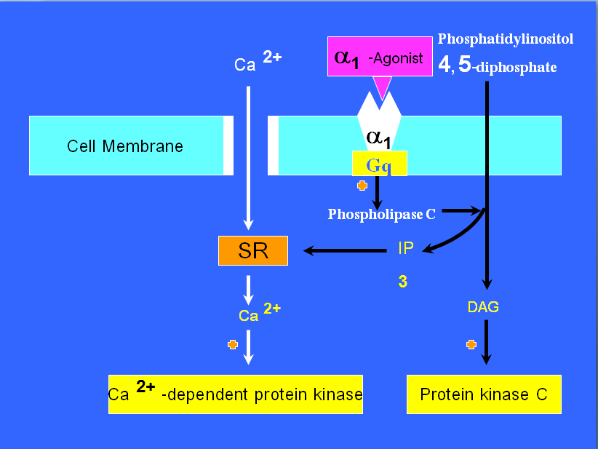
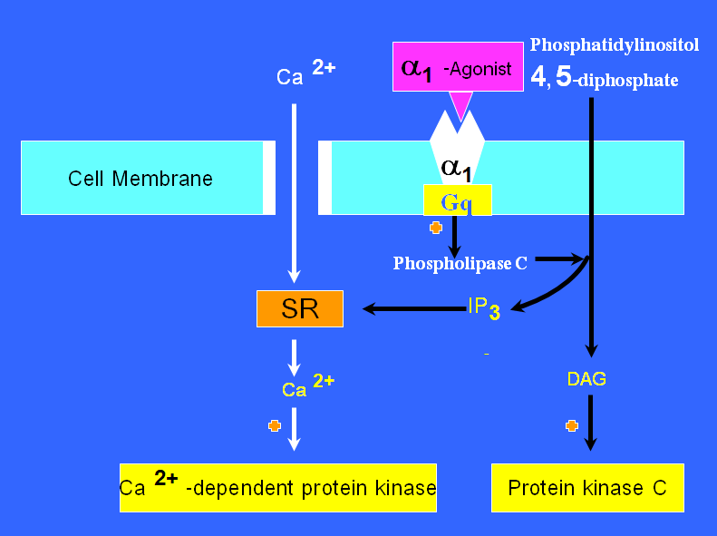

Slide 41
Phospholipase C: IP3-DAG pathway
PIP2
IP3 + DAG
Mobilize Ca ²⁺ PKc activation
Activation of CCPK, MLCK, PKc
-contraction
-neural excitation
-cell proliferation

Slide 47
RESENSITIZATION AND DOWN-REGULATION OF RECEPTOR
Agonist binding to receptors initiates signaling by promoting receptor interaction with G proteins (G_{s}) located in the cytoplasm.
Agonist-activated receptors are phosphorylated by a G protein-coupled receptor kinase (GRK), preventing receptor interaction with G_{s} and promoting binding of a different protein, - β arrestin (β-Arr), to the receptor.
The receptor- β arrestin complex binds to coated pits, promoting receptor internalization.
Dissociation of agonist from internalized receptors reduces - β Arr binding affinity, allowing dephosphorylation of receptors by a phosphatase.
Return of receptors to the plasma membrane result in the efficient resensitization of cellular responsiveness.
Repeated or prolonged exposure of cells to agonist favors the delivery of internalized receptors to lysosomes , promoting receptor down-regulation rather than resensitization.

Slide 50
Enzyme linked receptors
With intrinsic enzymatic activity.
Without intrinsic enzymatic activity (but bind a JAK-STAT kinase on activation

Slide 51
receptor tyrosine kinase and a cytokine receptor. Activation of the EGF receptor. The extracellular structure of the unliganded receptor (a) contains four domains (I-IV), which rearrange significantly upon binding two EGF molecules. (b). The conformational changes lead to activation of the cytoplasmic tyrosine kinase domains and tyrosine phosphorylation of intracellular regions to form SH2 binding sites. (c). The adapter molecule Grb2 binds to the phosphoryated tyrosine residues and activates the Ras-MAP kinsase cascade

Slide 54
JAKs- STATS PATHWAY Binding of the cytokine causes dimerization of the receptor and recruits the Janus Kinases (JAKs) to the cytoplasmic tails of the receptor. JAKs trans-phosphorylate and lead to the phosphorylation of the signal transducers and activators of transcription (STATs). The phosphorylated STATS translocate to the nucleus and regulate transcription. There are proteins termed suppressors of cytokine signaling (SOCS) that inhibit the JAK-STAT pathway

Slide 56
NATRIURETIC PEPTIDE RECEPTORS

Slide 57
NO SYNTHASE AND SOLUBLE GUANYLATE CYCLASE
The cellular effects of cyclic GMP on the vascular system are mediated by a number of mechanisms, but especially by PKG. For example, in vascular smooth muscle, activation of PKG leads to vasodilation by:
Inhibiting IP₃-mediated Ca²⁺ release from intracellular stores.
Phosphorylating voltage-gated Ca²⁺ channels to inhibit Ca²⁺ influx.
Phosphorylating phospholamban, a modulator of the sarcoplasmic Ca²⁺ pump, leading to a more rapid reuptake of Ca²⁺ into intracellular stores.
Phosphorylating and opening the Ca²⁺-activated K⁺ channel leading to hyperpolarization of the cell membrane, which closes L-type Ca²⁺ channels and reduces the flux of Ca²⁺ into the cell.

Slide 59
Receptors regulating gene expression
Several biologic ligands are sufficiently lipid-soluble to cross the plasma membrane and act on intracellular receptors.
e.g.
steroids (corticosteroids, mineralocorticoids, sex steroids, vitamin D), and thyroid hormone, whose receptors stimulate the transcription of genes by binding to specific DNA sequences near the gene whose expression is to be regulated.
Target DNA sequences called response elements.

Slide 60
In the absence of hormone, the receptor is bound to hsp90, a protein that appears to prevent normal folding of several structural domains of the receptor.
Binding of hormone to the ligand-binding domain triggers release of hsp90.
This allows the DNA-binding and transcription-activating domains of the receptor to fold into their functionally active conformations, so that the activated receptor can initiate transcription of target genes.

Slide 63
Therapeutic window
Therapeutic effect is seen only with in a narrow range of plasma conc.
Both above & below this range, beneficial effect is suboptimal.
Drugs having low therapeutic window
Theophylline
Carbamazepine
Digoxin
Lithium
Phenytoin

Slide 66
Therapeutic Index
Is the ratio of the LD50 to ED50
Represent an estimate of the safety of a drug.

Slide 67
Importance of graded dose-response curves
1.Calculation of the ED50 (The dose that produces 50% of the maximum response in one animal
Comparing ED50 of different drugs on the same animal gives an idea about the equieffective doses i.e the doses that produce the same effect.
Comparing ED50 of the same drug in different patients gives an idea about the relative sensitivity of the patients to the same drug i.e the degree of biological variation inherent in a population.
2. Calculation of the maximum response
Comparing the maximum response obtained by different drugs on the same organ gives an idea about the intrinsic activity.
3. Determination of the stepiness of the dose response
Any small change in the drug concentration produces significant increase in the tissue response. This means that maximum response to the drug could be reached very fast and the toxicity could be reached very fast too.

Slide 68
SYNERGISM
(Greek: Syn-together; ergon-work)
When the action of one drug is facilitated or increased by the other, they are said to be synergistic.
In a synergistic pair, both the drugs can have action in the same direction or given alone one may be inactive but still enhance the action of the other when given together.

Slide 69
Additive The effect of the two drugs is in the same direction and simply adds up: effect of drugs A + B = effect of drug A + effect of drug B

Slide 70
Supraadditive (potentiation) The effect of combination is greater than the individual effects of the components: effect of drug A+ B > effect of drug A+ effect of drug B This is always the case when one component is inactive as such.

Slide 71
Antagonism
Competitive antagonist
Same binding site as of agonist
resembles chemically with agonist
Right shift of DRC
Surmountable antagonism by increasing agonist dose
Inactivation of certain agonist molecules
Response depends on concentration of both
e.g Ach – Atropine, Morphine - Naloxone

Slide 72
Non-Competitive antagonist
Different binding site as of agonist.
Not resembles chemically with agonist.
Flattening/downward shift of DRC.
Unsurmountable antagonism (Maximum response is suppressed).
Inactivation of certain receptors.
Maximum response depends on concentration of antagonist
e.g. Diazepam - Bicuculline

Slide 74
Body size
It influences the concentration of the drug attained at the site of action. The average adult dose refers to individuals of medium built. For exceptionally obese or lean individuals and for children dose may be calculated on body weight (BW) basis:

Slide 75
Age
The dose of a drug for children is often calculated from the adult dose

Slide 76
Bibliography
Essentials of Medical Pharmacology -7th edition by KD Tripathi
Goodman & Gilman's the Pharmacological Basis of Therapeutics 12th edition by Laurence Brunton (Editor)
Lippincott's Illustrated Reviews: Pharmacology - 6th edition by Richard A. Harvey
Basic and Clinical pharmacology 11th edition by Bertram G Katzung
Rang & Dale's Pharmacology -7th edition by Humphrey P. Rang
Clinical Pharmacology 11th edition By Bennett and Brown, Churchill Livingstone
Principles of Pharmacology 2nd edition by HL Sharma and KK Sharma
Review of Pharmacology by Gobind Sparsh

