Slide 1
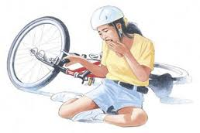
Traumatic injuries to the teeth
Presented by:
Dr. Rajeev Kumar Singh

Slide 2
Definitions
Trauma a physical injury or wound to the body
Traumatic relating to physical injuries or wounds to the body
Traumatology the branch of medicine that deals with serious injuries and wounds and their long-term consequences

Slide 3
Epidemiology
Dental trauma is common in childhood & adolescent
Incidence of dental trauma is 31-40% of boys & 16-30% of girls at 5 years of age
Incidence of dental trauma is 12-33% of boys & 4-19% of girls at 12 years of age
Boys are affected almost twice as often as girls in both the dentitions

Slide 4
Etiology
Most accident prone age is between 2 & 4 years for the primary dentition & 7 & 10 years for the permanent dentition
Pre-School Child:
Fall injuries.
Child abuse.
Injury during play.
Seizures.
School Age:
Athletic injuries.
Fighting.
Auto accidents.
Seizure disorders.

Slide 5
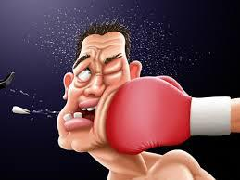
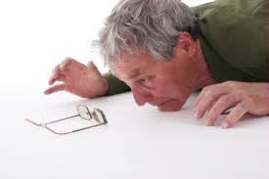
Type of trauma
Direct trauma :
When the tooth itself is struck
Indirect trauma:
When the lower dental arch is forcefully closed against the upper

Slide 6
Ellis classification
Class I: Enamel fracture
Class II: Enamel and dentin fracture without pulp exposure
Class III: Crown fracture with pulp exposure
Class IV: Traumatized tooth that has become non-vital with or without loss of tooth structure
Class V: Teeth lost as a result of trauma (Avulsion)
Class VI: Fracture of root with or without loss of crown structure
Class VII: Displacement of the tooth without fracture of crown or root
Class VIII: Fracture of the crown en masse and its replacement
Class IX: Fracture of deciduous teeth

Slide 7
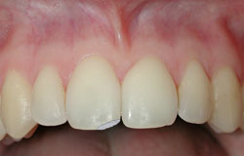
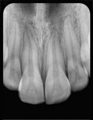
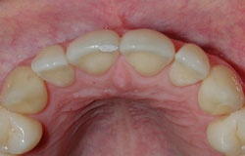
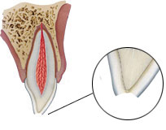
CLASS I
Enamel fracture
A fracture confined to the enamel with loss of tooth structure

Slide 8
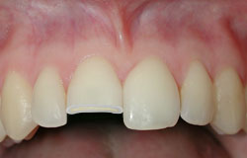
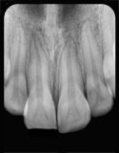
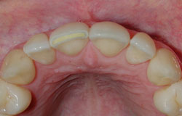
Class II
Enamel-dentin fracture
A fracture confined to enamel and dentin with loss of tooth structure but not involving the pulp

Slide 9
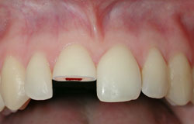
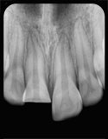
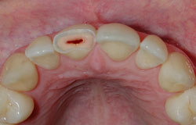
Class III
Enamel-dentin-pulp fracture
A fracture involving enamel and dentin with loss of tooth structure and exposure of the pulp

Slide 10
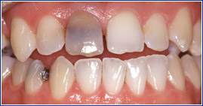
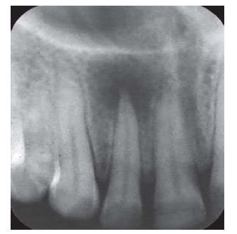
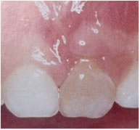
Tooth becomes non-vital
Class IV
Traumatized tooth that has become non-vital with or without loss of tooth structure

Slide 11
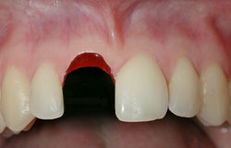
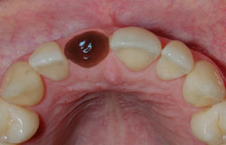
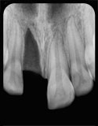
Class V
Avulsion
Teeth loss due to trauma

Slide 12
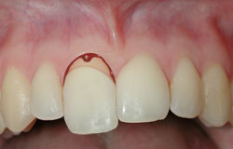
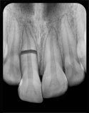
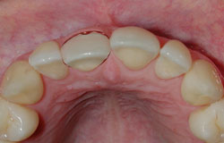
Class VI
Root Fracture
Fracture of root with or without loss of crown structure

Slide 13
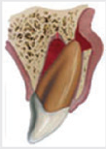
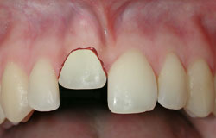
Tooth displacement
Class VII
Displacement of the tooth without fracture of crown or root

Slide 14
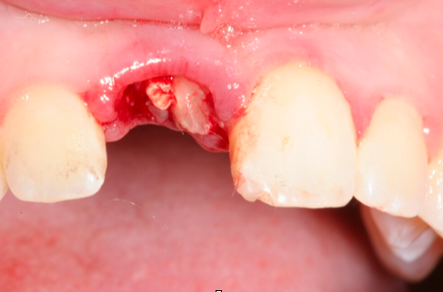
Fracture of crown en masse or its replacement
Class VIII
Complete fracture of the crown

Slide 15
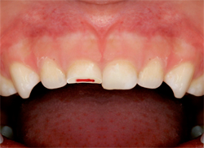
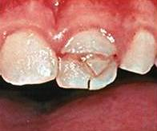
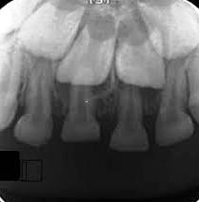
Class IX
Injuries to the primary teeth
Any injury to the primary tooth

Slide 16
Treatment of various dental fractures

Slide 17
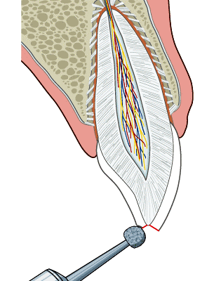
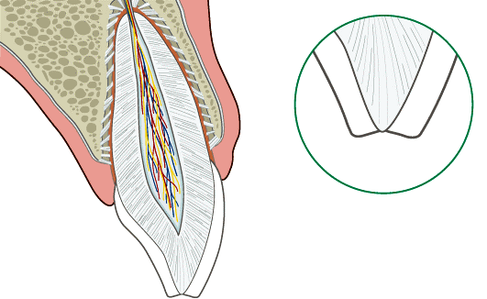
Management of Class 1 fracture
If a tooth fragment is available, it can be bonded to the tooth.
In many cases no immediate treatment is needed other than smoothing of sharp fracture edges. The fracture can be left for later restoration which in most cases will consist of augmentation with composite resin material.
Grinding or restoration with composite resin depending on the extent and location of the fracture.
Clinical and radiographic control at 6-8 weeks and 1 year.

Slide 18
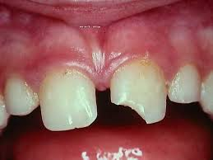
Management of Class 2 fracture
If a tooth fragment is available, it can be bonded to the tooth. Otherwise perform a provisional treatment by covering the exposed dentin with glass-ionomer or a permanent restoration using a bonding agent and composite resin.
The definitive treatment for the fractured crown is restoration with accepted dental restorative materials.
Radiograph of lip or cheek lacerations to search for tooth fragments or foreign material
Follow-up
Clinical and radiographic control at 6-8 weeks and 1 year

Slide 19
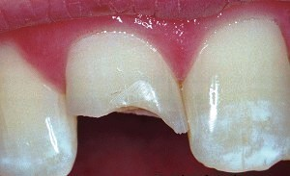
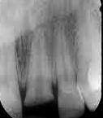
Management of class III fracture
Factors affecting management of class III fractures
Vitality of the pulp
Size of pulp exposure
Time elapsed since exposure
Stage of development of root apex
Restorability of fractured crown

Slide 20
Treatment summary for class III fractures
Open apex
Closed apex
Vital tooth
Non-vital tooth
RCT
Direct Pulp Capping
Pulpotomy
Apexification

Slide 21
Class IV fracture
Open apex
Closed apex
RCT
Apexification

Slide 22
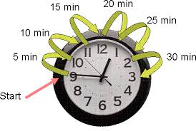
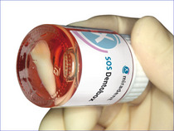
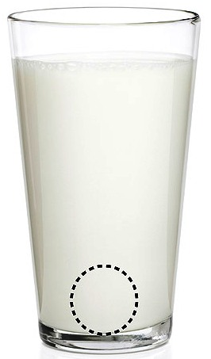
Treatment of Class V fracture (Avulsion)
Factors affecting management of class V fracture
Time interval between injury and treatment
Conditions under which the tooth is
stored

Slide 23
Instructions to the patient on Telephone

Slide 24
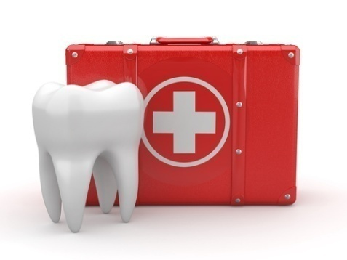
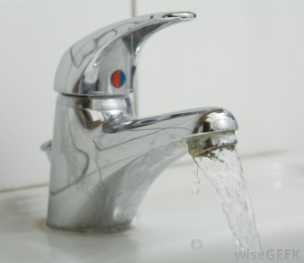
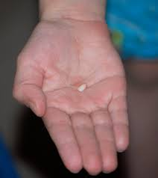
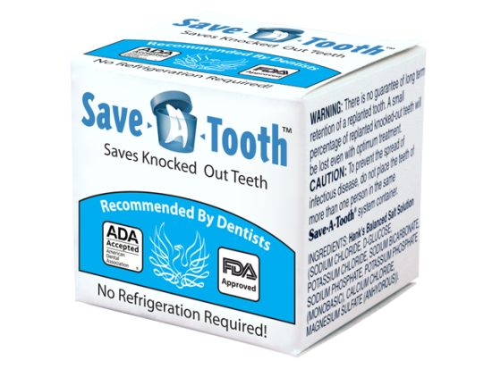
First aid for avulsed teeth
Keep the patient calm
Find the tooth & pick
it up by the crown
Clean the tooth
Place the tooth in a
suitable storage medium
Seek emergency dental treatment immediately

Slide 25
Storage media for avulsed tooth
Tissue or cell culture media like Hank’s Balanced salt Solution (HBSS)
Milk
Isotonic Saline
Contact lens solution
Buccal vestibule or under the tongue
Unsalted water
Saliva

Slide 26
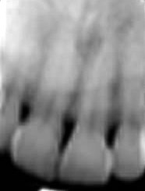
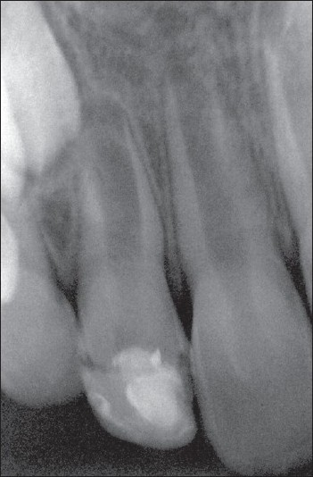
Treatment of Avulsion
Closed Apex
Open apex
Tooth replanted prior to the patient's
arrival at the dental clinic
Tooth replanted prior to the patients
arrival at the dental clinic
Extraoral dry time less than 60 min.
The tooth has been kept in suitable
storage media and/or stored
dry less than 60 minutes.
Extraoral dry time less than 60 min.
The tooth has been kept in suitable
storage media and/or stored
dry less than 60 minutes.
Extraoral dry time exceeding 60 min or
other reasons suggesting non-viable cells
Dry time longer than 60 min or other
reasons suggesting non-viable cells

Slide 27
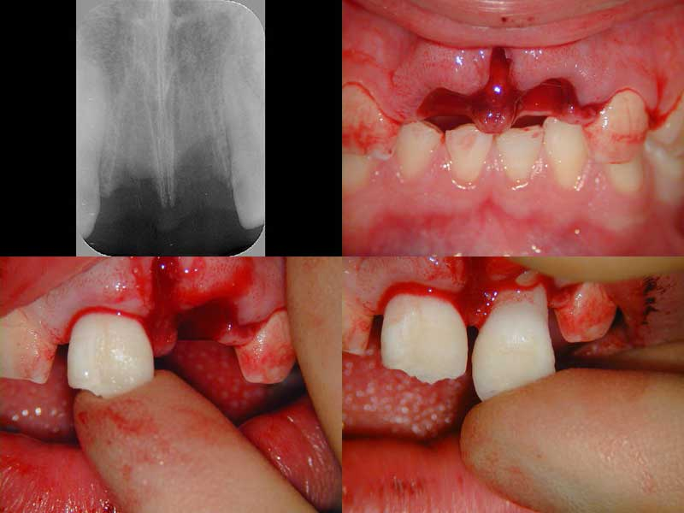
Closed Apex
Tooth replanted prior to the
patient's arrival at the dental clinic
Leave the tooth in place.
Clean the area with water spray, saline, or chlorhexidine.
Suture gingival lacerations if present.
Verify normal position of the replanted tooth both
clinically and radiographically.
Apply a flexible splint for up to 2 weeks.
Administer systemic antibiotics.
If the avulsed tooth has been in contact with soil, and if tetanus coverage is uncertain, refer to physician for a tetanus booster.
Initiate root canal treatment 7-10 days after replantation and before splint removal.

Slide 28
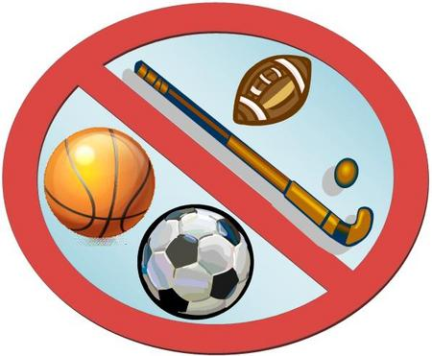
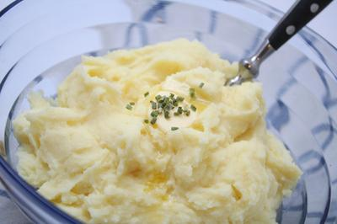
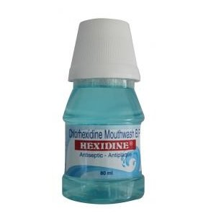
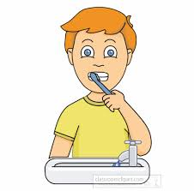
Patient instructions
Avoid participation in contact sports
Soft food for up to 2 weeks
Use a chlorhexidine (0.1 %) mouth rinse twice a day for 1 week.
Brush teeth with a soft toothbrush after each meal

Slide 29
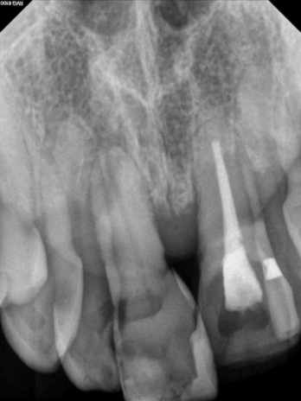
Follow-up
Root canal treatment 7-10 days after replantation. Place calcium hydroxide as an intra-canal medicament for up to 1 month followed by root canal filling with an acceptable material.
Alternatively an antibiotic-corticosteroid paste may be placed immediately or shortly following replantation and left for at least 2 weeks.
Splint removal and clinical and radiographic follow-up after 2 weeks.
Clinical and radiographic follow-up after 4 weeks, 3 months, 6 months, 1 year and then yearly thereafter.

Slide 30
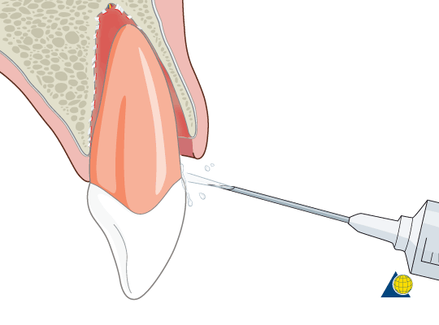
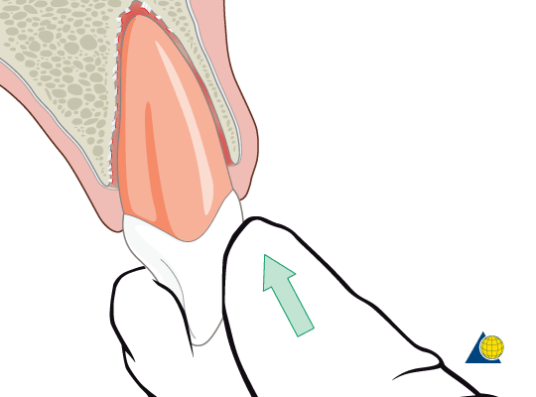
Extra-oral dry time less than 60 min. The tooth has been kept in suitable storage media and/or stored dry less than 60 minutes
Closed apex
Clean the root surface and apical foramen with a stream of saline and soak the tooth in saline thereby removing contamination and dead cells from the root surface.
Administer local anesthesia
Irrigate the socket with saline.
Examine the alveolar socket. If there is a fracture of the socket wall, reposition it with a suitable instrument.
Replant the tooth slowly with slight digital pressure. Do not use force.

Slide 31
Extra-oral dry time less than 60 min. The tooth has been kept in suitable storage media and/or stored dry less than 60 minutes
Closed apex
Suture gingival lacerations if present.
Verify normal position of the replanted tooth both, clinically and radiographically.
Apply a flexible splint for up to 2 weeks, keep away from the gingiva.
Administer systemic antibiotics.
If the avulsed tooth has been in contact with soil, and if tetanus coverage is uncertain, refer to physician for a tetanus booster.
Initiate root canal treatment 7-10 days after replantation and before splint removal.

Slide 32
Patient instructions
Avoid participation in contact sports
Soft food for up to 2 weeks
Use a chlorhexidine (0.1 %) mouth rinse twice a day for 1 week.
Brush teeth with a soft toothbrush after each meal

Slide 33
Follow-up
Root canal treatment 7-10 days after replantation. Place calcium hydroxide as an intra-canal medicament for up to 1 month followed by root canal filling with an acceptable material.
Alternatively an antibiotic-corticosteroid paste may be placed immediately or shortly following replantation and left for at least 2 weeks.
Splint removal and clinical and radiographic follow-up after 2 weeks.
Clinical and radiographic follow-up after 4 weeks, 3 months, 6 months, 1 year and then yearly thereafter.

Slide 34
Extra-oral dry time exceeding 60 min or other reasons suggesting non-viable cells
Closed Apex
Delayed replantation has a poor long-term prognosis. The periodontal ligament will be necrotic and can not be expected to heal. The goal in delayed replantation is, in addition to restoring the tooth for esthetic, functional and psychological reasons, to maintain alveolar bone contour.
However, the expected eventual outcome is ankylosis and resorption of the root and the tooth will be lost eventually.

Slide 35
Extra-oral dry time exceeding 60 min or other reasons suggesting non-viable cells
Closed Apex
Remove attached non-viable soft tissue carefully, with gauze.
Root canal treatment can be performed prior to replantation, or it can be done 7-10 days later.
Administer local anesthesia & Irrigate the socket with saline.
Examine the alveolar socket. If there is a fracture of the socket wall, reposition it with a suitable instrument.
Replant the tooth slowly with slight digital Do not use force.
Suture gingival lacerations if present. pressure.

Slide 36
Extra-oral dry time exceeding 60 min or other reasons suggesting non-viable cells
Closed Apex
Verify normal position of the replanted tooth clinically and radiographically.
Stabilize the tooth for 4 weeks using a flexible splint.
Administer systemic antibiotics.
If the avulsed tooth has been in contact with soil, and if tetanus coverage is uncertain, refer to physician for a tetanus booster.
To slow down osseous replacement of the tooth, treatment of the root surface with fluoride prior to replantation has been suggested (2 % sodium fluoride solution for 20 min.

Slide 37
Patient instructions
Avoid participation in contact sports
Soft food for up to 2 weeks
Use a chlorhexidine (0.1 %) mouth rinse twice a day for 1 week.
Brush teeth with a soft toothbrush after each meal

Slide 38
Follow-up
Root canal treatment 7-10 days after replantation. Place calcium hydroxide as an intra-canal medicament for up to 1 month followed by root canal filling with an acceptable material.
Alternatively an antibiotic-corticosteroid paste may be placed immediately or shortly following replantation and left for at least 2 weeks.
Splint removal and clinical and radiographic follow-up after 2 weeks.
Clinical and radiographic follow-up after 4 weeks, 3 months, 6 months, 1 year and then yearly thereafter.

Slide 39
Follow-up
Ankylosis is unavoidable after delayed replantation and must be taken into consideration. In children and adolescents ankylosis is frequently associated with infraposition.
Careful follow-up is required and good communication is necessary to ensure the patient and guardian of this likely outcome.

Slide 40
Open apex
Tooth replanted prior to the patient's arrival
at the dental clinic
Leave the tooth in place.
Clean the area with water spray, saline, or chlorhexidine.
Suture gingival laceration if present.
Verify normal position of the replanted tooth
both clinically and radiographically.
Apply a flexible splint for up to 1-2 weeks.
Administer systemic antibiotics.
If the avulsed tooth has been in contact with soil and if tetanus coverage is uncertain, refer to physician for a tetanus booster.
The goal for replanting still-developing (immature) teeth in children is to allow for possible revascularization of the tooth pulp. If that does not occur, root canal treatment is recommended.

Slide 41
Patient instructions
Avoid participation in contact sports
Soft food for up to 2 weeks
Use a chlorhexidine (0.1 %) mouth rinse twice a day for 1 week.
Brush teeth with a soft toothbrush after each meal

Slide 42
Follow-up
For immature teeth, root canal treatment should be avoided unless there is clinical or radiographic evidence of pulp necrosis.
Splint removal and clinical and radiographic control after 2 weeks.
Clinical and radiographic control after 4 weeks, 3 months, 6 months, 1 year and then yearly thereafter.

Slide 43
Open apex
Extra-oral dry time less than 60 min. The tooth has been kept in
suitable storage media and/or stored dry less than 60 minutes
Clean the root surface and apical foramen with a stream of saline.
Topical application of antibiotics has been shown to enhance chances for revascularization of the pulp and can be considered if available (minocycline or doxycycline 1 mg per 20 ml saline for 5 minutes soak).
Administer local anesthesia.
Examine the alveolar socket. If there is a fracture of the socket wall, reposition it with a suitable instrument.
Irrigate the socket with saline.
Replant the tooth slowly with slight digital pressure.
Suture gingival lacerations, especially in the cervical area.
Verify normal position of the replanted tooth clinically and radiographically.
Apply a flexible splint for up to 2 weeks.

Slide 44
Open apex
Extra-oral dry time less than 60 min. The tooth has been kept in suitable storage media and/or stored dry less than 60 minutes
Administer systemic antibiotics.
If the avulsed tooth has been in contact with soil and if tetanus coverage is uncertain, refer to physician for a tetanus booster.
The goal for replanting still-developing (immature) teeth in children is to allow for possible revascularization of the pulp space. The risk of infection-related root resorption should be weighed up against the chances of revascularization. Such resorption is very rapid in children. If revascularization does not occur, root canal treatment may be recommended.

Slide 45
Dry time longer than 60 min or other reasons suggesting non-viable cells
Open apex
Remove attached non-viable soft tissue with gauze.
Root canal treatment can be carried out prior to replantation or later.
Administer local anesthesia.
Irrigate the socket with saline.
Examine the alveolar socket. if there is a fracture of the socket wall, reposition it with a suitable instrument.
Replant the tooth slowly with slight digital pressure.
Suture gingival lacerations if present.

Slide 46
Dry time longer than 60 min or other reasons suggesting non-viable cells
Open apex
Verify normal position of the replanted tooth clinically and radiographically.
Stabilize the tooth for 4 weeks using a flexible splint.
Administer systemic antibiotics.
If the avulsed tooth has been in contact with soil or if tetanus coverage is uncertain, refer to physician for evaluation of the need for a tetanus booster.
To slow down osseous replacement of the tooth, treatment of the root surface with fluoride prior to replantation has been suggested (2 % sodium fluoride solution for 20 min.

Slide 48
MCQ_{S}

Slide 49
Q1- Ellis & Devey classified tooth avulsion in which of the following class:
a) Class IV
b) Class V
c) Class VI
d) Class VII

Slide 50
Q2- According to Ellis & Devey classification, class III fracture of anterior tooth is:
a) Enamel and dentin fracture without pulp exposur
b) Crown fracture with pulp exposure
c) Traumatized tooth that has become non-vital with or without loss of tooth structure
d) Fracture of root with or without loss of crown structur

Slide 51
Q3- Which of the following is treatment of choice for class III fracture in a non vital tooth with open apex:
a) RCT
b) Direct pulp capping
c) Pulpotomy
d) Apexification

Slide 52
Q4- Which of the following is considered best storage media for avulsed tooth:
a) HBSS
b) Water
c) Saliva
d) Glycerine

Slide 53
Q5- which of the following is treatment of choice in a Class III fractured vital tooth with open apex:
a) RCT
b) Pulpotomy
c) Apexification
d) No treatment required

Slide 54
Q6- which of the following is TRUE in a case of avulsed tooth that is replanted immediately:
a) There is always peri-dental inflammation
b) The socket is prepared by carefully removing the clot and irrigating gently with sterile normal saline
c) Reimplantation should occur within 12 hours
d) A tooth that has been dry for more than 60 minutes can often be successfully re-implanted

Slide 55
Q7- Ankylosis of tooth is commonly seen when:
a) Extraoral dry time is less than 30 minutes
b) Extraoral dry time is more than 30 minutes
c) Extraoral dry time is less than 60 minutes
d) Extraoral dry time is more than 30 minutes

Slide 56
Q8- Splinting of teeth in cases of reimplantation in children is recommended for a period of:
a) 1-2 weeks
b) 2-3 weeks
c) 3-4 weeks
d) 4-5 weeks

Slide 57
Q8- Identify the class of fracture in the picture given:
a) Ellis Class I
b) Ellis Class II
c) Ellis Class III
d) Ellis Class IX

Slide 58
Q8- Identify the class of fracture in the x-ray given:
a) Ellis Class IV
b) Ellis Class V
c) Ellis Class VI
d) Ellis Class VII

