Slide 1
FRACTURE OF MANDIBLE
7thAUG 2015

Slide 3
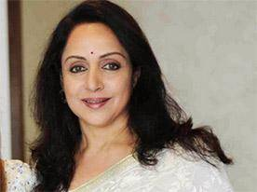
Notes:
Soft tissue & bone – cranium
Apperaence-look
Daily life function- sight smell hearing eating breathing talkin

Slide 4
Importance of Facial injury
Soft tissue & bone- antr protection to cranium
Face appearance- Look
Whole antr region with functions of daily life
- Sight ,smell,eating,breathing & Talking
Any significant impairment – Life style & Quality of Life

Slide 5
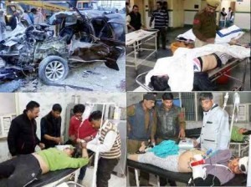
? Trauma care provider
Etiology
Incidence
Involv vital structures
Life threating conditions
HEALING (TREATMENT)WITHOUT COMPLICATION
Restore Pretrauma appearance and functions

Slide 6
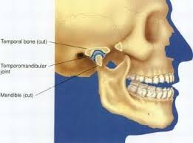
Development
Embryo logically Mandible is a membranous bone resembling a bent long bone
with two articular cartilage and
two nutrient arteries
This arch of Cortico cancellous bone projected - downwards & forward from the base of skull
Constitutes the rigid component of facial skeleton

Slide 7
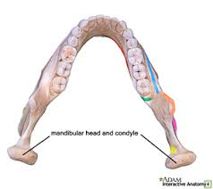
Mandible act mechanically as curved beam in the axial plane
Supported by muscles inserted in the angle and ascending ramus region.
Curved sts has pair of sling
support-Pterygo gmasstric sling.

Slide 8
Force to Fracture (Nahum 1975)
Curved beam like bone
Condylar Neck #- 425 lb frontal impact
Symphysis-800-900 lb Front impact with both condylar #
Mandible more sensitive to lateral impact than frontal
impact( cushioned by opening and retrusion of jaw

Slide 9
Incidence & Etiology

Slide 10
Incidence - Oikarinen & Malmstrom 1969
Analyed 600 mandibular fractures
Subcondlyar # - 33.4%
Angle- 17.4%
Ramus 5.4%
Body 33.6%
Alveolar 6.7%
Midline 2.9 %
Coronoid Process 1.3%

Slide 11
University of Freiburg Germany 2009
Etiology
incidence
Study of 444 patients
Male 74%
Female 26%
RTA 32%
Fights 28%
Fall 26%
Sports 10%
Condylar 42%
Angle 20%
Symphysis & Para Sym. 21%

Slide 12
Indian Studies
Chennai 2008
Motor cycle- 71%
Cars 15%
Assults 6%
Misc 8 %
Ahmadabad (n=2546)
Two wheelers 55%
Car/4 wheelrs 22%
Tri Rikshaw 15%
Assults 18%
Fall 12%

Slide 13
Zix Juergen A et al ( 2011) Swiss Med weeky 141:w13207
study of 420 Patients
RTA 28%
Sports 21%
Alcohol 13% ?
Condyle Fracture 43%
Symphysis/Para 35%

Slide 14
Level I trauma center AIIMS (2007-2010 ) CTR2014)
542 Patients
RTA 54.6%
Fall 22.3%
Fight 18.5%
Location
Body 29.6%
Angle 24.6%
Ramus 19.5%
Dento Alv 14.6%
Symphysis 11%
Condyle 0.8%

Slide 15
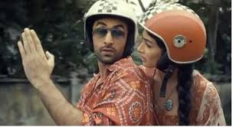
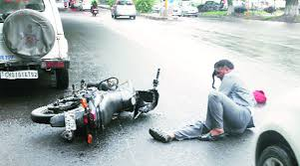
Death 30%
Facial Injuries 50%

Slide 16
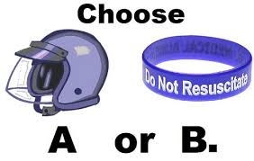
Helmet
More than 80 percent of all motorcycle crashes result in injury or death to the motorcyclist.
Per mile driven, a motorcyclist is 16 times more likely to die in a crash than an automobile driver. Wearing a motorcycle helmet reduces that risk by almost one-third (29 percent).
Head injury is a leading cause of death in motor cycle crashes. Riders who don�t wear helmets and who experience a crash are 40 percent more likely to sustain a fatal head injury.
A study of 900 motorcycle crashes (conducted by the University of Southern California) showed that wearing a helmet was the single most critical factor in preventing or reducing head and neck injuries among motorcycle drivers and passengers.
From 1984 through 1995, helmets saved the lives of more than 7,400 motorcyclists. But more than 6,300 additional deaths could have been prevented if all riders had been wearing helmets.

Slide 17
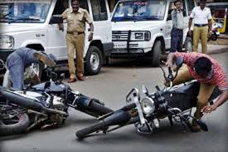
AIIMS study 2008 Kumar et al., 2008
Two-wheeled vehicles largely dominates share is around 70%.
RTA in Delhi 30%.
Injuries to the head and main cause of death 60%
of All India Institute of Medical Sciences’ (AIIMS) admissions —

Slide 18
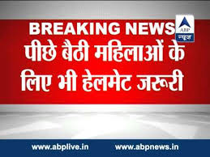
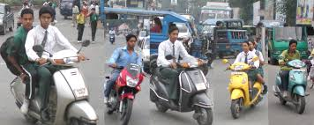
Chennai road fatalities

Slide 19
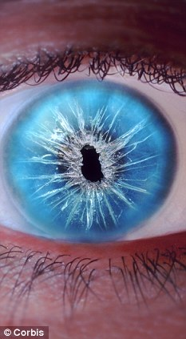
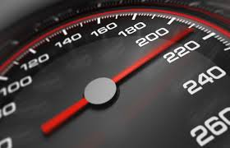
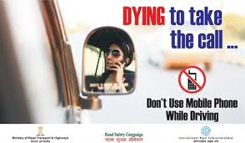
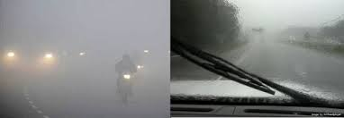
Other factors
Accidents due to poor Vision about 50%
Adding other factors ( Mobile,Bad weather )

Slide 20
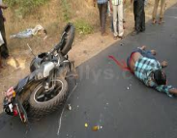
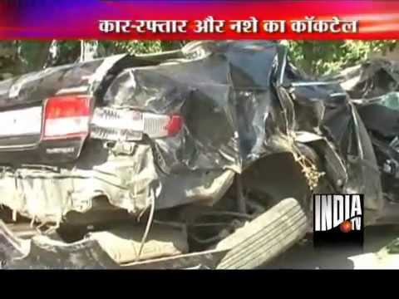
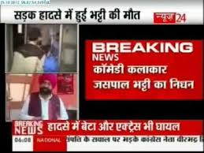
ALCOHOL
Assult 55% ( >100mg/dl
Facial injuries 24%
RTA Alcohol & or drug
disproportionaly intensification
of injury
Speed- ( K=1/2 MV2)
seriousness of injury sustained

Slide 21
UP Tops Road fatalities ( 83949)

Slide 22
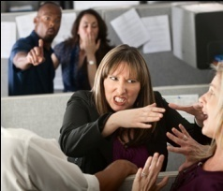
Urban Interpersonal violence
Reduced incidence of condylar fracture
Increased Body Fracture
Ellis, Moos and El Attar 1985
Busuito, Smith & Robson 1986
Notes:
implication-is that direct impact of personnel violence cause fracture at site of impact one or other side body of MND.
Etiology changes the location of fracture

Slide 23
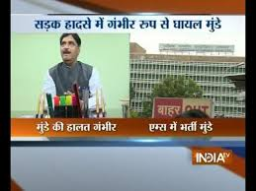
Predictability
Not consistent within all groups and hospitals
Location and community demographics
Trauma reported from industrial urban- Altercations
Rural setting- RTA

Slide 25
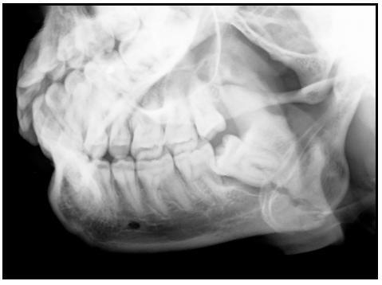
The Teeth
Relative area of weakness & potential source of infection
If tooth in # line
compound #
if devitalize- potential source of infn
hampers healing process

Slide 26
TOOTH IN FRACTURE LINE REMOVE/ RETAIN ?
Notes:
Help in stabilizing fragment,
Source of infection
mobile tooth, fractured root

Slide 27
TOOTH IN FRACTURE LINE

Slide 29
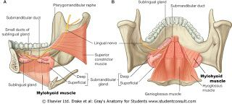
2-Muscle & their attachments
Periosteum of mandible is stout and unyeilding
No displacement of fragments unless periosteum detach from bone
Detached fragments pulled by – Attached muscle
Displacement of fractured fragment depends upon the attached muscles

Slide 30
Muscle attachments

Slide 31
Muscular Attachment
Temporalis M
Lateral Pterygoid M
Medial pterygoid M
Supr constrictor M
Mylohyoid M
Genohyoid,Genioglossus M
Anterior belly of Diagastric M

Slide 32
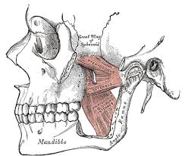
Masster & Medial Pterygoid Muscle

Slide 33
Classified-View & fracture line direction
Direction of fracture line resists muscle pull
Vertical direction –( View)
V favorable
V unfavorable
View horizontal direction
H favorable
H unfavorable

Slide 34
Vertically favourable & Unfavourble
Notes:
VF –vertical direction of fracture opposes the muscle pull of med pty and masster- no displacement
VUF-if fracture lines unopposed the muscle pull fragments will be displaced medially upwards

Slide 35
Muscle pull & view in Horizontal direction

Slide 36
HF & HUF facture
Notes:
HF- if horizontal direction of fracture opposes the muscle pull( masster ,medial pterygoid muscle ),so fragments will not be displced
HUF-if horizontal direction of fracture line favours unopposed action of muscle ( Mass,Medptry mucle, fragments will be displaced

Slide 37
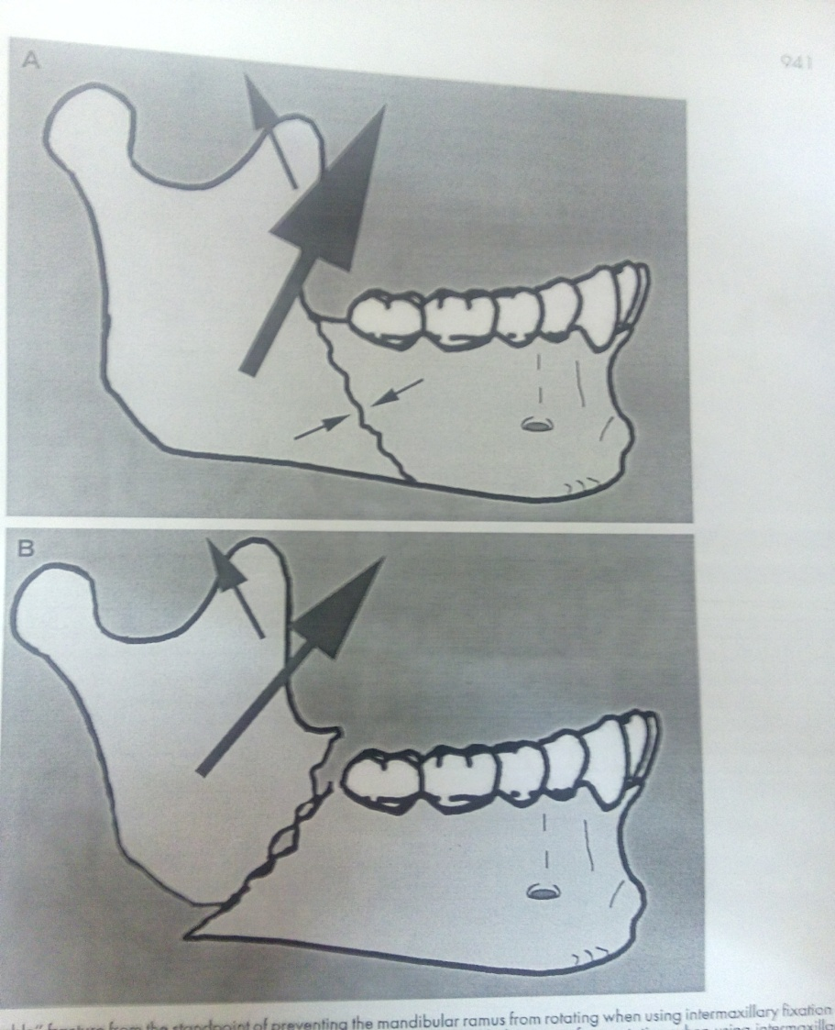
Favorable fracture Line- V/H
fragments easy to stabilize
If tooth in posterior fragment – prevents gross dis
placement of postr fragment in upward direction

Slide 38
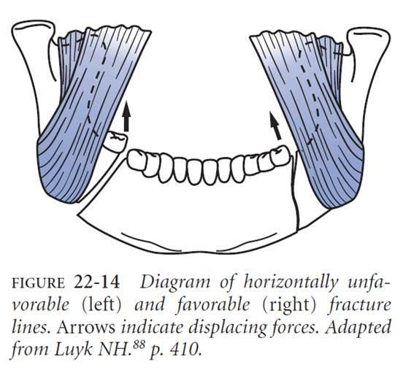
Angle region
Influenced by
Medial pterygoid –massteric sling ( medial pterygoid is stronger component

Slide 39
Displaced fracture
Inwards & upwards displacement

Slide 40
Body fracture
Muscles
Mylohyoid M
Medial pterygoid M
Antr belly of Diagastric M

Slide 41
Symphesis and Para symphysis fracture
Mylohyoid M
Geniohyoid M
Genioglossus M
Antr belly of Diagastric M

Slide 42
Muscles attached in symphyseal region

Slide 43
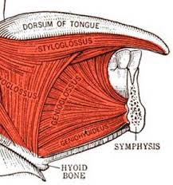
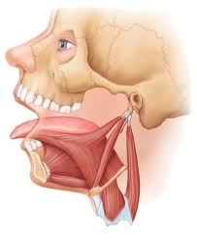
Genial tubercle
Geniolgossus
Geniohyoid

Slide 44
Symphyseal & Para symphyseal fracture
Midline fracture- no displacement
Geniohyoid & mylohyoid M And antr belly of Diagastric- in both side balanced
Oblique sf parasymphysis #-forces unequal due to pull of genoihyoid Genioglodssus and mylohyoid one side pulls the fragment –inwards & downwards
Resulting- collaspse of arch

Slide 45
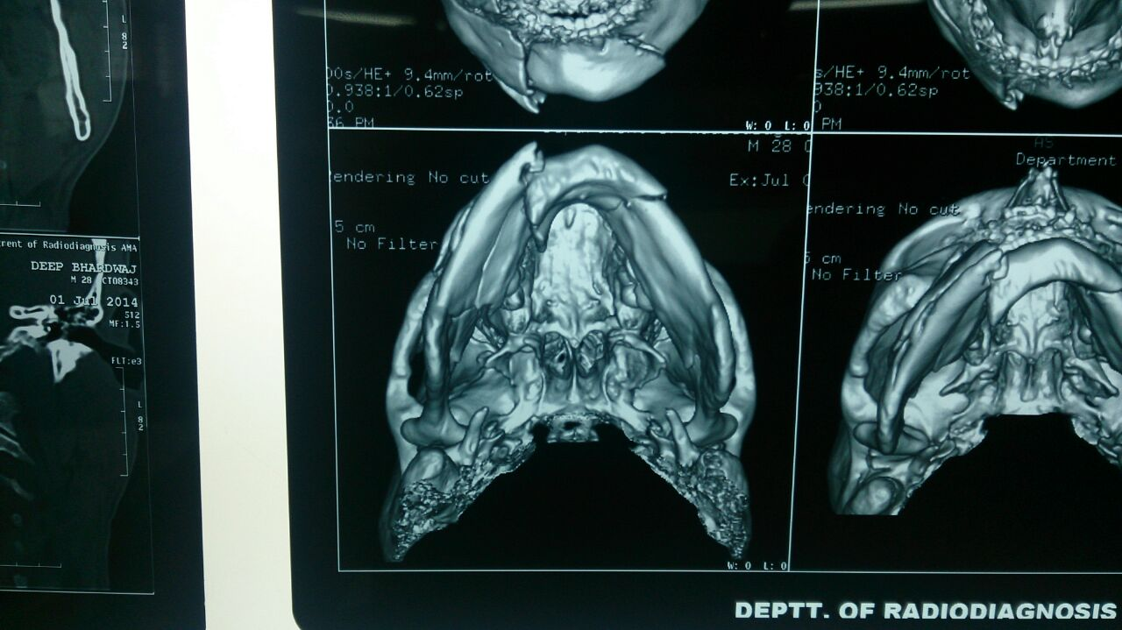

Slide 46
Oblique surface-fracture displacement

Slide 47
Bilateral parasymphyseal fracture
Displacement of fragment due to
Geniohyoid & grnioglossus pulls the fragment inwards and downwards
Mylohyoid & antr belly of Diagastric pulls other fragments resulting collaspe of arch
BUTTER FLY FRACTURE

Slide 48
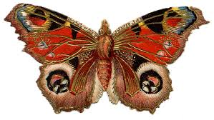
Butterfly Fracture

Slide 49
Bilateral fracture

Slide 50
Condylar process- Lat pterygoid M

Slide 51
Lateral Pt muscle pull

Slide 52
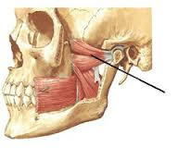
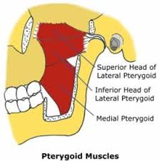
Condylar displacement-ant medially
Lat Pterygoid muscle pull- AM direction

Slide 53
Bleeding from ear

Slide 54
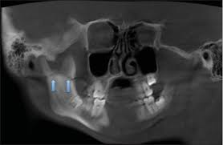
Coronoid Process- Temporalis M

Slide 55
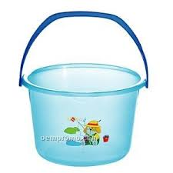
Edentulous Mandible fracture
Due to higher attachment of mylhyoid muscle-resolved ridge
Opp masster muscle attachemnt
Mylohyoid M
Ant belly of Diagastric M
Notes:
Resultant pull in downwards inward direction- Buckle handle fracture

Slide 56
Edentulous mandible fracture
Scan

Slide 57
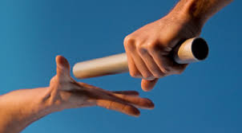
14th Aug 2015 In Continuation

Slide 58
3-Blood supply of Mandible
Inf Alv Arterry
Facial A
Peristeal blood supply

Slide 59
Periosteal blood supply
Lost with the tooth lost changes
IAA gradually diminishes in size
May eventually dis appear

Slide 60
Blood supply
External Carotid A and its branches
Maxillary A
Facial A

Slide 61
Arterial blood supply(Facial A)
Body& Angle fract
Comminuted #
Gunshot inj.
Axe/shrp obj

Slide 62
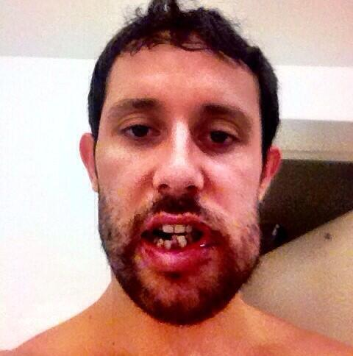
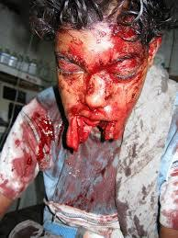
Injury to Vessels
Inf Al Artery- Body and angle fracture
Facial A- Angle fracture
Sublingual A- Parasymphyseal Fracture

Slide 63
Bleeding from fracture
Wound/Laceration
Blood stained saliva
Bleeding from mouth

Slide 64
4-Nerve supply of mandible & muscles
Inf Alv N
Mental N
Nerve to Mylohyoid
Notes:
Br of posterior divn of Mandibular Nerve & mixed in nature due to Mylohyoid branch.

Slide 65
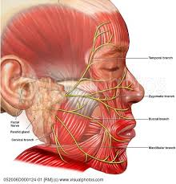
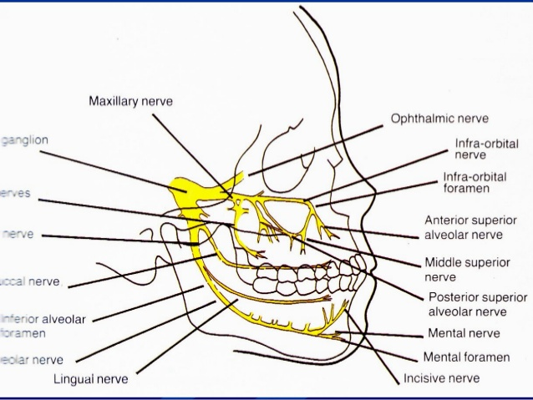
Nerve Injury
Inf Al.N- body and angle fracture-mental n-paresthesia anesthesia over lip
Facial N branches- Fracture of Ramus
Mandibular br of Facial N- Body fracture

Slide 66
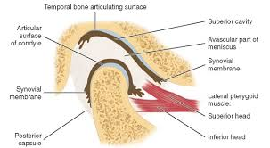
Temporo mandibular joint

Slide 67
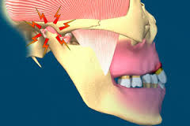
Injury

Slide 68
Effects of trauma-TMJ
TMJ effusion(-Fracture)
Heamorthrosis
Meniscus damage(IDTMJ)
TMJ ankylosis

Slide 69
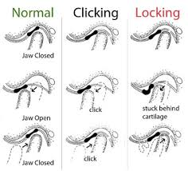
Internal derangement of TMJ

Slide 70
TMJ Ankylosis

Slide 71
Area of weakness-Vulnerable to Fracture
Junction of alv bone and basal mnd bone-so DA # are independent to mandibular fracture.
Symphyseal #-formed by the union of two half of mandible in centre at irst year of life. So area of weakness.
Parasymphyseal region- lateral to the mental prominence-presence of mental formen.
Body region-junction of thicker body with Ramus-angle regionand due to curvature of trajectories in this region.

Slide 72
Anatomical variations
Strength of lower jaw varies with presence r absence of tooth.
Presence of impacted tooth r long root of cannine make the area vulnerable for fracture.
Condylar region-slender neck of condyle render to fracture as a result of direct violence to chin.acts as safety mechanism to prevent injury to middle cranial fossa.
Curve of mandible is more distorted from trauma-so buccal and lingual plate fractures at different level-this may give appearance of double fracture.

Slide 73
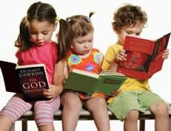
Referrence Books-
Text book of Oral& MaxFac Surgery- N.Malik
Kelly’s fractures of the mandible-Peter Banks,
Oral & Maxillofacial Surgery- R.J.Fonseca
Principles of Internal fixation of the Craniomaxillofacial Skeleton-Ehrenfeld,Manson& Prein.
Maxillofacial Surgery Reconstruction- Peter ward Booth

Slide 74
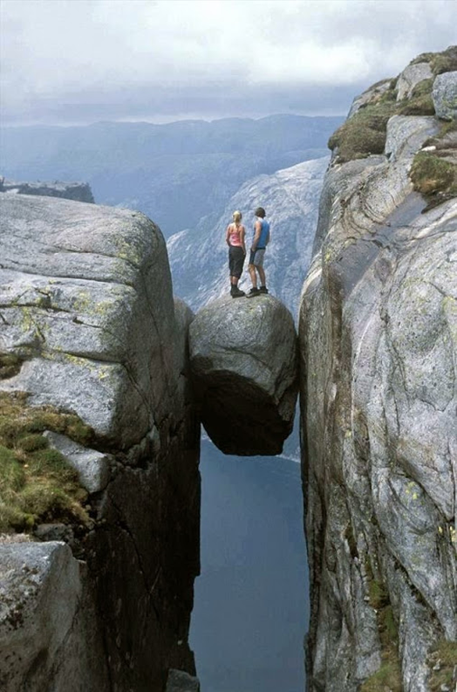
END

