Slide 1
ROOT CANAL ANATOMY AND ACCESS CAVITY PREPERATION
Dr. Rakesh kumar yadav
Associate professor

Slide 2
ROOT CANAL ANATOMY AND ACCESS CAVITY PREPERATION
The hard tissue surrounding the dental pulp can take a variety of configurations and shapes
thorough knowledge of tooth morphology
Careful interpretation of angled radiographs
Adequate access and interior exploration.
That are prerequisites for root canal treatment ….

Slide 3
ROOT CANAL ANATOMY

Slide 4
the apical constriction & cementodentinal junction apical foramina(AC,…CDJ,…AF……………………….)
The AC generally is considered the part of the root canal with the smallest diameter; it also is the reference point clinicians use most often as the apical termination for shaping, cleaning, and obturation.The CDJ is the point in the canal where cementum meets dentin; it is the point where pulp tissue ends and periodontal tissue begins. The AF is the “circumference or rounded edge, like a funnel or crater, that differentiates the termination of the cemental canal from the exterior surface of the root..

Slide 5
Types of canals: Vertucci's canal configurations

Slide 6
objectives of access cavity preparation
To remove all caries,
To conserve sound tooth structure
To completely unroof the pulp chamber
To remove all coronal pulp tissue.
To locate all root canal orifices
To achieve straight- or direct-line access
To establish restorative margins to minimize marginal leakage of the restored tooth.

Slide 7
An isthmus is a narrow, ribbon-shaped communication between two root canals that contains pulp or pulpally derived tissue.
Type I is an incomplete isthmus; it is a faint communication between two canals. Type II is characterized by two canals with a definite connection between them (complete isthmus). Type III is a very short, complete isthmus between two canals. Type IV is a complete or incomplete isthmus between three or more canals. Type V is marked by two or three canal openings without visible connections

Slide 8
Krasner and Rankow Law of access opening
Law of the CEJ: The distance from the external surface of the clinical crown to the wall of the pulp chamber is the same throughout the circumference of the tooth at the level of the CEJ, making the CEJ is the most consistent repeatable landmark for locating the position of the pulp chamber.
First law of symmetry: Except for the maxillary molars, canal orifices are equidistant from a line drawn in a mesiodistal direction through the center of the pulp chamber floor.
Second law of symmetry: Except for the maxillary molars, canal orifices lie on a line perpendicular to a line drawn in a mesiodistal direction across the center of the pulp chamber floor.

Slide 9
Law of color change: The pulp chamber floor is always darker in color than the walls.
First law of orifice location: The orifices of the root canals are always located at the junction of the walls and the floor.
Second law of orifice location: The orifices of the root canals are always located at the angles in the floor–wall junction.
Third law of orifice location: The orifices of the root canals are always located at the terminus of the roots’ developmental fusion lines.

Slide 10
Armamentaria of Access CavityPreparation
Magnification and illumination
Hand pieces
Burs
Endodontic explorer (DG-16, DE-17)
Endodontic spoon
#17 operative explorer
Ultrasonic unit and tips

Slide 11
Access CavityPreparation Anterior teeth
The access cavity is initiated in the middle of the palatal/lingual side of the tooth.
Initial preparation should be at 90° to the palatal/lingual aspect of the tooth.
Once dentine has been reached the angulation of the bur is changed to follow a long axis of the tooth using a slow handpiece.

Slide 12
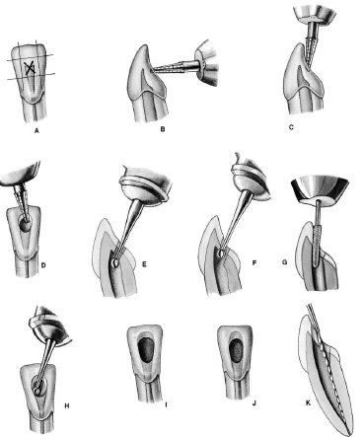

Slide 13
Premolar teeth
The access cavity is initiated in the middle of the palatal side of the tooth.
Initial preparation should be at 90° to the palatal aspect of the tooth.
Once dentine has been reached the angulation of the bur is changed to follow a long axis of the tooth using a slow handpiece.

Slide 14
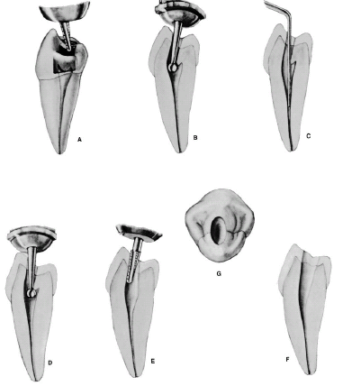

Slide 15
Molars
Initial Preparation is done in the mesial pit.
The cavity is then extended in the mesial half of the tooth to include all canals.
The mesial marginal ridge must not be damaged in upper molars as the cavity should lay mesially to it.
However lower molar teeth, have a distal canal, which is located just past the middle of the tooth.

Slide 16
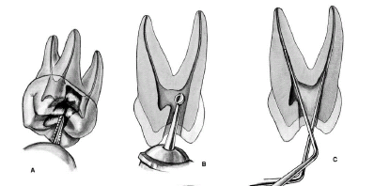
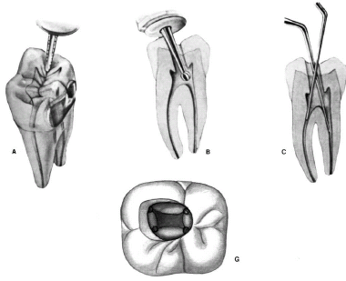

Slide 17
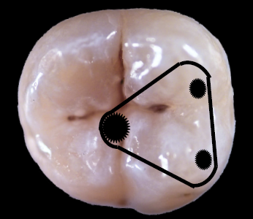
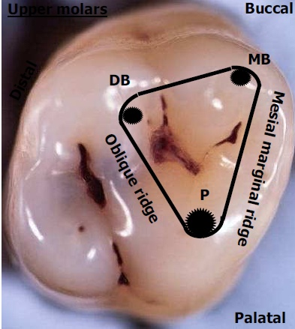

Slide 18
After the roof of the pulp chamber has been penetrated
and the access cavity prepared, the entrances to the
pulp canals must be probed.
A hooked explorer can be used to determine if
enough dentin has been removed
The canal entrances are found by feeling with a thin,
stiff explorer. If the explorer sticks in a spot, a size 15
Hedstr6m file is used to verify that the spot is indeed
the entrance to a root canal and not a perforation. Only
then is the opening gently enlarged. Narrow root canals
must first be enlarged coronally with a Hedstr6m file
before the deep preparation with Gates-Glidden burs can be started.

Slide 19
MCQ 1
Access openings is provide to-
a. Facilitate canal medication
b. Provide good access for irrigation
c. Aid in locating canal orifices
d. Provide straight line access to the apex

Slide 20
MCQ2
Which instrument is helpful in making access opening-
a. Gates glidden drill
b. K-file
c. Inverted bur
d. Round bur

Slide 21
MCQ3
Access cavity shape in mandibular 1st molar with 4 canals
a. Trapezoidal
b. Round
c. Oval
d. Triangular

Slide 22
MCQ4
The fourth root canal if present in a maxillary 1st molar is usually present in -
a. Mesiolingual root
b. Mesiobuccal
c. Palatal root
d. Distal root

Slide 23
MCQ5
Bifurcations and trifurcations are most commonly observed in-
a. Maxillary 1st premolar
b. Maxillary 2nd premolar
c. Mandibular 1st premolar
d. Mandibular 2nd premolar

