Slide 1
Working length determination
Prof. Promila Verma
Department Of Conservative Dentistry
&
Endodontics

Slide 2
WORKING LENGTH
Working length is defined as the distance from a coronal reference point to the point at which canal preparation and obturation should terminate

Slide 3
Anatomical considerations
Anatomic apex: it is defined as the tip or end of the root determined morphologically.
Radiographic apex: it is defined as the tip or end of the root determined radiographicaly.
Apical foramen (Major diameter): it is the main apical opening of the root canal.it is frequently eccentrically located away from the anatomic or radiographic apex.

Slide 4
Apical constriction (Minor diameter):
it is the apical portion of the root canal having the narrowest diameter
Cementodentinal Junction: it is the region where the dentin and cementum are united. It is a histological landmark and cannot be located clinically or radiographically. The CDJ does not always coincide with apical constriction and is located 0.5 -3mmshort of anatomic apex

Slide 5
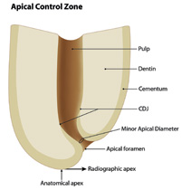

Slide 6
METHODS OF WORKING LENGTH DETERMINATION
RADIOGRAPHICAL METHOD
1.Grossman’s formula
2. Ingles method
3.Weine’s method
4.Radiovisiography
5.Xeroradiography
NON RADIOGRAPHICAL METHOD
1.Digital tactile sense
2.Apical periodontal sensitivity
3.Paper point method
4.Electonic apex locator

Slide 7
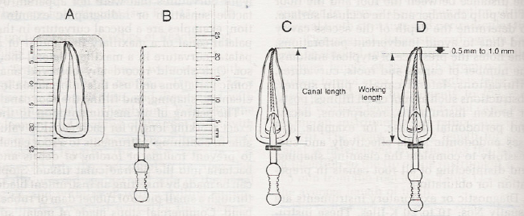
Grossman’s method
CLT = KLI × ALT / ALI Where, CLT= correct length of the tooth
KLI= known length of the instrument in the tooth
ALT= apparent length of the tooth on radiograph
ALI= apparent length of the instrument on radiograph
A,The length of the tooth is measured on the diagnostic radiograph (schematic view).
B, This measurement is transferred to a diagnostic instrument prepared with a silicone stop, the instrument is placed in the root canal, and a radiograph is made.
C and D, The root canal and working lengths are determined from the radiograph.

Slide 9
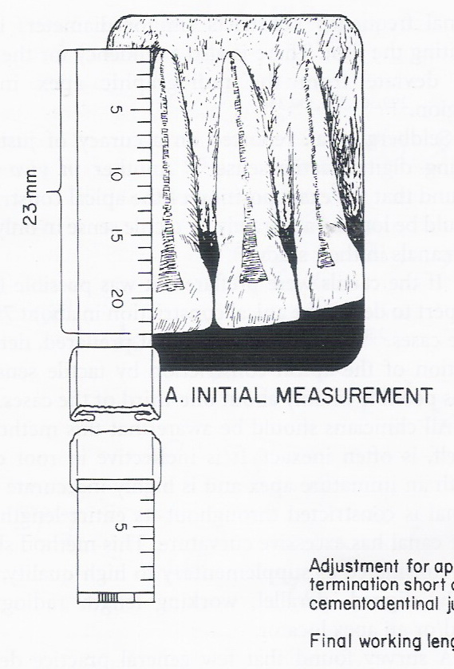
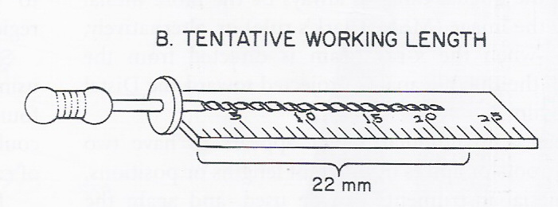
Ingle’s method
Tooth length is measured in the pre operative radiograph
1 mm “safety allowance” is subtracted for possible image distortion

Slide 10
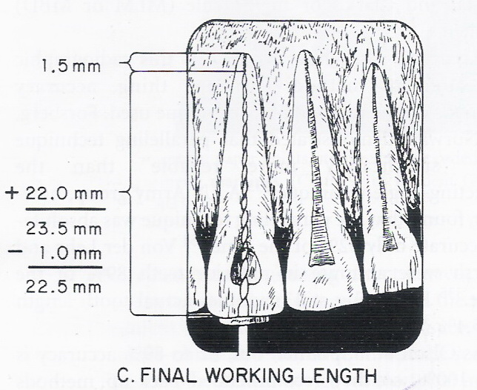
the endodontic file is set at this tentative working length, and the instrument is inserted in the canal
on the radiograph the difference between the end of file and root end is measured and this value is either subtracted or added to the initial working length measurement depending on weather the file is shortof apex or extended beyond apex
From this adjusted working length 1mm “ safety allowance” is subtracted again to confirm with the apical termination of instrument

Slide 11
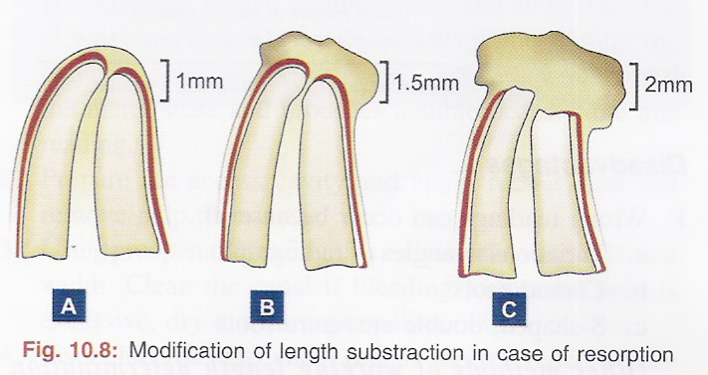
Weine’s modification
A .If, radiographically, there is no resorption of the root end or bone, shorten the length by the standard 1.0 mm.
B. If periapical bone resorption is apparent, shorten by 1.5 mm, and
C. if both root and bone resorption are apparent, shorten by 2.0 mm

Slide 12
Electronic method of determining working length: electronic apex locators
With a apex locator the working length is determined by comparing the electrical resistance of the periodontal membrane with that of gingiva surrounding the tooth, both of which should be similar
A probe , such as a file, is attached to an electronic instrument with an electric cord and is inserted through the root canal until it contacts the surrounding PDL.
When the probe touches the soft tissues of the PDL, the electrical resistance gauges for both gingiva and PDL would have similar readings.
By measuring the depth of insertion of the probe, one may determine the exact working length of root canal

Slide 13
Classification of apex locators
First-generation apex locators – based on Resistance
Second-generation apex locators – based on Impedance
Third-generation apex locators – based on Frequency or comparative
impedence
Fourth generation apex locator- measures resistance and capacitance
separately rather than the resulting
impedence

Slide 14
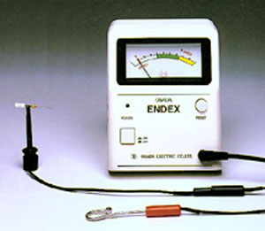
First generation apex locator
First-generation apex locator devices, also known as resistance apex locators
Measure opposition to the flow of direct current or resistance.
When the tip of the reamer reaches the apex in the canal, the resistance value is 6.5 kilo-ohms (current 40 mA)
often yield inaccurate results in presence of electrolytes, excessive moisture, vital pulp tissue, exudates and blood
Examples:
Neosono apex locator

Slide 15
Second generation apex locator
Second-generation apex locators, also known as impedance apex locators
measure opposition to the flow of alternating current or impedance
Uses the electronic mechanism that the highest impedance is at the apical constriction where impedance changes drastically
Examples
endocater,
sono explorer,
apex finder
endoanalyzer

Slide 16
Third generation apex locator
Works on the principle of frequency or comparative impedence
Examples: Endex,
Root zx,
Neosono
Ultima Ez,
Mark V plus,

Slide 17
MULTIPLE FREQUENCYAPEX LOCATORS
Uses two wavelength: one high (8kHz) and one low(400Hz)
They assess the apical terminus by the simultaneous measurements of the impedence of two different frequencies that are used to calculate the quotient of the impedence

Slide 18
New advancement electronic apex locators
Integration of the apex locators with the battery powered endodontic slow speed hand piece.
File start to automatically rotate the moment the instruments is introduced in to the canal.
If the preset torque level for the instruments is exceeded then the hand piece automatically stops and reverse rotation.
The integrated apex locators stops the file rotation and reverse the moment the file tip extends beyond the apical constriction.

Slide 19
Advantages of apex locator
Devices are mobile, light weight and easy to use
Much less time required
Additional radiation to the patient can be reduced (particularly useful in cases of pregnancy)
80 - 97 % accuracy observed

Slide 20
Disadvantages OF APEX LOCATORS
Accuracy limited to mature root apices
Extensive periapical lesion can give faulty readings
Weak batteries can affect accuracy
Can interfere with functioning of artificial cardiac pacemakers – cuatious use in such patients

Slide 21
xeroradiography
Xeroradiography – an electrostatic imaging system that uses a uniformly charged x-ray sensitive selenium alloy photoreceptor plate in a light-proof cassette.
Advantages:
1.Produces image of superior quality – edge enhancement property and sharper contrast
2.Radiation levels are reduced to only 1/3rd
3.Rapid – require only 20 sec to produce a permanent dry image
Disadvantages:
1.Large areas of bone > 2 cm are shown better with conventional intra
oral film technique than with xeroradiography
2.Greater degree of artefacts than in conventional technique

Slide 22
Digital tactile sense
Although it may appear to be very simple, its accuracy depends on sufficient experience.
Confirmation may be done either by the radiographic or electronic method.
If the coronal portion of the canal is not constricted, an experienced clinician may detect an increase in resistance as the file approaches the apical 2 to 3 mm.
Tactile sensation, although useful in experienced hands, has many limitations.
The anatomical variations in apical constriction, location of apical constriction, tooth size, tooth type, age make working length assessment unreliable.
In some cases the canal is sclerosed or the constriction has been destroyed by inflammatory resorption

Slide 23
Apical periodontal sensitivity
Based on patient’s pain perception
Any method of working length determination, based on the patient’s response to pain, does not meet the ideal method of determining WL

Slide 24
Paper point method
In a root canal with an immature (wide open) apex, the most reliable means of determining WL is to gently pass the blunt end of a paper point into the canal after profound anesthesia
The moisture or blood on the portion of the paper point that passes beyond the apex - an estimation of WL or the junction between the root apex and the bone.
This method, however, may give unreliable data
If the pulp not completely removed
If the tooth – pulpless but a periapical
lesion rich in blood supply present
If paper point – left in canal for a long time

Slide 25
REFERENCE POINT
The reference point is the site on the occlusal or incisal surface from which measurements are made. This point is used throughout canal preparation and obturation.

Slide 26
SELECTION
A reference point is chosen that is stable and easily visualized during preparation. Usually this is the highest point on the incisal edge on anterior teeth and a buccal cusp tip on posterior teeth. The same reference point is best used for all canals in multirooted teeth. The mesiobuccal cusp tip is preferred in molars.

Slide 27
STABILITY
A reference point that will not change during or between appointments is selected. If it is necessary to use an undermined cusp, it should be reduced considerably before access preparation. Areas other than cusp tips, such as marginal ridges or the floor of the chamber, are unreliable or difficult to visualize.

Slide 28
Do not use weakened enamel walls or diagonal lines of fracture as a reference site for length-of-tooth measurement.
B, Weakened cusps or incisal edges are reduced to a well-supported tooth structure.
Diagonal surfaces should be flattened to give an accurate site of reference

Slide 29
Determination of Working Length by Radiographic Methods
Good, undistorted, preoperative radiographs showing the total length and all roots of the involved tooth.
Adequate coronal access to all canals.
An endodontic millimeter ruler.
Working knowledge of the average length of all of the teeth.
A definite, repeatable plane of reference to an anatomic landmark on the tooth, a fact that should be noted on the patient’s record.

Slide 30
ESTIMATED WORKING LENGTH
The diagnostic film, which is made using a paralleling technique, is measured from the reference point to the apex with a millimeter endodontic ruler.

Slide 31
A, Initial measurement.
The tooth is measured on a good preoperative radiograph using the long cone technique.
In this case, the tooth appears to be 23 mm long on the radiograph.
Subtract at least” 1.0 mm “safety allowance” for possible image distortion or magnification.

Slide 32
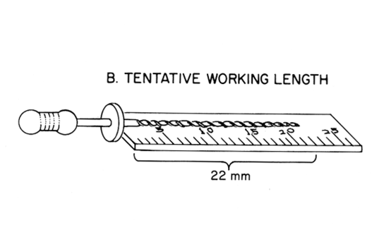
. Set the endodontic ruler at this tentative working length and adjust the stop on the instrument at that level

Slide 33
BTentative working length.
As a safety factor, allowing for image distortion or magnification,subtract at least 1 mm from the initial measurement for a tentative working length of 22 mm.

Slide 34
. Place the instrument in the canal until the stop is at the plane of reference , the instrument is left at that level and the rubber stop readjusted to this new point of reference.
5. Expose, develop, and clear the radiograph.

Slide 35
C, Final working length.
The instrument is inserted into the tooth to this length and a radiograph is taken.
Radiograph shows
That the image of the instrument appears to be 1.5 mm from the radiographic end of the root. This is added to the tentative working length,giving a total length of 23.5 mm.
From this, subtract 1.0 mm as adjustment for apical termination short of the cementodentinal junction. The final working length is 22.5 mm.

Slide 36
6. On the radiograph, measure the difference between the end of the instrument and the end of the root and add this amount to the original measured length the instrument extended into the tooth If, through some oversight, the exploring instrument has gone beyond the apex, subtract this difference.

Slide 37
From this adjusted length of tooth, subtract a 1.0 mm “safety factor” to conform with the apical termination of the root canal at the apical constriction.
If there is root resorption, the apical constriction is probably destroyed—hence the shorter move back up the canal.
8. Set the endodontic ruler at this new corrected length and readjust the stop on the exploring instrument

Slide 38
D, Setting instruments.
The final working length
of 22.5 mm is used to set stops on instruments used to enlarge the root canal.

Slide 39
Because of the possibility of radiographic distortion, sharply curving roots, and operator measuring error, a confirmatory radiograph of the adjusted length is highly desirable.
10. When the length of the tooth has been accurately confirmed, reset the endodontic ruler at this measurement.

Slide 40
11. Record this final working length and the coronal point of reference on the patient’s record.
12. Once again, it is important to emphasize that the final working length may shorten by as much as 1 mm as a curved canal is straightened out by instrumentation. It is therefore recommended that the “length of the tooth” in a curved canal be reconfirmed after instrumentation is completed.

Slide 41
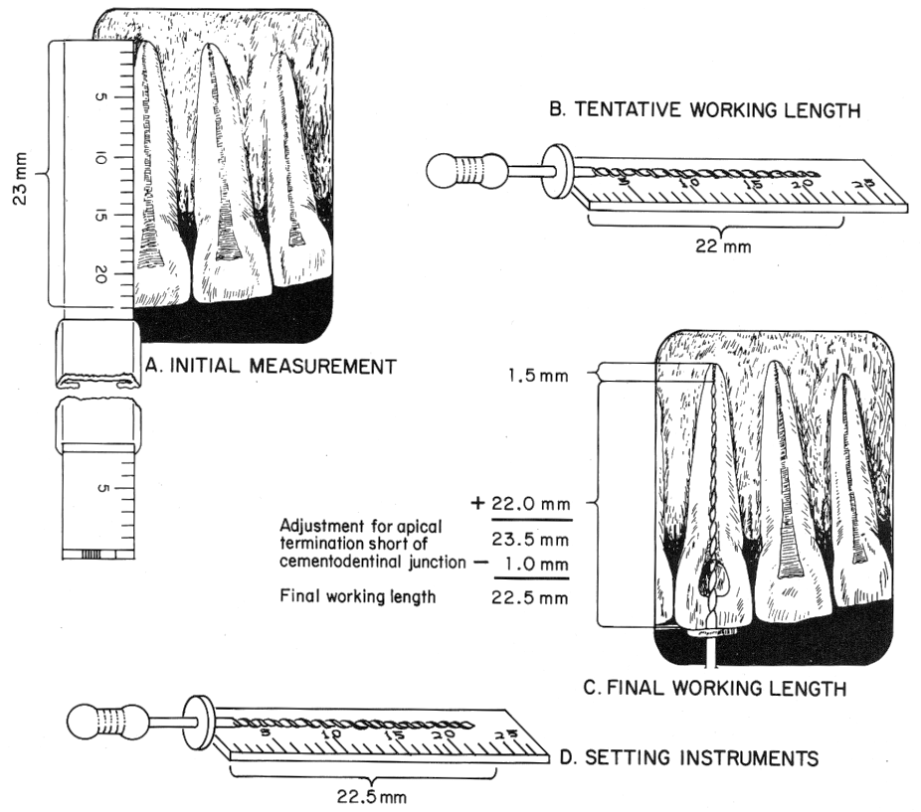

Slide 42
SUMMARY AND CONCLUSION
The cementodentinal junction or minor diameter is a practical and anatomic termination point for the preparation and obturation of the root canal – and this cannot be determined radiographicaly.
Modern apex locators can determine this position with accuracies greater than 90% but with some limitations.
No individual method is truly satisfactory in determining endodontic working length.
Therefore, combination of methods should be used to assess the accurate working length determination

Slide 43
Thank you

