Slide 1
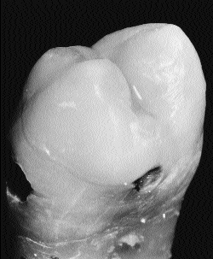
Newer concepts in classification of carious lesions
Dr. Rhythm
Assistant Professor

Slide 2
Earlier, cavities were designed without the present understanding of the action of the fluoride ion and, in the presence of restorative materials which had no inherent therapeutic properties, were subject to micro leakage and were often not aesthetic.

Slide 3
In the absence of adhesive restorative materials, it was regarded as essential to remove all unsupported enamel regardless of its location.

Slide 4
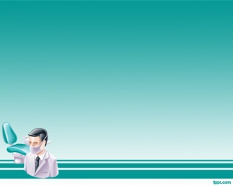
Paradigm shift
MACRO DENTISTRY
G.V BLACKS
“EXTENSION FOR PREVENTION”
MICRO DENTISRY
“PREVENTION OF EXTENSION”

Slide 5
In the presence of a better understanding of the caries process and improved knowledge of the function of fluoride, it is now possible to limit the size of a cavity

Slide 6
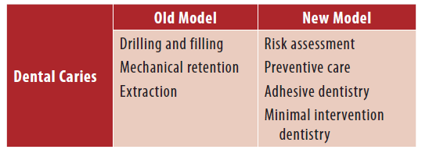
PARADIGM SHIFT

Slide 7
CLINICAL EXAMINATION
G.V.Black – “ a sharp explorer should be used with some pressure & if a very slight pull is required to remove it i.e. ‘CATCH POINT’, the pit should be marked for restoration even if there are no signs of decay” .

Slide 8
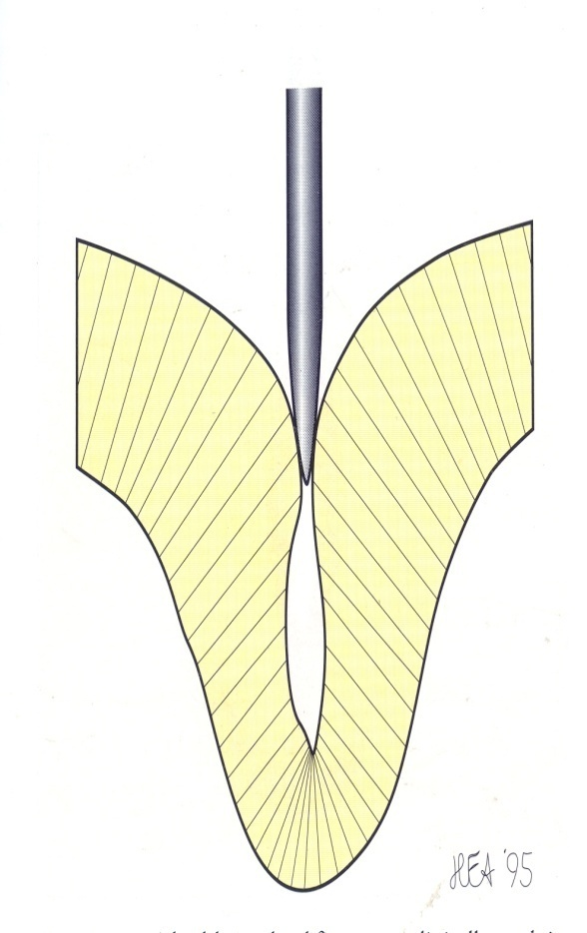
“ SHARP EYES
BUT
BLUNT PROBE”
The enamel is damaged by forceful probing with sharp sickle probes, so probes used to examine occlusal surfaces should be blunt and the probing forces light

Slide 9
Limitations of Black’s Classification
The five categories of carious lesion were related to the site of the lesion and to the nature of the intended restoration
but they did not take into account the dimensions of a cavity

Slide 10
Black’s criterion
1) To remove tooth structure to gain access andvisibility
2) To remove all traces of affected dentine from the floor of the cavity
3) To make room for the insertion of the restorative material itself

Slide 11
4) To provide a mechanical interlocking retentive designs, and
5) To extend the cavity to ‘self cleansing’ areas to avoid recurrent caries.

Slide 12
Classification (Mount & Hume, 1998)
Size
Minimal Moderate Enlarged Extensive
1 2 3 4
Site
Pit/fissure 1 1.1 1.2 1.3 1.4
Contact area 2 2.1 2.2 2.3 2.4
Cervical 3 3.1 3.2 3.3 3.4
Australian Dental Journal 1998;43:3.

Slide 13
Three sites of carious lesions
Site 1. Pits, fissures and enamel defects on occlusal surfaces of posterior teeth or other smooth surfaces, such as cingulum pits on anteriors.

Slide 14
Site 2. Approximal enamel immediately below areas in contact with adjacent teeth.

Slide 15
Site 3. The cervical one-third of the crown or,
following gingival recession, the exposed root.

Slide 16
4 sizes of the lesion
Size 1. Minimal involvement of dentine just
beyond treatment by re-mineralization alone.
Size 2. Moderate involvement of dentine.
Size 3. The cavity is enlarged beyond moderate.
Size 4. Extensive caries with bulk loss of tooth
structure has already occurred.

Slide 17
The Size 1 cavity will necessarily be a new lesion and adhesive restorative materials are ideal, and should always be used for restoration under these circumstances

Slide 18
Cavities in the Size 2, 3 and 4 range may be new lesions that have progressed to a considerable extent without the patient presenting for treatment or they may result from a breakdown of an old restoration which requires replacement.

Slide 19
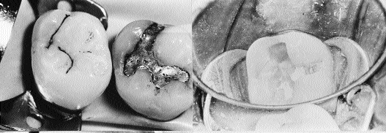
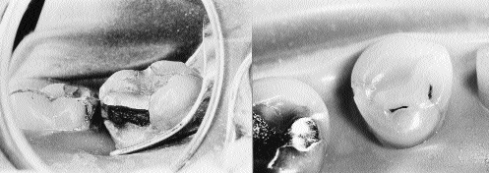
Black Class I Site 1, Size 2 (#1.2).

Slide 20
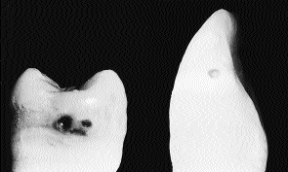
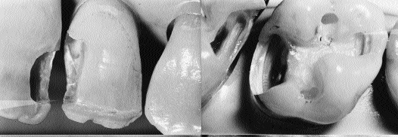
Black Class II Site 2, Size 2 (#2.2) in both posteriors and anteriors.

Slide 21
Black Class III Site 2, Size 2 (#2.2) and
extends to Site 2, Size 3 (#2.3)
Black Class IV Site 2, Size 4 (#2.4)

Slide 22
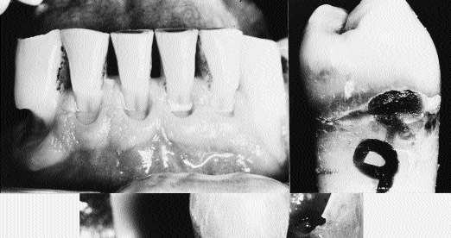
Black Class V An erosion/abrasion lesion or a small carious cavity would be a Site 3, Size 1 (#3.1) or Site 3, Size 2 (#3.2) and interproximal lesions would generally be recorded as Site 3, Size 3(#3.3) or Site 3, Size 4 (#3.4).

Slide 23
MCQ
Q1 The new classification is based on
A. frequency of lesion
B. shape of lesion
C. site of lesion
D. depth of lesion

Slide 24
Q. 2 Black’s principles are based on
A. extension and prevention
B. extension for prevention
C. prevention of extension
D. extensive prevention.

Slide 25
Q.3 Site 1 lesion corresponds to
A. pit and fissure caries
B. smooth surface lesions
C. erosive defects
D. anterior tooth caries

Slide 26
Q.4 Site 2 lesions correspond to
A. Blacks class III
B. Black’s class I
C. Black’s class V
D. Black’s class VI

Slide 27
Q. 5 Caries on exposed proximal root surface are classified under
A. Site 3
B. Site 2
C. Site 1
D. Not classified.

