Slide 1
INLAY WAXES AND CASTING PROCEDURES
DR PROMILA VERMA

Slide 2
DEFINITIONS
Dental wax
A low molecular weight ester of fatty acids
derived from natural & synthetic components
such as petroleum derivatives that soften to
plastic state at a relatively low temperature.
Inlay wax
A specialized dental wax that can be applied to
dies to form direct & indirect patterns for the
lost wax technique used for casting metals or
hot processing of ceramics.

Slide 3
DENTAL WAXES
Components
  Natural waxes:
Natural waxes
Synthetic waxes
Additives
Minerals
Insects
Plants
Animal

Slide 4
CLASSIFICATION
Mineral
Plant
Insect
Animal
ORIGIN:

Slide 5
CLASSIFICATION
USE:
Processing
Boxing & Beading
Sticky
Impression
Corrective
Bite registration
Pattern
Inlay casting
Base plate
Utility
RPD casting
Carving
Block

Slide 6
INLAY WAX
Classification
ANSI/ADA No. 4:
Type I: Medium waxes used in direct techniques.
Type II: Soft waxes used in indirect techniques.
Wax pattern of a inlay made using direct
technique results in a looser fitting inlay than
one made using the indirect technique.
Supplied as deep blue, green, or purple rods or
sticks about 7.5 cm long & 0.64 cm in diameter.

Slide 7
Composition
Essential ingredients:
Natural waxes.
Synthetic waxes.
Ingredients | Wt%
Paraffin wax | 40-60
Gum dammer | 3
Carnauba wax | 25
Candelilla wax | -
Ceresin wax | 10
Bees wax | 5

Slide 8
Composition
Modern inlay wax:
Synthetic waxes often replaces the carnauba wax.
E.g. Esters of acids derived from montan wax,
Nitrogen derivative of higher fatty acids.
Coloring agents:
Aesthetic purpose.
Fillers:
Control expansion & shrinkage.

Slide 9
Desirable Properties
When softened, the wax should be uniform.
The color should contrast with die material or prepared tooth.
No flakiness or roughening when the wax is bent or molded after softening.
The wax should not pull or chip during carving.
During burnout, it should vaporize completely without residue.
The wax pattern should be completely rigid & dimensionally stable at all times until it is eliminated.

Slide 10
Flow
Imp. property for carving & preparation.
Flow is dependent on:
    Temperature of wax.
    Force applied.
    The length of time the force is applied.
Requirements for flow (ANSI/ADA No. 4)
    Maximum permitted flow for Type I waxes at 37°c is 1%.
    Both Type I & Type II waxes must have a minimal flow of 70% & a maximum flow of 90% at 45°c.

Slide 11
Flow
Insufficient flow
Lack of cavity detail.
Excessive stress
Difficultly in compression
Excessive flow

Slide 12
Thermal Properties
Thermal conductivity:
Low.
Coefficient of thermal expansion:
High.
Has a linear expansion of 0.7% with increase in temperature of 20°c.
Direct Technique: Contraction of wax pattern.

Slide 13
Wax Distortion
Release of stresses in pattern due to:
  Contraction on cooling.
  Occluded gas bubbles.
  Change of shape of wax pattern during molding.
  From manipulation, carving, pooling & removal.
Due to any method of manipulation that creates
inhomogeneity of wax involving the intermolecular
distance.

Slide 14
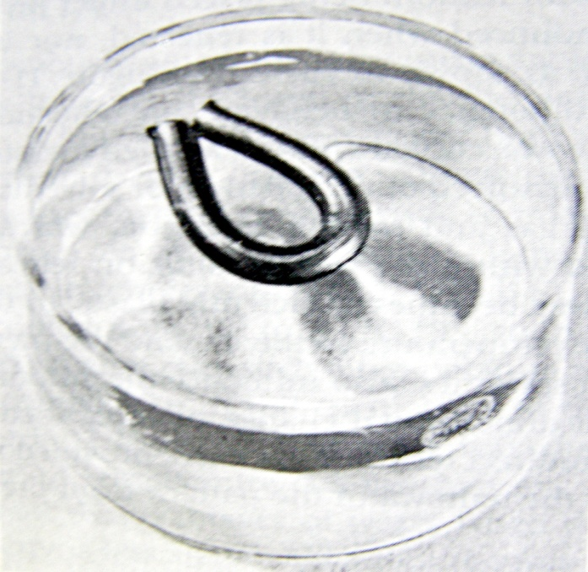
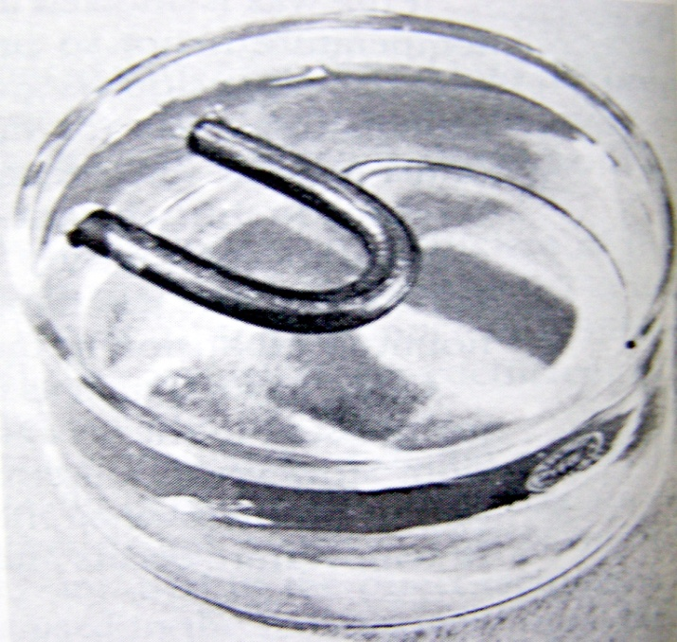
Wax Distortion
Elastic memory: Wax tend to return partially to original shape after manipulation.

Slide 15
Wax Distortion
Other causes:
  If wax is not at uniform temperature when inserted in the cavity.
  If wax is not held under uniform pressure during cooling.
  If the wax is melted & added in the area of deficiency, introduce stresses during cooling.
  During carving.

Slide 16
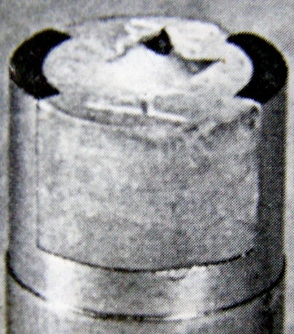
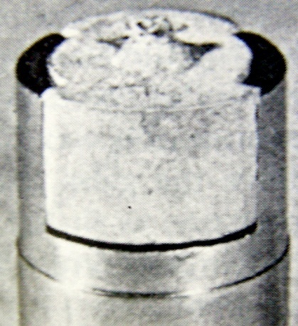
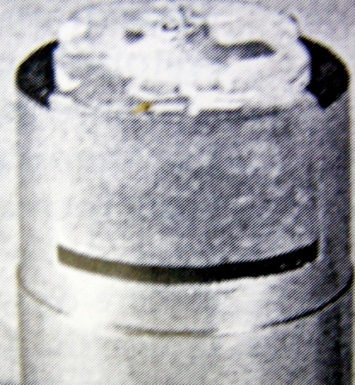
Wax Distortion
To avoid:
  Minimal carving & change in temperature.
  Invest immediately.
  Use warm instruments for carving.
  Store in fridge if necessary.

Slide 17
Manipulation of Inlay Wax
Dry heat is generally preferred to the use of water
bath.
Direct technique:
Wax should be twirled over flame & then remove
Process repeated until wax is uniform throughout.
Kneaded together & shaped to prepared cavity.
Pressure applied.
Carefully removed.

Slide 18
Manipulation of Inlay Wax
Die lubricated.
Melted wax is added in layers.
Cavity is overfilled & carved.
Final finishing with fine cloth toward the margins.
Indirect technique:

Slide 19
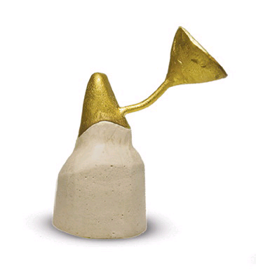
CASTING PROCEDURE

Slide 20
INTRODUCTION
HISTORY
Phillbrook 1st described the “lost wax” technique in 1897.¹
It was Taggart who made this technique popular in dental profession in 1906.¹⁻³
Initially gold was the material which was used as a cast restoration material.

Slide 21
STEPS IN CASTING PROCEDURE
Wax pattern
Spruing
Investing
Burnout
Casting
Notes:
HELLO

Slide 22
STEPS IN CASTING PROCEDURE
Breakout casting from investment
Pickle casting
Removal of sprue and polish
Deliver to patient

Slide 23
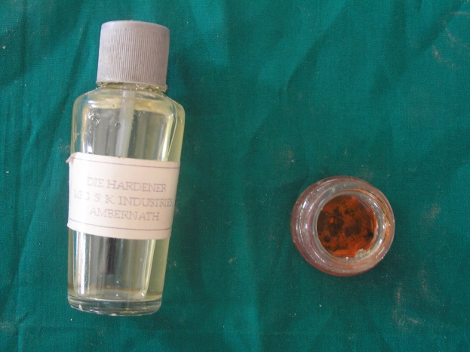
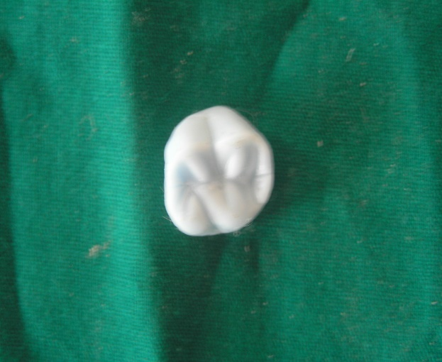
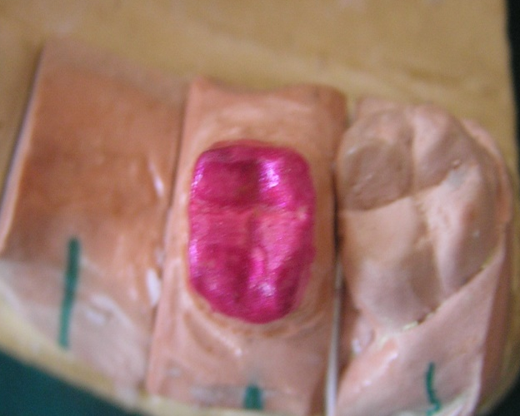
WAX PATTERN
Die hardner
oil
Wax pattern
spacer

Slide 24
SPRUE
Definition (GPT-8)
SPRUE A channel or hole through which plastic or metal is poured or cast into a gate or reservoir and then into a mold.

Slide 25
SPRUE FORMER
A wax, plastic, or metal pattern used to form the channel or channels allowing molten metal to low into a mold to make a casting (GPT-8)

Slide 26
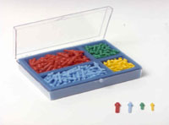
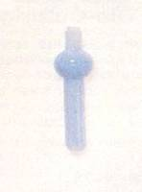
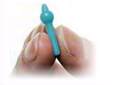
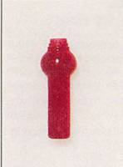
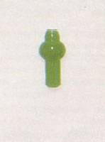
TYPES OF SPRUE FORMER
Wax- easily eliminated
Metal – removed before casting
Plastic- more rigid than wax, resist
distortion

Slide 27
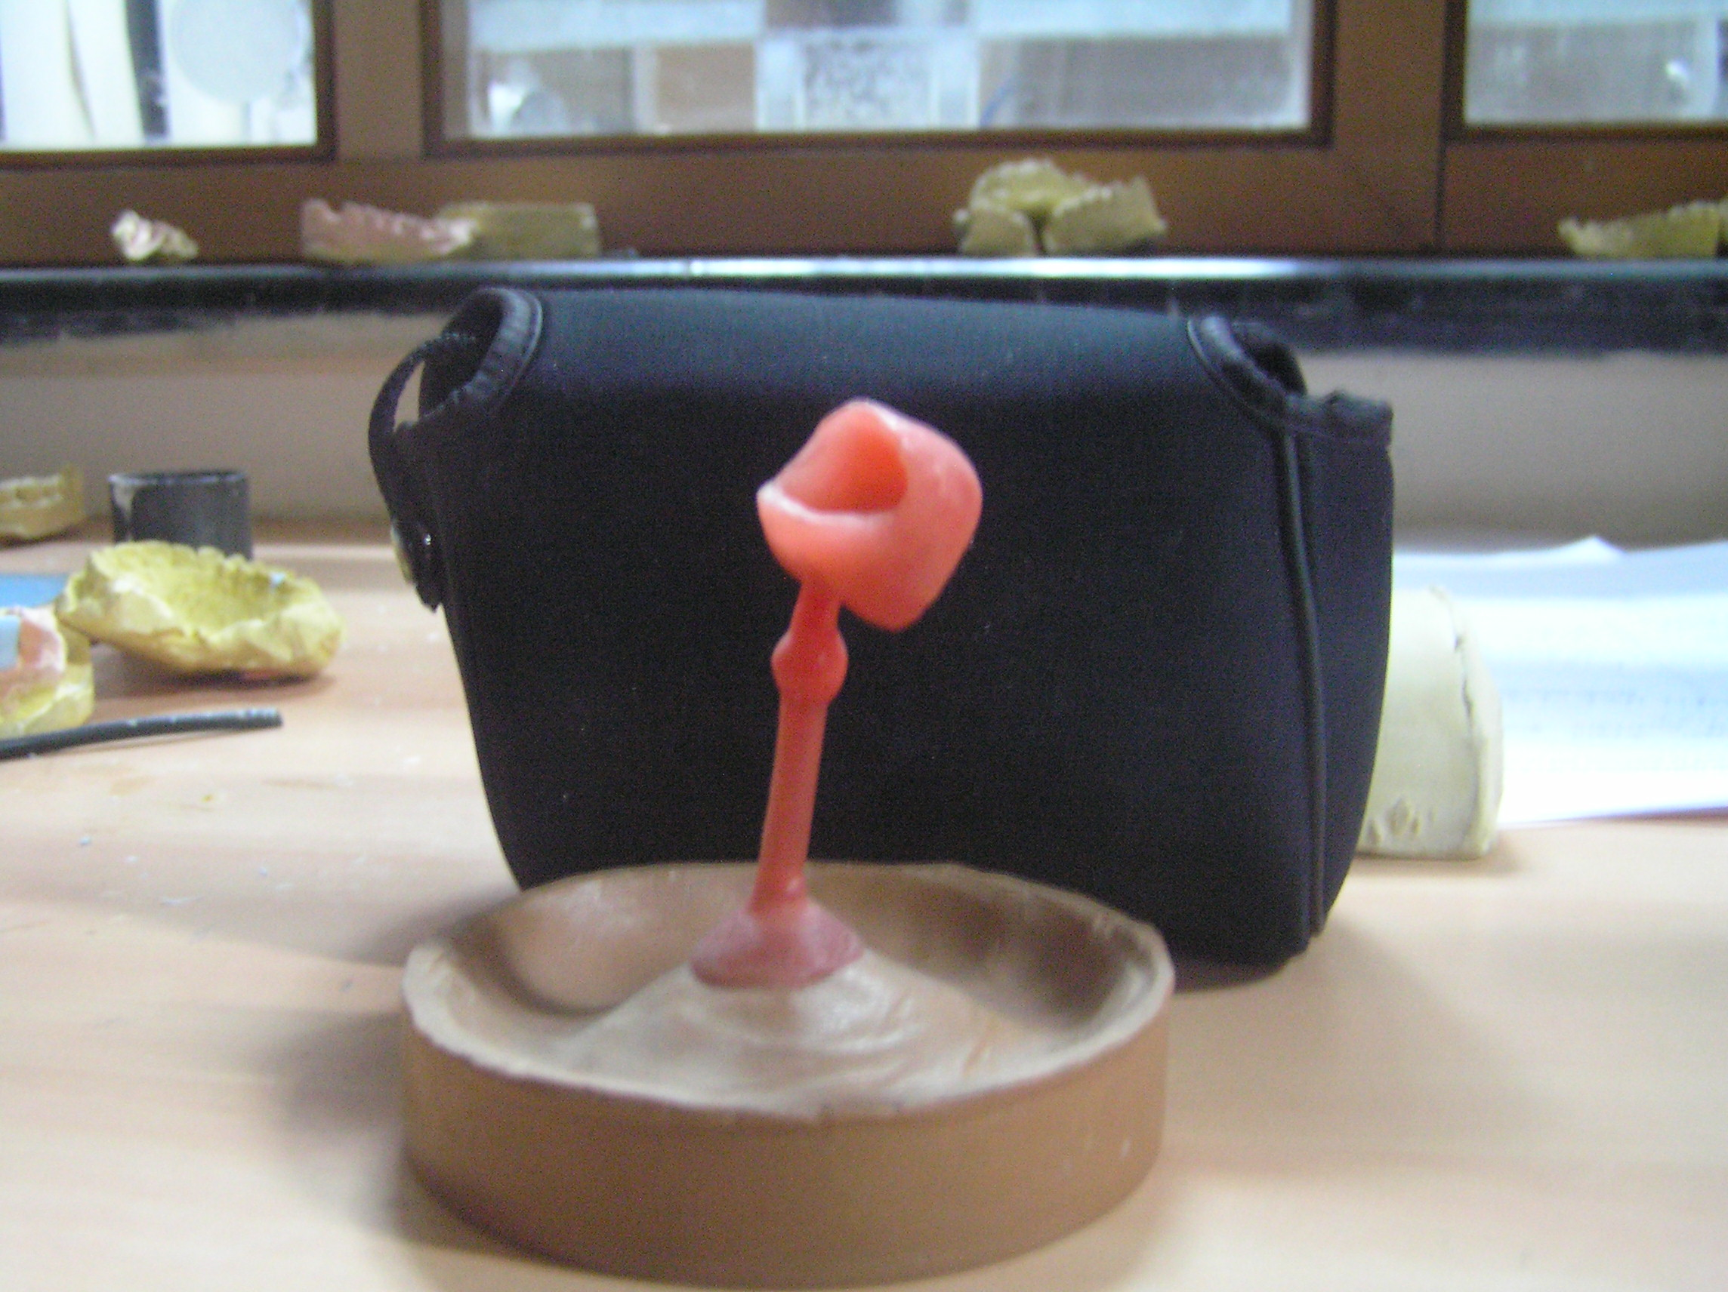
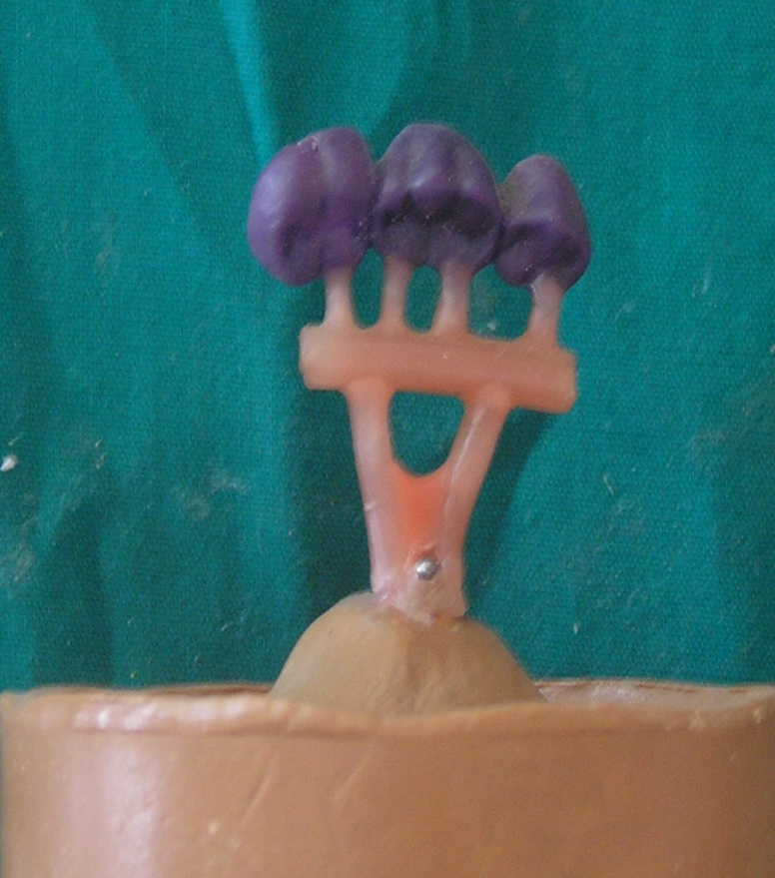
DESIGNS OF SPRUE FORMER
Single Reservoir
Large reservoir
with multiple sprues

Slide 28
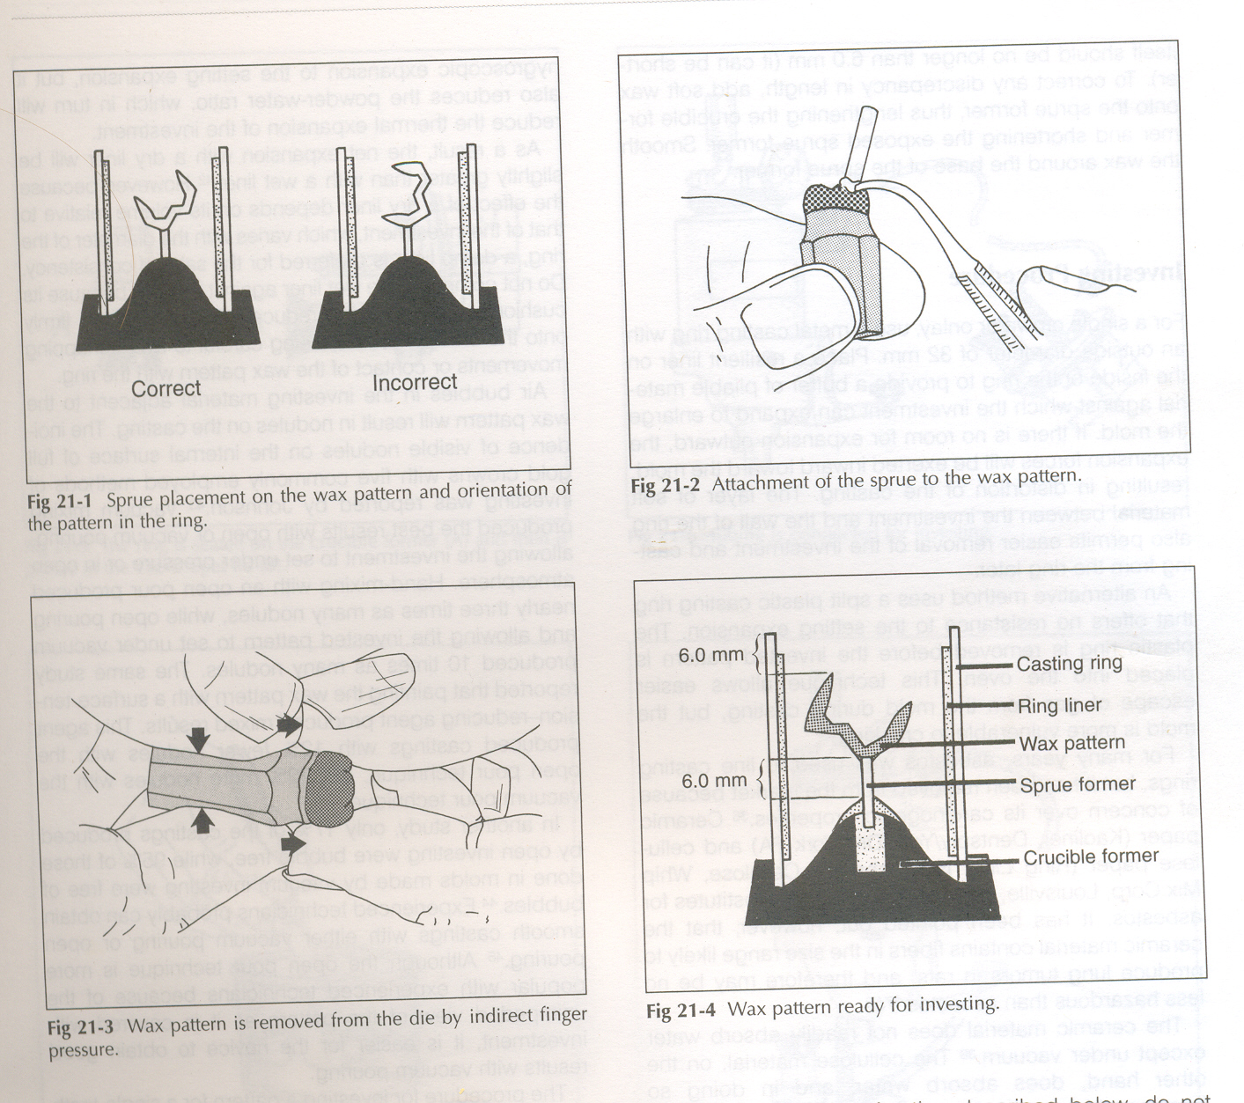
ATTACHMENT OF SPRUE TO WAX PATTERN
Sprue former is attached to wax pattern to its greatest bulk, avoiding centric occlusion contact.
Drop a bead of sicky wax on to the attachment surface
Use PKT no 1 instrument for attachment
Best attachment
junction is either
straight or slightly flared4

Slide 29
DIAMETER AND LENGTH OF SPRUE FORMER
A 10 gauge (2.6 mm diameter) is used for most patterns.
12 gauge (2 mm diameter) for small premolars.
The length of Sprue former should be long enough .
The recommended investment thickness between mold cavity and end of investment ring is approximately 6mm for gypsum and 3-4 mm for phosphate investment.

Slide 30
Number of sprues
If the pattern is thick-one sprue .
If the pattern have a thin area then more than one sprue is required

Slide 31
Location of the sprue
Sprue should be located to the bulkiest part of the pattern .
- minimizes the effect of released stress.
-insures thinnest section to get complete fill.
- the melt will always fluid enough and available until all dimension gets complete fill.

Slide 32
Angulations of the sprue former
Never directed towards thin ,delicate area.
Never at 90⁰ to flat portion of the wax .
It should be directed away or at 45^{0.}

Slide 33
MCQs
An ideal location to attach a sprue pin is
A Thickest point
B Thinnest point
C Anywhere
D Where carving is least disturbed

Slide 34
Angulation of the sprue is
A 90⁰
B 65⁰
C 45⁰
D 35⁰

Slide 35
Carnuba wax is added to
A Increase melting
B Increase plasticity
C Decrease flakiness
D No effect

Slide 36
Advantage of the less flow of the wax is
A -Adaptation details
B -Less distortion
C- Dimensionally stable
D- reduce flakiness

Slide 37
REMOVAL OF WAX PATTERN
Sprue former
Two finger (thumb and first finger)
Use of paper staple or wire attached with sticky wax to further ends of pattern.

Slide 38
Surface treatment of wax pattern
Casting waxes are hydrophobic .
Surface active agents are applied before investment.

Slide 39
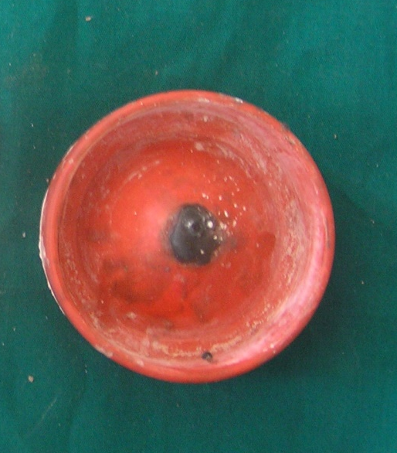
ATTACHMENT OF WAX PATTERN WITH CRUCIBLE FORMER
Wax pattern is attached to crucible former in two ways:
(A) Direct technique – where wax pattern is attached to crucible former directly with the help of Sprue former.
Crucible former

Slide 40
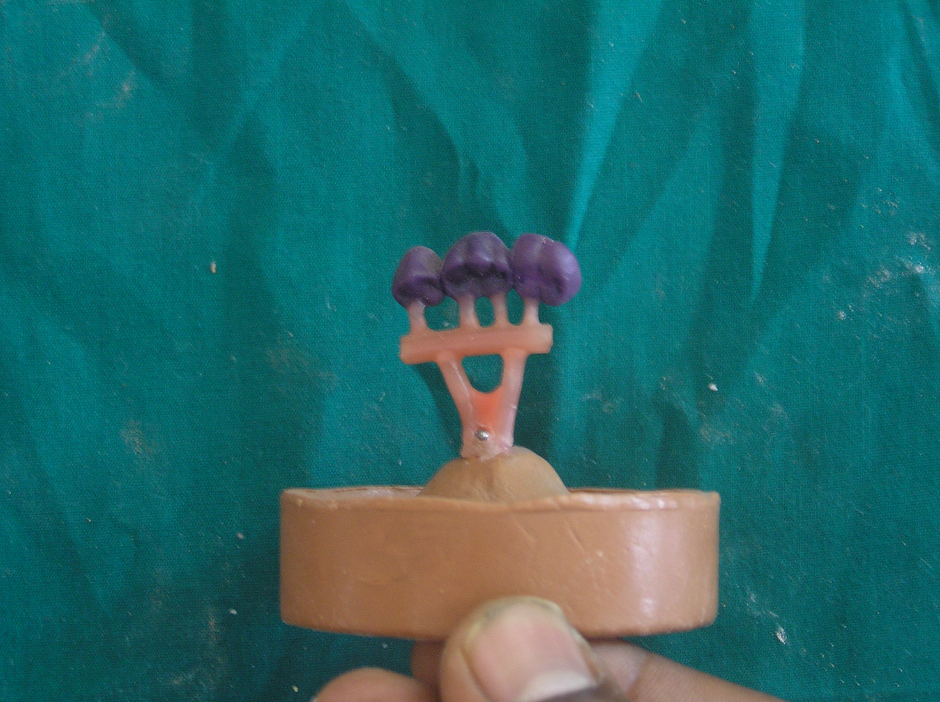
(B) Indirect technique – in this technique reservoir bar is attached between wax pattern and crucible former.

Slide 41
CASTING RING
Definition- The inferior portion of a refractory flask that provides negative likeness or dimple into which a metal is cast in the refractory environment.( GPT-8 )
This casting ring is lined by a material for
the following purpose-
a) To allow enough lateral expansion of mold during setting.

Slide 42
CASTING RING LINER
b) Easy removal of investment from casting ring.
c) Support the casting ring.
Ring liners can be of the following types
1)Asbestos - initially used
carcinogenic properties
2)Cellulose paper - burn before casting is made
provide unrestricted
expansion
3)Ceramic paper

Slide 43
Ring liner
Clinicians cuts the liner to fit the inside diameter of the ring with no overlap.
Dry liner is immersed in water and excess water is shaken away.
Squeezing of liner is avoided.
Ring liner affords greater setting expansion.

Slide 44
PATTERN READY FOR INVESTMENT
Casting ring
Ring liner
Wax pattern
Sprue former
Crucible former

Slide 45
INVESTING PROCEDURE
Investing - surrounding the wax pattern with material that can accurately duplicate its shape and anatomic features.
Two methods are used
Hand mixing
Vacuum mixing and investment

Slide 46
A) HAND MIXING
-Distilled water + powder of investment
material ( gypsum, phosphate etc ) are
added and mixed thoroughly.
-Small amount of mix is painted on surface
of wax pattern for better wetting.
-Casting ring is filled with material.

Slide 47
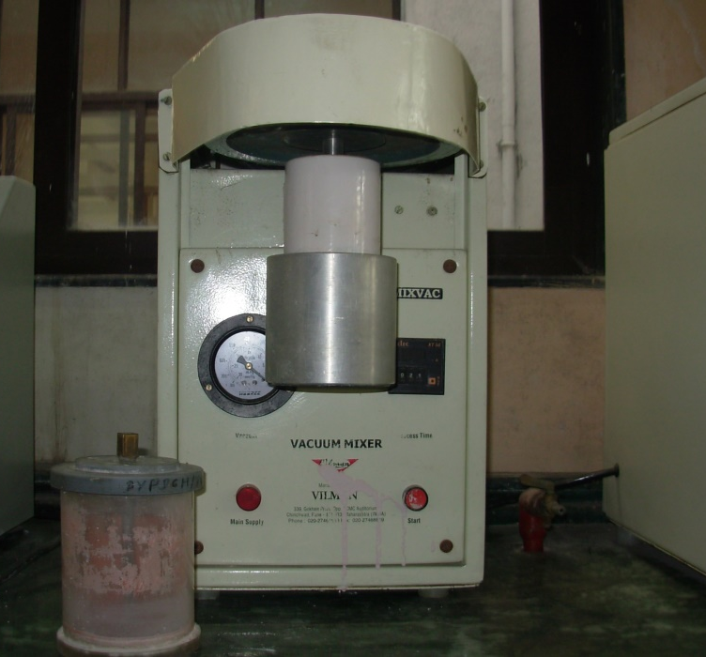
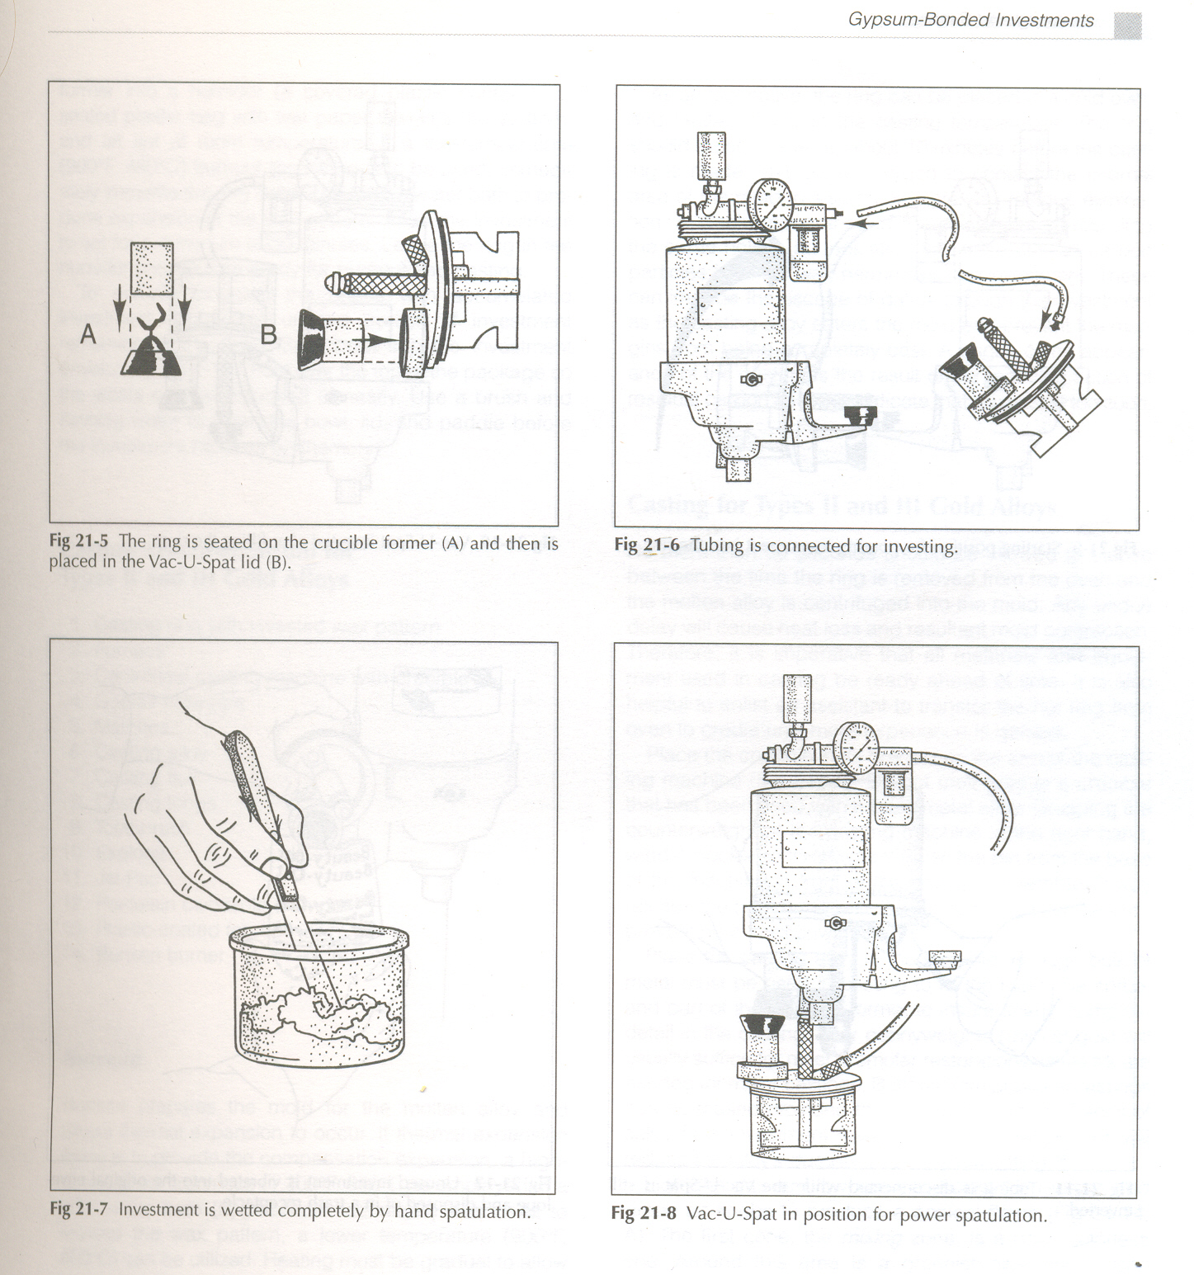
B) VACUUM MIXING
Vacuum
mixer
A) The ring is seated
B) Placement of ring in vacuum machine

Slide 48
VACUUM MIXING
c
D
C) Tubing connected to vacuum machine.
D) Investment is wetted by hand spatulation.

Slide 49
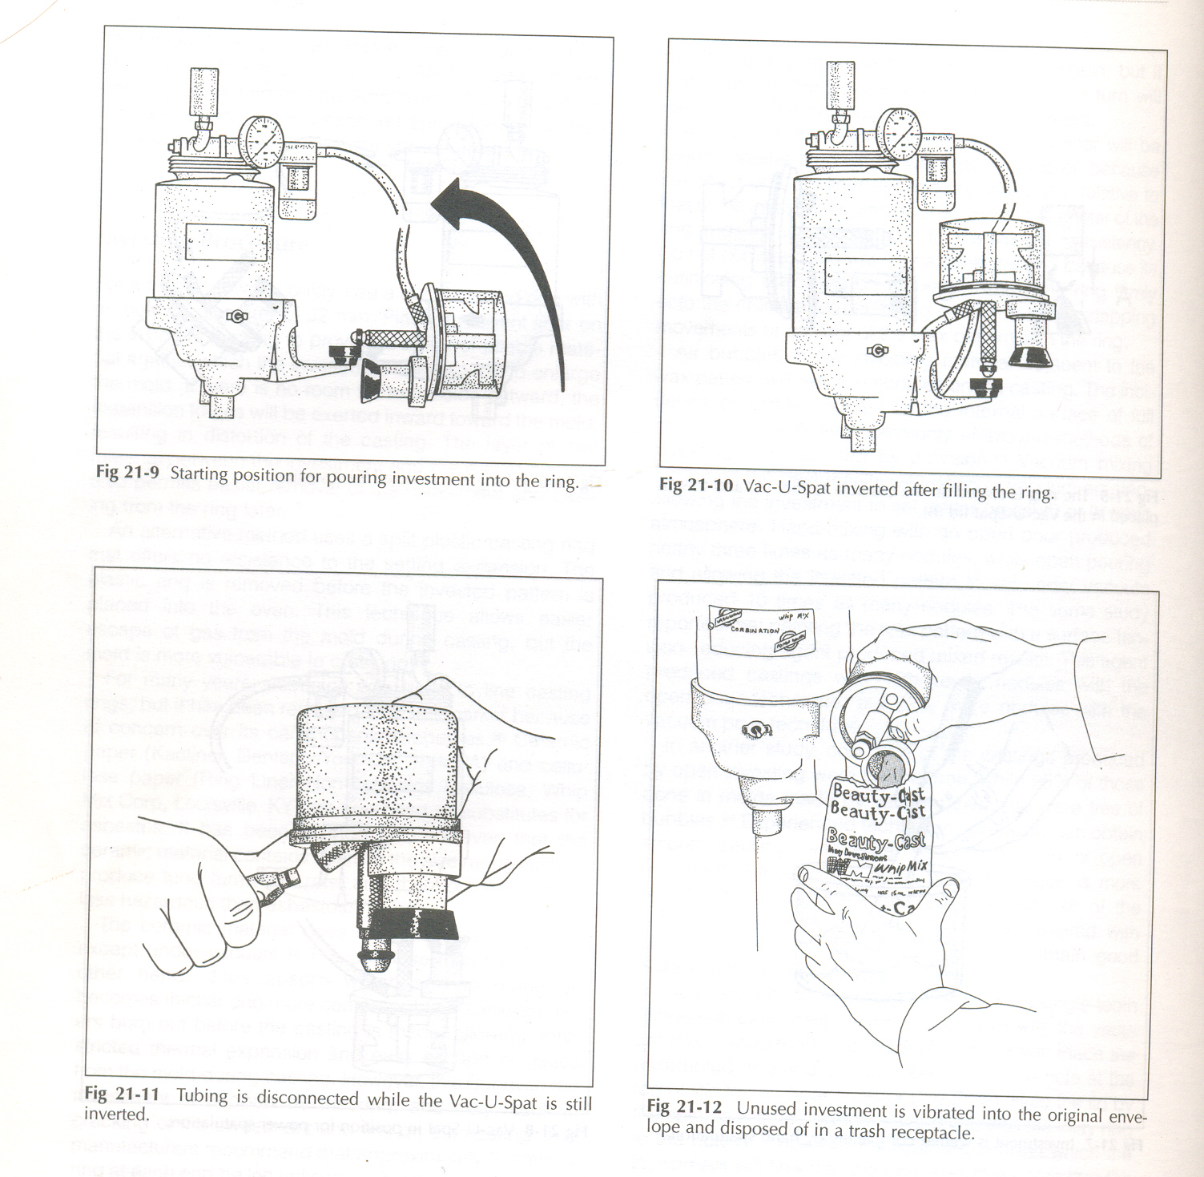
VACUUM MIXING
E
F
G
E) Positioning for power spatulation
F) Positioning for pouring
G) Inversion of vacuum after filling the ring

Slide 50
VACUUM MIXING
H
I
H) Tubing is disconnected
I) Unused investment is disposed

Slide 51
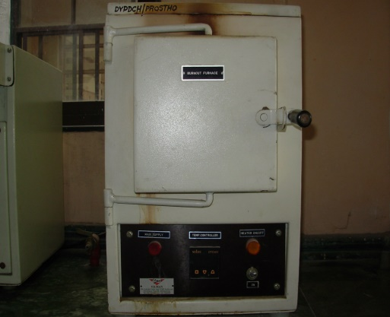
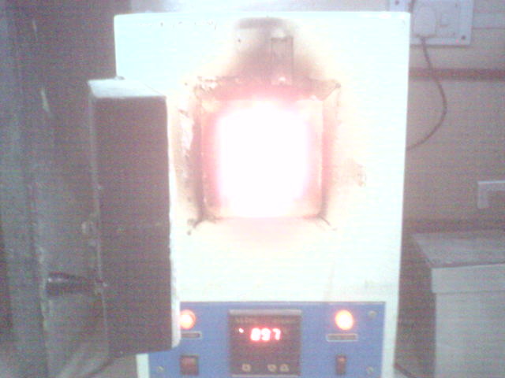
BURN OUT PROCEDURE
TEMPRATURE FOR
BURNOUT
Slowly raising from
400 0C to 7000C
(hygroscopic setting
expansion technique
or for normal
setting expansion)
For 30 to 60 min.
.
Gypsum bonded investment
BURN OUT FURNACE

Slide 52
BURN OUT PROCEDURE
TEMPRATURE FOR
BURNOUT
Slowly raising from
300 0C to prevent cracking of investment.
Then raised 700 0C to 1100 0C For 30 to 60 min.
(this give large thermal expansion)
.
Phosphate bonded investment
BURN OUT FURNACE

Slide 53
Casting defect
Distortion
Surface roughness
Air bubbles
Water films
Rapid heating rates under heating
Liquid powder ratio
Prolonged heating
Temperature of the alloy
Casting pressure
Foreign bodies
Impact of molten metal
Pattern position

Slide 54
Distortion
Manipulation of waxes
As the investment hardens(setting and hygroscopic expansion)
Configuration of the pattern,type of wax and thickness of the pattern

Slide 55
Surface roughness, irregularities and discoloration.
“Surface roughness is relatively finely spaced surface imperfections whose height ,width, and directions establish the predominant surface pattern”.
“Surface irregularities are isolated imperfections such as nodules that are not characteristic of the pattern”.

Slide 56
Air Bubbles and water films
Small nodules on a casting are caused by air bubbles that becomes attached to the pattern.
Wax is repellent to water. If investment becomes separated from the wax pattern water film may form irregular on the surface—minute ridges or veins.

Slide 57
Rapid heating rates and under heating
Rapid heating –fins or spines
Surface roughness due to flaking of the investment when water is poured in mold.
Under heating –incomplete elimination of waxes, voids or porosity

Slide 58
Prolonged heating & temperature of the alloy
Prolonged heating – disintegration of the investment , molds wall get roughened.
Product of decomposition –sulphur may contaminate the alloy-texture is affected .
Casting may not respond to pickling
Alloy heated too high - surface roughness may appear

Slide 59
Casting pressure
Too high pressure –surface roughness on the casting .
Guage pressure -0.10-0.14MPa in an air pressure casting machine.

Slide 60
Foreign bodies, pattern position
Foreign bodies- Surface roughness
If several pattern are invested in the same ring they should not be placed too close.
Expansion of waxes is much higher than that of investment – causing breakdown or cracking of investment.

Slide 61
PRECAUTIONS DURING BURNOUT
All adhering wax to mold walls should be eliminated.
Rapid heating should not be done (excess of water in investment converts into steam of high pressure which may crack the investment).

Slide 62
PRECAUTIONS DURING BURNOUT
Over heating of investment , cause disintegration, leading to tarnish, rough surface of casting, too much mold expansion and also cracks.
Prolonged heating also may fracture and produce cracks.

Slide 63
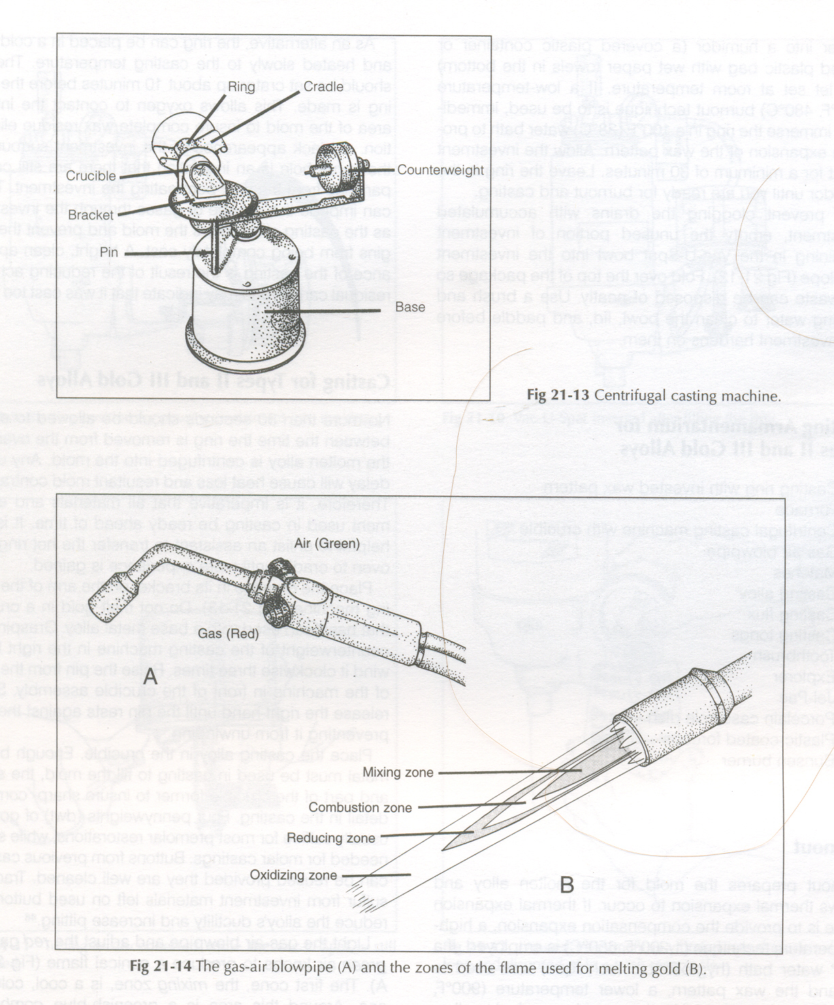
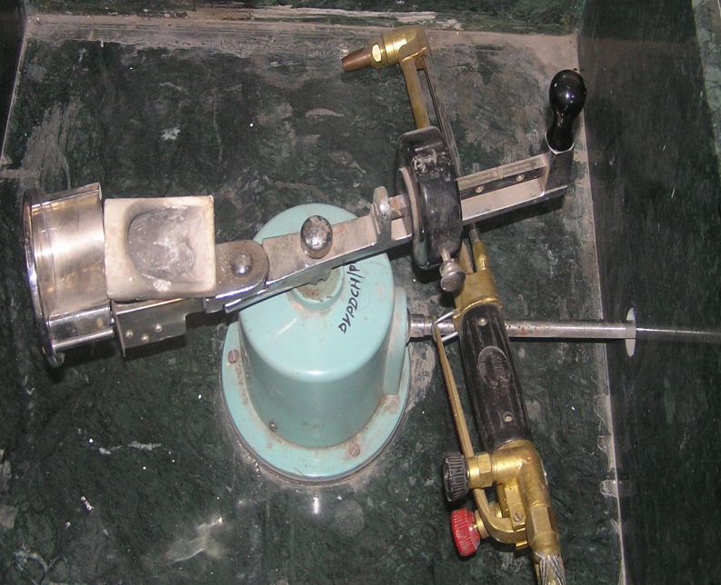
CASTING MACHINES
1) Centrifugal casting machine
Ring
Cradle
Counter weight
Base
Handle
Bracket
crucible

Slide 64
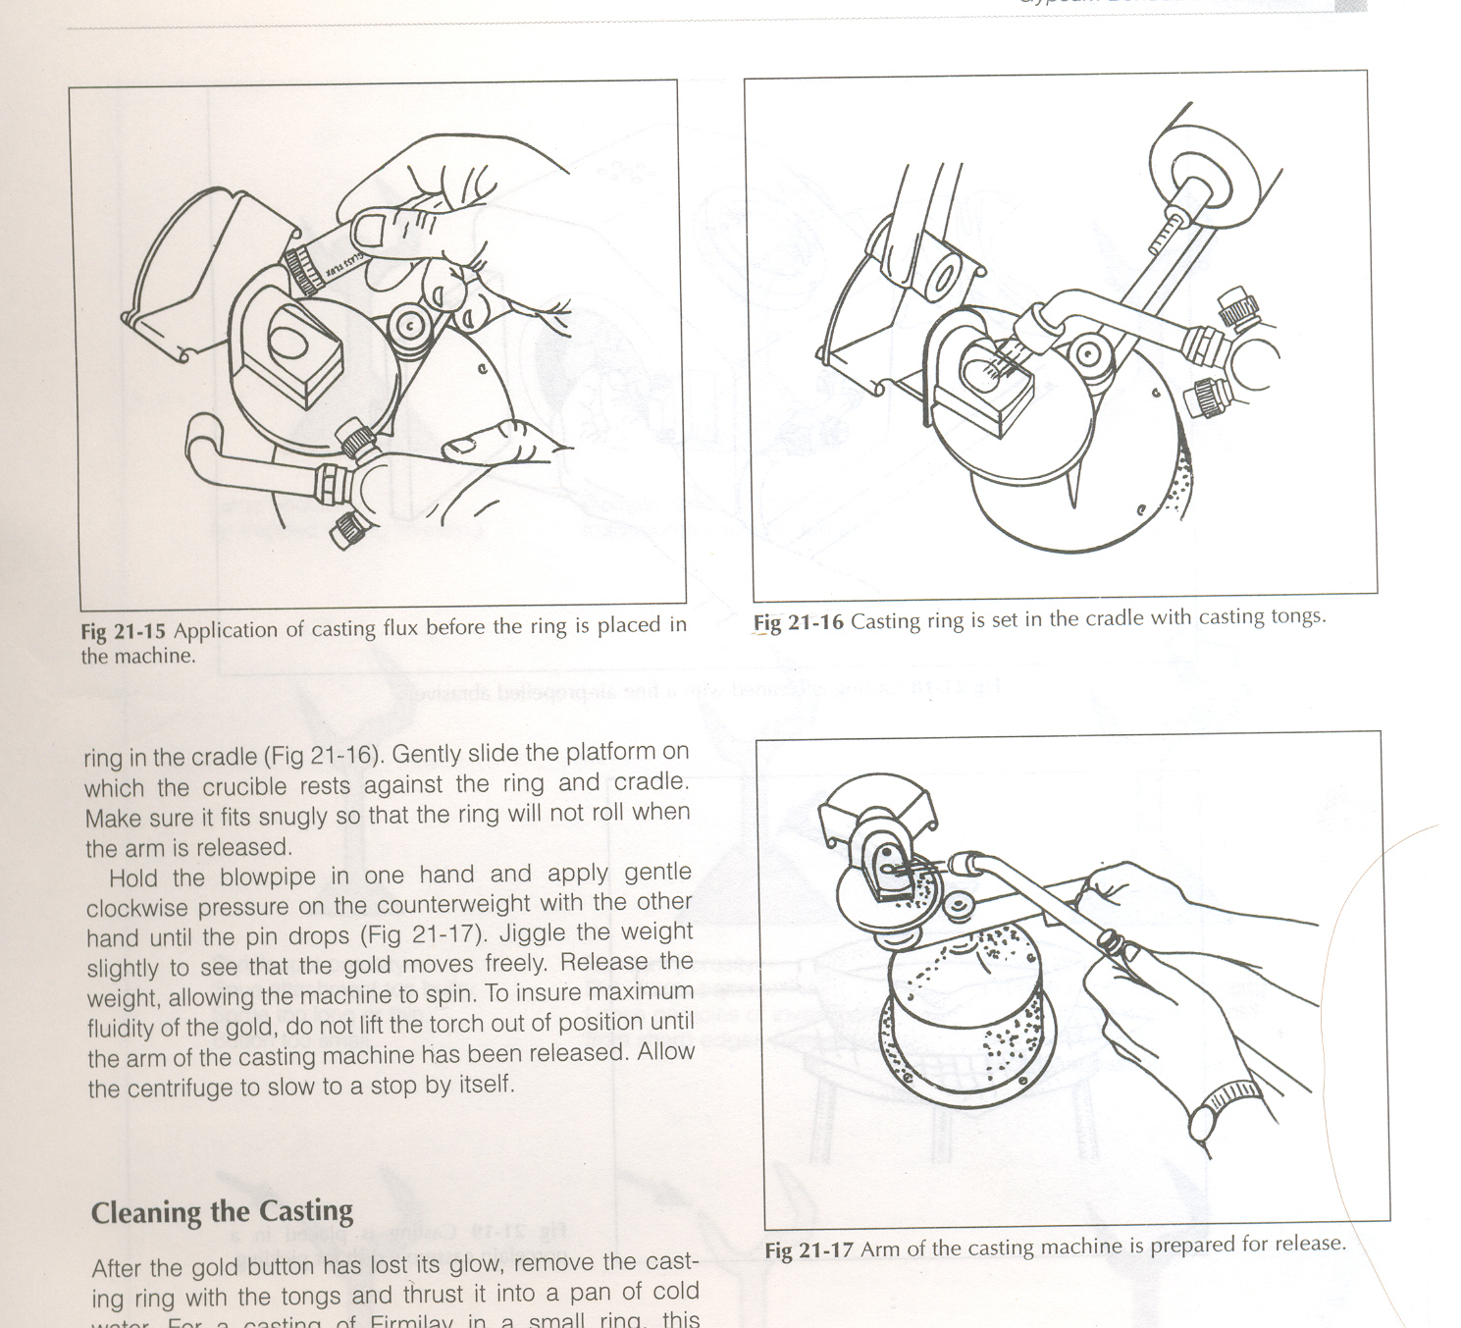
CASTING MACHINES
a
b
c
a) Flux application
b) Gas torch
flame is applied
and investment
is placed in ring
c) Handle is
released
and flame is
kept in position

Slide 65
CASTING MACHINES
AIR
Gas torch flame
Different flame zones
GAS
A
1
2
3
4
B
MIXING ZONE
COMBUSTION ZONE
REDUCING ZONE
OXIDIZING ZONE

Slide 66
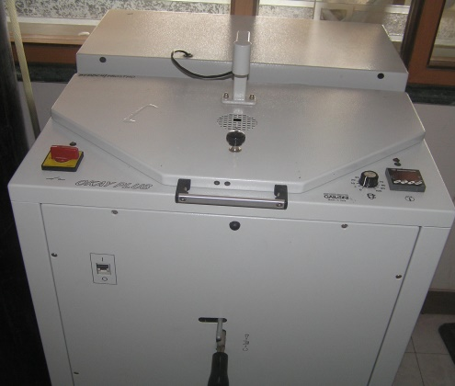
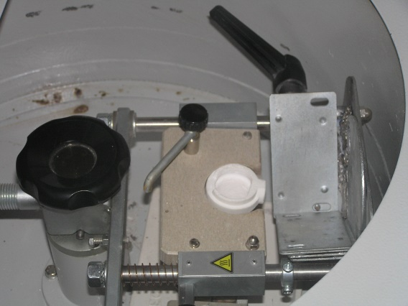
CASTING MACHINES
2) A. C Induction casting machine
A copper tube coil is wound around crucible.
High frequency alternate current is applied
Temperature of 1500 0C to 1600 0C
Used for high melting base metal alloys

Slide 67
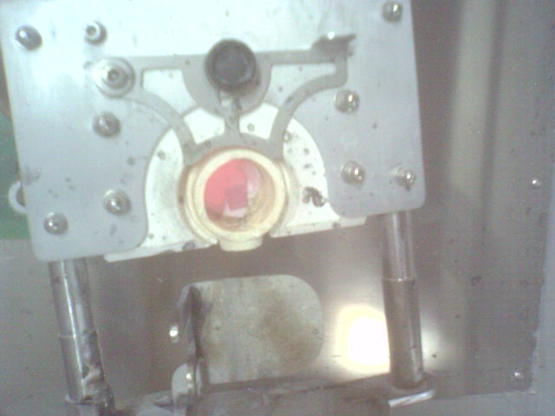
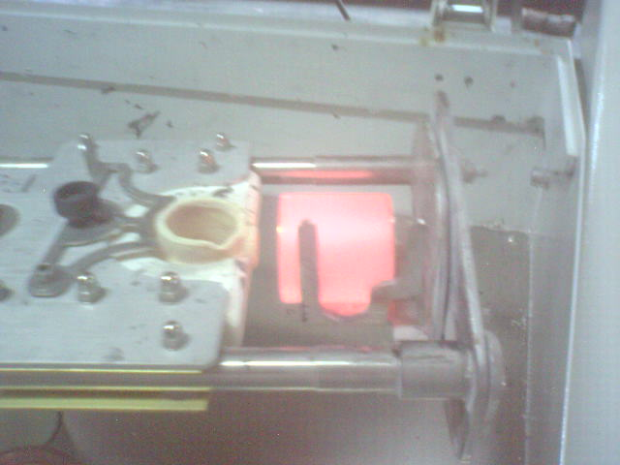
CASTING PROCEDURE
Side view
Top view
2) A. C Induction casting machine

Slide 68
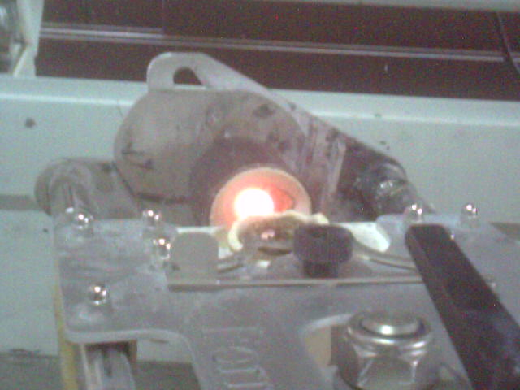
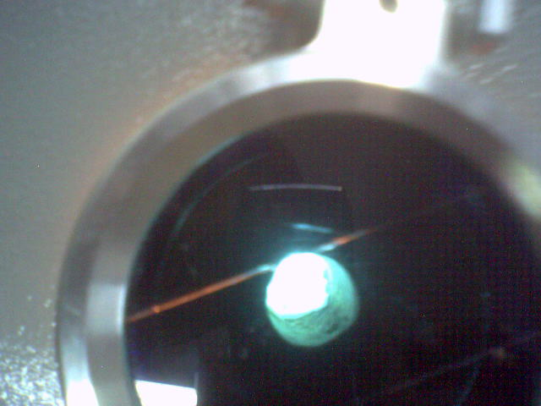
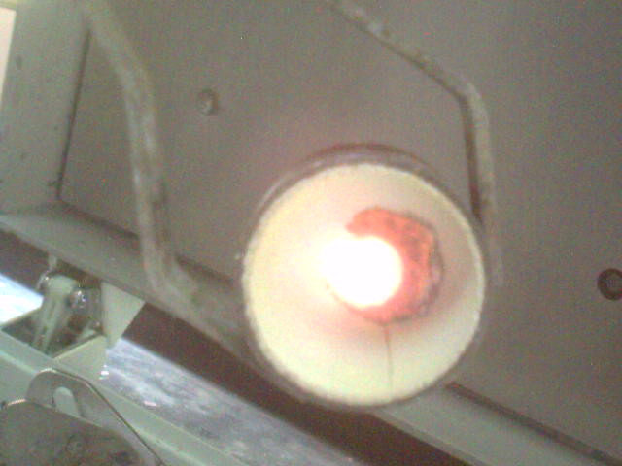
CASTING PROCEDURE
Side view
Melting of metal
(mirror like-
shiny)
Completion of
casting

Slide 69
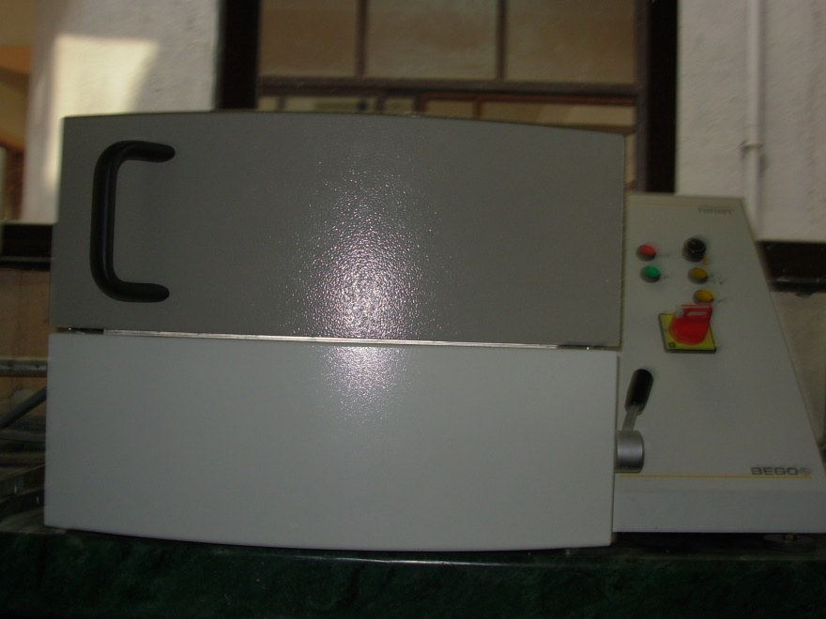
CASTING MACHINES
3) D .C arc melting system
Direct current electric
arc is produced b/w alloy
and water cooled
tungsten electrode.
Temperature >4000 0C
No control over highest
temperature
Used for titanium
and its alloys

Slide 70
CASTING MACHINES
4) Vacuum pressure assisted casting machine
Used for titanium and its alloys.
Temperature at 1668 ⁰C.
Centrifugal force is not sufficient so vacuum is used.
Melting is done under electric arc and casting is done under argon gas pressure.

Slide 71
DEVESTING
As soon as the rotation stops casting ring is quenched in water for 5 min for perfect grain structure.
The water rushed inside with hissing sound, disintegrating investment and separate the casting.
It also leaves gold alloy casting soften helping in trimming and finishing.
For cobalt chrome cobalt or nickel alloys, the cast investment is allowed to cool slowly by itself overnight.

Slide 72
PICKLING
Used for cleaning gold casting.
Jel Pak
- much safer pickling agent used,
- less corrosive,
- still avoid contact with skin
and vapors inhalation.
Sulfuric acid
Hydrochloric acid

Slide 73
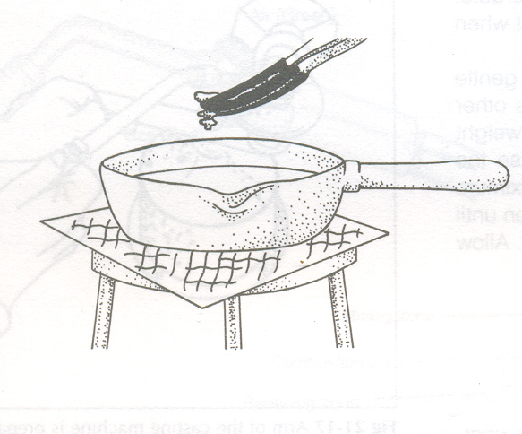
PICKLING
Plastic coated
pliers
A porcelain casserole
dish is used.
Plastic coated pliers are
used for introducing and
removing the casting.
Metal surface are avoided
from contact as it may lead
to electro deposition
on casting.
Jel Pak
A porcelain
casserole dish

Slide 74
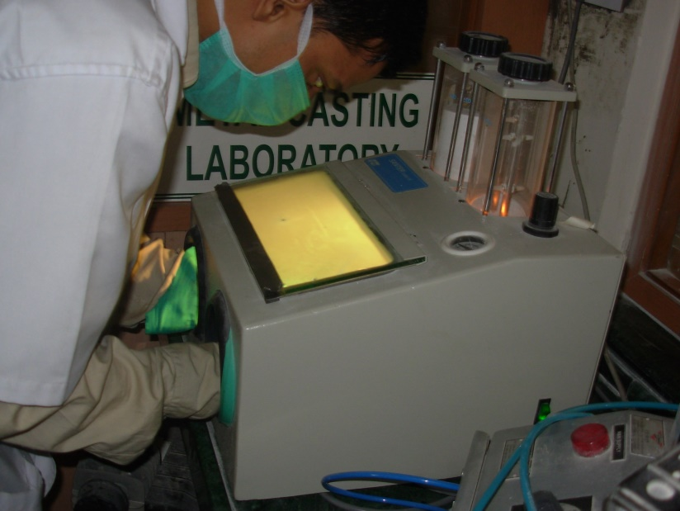
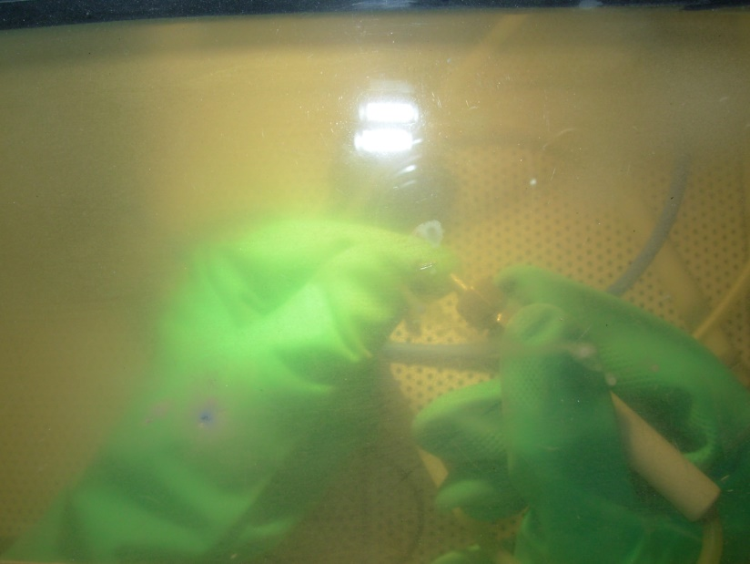
SAND BLASTING
SAND BLASTER
INSIDE VIEW
Chamber for sand
Fine air propelled inside
Air abrasion with small particle
size abrasives

Slide 75
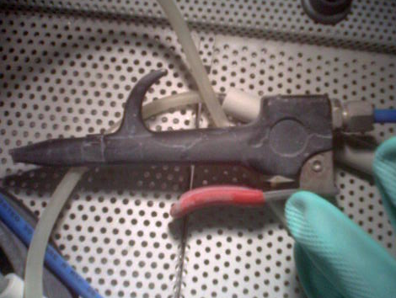
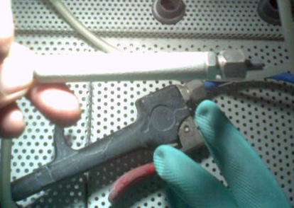
SAND BLASTING
Sand
Air

Slide 76
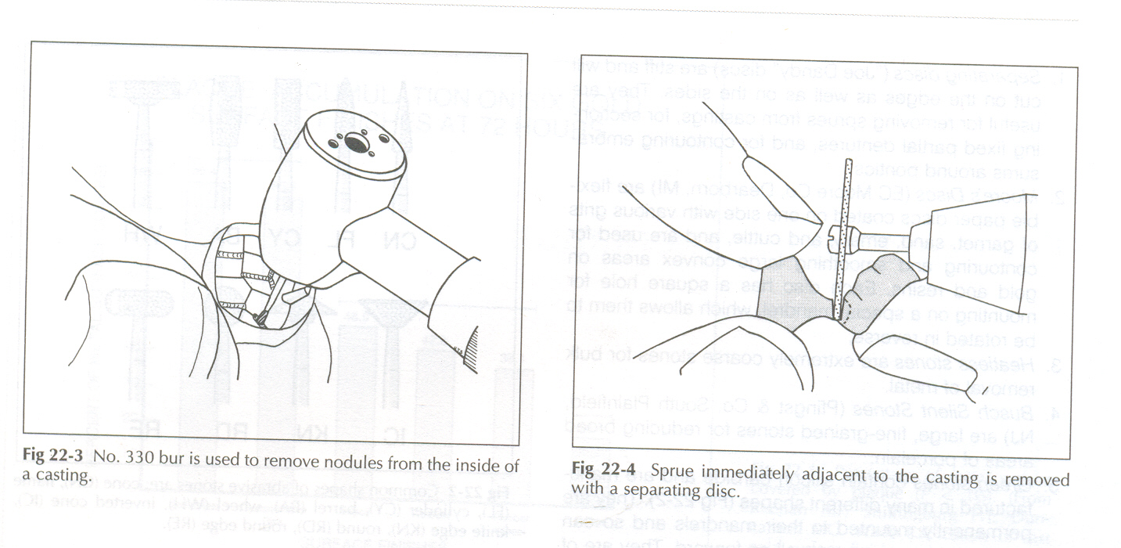
FINISHING OF THE PREPARATION
SPRUE IS REMOVED
NODULES REMOVED FROM INSIDE

Slide 77
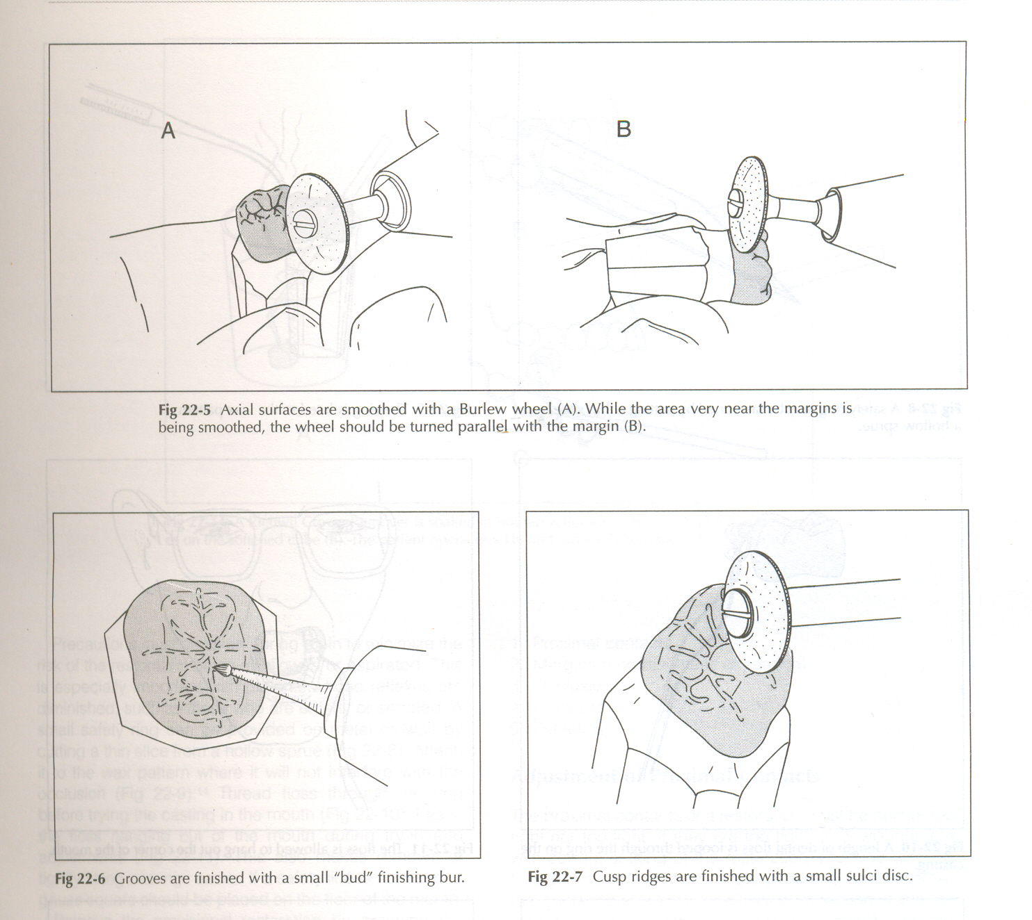
FINISHING OF THE PREPARATION
AXIAL WALLS
ARE SMOOTHENED
AREA NEAR MARGIN
IS BEING SMOOTHED

Slide 78
FINISHING OF THE PREPARATION
GROOVES ARE FINISHED
CUSP RIDGES
ARE FINISHED

Slide 79
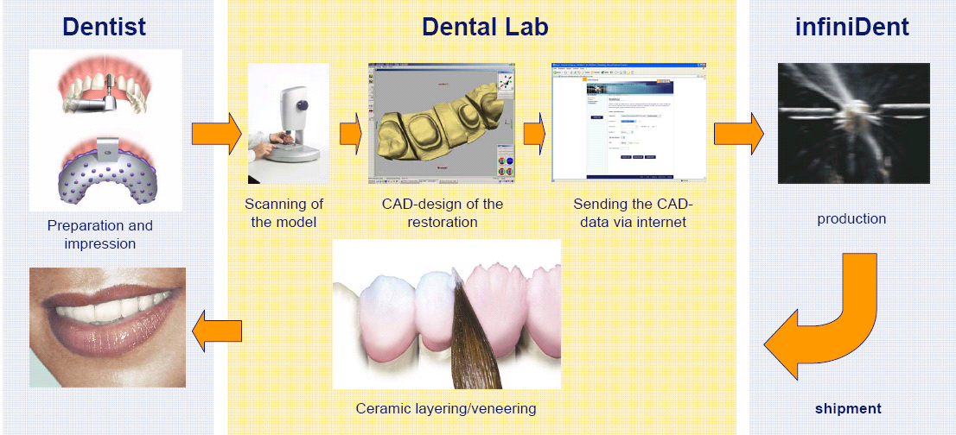
CAD-CAM TECHNIQUE

Slide 80
CONCLUSION
“Few experiences in dentistry are more frustrating
then having finished a casting that will not fit and
therefore can not be used for patient”
-SHILLINGBERG

Slide 81
REFERENCES
Hollenback GM “science and technic of the cast restoration” CV mosby Co, 1964,pg 21.
Taggart WH “A new and accuratemethod of making gold inlays” Dent cosmos 1907,49, pg1117-1121.
O ‘Brien WJ “Evolution of dental casting” 1977, pg 2-9.

Slide 82
REFERENCES
Verrett RG “The effect of sprue attachment design on castibility and porosity” JPD 1989,61,pg 418-424.
Priest G Horner JA “Fibrous ceramic aluminum silicate as alternative to asbestos lining” JPD 1980,44,pg51-56.
Davis DR “potential hazards of ceramic ring liners” JPD 1987,57,365-369.

Slide 83
REFERENCES
Craig RG “Restorative dental materials” pg 465.
Du Bois LM “The effect of temperature at quenching on mechanical properties of casting alloys” JPD 1987, 57,556-571.
H T Shillinburg, JR,DDS “Fundamentals of fixed Prosthodontics” 3rd Edn, pg 365-383

Slide 84

THANK YOU

