Slide 1
Activities for the Year 2024-2025 by Mahila Addhyan Kendra

Slide 2
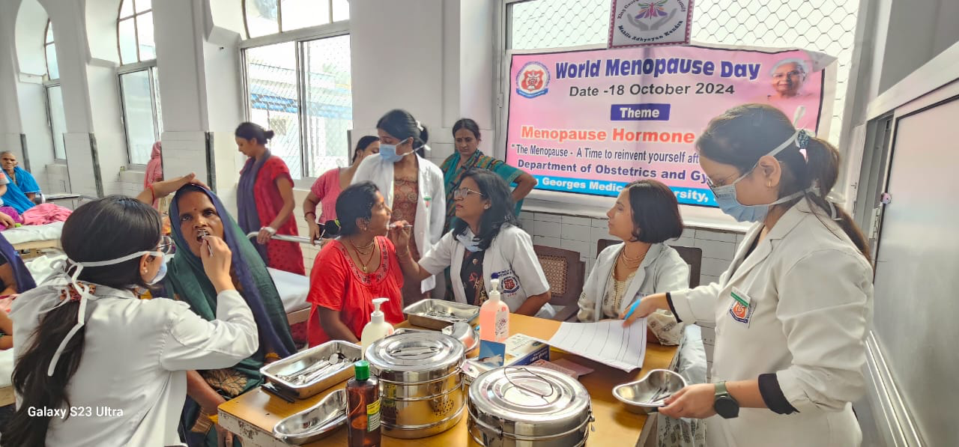
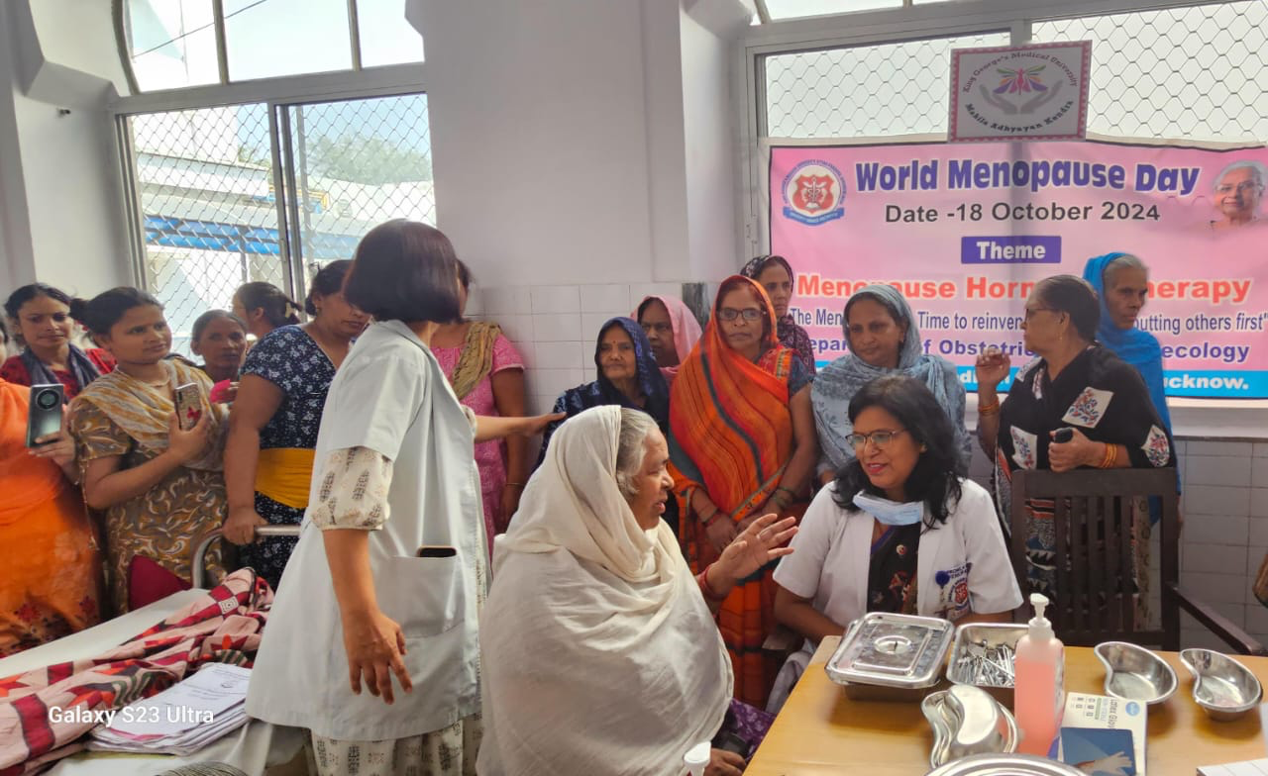
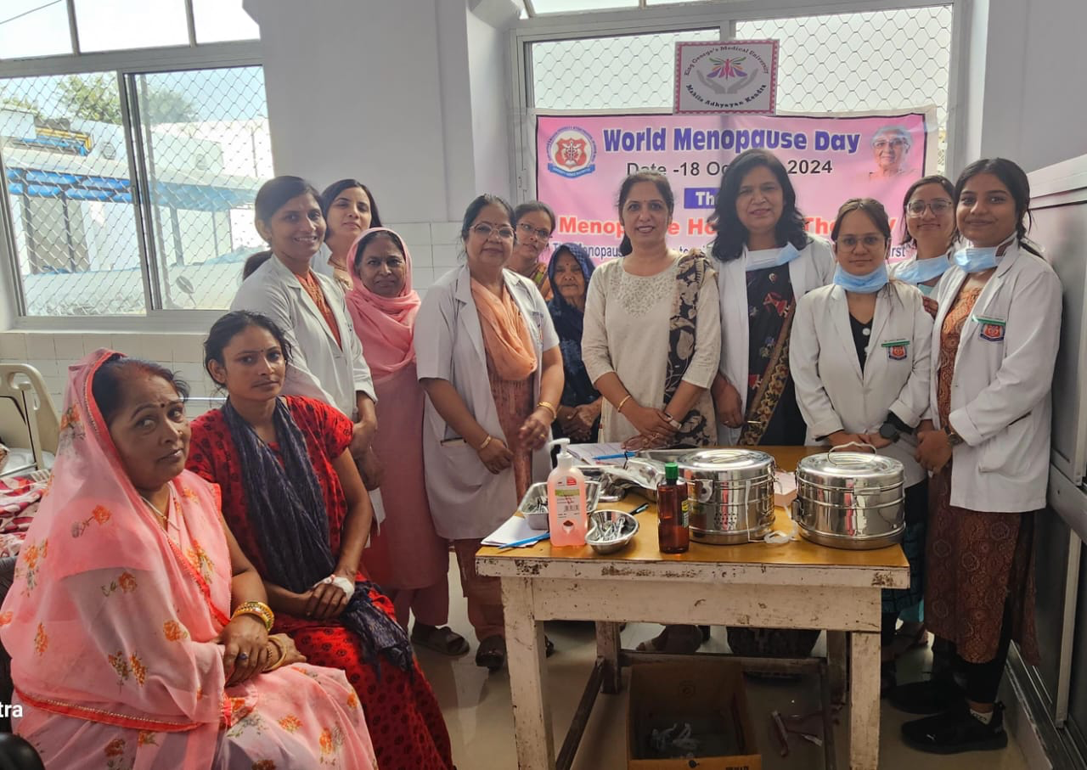
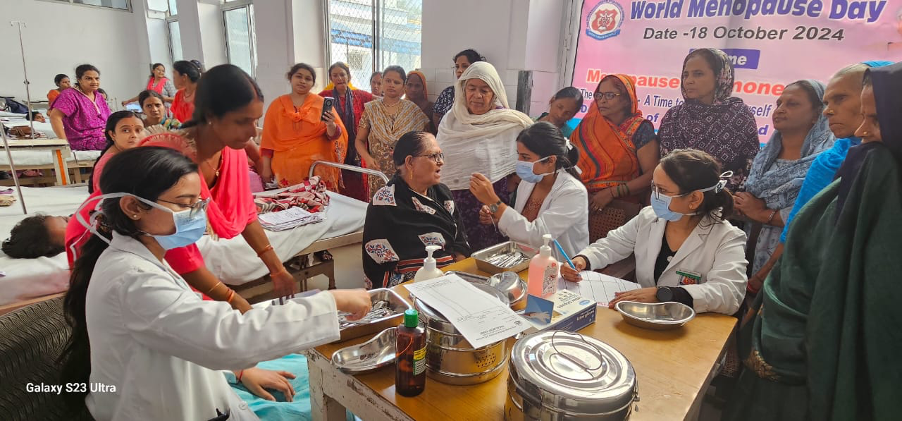
Oral Health Checkup on the occasion of World Menopause Day 18th October 2024

Slide 3

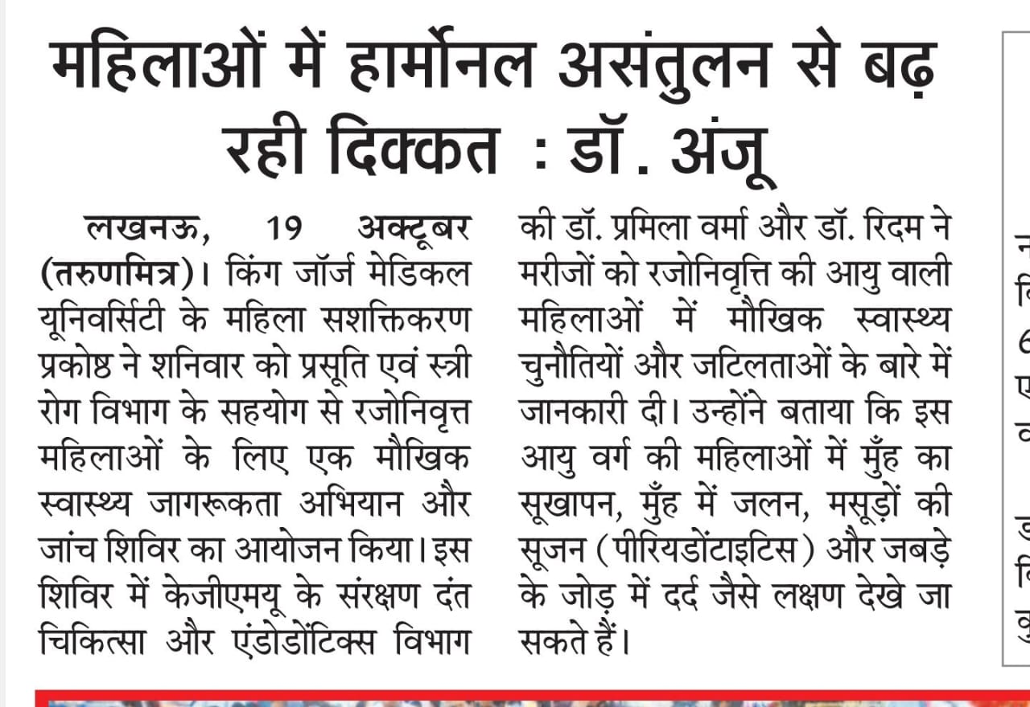
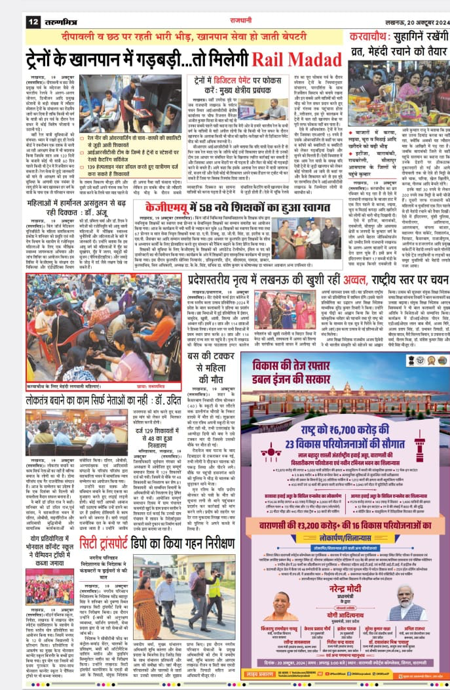
Oral Health Checkup on the occasion of World Menopause Day 18th October 2024

Slide 4
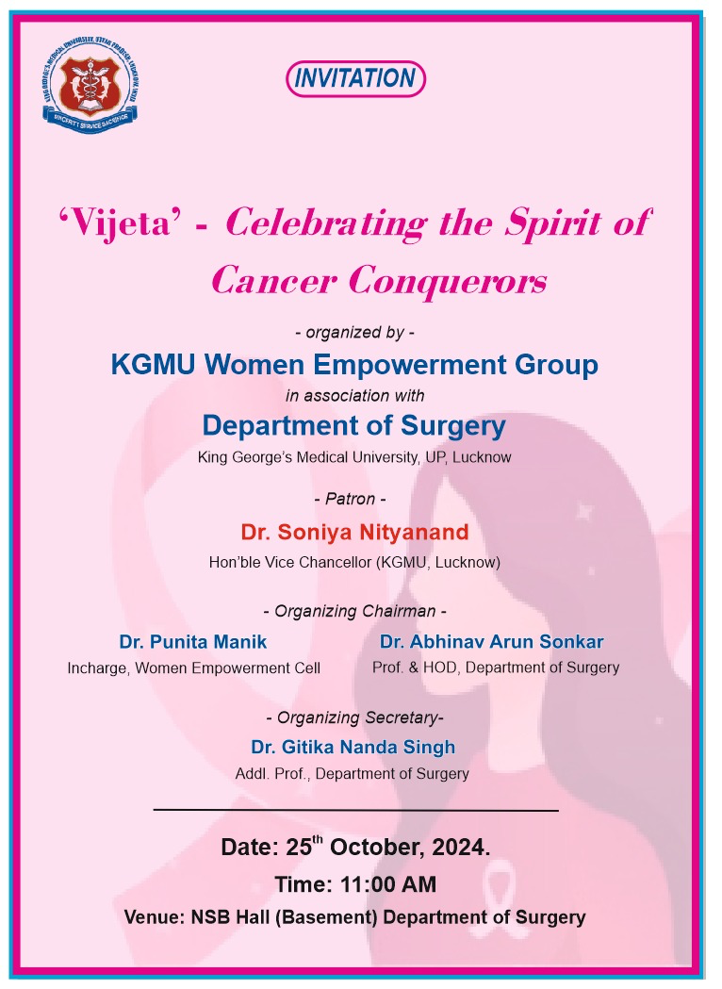
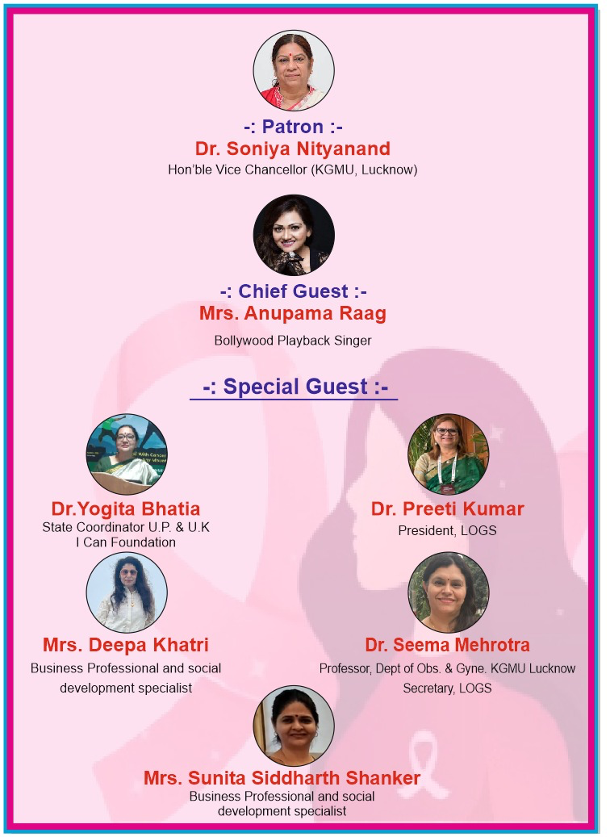
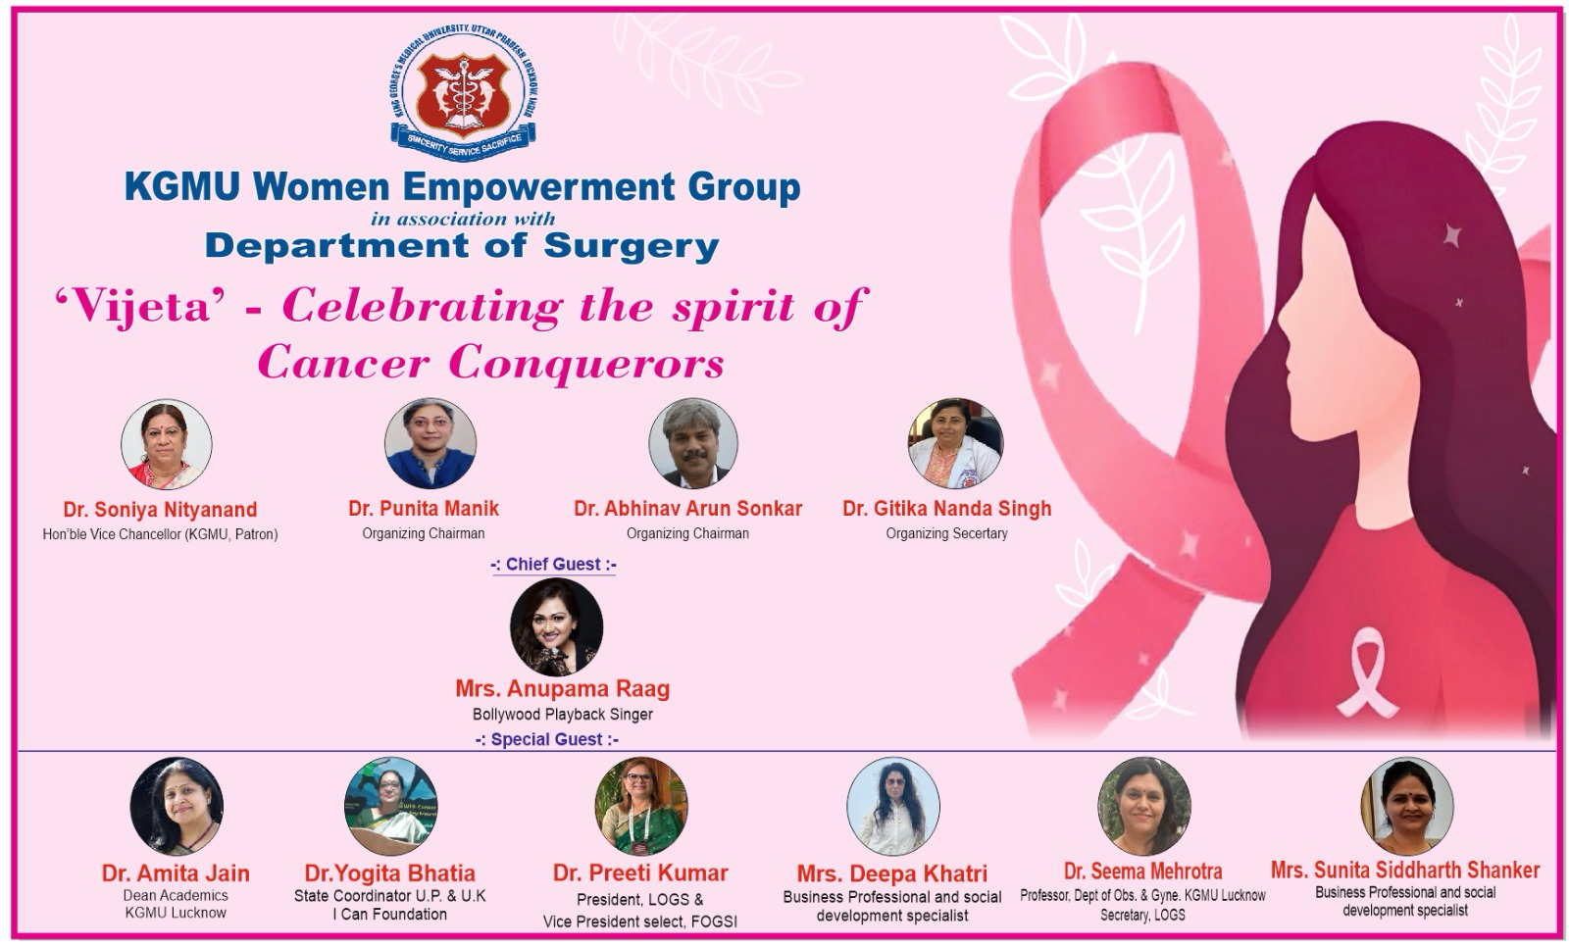
Vijeta –Celebrating the spirit of Cancer Conquerors 25th October 2024

Slide 5
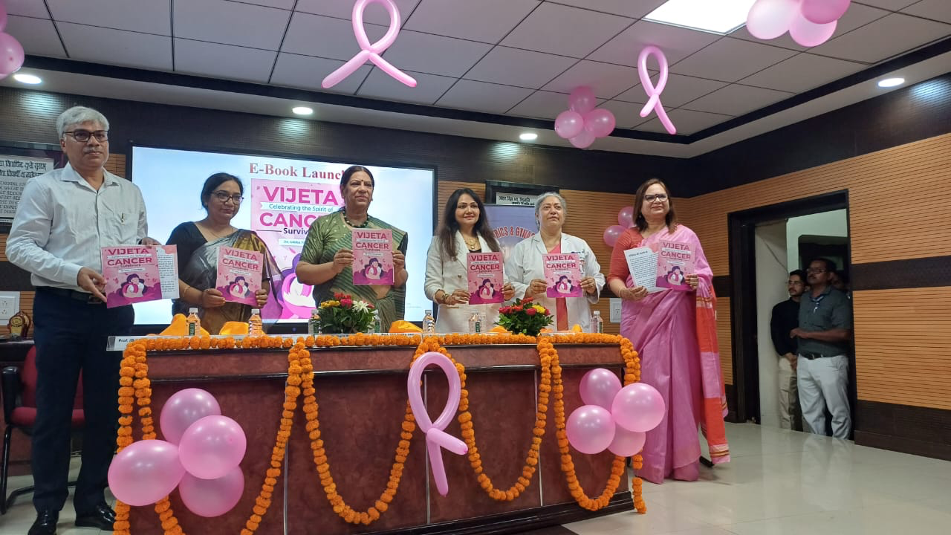
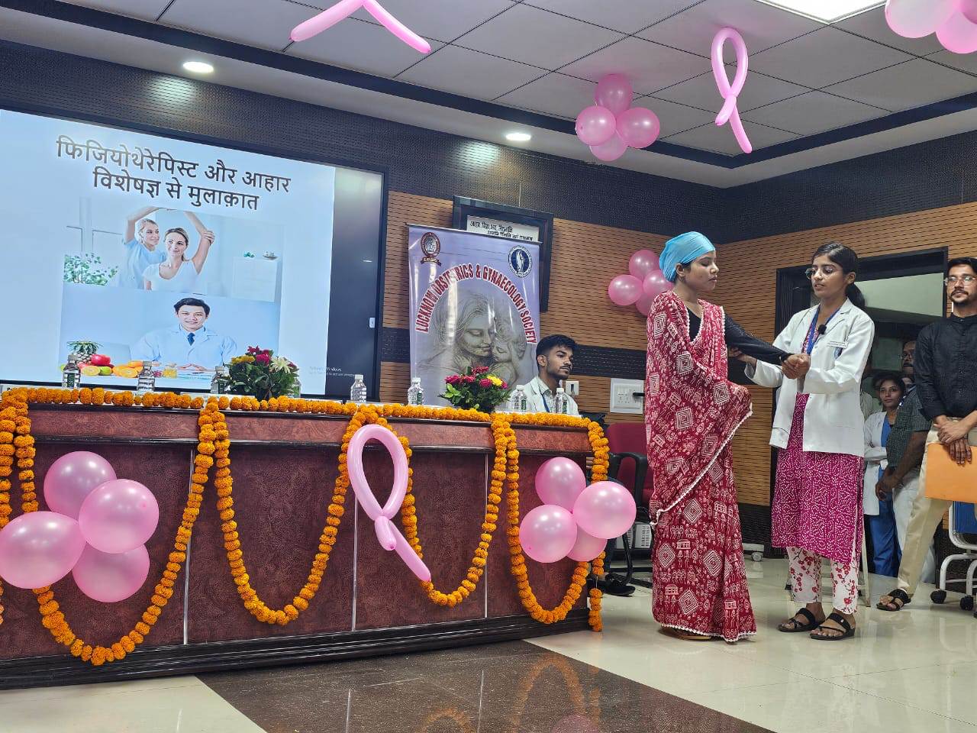
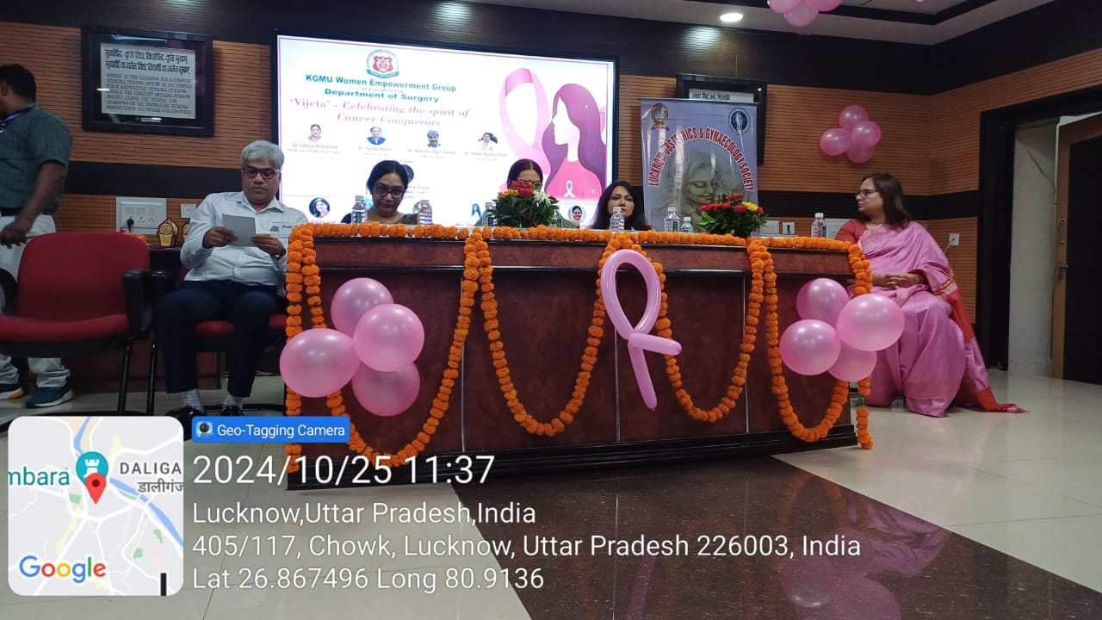
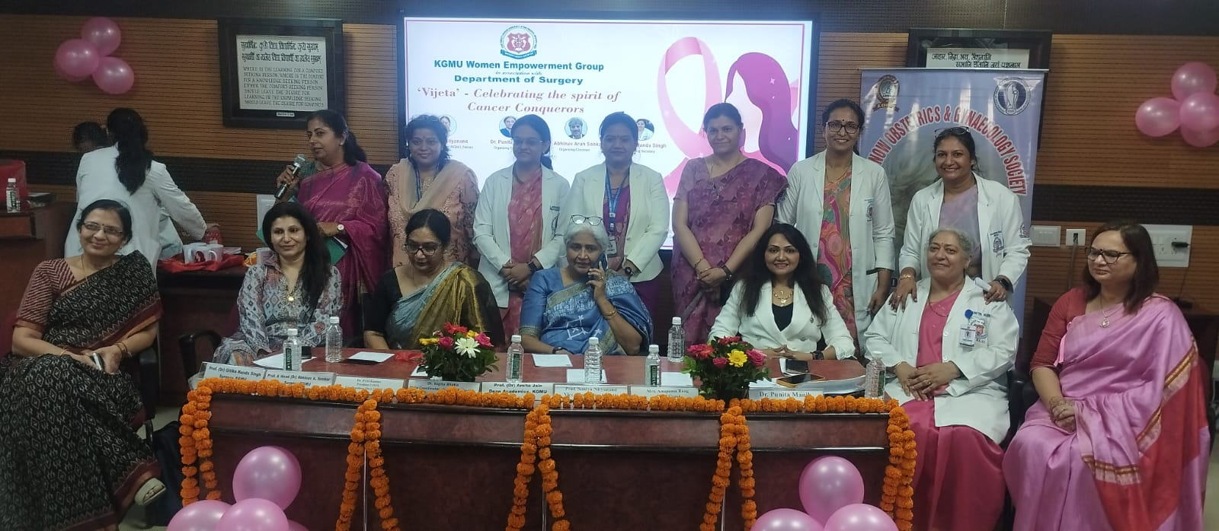
Vijeta –Celebrating the spirit of Cancer Conquerors 25th October 2024

Slide 6
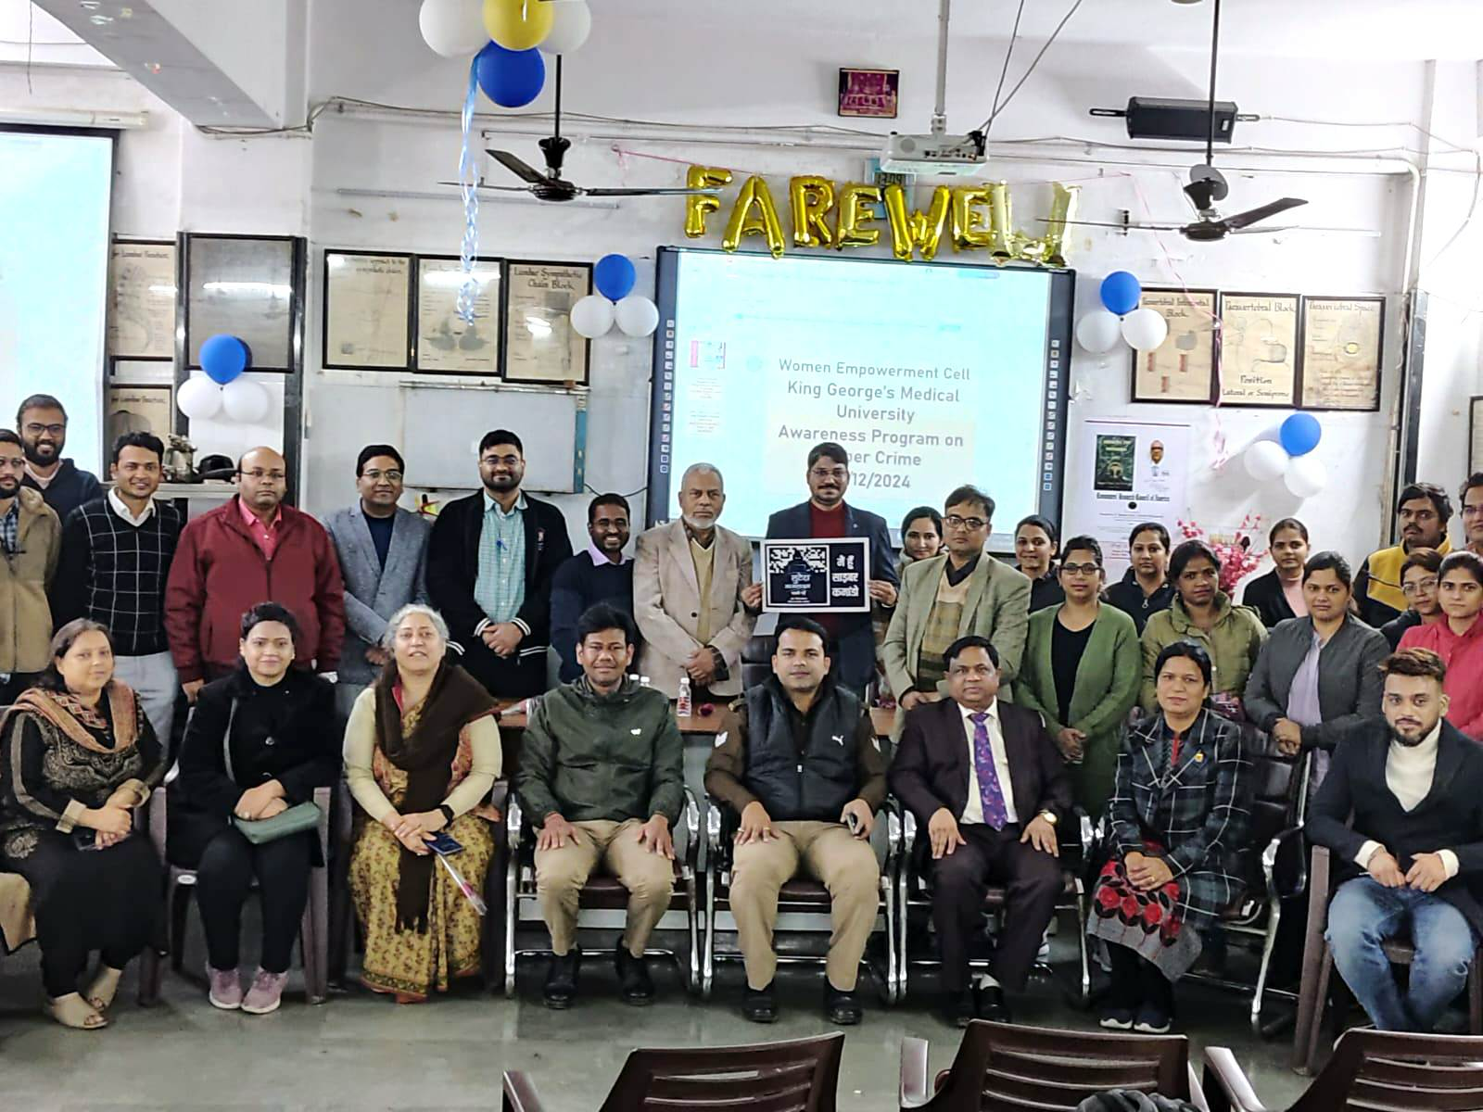
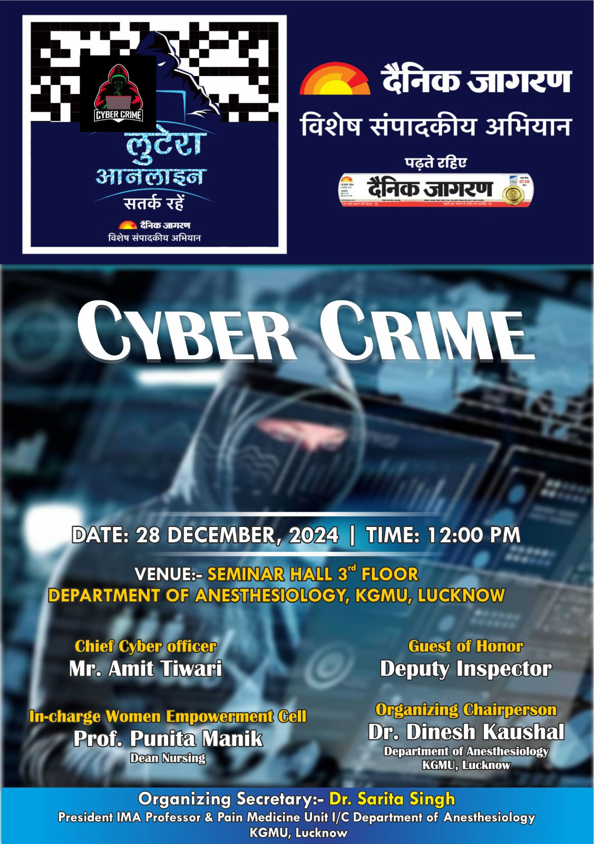
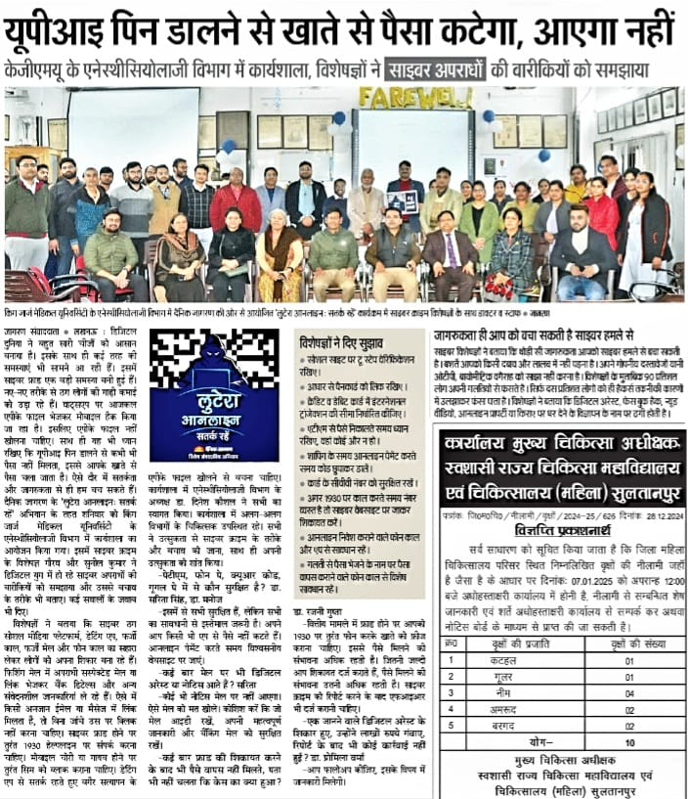
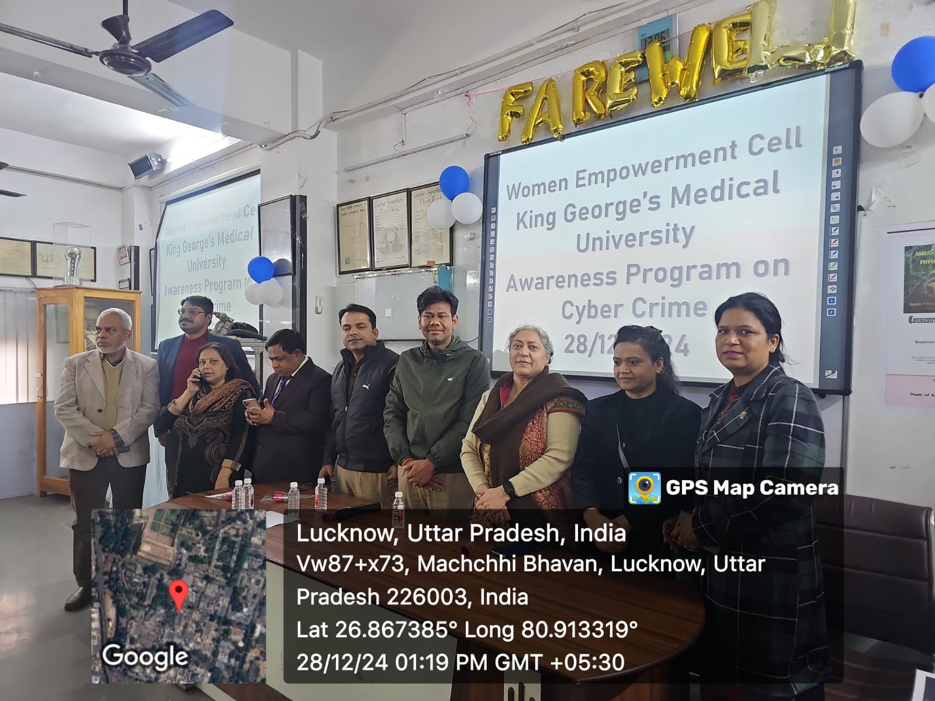
Cyber Crime Awareness Program 28th December 2024

Slide 7
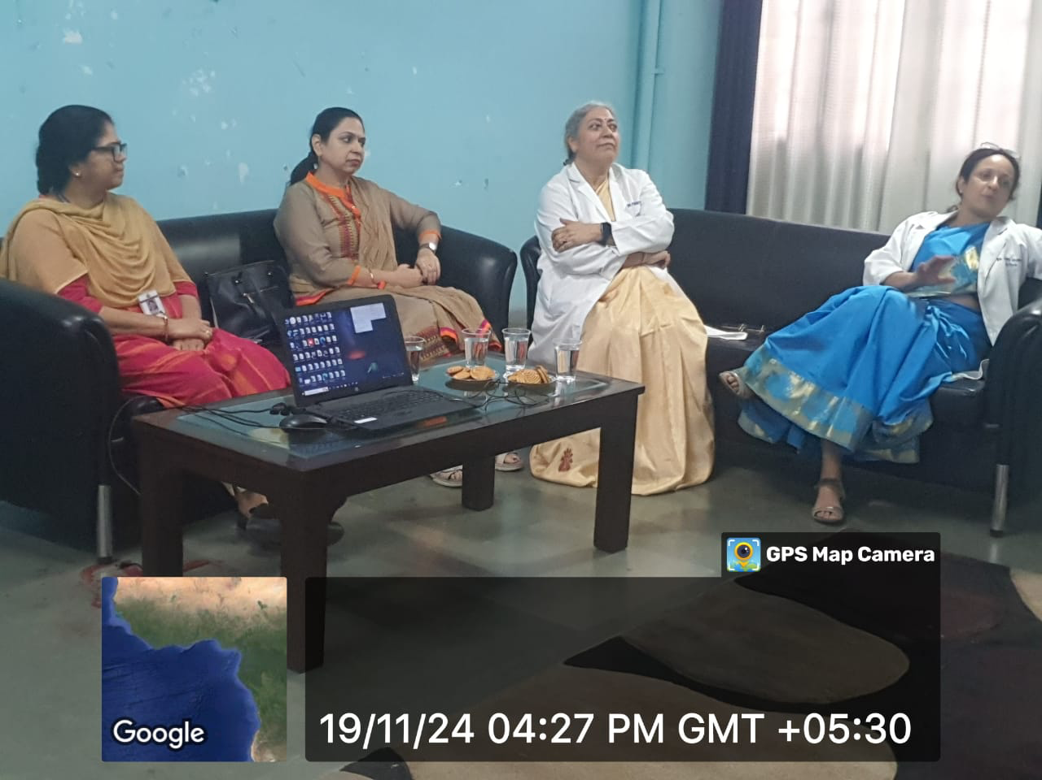
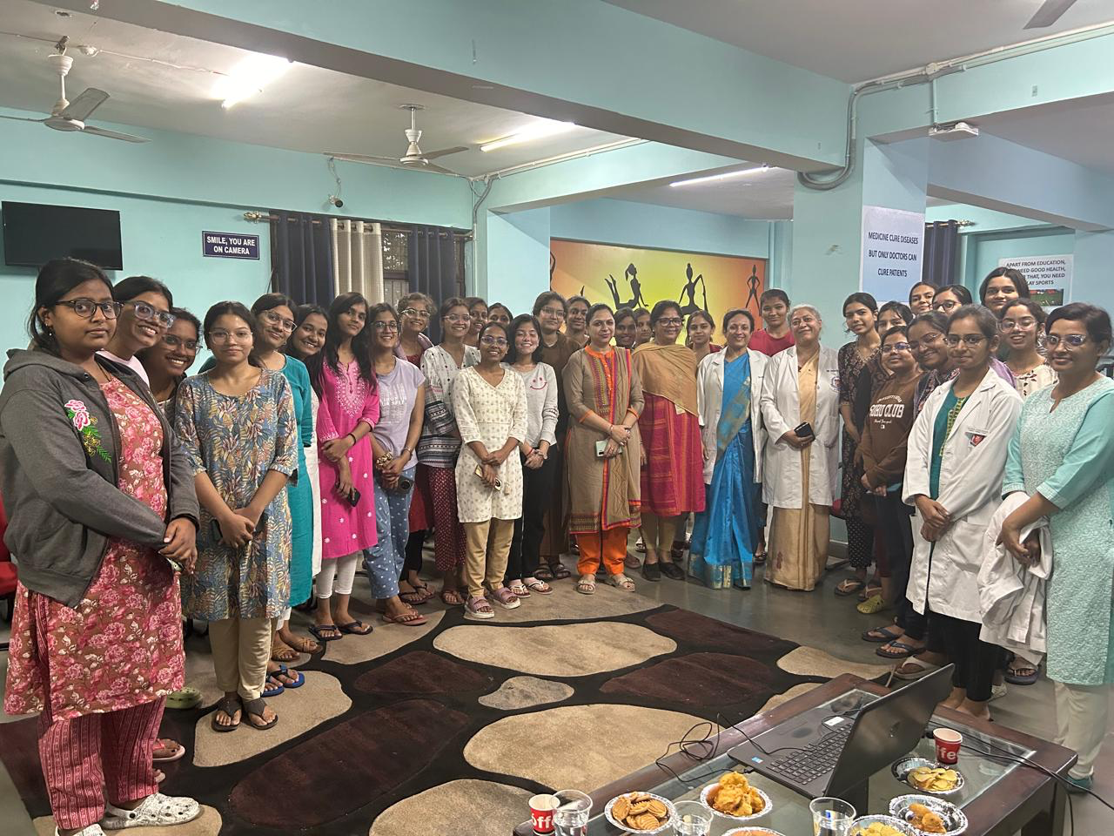
Menstrual And Sexual Health Talk by Dr Amita Pandey for Undergraduate Student(Female)

Slide 8
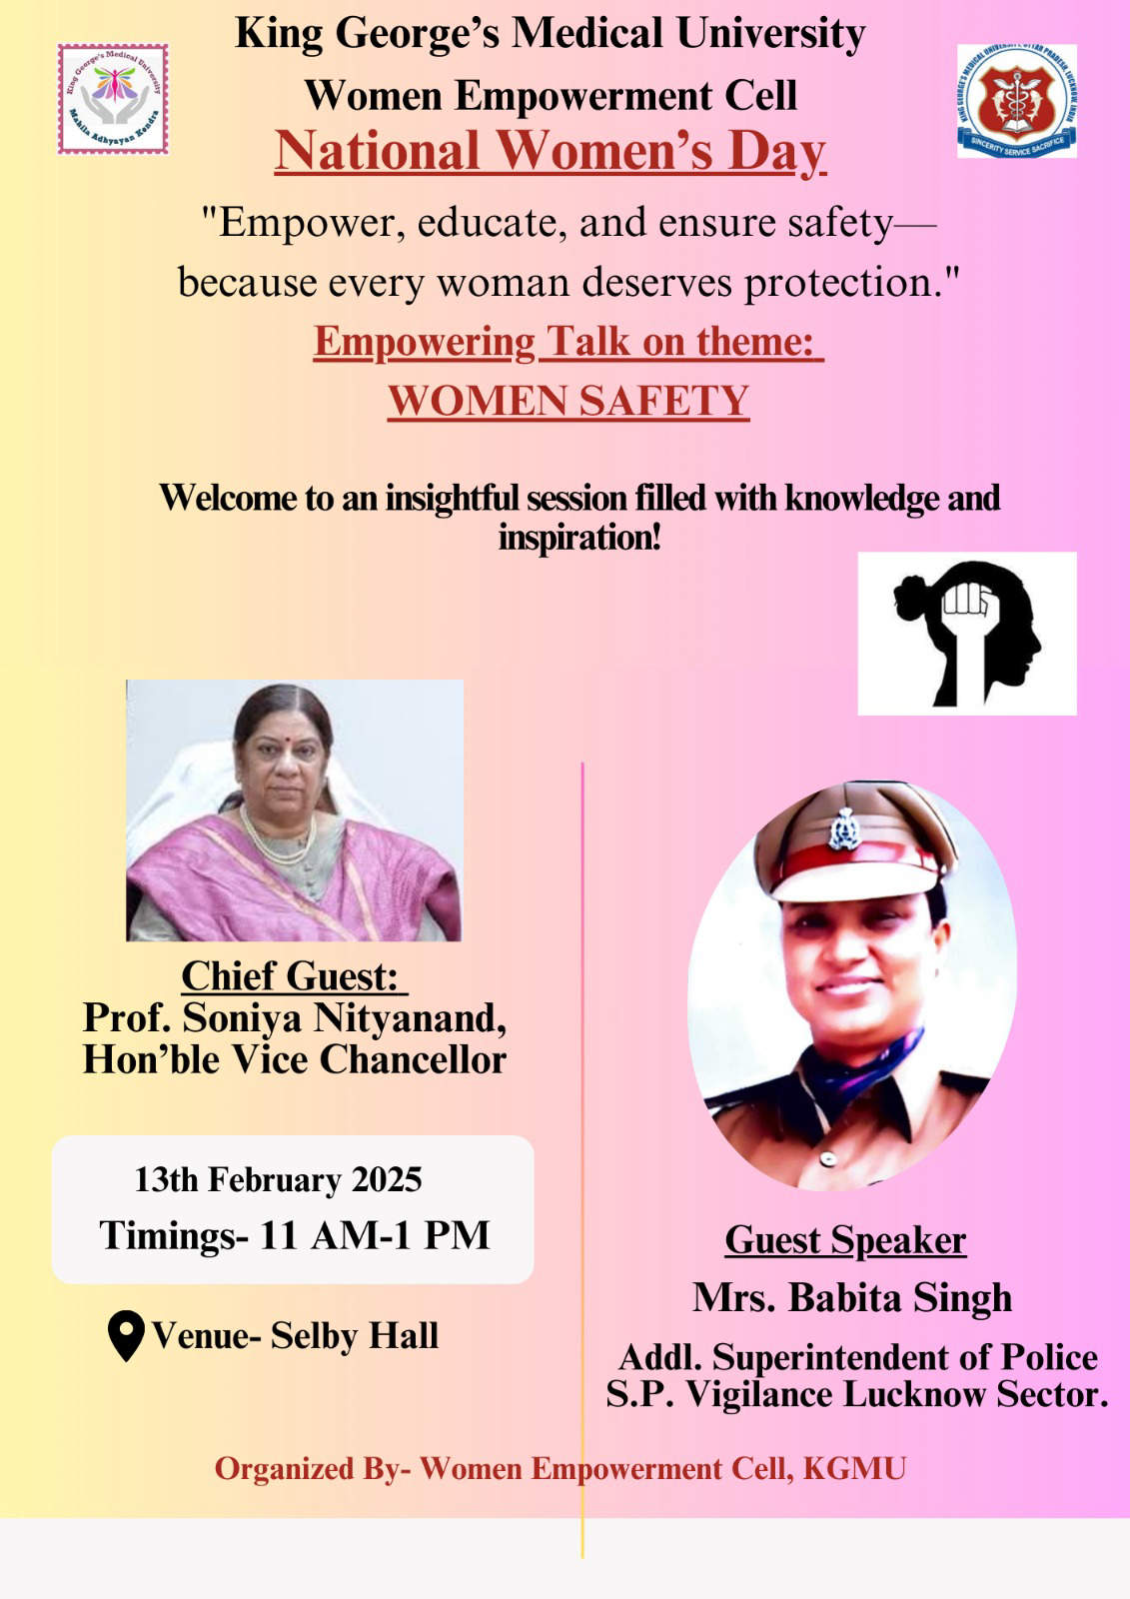
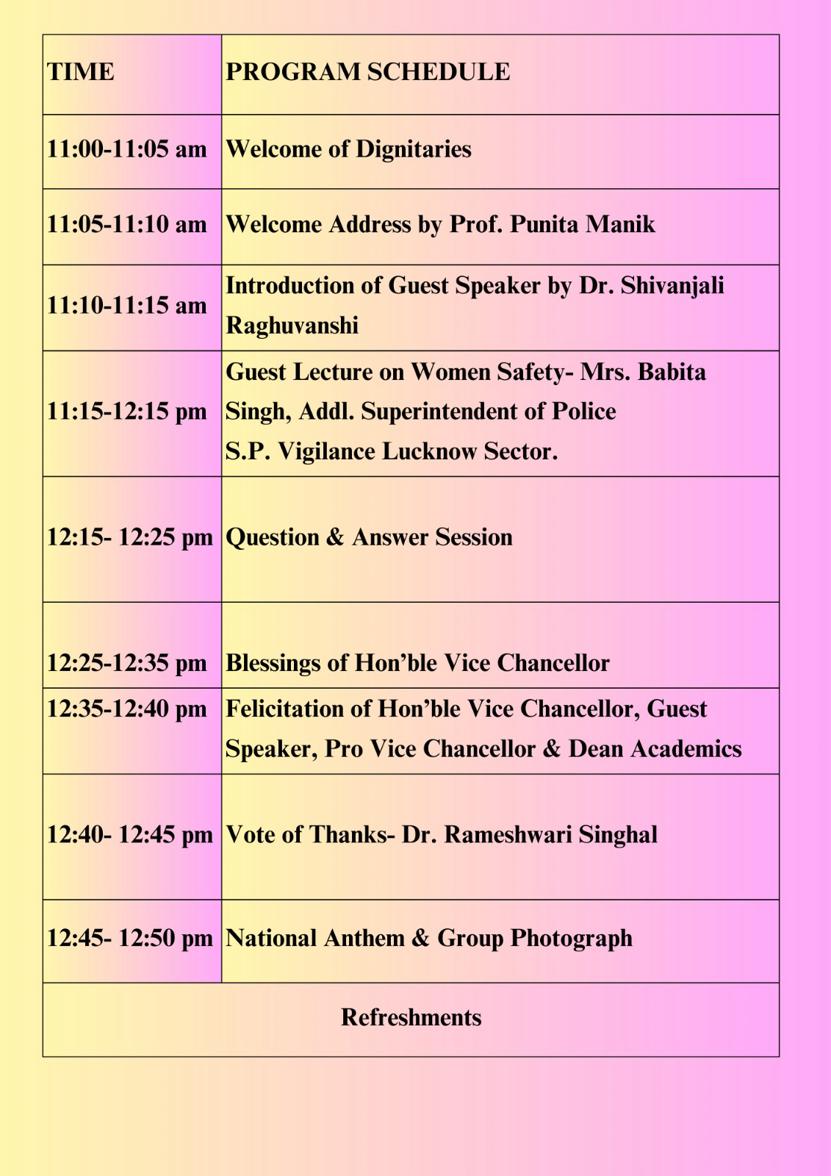
National Women’s Day celebration
13th February 2025

Slide 9
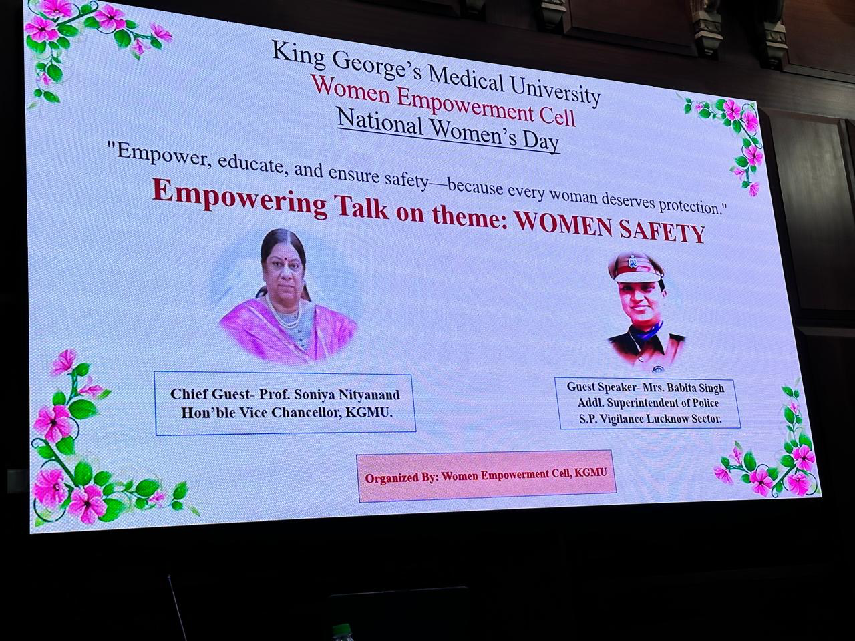
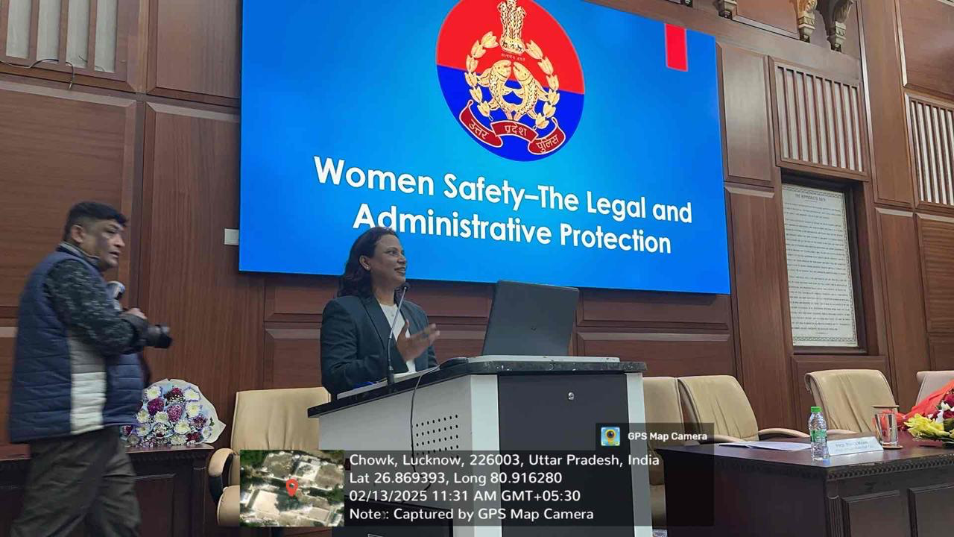
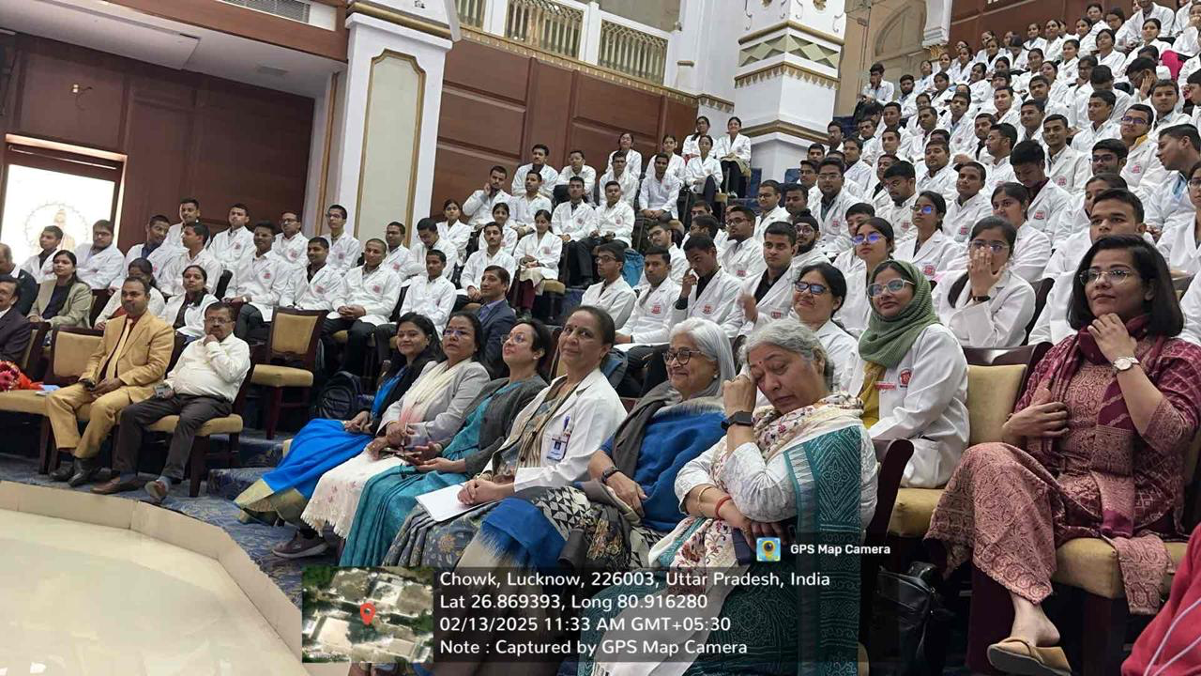
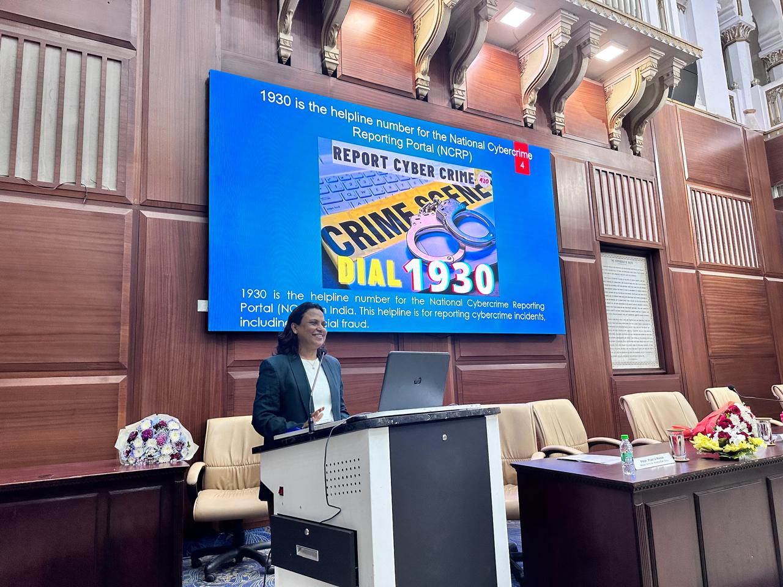
National Women’s Day Celebration
13th February 2025

Slide 10
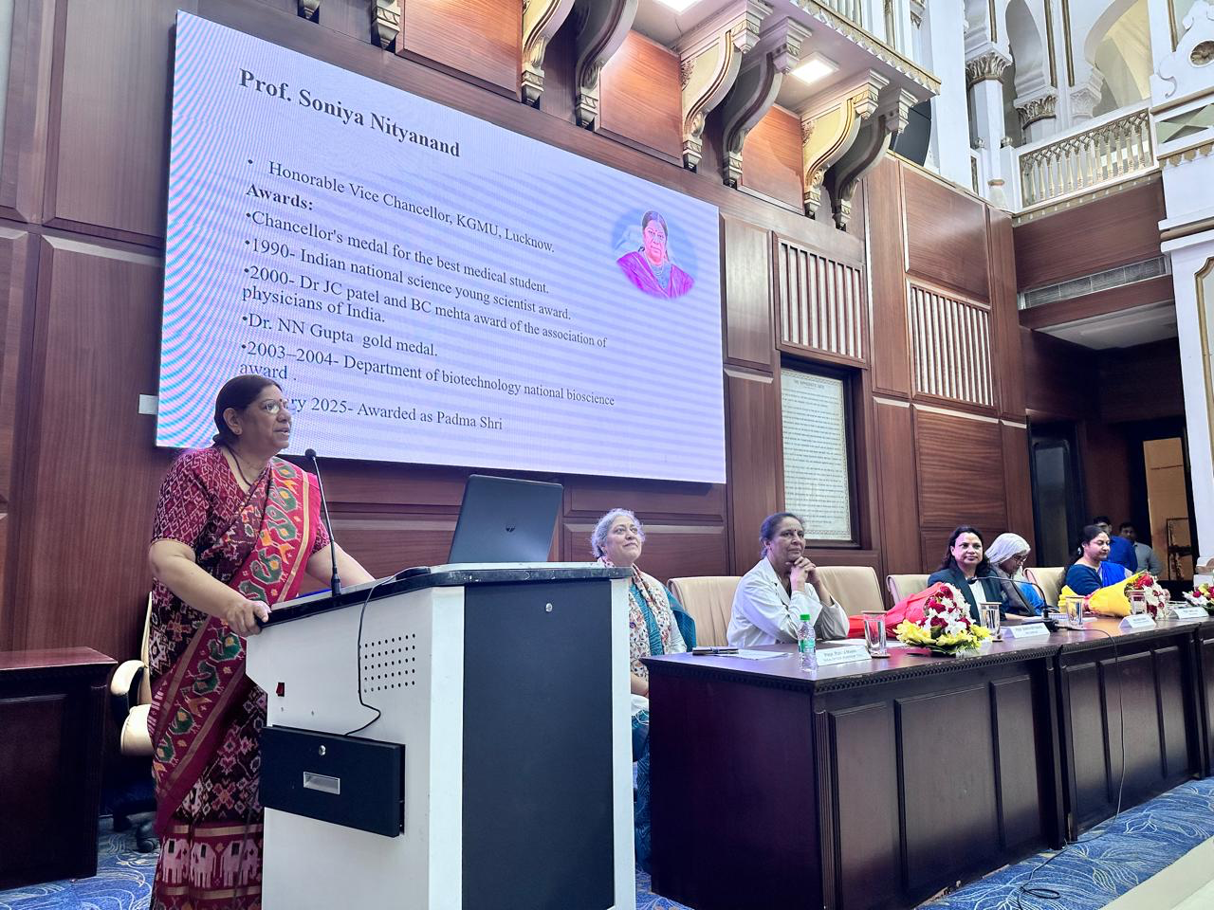
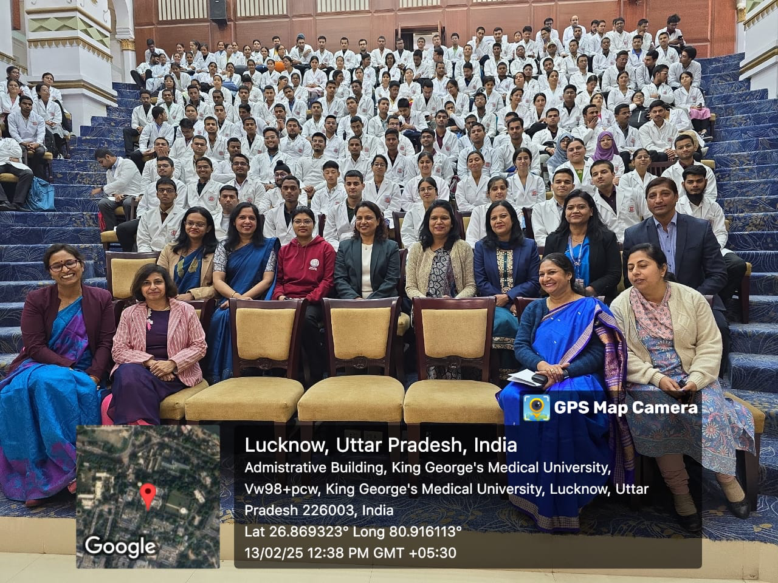
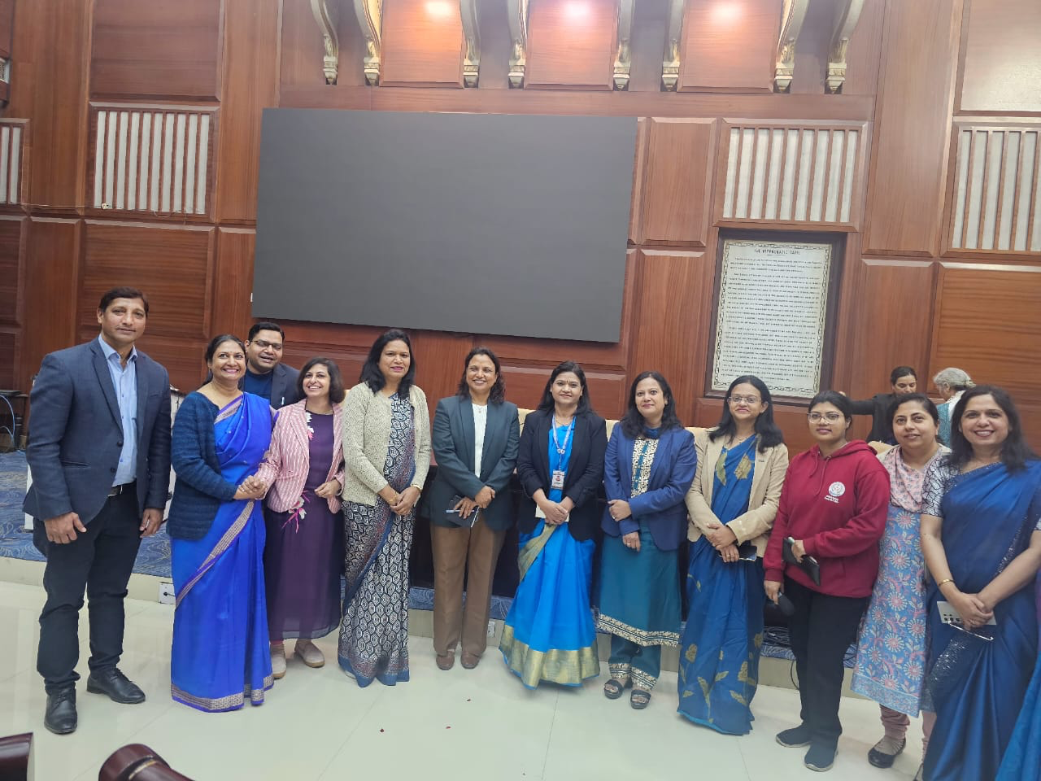
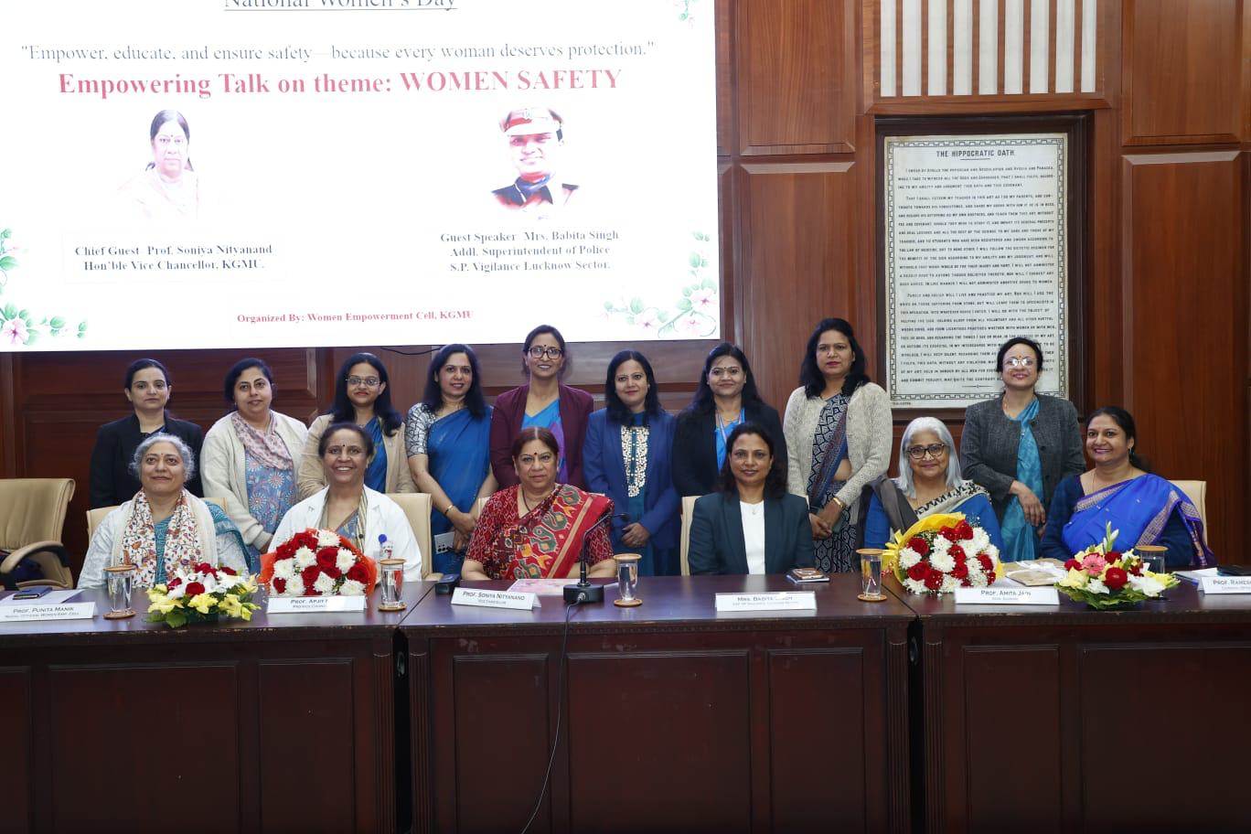
National Women’s Day Celebration
13th February 2025

Slide 11
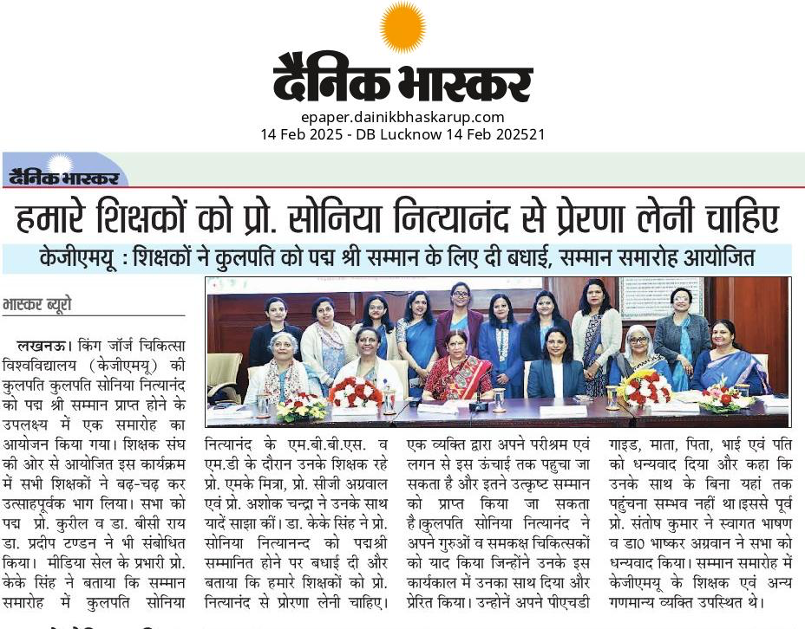
National Women’s Day Celebration
13th February 2025

Slide 12
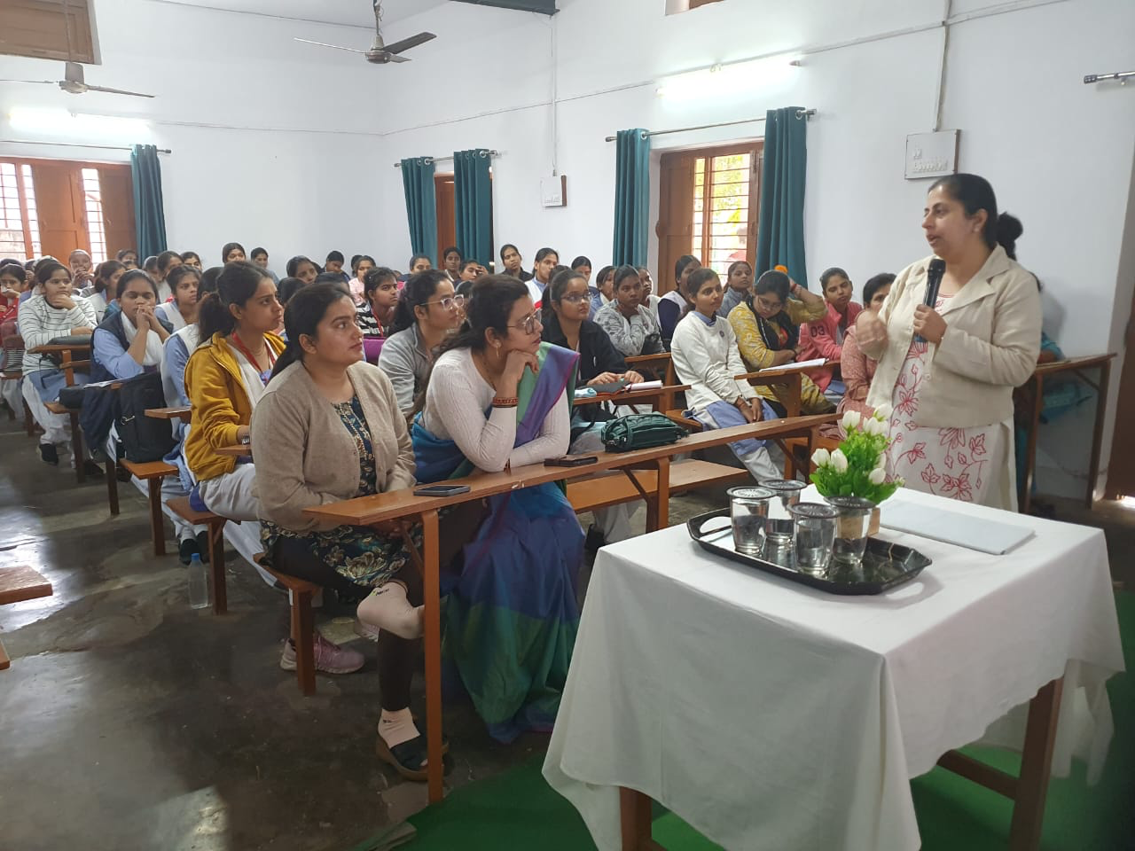
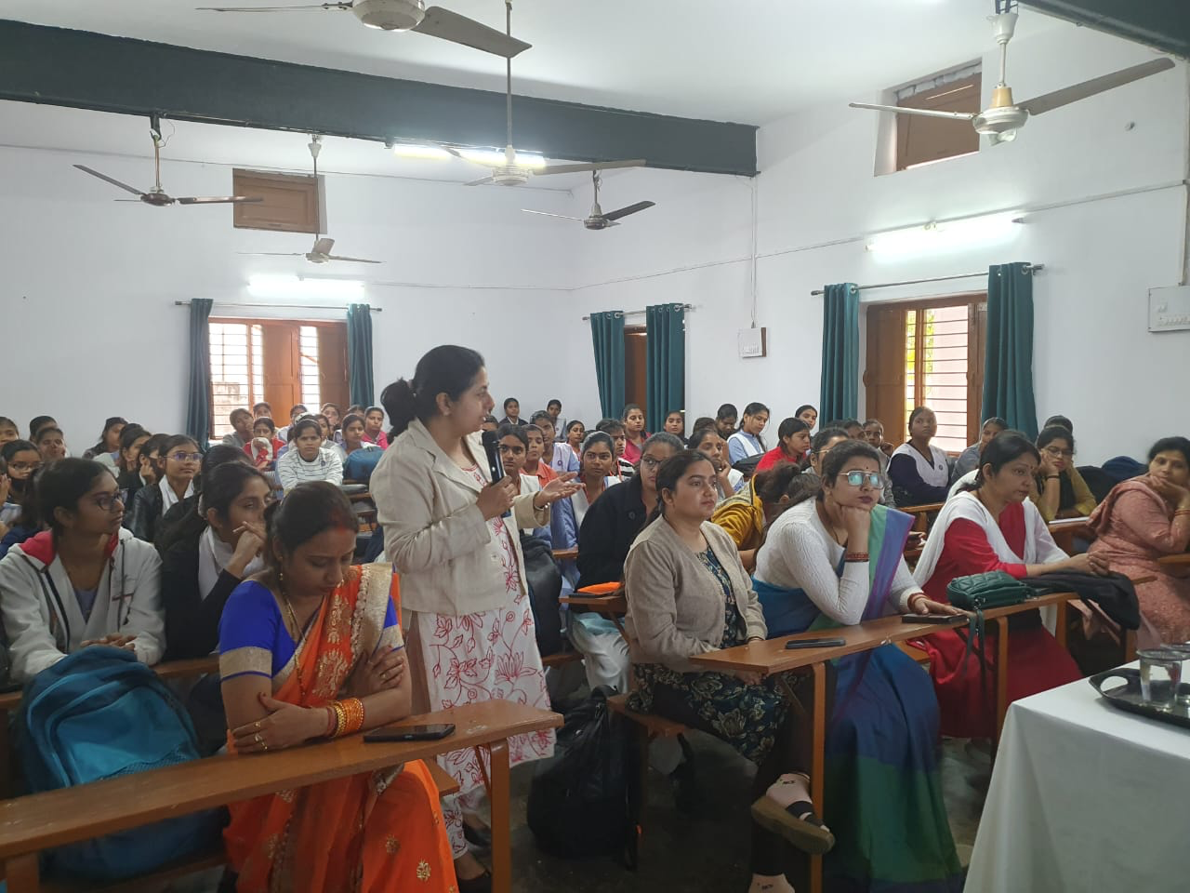
Good Interactive session on the awareness of Breast and Cervical Cancer by Dr Gitika Nanda to 77 students of A P Sen Memorial girls PG College, Charbagh Lucknow

Slide 13
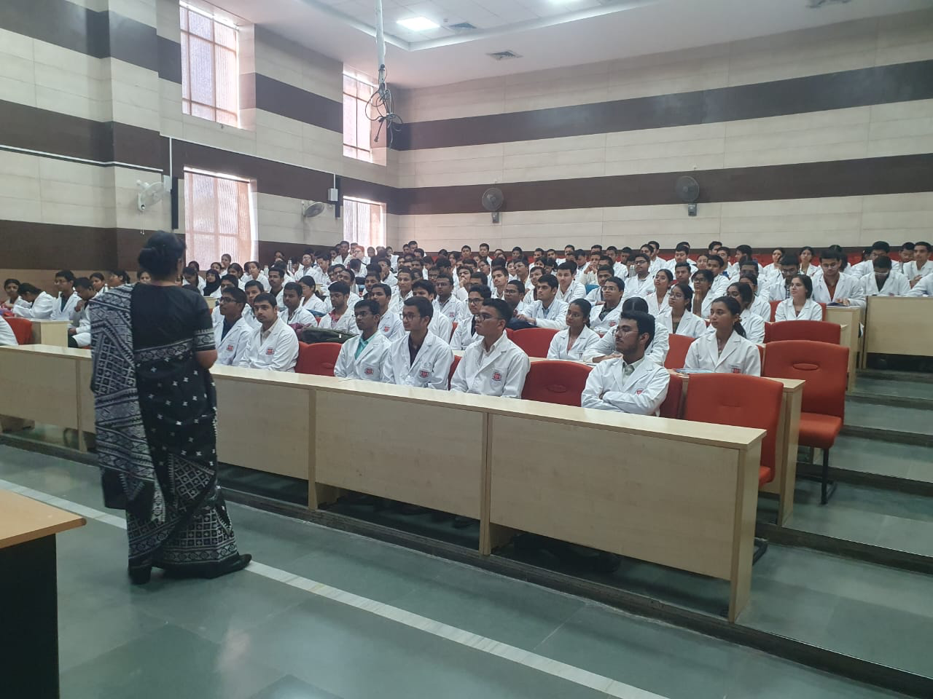
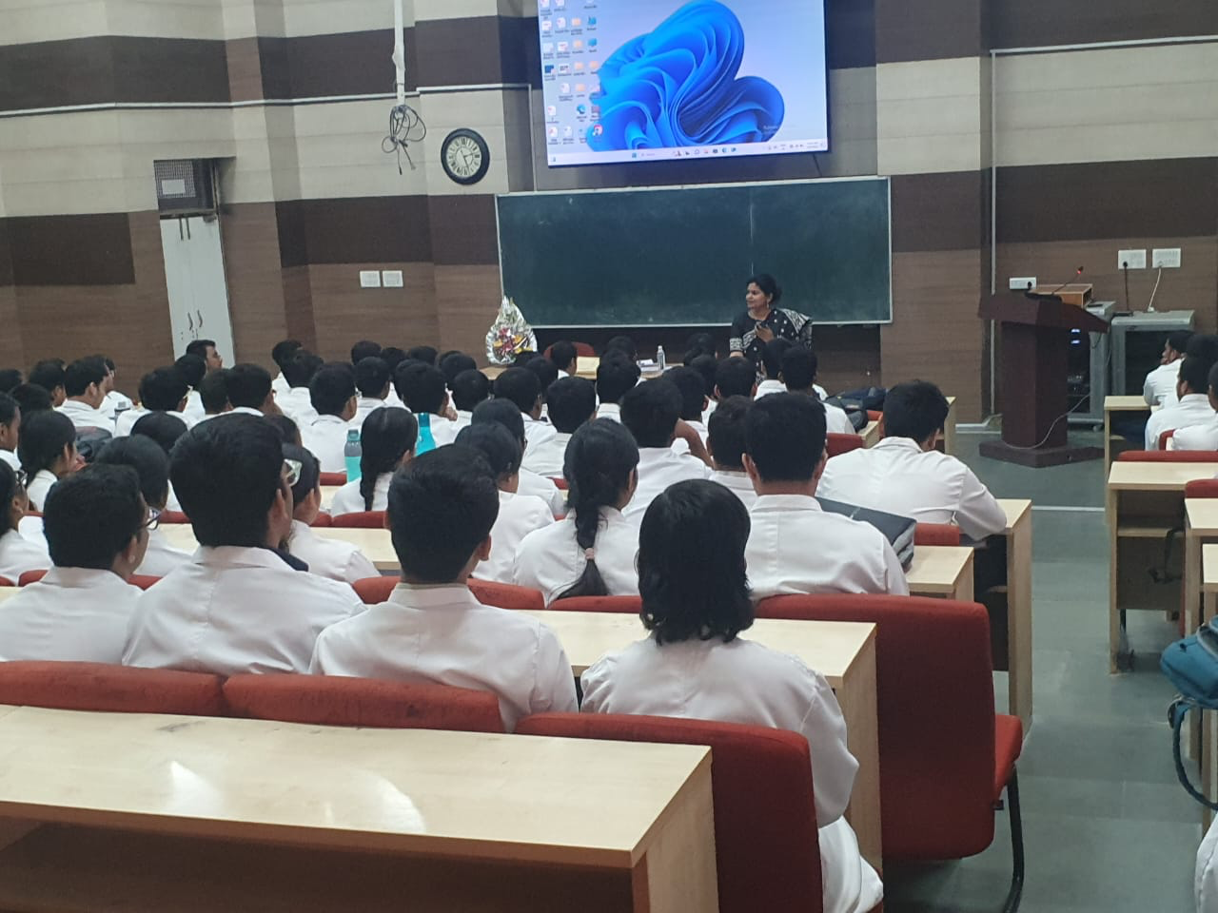
“Social Dynamics and Safety” by Association for Advocacy and Legal Initiative (AALI) 6th of March 2025

Slide 14
Speech and Drama Competition on
4th March2025
https://drive.google.com/file/d/1_kqL_mFrdVJykkh2SgNv6c-B1_PvUkUJ/view?usp=drivesdk

Slide 15
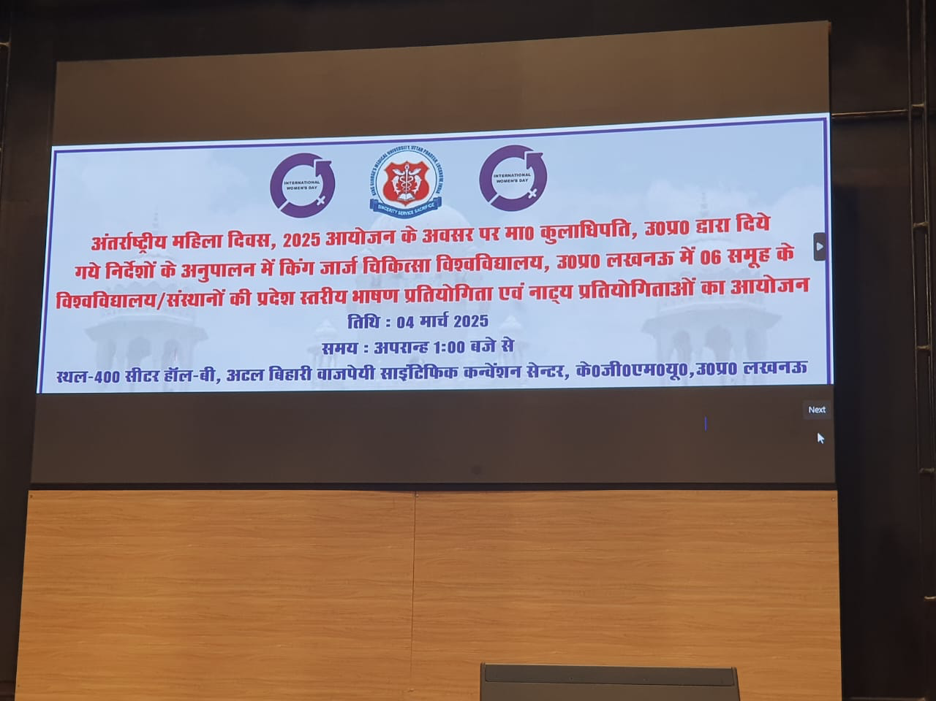
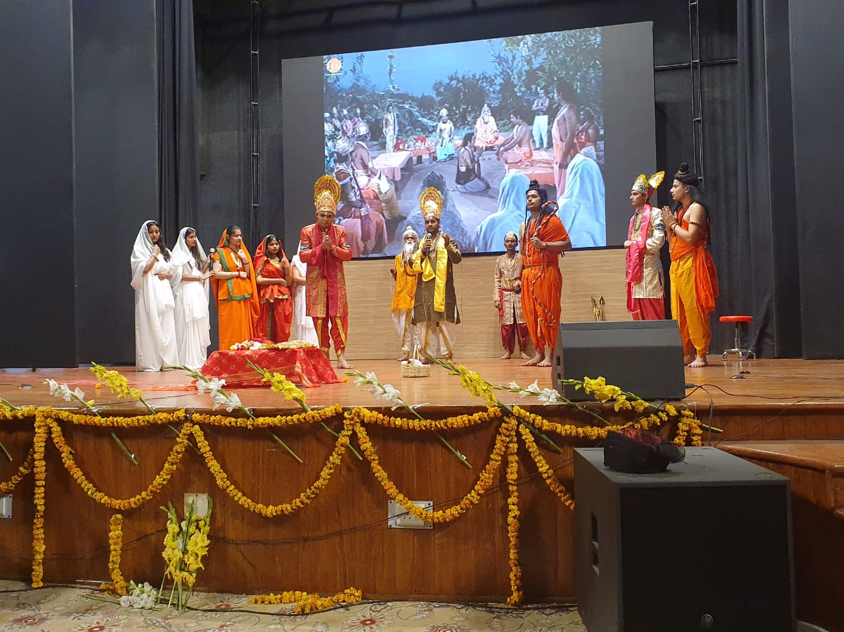
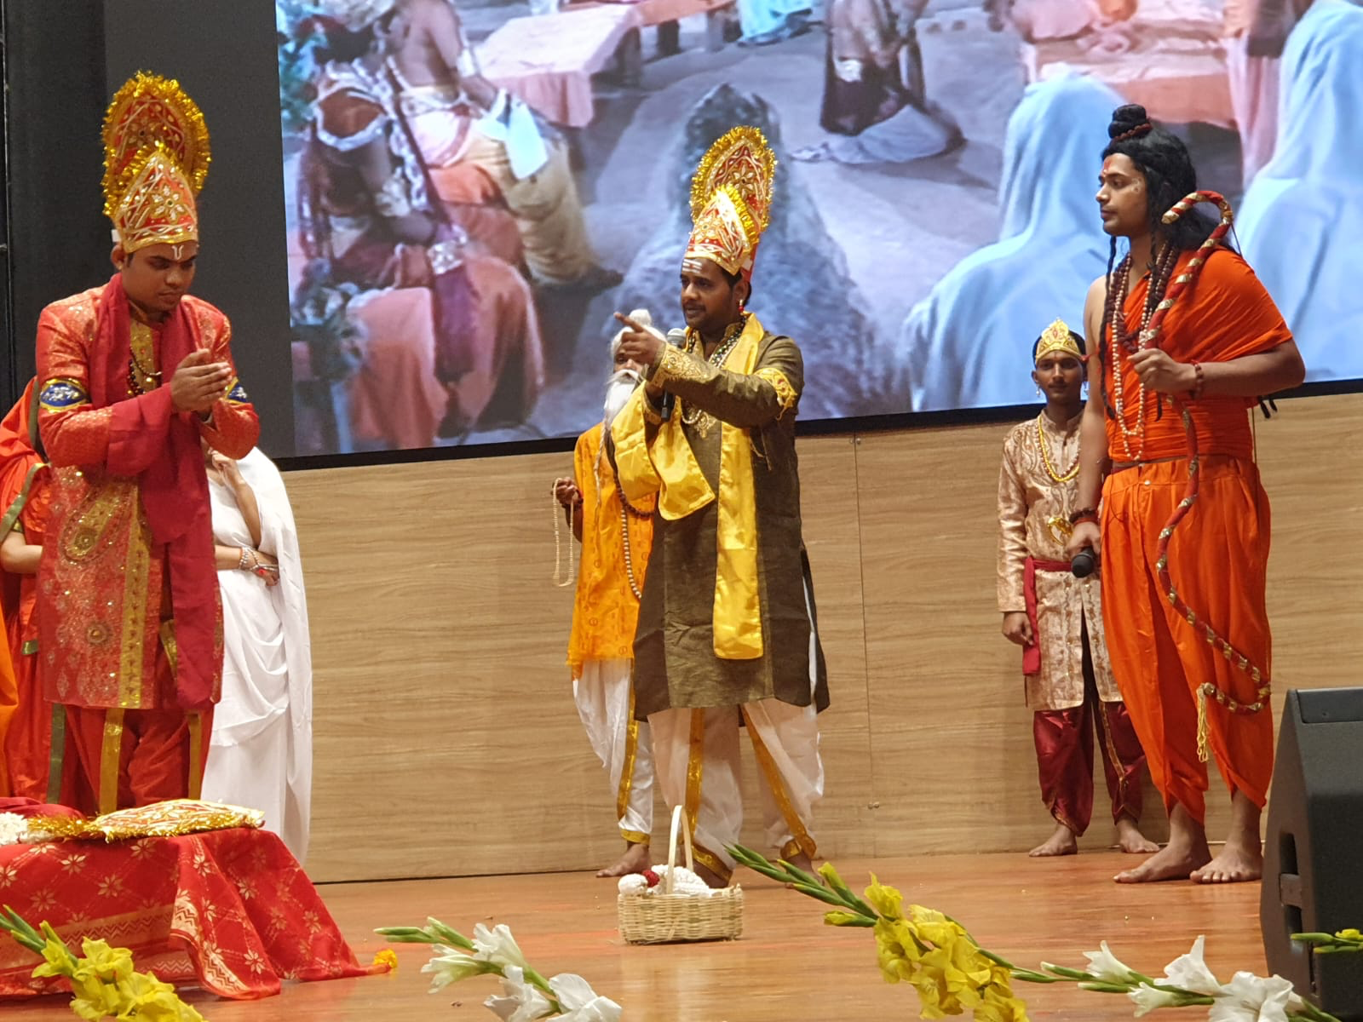
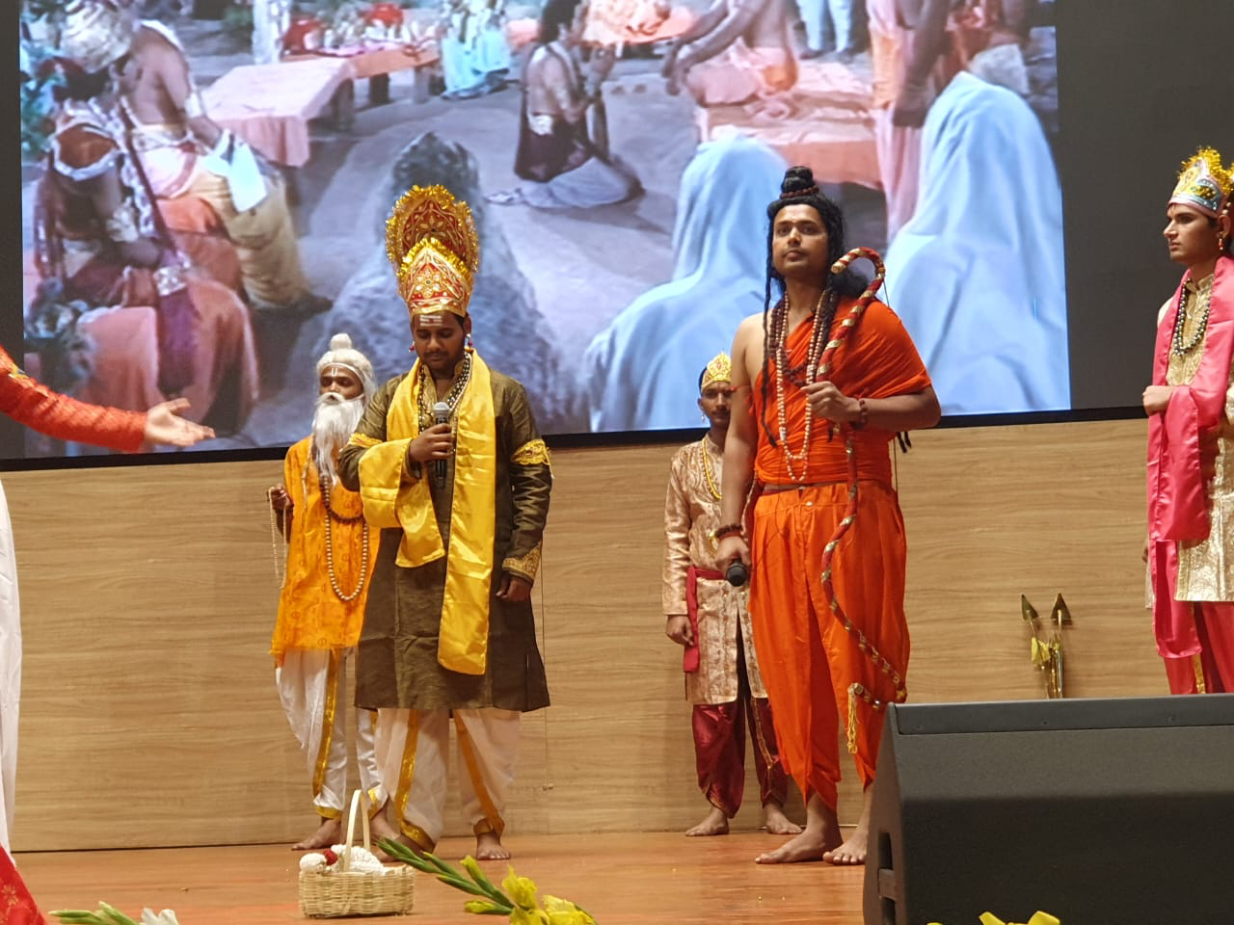
Speech and Drama Competition on 4th March

Slide 16
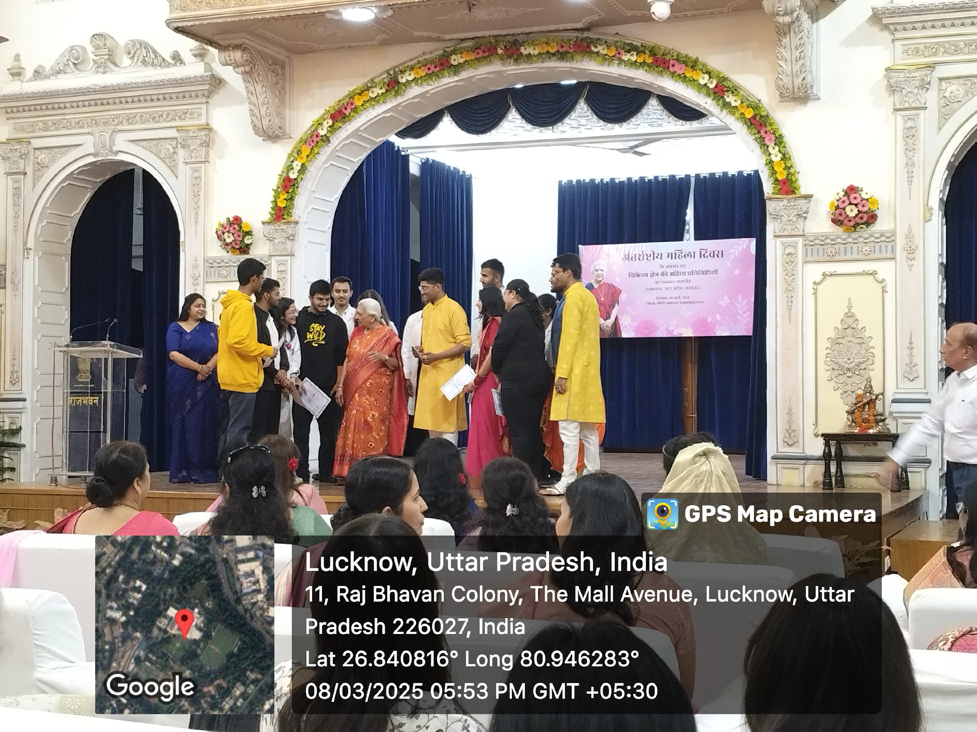
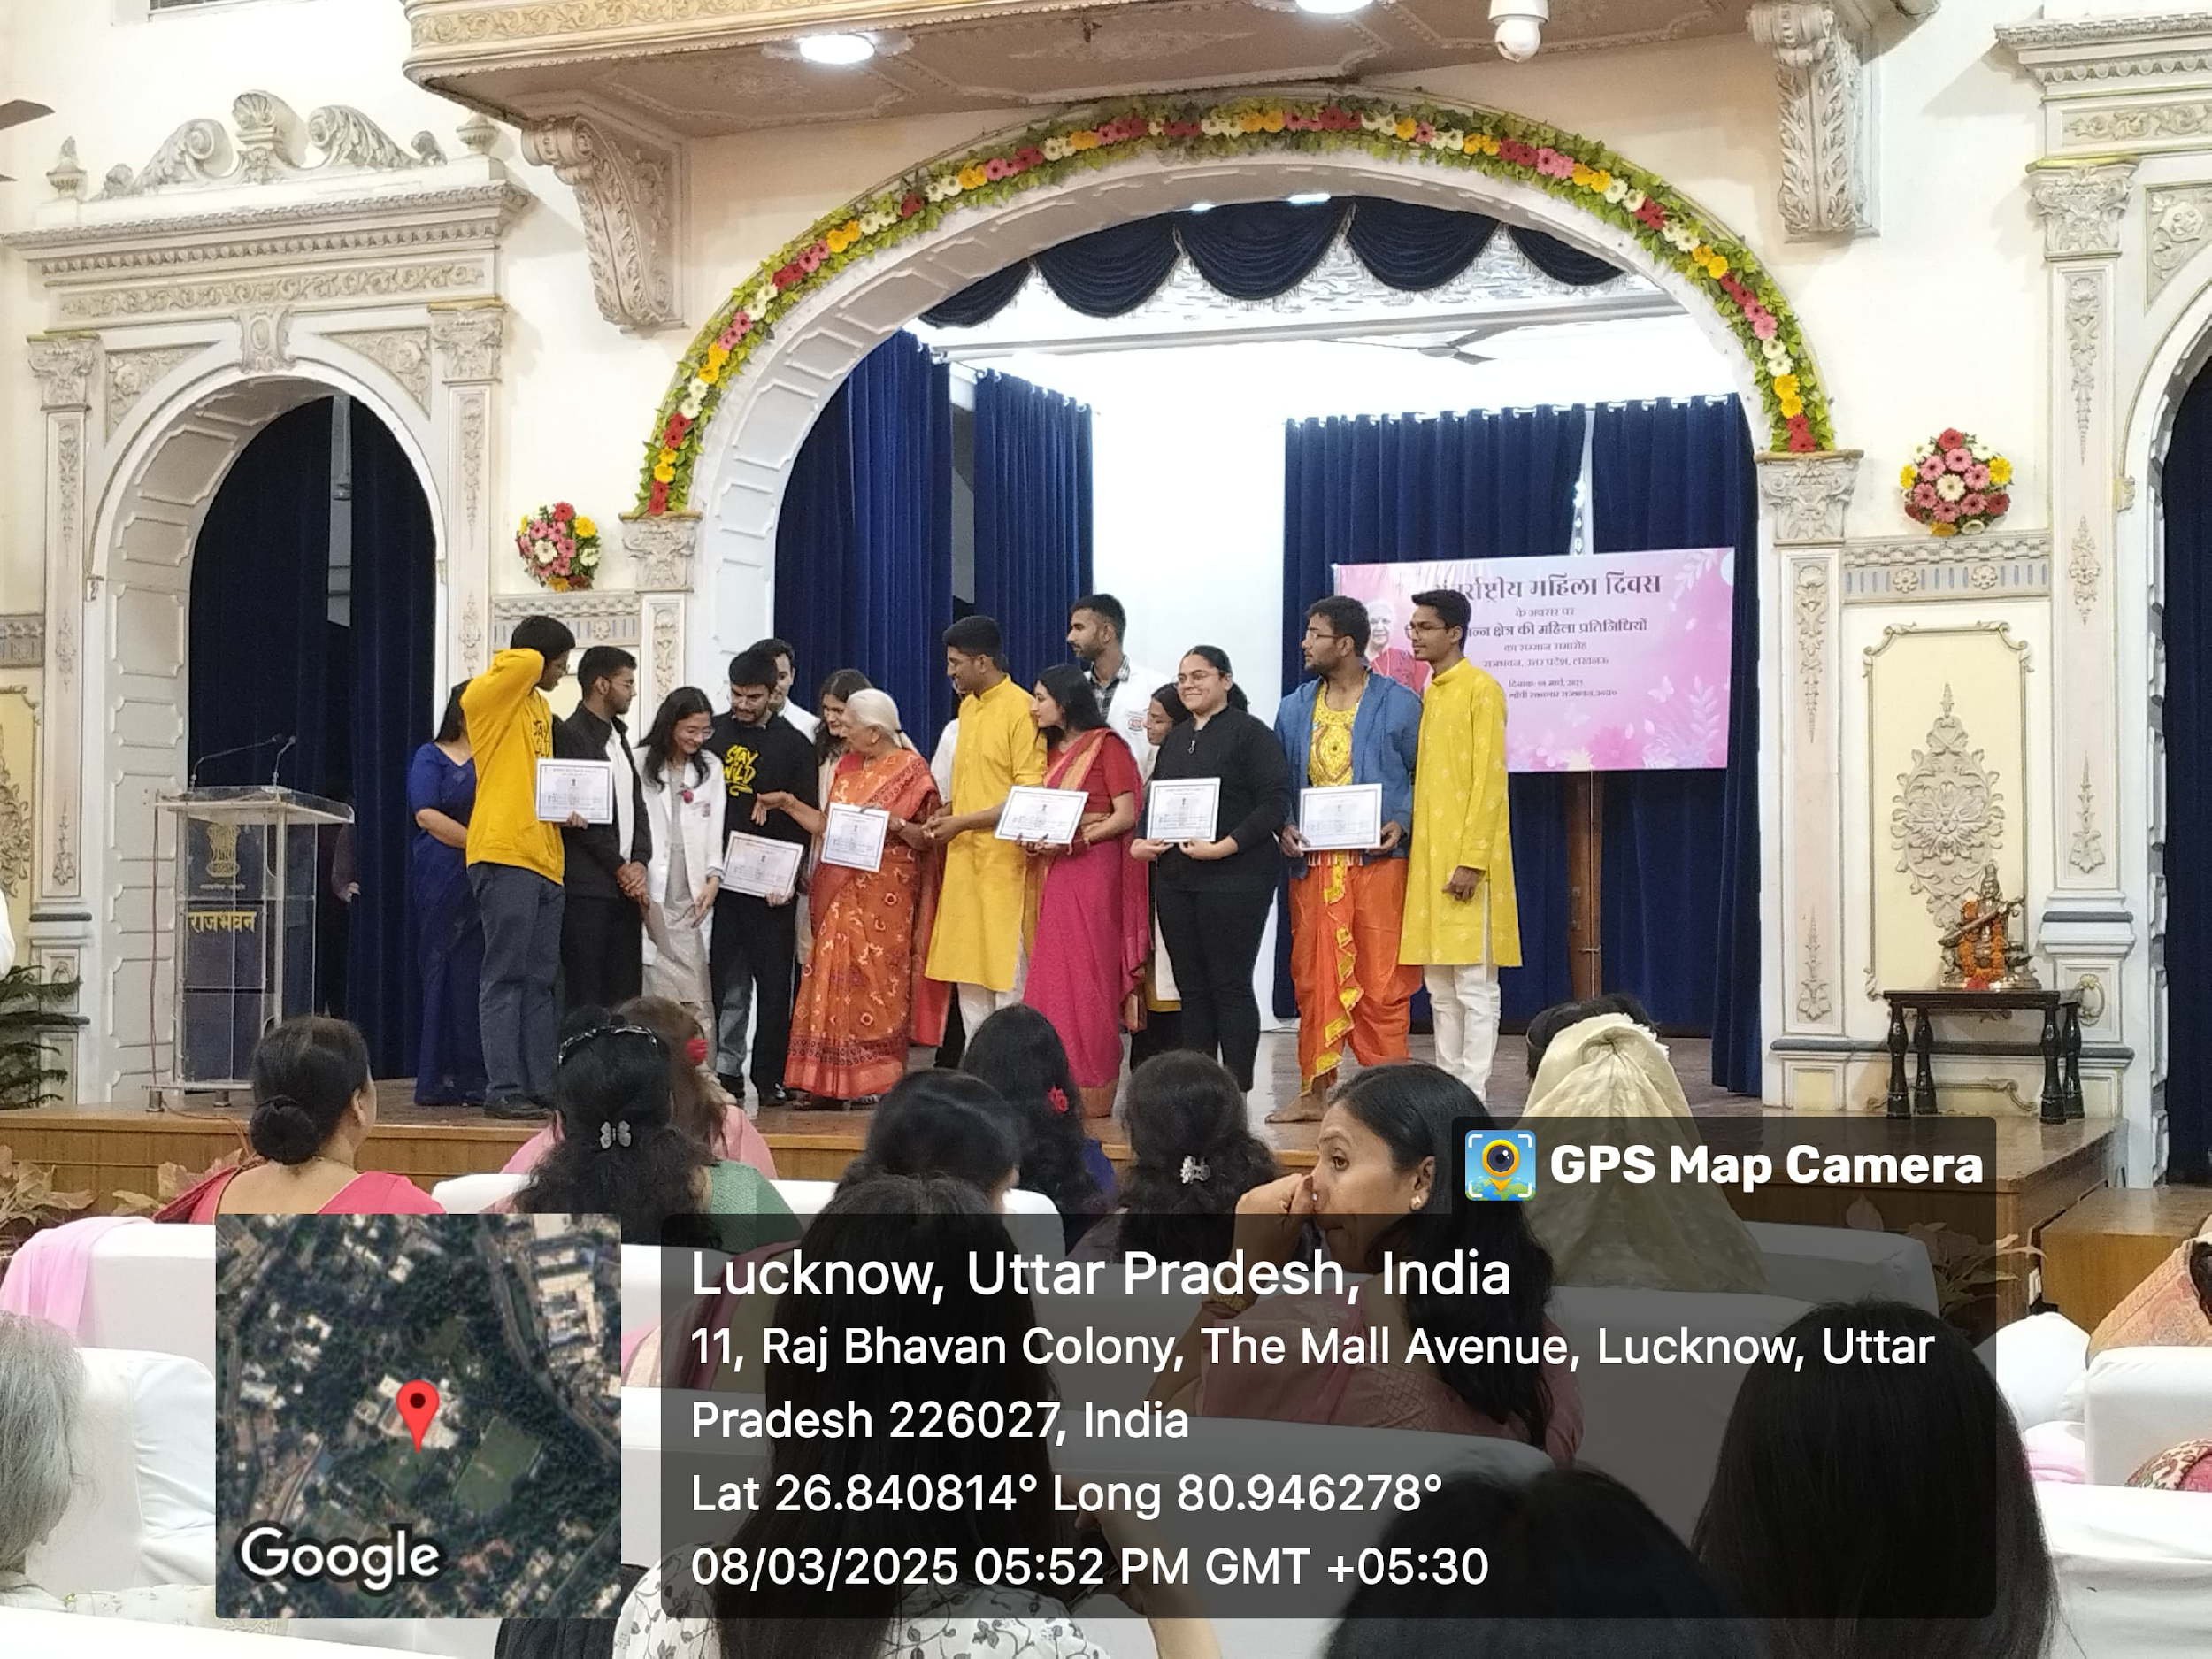
Speech and Drama Competition at Governor House between all the university of UP on 8th March 2025

Slide 17
International women’s day Panel Discussion by KGMU Female Faculty on Women Health 8th March2025
https://youtu.be/y2Zd1Z1vXBM?si=GxSe794ms0l12RL5
https://youtu.be/x195MVb01ZM?si=2tTekA7Oorc84Z-y
https://www.kgmu.org/goonj_live_radi…

