Slide 1
PHARYNX-II
Presented by :- Dr. Sushma Tomar
Associate Professor
Department of Anatomy

Slide 2
Lesson Plan
Oropharynx:
Introduction
Oropharyngeal Isthmus
Features
Laryngopharynx:
Introduction
Features
Pharyngeal Wall

Slide 3
Oropharynx

Slide 4
Introduction
Extent-
From lower surface of soft palate to upper border of epiglottis.
Communications-
Anteriorly- with Oral cavity.
Above- with Nasopharynx.
Inferiorly- with Laryngopharynx.

Slide 5
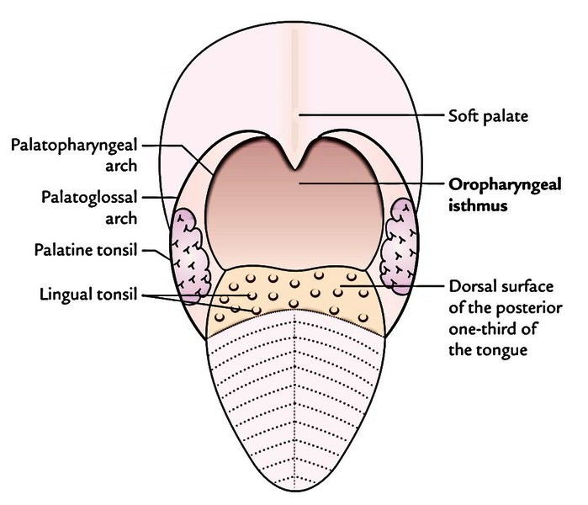
Oropharyngeal Isthmus
It is a communicating channel between oropharynx and oral cavity.
Boundaries-
Above- Soft Palate
Below- Dorsal surface of posterior 1/3rd of tongue.
Laterally- Palatoglossal arch.
Oropharyngeal Isthmus is closed during deglutition.

Slide 6
Features
Palatine tonsils.
Anterior faucial pillar ( Palatoglossal arch).
Posterior faucial pillar (Palatopharyngeal arch).
Lingual tonsils.
Upper free end of Epiglottis.
Median and lateral glossoepiglottic folds.
Epiglottic valleculae.

Slide 7
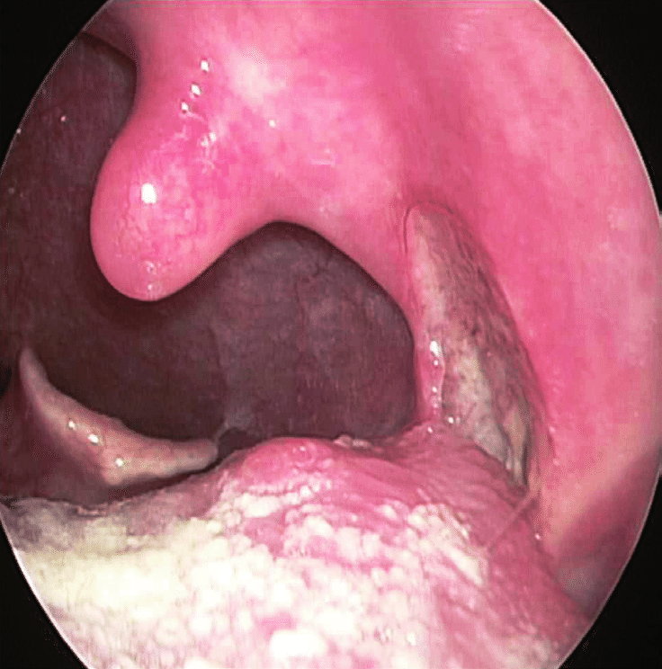
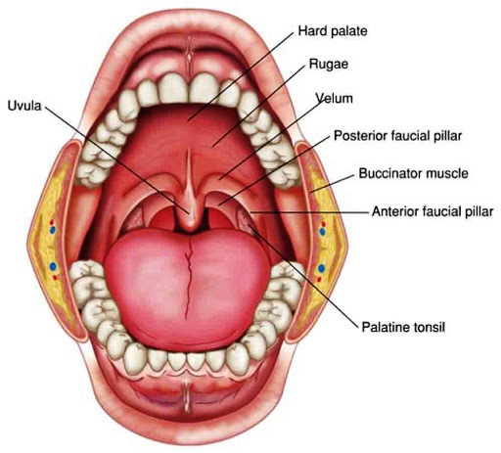
Features in Lateral Wall
Palatine Tonsil-
Location:
In the tonsillar fossa.
Tonsillar fossa is located in the lateral wall of oropharynx.
Tonsillar fossa is bounded anteriorly by the anterior faucial pillar (palatoglossal arch).
Tonsillar fossa is bounded posteriorly by the posterior faucial pillar (palatopharyngeal arch).
Uvula
Posterior 1/3rd of Tongue

Slide 8
Features in Lateral Wall contd…
Anterior faucial pillar ( Palatoglossal arch)-
Runs downwards and forwards from soft palate to lateral margin of tongue (at the junction of anterior 2/3rd and posterior 1/3rd ).
It contains Palatoglossus muscle.
Posterior faucial pillar (Palatopharyngeal arch)-
Runs downwards and backwards to the pharyngeal wall.
It contains Palatopharyngeus muscle.

Slide 9
Features in Anterior Wall
Lingual tonsils-
These are the collections of lymphoid tissue underneath the mucosa of pharyngeal part of tongue.
Upper free end of Epiglottis.
Median glossoepiglottic fold-
A mucosal fold connecting anterior surface of epiglottis to the dorsal surface of posterior 1/3rd of tongue.
Lateral glossoepiglottic folds-
Mucosal folds connecting edges of epiglottis to the dorsal surface of posterior 1/3rd of tongue.
Epiglottic valleculae-
Shallow fossae between median and lateral glossoepiglottic folds.

Slide 10
Applied Aspects
As oropharynx is a common channel for both food and air, sometimes food may enter into respiratory tract and cause choking.

Slide 11
Laryngopharynx [Hypopharynx]

Slide 12
Introduction
Vertical Extent-
Anteriorly-
From upper border of epiglottis to lower border of lamina of cricoid cartilage.
Posteriorly-
From C3 vertebra to the lower border of C6 vertebra.
Communications-
Anteriorly- with Laryngeal cavity.
Superiorly- with Oropharynx.
Inferiorly- with Esophagus.
Laryngopharynx communicates with laryngeal inlet through Laryngeal Inlet.

Slide 13
Features
Laryngeal Inlet.
Piriform fossa/recess.
Laryngeal Inlet closes during deglutition.
Piriform fossa [Smuggler’s Fossa]-
Location-
Anterior part of lateral wall, on each side of laryngeal inlet.
Piriform fossa

Slide 14
Pharyngeal Wall
Consists of 4 layers (from within outwards)-
Mucous membrane.
Pharyngobasilar fascia (Pharyngeal aponeurosis).
Muscle layer.
Buccopharyngeal fascia.

Slide 15
Mucous Membrane
Epithelium- Stratified squamous except nasopharynx.
Nasopharynx is lined by ciliated columnar epithelium.
Epithelium tends to invaginate in sub epithelial collections of lymphoid tissue in the form of clefts (crypts).
Waldeyer’s Ring-
Aggregations of lymphoid tissue underneath the epithelium of pharyngeal wall in the form of an interrupted ring.
Surround the commencement of air and food passages.
Lymphoid collections in the Waldeyer’s ring are:
Nasopharyngeal (Pharyngeal) Tonsil [Adenoids]- Posteriorly
Tubal Tonsils- Postero-laterally
Palatine Tonsils- Antero-laterally
Lingual Tonsils- Anteriorly.
These lymphoid collections prevent the invasion of microorganisms in the air and food passages.

Slide 16
Waldeyer’s Ring

Slide 17
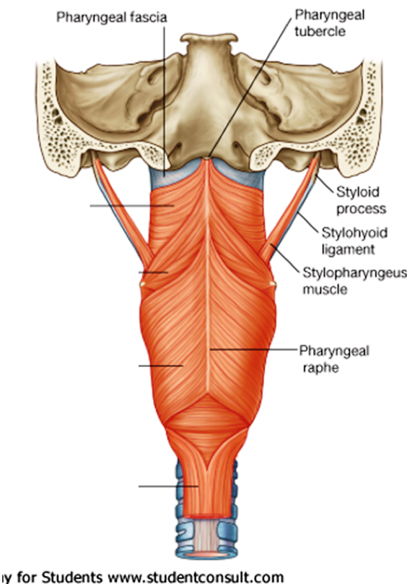
Pharyngobasilar Fascia
Fibrous thickening of submucosa.
It is thick near the base of skull but thin and indistinct inferiorly.
It is thickest:
where it fills the gap between upper border of superior constrictor and base of skull.
where it forms the pharyngeal raphe (posteriorly).

Slide 18
Muscle Layer
2 layers of striated muscles.
Outer layer of 3 pairs of circular muscles (constrictor muscles):
Superior constrictor.
Middle constrictor.
Inferior constrictor.
Inner layer of 3 pairs of longitudinal muscles.
Stylopharyngeus.
Salpingopharyngeus.
Palatopharyngeus.

Slide 20
Buccopharyngeal Fascia
It is a layer of loose areolar tissue.
It covers the outer surface of constrictor muscles.
In the upper part, it is prolonged forwards to cover the Buccinator muscles.
It blends with the pharyngobasilar fascia, above the upper border of superior constrictor muscles.

