Slide 1
PHARYNX-I
Presented by :- Dr. Sushma Tomar
Associate Professor
Department of Anatomy

Slide 2
Lesson Plan
Introduction
Boundaries
Subdivisions
Nasopharynx:
Location.
Communications.
Pharyngeal Isthmus.
Features.
Applied Aspects.

Slide 3
Introduction
Pharynx is a fibromuscular tube.
It is a common channel for both food and air.
Location- Behind the cavities of nose, mouth and the larynx.
Shape - funnel shaped.
Extent- From the base of the skull to the esophagus.

Slide 4
Introduction contd…
Dimensions-
Length- 12-14 cm
Width-
At base- 3.5 cm
At pharyngo-esophageal junction- 1.5 cm

Slide 5
Boundaries
Superior-
Base of skull [ posterior part of body of Sphenoid & Basilar part of Occipital bone in front of pharyngeal tubercle.
Inferior-
Continuous with esophagus at the level of lower border of cricoid cartilage anteriorly and lower border of C6 vertebra posteriorly

Slide 6
Boundaries contd…
Posterior-
Prevertebral fascia.
Anterior-
Opens into cavities of nose, mouth and larynx.
Lateral-
Neurovascular bundle of neck.
Styloid process with its attached muscles and ligaments.

Slide 7
Subdivisions
3
From above downwards:
Nasopharynx.
Oropharynx.
Laryngopharynx.

Slide 8
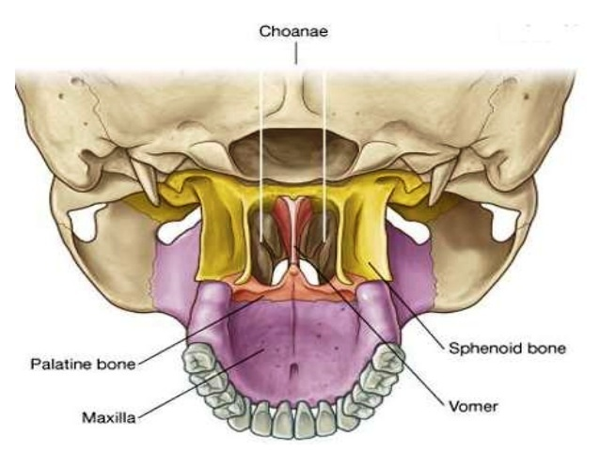
Nasopharynx
Location-
Behind choanae (posterior nasal apertures) and above soft palate.
Communications-
Anteriorly- with nasal cavities.
Inferiorly- with oropharynx.

Slide 9
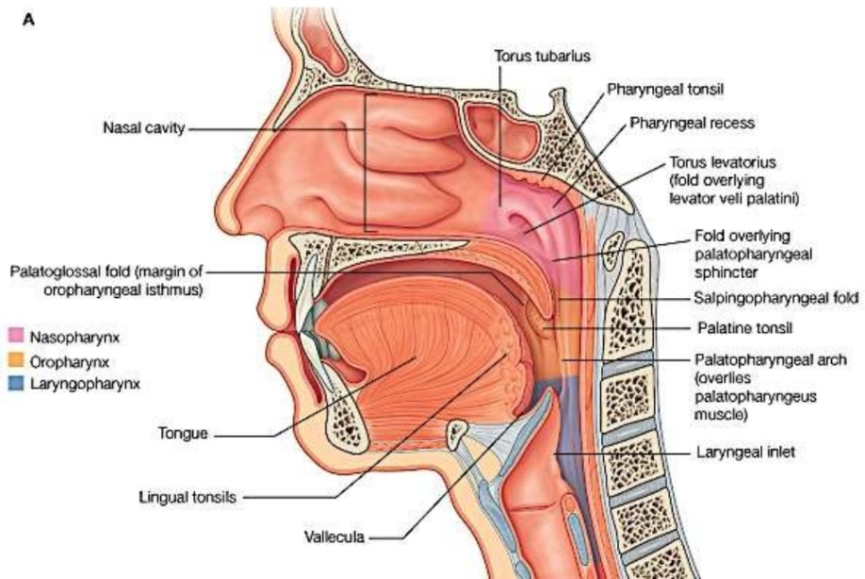
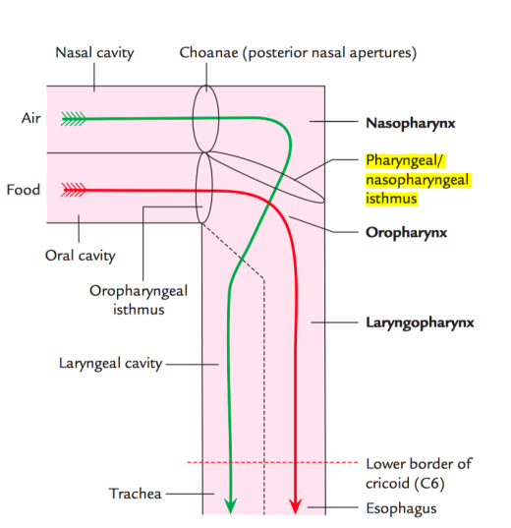
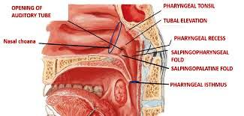
Pharyngeal Isthmus [Nasopharyngeal Isthmus]
An opening bounded anteriorly by the soft palate and posteriorly by the posterior wall of pharynx ( Passavant’s ridge).

Slide 10
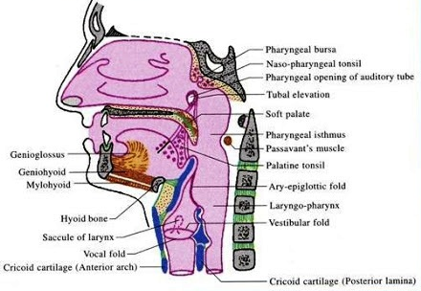
Nasopharynx contd…
Features:
Nasopharyngeal (Pharyngeal) Tonsil).
Orifice of Pharyngo-tympanic tube (Auditory tube or Eustachian tube).
Tubal elevation.
Tubal tonsil.
Salpingopharyngeal fold.
Salpingopalatine fold.
Pharyngeal recess (Fossa of Rosenmüller).
Nasopharyngeal (Pharyngeal) Tonsil [Adenoids]-
A collection of lymphoid tissue.
Location- At the junction of roof and posterior wall of nasopharynx.
Contains nasopharyngeal bursa.
Nasopharyngeal (Pharyngeal) bursa [Pouch of Luschka]-
A mucous diverticulum which extends upwards into the substance of pharyngeal tonsil from its apex.
It is developed due to adhesion of notochord to the dorsal wall of pharyngeal part of foregut.

Slide 11
Nasopharynx contd…
Orifice of Pharyngo-tympanic tube (Auditory tube or Eustachian tube)-
Location-
On lateral wall of nasopharynx, approximately 1.25 cm behind inferior nasal concha.
Tubal elevation-
Upper and posterior margins of orifice of eustachian tube are elevated due to collection of lymphoid tissue.
These elevated margins are known as tubal elevation.
Tubal tonsil-
Collection of lymphoid tissue in tubal elevation is known as tubal tonsil.

Slide 12
Nasopharynx contd…
Salpingopharyngeal fold-
A mucous fold which extends vertically downwards on the side wall of pharynx from tubal elevation.
It contains Salpingopharyngeus muscle.
Salpingopalatine fold-
A mucous fold which extends downwards and forwards to the soft palate from tubal elevation.
It contains Levator Palati muscle.
Pharyngeal recess (Fossa of Rosenmüller).
It is a deep depression behind the tubal elevation.

Slide 13
Applied Aspects
Adenoids-
Enlarged nasopharyngeal tonsils due to infection.
Block the posterior nares.
Clinical Features-
Nasal obstruction.
Nasal discharge.
Mouth breathing.
Snoring.
Protrusion of tongue.
Toneless voice
Small nose.
Epistaxis (Nose Bleeding).
Nasopharyngeal tonsils are prominent in children up to the age of 6 years.
They gradually undergo atrophy at puberty.
They completely disappear by the age of 20 years.

Slide 14
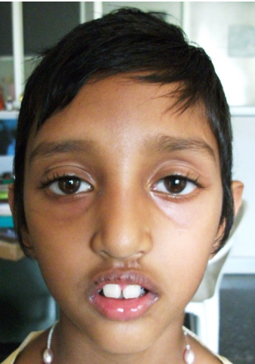
Adenoid Facies [Long Face Syndrome]
Long, open-mouthed face of children with adenoid hypertrophy.
These children are ‘Obligatory Mouth Breathers’.
Persistent mouth breathing may be associated with development of craniofacial anomalies.
The characteristic facial appearance consists of:
Underdeveloped thin nostrils
Short upper lip
Prominent upper teeth
Crowded teeth
Narrow upper alveolus.
High-arched palate
Hypoplastic maxilla

Slide 16
Nasopharyngeal Swab

