Slide 1
Parotid Region [para=around, otic=ear]
Presented by :- Dr. Sushma Tomar
Associate Professor
Department of Anatomy

Slide 2
Boundaries of Parotid Region
Anterior-
Anterior border of Masseter.
Above-
Zygomatic arch.
Posterior-
Mastoid process.
Below-
An imaginary line joining the angle of mandible with mastoid process.

Slide 3
Parotid Gland

Slide 4
Parotid Gland
It is the largest salivary gland.
Location-
Retromandibular fossa (posterior to ramus of mandible).

Slide 5
Boundaries of Parotid Bed
Anterior-
Posterior border of ramus of mandible.
Posterior-
Mastoid process.
Above-
External acoustic meatus.
Posterior part of Temporomandibular joint.
Medial-
Styloid process.

Slide 6
Extension of Parotid Gland
Above-
To the External auditory meatus.
Below-
To the upper part of carotid triangle.
Medial-
To the styloid process.
Anterior-
Extends over Masseter.
Posterior-
Overlaps Sternocleidomastoid muscle.

Slide 7
Accessory Parotid Gland
A part of the forward extension of parotid gland is detached from the rest of the gland and is known as accessory parotid gland.

Slide 8
Capsule of Parotid Gland

Slide 9
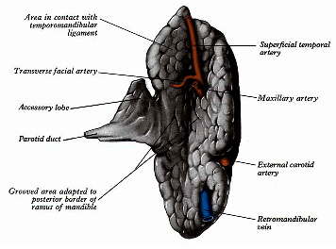
Presenting Parts
Shape-
Three – sided pyramid.
Apex is directed downwards.
Surfaces- 4
Superior (Base)
Superficial
Anteromedial
Posteromedial
Borders- 3
Anterior
Posterior
Medial

Slide 10
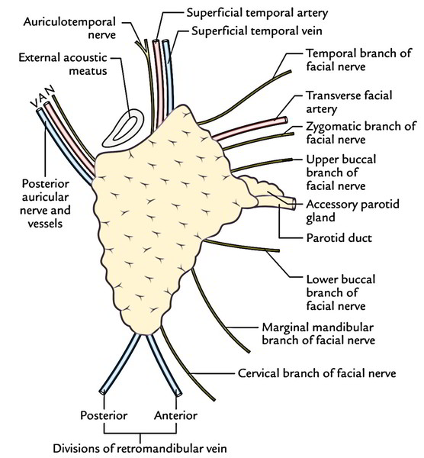
Relations of Apex
Apex overlaps the posterior belly of digastric muscle.

Slide 11
Relations of Superior surface (Base)

Slide 12
Relations of Anteromedial and Posteromedial surfaces
Anteromedial surface-
Deeply grooved by posterior border of ramus of mandible.
Posteromedial surface-
Molded onto mastoid and styloid processes.

Slide 13
Structures entering into Posteromedial surface

Slide 14
Relations of Anterior and Posterior borders

Slide 15
Relations of Medial border

Slide 16
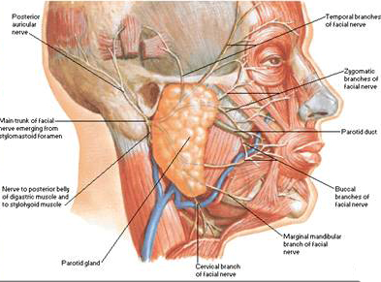
Parotid Duct/Stenson's Duct
Length –5 cm
Direction- Forwards and slightly downwards on masseter.
It runs between buccinator and oral mucosa and opens into the vestibule of mouth opposite the crown of upper second molar tooth.

Slide 17
Parotid Duct/Stenson's Duct contd…
It pierces:
1.buccal pad of fat
2.buccopharyngeal fascia
3.buccinator muscle
4.buccal mucosa

Slide 18
Structures within Parotid gland

Slide 19
Lobes of Parotid Gland & Patey’s Fasciovenous Plane

Slide 20
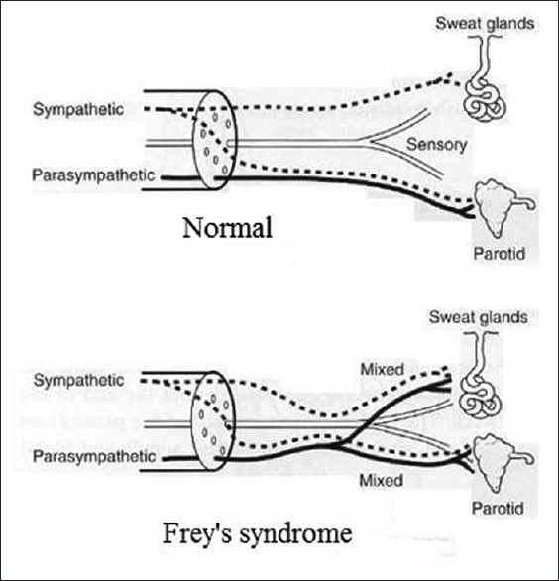
Frey’s Syndrome

