Slide 1
Nasal Cavity-I
Presented by:-
Dr. Sushma Tomar
Associate Professor
Department of Anatomy

Slide 2
Lesson Plan
Introduction
Parts of Nasal Cavity:
Vestibule
Nasal Cavity Proper
Roof of Nasal Cavity
Floor of Nasal Cavity
Nasal Septum:
Introduction
Parts
Arterial Supply
Venous Drainage
Nerve Supply
Lymphatic Drainage
Applied Aspects

Slide 3
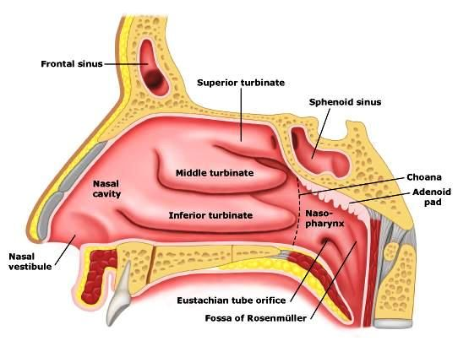
Introduction
Internal nose is divided into right and left nasal cavities by a nasal septum.
Each nasal cavity communicates with the exterior through nostril (naris).
Each nasal cavity communicates with the nasopharynx through posterior nasal aperture (choana).
Nostril

Slide 5
Parts of Nasal Cavity
2 parts:
Vestibule
Nasal cavity proper
Vestibule-
A small anteroinferior part.
Lined by skin.
Nasal Cavity Proper-
Large posterosuperior part.
Lined by mucosa.

Slide 6
Vestibule
Its upper limit on lateral wall of nasal cavity is marked by Limen nasi.
Its medial wall is formed by columella.

Slide 7
Nasal Cavity Proper
Boundaries-
Roof.
Floor.
Medial wall (Nasal Septum).
Lateral wall.
Roof
Nasal Septum
Lateral Wall
Floor

Slide 8
Roof of Nasal Cavity
Divided into 3 parts:
Anterior 1/3rd .
Middle 1/3rd .
Posterior 1/3rd .
Anterior 1/3rd –
Slopes downwards and forwards.
Formed by:
Nasal spine of Frontal bone.
Nasal bone.
Junction of Septal and Lateral cartilages
Nasal spine of Frontal bone
Nasal bone
Junction of
Septal and
Lateral
cartilages

Slide 9
Roof of Nasal Cavity contd…
Middle 1/3rd –
Horizontal.
Formed by:
Cribriform plate of Ethmoid bone.
Through the cribriform plate, olfactory nerves enter the cranial cavity.

Slide 10
Roof of Nasal Cavity contd…
Posterior 1/3rd –
Slopes downwards and backwards.
Formed by:
Anterior surface of body of Sphenoid bone.

Slide 11
Floor of Nasal Cavity
Almost horizontal.
Formed by:
Upper surface of hard palate.
Anterior 3/4th –
By palatine process of Maxilla.
Posterior 1/4th –
Horizontal plate of Palatine bone.

Slide 12
Nasal Septum

Slide 13
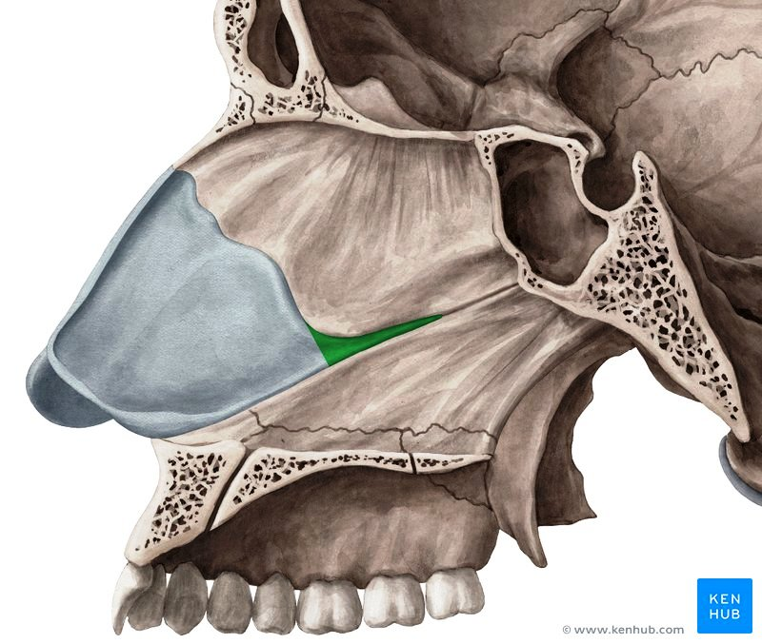
Introduction
A median osseocartilaginous partition between two nasal cavities.
Forms the medial wall of nasal cavity.
Nasal Septum
Nasal Septum

Slide 14
Parts of Nasal Septum
3 parts:
Bony part.
Cartilaginous part.
Membranous part.
Framework of Bony Part-
Ethmoid- perpendicular plate
Vomer
Frontal - nasal spine
Nasal- crest
Sphenoid- crest
Maxilla- palatine process
Palatine- horizontal plate

Slide 15
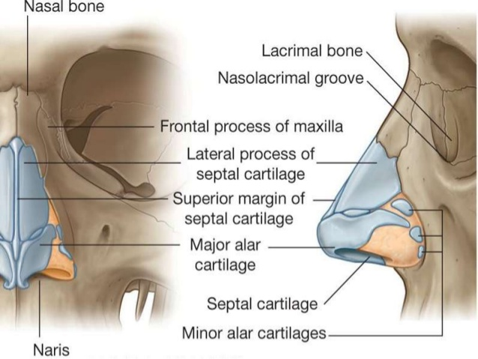
Cartilaginous Part
Framework of Cartilaginous Part-
Septal cartilage
Medial crura (septal processes) of 2 major alar cartilages.

Slide 16
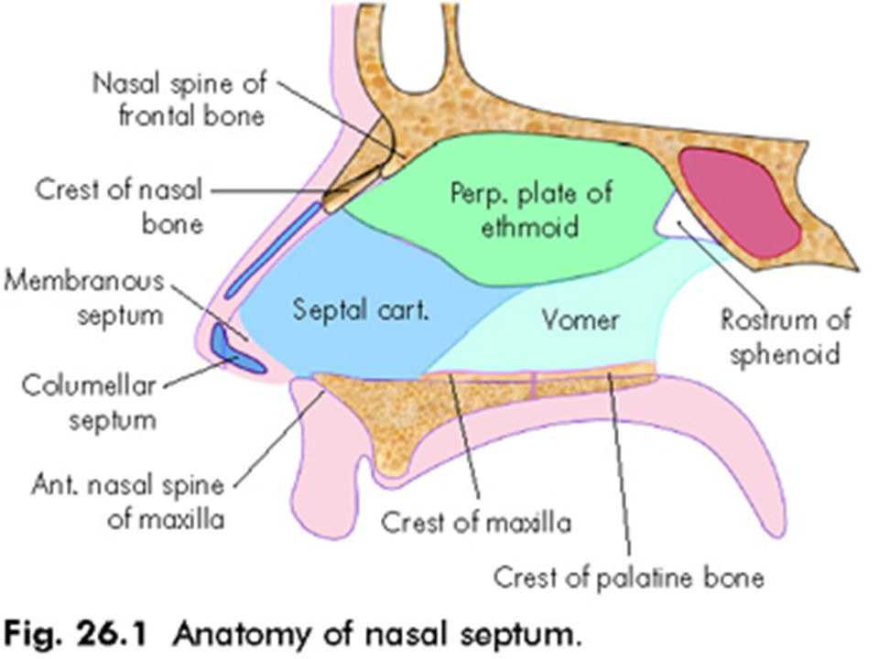
Cartilaginous Part contd…
Columellar Septum-
Medial crura of 2 major alar cartilages are united together in the midline by a fibrous tissue to form columellar septum (columella).

Slide 17
of
Major Alar Cartilage

Slide 18
Membranous Part
Between the columella and caudal border of septal cartilage, a small portion of septum is made up of double layer of skin and is referred as membranous septum.
Both columellar and membranous parts of the septum are freely movable from side to side.

Slide 19
Arterial Supply of Nasal Septum
Septal b/o Anterior Ethmoidal artery
Septal b/o Posterior Ethmoidal artery
Septal b/o Sphenopalatine artery
Septal b/o Greater Palatine artery
Septal b/o Superior labial artery

Slide 20
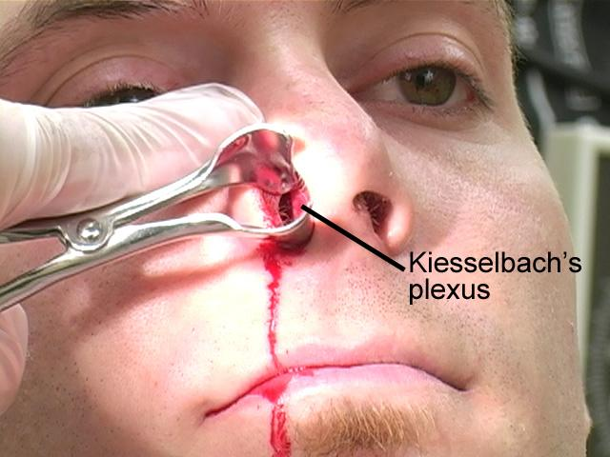
Little’s Area
An area in anteroinferior part of nasal septum just above the vestibule.
It is highly vascular.
In this area, an arterial plexus is formed by the following arteries:
Septal b/o Anterior Ethmoidal artery
Septal b/o Sphenopalatine artery
Septal b/o Greater Palatine artery
Septal b/o Superior labial artery.
This plexus is known as Kiesselbach’s plexus.
In Little’s area, submucous venous plexus is also more marked.
Applied aspect-
Little’s area is the commonest site of epistaxis (bleeding through the nasal cavity) in children and young adults usually due to finger nail trauma during pricking of nose.

Slide 23
Venous Drainage of Nasal Septum
In nasal septum, veins accompany the arteries.
A venous plexus is formed beneath the mucosa.
Veins drain into:
Facial vein.
Pterygoid venous plexus.
Pharyngeal venous plexus.

Slide 24
Nerve Supply of Nasal Septum
Anterosuperior Part-
Internal nasal nerve (a branch of Anterior Ethmoidal Nerve).
Anteroinferior Part-
Anterior Superior Alveolar Nerve (a branch of Infraorbital nerve).
Posterosuperior Part-
Medial posterior superior nasal nerves ( branches of Pterygopalatine ganglion).
Posteroinferior Part-
Nasopalatine nerve ( a branch of Pterygopalatine ganglion).
Olfactory Part (upper 1/3rd of nasal septum just below cribriform plate)-
Olfactory Nerves.

Slide 25
Lymphatic Drainage of Nasal Septum
Anterior ½-
Drains into:
Submandibular lymph nodes.
Posterior ½-
Drains into:
Retropharyngeal lymph nodes.

Slide 26
Applied Aspects
Nasal Septum is seldom exactly in median plane.
Usually it bulges to right or left side, more frequently to the right.
DNS [Deviated Nasal Septum]-
An important cause of nasal obstruction.
Sex Predilection-
Male>Female.
Etiology-
Trauma.
Developmental error.
Clinical Features-
Mechanical nasal obstruction.
Sinusitis.
Headache etc.
Treatment-
Surgical correction-
SMR (Submucosal resection).
Septoplasty.

Slide 27
Applied Aspects contd…
Supratip depression of External Nose-
Septal cartilage provides support to dorsum of anterior 2/3rd of nose.
Excessive removal of septal cartilage during submucosal resection can lead to Supratip depression of External Nose.
Destruction of septal cartilage due to disease may result into this deformity.

