Slide 1

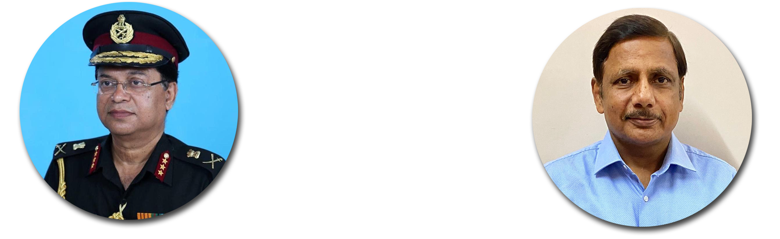


King George’s Medical University U.P., Lucknow
KGMU Institute of Paramedical Sciences
17 October to 25 October 2020

Slide 2
INTRODUCTION
S.no. | Date | Topic | Activity | No. of Participants
1 | 17/10/2020 | Medical Ethics for Women | e-Lecture (Prof. Vinod Jain) with Students | 150
2 | 20/10/2020 | Fundamentals and Basic Techniques of Self- Defence | Online Self- Defence training module | 100
 |  | Strengthen the feeling of Self- Defence | e-Poster Competition | 15
3 | 21/10/2020 | Awareness of POCSO Act and Strengthen the feeling of Self- Defence | Banner cum Poster Competition | 15
 |  | Women Empowerment | Movie Show | 100
4 | 22/10/2020 | Women Empowerment | e- Guest Lecture (Mrs. Shivi Jain) with Students | 121
 |  | Courage, Boldness, Self-Defence, Self Respect, Immolation, Sacrifice | Online Poetry Competition by Videos | 17
5 | 23/10/2020 | Women Empowerment | Rangoli Competition | 17
 |  | Legal Issues for Women | e-Guest Lecture | 100
6 | 17/10/2020 to 25/10/2020 | Ongoing Physical Self-Defence Training

Slide 3
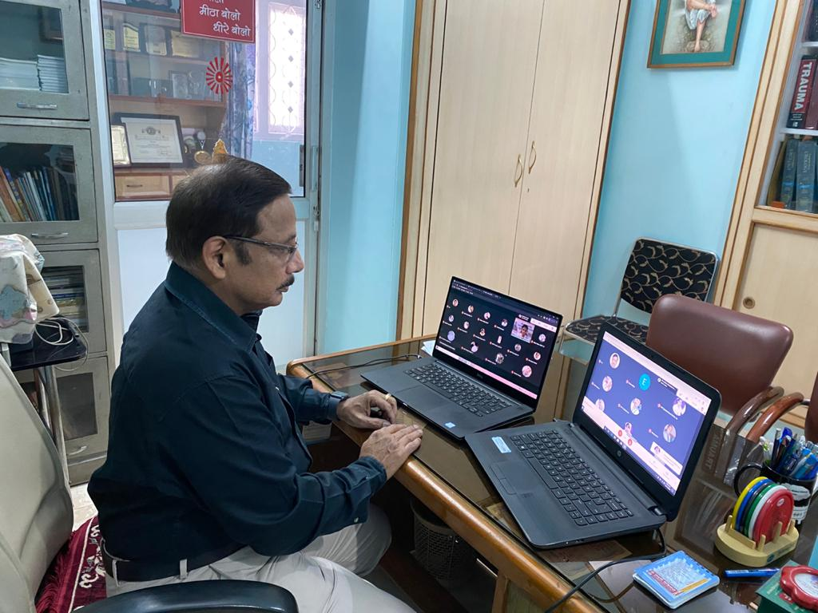
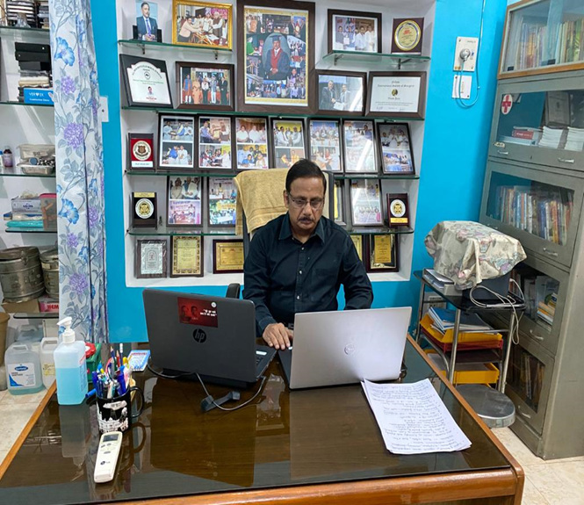
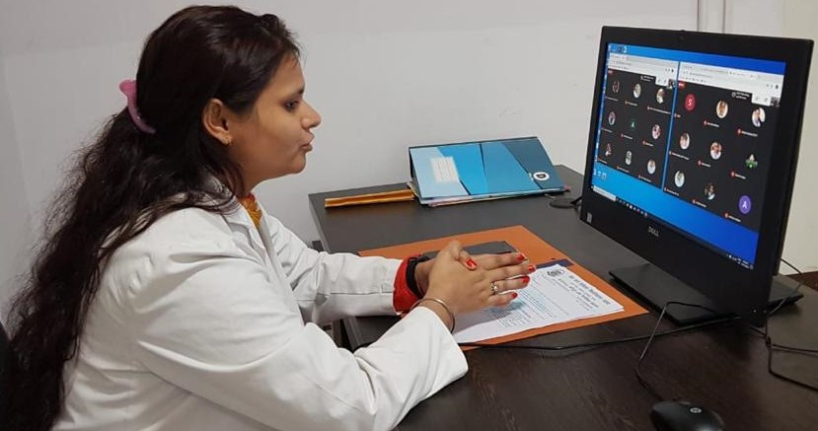
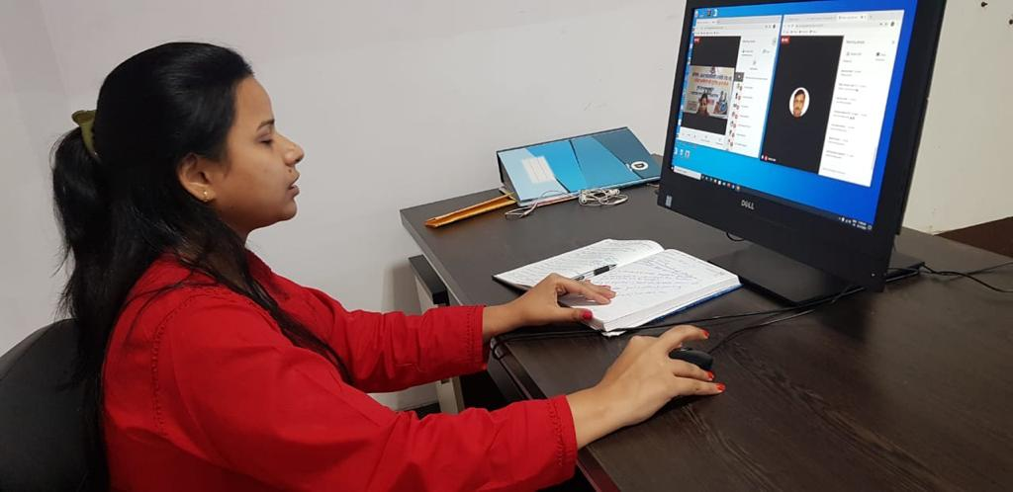
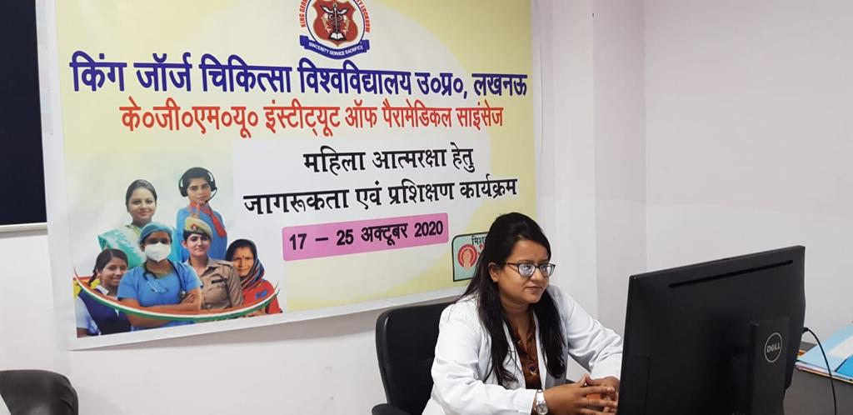
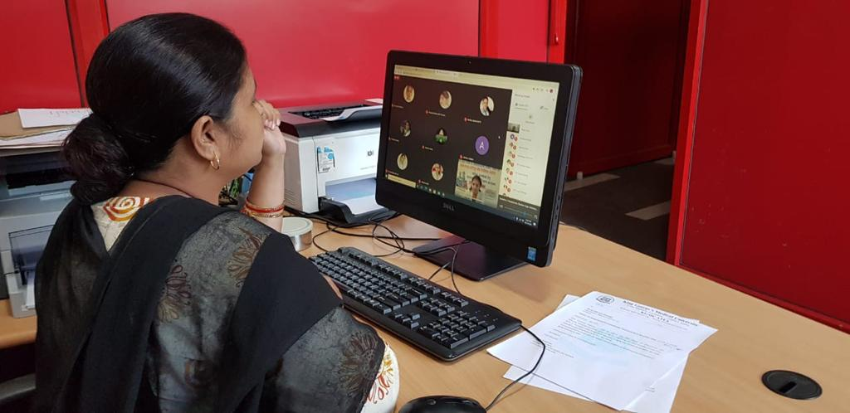
Medical Ethics
Date-17.10.2020, Time (11:00 am to 01:00 pm)

Slide 4
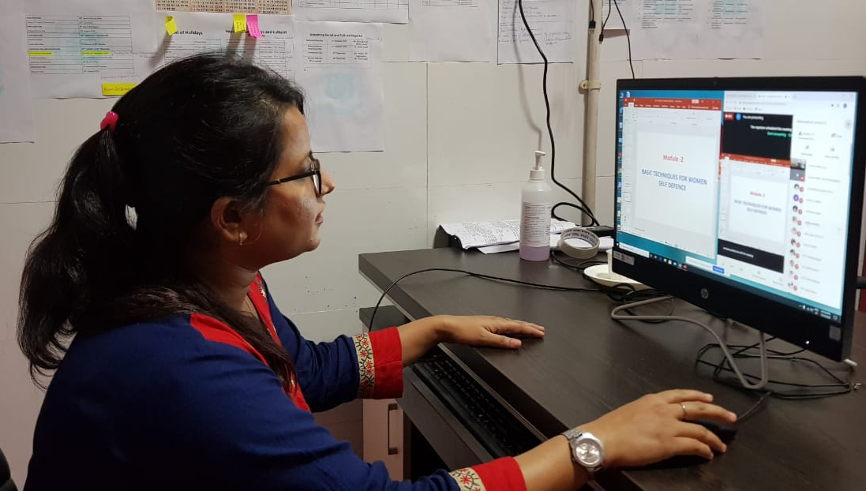
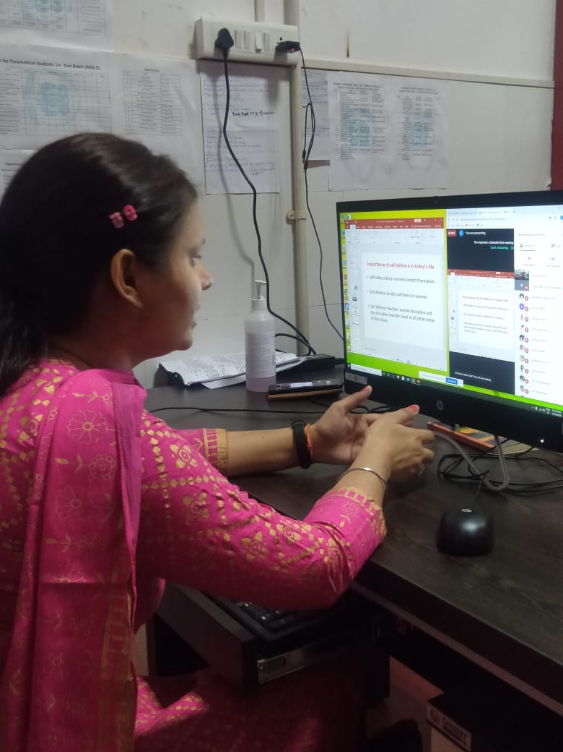
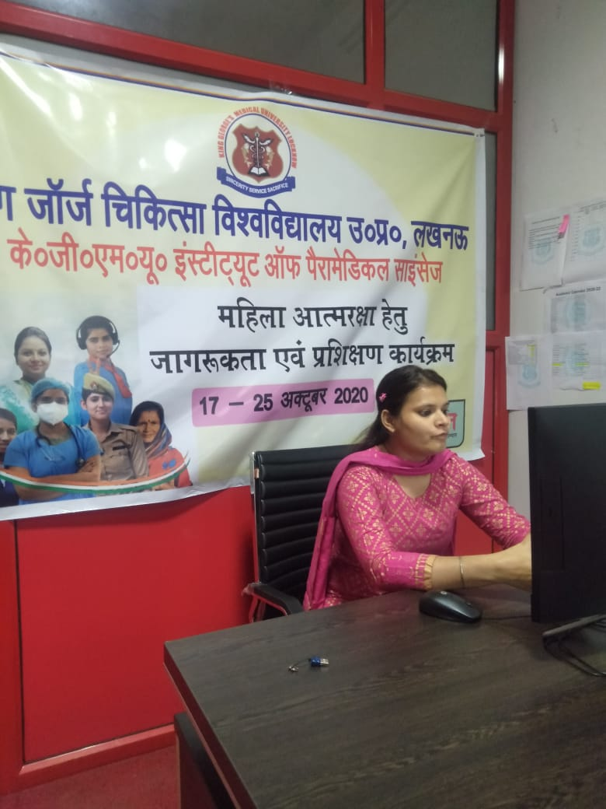
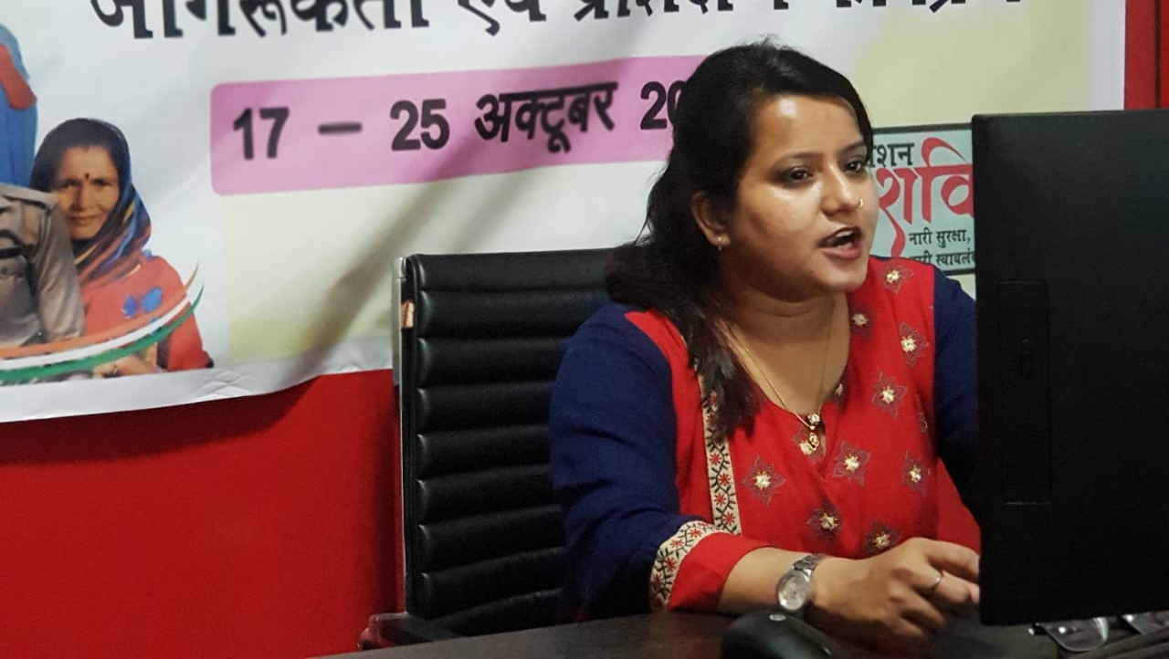
Online Module - Self Defence Training
Date-20.10.2020, Time (02:00 pm to 04:00 pm)

Slide 5
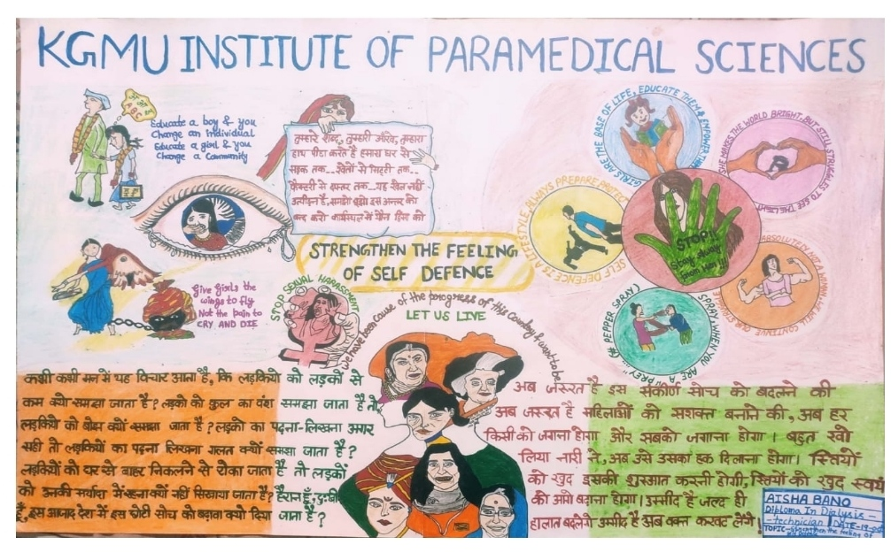
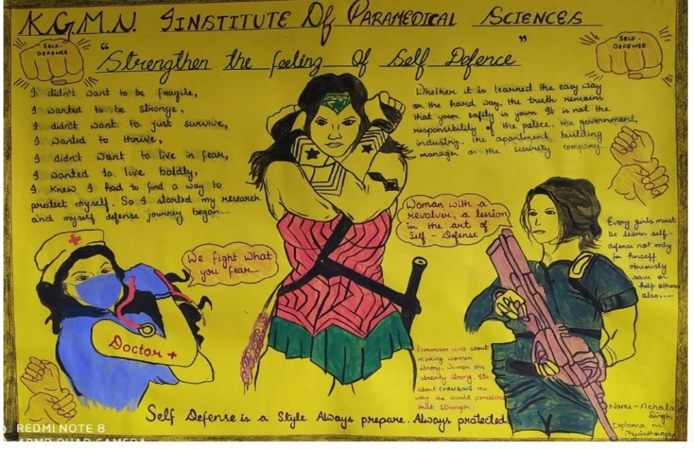
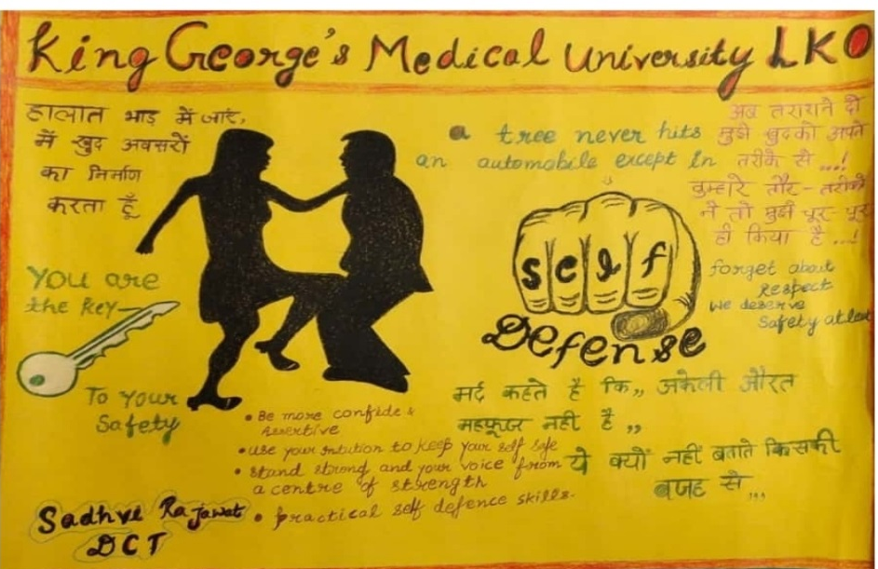
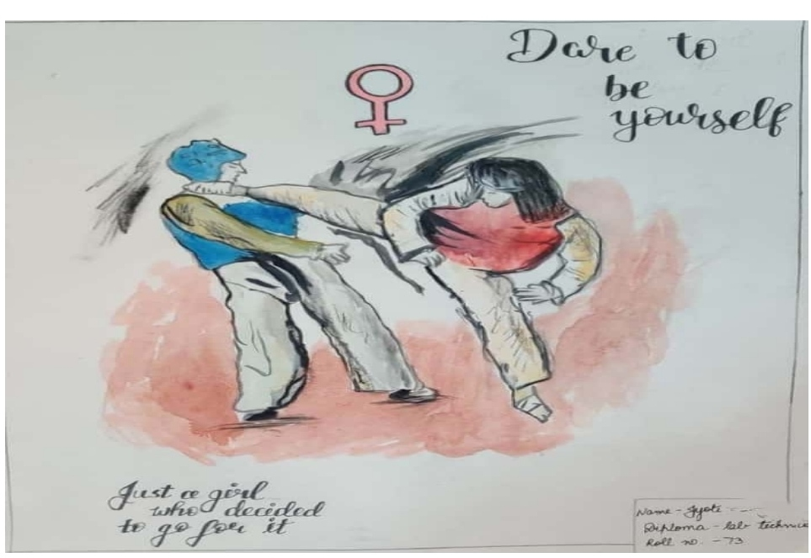
E-Poster Competition
Date-20.10.2020, Time (01:00 pm to 02:00pm)

Slide 6
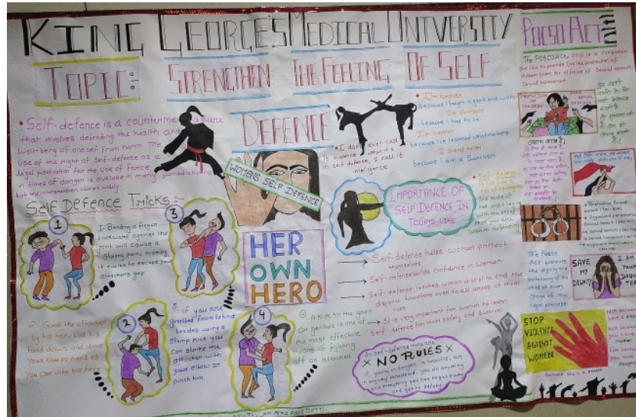
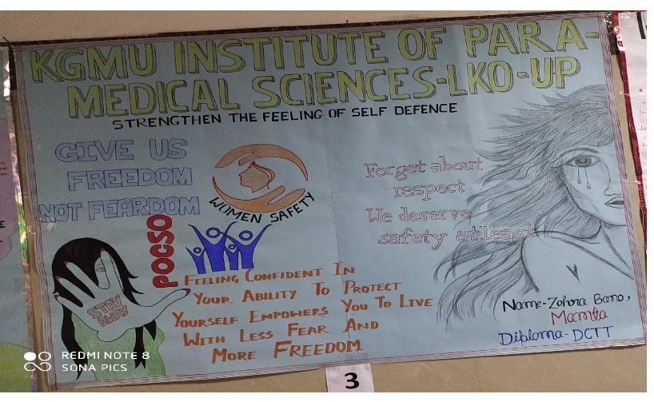
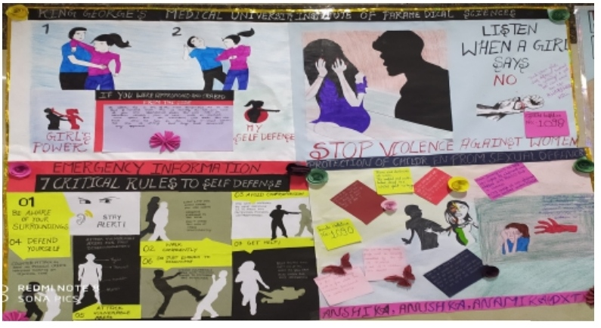
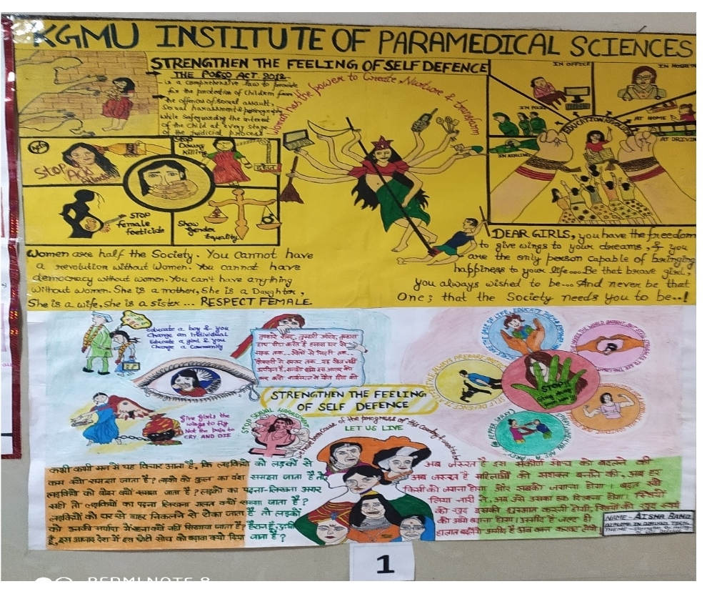
Banner Cum Poster Competition
Date-21.10.2020, Time (01:00 pm to 01:30pm)

Slide 7
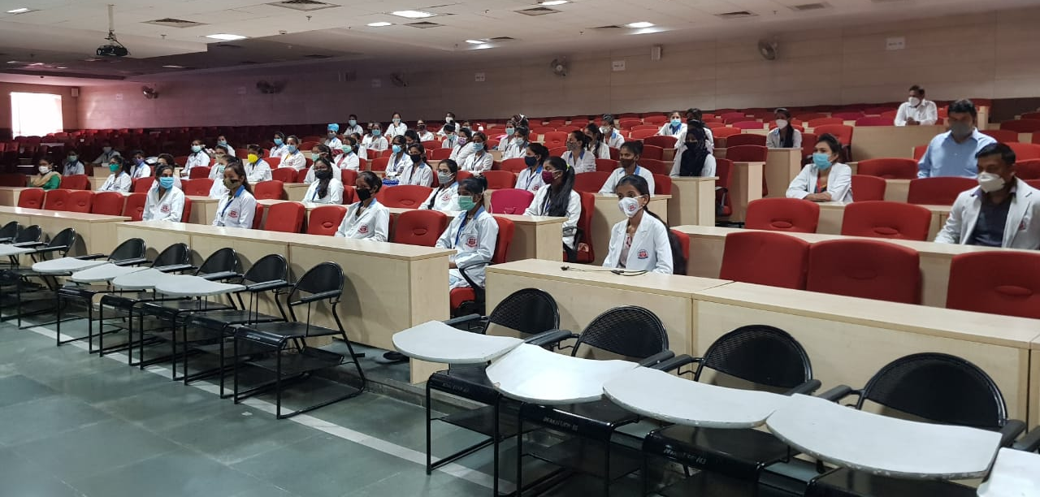
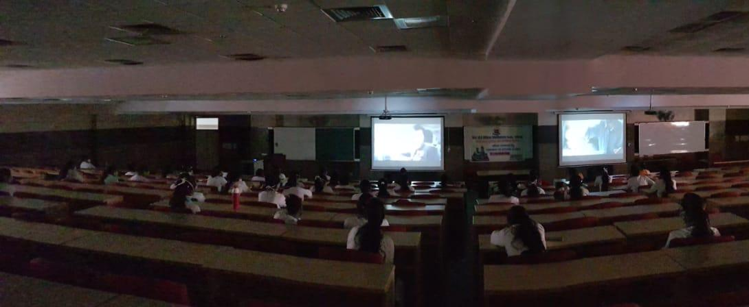
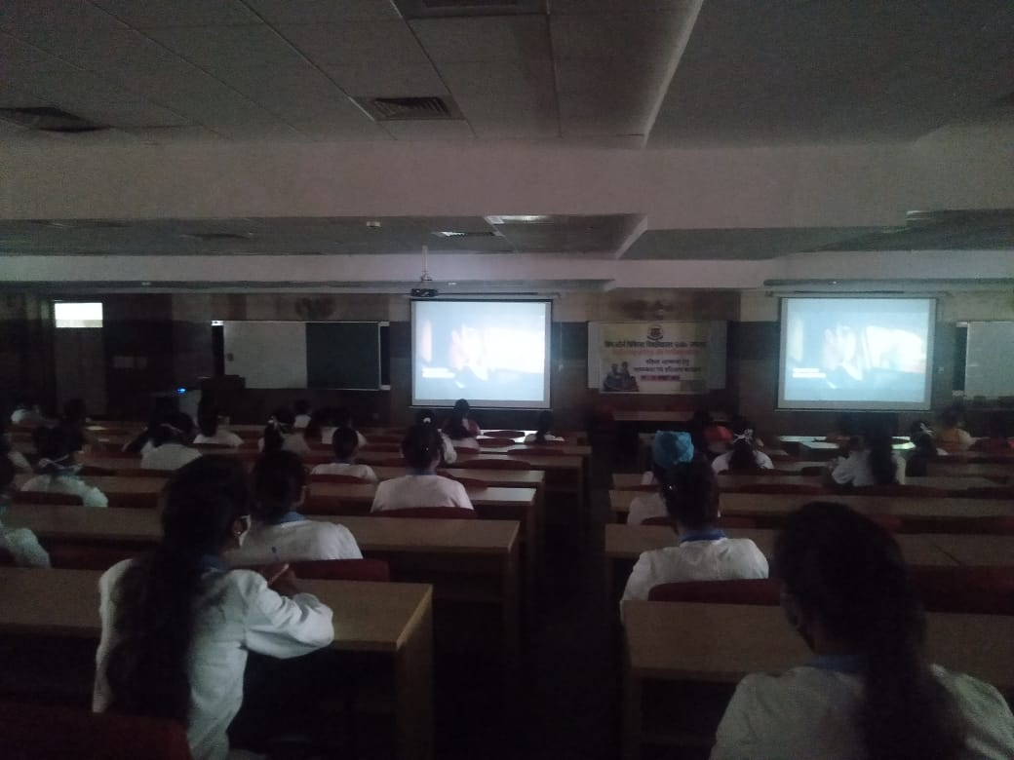
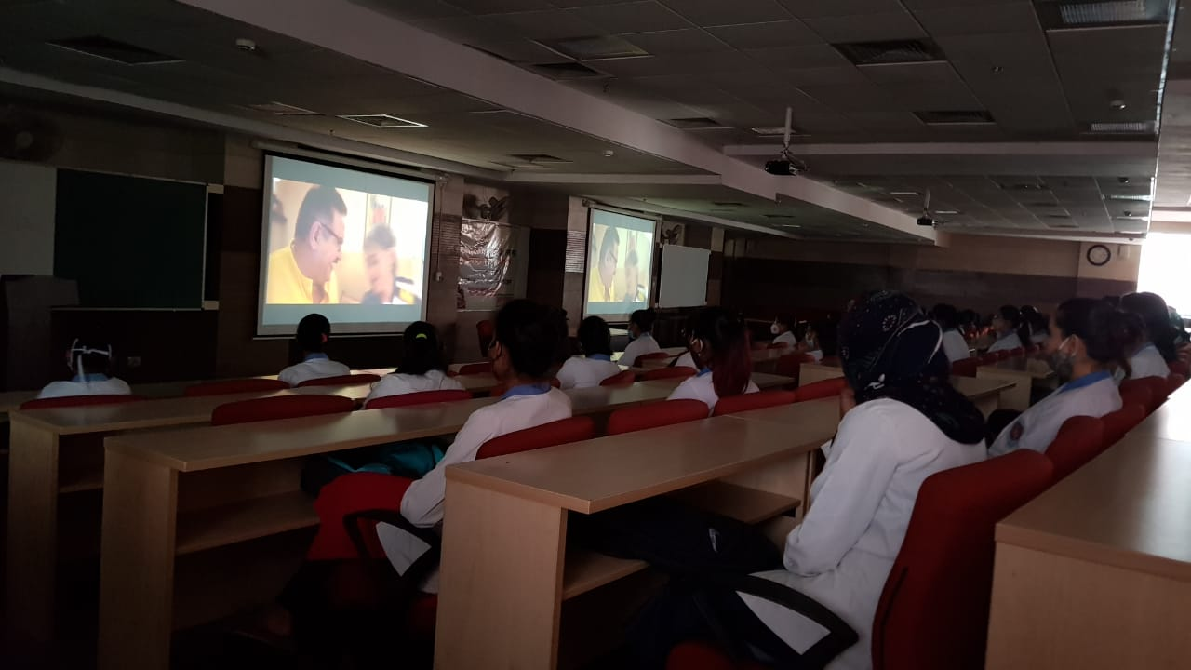
Movie Show based on Women Empowerment
Date-21.10.2020, Time (02:00 pm to 04:00 pm)

Slide 8
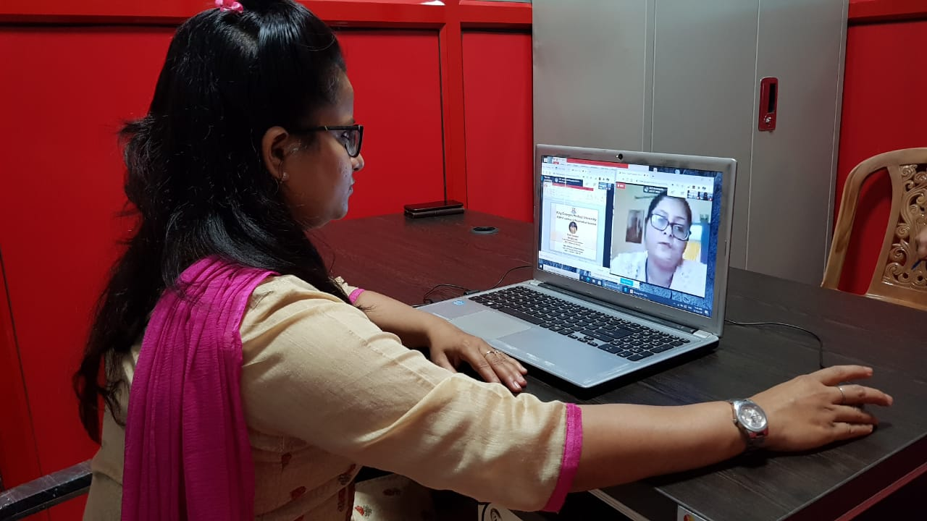
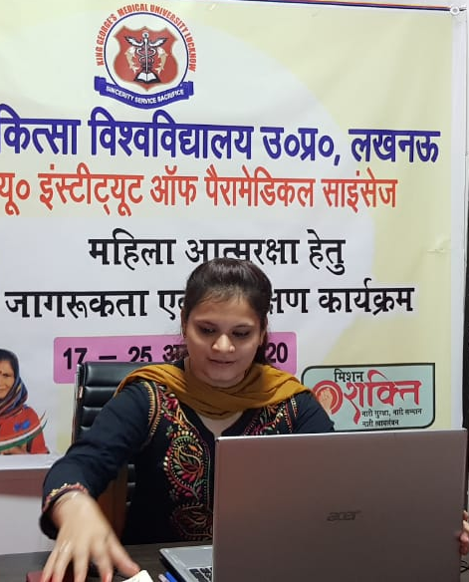
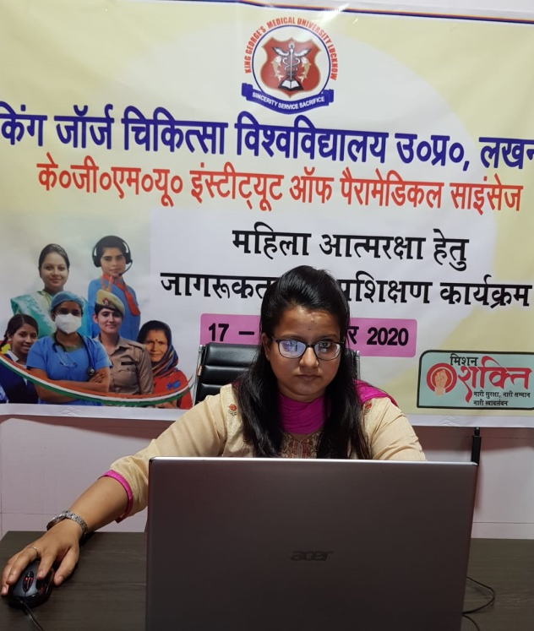
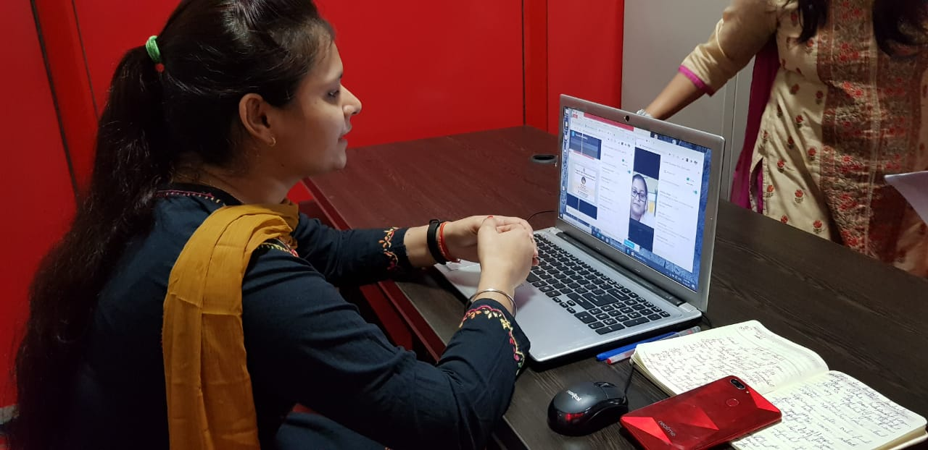
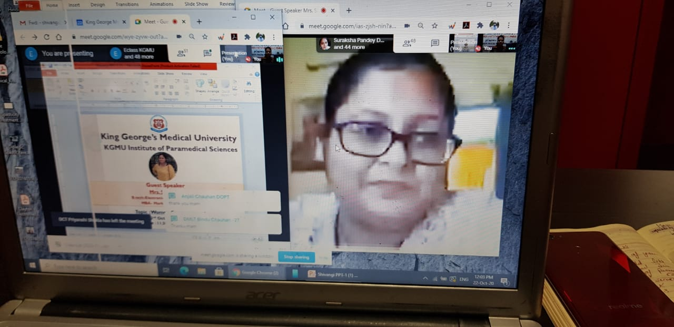
E-Guest Lecture
Date-22.10.2020, Time (11:30 am to 12:00 pm)

Slide 9
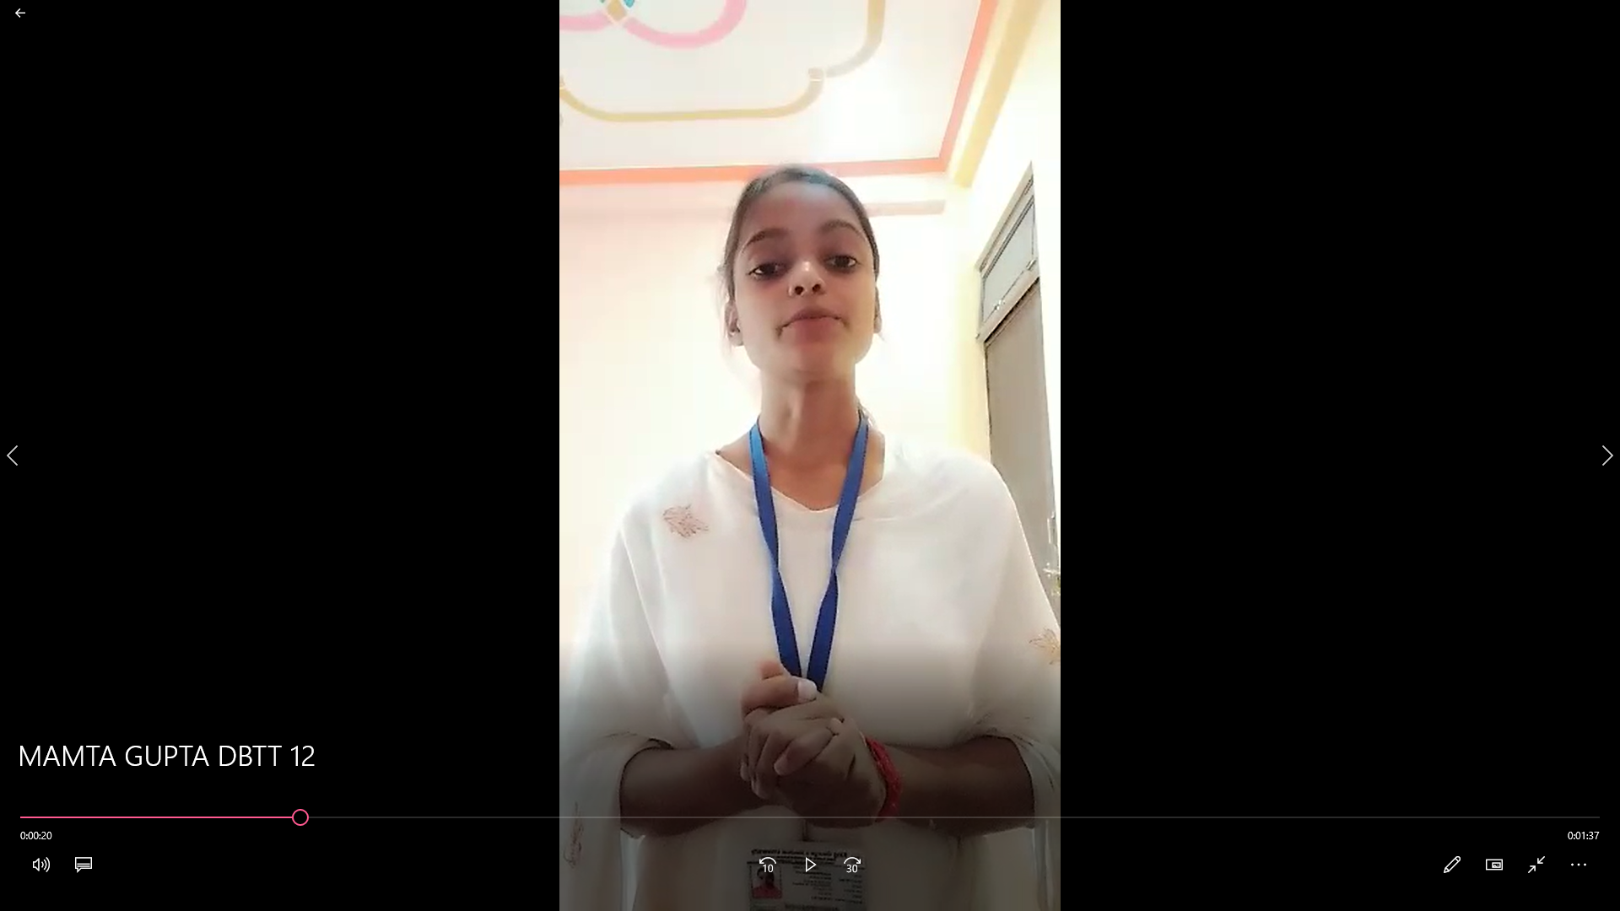
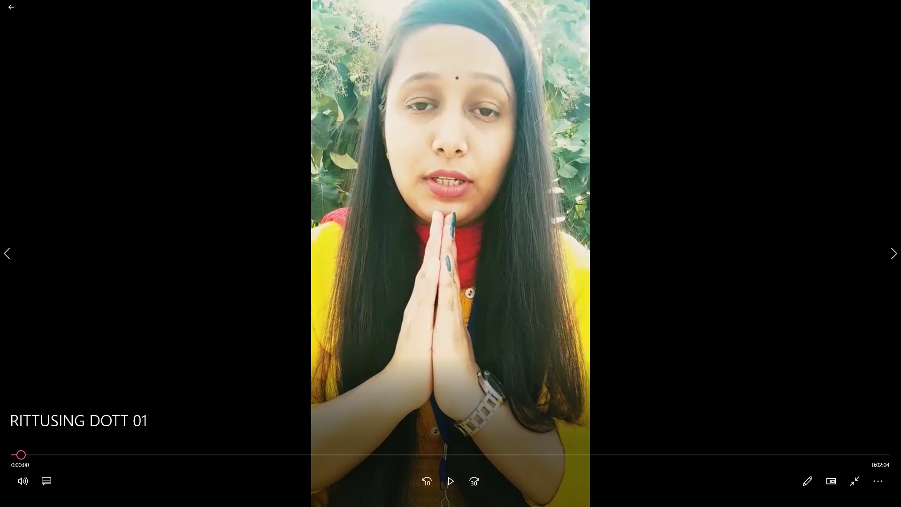
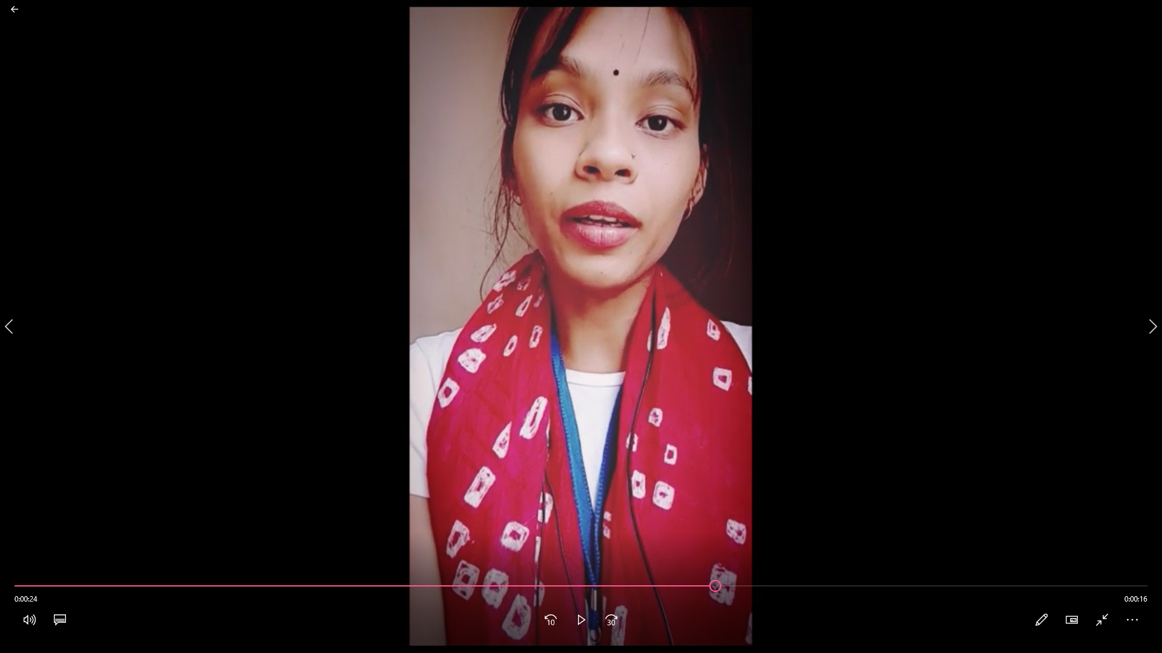
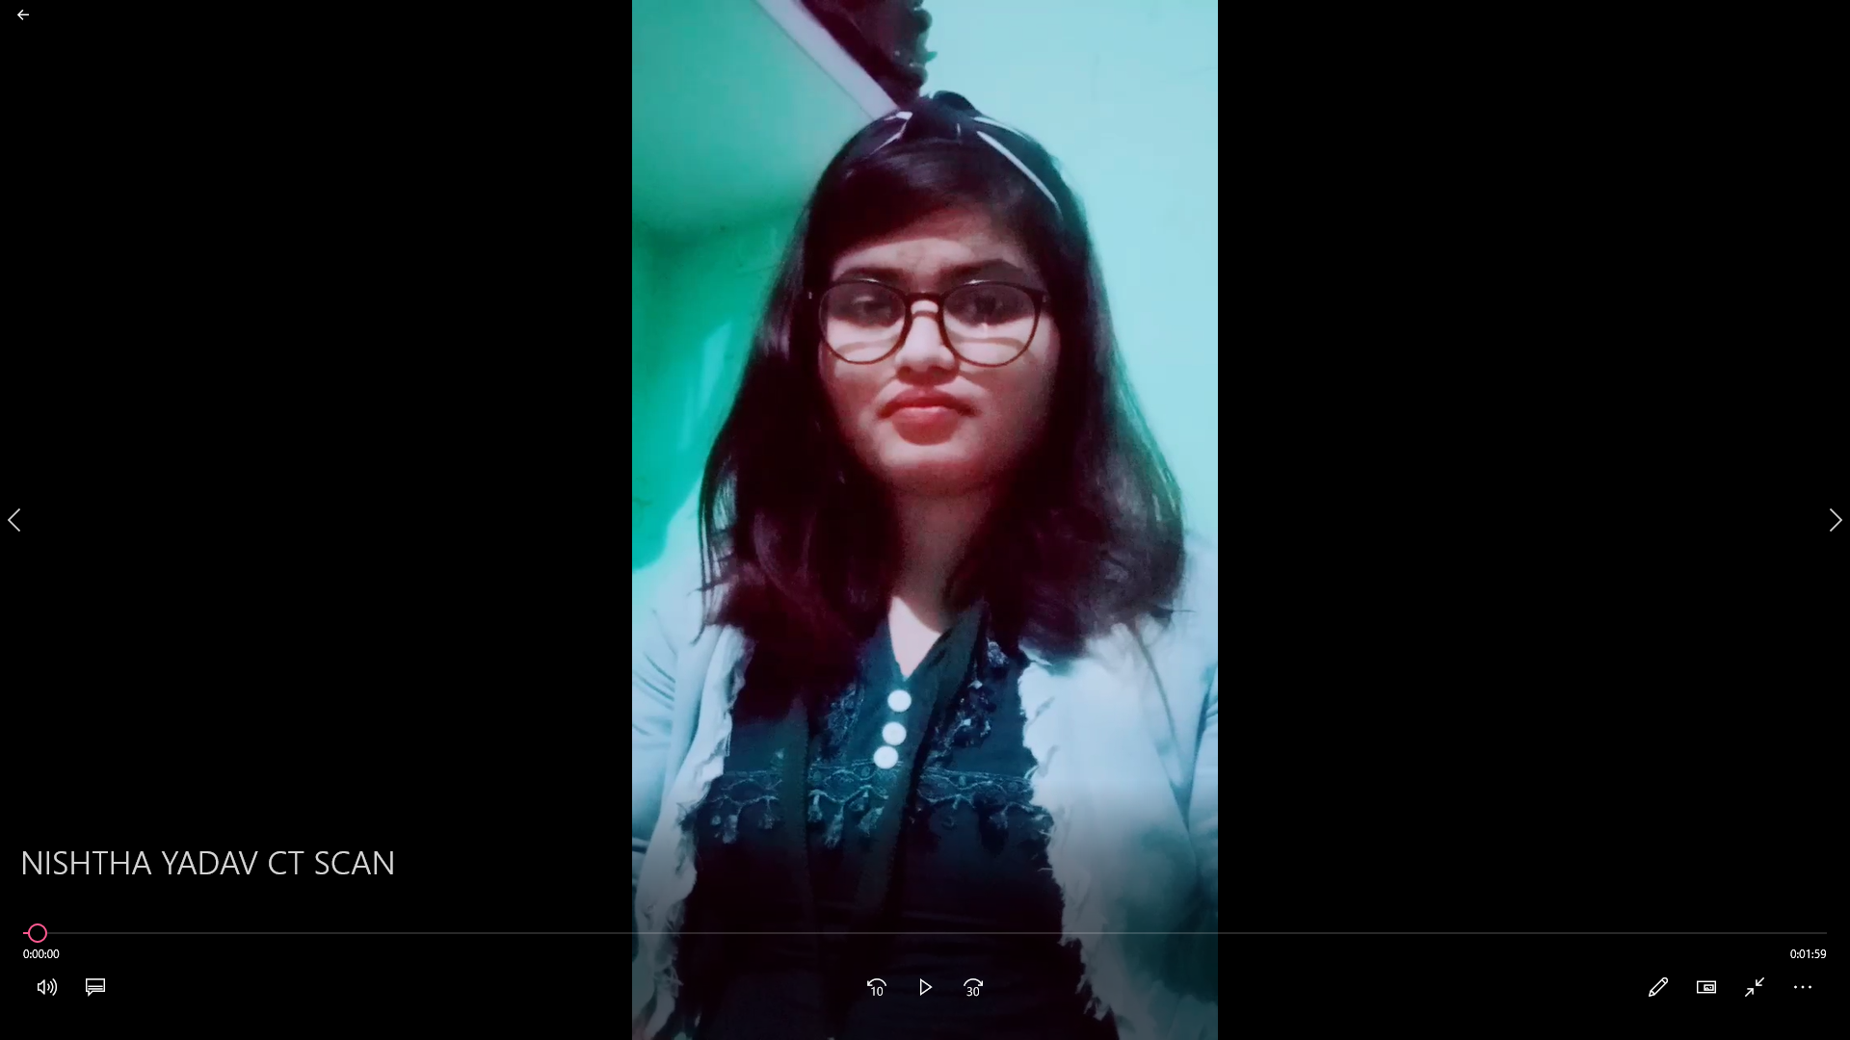
e-Poetry Competition
Date-22.10.2020, Time (12:30 pm to 01:30 pm)
Mamta Gupta- DBTT
Ritu Singh- DOTT
Stuti Gupta - DOTT
Nistha Yadav- DCTT

Slide 10
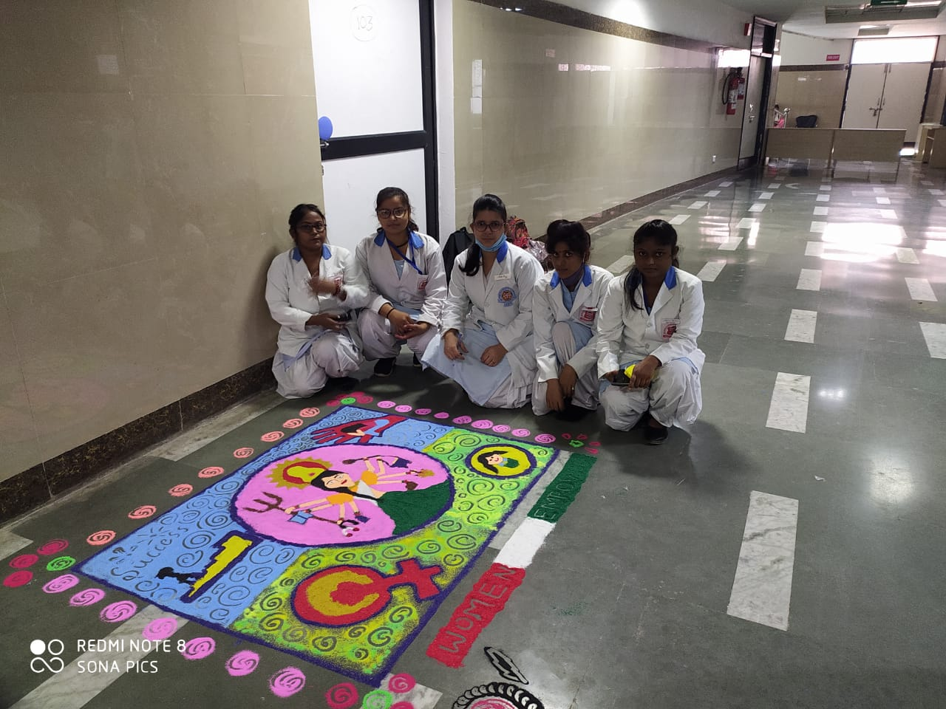
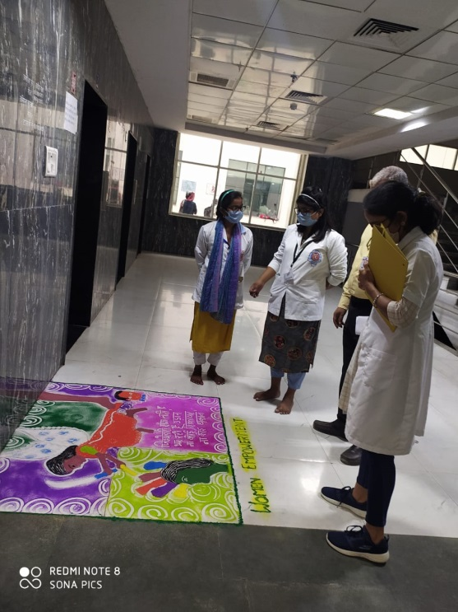
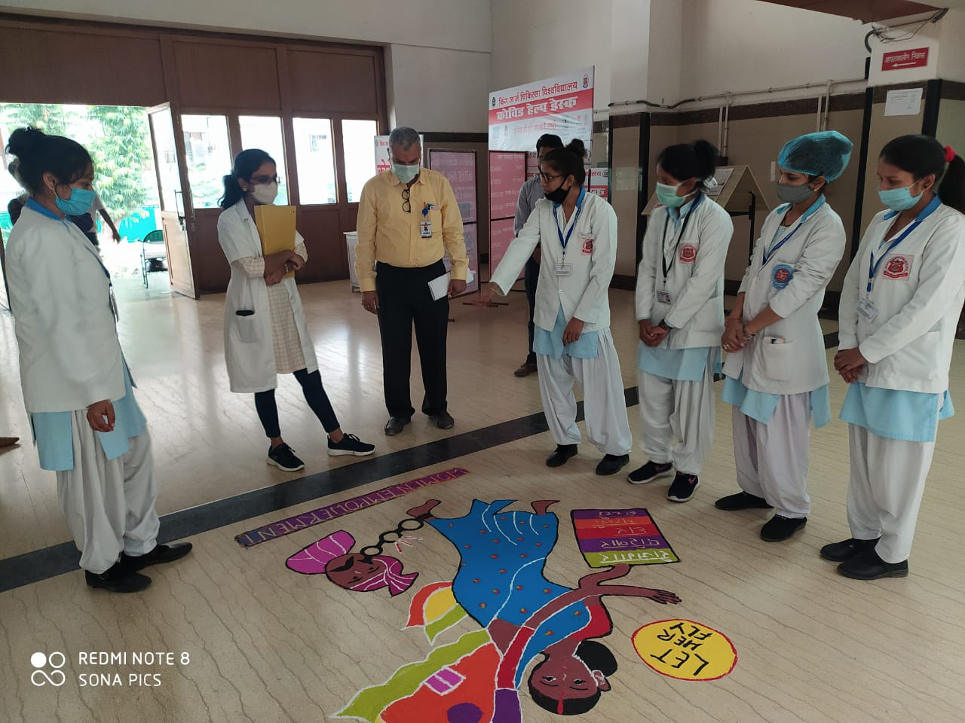
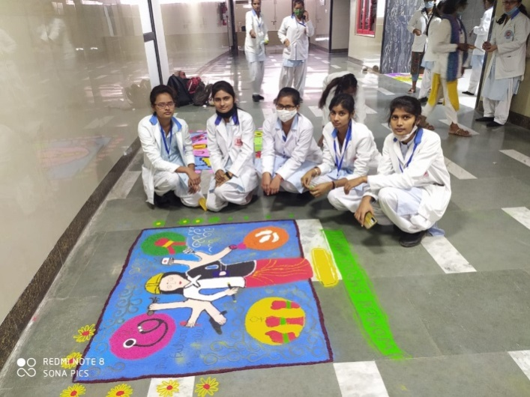
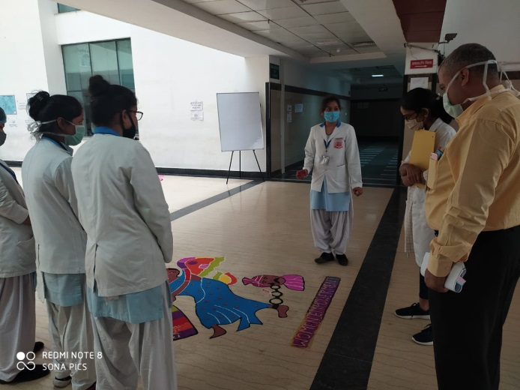
Rangoli Competition
Date-23.10.2020, Time (08:30 am to 10:00 pm)

Slide 11
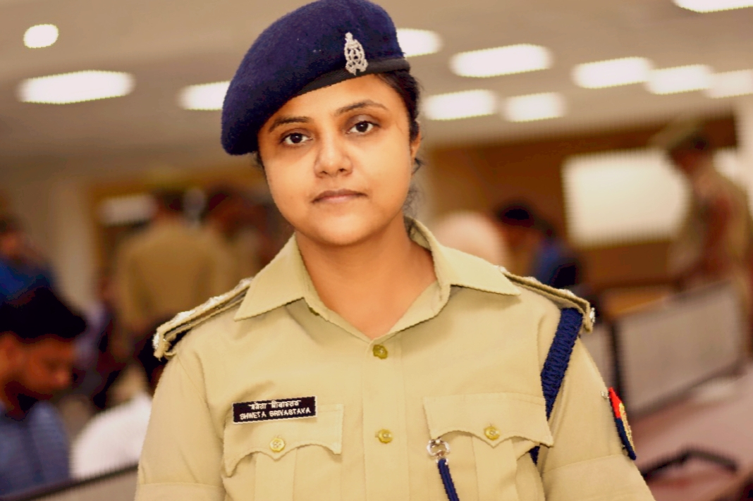
After Ceremony Guest e-Lecture
Date-23.10.2020, Time (01:30 pm to 02:00 pm)
Ms. Shweta Srivastava
ACP Lucknow, Commissionerate

Slide 12
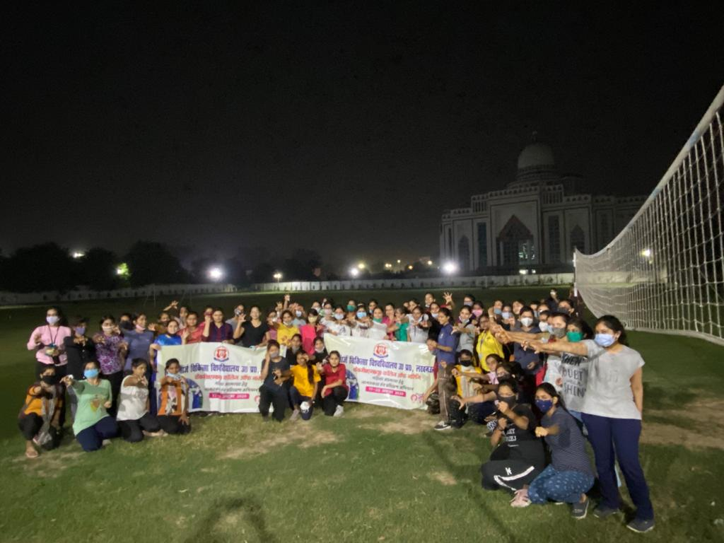
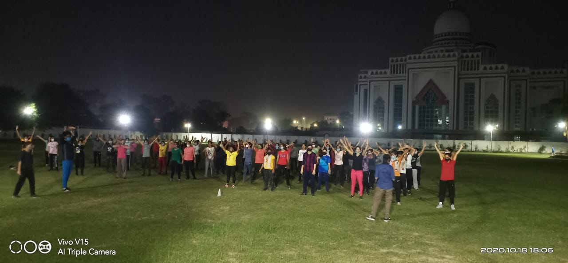
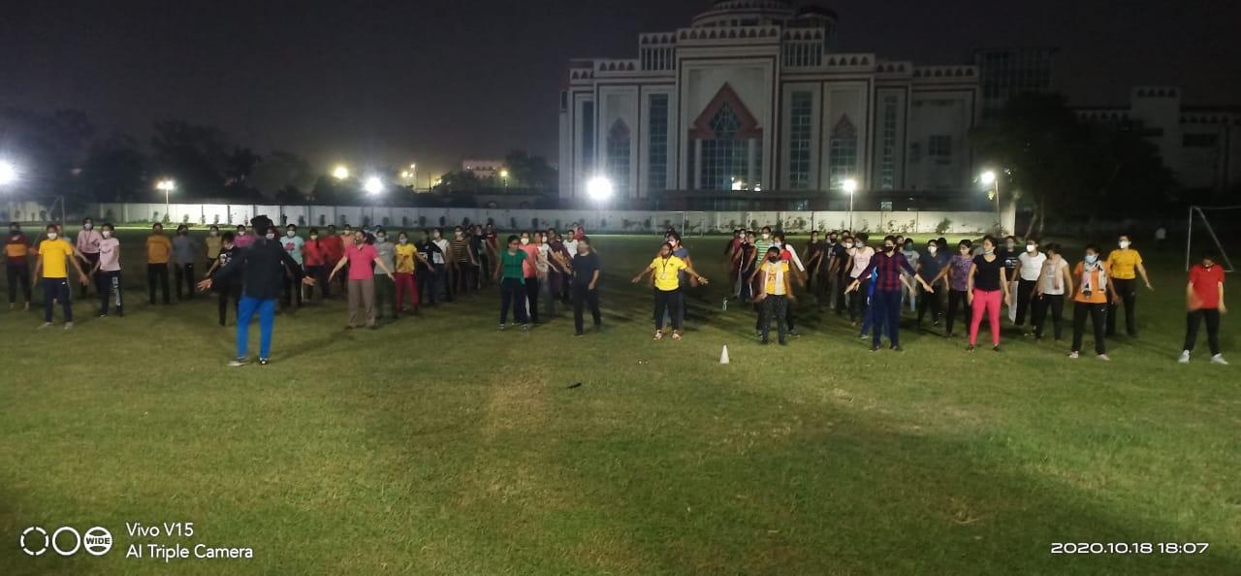
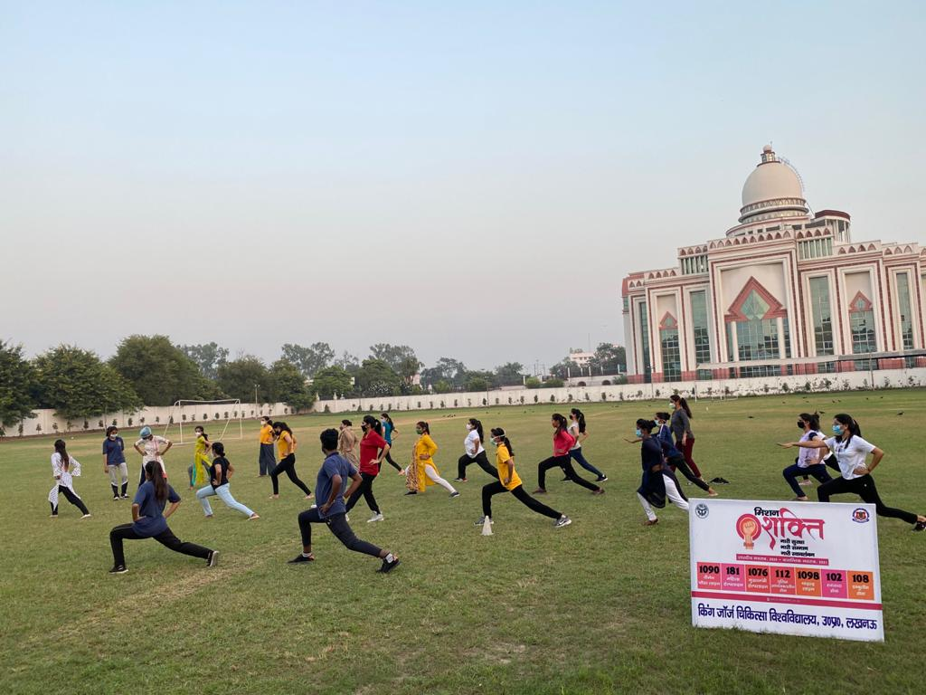
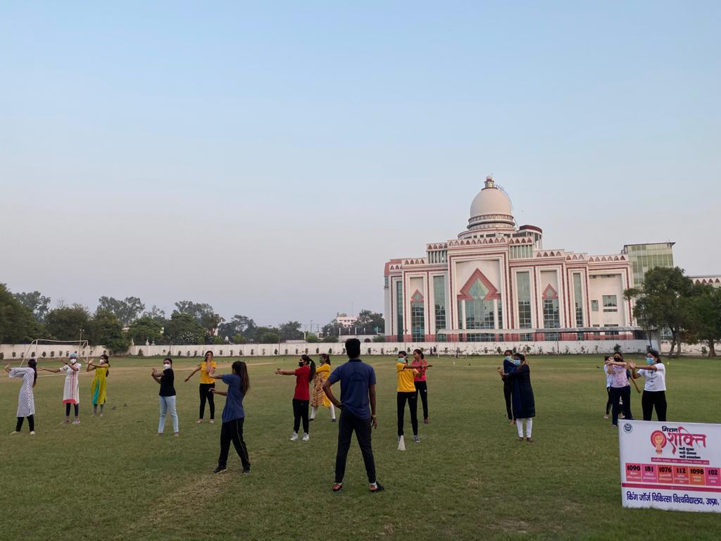
Physical Self- Defence training
Date : 17/10/2020 to 23/10/2020, Time 05:00 pm to 06:00 pm

Slide 13
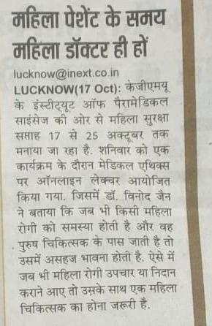
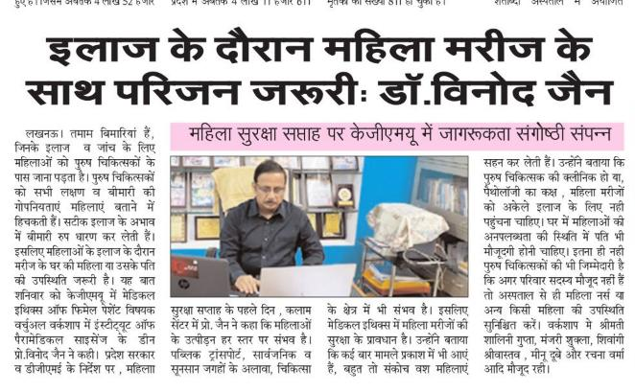
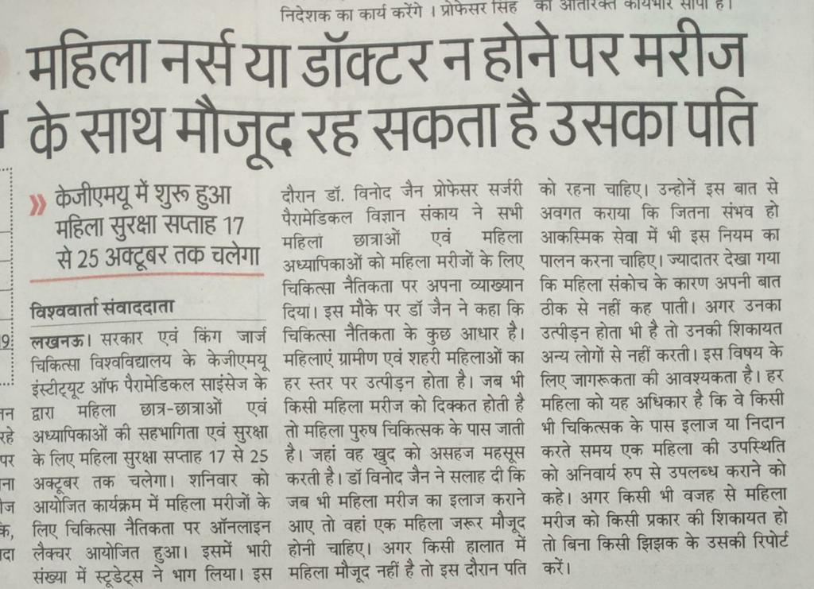
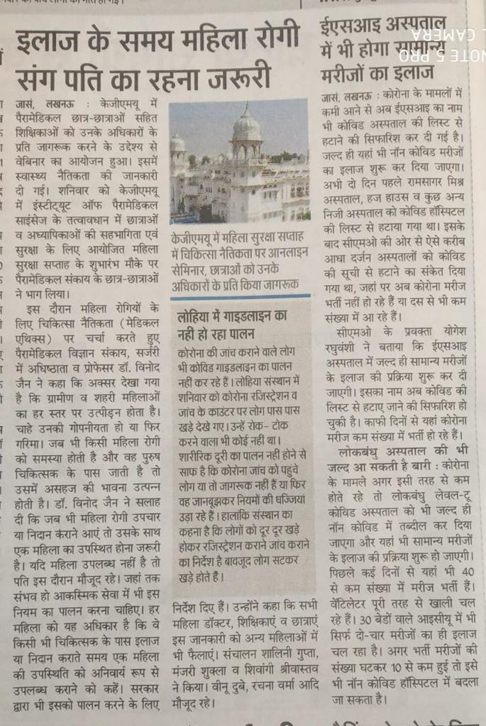
Media Coverage

Slide 15
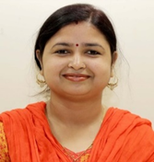
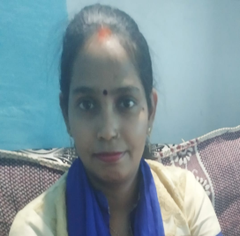
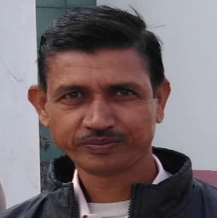













Contributors

Slide 16
Thank You

