Slide 1
Gestational Diabetes Mellitus – One Disease Two Lives at Stake
Dr. VK Srivastava
MD, DPH, MSc Comm. Med. (London), FAMS, FIPSM, FIPHA, FSMS
Secretary, International Epidemiological Association &
Prof. & Head, Department of Community Medicine,
Hind Institute of Medical Sciences, Lucknow Metro.

Slide 2
Introduction
Gestational Diabetes Mellitus (GDM) is defined as Impaired Glucose Tolerance (IGT) with onset or first recognition during pregnancy
Worldwide, one in 10 pregnancies is associated with diabetes, 90% of which are GDM
Undiagnosed or inadequately treated GDM can lead to significant maternal & foetal complications
Women with GDM and their offsprings are at increased risk of developing Type 2 diabetes later in life

Slide 3
The Problem
In India, prevalence of GDM is appox.10-14.3% - much higher than the west
As of 2010, India has:-
22 mill. women with diabetes in the age group of 20-39 with an additional 54 mill. women in this age group with impaired glucose tolerance (IGT)
In view of high prevalence of GDM in Indian women, Govt. of India has released National Guidelines for Diagnosis & Management of Gestational Diabetes Mellitus in Dec 2014.

Slide 4
Patho-physiology
GDM is characterised by hyper-insulinaemia and insulin resistance
In first trimester and early second trimester, increased insulin –due to high levels of oestrogen
In late second and early third trimesters, insulin resistance - due to a number of antagonistic hormones especially, placental lactogen, leptin, progesterone, prolactin, cortisol and adiponection

Slide 6
Implications of Diabetes in Pregnancy
The risk of serious injury at birth - Doubles
The likelihood of Caesarean delivery - Triples
The incidence of Neonatal Intensive
Care Unit admission - Quadruples

Slide 7
Pregnancy and Diabetes- The vicious cycle
Pregnancy
Diabetes Mellitus

Slide 8
Effects of Pregnancy on Diabetes
During pregnancy, there is altered carbohydrate metabolism and impaired insulin action
Insulin requirement increases as pregnancy advances
Accelerated starvation----rapid activation of lipolysis with short period of fasting
Higher risks of Ketoacidosis complications
Accelerates vascular changes

Slide 9
Effect of Diabetes on Pregnancy: 1. Respiratory Distress Syndrome 2. Polydydramnios 3. Foetal macrosomia 4. Erb’s Palsy 5. Birth asphyxia 6. Abortion/Intra uterine death 7. Neonatal hyperbilirubinemia 8. Congenital malformations

Slide 10
Maternal Hyperglycaemia
Decreased cortisol production
Foetal hyperglycaemia
Foetal hyperinsulinaemia
Decreased surfactant synthesis in lung
Foetal osmotic diuresis
Foetal hypoglycaemia
Increased IGF
Polyhydramnios
Respiratory distress syndrome
Fetal macrosomia
Polyhydramnios
Obstructed labour
Shoulder Dystocia
Erb's Palsy/ Birth Asphyxia

Slide 11
Chronic maternal hyperglycaemia
Hyperglycaemia in 1st trimester
Glycosylated Hb carries less oxygen molecule and O2 binds more avidly and releases O2 less
Foetal hyperglycaemia
Impaired organogenesis
Foetal hyper-insulinemia
Congenital abnormalities
Increased foetal oxygen demand
Decreased Oxygen tension (hypoxemia)
Increased erythropoiesis
Increase in anaerobic metabolism
Polcythaemia and hyper viscosity
Increased lactate and academia
RBC breakdown and Neonatal hyper-bilirubinemia
Abortion/ IUD

Slide 12
GDM: Risk Factors
Age >25years
BMI >25kg/m²
Increased weight gain during pregnancy
Previous history of large for gestational age infants
History of GDM during previous pregnancies
previous stillbirth with pancreatic islet hyperplasia on autopsy
Ethnic group ( East Asian, Pacific Island ancestry)
Elevated fasting or random blood glucose levels during pregnancy
Family history of diabetes in first degree relatives
History of metabolic X syndrome
History of type I or type II Diabetes Mellitus
Unexplained fetal loss

Slide 13
GDM: Maternal Complications
During Pregnancy
Abortion
Preterm labour (due to infection or polyhydramnios)
Pre-eclampsia
Polyhydramnios
Maternal distress due to oversized fetus and polydramnios
Microangiopathy- Nephropathy, retinopathy, neuropathy
Large vessel disease
Coronary artery disease
Thromboembolic disease
Infection
Hypo and hyperglycaemia
During labour
Prolonged labour
Shoulder dystocia
Perineal injuries
PPH
Operative interference
Increased risk of Caesarean delivery
Puerperium
Puerperal sepsis
Lactational failure

Slide 14
GDM: Foetal Complications
1st Trimester
Congenital abnormalities
Cardiac : ASD, VSD
NTD
Sacral agenesis/ CRS
PCKD
Renal agenesis
Duodenal atresia
Tracheo-esophageal fistula
2nd Trimester
Macrosomia
During delivery
Birth asphyxia
Shoulder dystocia
After delivery
RDS
Hypoglycaemia
Polycythaemia
neonatal jaundice

Slide 15
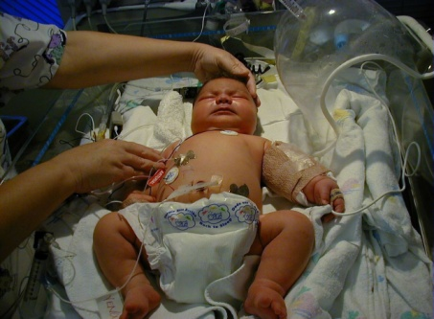
GESTATIONAL DIABETES | PRE-EXISTING DIABETES
No increased risk of congenital anomalies Increases risk of foetal macrosomia Increases risk of having Caesarean section Increased risk for metabolic syndrome and type II diabetes later in life (>50% women with gestational diabetes develop type II DM) Babies born to women with gestation diabetes are at increased risk for obesity, glucose intolerance and diabetes in adolescence | Higher risk of congenital malformations and miscarriages Recurrent urinary tract infections Vulvo-vaginal infections with poor control Associated with risk of (PPPPRIM) Pre-eclampsia, Polyhydraminos, PPROM, Preterm labour, Risk of operative deliveries IUGR Macrosomia Ketoacidosis in type I, progression of microvascular complications Caesarean section rates invariably increased due to fetal macrosomia, poor blood sugar control, polyhydramnios or associated with failure of induction

Slide 16
The White classification, named after Priscilla White on the effect of diabetes types on perinatal outcome.
It distinguishes between gestational diabetes (type A) and diabetes that
existed before pregnancy (pre-gestational diabetes).
There are 2 classes of gestational diabetes (diabetes which began during pregnancy):
Class A₁: gestational diabetes; diet controlled
Class A₂: gestational diabetes; medication controlled
The second group of diabetes which existed before pregnancy can be split up
into these classes:
Class B: onset at age 20 or older or with duration of less than 10 years
Class C: onset at age 10-19 or duration of 10–19 years
Class D: onset before age 10 or duration greater than 20 years
Class E: overt diabetes mellitus with calcified pelvic vessels
Class F: diabetic nephropathy
Class R: proliferative retinopathy
Class RF: retinopathy and nephropathy
Class H: ischemic heart disease
Class T: prior kidney transplant

Slide 17
GDM: Diagnosis
Symptoms
Asymtomatic
Insidious onset
Polyuria, polyuria, polyphagia
Fatigue and weight loss
Women with established diabetes may have retinopathy or neuropathy
Signs
Elevated serum glucose
Glycosuria is of uncertain significance
Ketonuria
Elevated glycosylated haemoglobin
Greater than normal abdominal circumference

Slide 18
Principles of Management (National Guidelines for Diagnosis and Management of GDM-2014)

Slide 19
Who should be tested :
The first testing - first antenatal contact as early as possible
The second testing -24-28 weeks of pregnancy if the first test is negative
At least 4 weeks gap between the two tests
All Pregnant Women to be tested even if they come late in pregnancy
If presents beyond 28 weeks of pregnancy-only one test to be done

Slide 20
How to Test:
Single step testing - 75 gm oral glucose & measure plasma glucose 2 hour after ingestion
75 gm glucose mixed with 300 ml water ingested whether the PW comes in fasting or non-fasting state
A plasma standardised glucometer should be used to evaluate blood glucose 2 hours after the oral glucose load
The threshold plasma glucose level of ≥140 mg/dl is taken as cut off for diagnosis of GDM.

Slide 21
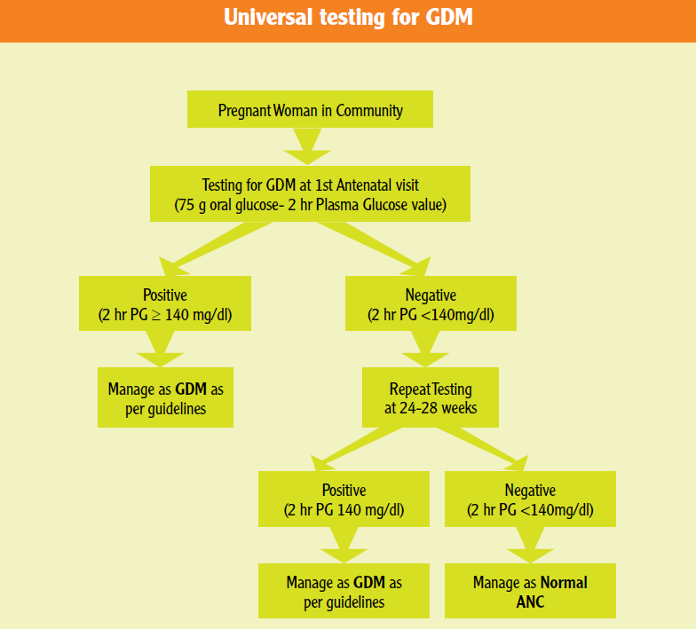

Slide 22
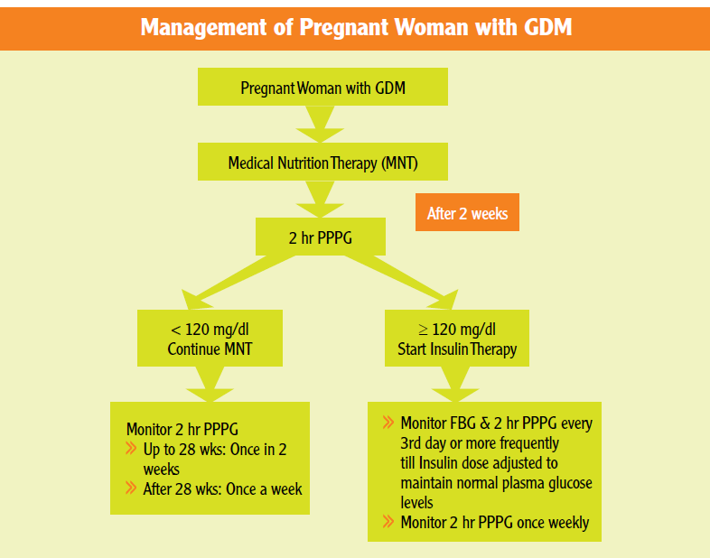

Slide 23
Antenatal care:
All diabetic women are managed in a multidisciplinary combined obstetric and diabetic clinic with specialist obstetrician, diabetologist, specialist midwife, paediatrician and dietician
All women should receive dietary instruction, with individual recommendations based on weight and height
Patient should receive nutrition counselling from a registered dietician
Daily calories should be made up approximately 40% carbohydrate, 20% proteins and 40% fats.
This should improve blood glucose levels

Slide 24
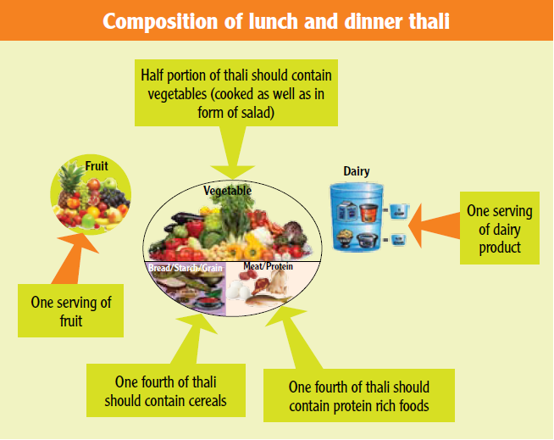
Medical Nutritional Therapy:
Recommended diet should provide
1800 Kcal/ day
50%-60% -carbohydrate
10-20% - Proteins
25-30% - Fat

Slide 25
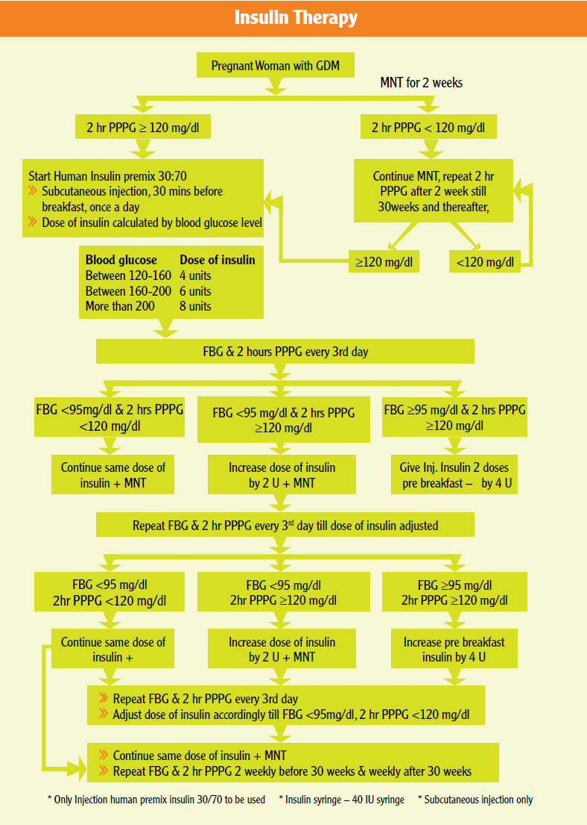

Slide 26
Role of Ultrasound:
Preferably done in first trimester to confirm gestational age by dates
Repeated at 18 to 20 weeks gestation to evaluate the foetus for congenital anomalies
Particularly important in patients with pre-existing type 1 and 2 diabetes and elevated first trimester HbA1c (>6.5%)
Should be done at 30 to 32 weeks and 36-38 weeks of gestation to evaluate foetal size, amniotic fluid index, and to help ascertain the mode of delivery

Slide 27
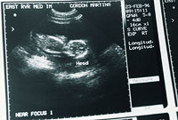
Tests of Foetal wellbeing
Daily foetal movement counting: 32 weeks gestation and continue until delivery.
Amniotic fluid index and biophysical profile.
These tests are usually conducted twice weekly and are instituted at 32 to 34 weeks of gestation in women on insulin and can be done from 34-36 weeks of gestation in women whose diabetes is controlled by diet.
Some clinicians manage patients with dietary control without any additional testing.

Slide 28
Sulfonylureas
Insulin secretagogues
Glipizide, glyburide
Increase insulin secretion, decrease hepatic glucose production with resultant reversal or hyperglycaemia and indirect improvement of insulin sensitivity
Meglitinides
Biguanides
Decrease insulin resistance
ORAL
HYPOGLYCAEMIC
AGENTS
Alpha glucosidase inhibitors eg acarbose)
Decrease intestinal absorption of starch and glucose
Thiazolidinediones
Eg rosiglitazone and pioglitazone
Not Recommended in National Guidelines - only Insulin to be used

Slide 29
Time and Mode of Delivery
All pregnant women advised during the antenatal care about the potential risks of pregnancy progressing beyond term
Gestational diabetes
GDM on diet with no complications can be delivered at 40 weeks
GDM on insulin should be delivered by induction of labour at 38-39 weeks
Pre-existing diabetes
Diabetes itself not an indication for Caesarean Section
Pregnant women with diabetes who have a normally grown fetus should be offered elective birth through induction of labour, or by elective caesarean if indicated, after 38 completed weeks
Pregnant women with ultrasound features of macrosomic fetus (fetal weight more than 4.5kg) and poorly controlled blood sugar are delivered by elective caesarean section.

Slide 30
Post-delivery Follow up of GDM Cases
Women with GDM are at higher risk for Type 2 Diabetes mellitus.
Maternal glucose levels usually return to normal after delivery.
GDM cases are not discharged after 48 hours unlike others, FPG & 2 hr PPPG is performed on the 3rd day of delivery
Subsequently, ANM to perform 75 g GTT at 6 weeks postpartum
Cut offs for normal blood glucose values are:
Fasting plasma glucose: ≥ 126 mg/dl
75 g OGTT 2 hour plasma glucose
Normal: < 140 mg/dl
IGT: 140-199mg/dl
Diabetes: ≥ 200 mg/dl

Slide 31
Operational Aspects of National GDM Guidelines

Slide 32
Role of Health Personnel at different levels of Health Facility:
Village Level
ASHA: To mobilise & counsel PW for timely testing & follow up
Sub-centre Level
ANM: Testing/MNT/Referral of cases needing medical
management
Maintaining records, monitoring & follow up

Slide 33
Role of Health Personnel at different levels of Health Facility...contd.
PHC/ UPHC Level
GDM controlled on MNT can be delivered by ANM/SN
GDM on Medical management with Insulin therapy- by MOs
GDM not controlled by Insulin therapy/GDM with complications should –to referred to higher facility for care by a specialist
Maintaining records, monitoring & follow up

Slide 34
Role of Health Personnel at different levels of Health Facility ..contd.
DH & All CEmOC centres
All jobs as defined under PHC level
+
Specialist/Gynaecologist/MO: Management of all types of GDM cases
MC & other Super-speciality centres
Comprehensive management of GDM including all referral cases

Slide 35
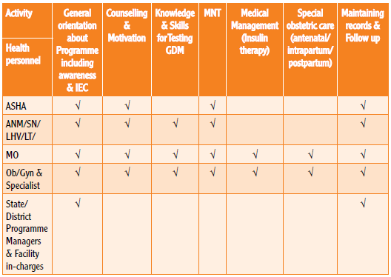
Capacity building of Health personnel under GDM Guidelines

Slide 36
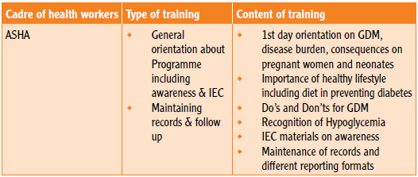
Training needs for different cadres

Slide 37
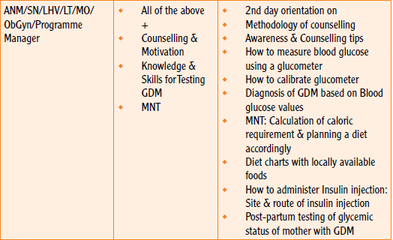
Training needs for different cadres

Slide 38
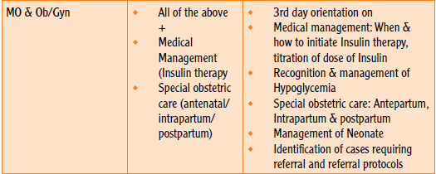
Training needs for different cadres

Slide 39
Screening for GDM
Most patients with GDM have normal fasting glucose levels.
The challenge of glucose tolerance must be done for most cases with GDM.

Slide 40
Screening –at the 24 weeks visit
OGTT should be done.
There are some controversies.
whether the universal or selective OGTT should be done?
Which blood glucose level should be the optimal cutoff for diagnosis?

Slide 41
Screening Strategy
Every pregnant woman to undergo OGTT at about 24 weeks of gestation.
If the GDM symptoms are present after 24 weeks, the OGTT should be done again.

Slide 42
Target Blood Glucose Values

Slide 44
Ante-partum Management
There is a consensus that once diabetes is diagnosed, the treatment should be recommended for diabetes during pregnancy.
The goals of treatment are to prevent macrosomia, avoid ketosis, and detect pregnancy complications (eg, hypertension, intrauterine growth restriction, and fetal distress).
The management includes diet, exercise and insulin.

Slide 45
Diet Therapy
The goals of diet therapy in GDM are to avoid ketosis, achieve normal blood glucose levels, obtain proper nutrition, and gain weight appropriately.
The amount and distribution of carbohydrate should be based on clinical outcome measures (eg, hunger, blood glucose levels, weight gain), but a minimum of 175 g of carbohydrate per day should be provided.
Carbohydrate should be distributed throughout the day in 5 to 7 meals and snacks.
Use of a low–glycemic index diet decreases the need for insulinto maintain euglycemia.

Slide 46
Exercise
Experts recommend that women with GDM should exercise regularly to control blood glucose levels.
but an improvement in clinical outcomes has not been demonstrated from compliance with this recommendation.

Slide 47
Insulin Therapy
Traditionally, insulin is used if dietary management does not maintain blood glucose at normal levels.
Insulin may be initiated at 0.7 U/kg actual body weight/d given in divided dosages: two-thirds of the daily dosage before breakfast and the remainder of the dosage before dinner.
Insulin therapy require close monitoring and adjustment based on blood glucose levels, meal choices, and activity levels.

Slide 48
Obstetrics Management
The goal of intra-partum GDM management is to avoid operative delivery, shoulder dystocia, birth trauma, and neonatal hypoglycemia.
For patients who have maintained excellent control of blood glucose levels with diet and exercise, delivery is recommended at 40 weeks.
For patients with medication-requiring GDM, induction at 38 to 39 weeks’ gestation is recommended

Slide 49
Obstetrics management…contd
In general, women with gestational diabetes who do not require insulin seldom require early delivery or other interventions.
Elective cesarean delivery to avoid brachial plexus injuries in macrosomic infants is an important issue.

Slide 50
Postpartum Management
In most women with GDM, hyperglycemia rapidly resolves shortly after delivery.
It is reasonable to measure a single random or fasting blood glucose level before discharge from the hospital.

Slide 51
Postpartum Management..contd
Postpartum glucose tolerance testing is important for women who had GDM.
Women with GDM have a 7-fold increased risk of developing type 2 diabetes mellitus compared with those who had a normoglycemic pregnancy.
At 6 to 12 weeks postpartum, only one-third of women with persistent glucose intolerance have an abnormal fasting blood glucose level.
Therefore, to detect all women with glucose intolerance, a 75-g, fasting, 2-hour, oral glucose tolerance test is recommended.

Slide 52
Summary- Key Points
Universal testing of all PW for GDM
Testing recommended twice in pregnancy at 1st antenatal visit and then at 24-28 weeks of gestation
Single step 75 g 2 hr PPPG test to be performed
PW testing positive (2 hr PPPG > 140mg/dl) should be started on MNT for 2 weeks
If 2 hr PPPG ≥ 120 mg/dL after MNT, medical management (Insulin therapy) of PW to be started
PW to be monitored by 2 hr PPPG throughout pregnancy

Slide 53
Summary-Key Points..contd
Antenatal visits 2 weekly in 2nd trimester & weekly in 3rd trimester
PW on Insulin therapy with uncontrolled Blood glucose levels (2 hr PPPG ≥120 mg/dl) or insulin requirement >20 U/day should be referred for delivery at CEmOC centres
GDM pregnancies associated with delay in lung maturity of foetus- routine delivery prior to 39 weeks not recommended.
Vaginal delivery preferred, LSCS for only obstetric indications or foetal macrosomia
Postpartum evaluation of glycaemic status by a 75 g OGTT at 6 weeks after delivery.

Slide 54
Thank You

