Slide 1
Respiratory System
Dr Archna Ghildiyal
Associate Professor
Department of Physiology
KGMU

Slide 2
LECTURE:7
Contents
Pulmonary circulation- features
Gaseous transport: CO₂
CO₂-Hb dissociation curve

Slide 3
Learning Objectives
Partial pressure of gases
CO₂ Transport : Methods
Chloride Shift
CO₂-Hb dissociation curve
Haldane effect

Slide 4
Pulmonary Circulation:Features
Lungs Receive blood from-
Pulmonary arteries(deoxygenated)&
Bronchial arteries(oxygenated)
Pulmonary arteries- Thin wall (thickness 1/3 rd that of aorta)
Smaller arteries & arterioles have larger diameter than their counterpart systemic arteries

Slide 5
Pulmonary vessels
Distensible
Large compliance (to accommodate stroke volume output of right ventricle)
Constrict in response to localized hypoxia(↓ O₂ level)-Diverts pulmonary blood from poorly ventilated areas of lungs to well ventilated regions)

Slide 6
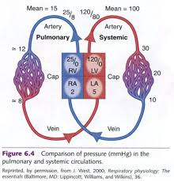

Slide 7
Contd…
Effects of ↑ in pulmonary blood flow and vascular pressure
-Recruitment
- Distention
Effects of high Lung volume
-Alveolar vessels-compression by enlarging alveoli, ↑ Resistance
-Extra alveolar vessels-distention,↓ Resistance

Slide 8
Effects of chemical & humoral substances
Vasoconstrictors
Alveolar hypoxia
ᾳ-adrenergic agonists
Thromboxane
Norepinephrine
Angiotensin
Histamine
Endothelin
Vasodilators
Β-adrenergic agonists
Bradykinin
Prostacyclin
Nitric oxide

Slide 9
Carbondioxide Transport
Three Forms:
1.Dissolved in the plasma 7%
2.Chemically Bound to Hemoglobin in RBC’s
(as carbaminohaemoglobin) 23%
3.As Bicarbonate ions (HCO₃⁻) in plasma 70%

Slide 10
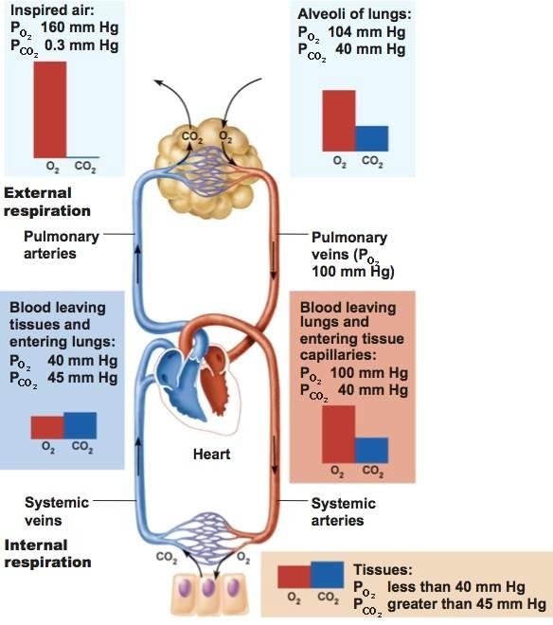

Slide 11
Transport in Dissolved state
PCO₂ venous blood=45 mmHg
(amount dissolved=2.7ml/dl)
PCO₂ of arterial blood=40 mmHg(2.4 ml/dl dissolved CO₂)
0.3 ml of CO₂ is transported in dissolved form by each 100 ml of blood flow

Slide 12
Combination with Hb & Plasma Proteins
Carbon dioxide molecule reversibly attaches to an amino portion of hemoglobin.
CO₂+HB HbCO₂
CO₂ +Plasma proteins in tissue capillaries
(CO₂Transport in small amount)

Slide 13
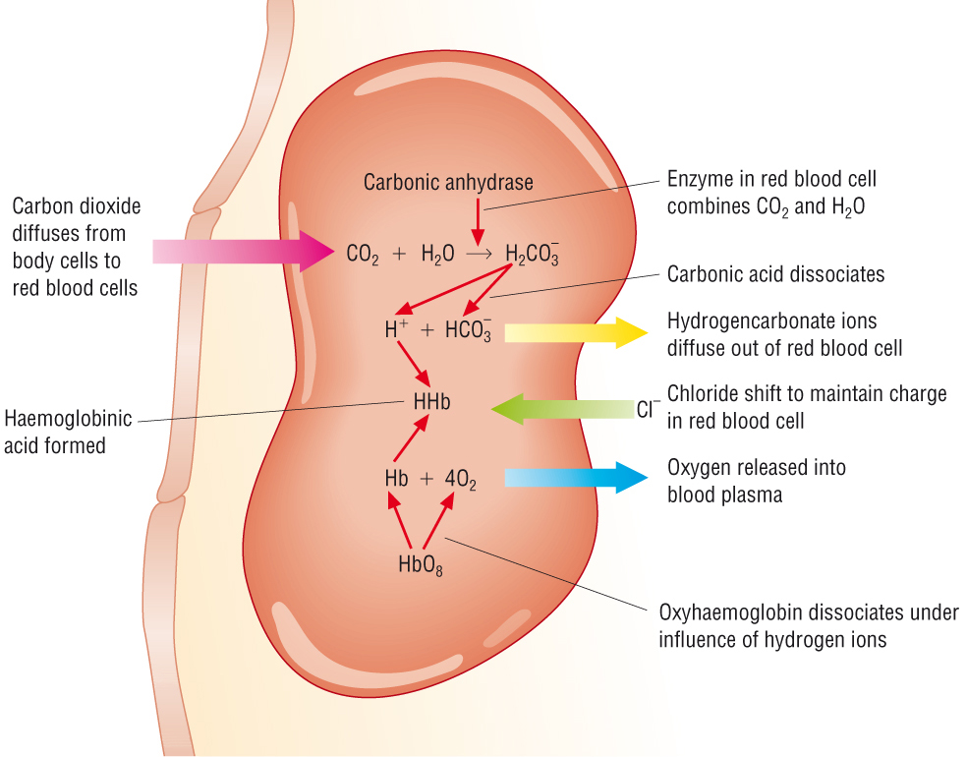
AS bicarbonate ions

Slide 14
Contd…
Dissolved CO₂ + H₂O→H₂CO₃
Catalyst: carbonic anhydrase( Rbc protein enzyme)
5000 fold increase in rate of reaction
Within a very small fraction of seconds

Slide 15
Contd…
Dissociation of carbonic acid into bicarbonate & H⁺ ions
Hemoglobin protein is a powerful acid base buffer

Slide 16
Chloride shift
To maintain electrical neutrality of Red cells
HCO₃⁻ diffuses out of the cell and is replaced by Cl⁻ from plasma
Chloride content of venous Rbc’s >arterial red cells

Slide 17
Carbon dioxide dissociation curve
Haladane effect
Lungs-Binding of O₂ with Hb(stronger acid forms) tends to displace CO₂ from the blood and into the alveoli
Released H⁺ binds with HCO₃- to form carbonic acid

Slide 18
Contd…
Lungs- P_{CO2} is low
CO₂diffuses out of the capillaries into the alveoli to be exhaled
Volume percent (vol%) refers to the milliliters of Gas extracted from a 100-ml sample of whole blood

Slide 19
Contd…
Normal conc. Of CO₂ in blood in all forms =50 volume %
Only 4 volume % of total is exchanged during normal transport of CO₂ from tissues to the lungs(Conc of CO₂ in Tissues 52 vol%,Lungs 48 vol%)

Slide 20
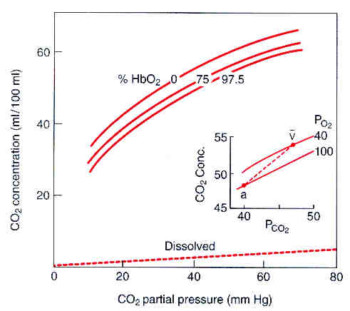
Carbon dioxide dissociation curve

Slide 21
Contd…
CO₂ dissociation curve is more linear than O₂ dissociation curve
Deoxygenated blood carries more CO₂ than oxygenated blood for a given P_{CO2}(due to better ability of reduced Hb to mop up/wash more H⁺)

Slide 22
Question:1
If you increase the left atrial pressure from
5 mmHg to 15 mmHg, what effect would
that have on pulmonary circulation?
A. It would force blood the opposite direction
B. It would increase the speed at which blood moves through the pulmonary circulation
C. No change
D. Blood flow would almost or completely stop

Slide 23
Question:2
Pulmonary circulation differs from systemic circulation A) Pulmonary vasodilation in hypoxia B) Pulmonary vasoconstriction in
hypoxia C) Decreased blood volume during
systole D) Increased basal vasoconstrictor
tone

Slide 24
Question:3
As blood passes through systemic capillaries, the
enzyme carbonic anhydrase catalyzes
A. Conversion of dissolved CO₂ to
carbonic acid
B. Conversion of carbonic acid to
bicarbonate ion
C. Conversion of gaseous CO₂ to dissolved
CO₂
D. Binding of carbon dioxide to hemoglobin,
thus displacing oxygen

Slide 25
Question:4
To which of the following is alveolar PCO2 directly
proportional?
A. Rate of CO2 production and alveolar ventilation
B. Rate of CO2 production and rate of O2 consumption
C. Alveolar ventilation and rate of O2 consumption
D. Alveolar ventilation, rate of O2 consumption, and rate of CO2 production

Slide 26
Question:5
The normal arterio-venous difference for CO2 is:
A. 2ml/100ml
B. 4ml/100ml
C. 6ml/100ml
D. 10ml/100ml

Slide 27
Answers
1- D
2- B
3- A
4- B
5- B

Slide 28
References
Guyton & Hall.Text book of Medical Physiology
Ganong’s Review of Medical Physiology
Berne & Levy Physiology

