Slide 1
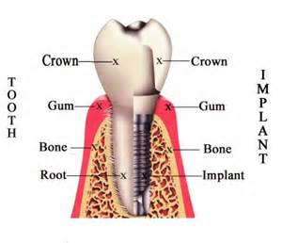
BASIC CONCEPT OF DENTAL IMPLANT
“An artificial dental root that is surgically inserted into the jaw bone &that can be used by the dentist as platform for prosthesis”

Slide 2
HISTORY OF DENTAL IMPLANT
1950s P.I.Branemark & associates
1965 first patient
1976 Schroder et al.
1978 Schulte(German)
1981 Albrektsson

Slide 3
OSSEOINTEGRATION
“A direct structural&functional connection between bone and the surface of a load-carrying implant”(Branemark 1960)
Fibro-osseous integration
-soft tissue(fibres)interposed between the implant surface & bone
Biointegration
-implant is covered with bioactive material like hydroxyapatite

Slide 4
RATIONALE FOR IMPLANT THERAPY
Tooth loss related to age
Anatomic consequences
Poor performance of RPD
Predictable long term results of implant-supported prosthesis
Eliminating the need to grind healthy tooth

Slide 5
CLASSIFICATION OF DENTAL IMPLANT
Based on type of Anchorage
-submucosal
-subperiosteal
-transosteal
-endoosteal

Slide 6
CLASSIFICATION OF DENTAL IMPLANT Contd..
Based on shape&form
Root form-solid cylinderical/tapered
-pin type
-screw type
-basket type
-hollow cylinder

Slide 7
CLASSIFICATION OF DENTAL IMPLANT Contd…
Blade form-conventional blade design
-vented blade design
Based on the surface texture
-surface with pure titanium
-acid-etched surface
-porous beaded surface
-hydroxyapatite coated

Slide 8
PERI-IMPLANT MUCOSA
Dense lamina propria covered by stratified squamous keartinized epithelium
Implant-epithelium junction is analogous to the JE
Epithelial cells attach to the titanium implant by means of hemidesmosomes&basal lamina
Sulcus arround implant lined by sulcular epithelium

Slide 9
PERI-IMPLANT MUCOSA Contd..
Depth of sulcus 1.5-2.0mm
Collagen fibers are nonattached&parallel due lack of cementum
Marginal periimplant mucosa contains significantly more collagen&fewer fibroblasts
Periodontal ligament absent
Biologic width(3-4mm)=epithelial attachment(2mm)+supracrestal CT(1-2mm)

Slide 10
VASCULAR SUPPLY&INFLAMMATION
Limited due to lack of Pdl
Capillary loops below JE&SE similar to normal periodontium
Inflammatory response similar to periodontal tissue

Slide 11
TEETH vs. IMPLANTS
Lack of Pdl
Implant can not intrude/migrate
Proprioception -ce
C/I in growing individuals
Overload/parafunctional habits cause microstrain/microfracture in bone bone loss

Slide 12
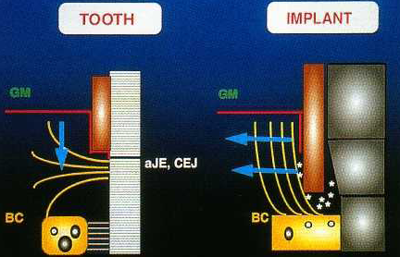
TEETH vs. IMPLANTS Contd..

Slide 13
MCQ-1
Which of the following shows the difference between peri-implant and periodontal mucosa
(a)Stratified squamous keratinized epithelium
(b)Sulcus lined with sulcular epithelium
(c)Viable bioloigic seal between implant and epithelial cells
(d)Attachment of collagen fibers

Slide 14
MCQ-2
The term which describes the ultrastructural contact between bone and implant is
(a)Fibrous integration
(b)Osseointegration
(c)Ankylosis
(d)Bonyintegration

Slide 15
MCQ-3
The less frequently used dental implant biomaterial is
Alloys of titanium
aluminum
Vanadium
Platinum

Slide 16
MCQ-4
The most widely used dental biomaterial in implantology is
(a)Gold
(b)Chromium
(c)Nickel
(d)Titanium

Slide 17
MCQ-5
Which of the following is responsible to prevent the attachment of collagen fibers to the implant surface
(a)Plasma sprayed implant surface
(b)Biocompatibility of implant surface
(c)Absence of cementum on implant surface
(d)Acid etched/ blast implant surface

