Slide 1
TUBERCULOSIS OF HIP

Slide 2
TB Knee Joint
Third Commonest Site (10%)
Onset and course insidious
Swelling- earliest in medial parapatelar fossa,Warm,patellar tap present
Synovium thickened (doughy or semi elastic)
Tumor alba ( Skin stretched and blenched)
Tenderness –most at synovial reflection

Slide 3
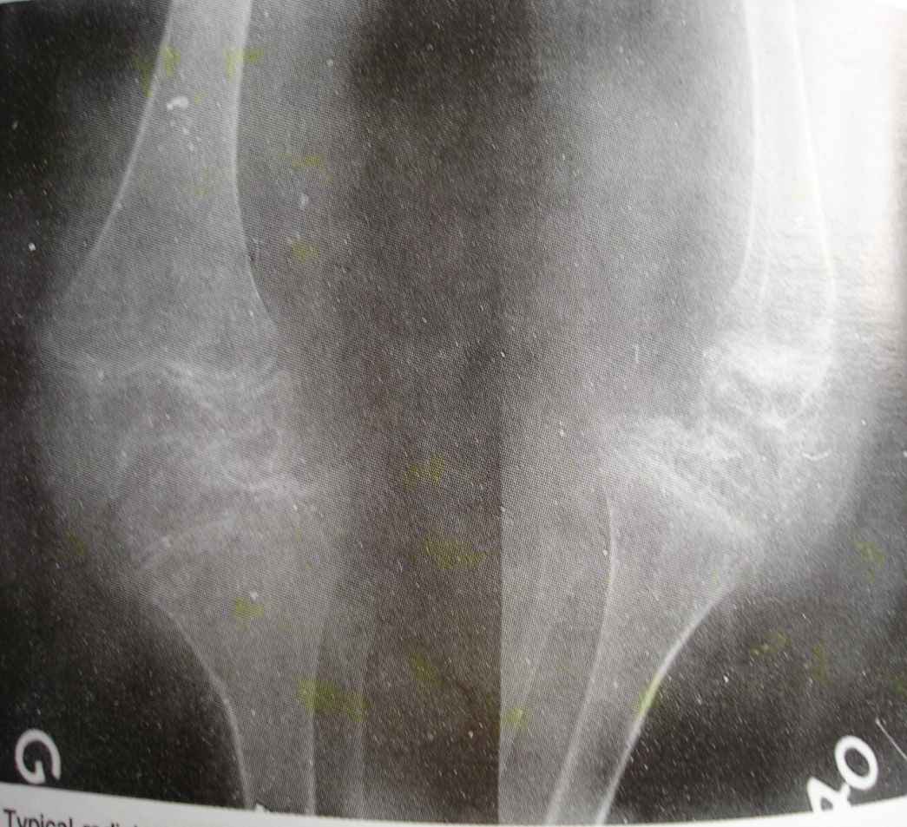
Neglected Case
Due to Spasm and Contracture of Hamstring (Biceps Femoris)
Deformity-Flexion posterior Subluxation,Lat. subluxation,lat. rotation and abd.of tibia
Frame Knee (Premature fusion )

Slide 4
Path mechanics of the development of Deformity
FLEXION- To Accommodate for the increased Swelling due to Synovitis
EXTERNAL ROTATION-Pt. keeps lower limb ext.rotated from the hip
Gravity assisted ITB contracture- Subluxated the tibiofibular joint
The above Deforming forces further pull the leg

Slide 5
D/D
Rheumatoid Arthritis
Chronic Traumatic Synovitis
Loose body
Osteocondritis dissecans
Condromalasia patella
Villonodular Synovitis

Slide 6
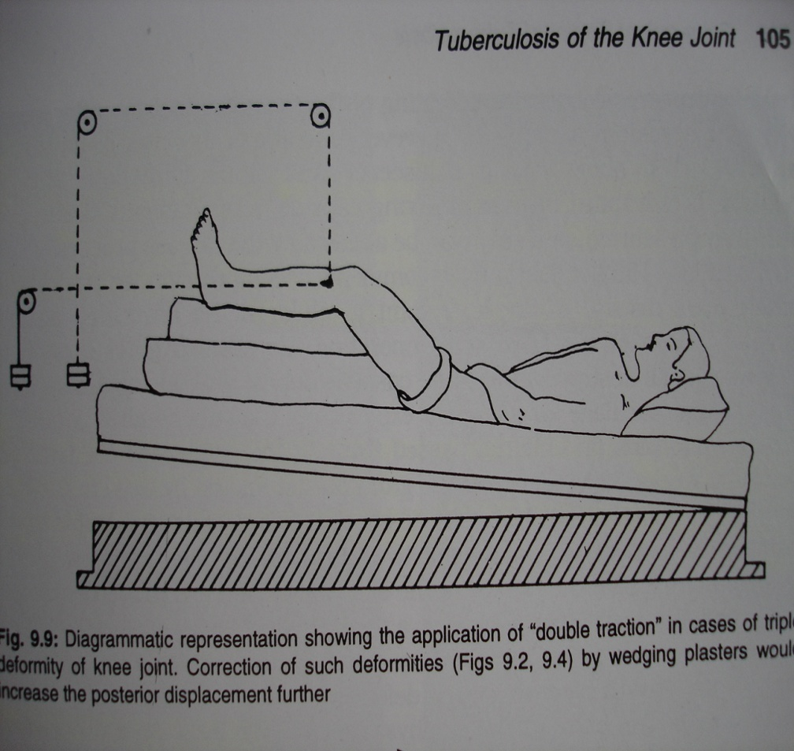
Treatment
Non operative treatment-TB Synovitis and children
ATT
Traction
Physiotherapy
After 12 wks non weight crutch walking-For 6 to 12 months
Protected wt . Bearing-For 18 to 24 months.

Slide 7
Operative treatment
Synovitis Stage-No Response-Arthrotomy and Synovectomy
Early Arthritis-Synovectomy (Removal of loose body,debris,pannus,loose articular cartilage and curettage of juxta- articular foci
Advanced arthritis- in adults Arthrodesis

Slide 8
Thank You

