Slide 1
Secondaries in bone

Slide 2
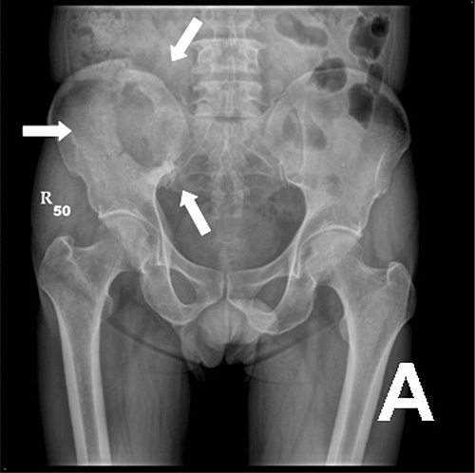
Content
Introduction
Epidemiology
Pathogenesis
Clinical features
Diagnosis
Management
Medical management
Surgical management

Slide 3
Introduction

Slide 4
Introduction
The skeleton is a common site for metastatic spread from epithelial tumours, so patients may present with symptoms from secondary bone cancer to a number of different specialists.
In terms of numbers of patients, the most common cancers to present with bony secondaries are prostate, breast and lung.
Certain patterns of bony spread are common, and an identification of these can guide the need for further investigations.
British Orthopaedic Association. Metastatic bone disease: a guide to
good practice. London: British Orthopaedic Association; 2001

Slide 5
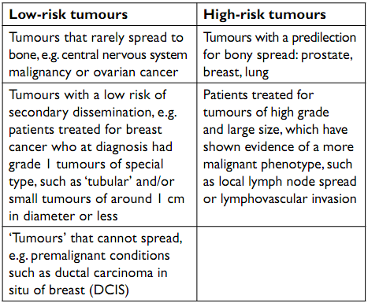
Introduction…

Slide 6
Introduction…
Secondary breast cancer for example typically presents with multiple metastases affecting the axial skeleton, with a concentration of metastases in the skull, spine, ribs, pelvis and proximal long bones, whereas single metastases or metastases in distal long bones are relatively rarer.
The pathological features of the original breast tumour can be used to predict the risk of systemic recurrence.

Slide 7
Introduction…
The risk of secondary spread in breast cancer is related to-
the grade of the cancer (grade 3 tumours being more likely to metastasize than grade 1),
the size of the original primary tumour (with larger tumours posing a bigger risk) and
the lymph node status of the axilla at the time of the original surgery (with heavily ‘node-positive’ patients – those with metastatic cancer within the axillary nodes at the time of surgical staging – more likely to relapse systemically than ‘node-negative’ ones)

Slide 8
Introduction…
The abnormal investigations need to be interpreted in light of the patient’s risk of developing metastatic disease.
A patient who has been treated for a small grade 1 breast cancer, particularly a tumour of special type such as a tubular carcinoma, is highly unlikely to ever have a recurrence.
A positive bone scan in such a case is therefore more likely to represent either benign disease or secondary spread from a second, undiagnosed primary cancer.
Chow E, Finkelstein JA, Sahgal A, Coleman RE. Metastatic cancer to the bone. In: DeVita VT, Lawrence TS, Rosenberg SA, eds. DeVita, Hellman, and Rosenberg's Cancer: Principles & Practice of Oncology. 9th ed. Philadelphia, Pa: Lippincott Williams & Wilkins; 2011: 2192−2204.

Slide 9
Introduction…
On the other hand, a patient with a ‘positive’ bone scan who has been treated for a grade 3 cancer measuring 50 mm in diameter two years previously and who had all 14 axillary nodes involved by tumour at the time of surgery, is much more likely to have metastatic breast cancer.
Certain pathological types of tumour are less likely to spread to bone and these include ovarian cancer, which tends to cause problems throughout the peritoneum, and primary central nervous system (CNS) tumours, which ‘never’ metastasise outside the CNS.

Slide 10
Epidemiology

Slide 11
Epidemiology
Secondary bone tumor most frequently occur in patient over 40 year old
Common site of origin are lung, prostate, breast & liver
Common site of deposit are vertebrae, pelvis, femur & ribs
Clinical presentation is extensive and non specific
Most lesion present with osteolytic pattern
Secondary of unknown origin account for 24%

Slide 12
Epidemiology…
Male : Female 2.12 :1
Mean age 55.7 years & 81.51% Over 41 years
Primary site :-
lung 21.8%
prostate 13.1%
breast 07.4%
liver 06.4%
G.I.T 05.7%
unknown 24.6%

Slide 13
Epidemiology…
Common sites of deposition:
Spine 47.7 %
Pelvis 18.2 %
Femur 15.4 %
Ribs 12.6 %
Multi 20.5 %

Slide 14
Epidemiology…
Primary tumor diagnose before 2dry 29.7 %
Median metastatic time 319 days
Uncertain time in 70.3 %
Osteolytic pattern 80.7 %
Osteosclerotic pattern in 10.5 %
Mixed pattern in 09.8 %

Slide 15
Pathogenesis

Slide 16
Pathogenesis
Mechanism of Signal Transduction Mediated by Transforming Growth Factor β (TGF-β).
In the extracellular space TGF-β binds either to the type III TGF-β receptor (RIII), which presents it to the type II receptor (RII), or directly to RII on the cell membrane.
The binding of TGF-β to RII then leads to binding of the type I receptor (RI) to the complex and the phosphorylation of RI.

Slide 17
Pathogenesis…
This phosphorylation activates the RI protein kinase, which then phosphorylates the transcription factor Smad2 or Smad3.
Phosphorylated Smad2 or Smad3 binds to Smad4, the common Smad, and the resulting complex moves from the cytoplasm into the nucleus.
In the nucleus, the Smad complex interacts in a cell-specific manner with various other transcription factors to regulate the transcription of TGF-β-responsive genes and mediate the effects of TGF-β at the cellular level.

Slide 18
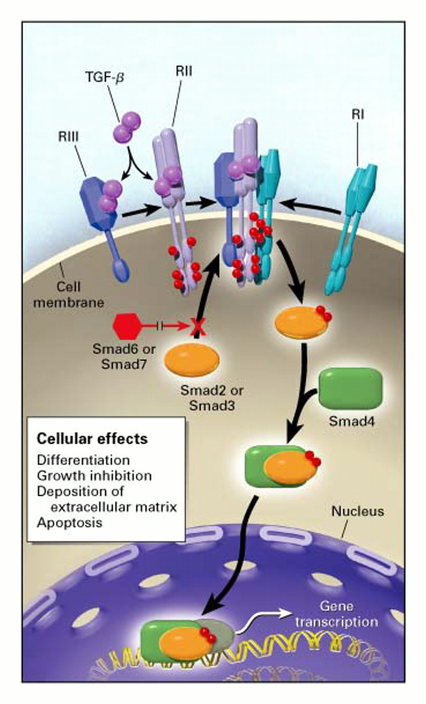
Pathogenesis…
Blobe G et al. N Engl J Med 2000;342:1350-1358

Slide 19
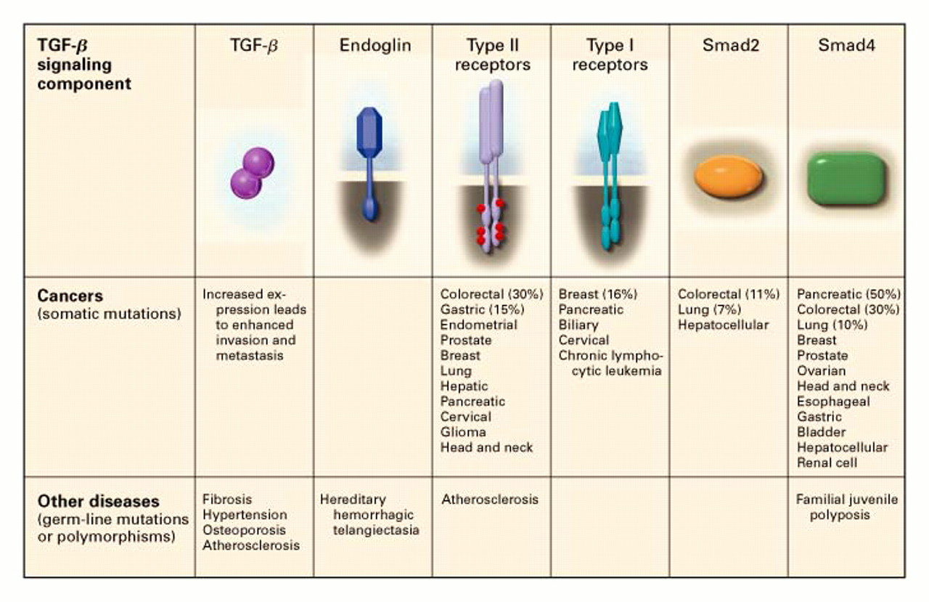
Pathogenesis…
Blobe G et al. N Engl J Med 2000;342:1350-1358

Slide 20
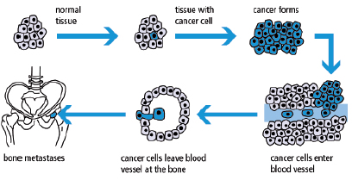
Pathogenesis…
Bone secondaries are common because-
Bone is big organ
Have rich blood supply
Heterogeneous cellular element
Wide orientation along the body
Continues modeling through life
Mode of transmission:
Direct spread
Heamatogenous
Lymphatic

Slide 21
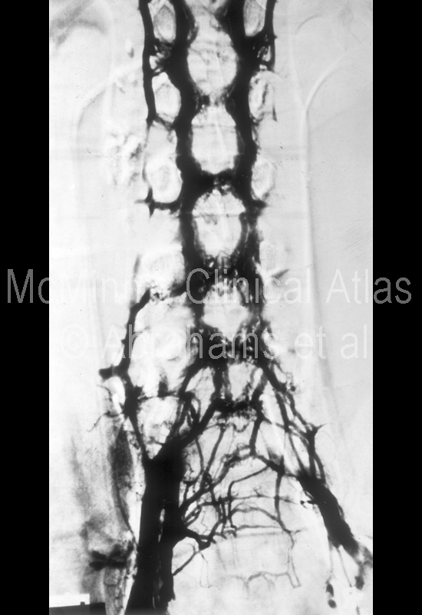
Pathogenesis…
Batson valveless
Connecting inside and outside vertebra and segmentally from pelvis to the skull

Slide 22
Clinical features

Slide 23
Clinical features
Patients typically complain of increasing and persistent pain at the site of bony metastases.
In ‘high-risk’ patients, increasing or new back pain, rib pain or pelvic/hip pain are common symptoms of developing bone metastases.
Rarer symptoms include cranial nerve involvement from base-of-skull metastases, pathological fracture from minimal or no trauma (typically ribs or long bones), sternal pain or sciatica or bladder disturbance from tumour impingement on the sacral formina.
Jakofsky DJ et al. Metastatic disease to bone. Hospital physician 2004 Nov: 21-39.

Slide 24
Clinical features…
Vertebral metastases may progress to cause spinal cord compression.
Often the symptoms from this are relatively subtle for a number of weeks, but paradoxically this is the time when early treatment is most effective at preventing catastrophic loss of function.
Therefore any patient at high risk of vertebral metastasis who notices subtle difficulty in walking or a deterioration in leg function, even if no neurological signs are present, should be considered for an urgent magnetic resonance imaging (MRI) scan to exclude spinal cord compression before the condition progresses to paraplegia with loss of sphincter function.
By the time these symptoms occur, treatment is unlikely to restore function.

Slide 25
Clinical features…
Bone metastases may give symptoms of anaemia and investigation is required in more advanced disease.
The full blood count may also show reduced white cell and platelet numbers, owing to bone marrow involvement.
Such haematological abnormalities are particularly common in advanced prostate cancer and these patients may eventually die from pancytopenia and disseminated intravascular coagulation associated with the bony secondaries.
Campbells Operative Orthopaedics. Canale ST, Beaty JH editor.
12th edition

Slide 26
Clinical features…
Often the alkaline phosphatase level is raised when bone metastases are present, but the occurrence of hypercalcaemia is less common and often occurs as a paraneoplastic phenomenon in the absence of bone metastases.
It is found more commonly in association with certain cancers, such as lung cancer.

Slide 27
Diagnosis

Slide 28
Diagnosis
It is generally unhelpful to check ‘tumour markers’ during investigation of suspected metastatic bone disease, although such tests can be used to assess the efficacy of treatment in patients in whom metastatic disease has been confirmed.
Cancer patients with concerning bone pain should have an initial radiograph of the affected site.
Surprisingly often, this will demonstrate a benign cause for the pain, which requires no further work-up.
Sometimes radiographs will show non-specific abnormality, the nature of which can be clarified by further imaging such as computed tomography (CT) or MRI

Slide 29
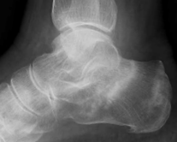
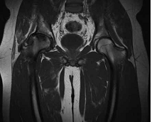
Diagnosis…
Cancer patient receiving steroids complaining
of heel pain. A radiograph demonstrated two calcaneal stress fractures.
Cancer patient receiving steroids complaining of hip pain. T1-weighted magnetic resonance
image demonstrated right femoral head avascular necrosis

Slide 30
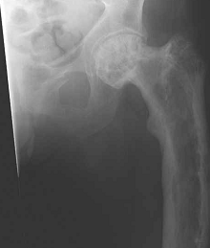
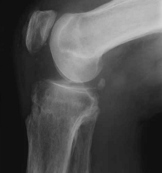
Diagnosis…
Cancer patient complaining of left pelvic and
hip pain. A radiograph demonstrated acute left pubic rami fractures and left femoral Paget’s disease.
Lung cancer patient complaining of generalised
limb pain. A knee radiograph demonstrated multifocal periosteal thickening consistent with hypertrophic pulmonary osteoarthropathy (HPOA).

Slide 31
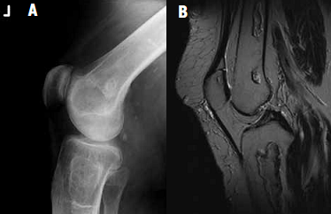
Diagnosis…
Patient with haematological malignancy complaining of knee pain.
A: A radiograph showed non-specific sclerosis within the distal femur and proximal tibia.
B: Subsequent T2-weighted magnetic resonance imaging showed that this was due to medullary bone infarcts.

Slide 32
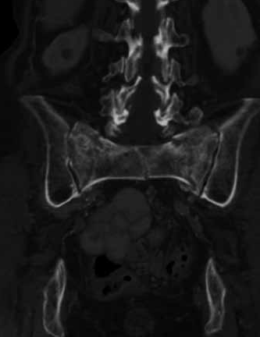
Diagnosis…
Pelvic insufficiency fractures are a pitfall in the imaging of cancer patients.
A well-recognised cause of bone pain in the elderly, they are especially common in cancer patients who have received steroids or pelvic radiotherapy.
They may occur at several sites in the pelvis but typically the sacral ala and pubic rami.
Often invisible on radiographs, they may be mistaken
for metastases on isotope bone scans where they
cause intense tracer uptake, or on CT scan where
their tendency to heal by sclerosis may be
misinterpreted by radiologists primed to search for
metastatic disease
Coronal computed tomography image from cancer staging scan demonstrating three vertically oriented sacral insufficiency fractures.

Slide 33
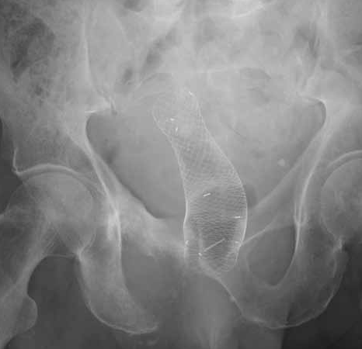
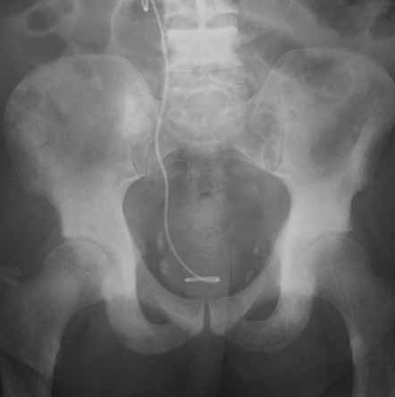
Diagnosis…
If bone pain is due to metastatic disease, a radiograph may show bone destruction (typical of lung cancer), bone sclerosis (typical of prostate cancer), or a mixture of both patterns (common with breast cancer)
Radiograph of patient with rectal cancer, showing
lytic right inferior pubic ramus metastasis and a colonic stent.
Radiograph of patient with prostrate cancer, showing sclerotic metastases in L4, the right sacrum and both acetabula, along with a ureteric stent.

Slide 34
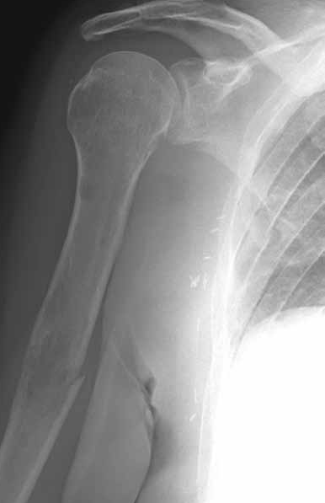
Diagnosis…
Where single long bones such as the femur, tibia or humerus are affected, it is important to assess the risk of pathological fracture through the weakened bone, as elective orthopaedic surgical treatment may be indicated to relieve pain and prevent a future fracture requiring emergency admission
Radiograph of patient with breast cancer and
myeloma, who sustained a pathological fracture of the midhumeral shaft through a lytic metastasis. Prophylactic intramedullary nailing could have saved this complication.

Slide 35
Diagnosis…
An isotope bone scan is a sensitive method to show metastatic disease at unsuspected and possibly symptomless sites and is commonly used as a staging investigation.
Increased tracer uptake on a bone scan indicates increased activity of osteoblasts, a non-specific reaction to any bony insult, including tumour, trauma, infection, osteoarthritis or inflammatory disease.
This makes bone scans very sensitive to bone pathology but rather non-specific as to its nature.
Love C, Tomas MB, Kalapparambath TP et al. Radionuclide bone
imaging: an illlustrative review. Radiographics 2003; 23:341–58.

Slide 36
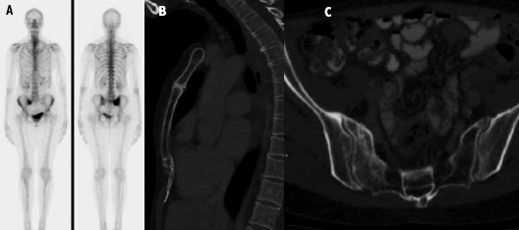
Diagnosis…
When interpreting bone scans, the chance of making a false positive diagnosis of metastatic bone disease is reduced if the pattern of abnormality and underlying likelihood of metastatic disease are taken into account.
Asymptomatic cancer patient. A: Isotope bone scan showed increased uptake in sternum and right sacrum, thought suspicious of metastatic disease. B: Subsequent sagittal chest and C: axial pelvic compute tomography (CT) images demonstrated manubriosternal osteoarthritis and a right sacral insufficiency fracture, which account for bone scan findings.

Slide 37
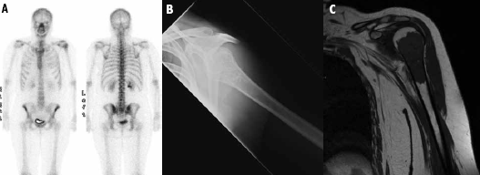
Diagnosis…
Breast cancer patient with shoulder pain but low probability of metastatic disease.
A: Isotope bone scan showed increased uptake in left humerus, thought suspicious of metastatic disease.
B: Subsequent radiograph and
C: T1-weighted magnetic resonance images showed a pattern of mineralisation and humeral marrow appearance typical of a benign enchondroma.

Slide 38
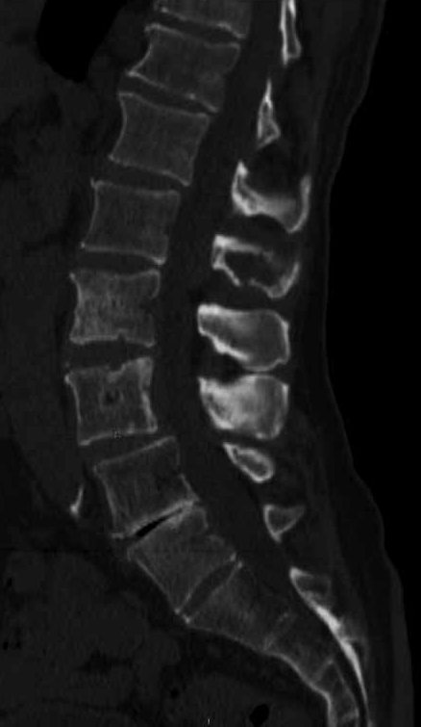
Diagnosis…
Computed tomography and MRI scans are also sensitive ways to detect metastatic bone disease but have higher specificity than an isotope bone scan.
In practice, these tests are used to image specific body parts relevant to staging the patient’s cancer and in this situation do not give the comprehensive skeletal coverage offered by a bone scan.
Sagittal lumbar spine computed tomography
image from lymphoma patient showing sclerotic and lytic
bone disease.

Slide 39
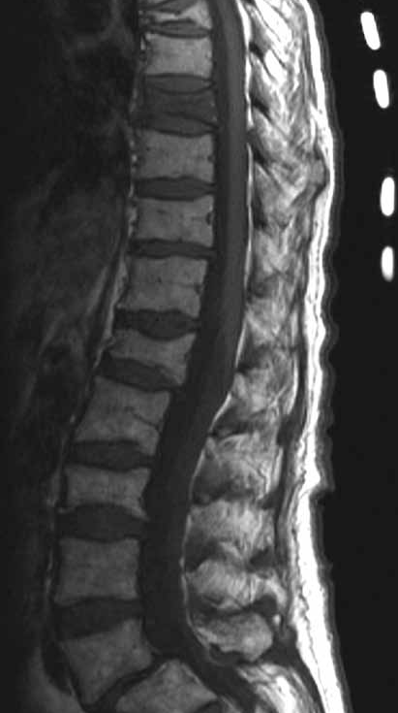
Diagnosis…
Vertebral body compression fractures are common in patients with cancer.
Radiographs and bone scans commonly fail to differentiate whether these are due to osteoporosis or metastatic infiltration.
MRI can usually make this distinction, but differentiation between metastasis and a very acute osteoporotic fracture can prove difficult
T1-weighted lumbar spine MRI showing multiple chronic osteoporotic vertebral compression fractures characterised by ‘normal’ marrow
signal. By contrast, note an acute fracture at D8 exhibiting marrow signal similar to that of metastatic infiltration.

Slide 40
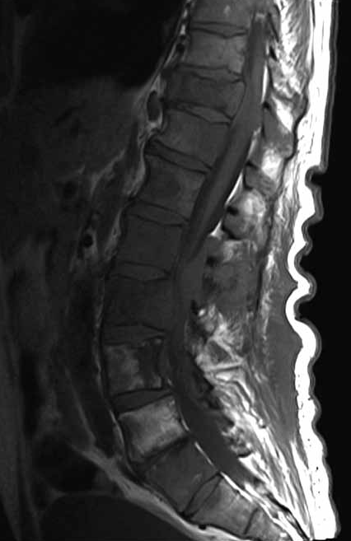
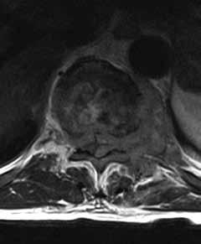
Diagnosis…
In patients with metastases, an MRI scan can uniquely demonstrate the extent of metastatic spinal canal disease.
Axial & Sagittal T1-weighted lumbar spine MRI from a lymphoma patient showing multifocal bone marrow infiltration and D10 vertebral body compression fracture.

Slide 41
Management
Medical management
Surgical management

Slide 42
Medical Management
Adequate analgesia is required and often morphine or related analgesics are necessary.
Non-steroidal antiinflammatory drugs (NSAIDs) are particularly useful in many cases of bony pain, if they can be tolerated.
Systemic treatment of the cancer is often helpful in relieving pain, for example the use of chemotherapy or appropriate hormonal blockade.
Oliver TB et al. Diagnosis & Management of bone metastases.
J R Coll Physicians Edinb 2011; 41:330–8

Slide 43
Medical Management…
Radiotherapy may also be useful, but there is a limit to how much radiation dose can be given to one area.
Since, extensive irradiation of the axial skeleton has detrimental effects on the synthetic function of the bone marrow and may lead to poorly tolerated chemotherapy (should this be required), due to unexpectedly severe chemotherapy-induced neutropenia caused by the previous radiation treatment.
Fairchild A, Barnes E, Ghosh S, et al. International patterns of practice in palliative radiotherapy for painful bone metastases: evidence-based practice? Int J Radiat Oncol Biol Phys 2009;75:1281-1628.

Slide 44
Medical Management…
Bisphosphonates have been shown to prevent deterioration in breast cancer and myeloma and, although they have not been proven to be effective in reducing skeletal morbidity in all cancers, are required for the treatment of hypercalcaemia, if present.
All bisphosphonates tend to have some degree of nephrotoxicity, and this needs to be considered when treating patients with abnormal renal function.
Mhaskar R, Redzepovic J, Wheatley K et al. Bisphosphonates in
multiple myeloma. Cochrane Database Syst Rev 2010; 3: CD003188.

Slide 45
Medical Management…
It is likely that all bisphosphonates have some beneficial activity in this situation; commonly used drugs include zoledronic acid, pamidronate, clodronate and ibandronic acid.
The choice is often determined by patient need and preference (oral versus intravenous) and what trials have been done in the particular tumour site.
If initial analgesic intervention is inadequate, then radiotherapy can be considered.

Slide 46
Surgical Management
Orthopaedic surgery:
Since some patients with metastatic bone disease (MBD) will survive three years or more and metastatic pathological fractures rarely unite, it is important to consider fixation of any pathological fracture or lytic lesion.
The decision to operate may be influenced by the histological sub-type of the tumour, as some cancers carry a much poorer prognosis than others, although longevity will not be the only consideration if the operation is expected to provide good palliation.
Campbells Operative Orthopaedics. Canale ST, Beaty JH editor.
12th edition

Slide 47
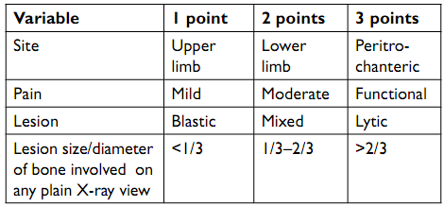
Surgical Management…
Mirel’s scoring system can be used for prophylactic fixation of long bones.

Slide 48
Surgical Management…
Care should be taken to thoroughly investigate bone lesions, especially a solitary lytic lesion (which may not be a metastasis).
There should be no rush to fix the fracture; traction or splintage will keep the patient comfortable while investigations are performed and the case discussed with the lead surgeon for MBD.
Janjan N, Lutz S, Bedwinek J, et al. Therapeutic guidelines for the treatment of bone metastasis: A report from the American College of Radiology Appropriateness Criteria Expert Panel on Radiation Oncology. J Palliative Medicine 2009;12:417-426.

Slide 49
Surgical Management…
Surgery aims to relieve pain and restore function and prevent the need for emergency intervention for an unexpected pathological fracture.
The surgery must be planned to allow immediate weight bearing and aim to last the lifetime of the patient.
Surgery for spinal metastases should aim for decompression and stabilisation.

Slide 50
Surgical Management…
Fixation of pathological fractures or lytic lesions tends to have higher failure rates than other types of fracture as the bone rarely heals.
Therefore, for lesions around the hip or proximal femur, a cemented hip prosthesis (standard or tumour prosthesis) is recommended due to its low failure rate.
Campbells Operative Orthopaedics. Canale ST, Beaty JH editor.
12th edition

Slide 51
Surgical Management…
If there is any doubt about the underlying pathology a biopsy should be performed.
This must be done under X-ray guidance and after discussion with the surgical team to avoid biopsy tracts passing through unaffected muscle compartments.
A solitary renal metastasis will have a good prognosis if a radical excision is carried out at a regional centre.
Reamings taken at the time of surgery may help confirm the diagnosis.

Slide 52
Surgical Management…
Radiotherapy can help control symptoms, but it will not relieve pain which is mechanical in nature.
If the lesion is at high risk of fracture, fixation is performed before radiotherapy.
After the fixation, radiotherapy is often given, although it is not clear how much additional benefit this confers.
However, only 30–40% of pathological fractures unite after radiotherapy.
Patients whose life expectancy is less than six weeks are unlikely to benefit from major reconstructive surgery.

Slide 53
Surgical Management…
In Mirel’s scoring system, a score of eight or more indicates high risk of fracture and the need for prophylactic fixation before radiotherapy.
Generally speaking, if 50% of a single cortex of a long bone is destroyed, in any X-ray view, then fracture is inevitable.
Avulsion of the lesser trochanter indicates impending hip fracture.

Slide 54
Surgical Management…
Percutaneous cementoplasty/vertebroplasty:
Painful bony metastases refractory to analgesia in the axial skeleton can be treated effectively with image-guided injection of acrylic bone cement (polymethylmethacrylate [PMMA]), and this could be done after lesion ablation with radiofrequency ablation or cryotherapy.
The response is generally good and quicker than radiotherapy and these procedures can be performed before or after radiotherapy.

Slide 55
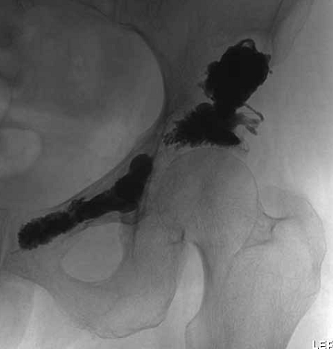
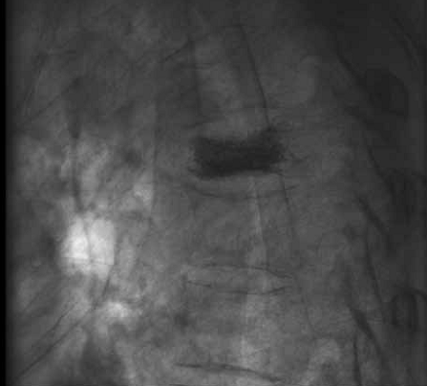
Surgical Management…
Indications:
painful bony metastases in the spine and pelvis mostly,
but it can be used in the scapula and ribs as well.
Lung metastases in the superior pubic ramus and acetabular margin treated by cementoplasty
Percutaneous vertebroplasty of a painful metastatic deposit in a thoracic vertebral body

Slide 56
Surgical Management…
It can be performed in focal, painful bony deposits in the spine even if there is no collapse.
If some height reduction is required, then kyphoplasty (balloon reduction of the vertebral body before cement injection) can also be used.
BUT, long bones do not respond well.

Slide 57
Surgical Management…
Contra-indications:
Posterior cortical breach in the spine (risk of cement leak compressing the spine)
Cortical breach into the articular surface of a major joint
Local infection

Slide 58
Points to remember
M/C cause – Lung Carcinoma
Male – Prostate Carcinoma
Female – Breast Carcinoma
M/C Area – D-L Spine
In prostate carcinoma –
Pelvis > Lumber spine > Dorsal spine

Slide 59
M/C lesion – Lytic lesion
Purely osteoblastic sec. – Prostate
- Carcinoid
Metastasis do not cross elbow and knee

Slide 60
Bone tm. Which have bony metastasis –
Osteosarcoma
Neuroblastoma
Ewing sarcoma

Slide 61
THANK YOU

Slide 62
THANK YOU!!!

