Slide 1
OSTEOARTICULAR TUBERCULOSIS

Slide 33
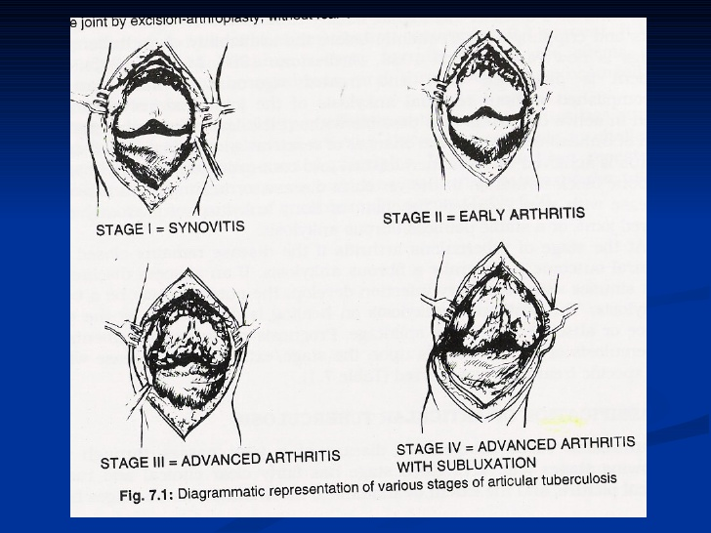

Slide 43
Thank You

