Slide 1
Histology of Blood Vessels

Slide 2
Main functions of Vascular system
Transport of oxygen, carbondioxide, nutrients, hormones, metabolic products, cells of immune defense system and many other essential products
Gaseous exchange
Temperature control

Slide 3
Types of Blood Vessels
Arteries: Large or Elastic Artery
Medium sized or Muscular Artery
Arterioles
Capillaries: Continuous capillary
Fenestrated capillary
Sinusoidal capillary
Venules
Veins: Medium sized Vein
Large Vein

Slide 4
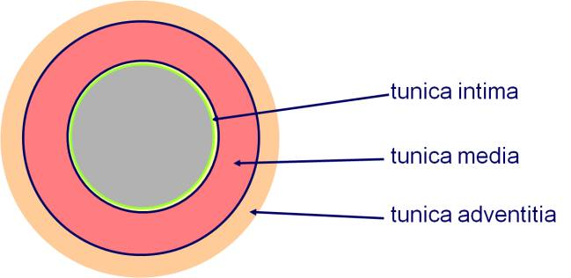
Structure of Blood Vessels
All blood vessels except capillaries have 3 basic Tunics or Coats concentrically arrranged
Tunica Intima
Tunica Media:
Tunica Adventitia :

Slide 5
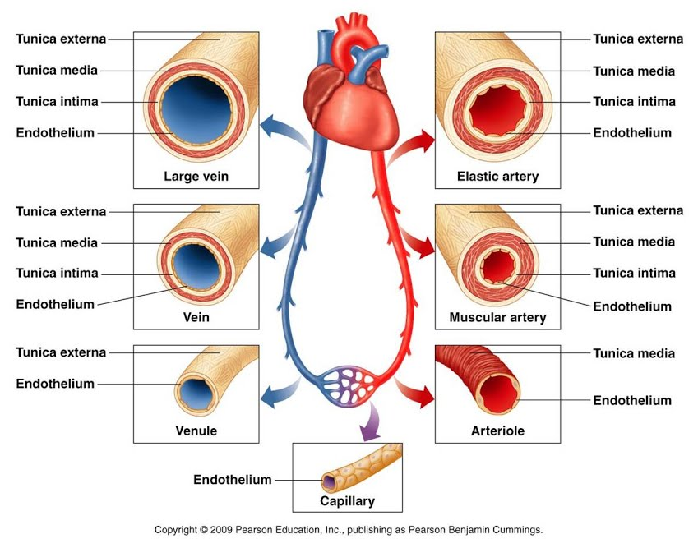
Arteries and Veins

Slide 6
Arteries
Thick walled blood vessels that carry blood from heart to the capillaries.
They divide repeatedly like branch of a tree and gradually become smaller in size.
However, their luminal surface is increased many times(800 fold) compared to that of a large artery (aorta).
This causes a decrease in the rate of blood flow, facilitating an exchange of substances through capillaries.

Slide 7
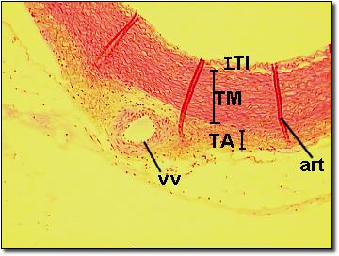
Low Power View of Large Artrery
Examples of Large artery:
Aorta and its branches
Brachiocephalic, Carotid carotid, Subclavian, axillary and common iliacs, pulmonary & vertebral
It conducts blood from heart.
Thickness of the wall is 1/10 the luminal diameter.

Slide 8
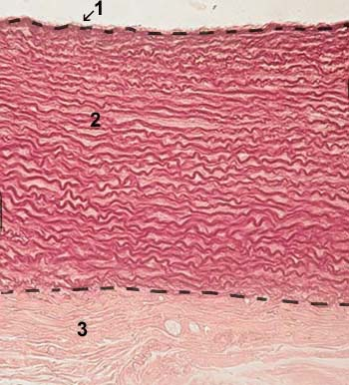
Elastic Artery(stained with orcein)
Tunica Intima:
Endothelium
Basal lamina :A thin layer of glycoprotein
Subendothelial C T which contains fibrocytes, macrophages and smooth muscle like-cells called Myointimal Cells.
The collagen and elastic fibres are longitudinally arranged.
Internal Elastic Lamina forms the boundry between T Intima and T media. Consists of elastic fibres is poorly defined and is fenestrated

Slide 9
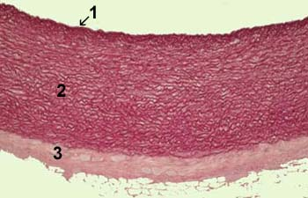
Elastic Artery (stained with orcein)
Tunica Media:
Elastic tissue in the form of 40-70 fenestrated elastic membranes
Smooth muscles and collagen fibres in matrix
Matrix rich in chondroitin sulfate.
A layer of elastic fibers external elastic lamina forms the boundary between T media and T adventitia.
Tunica Adventitia: Fibroelastic C T having Vasa Vasorum and unmyelinated sympathetic fibres.

Slide 10
Interesting features of Elastic Artery
Fibrous elements in intima and adventitia (mainly collagen) run longitudinally that is along the length of the vessel.
Elastic fibres in the internal and external elastic lamina are often in the form of fenestrated sheets(holes in them)
Internal Elastic Lamina and External Elastic Lamina are not prominent because of the presence of large amount of elastin within the media .
In T adventitia, small blood vessels may be found, termed Vasa Vasorum. They serve to nourish the vessel.

Slide 11
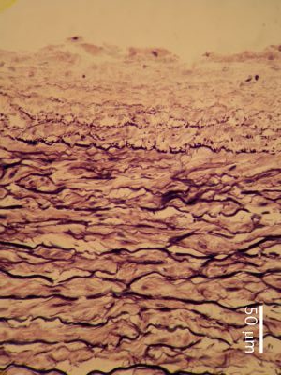
Elastic Artery
Presence of elastic fibres in the wall allows it to expand during contraction (systole) and recoil during relaxation (diastole).
This maintains necessary Blood Pressure and permits the blood to flow more evenly through other arterial channels

Slide 12
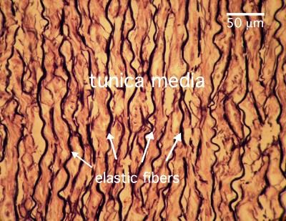
Prominent Elastic fibres in T Media of Elastic Artery

Slide 13
Changes due to age in Large Artery
Thickening of Tunica Intima due to migration and proliferation of smooth muscle cells from T Media.
Accumulation of lipid in the Myointimal cells and macrophages.
Formation of fibrofatty plaques by the deposition of fat and collagen in T Intima (Atheroma)
Atheroma leads to narrowing of the arterial lumen and consequently reduced blood flow.
Calcification of T Media (Arteriosclerosis)
Atherosclerosis(atheroma+arteriosclerosis)
Damage to the endothelium can cause coagulation of blood forming a thrombus which can completely obstruct the artery leading to death of the tissue it supplies
If this happens with Myocardium: Coronary thrombosis leading to Myocardial Infarction (may manifest as heart attack)
In brain: Cerebral thrombosis leading to stroke and paralysis

Slide 14
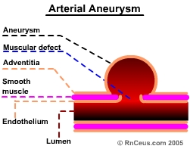
Aneurysm
Tunica media may undergo atrophy resulting in loss of elasticity of the wall.
The weakened wall may get stretched forming aneurysm.
Its rupture may cause death.

Slide 15
Muscular Artery
Large elastic arteries branch and become medium-sized muscular arteries.
Most numerous vessels in the body.
Examples: Branches of External Carotid artery, radial & Ulnar arteries, femoral, popliteal etc
Distributes blood to various parts of the body.
Wall thickness=1/4 the luminal diameter.
Presence of smooth muscle in its wall helps to control flow and pressure of blood through vasoconstriction and vasodilatation.

Slide 16
Muscular Artery
T Intima:
Endothelium
Internal Elastic lamina (No subendothelial Tissue)
Internal Elastic Lamina is a bright refractile membrane thrown into wavy folds due to contraction of the elastic membrane during the fixation process.

Slide 17
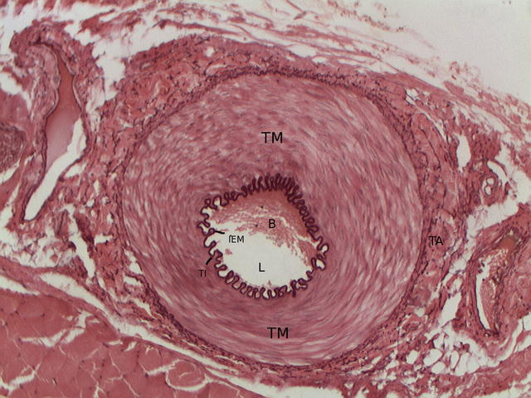
Muscular Artery
T Media: 40 layers of smooth muscle cells arranged circularly, hence the name muscular artery.
Contains few collagen and elastic fibres intermixed with smooth muscle cells

Slide 18
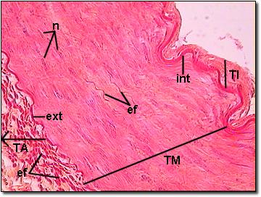
Muscular Artery
T Adventitia:
Elastic and collagen fibres running longitudinally
Contains vasa vasorum and unmyelinated sympathetic nerve fibres.

Slide 19
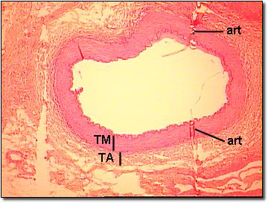
Low Power View of Medium Sized Artery

Slide 20
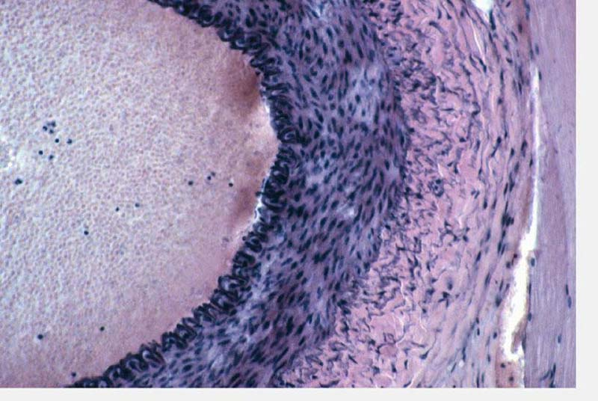
Muscular Artery

Slide 21
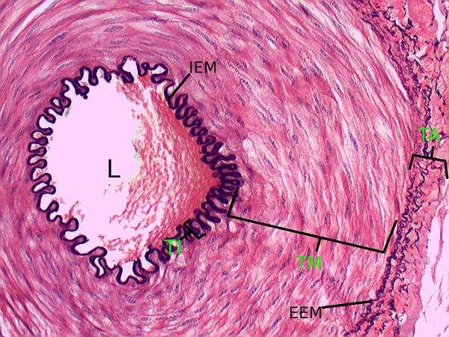
Muscular Artery

Slide 22
Cross section of Muscular artery(100X) stained specifically for elastin

Slide 23
Difference between Elastic & Muscular artery
Elastic Artery
T Intima: is much thicker, sometimes 20% of the total wall thickness.
Subendothelial C T has more elastic fibres
IEL is not distinct (as it has the same structure as the elastic membranes of the media)
T Media:Elastic fibres ++
Muscular Artery
T Intima: IEL is well demarcated.
T Media: Smooth M +
EEL is also very prominent.
T adventitia: Thickness is more and sometimes may be equal to the thickness of the media.

Slide 24
Elastic and Muscular artery

Slide 25
Arteriole
Smallest branches of the arterial system.
Deliver blood to the smallest blood vessels, the capillaries.
Diameter - less than 100 Micron m
Larger Arterioles: Dia 100-50 Micron m
Terminal Arterioles: Dia less than 50 Micron m
Wall is relatively thicker than the lumen.
Serve as a transition vessel between muscular arteries and capillaries.
Three coats are present
T Intima: Endothelium +
no subendothelial layer
thin or absent IEL.
T Media: 1-5 layers of circularly arranged smooth muscle cells.
T Adventitia: thin and poorly developed. Made up of a thin network of collagen fibers.

Slide 26
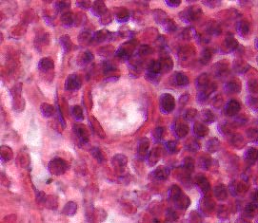
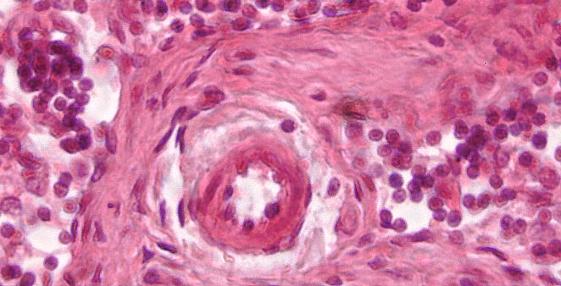
Capillary and Arteriole

Slide 27
Capillaries
Arterioles break up into small blood vessels, the capillaries.
Often referred to as Exchange vessels as they are involved in the exchange of gases, nutrients and metabolities between blood and tissue.
Tissues with high metabolic rate have abundant capillary network. Example: kidney, liver and cardiac muscle.

Slide 28
Capillary
Diameter – 8 micron m,(7-9 micron m)equal to the size of an erythrocyte.
Wall has only one layer-the Intima-Consists of 1-3 circimferentially arranged endothelial cells
Underlying basal lamina
Few randomly scattered Pericytes, branching perivascular cells.
Lacks T Media and therefore no smooth muscle cells
Pericytes or Adventitial cells contain contractile filaments in the cytoplasm and can transform into other cells

Slide 29
Types of Capillaries
Fenestrated or visceral
Tiny pores(openings , fenestrations) are present in the cytoplasm of endothelial cells.
Pores are often closed by a thin diaphragm(thinner than the cell membranes)
Pores are so designed for rapid exchange of molecules between blood and tissue(greater permeability)
Examples: Kidney glomeruli intestinal villi, choroid plexus, endocrine glands etc
Continuous or Somatic
Commonest type
Present in connective tissue, muscle, brain, lung etc
Endothelial cells form the continuous lining of the capillary.
Tight junctions, desmosomes and gap junctions are seen.

Slide 30
Sinusoidal capillary
Also called Discontinuous capillaries because basal lamina is not continuous(Lumen is lined by discontinuous endothelium)
Thin walled, irregular and tortuous
Have much wider irregular lumen (30-40 micron m) which slow down the flow of blood.
Wide gaps are present between the individual endothelial cells
These two facts permit passage of blood cells and macromolecules.
Found in liver and haemopoietic organs like red bone marrow and spleen.
Phagocytic cells may be seen in its wall(e.g. kuffer cells in liver)

Slide 31
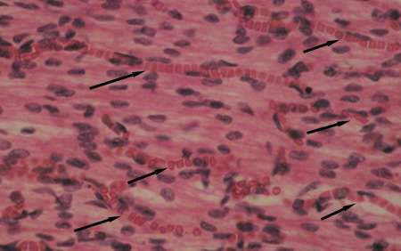
Capillaries with RBCs( Longitudinal Plane)

Slide 32
Functions of Capillary Endothelium
Permeability:
Allows exchange of water, CO2 and metabolites between blood and tissue
.Allows migration of leucocytes from blood to tissue (diapedesis) which is increased during inflammation.
Forms Blood brain Barrier-the tight junctions between the endothelial cells
Metabolic function:
Activates- angiotensin I to angiotensin II
Inactivates bradikinin,serotonin.prostaglandin.norepinephrin and thrombin into inert compounds
Breaks down lipoproteins into triglycerides and cholesterol.
Nonthrombogenic Function:
Platelets normally do not adhere to an intact endothelium because Prostacyclin is released by endothelium which is a powerful inhibitor of platelet aggregation and thus prevents clot formation

Slide 33
Summary of Histological features of Capillary and Arteries

Slide 34
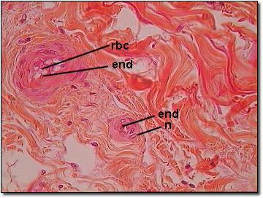
High Power of Small Artery and arteriole

Slide 35
Venous System
Veins are thin walled
Carry blood from capillaries to heart
Large veins are formed by the union of smaller vein like tributary of a river.
Often provided with valves
Valves serve to prevent reflux of blood.

Slide 36
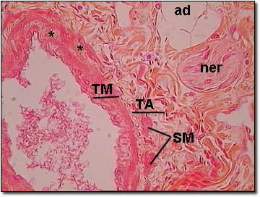
Features of venous system to distinguish them from arteries
The ratio of wall thickness to lumen diameter is less
Media is thin and poorly developed (Intima and adventitia are more prominent)
Internal and external elastic lamina are difficult to distinguish
An artery will always have a larger wall-thickness-to-lumen ratio than a vein of corresponding size.

Slide 37
Types of Veins
Large sized Veins
Medium sized veins
Venules
A clear distinction between T intima, media and adventitia cannot be made outin small veins as all the layers consist predominantly of fibrous tissue
Same 3 layered organisation as arterial system.
T intima
T media
T adventitia

Slide 38
Histological features of Large vein
Examples: SVC and IVC
T intima: well developed, endothelium and subendothelial C T +
T media: thin or –
T adventitia: well developed, thickest coat, many longitudinal bundles of smooth muscle fibers are embedded in C T.
Longitudinal bundles facilitate shortening and elongation of the vena cava with respiration.

Slide 39
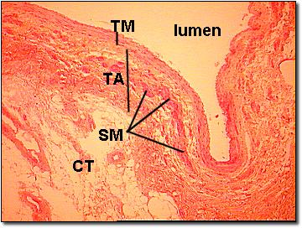
Low Power View of Large Vein

Slide 40
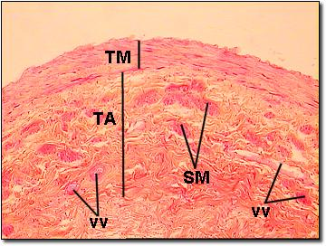
High Power View of Large Vein

Slide 41
Medium sized Vein
T intima: endothelium & thin layer of subendothelium
T media: Few circularly arranged smooth muscle fibers embedded in C T having predominantly collagen fibers, less elastic fibers.
T adventitia:loose fibroelastic C T with vasa vasorum and nerve fibres.

Slide 42
High Power View of Medium Vein

Slide 43
Differences between Medium sized Vein and a medium sized artery
Medium sized vein
Medium sized artery
A collapsed larger lumen
Thin wall
No IEL
T media has large quantity of collagen (few smooth muscles and less elastic fibers) that is the reason veins are easily compressed.
T adventitia is thicker than T media in large veins
Presence of valves to prevent back flow
Thick wall
Arteries retain their patency
Internal Elastic Lamina is present only in arteries
T media is thicker than adventitia

Slide 44
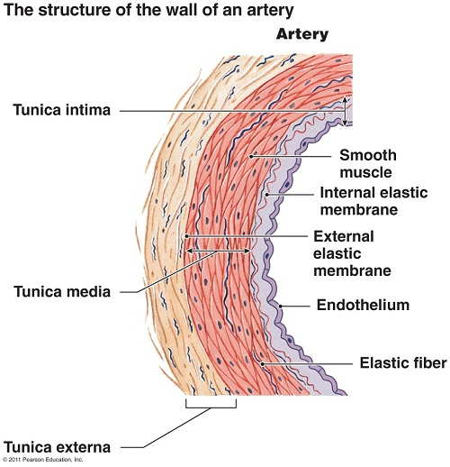
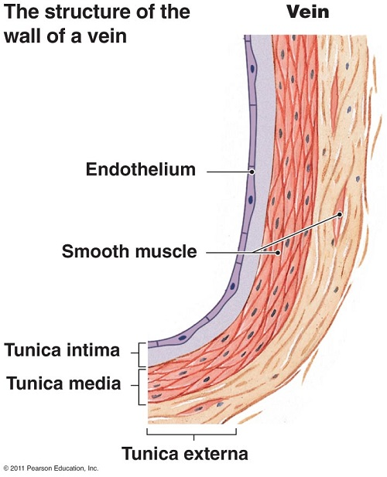
Artery and Vein

Slide 45
Venules
Receive blood from capillaries
Have a larger diameter than arterioles(0.5-1 mm)
Small venules(post capillary venules) take part in exchange of metabolites between blood and tissue
Also permit leucocytes migration as do capillaries.
Venules are sensitive to inflammatory agents resulting in leakage of fluids and defensive cells.
The post capillary venules in mucosa associated lymphoid tissue(MALT) are lined by tall cuboidal endothelial cells and are called high endothelial venules(HEV)

Slide 46
Three layers of Venules
Wall is thin
Large collapsed lumen
T intima: endothelium
T media: 1-2 layers of smooth muscle fibers.
T adventitia: thick and composed of connective tissue rich in collagen fibres.

Slide 47
Cross section of a venule and arteriole(200X)

Slide 48
Arterioles, venules and capillaries within adipose tissue(200X)

Slide 49
Cross section of a vein and an artery(200X)

Slide 50
Cross section of artery and vein

Slide 51
Summary of Histology of Veins

Slide 52
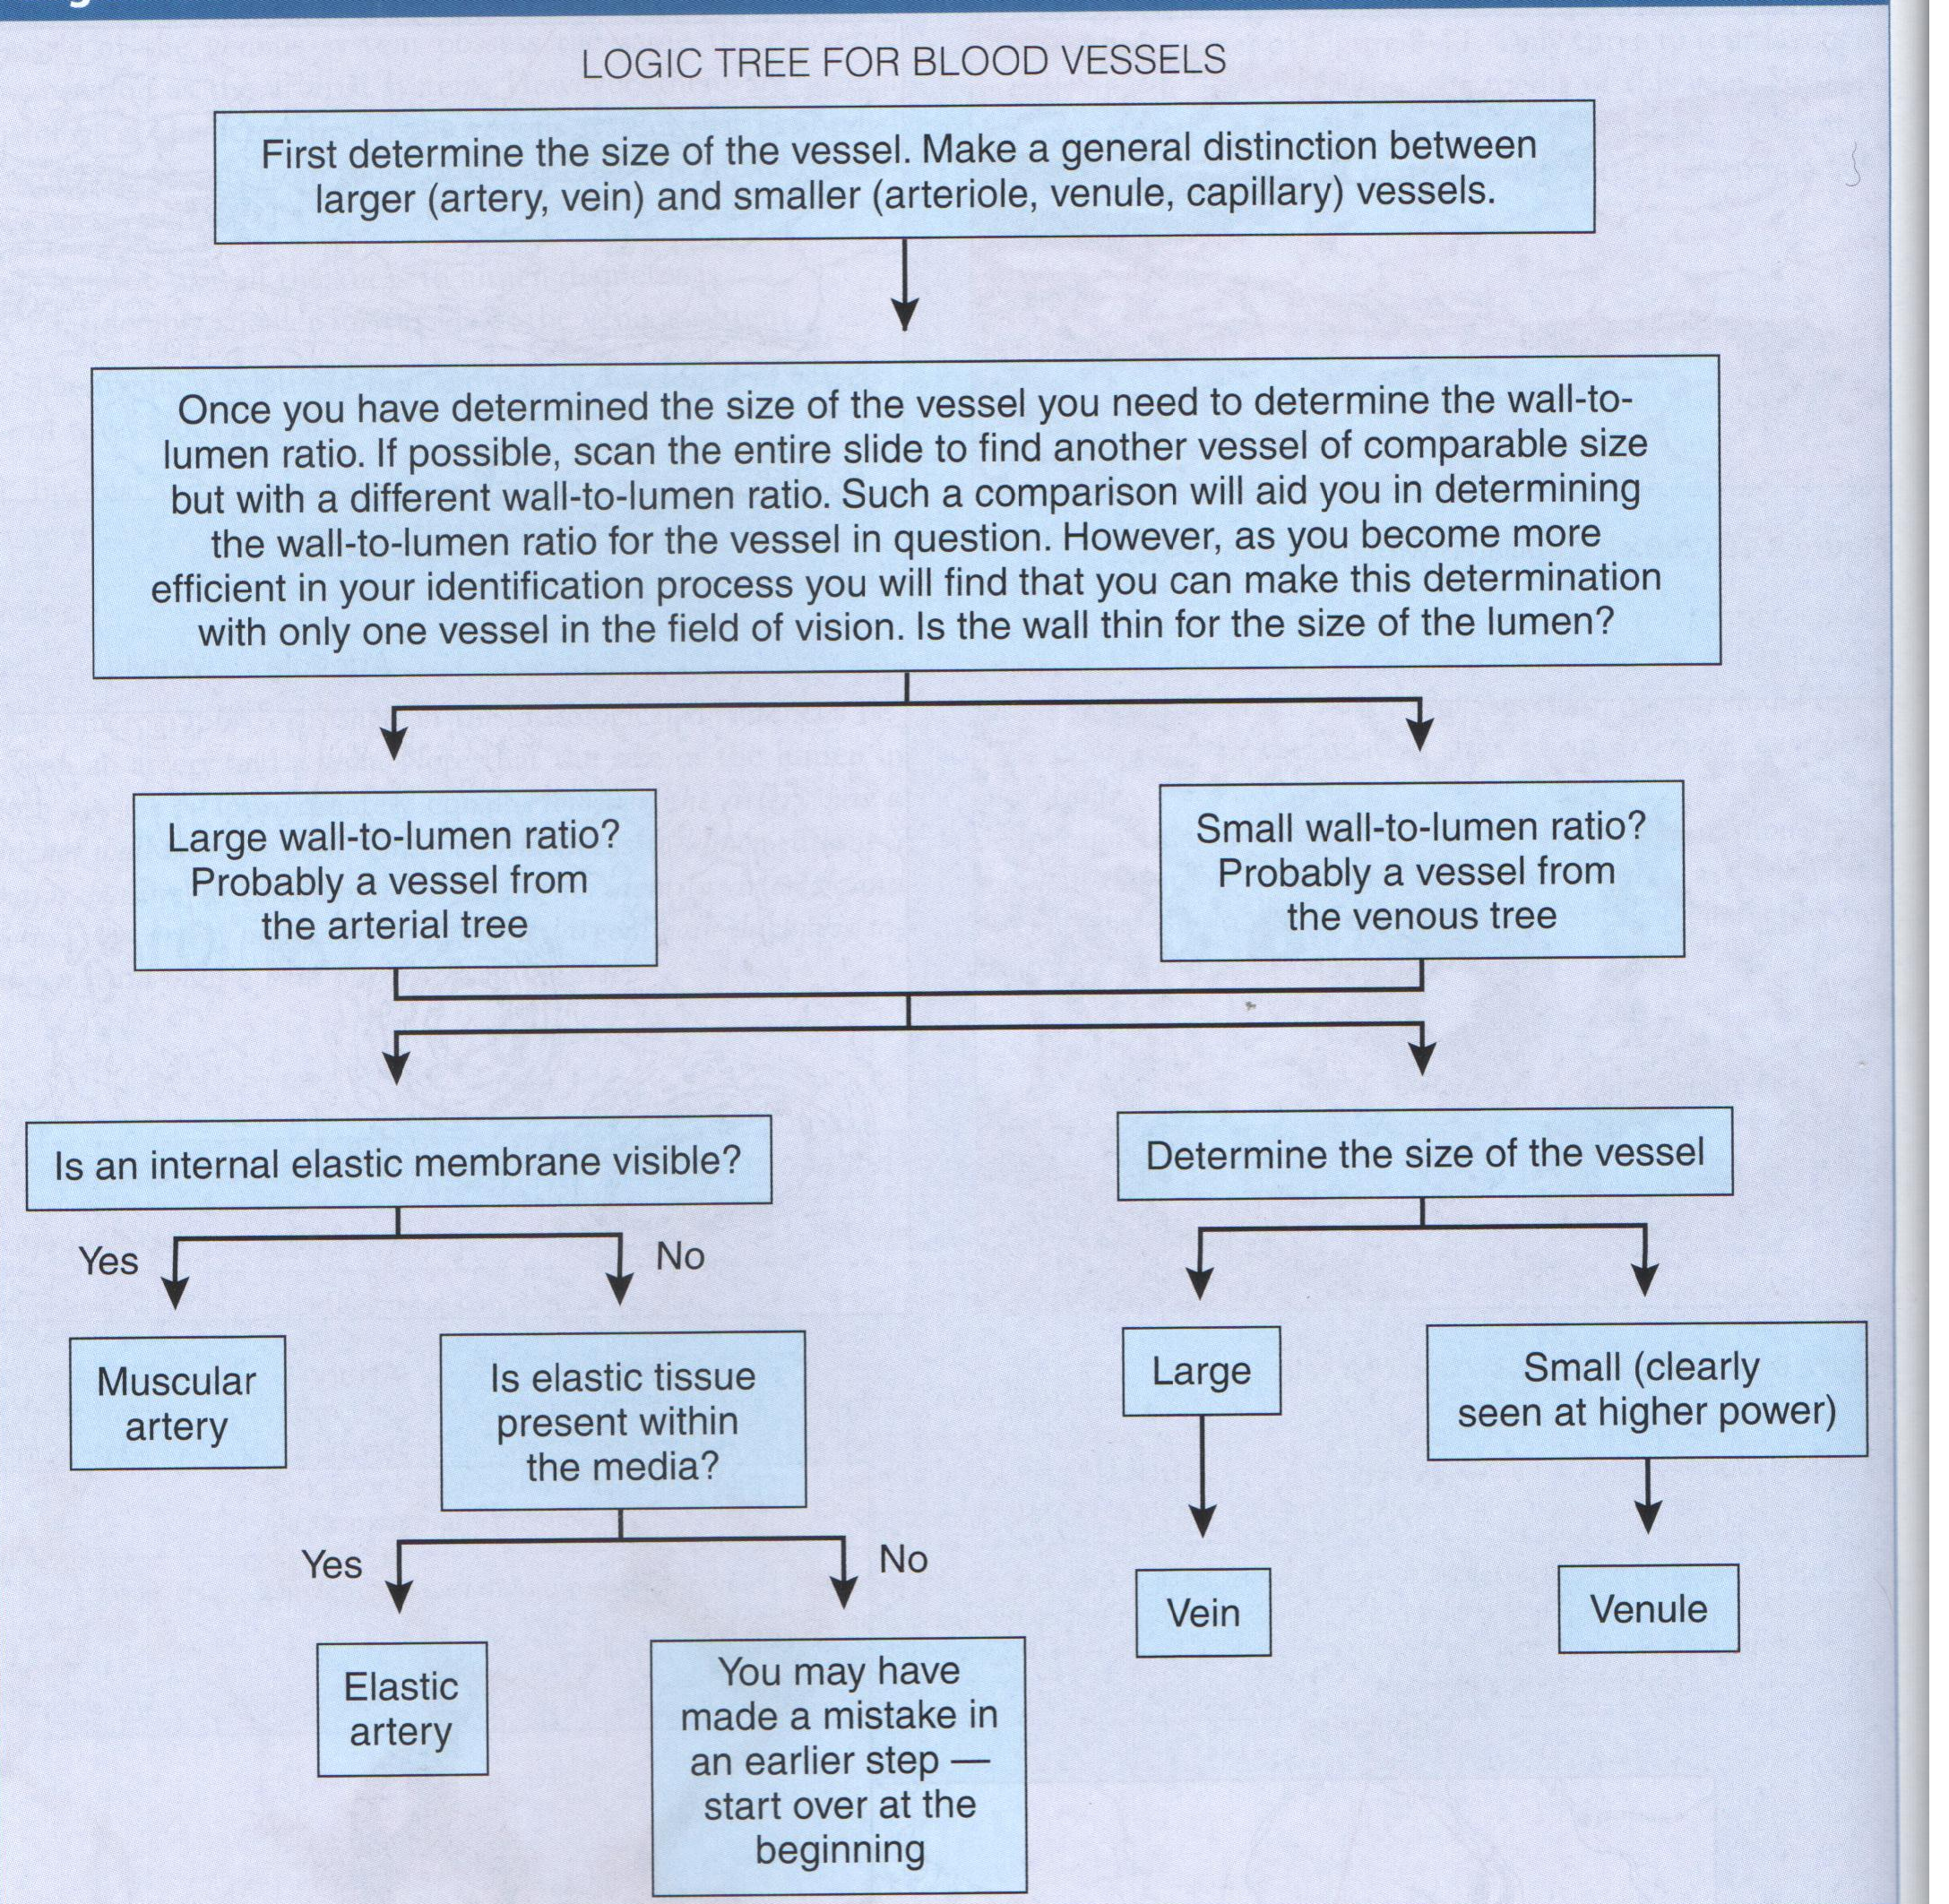

Slide 53
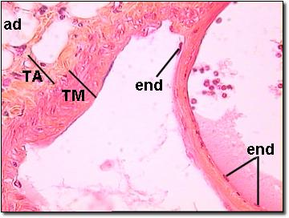
High Power View of Medium Sized Vein and valve
Valves + in most Veins
For unidirectional flow of blood
Made of 2 semilunar cusps
Each cusp is afold of endothelium with elasitic fibre rich connective tissue in them.

Slide 54
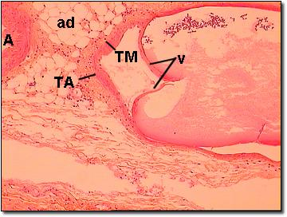
Medium Vein and Valve

Slide 55
MCQ 1
A large artery is characterized by the presence of
a) A Well Developed Internal Elastic Lamina
b)Elastic Fibres In Tunica Media
c) Smooth Muscle Fibres In Tunica Adventitia
d)Mesothelial lining

Slide 56
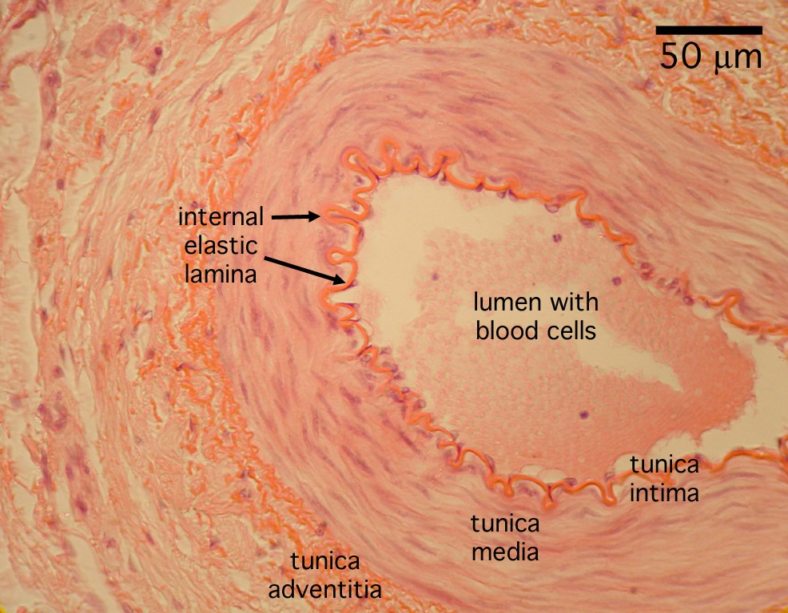
Identify the vessel

Slide 57
MCQ 2
Atherosclerosis in an artery is due to
a) Thickening of T intima
b) accumulation of lipid in myointimal cells
c) Calcification of T media
d) All of the above

Slide 58
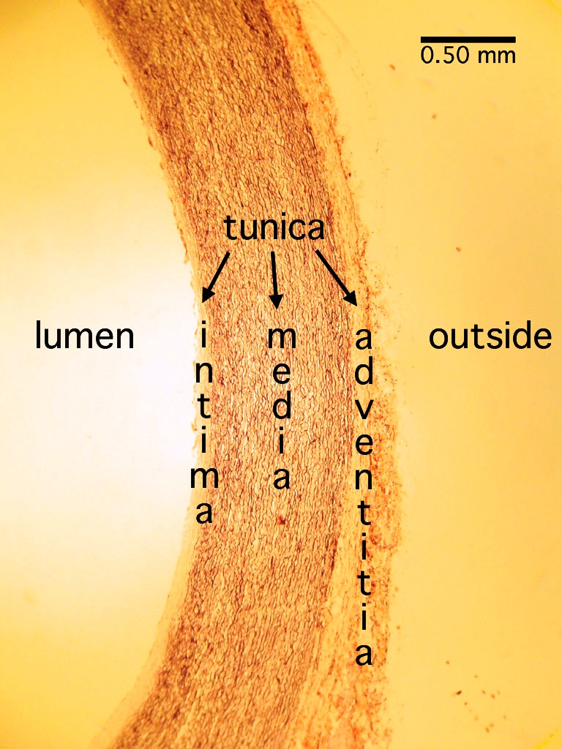

Slide 59
MCQ
Medium-sized artery is characterized by the presence of
a) a well developed Internal elastic lamina
b) a well developed subendothelial connective tissue
c)elastic fibres in tunica media.
d)smooth muscle fibres in tunica adventitia

Slide 60
Identify the vessel

Slide 61
MCQ
Pericytes are
a) Modified endothelial cells
b) Phagocytic cells
c) Pluripotent cells found in association with capillaries
d) Found in tunica media of arterioles

Slide 62
MCQ
Capillary endothelial cells are involved in
a) Conversion of angiotensin I to angiotensin II
b)Exchange of metabolites
c)Diapedesis
d) All of the above

Slide 63
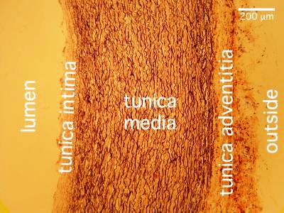
Identify the vessel

Slide 64
MCQ
Capillaries in endocrine glands are lined with
a) Continuous endothelium
b) Discontinuous endothelium
c) Fenestrated endothelium
d) Sinusoidal endothelium

