Slide 1
Introduction of Public Health Dentistry

Slide 2
Public Health Dentistry: It is that specialized branch of dentistry which deals with delivery of comprehensive dental & oral health care to the masses so as to improve the total dental & oral health of the community as a whole.

Slide 3
Aims of Public Health Dentistry
To prevent & Control oral diseases &
promote oral health
through organized community efforts.

Slide 4
Objectives of Public Health Dentistry :
To get knowledge about public oral health, Preventive dentistry
Public oral health problems in India: relating with Nutrition, environment & their role in health.
Conducting oral health survey, oral health education etc

Slide 5
How Public Health Dentistry is different from General Dentistry ?
Public Health Dentistry
Focus is on Prevention
Patients are Families, Community and entire population
Diagnosis: Epidemiological Studies
Treatment: Health Education, clinical services, preventive Programmes
General Dentistry
Focus is on treatment
Patients are individual and Families
Diagnosis: Physical examination and test
Treatment: Medication, surgery and therapy

Slide 6
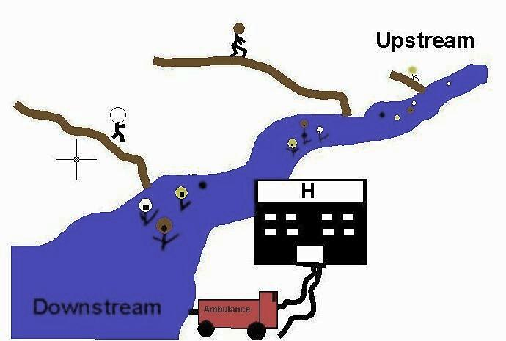
Upstream-Downstream……
Notes:
In public health, we try to catch people upstream before they get sick and fall down the stream where the hospital has to then care for them.
Public health takes a proactive, preventative approach. The focus is on health and wellness for the entire population.

Slide 7
Core areas (tools) in Public Health Dentistry
EPIDEMIO-LOGY
BIOSTATISTICS
SOCIAL SCIENCES
PRINCIPLES OF ADMINISTRATIONS
PREVENTIVE DENTISTRY

Slide 8
Epidemiology: the study of distribution and determinant of health related event in population and the application of this study to control health problem.
Objective: to define magnitude of disease
to identify etiological factor
to provide data necessary for planning
Biostatistics: science of compiling, classifying and tabulating numerical data and expressing the results in a graphical form

Slide 9
Social science: sociology
Principal of administration: leadership quality
it devided into organisation and management.
Preventive dentistry: level of prevention

Slide 10
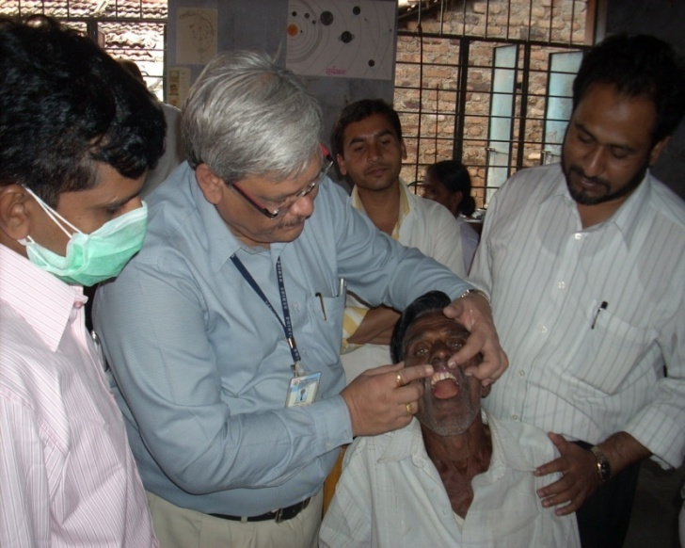
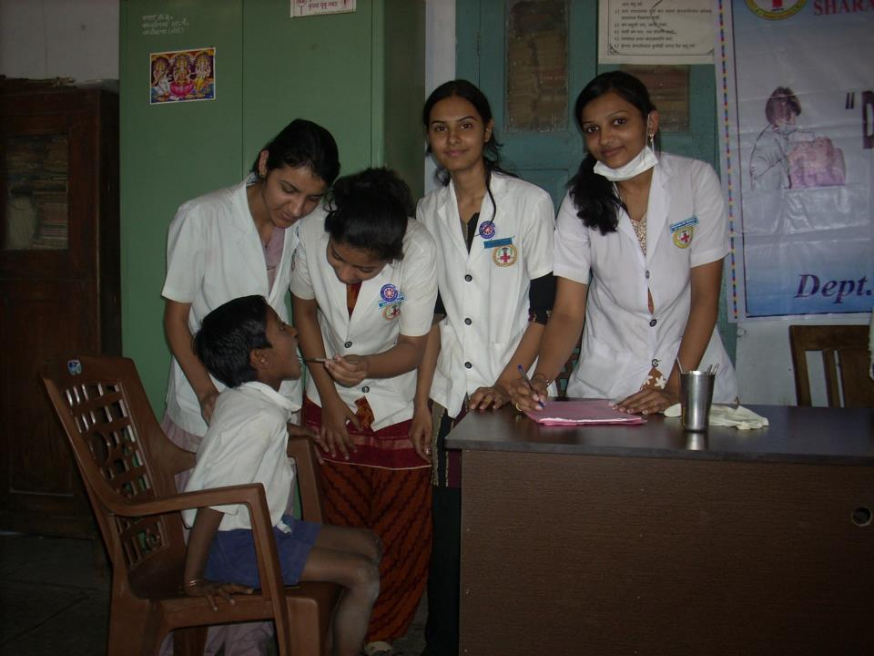
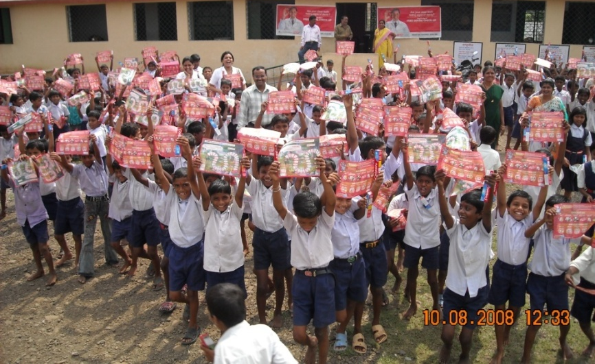
key functions of public health Dentist are:
Health Promotion
Disease Prevention
Delivering dental treatments.
Conducting field activities.
Conducting school Health Programme.
Notes:
So what does public health do? On a daily basis, Ontario’s public health sector contributes to keeping Ontarians healthy and safe through health protection, disease prevention and management, and health promotion activities.
Promotion – Healthy Lifestyle (eat well, exercise, drug and alcohol prevention, stress reduction at work), Health Equity
Prevention, Early Detection & Screening – Monitoring water, air, soils; Early detection of cancer; dental screening
Protection - Immunizations, safe water, air quality, safe disposal of sewage, tobacco by-law enforcement
Surveillance– Keeping track of patterns of disease to enable timely action
Health Assessment– Measuring, monitoring and reporting on the status of health in the community (Infectious Diseases such as Influenza, Meningitis etc.)
Population health is an approach to health that aims to improve the health of the entire population and to reduce health inequities among population groups

Slide 11
What would happen if we didn’t have public health Approach?
Oral Infectious diseases such as Dental Caries, Periodontitis and oral cancer would be more prevalent
People would be ill from preventable Oral diseases.
More children would be suffering from dental caries.
More youth and adults would be smoking or abusing drugs and alcohol
Ultimately economy of nation will go down.
Notes:
What will happen with inadequate Public Health?
Here's just a few of the things...
Communicable diseases will make a comeback. When New York City cut back on funding for public health programs in the late ’80s, tuberculosis came roaring back1. NYC had to spend 10 times as much to get this disease under control. When the Soviet Union collapsed in 1990, state funding for infectious disease prevention was cut. Diphtheria rates increased almost 30-fold by 1994, the incidence of mumps nearly tripled between 1990 and 1998 and tuberculosis rates increased by 70% from 1990 to 1995.
Higher incidences of food poisoning from restaurants and other commercial food establishments will result.
Fewer public health nurses visiting homes will mean that the incidence of low birth weight babies will rise, forcing hospitals to increase neo-natal resources.
Fewer public health staff in schools and the community will mean that more youth will start smoking or abusing drugs and alcohol.
Unwanted pregnancies and the spread of sexually transmitted diseases, including AIDS, will increase if sexual health clinics are closed. This will result in increasing health care costs that will be borne by everyone.

Slide 12
Introduction of Public health

Slide 13
The Birth of public health concept arises in England around 1840s.
It arose from the need to protect the public from spread of communicable disease.
An English epidemiologist, John Snow worked on Cholera which is often called the “father of public health”..
William Budd -an outbreak of typhoid fever.
A comprehensive piece of legislation was brought into force in England, the Public Health Act of 1875 for the control man’s physical environment.
Sanitary reforms- Sir John Simon (1816-1904) of London. He built up a system of public health in England which became the admiration the rest of the world .

Slide 14
Definition of Public Health
In 1920, C.E.A. Winslow earlier definition, has defined it as
“The science and art of preventing diseases, prolonging life and promoting health and efficiency through organized community efforts for
the sanitation of the environment,
the control of communicable infections,
the education of the individual in personal hygiene, organization of medical and nursing services for early diagnosis and preventive treatment of the disease
development of social machinery to ensure for every individual a standard of living adequate for maintenance of health, so organizing these benefits as to enable every citizen to realize his birth right to health and longevity.”

Slide 15
CHANGING CONCEPTS IN PUBLIC HEALTH
In the history of Public Health 4 distinct phases.
A. Disease Control Phase: (1880 - 1920)
Control of man’s physical environment. E.g. water supply, Sewage disposal etc. These measures were not aimed at the control of any specific disease. Sanitary legislation e.g. Sanitary awakening in England.

Slide 16
B. Health Promotional Phase: (1920 - 1960)
Beginning of the 20th century, a new concept, the concept of health promotion, began to take shape.
Initiate as personal health services such as
mother and child health services,
school health services,
industrial health services,
mental health rehabilitation services.

Slide 17
Two great movements were initiated for human development during the first half .
Provision for basic health services through the medium of primary health and subcentres for the rural and urban concept of health centre was first quoted in 1920, by LORD DAWSON of England.
2.Second great movement was community development programme promote village development through the participation of whole community.

Slide 18
C. Social Engineering phase: (1960 - 1980)
With advances in preventive medicine and practice of public health, the pattern of disease began to change in the developed world.
Many of the acute illness problems solved, new health problems in the form of chronic disease began to emerge, e.g. cancer, diabetes, cardiovascular diseases, and alcoholism etc.
These problems could not be tackled traditional approaches to public health isolation, immunization and disinfection.
A new factor “Risk factors” as determinants of these diseases came existence. Social and behavioral aspects of disease and health were given a new priority

Slide 19
D. Health for all phase : (1981 – 2000 A.D)
Most people in the developed countries enjoy all the determinants of good health, income, nutrition and education, sanitation etc.
In contrast, only 10-20% of population in developing countries enjoy access to health services of any kind.
Against the background in 1981, the of WHO target to provide- “Health for all by the year 2000”, that is attainment for all of a level of health that will permit all people to lead a socially and economically productive life.

Slide 20
What is a Public health problem ?

Slide 21
Criteria for Public health problem
Prevalence of health condition
Impact of the condition at the individual level
Impact on wider society
Condition is preventable and effective treatment are available

Slide 22
Prevalence of health condition
Essence is the disease widespread?
Who has the disease?
What percentage of the total population is affected?
What is the distribution of the disease?
Is the prevalence of the condition increasing or decreasing?

Slide 23
Impact of the condition at the individual level
How severe are the effects of the disease to the patient?
Do people die as a result of it?
Do they suffer pain, discomfort, or loss of function?
Can they perform their normal social roles?
Are they prevented from going to school or becoming employed because of the problem?

Slide 24
Impact on wider society
What are the costs to the health service of treatment and care?
What effect does the condition have on economic performance and productivity of the country?

Slide 25
Condition is preventable and effective treatment are available
Is the natural history of the disease fully understood?
Can the early stages of the condition be recognized? If so, are there interventions that can implemented to stop the disease progressing? If it does progress, are there effective treatments available?

Slide 26
Milestones in Dental Public Health

Slide 27
3000 BC: Gold toothpicks found in mesopotamia
2500 BC: H.Wang Ti devoted a chapter in his book to dental and gingival disease
1500 BC: Ebers papyrus –prescription on strengthening of teeth and gums
1000 BC: Indian civilization
Sushutha samita: Description of periodontal disease
Charak samita: Stress on toothbrushing –stick use
480 BC: Hippocrates-discussed the function and eruption of teeth.

Slide 28
1640: toothbrush was introduced
19th century: Craftsmanship to Professionalism
1791: first dispensary for the dental treatment of poor was established by skinner in new york city.
1826: M. Taveace in paris- introduced the first form of amalgam
1833: Crawcour brother introduced amalgam in US and advertised it as a substitute for gold restoration.
This time in dental history known as :Amalgam War”

Slide 29
1840: Baltimore college of dental surgery marked the official birth of formal dental education.
1865: First children's dental clinic in Germany
1884: M L Rhein, coined the term “oral hygiene”. He urged, dentists to teach their patients proper methods of tooth brushing
1896: Dr GV Black modified the composition of silver amalgam.
1898: J Leon William gave slogan –
“a clean tooth never decay”

Slide 30
Early 20th century
1901: F Mckay –Colorado stain
1902: GM Wright- Subspecialty of dental profession- dental hygienist.
1905: Dr Fones- trained mrs irene newman for oral prophylaxis: the first professionally trained dental auxilllary.
1908: Epidemiological investigation related to mottled enamel.
Dr Black and Mckay start the study on colorado stain and termed “Dental flourosis”.
1910: WG Ebersole
“tomorrow will show every dental organization in the world working in the oral hygiene field from educational point”

Slide 31
1913: Dr fones- Dental hygienist course started in Bridgeport
1921: 1st training school for dental nurses in New zealand.
Dentist act passed in england
1945: USA launch 1st community water fluoridation at Grand rapids , Michigan.

Slide 32
In India
1926: Dr R Ahmed Dental College, Calcutta- 1st dental college established by Dr R Ahmed
1948: Dentist act
1985: Draft for National Oral Health Policy

