Slide 1
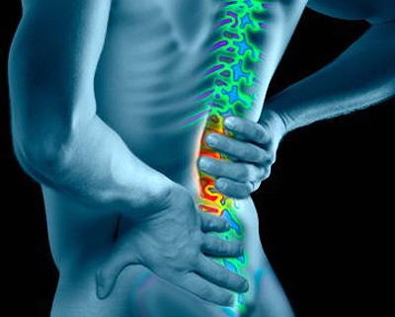
LOW BACK PAIN
Dr. Dileep Kumar
MS (Ortho)
Assistant Professor

Slide 2
INTRODUCTION
Low back pain is a very common problem and has a ubiquitous distribution.
The most common cause of LBP is lumber disc disease.
Bad posture plays a very significant role in the genesis of LBP.
LBP refers to pain from the low lumber areas, lumbosacral areas and both the sacroileac joint.

Slide 3
Low back pain is an extremely common malady affecting the human race across globe.
It is a price mankind has to pay for their upright posture

Slide 4
Epidemiology
60 – 90% of adults experience back pain at some point in their life.
- ↑ incidence age 35- 55 yr.
- 90% resolve in 6 weeks.
- 7% become chronic.
- M/F equally affected.
5th Leading reason for medical visits.

Slide 5
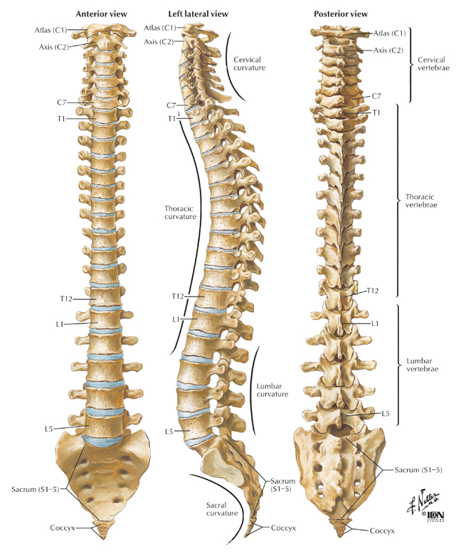
Normal posture of spine
Moderate lordosis of cervical and lumber spine.
Kyphosis of the thorasic and sacrococcygeal section.
Forward pelvic inclination of 30 degree.
Neutral rotation og femur.

Slide 6
Pathophysiology
Physiologic curves give the spine its “S” shape.
If due to our posture this “S” curve fails to maintain, muscles attach to spine starts to ratain posture by contraction.
Repeated contraction of muscle causes fatigue and strain in ligaments and posterior articulating faces and pain starts over back.

Slide 7
Common causes of backache
Unaccustomed activities
Poor posture
Occupational backache
Obesity
Muscle strain
Prolapsed lumbar intervertebral disc
The facet joint arthritis
Spinal stenosis
Osteoporosis/Osteomalacia

Slide 8
Uncommon causes of backache
Spina bifida
Lumber scoliosis
Tuberculosis
Ankylosing spondylitis
Neoplastic diseases affecting spine
Pain referred from viscera
Spondylolysis
Spondylolisthesis

Slide 9
Structures Involved in Backache
Vertebral bodies
Intervertebral disc
Posterior intervertebral joint
Ligaments and small intervertebral muscles
Posterior longitudinal ligament
Nerves

Slide 10
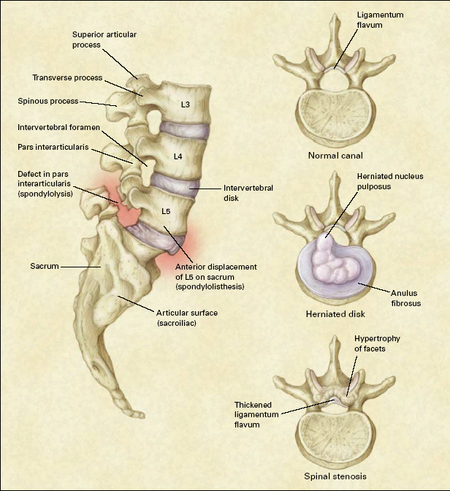
Common Pathoanatomical Conditions of the Lumbar Spine

Slide 11
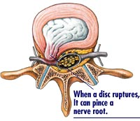
Disc Herniation – Physiology
Tears in the annulus.
Herniation of nucleus pulposus.
Notes:
11

Slide 12
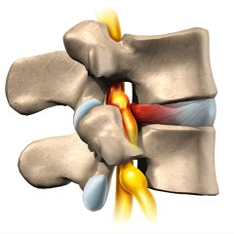
Disc Herniation – Physiology
Compression of the nerve root in the foramen leads to pain.
Lumber disc prolapse most commonly occurs in L4-5 vertebral level.
Notes:
12

Slide 13
Level of disc prolapse and nerve root compression
Disc prolapse between | Pain | Radiation | Sensory loss | Motor loss
L3 and L4 (L4 nerve root involve) | Lumber region | Along the antero- medial aspect of thigh | Medial shin | Quadriceps | Knee jerk- | Normal
L4 and L5 (L5 nerve root is involve) | Lumber region, groin, Sacroiliac region | Lateral thigh, leg, dorsum of the foot and 1st toe | 1st toe area | Extensor hallucis muscle | Medial hamstrings | Redused
L5 and S1 | Lumber region, groin, Sacroiliac region | Buttocks, posterior thigh,leg and lateral foot | Lateral foot | Grastrocne-mius | Ankle jerk | Reduced

Slide 14
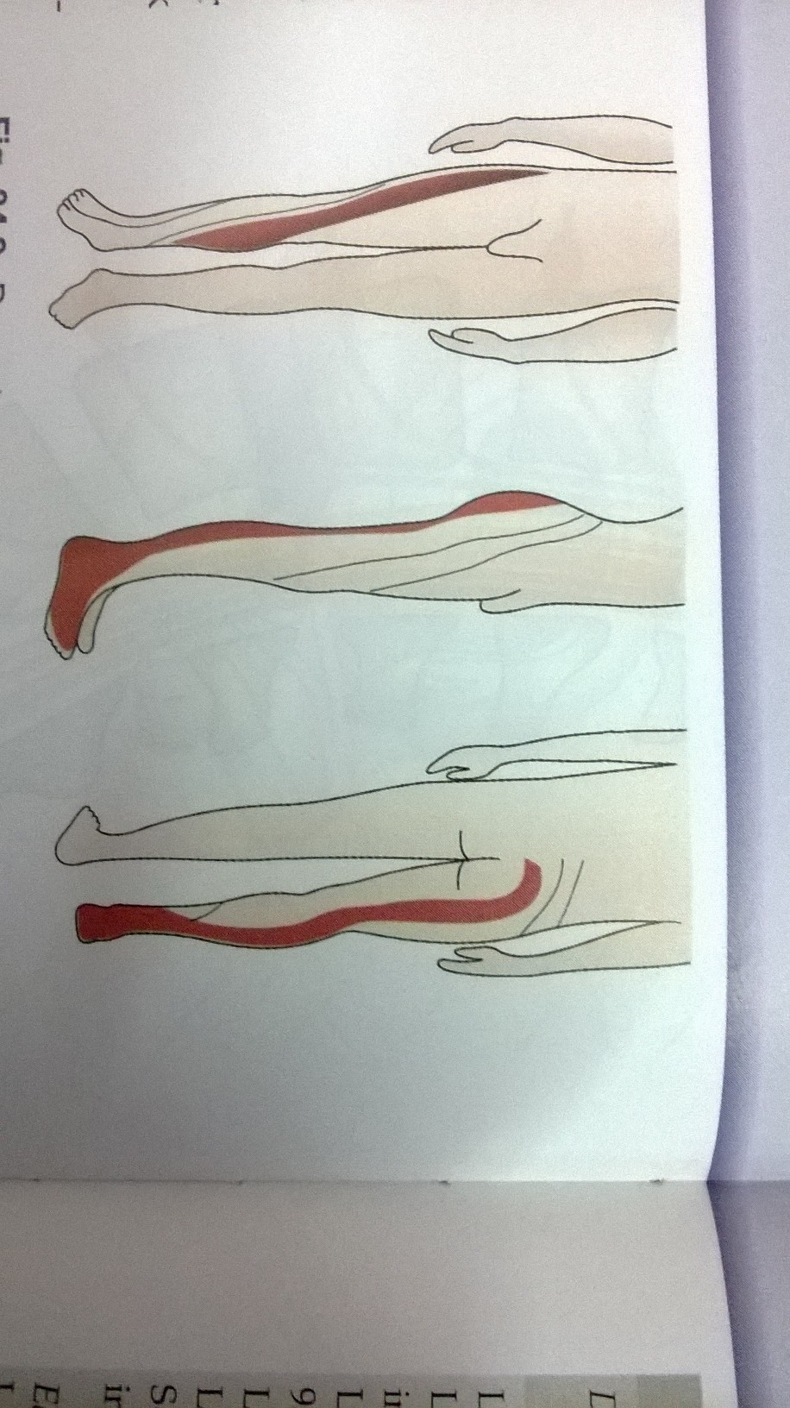
Easy way to remember
L4 nerve root involvement- “4” heads of Quadriceps. Hence knee jerk affected.
L5 nerve root involvement- “5” toes- Great toe and lateral 4 toes lose extension.
S1 nerve root involvement- “A” of Tendo-Achilles. Hence, ankle jerk lost.

Slide 15
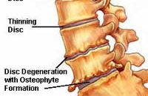
Disc Degeneration – Physiology
With age and repeated efforts, the lower lumbar discs lose their height and water content (“bone on bone”)
Abnormal motion between the bones leads to pain.
Notes:
15

Slide 16
FEATURES OF PAIN
LOCATION - The pain may be located in the lower middle or upper back .
Disc prolapse and degenerative spondylitis occur in the lower lumbar spine.
Infection and trauma occur in the dorso lumbar spine.

Slide 17
ONSET- Often there is a history of significant trauma immediately preceding the onset of the back pain.
LOCALISATION OF THE PAIN- A pain arising from the tendon or muscle injury is localized whereas that originating from the deeper structures is diffuse.

Slide 18
PROGRESS OF PAIN
In traumatic and in acute disc prolapse the pain is maximum at onset and then gradually subsides.
The back pain due to disc prolapse often has periods of remission and exacerbations, an arthritic pain is more constant.

Slide 19
RELIEVING OR AGGRAVATING FACTORS
Most back pains are worsened by activity and relieved by taking rest.
Pain due to ankylosing spondylitis and sero negative arthritis are typically worse after taking rest, and improve with activity.
A pain initiated on walking or standing and relieved by rest is a feature of spinal stenosis.
An increase in pain during menstrual period indicates gynaecological pathology.

Slide 20
SPASM-Muscle spasm may be present in acute back pain and can be assess by the prominence of the para vertebral muscles at rest which stand out on the slightest movement.
TENDERNESS-Localized tenderness may be indicate a ligament or muscle tear.
Pain originating from the sacro iliac joint may have tenderness localized to the posterior superior iliac spine.
SWELLING-A cold abscess may be present, indicating tuberculosis as the cause.

Slide 21
Assosiated symptoms
STIFFNESS- Associated with most painful backs but it is a prominent symptom in pain due to ankylosing spondylitis, more in early morning.
PAIN IN OTHER JOINTS- In Rheumatic diseases.
RADICULOPATHY- Pain in distribution of the sciatic nerve. Generally occurs due to disk herniation.
Also called as Sciatica.

Slide 22
EXTRA SKELETAL SYMPTOMS- A history suggestive of abdominal complaints, urogenital complaints or gynecological complaints may indicate an extra skeletal cause of pain.
THE PSYCHOLOGICAL STATUS- of the patient must be judged to rule out hysteria or malingering as a cause of back pain.

Slide 23
Physical examination
1) STANDING POSITION
POSITION
Normally a person stands erect with the center of the occiput in the line with the two shoulders are at the same level, the lumbar hollows are symmetrical and the pelvis is square.
In case of back pain look for scoliosis, kyphosis, lordosis, pelvic tilt, and forward flexion of the lower limbs.

Slide 24
Range of movement
Flexion- 80 degree
Lateral flexion-35 degree
Extension-20-30 degree
Rotation- 45 degree

Slide 25
2) Lying down position
Straight leg raising test
Peripheral pulses
Adjacent joints
An abdominal rectal or per vaginal examination

Slide 26
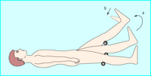
STRAIGHT LEG RAISE TEST
STRAIGHT LEG RAISE TEST
The straight leg raise test is positive if pain in the sciatic distribution is reproduced between 30° and 70° passive flexion of the straight leg. Dorsiflexion of the foot exacerbates the pain.

Slide 27
Modifications of SLRT
Lasegue’s test
Buckling’s sign
Sicard’s test
Fajersztajn’s test

Slide 28
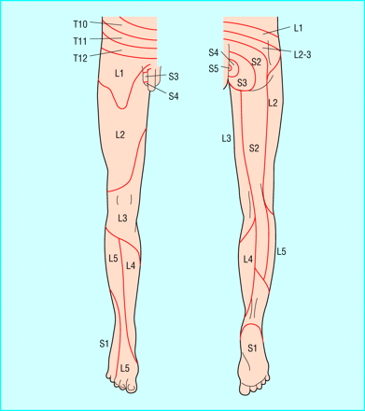
Lumbrosacral Dermatones

Slide 29
INVESTIGATIONS
The diagnosis of back pain is essentially clinical.
There is no use of getting x-rays done in acute back pain less than 3 weeks duration.
There are number of other investigations like CT scan, MRI, bone scan, blood investigations etc.

Slide 30
BLOOD INVESTIGATIONS
These should be carried out in case if one suspects malignancy, metabolic disorders, or chronic infections.

Slide 31
RADIOLOGICAL EXAMINATION
Routine x rays of the lumbo-sacral spine and pelvis should be done in all cases.
Though x-rays are usually normal in non specific back pain these provide a base line.
It shows bony pathology.

Slide 32
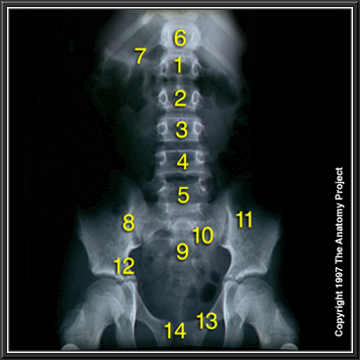
Abdomen, X-ray, Anteroposterior View
1. 1st Lumbar vertebra
2. 2nd Lumbar vertebra
3. 3rd Lumbar vertebra
4. 4th Lumbar vertebra
5. 5th Lumbar vertebra
6. T12
7. Twelfth rib
8. Sacroiliac joint
9. Sacrum
10. Sacral foramen
11. Ilium
12. Pelvic brim
13.Superior ramus of pubic bone
14. Pubic symphysis

Slide 33
MRI/CT
MRI-To rule out soft tissue pathology or nerve root compression.
CT- To rule out mainly bony pathology.

Slide 34
Bone scan- It may be helpful if a benign or malignant bone tumor is suspected on clinical examination but is not seen on plain x rays.
Electromyography- To rule out nerve root compression.
Discography

Slide 35
TREATMENT
Conditions for treatment- An unremitting backache not cured by simple treatment methods.
A backache with pain radiation to legs.
Sensory compromise.
Bladder and bowel disturbances.
Severe backache and severe restrictions of spine.
Backache due to spine deformities, infections, trauma, ankylosing spondylitis, rheumatoid diseases , malignancy etc.

Slide 36
Most back pain fall in non specific category have a set of program of treatment mostly conservative.
It consists of rest, drug, hot packs, spinal exercises, traction corset, education regarding prevention of back pain etc.

Slide 37
DRUGS
Drugs like pain killers, muscle relaxants, anti depressants, calcium supplements, vitamin supplements and very rarely steroids.
Local application of the ointment and gel are also widely recommended.
Drugs are however not safe for long periods.

Slide 38
PHYSIOTHERAPY
This is an important method of treatment and may be used to support the drug treatment or during post surgical recovery.
There are various recommended physiotherapy methods of treatment.

Slide 39
HEAT THERAPY
Heat helps to increase the blood circulation to the skin muscles, bones and joints.
Increased blood supply takes away the pain producing sustains from the tissues and rids patient of the pain.
E.g. hot water packs and infrared rays.

Slide 40
COLD THERAPY
It consists of ice packs, ice massage, cold water packs etc.
It is very effective if used within 24 hrs. of an acute injury of the back.
After 24-48 hrs. one can switch over to heat therapy

Slide 41
MASSAGE
This has been a very common method of treatment since ages.
It is a popular method and if done skillfully it provides a soothing effect and induces relaxation of spine muscles and ligaments.

Slide 42
Pelvic traction
This method involves applying pulling forces over the muscles, ligaments and joints with the help of appropriate pulling devices.
This induces relaxation of the muscles and ligaments, separates the bones and joints and thus helps to reduce pain and muscle spasm.
It ensures complete bed rest too.

Slide 43
ADJUVANT METHODS
LUMBO SACRAL CORSETS
They are useful in acute stages of low back pain and also act as a psychological boost.
However it weakens the spine if used for prolong period as the back muscles tend to get weakened due to inactivity.
It negates the advantages gained by the way of exercises which actually strengthens back muscles.

Slide 44
EXERCISES OF THE BACK
Exercises serve the role of putting spine back to its normal shape.
They are aimed to strengthen posterior spinal muscles, abdominal muscles and thigh (quadriceps) muscles.
To tone the other muscles of the trunk.

Slide 45
GENERAL INSTRUCTIONS
Do exercises on a hard floor
Do all exercises at least five repetition each time slowly increase it to ten
Be well relaxed and at ease
Use well fitting clothes
Keep breathing rhythmically
If it increase pain abandon it
If possible do exercises in company.

Slide 46
EXERCISES RECOMMENDED FOR BACK
ABDOMINAL MUSCLE EXERCISES
Head raising exercises
Straight leg raising exercises
Knees to chest exercises
Abdominal flexion to toe touch
Rotational exercises

Slide 47
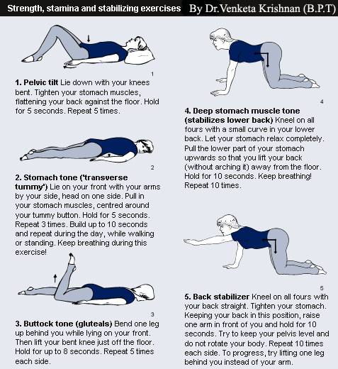

Slide 48
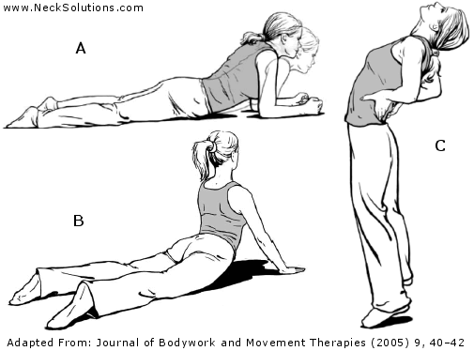

Slide 49
Exercises of trunk hip and thigh muscles
Hip extension
Trunk flexion
Quadriceps exercises
Hamstring stretch exercises
Back extensor muscles exercises

Slide 50
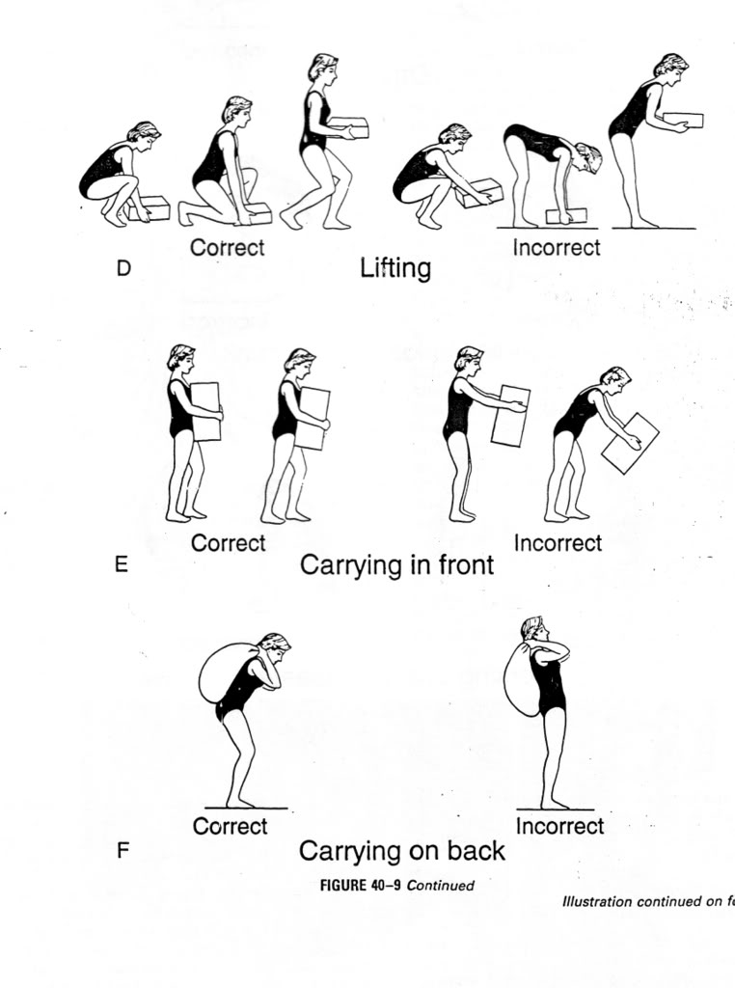
PREVENTION OF BACKACHE

Slide 51
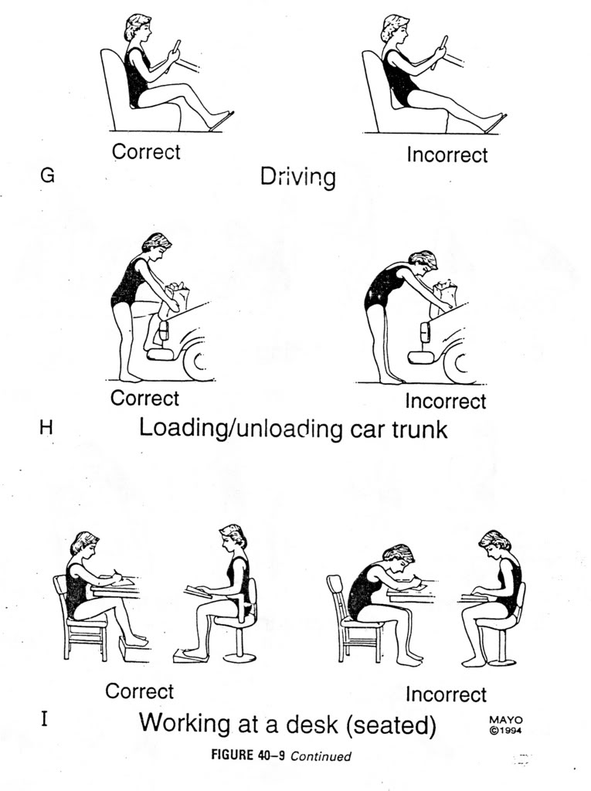

Slide 52
Surgery
Laminectomy and disc excision
Hemileminectomy
Fenestration surgery
Microscopic and Endoscopic lumbar discectomy

Slide 53
Newer procedures
MISS (Minimally invasive spinal surgery)
Laser diskectomy
Percutaneous diskectomy
Total disc replacement

Slide 54
THANK YOU

Slide 55
MCQ

Slide 56
MCQ-1
The most common cause of LBP is-
Metabolic
Malignancy
Trauma
Lumber disc disease

Slide 57
MCQ-2
Structure not involved in Backache-
Intervertebral disc
Posterior intervertebral joint
Anterior longitudinal ligament
Posterior longitudinal ligament

Slide 58
MCQ-3
A back pain initiated on walking or standing and relieved by rest is a feature of-
Spinal stenosis
Osteoporosis/osteomalacia
Ankylosing spondylitis
Tuberculosis

Slide 59
MCQ-4
The straight leg raise test is positive-
Between 30° and 70° passive extention of the straight leg.
Between 30° and 70° passive flexion of the straight leg.
Between 30° and 70° active flexion of the straight leg.
Between 30° and 70° active extention of the straight leg.

Slide 60
MCQ-5
Lumber disc prolapse most commonly occurs in-
L3-4 vertebral level
L4-5 vertebral level
L2-3 vertebral level
L1-2 vertebral level

Slide 61
ANSWERS
1) D
2) C
3) A
4) B
5) B

