Slide 1
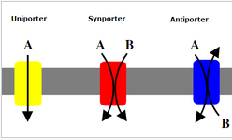
PHARMACOKINETICS
DR NARENDRA KUMAR

Slide 2
Pharmacokinetics of drugs (ADME)
Are studies of
Absorption
Distribution
Metabolism
Excretion of drugs

Slide 5
Importance of PK studies
Patients may suffer:
Toxic drugs may accumulate
Useful drugs may have no benefit because doses are too small to establish therapy
A drug can be rapidly metabolized.

Slide 6
DRUG ABSORPTION
Is the passage of drug through cell membranes to reach its site of action.
Mechanisms of drug absorption
Simple diffusion = passive diffusion.
Active transport.
Facilitated diffusion.
Pinocytosis (Endocytosis).

Slide 7
Cell membrane

Slide 9
Simple or passive diffusion
water soluble drug (ionized or polar) is readily absorbed via aqueous channels or pores in cell membrane.
Lipid soluble drug (nonionized or non polar) is readily absorbed via cell membrane itself.

Slide 12
Simple diffusion
Characters
common.
Occurs along concentration gradient
Non selective
Not saturable
Requires no energy
No carrier is needed
Depends on lipid solubility
Depends on pka of drug - pH of medium

Slide 16
PKa of the drug
(Dissociation or ionization constant):
pH at which half of the substance is ionized & half is unionized.
pH of the medium
Affects ionization of drugs.
Weak acids → best absorbed in stomach.
Weak bases → best absorbed in intestine.

Slide 17
Active Transport
Occurs against concentration gradient.
Requires carrier and energy.
Specific
Saturable.
Iron absorption.
Uptake of levodopa by brain.

Slide 21
Carrier-mediated Facilitated Diffusion
Occurs along concentration gradient.
Requires carriers
Selective.
Saturable.
No energy is required.

Slide 25
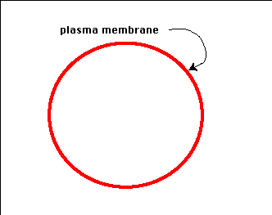
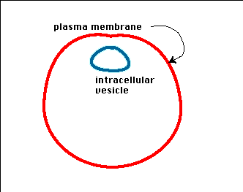
Phagocytosis (Endocytosis & Exocytosis)
Endocytosis: uptake of membrane-bound particles.
Exocytosis: expulsion of membrane-bound particles.
High molecular weight drugs or
Highly lipid insoluble drugs

Slide 29
Factors Affecting Bioavailability
Molecular weight of drug.
Drug Formulation (ease of dissolution).
(solution > suspension > capsule > tablet)
Solubility of the drug
Chemical instability in gastric pH
(Penicillin & insulin )
First pass metabolism reduces bioavailability

Slide 31
Factors Affecting Bioavailability (BAV)
Intestinal motility (Transit Time)
Diarrhea reduce absorption
Drug interactions
Food
slow gastric emptying
generally slow absorption
Tetracycline, aspirin, penicillin V

Slide 33
Drug Distribution
• Once in the bloodstream, a drug is distributed throughout the body
• Very little of the drug is in contact with receptors at any given time
• Most of the drug is in areas remote from the site of action (of interest), such as
– Plasma binding sites
– Muscle tissue
– Adipose tissue (fat)
– Liver
– Kidneys

Slide 34
VOLUME OF DISTRIBUTION
Apparent volume of distribution (V _{d}) Presuming that the body behaves as a single homogeneous compartment with volume V into which drug gets immediately and uniformly distributed

Slide 38
Metabolism
Liver is the primary site for metaboloism.
Most of the drugs are inactivated by metabolism.
Some drugs may be activated from the inactive compunds (Prodrugs) and others may give rise to active metabolites from the active compound.
Metabolism may occur with help of microsomal or non-microsomal enzymes.
Microsomal enzymes (monooxygenase, cytochrome P450 and glucoronyl transferase) may be induced or inhibited by other drugs whereas non-microsomal enzymes are not subjected to these interactions.

Slide 39
Enzyme inducers
Increases the metabolism of other drugs and reduce their effect.
G | Griseofulvin
P | Phenytoin
R | Rifampicin
S | Smoking
Cell | Carbamazepine
Phone | Phenobarbitone

Slide 40
Enzyme inhibitors
Vitamin | Valproate
K | Ketoconazole
Cannot | Cimetidine
Cause | Ciprofloxacin
Enzyme | Erythromycin
Inhibition | INH

Slide 41
Prodrug Few drugs are inactive as such and need conversion in the body to one or more active metabolites. Such a drug are called a prodrug . The prodrug may offer advantages over the active form in being more stable, having better bioavailability or other desirable pharmacokinetic properties or less side effects and toxicity. Some prodrugs are activated selectively at the site of action.

Slide 42
Phases of Drug Metabolism
Phase I (non-synthetic) – in this reaction functional group get attached with drug molecule.
After phase I reaction, drug may become water soluble or lipid soluble.
Phase II (synthetic) – in this reaction a conjugate is attached to drug and make it water soluble.

Slide 43
Metabolic Reactions
Phase I (non-synthetic) | Phase II (synthetic)
Functional group get attached with drug molecule | Conjugate is attached to drug .
Drug may become water soluble or lipid soluble. | Make it water soluble
Include oxidation, reduction, hydrolysis, cyclization, and decyclization etc. | Include glucuronidation, acetylation, methylation, sulfation,and glycine conjugation etc.

Slide 45
Excretion
Kidney is the major route of excretion.
Excretion through kidneys occurs by glomerular filtration, tubular reabsorption and tubular secretion.
Glomerular filtration depend on the plasma protein binding and renal blood flow.
It does not depend on the lipid solubility because all substances (wether water soluble or lipid soluble) can cross fenestrated glomerular membrane.
Tubular reabsorption depends on lipid solubility.
If a drug is lipid soluble, more of it will be reabsorbed and less will be excreted. Opposite is true for lipid insoluble drugs.

Slide 46
Excretion
As lipid solubility depends on ionization, the ionized drug will be excreted by the kidney.
Thus, in acidic drug poisoning (salicylate, barbiturates etc.) urine should be alkalinized with sodium bicarbonate because weak acids are in ionized from in alkaline urine and thus are easily excreted.
Similarly for basic drug poisoning (e.g. morphine, amphetamine etc.), urine should be acidified using ammonium-chloride.

Slide 47
Excretion
Tubular secretion
Does not depend on lipid solubility or plasma protein binding.
In the nephron, separate pumps are present for acidic and basic drugs.
Drugs utilizing the same transporter may show drug interactions e.g. Probenecid decreases the excretion of penicillin and increases the excretion of uric acid.
Remember, exogenous substances e.g. Penicillins are removed whereas endogenous substances like uric acid are retained by these pumps.

Slide 48
Kinetics Of Elimination
Rate of elimination is the amount of drug eliminated (in units of weight like grams) per unit time.
If it is seen as a function of plasma concentration, we derive an important parameter known as clearance (CL).
Thus clearance is the rate of elimination of a drug divided by its plasma concentration.

Slide 49
First Order kinetics (Linear kinetics) | Zero Order kinetics (Non linear kinetics)
Constant fraction of drug is eliminated per unit time. Rate of elimination is proportional to plasma concentration. Clearance remains constant. Half life remain constant. Most of the drugs follow first order kinetics. | Constant amount of the drug is eliminated per unit time. Rate of elimination is independant of plasma concentration. Clearance is more at low concentrations and less at high conc. Half life is less at low conc. and more at high conc. Very few drugs follow pure zero order kinetics e.g. alcohol. Any drug at high conc. (when metabolic or elimination pathway is saturated) May show zero order kinetics.

Slide 51
The drugs whose kinetics changes from first order to zero order at therapeutic concentration are said to follow pseudo- zero order kinetics.
Zero | Zero order kinetics shown by
W | Warfarin
A | Alcohol and Aspirin
T | Theophylline
T | Tolbutamide
Power | Phenytoin

Slide 52
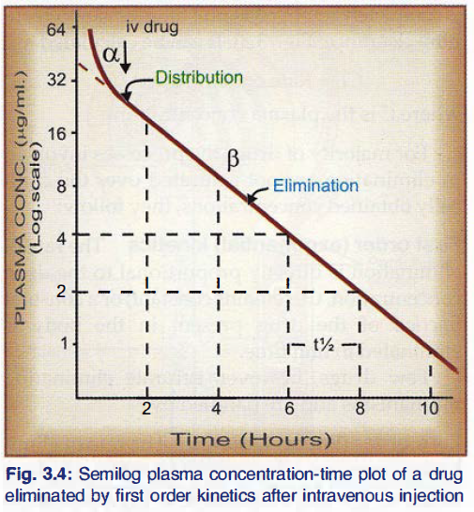
Plasma half-life
The Plasma half-life (t_{1/2}) of a drug is the time taken for its plasma concentration to be reduced to half of its original value. • initial rapidly declining (α) phase-due to distribution. • later less declined (β) phase-due to elimination. 2. At least two half-lives (distribution t_{1/2} and elimination t_{1/2}) can be calculated from the two slopes. 3. The elimination half life derived from the β slope is simply called the 'half life' of the drug.

Slide 55
Dose strategy
The drugs having high volume of distribution are given by this strategy.
First a large dose (loading dose) is administered to attain the steady state quickly and later on, to maintain the plasma concentration smaller dose is given (maintenance dose).
Loading dose : it is given to load (saturate) the tissue stores. So it is mainly dependent on V _{d} .
Loading dose = V _{d} x Target plasma concentration

Slide 56
Maintenance Dose
It is mainly dependent on CL.
Maintenance dose = CL x Target plasma conc.

Slide 57
Therapeutic Drug Monitoring (TDM)
TDM is a process by which the dose of a drug is adjusted according to its plasma concentration.
It is done for drugs having wide variation in pharmacokinetics ,both intra- as well as inter- individual.
It is done for the drugs having low therapeutic index like theophylline, lithium, antiepileptics, immuno-modulators and anti-arrhythmics etc.
TDM is done for those whose effect cannot be easily measured (like effect of antihypertensive drugs can be easily measured by monitoring BP, so TDM is not used).
TDM is not done for the drugs which are activated in the body or produce active metabolites (Prodrugs).

Slide 58
Fixed dose ratio combination preparations
Advantages
Convenience and better patient compliance.
2. Certain drug combinations are synergistic, e.g. sulfamethoxazole + trimethoprim; levodopa + carbidopa/benserazide; combination oral contraceptives.
3. The therapeutic effect of two components being same may add up while the side effects being different may not, e.g. amlodipine + atenolol as antihypertensive.
4. The side effect of one component may be counteracted by the other, e.g. a thiazide + a potassium sparing diuretic.
5. Combined formulation ensures that a single drug will not be administered. This is important in the treatment of tuberculosis and HIV-AIDS.

Slide 59
Disadvantages of fixed dose ratio combinations
1. The patient may not actually need all the drugs present in a combination
2. The dose of most drugs needs to be adjusted and individualised. When a combined formulation is used, this cannot be done without altering the dose of the other component(s).
3. The time course of action of the components may be different: administering them at the same intervals may be inappropriate.
4. Altered renal or hepatic function of the patient may differently affect the pharmacokinetics of the components.
5. Adverse effect, when it occurs, cannot be easily ascribed to the particular drug causing it.
6. Contraindication to one component (allergy, other conditions) contraindicates the whole preparation.
Confusion of therapeutic aims and false sense of superiority of two drugs over one is fostered, specially in case of antimicrobials whose combinations should be avoided.
Corticosteroids should never be combined with any other drug meant for internal use.

Slide 60
Bibliography
Essentials of Medical Pharmacology -7th edition by KD Tripathi
Goodman & Gilman's the Pharmacological Basis of Therapeutics 12th edition by Laurence Brunton (Editor)
Lippincott's Illustrated Reviews: Pharmacology - 6th edition by Richard A. Harvey
Basic and Clinical pharmacology 11th edition by Bertram G Katzung
Rang & Dale's Pharmacology -7th edition by Humphrey P. Rang
Clinical Pharmacology 11th edition By Bennett and Brown, Churchill Livingstone
Principles of Pharmacology 2nd edition by HL Sharma and KK Sharma
Review of Pharmacology by Gobind Sparsh
Internet web.

