Slide 1
NEUROHUMORAL TRANSMISSION
PROF. A. K. SAKSENA

Slide 2
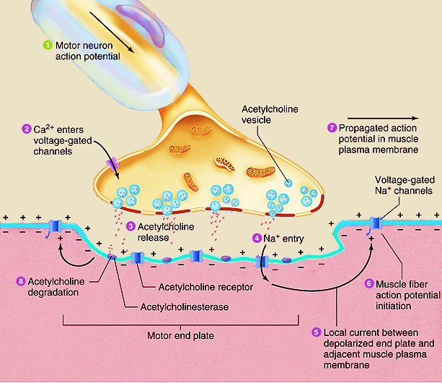

Slide 4
Neurohumoral Transmission
SYNTHESIS :- Terminal/ Cyton
Rate limiting step
Precursor + synthesizing enzymes
2) STORAGE :- With ATP (as complex)
Different granules – Ad
Reserpine
3) CONDUCTION :- Polar membrane,
Na⁺ channels (voltage gated)
4) RELEASE :- Ca⁺⁺ (exocytosis)

Slide 5
Neurohumoral Transmission(contd.)
5) ACTION ON POST-SYN. RECEPTOR :-
EPSP/IPSP- Ligand gated ion channels
Secondary messengers
↑ IP3/DAG or ↑/↓cAMP
6) ACTION ON PRE–SYN. RECEPTOR:-
a. Autoreceptors
b. Heteroreceptors
α2↓ , β2↑, m2
7) TERMINATION :-
a) Two step reuptake
b) Enzymes- ChE, MAO/COMT

Slide 6
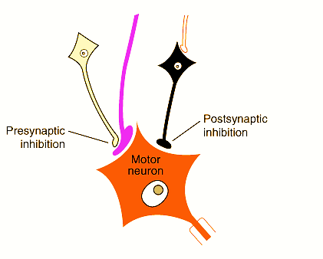

Slide 7
NERVOUS SYSTEM

