Slide 1
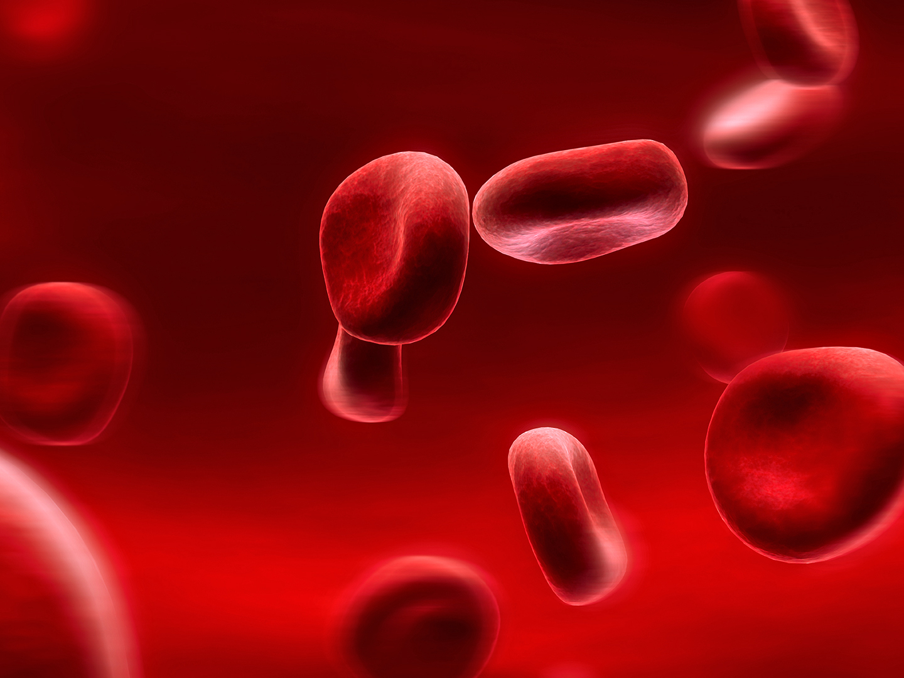
Blood Component Therapy
Dr Nishant Verma
Department of Pediatrics,
KGMU, Lucknow

Slide 2
Historical Time Line
17th century- 1st recorded transfusion (from man to animal)
1901- Karl Landsteiner’s discovery of ABO grouping laid foundation for scientific transfusion practices
1920’s - development of anti-coagulation solutions to store donated blood
1950’s - disposable plastic systems for collection and aseptic separation of blood components came into use

Slide 3
Blood Components
Role of Whole Blood ???
Notes:
Role of whole BT in pediatrics is limited.
- the only indications
- neonatal exchange transfusion
- during cardiac surgery
MISUSE OF WHOLE BLOOD:
A. To provide platelets
B. To provide clotting factors
C. Acute blood loss without shock

Slide 4
APROPRIATE USE OF BLOOD COMPONENTS
Use Blood Components – Only if necessary
Risk Of Adverse Reactions
Use Screened Blood
Avoid Blood Transfusions as much as possible

Slide 5
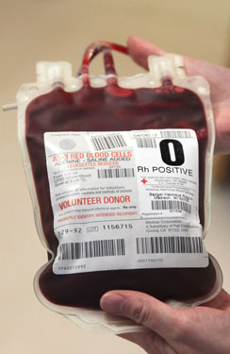
PRBC transfusion
Indications
Acute loss of >25% blood volume
Hb<8gm/dl in perioperative period
Hb<8gm/dl and symptomatic
Aplastic vs Hemolytic anemia
Notes:
Source of Ix: Nelson

Slide 6
PRBC transfusion
Packed RBC
Anticoagulant – CPDA / CPD
Volume – 150-200ml
Shelf life – 21-42 days (depending on the anticoagulant)
HCT – 60-80%
Storage
Notes:
21days if CPD, 35days if CPDA-1
Storage- 2-6 C

Slide 7
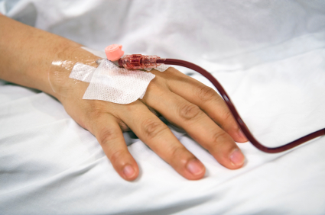
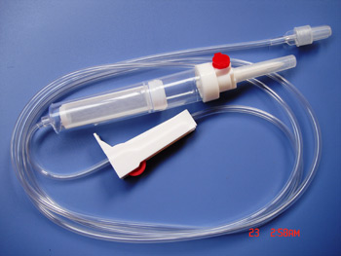
Administration of PRBC
Cross matching
Patient identification
Catheter size
>22G
Separate line
Use Filter
Notes:
Never co-adminster with calcium, dextrose, RL.
Filter is used to remove small clots. Not for leucoreduction

Slide 8
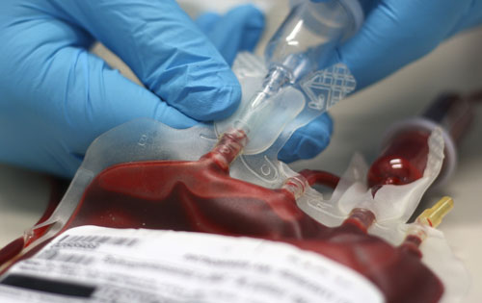
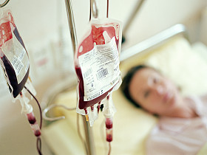
Administration of PRBC
Method
Universal precautions
Volume
Depends on indication
10-15ml/kg ↑ Hb by 2-3gm/dl
Infusion time – 4hr
Monitor

Slide 9
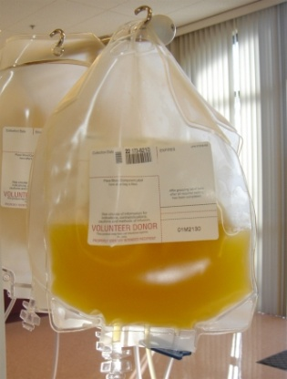
Platelet Transfusion
Types
Isolation from a unit of donated blood (RDP) (50-60ml)
Apheresis from a donor (SDP) (150-300ml)
1 SDP ~ 4-6 RDP
Notes:
RDP: Random donor platelet
SDP: one- to two-hour pheresis procedure. A typical apheresis platelet unit provides the equivalent of six or more units of platelets from whole blood.

Slide 10
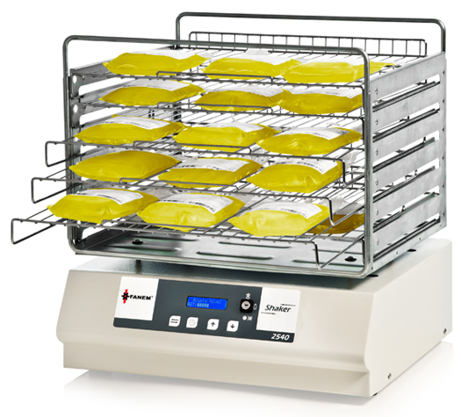
Platelet Transfusion
Indications
<50000/mm³ and bleeding
<50000/mm³ and invasive procedure
<20000/mm³ and with risk factors
<10000/mm³ without risk factors
Storage : Room temperature under constant agitation
Shelf life: 5 days
Notes:
A disadvantage of room temperature storage is the increased growth of bacteria compared with blood products stored in the refrigerator or freezer.

Slide 11
Platelet Transfusion
Dose
1 U RDP / 10kg body wt, or
10ml/kg (↑ Plt count by 30000/mm³)
Cross matching
Administration
Rate
Over 20-30min
Notes:
Platelets express ABO antigens on their surface, as well as HLA class I antigens. They do not express Rh or HLA class II antigens. ABO and HLA compatible platelets appear to cause a greater platelet count increment in the recipient, and they can be used to improve responses in patients who have become refractory to platelet transfusion due to alloimmunization. Due to inventory constraints, most transfusion services issue ABO mismatched platelets when type-specific platelet products are not available. Clinically significant hemolytic transfusion reactions secondary to transfusion of ABO-incompatible platelet products (eg, group O platelets given to group A patient) are uncommon, but they do occur.

Slide 12
FRESH FROZEN PLASMA
Plasma Frozen At –18 to -30⁰ C within 8 hrs
Shelf life – 1yr
Stable Clotting Factors as well as Factor VIII
200 - 250 ml
Ideally Thawed in Blood Bank
ABO matching
Donor plasma contains A and/or B alloantibodies
Must be either ABO-identical or ABO-compatible with the recipient.

Slide 13
FRESH FROZEN PLASMA
A patient with type A blood can accept plasma from donors who are type A (identical) or type AB (compatible)
A patient with type B blood can accept plasma from donors who are type B (identical) or type AB (compatible)
A patient with type O blood can accept plasma from donors who are type O (identical) or types A, B, or AB (compatible)
A patient with type AB blood can only accept plasma from donors who are type AB (identical)

Slide 14
FFP- INDICATIONS
Indications
Hereditary clotting factor deficiencies
von Willebrand disease
Acquired coagulation defects
severe liver disease
DIC
Severe Vitamin K deficiency bleeding
Availability of purified and recombinant coagulation factors - the use of FFP has markedly declined
Dose – 10ml/kg

Slide 15
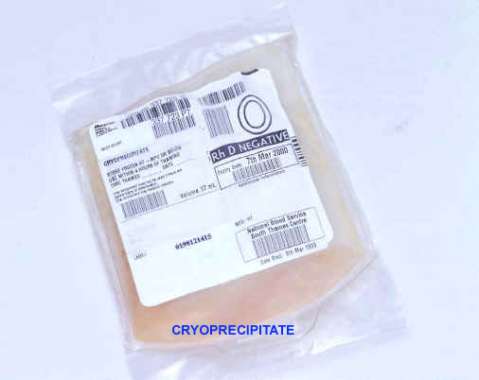
CRYOPRECIPITATE
Cryoprecipitate is prepared by thawing FFP between 1ºC and 6ºC and recovering precipitate
Factor VIII 80 – 100 IU /Bag,
Fibrinogen 150 –300 mg/pack

Slide 16
INDICATIONS
von Willebrandt Disease
Hemophilia A
Factor XIII deficiency
DIC
Dys & Hypofibrinogenemia
One Unit per 7 – 10 Kg. BW

Slide 17
Complications of Blood Transfusion

Slide 18
Types
Infection
Transfusion reactions
Circulatory overload
Metabolic
Iron overload

Slide 19
Types
Infection
Transfusion reactions
Circulatory overload
Metabolic
Iron overload

Slide 20
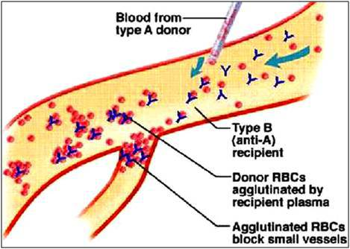
Transfusion reactions
1. Acute Hemolytic reaction
Results from mistransfusion of ABO- incompatible red cells
Is best prevented, rather than treated
Notes:
Complement mediated hemolysis. Coomb’s positive. Stop transfusion

Slide 21
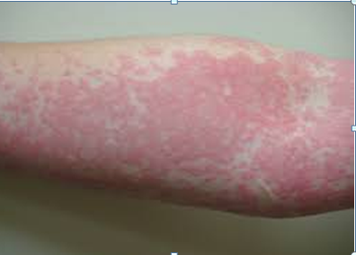
Transfusion reactions
2. Febrile reaction
Related to the presence of cytokines produced by donor leukocytes
3. Allergic reaction
Vary in severity from mild hives and itching to fatal anaphylaxis
More common with plasma and platelet transfusions

Slide 22
Transfusion reactions
4. Transfusion Associated Lung Injury (TRALI)
New ALI/ARDS occurring during or within six hours after blood product administration
Recipient WBC
Complement
activation
Pulmonary sequestration and
activation of neutrophils
Anti HLA or
anti granulocyte Ab
in donor plasma
Endothelial damage
Capillary leak in Lungs
TRALI
Notes:
Another theory postulates that TRALI is mediated by an interaction between biologically active mediators in banked blood products and the lung.
There is evidence that TRALI is more common in recipients of blood products from multiparous female donors who are more likely to possess anti-HLA antibodies and anti-neutrophil-specific antibodies.
Treatment is supportive. It can be caused by any blood component, including red blood cells (RBC), plasma, cryoprecipitate, platelets.

Slide 23
TRALI
C/F
Dyspnea, bilateral noncardiogenic pulmonary edema, hypotension, fever
Tt
Supportive

Slide 24
Transfusion reactions
5. Transfusion Associated GVHD (TA-GVHD)
Notes:
It occurs in two clinical settings: when the recipient is immunodeficient or immunosuppressed (eg, from hematopoietic cell transplant, lymphoma); and when there is a specific type of partial HLA matching between the donor and recipient.
Pathogenesis: TA-GvHD is a rare but serious complication of cellular blood component transfusion. The pathogenesis underpinning this condition is the transfusion of immunocompetent T lymphocytes which are not cleared (as normally occurs) by the recipient and subsequently engraft and proliferate in the recipient‟s bone marrow. Survival of these transfused lymphocytes may occur either as a result of shared human leucocyte antigen (HLA) epitopes and/or recipient immunosuppression. Engraftment and proliferation of CD4+ and CD8+ T cell lineages and subsequent immunologic responses culminate in GvHD. Recipient HLA class II antigens as well as minor histocompatibility antigens are presented to donor lymphocytes resulting in T lymphocyte activation, proliferation, cytolytic activity and cytokine liberation. The cytokine release and direct cytotoxic effect of the donor T cells produce the constellation of signs and symptoms associated with GvHD.
C/F: multisystem and cutaneous involvement. Fever is most commonly the first presenting symptom. Most patients developing signs and symptoms 2-30 days after transfusion. An erythematous maculopapular rash subsequently develops. Gastrointestinal complications may range from abdominal pain to profuse bloody diarrhoea. Liver dysfunction manifests predominantly as a cholestatic hepatitis. Bone marrow failure, presenting as progressive pancytopenia with neutropenic infections, occurs at a median of day 16. The bone marrow aplasia is the most significant contributor to the dismal prognosis in TA-GvHD. TA-GvHD is fulminant and rapidly fatal in the vast majority of cases. Death occurs on average 51 days following the transfusion. Immunosuppressive regimens have yielded poor results with only a few documented survivors.
Almost universally fatal.
Dx: TA-GvHD should be suspected in any patient presenting with rash, fever, liver dysfunction and gastrointestinal symptoms with a recent history of transfusion. Bone marrow biopsy frequently reveals a variably hypocellular marrow with a lymphocytic infiltrate. Haemophagocytosis may be prominent.
Directed transfusions from family members significantly increase a recipient‟s susceptibility to TA-GvHD, as blood relatives share HLA haplotypes, thus increasing the risk of a one-way matched transfusion. Therefore, directed transfusion from relatives should not be encouraged outside specific medical indications.
Gamma irradiation to inactivate viable T lymphocytes contained within the blood components remains the mainstay in prevention of TA-GvHD

Slide 25
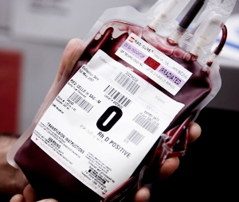
TA- GVHD
At risk population
C/F
Prevention: Irradiated products
Notes:
It occurs in two clinical settings: when the recipient is immunodeficient or immunosuppressed (eg, from hematopoietic cell transplant, lymphoma); and when there is a specific type of partial HLA matching between the donor and recipient.
C/F: multisystem and cutaneous involvement. Fever is most commonly the first presenting symptom. Most patients developing signs and symptoms 2-30 days after transfusion. An erythematous maculopapular rash subsequently develops. Gastrointestinal complications may range from abdominal pain to profuse bloody diarrhoea. Liver dysfunction manifests predominantly as a cholestatic hepatitis. Bone marrow failure, presenting as progressive pancytopenia with neutropenic infections, occurs at a median of day 16. The bone marrow aplasia is the most significant contributor to the dismal prognosis in TA-GvHD. TA-GvHD is fulminant and rapidly fatal in the vast majority of cases. Death occurs on average 51 days following the transfusion. Immunosuppressive regimens have yielded poor results with only a few documented survivors.
Almost universally fatal.
Dx: TA-GvHD should be suspected in any patient presenting with rash, fever, liver dysfunction and gastrointestinal symptoms with a recent history of transfusion. Bone marrow biopsy frequently reveals a variably hypocellular marrow with a lymphocytic infiltrate. Haemophagocytosis may be
prominent.
Directed transfusions from family members significantly increase a recipient‟s susceptibility to TA-GvHD, as blood relatives share HLA haplotypes, thus increasing the risk of a one-way matched transfusion. Therefore, directed transfusion from relatives should not be encouraged outside specific medical indications.
Gamma irradiation to inactivate viable T lymphocytes contained within the blood components remains the mainstay in prevention of TA-GvHD

Slide 26
Immunosuppression
FNHTR
GVHD
DONOR LEUKOCYTE
HLA alloimmunization
Infections (esp. CMV)
LEUKODEPLETION
Notes:
Certain HLA antigens expressed on the surface of donor leukocytes can induce the production of HLA antibodies in multiply transfused patients. Clinical problems that result from such allosensitization include an increased risk of graft rejection in patients awaiting organ or bone marrow transplantation and platelet refractoriness in those requiring subsequent platelet transfusion support.

Slide 27
Leukodepletion
Each unit of whole blood or unmodified PRBC contains roughly 2 to 5 x 10⁹ leukocytes
Filters
2nd generation: 90-99% reduction [1-2 Log↓]
3rd generation: 99.9-99.99% reduction [3-4 Log↓]

Slide 28
If possible always avoid a transfusion……
Risk of infections/ reactions
Transfusion may prove fatal (TRALI)

Slide 29
If transfusion is must…
Use appropriate blood component not just blood

Slide 30
