Slide 1
Case
6yr boy is brought to the OPD with complaints of recurrent painful swelling of the Lt Knee joint since 2yr of age. He also has a history of prolonged bleeding from cut sites.
One maternal uncle of the child died due to prolonged bleeding following a minor surgery.
O/E, No petechiae/purpura.
Lt Knee joint swollen, tender

Slide 2
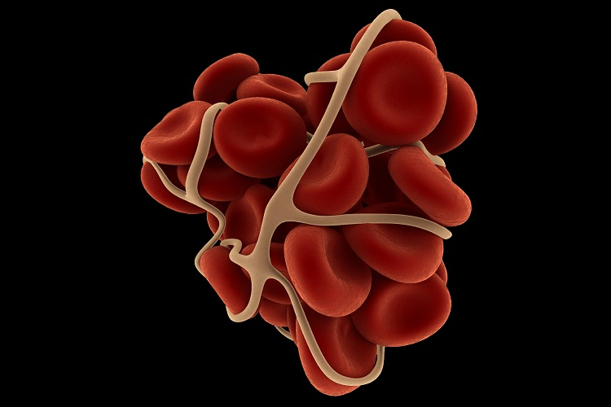
Hemophilia and Coagulation Disorders
Dr Nishant Verma

Slide 3
Hemostatic Mechanism
Platelet adhesion
Platelet aggregation
Clot formation
Clot stabilization
Limitation of clotting to the site of injury by regulatory anticoagulants, and
Re-establishment of vascular patency through fibrinolysis and vascular healing

Slide 4
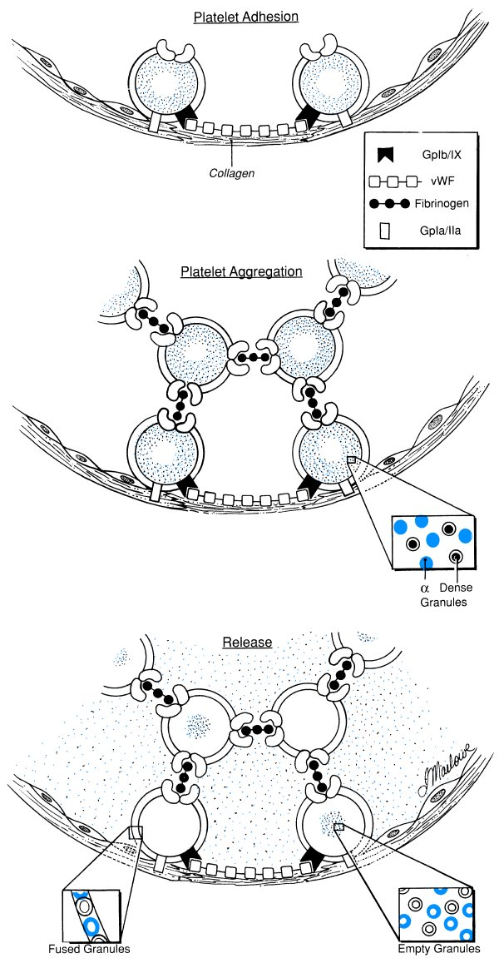
von Willebrand‘s
Factor (vWF)
binds to
subendothelial
collagen.
BERNARD- SOULIER SYNDROME
Conformational changes occur in vWF allow it to bind to the GP Ib/IX receptor on platelets,
causing adhesion
Notes:
vWF circulates in plasma, is stored in Weibel-Palade bodies in endothelial cells and is also present in the alpha granules of the platelets. Plasma vWF transports and stabilizes factor VIII and protects it from inactivation by activated protein C.

Slide 5
Fibrinogen acts as a glue binding platelets together.
The GP IIb/IIIa receptor complex changes conformation allowing binding of fibrinogen.
GLANZMANN’s Thrombasthenia

Slide 6
Clotting Factors
I | Fibrinogen
II | Prothrombin
V | Labile factor, proaccelerin
VII | Stable factor or proconvertin
VIII | Antihemophilic factor (AHF)
IX | Christmas factor
X | Stuart-Power factor
XI | Plasma thromboplastin antecedent
XII | Hageman factor
XIII | Fibrin Stabilizing Factor

Slide 7
Waterfall cascade:
Intrinsic pathway
Factor XII, prekallikrein and HMWK , factor XI , factor IX, factor VIII
Extrinsic pathway
Tissue factor,
factor VII
Factor X
Factor Xa
Factor V
Common Pathway
Prothrombin
Thrombin
Fibrinogen
Fibrin

Slide 8
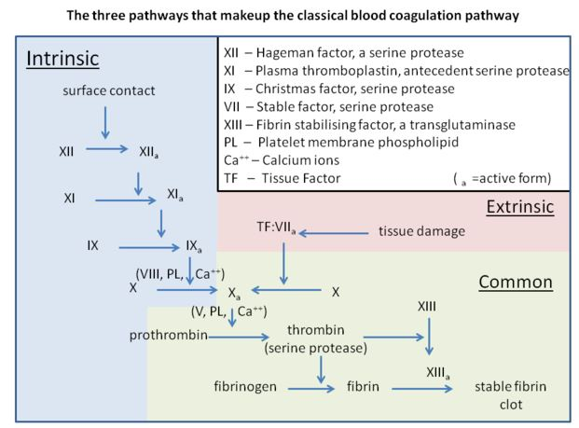
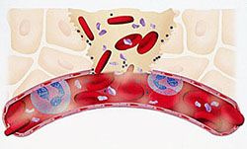
HEMOPHILIA
Notes:
Blood coagulation reaction can be described as ocurring in 3 overlapping phases: Initiation, Propagation and Termination.
Initiation: Perforation results in delivery of blood and with it circulating FVIIa and platelets to the extravascular space rich in membrane bound TF. This activates the extrinsic pathway. The TF:VIIA complex activates F IX and X to IXa and Xa. F Xa activates small amount of prothrombin to thrombin, which activates more platelets, and converts F V and VIII to Va and VIIIa.
Propagation: The activated F VIIIa combines with F IXa to form the intrinsic factor Xase (FVIIIa-FIXa complex). >90% of factor Xa is produced by this intrinsic factor Xase. FXa combines with FVa to form FVa – FXa prothrombinase complex, which converts most prothrombin to thrombin.

Slide 9
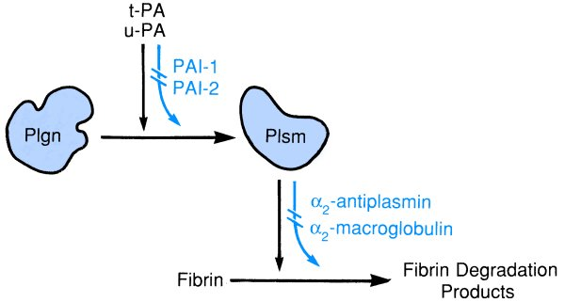
Overview of fibrinolytic mechanism

Slide 10
von Willebrand Factor

Slide 11
Classification of bleeding disorders
Primary Hemostatic defect
  Platelet disorder
    Congenital
    Acquired
  Von Willebrand Disease
Coagulation Disorders (Clotting factor deficiency)
  Acquired
  Inherited
Vascular

Slide 12
Classification of bleeding disorders
Clinical characteristic | Primary Hemostatic Defect | Coagulation Disorder
Site of bleeding | Skin, mucous membrane | Soft tissues, muscles, joints
Bleeding after minor cuts | Yes | No
Petechiae | Yes | No
Ecchymosis | Small, superficial | Larger, deeper
Hemarthrosis | Rare | Common
Bleeding after trauma/surgery | Immediate | Delayed
Example | Platelet defect, vWD | Hemophilia
Source: Nathan and Oski’s Hematology of Infancy and Childhood. 7th Edition, Pg 1450

Slide 13
Clinical Approach to bleeding disorders
History
Physical Examination
Laboratory Evaluation

Slide 14
Clinical Approach to bleeding disorders
History
Nature of bleeding-
- Immediate vs delayed
- Superficial vs deep
- Surgical / dental history
Family H/O bleeding-
- Others involved ?
- Males only? (x-linked)
- Consecutive generations
Medication history-
-NSAID, Heparin (patients with central lines)
Others- Liver / renal disease

Slide 15
Clinical Approach to bleeding disorders
Physical Examination
Bruises-
- Number
- Location
- Site
Petechiae
Joint bleeding
Other Physical findings-
- Jaundice
- Skeletal deformity
- Hepatosplenomegaly

Slide 16
Clinical Approach to bleeding disorders
Screening Laboratory Evaluation
Platelet count / morphology
Coagulation profile
  Prothrombin time (PT)
  Activated partial thromboplastin time (APTT)
  Bleeding time (BT)

Slide 17
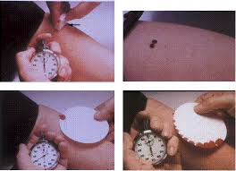
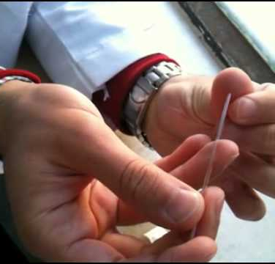
BT / CT
Bleeding time
  3-9 min
Clotting time
  3-6 min

Slide 18
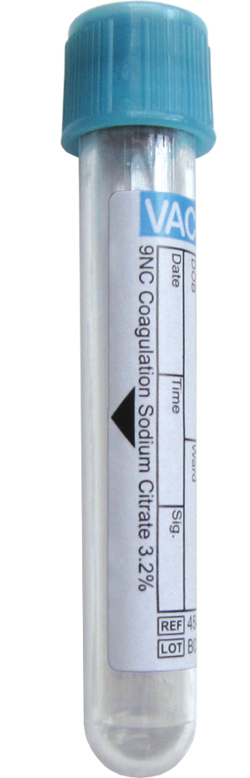
Coagulation profile
Sample collection
  Citrated tube
  Gently mixed
  Immediate transport
Notes:
1 part citrate:9 part blood. Gently mixed by inversion 3-4 times. Tested within 2hr (room temp), 4hr (preserved in cold)

Slide 19
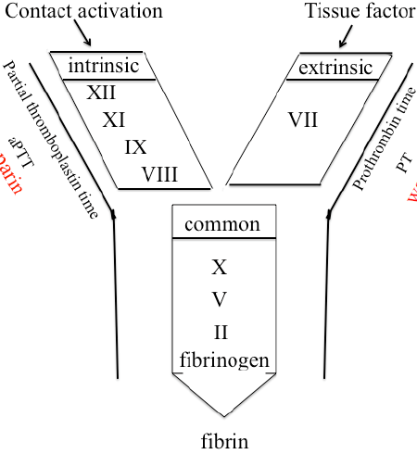
Coagulation profile
PT
  Method
  Normal – 10-11s
  INR = (Patient PT/Control PT)^{ISI}
  Isolated ↑ PT
APTT
  Method
  Normal – 26-35s
  Isolated ↑ APTT
  ↑ PT + ↑ APTT
TT
TT
Notes:
PT: adding thromboplastin to citrated plasma
APTT: adding partial thromboplastin (no tissue factor) to citrated plasma, followed by controlled activation of contact factor.

Slide 20
Advanced tests
Factor assays
Testing for vWD
Platelet function analyzer (PFA 100)

Slide 21
Classification of bleeding disorders
Primary Hemostatic defect
  Platelet disorder
    Congenital
    Acquired
  Von Willebrand Disease
Coagulation Disorders (Clotting factor deficiency)
  Acquired
  Inherited
Vascular

Slide 22
Coagulation Disorders: Acquired
Vitamin K deficiency
Liver disease
Accelerated destruction of coagulation factors
Inhibitors of coagulation
Miscellaneous

Slide 23
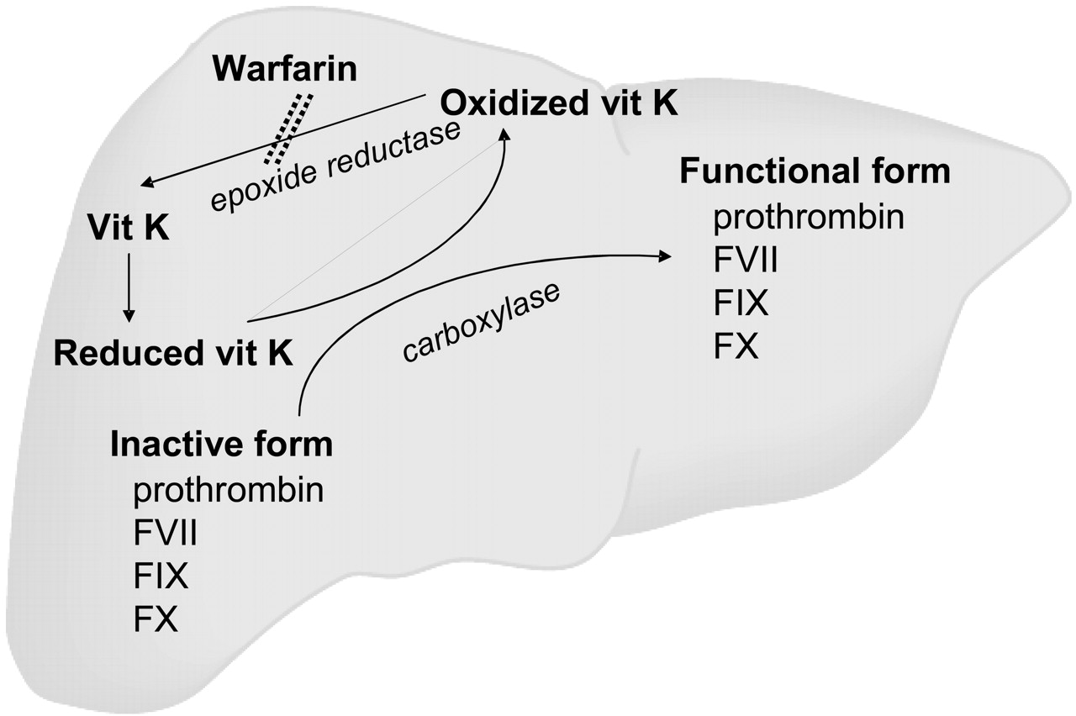
Vitamin K Dependent Proteins
Dietary
Vitamin K
Vitamin K
Reductase
Notes:
T ½ of factor VII – 6hr, IX-1d, X-1.5d, prothrombin- 2.5days

Slide 24
Vitamin K deficiency
  Liver Disease or Vit. K deficiency
  Hemorrhagic disease of the newborn
  Biliary obstruction (neonatal cholestatic disorders)
  Malabsorption of vitamin K (celiac disease, ulcerative colitis)
  Drugs
    Vit.K antagonists – warfarin, phenytoin
    Broad-spectrum antibiotics – alter gut flora

Slide 25
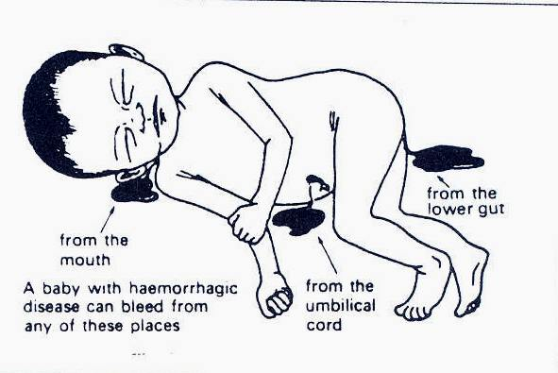
Vitamin K deficiency
Manifestations
Diagnosis: PT, APTT
Management
  Vitamin K oral / sc / iv
  Repeat PT after 6hr
Prevention
  Prophylactic Vit K to at risk population
Notes:
Manifestations include mild to moderate bleeding, ecchymoses, oozing from iv sites, and rarely internal bleeding. PT and APTT may both be abnormal. Decreased levels of > 1 VK dependent factors. Do a LFT to detect liver disease.
IV administration only in emergent conditions (risk of anaphylactoid rkn); Oral route if absorption is unimpaired.

Slide 26
Coagulation Disorders: Inherited
Hemophilia A
Hemophilia B
Factor XIII Deficiency
Prothrombin Deficiency
Factor V Deficiency
Factor VII Deficiency
Factor X Deficiency
Factor XI Deficiency
Factor XII Deficiency
Prekillikrein Deficiency
High Molecular Weight Kininogen Deficiency
a2-antiplasmin Deficiency
Plasminogen Activator Inhibitor Deficiency
Incidence 1 in 5000 to 10,000
Rare
Notes:
Highlighted Pink: Markedly prolonged APTT, but no bleeding

Slide 27
HEMOPHILIA
Often called ‘the disease of kings’ because it was carried by many members of Europe’s royal family. Queen Victoria of England was a carrier of Hemophilia

Slide 28
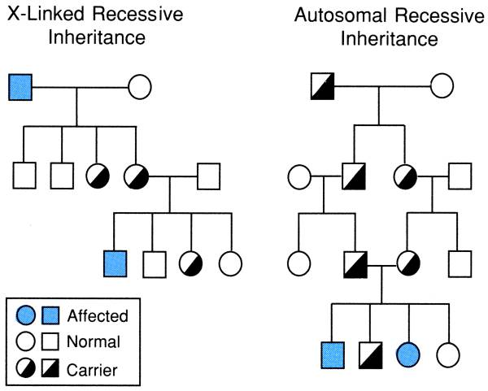
X-linked recessive
Hemophilia A (FVIII def): 80-85%
Hemophilia B (FIX def)
Mutations of the clotting factor gene
Family H/O bleeding common,
- generally affects males on the maternal side
- 1/3 no family history – due to new mutations

Slide 29
TYPES
Disease | Factor deficiency | Inheritance
Hemophilia A | VIII | X linked recessive
Hemophilia B | IX | X linked recessive
Hemophilia C | XI | Autosomal recessive
Parahemophilia | V | Autosomal recessive

Slide 30
Severity of Hemophilia is defined by measured level of clotting factor activity
 | Distribution | Clotting factor activity
Severe hemophilia | 50% | <1%
Moderate hemophilia | 10% | 1-5%
Mild hemophilia | 30-40% | 5-40%
Notes:
Clotting factor activity is defined as the activity present in 1 ml of fresh plasma from normal donors

Slide 31
HEMOPHILIA
Notes:
Blood coagulation reaction can be described as ocurring in 3 overlapping phases: Initiation, Propagation and Termination.
Initiation: Perforation results in delivery of blood and with it circulating FVIIa and platelets to the extravascular space rich in membrane bound TF. This activates the extrinsic pathway. The TF:VIIA complex activates F IX and X to IXa and Xa. F Xa activates small amount of prothrombin to thrombin, which activates more platelets, and converts F V and VIII to Va and VIIIa.
Propagation: The activated F VIIIa combines with F IXa to form the intrinsic factor Xase (FVIIIa-FIXa complex). >90% of factor Xa is produced by this intrinsic factor Xase. FXa combines with FVa to form FVa – FXa prothrombinase complex, which converts most prothrombin to thrombin.

Slide 32
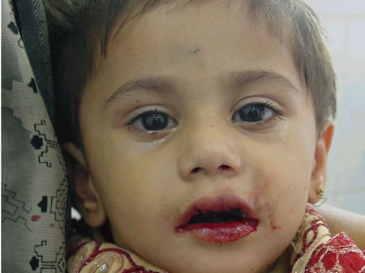
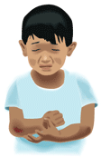
CLINICAL MANIFESTATIONS
Bleeding can happen anywhere in the body.
Following an injury / surgery or rarely spontaneous.

Slide 33
CLINICAL MANIFESTATIONS
Musculoskeletal bleeding
  Deep bleeding into joints and muscles
  Begin when child reaches toddler age.
  In toddlers ankle the most common
  site.
  Later knees and elbow become common sites.

Slide 34
Hemophilic arthropathy
Target joint
  Repeated bleeds

Slide 35
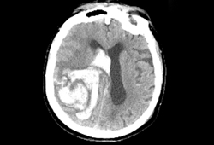
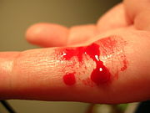
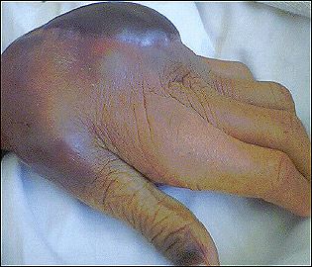
Other manifestations
Intracranial haemorrhage
Hematuria
Traumatic bleeding
Venipuncture
Notes:
After s.c., i.d., and small i.m. injections apply firm finger pressure for at least 5 min. Large i.m. injections should be avoided.

Slide 36
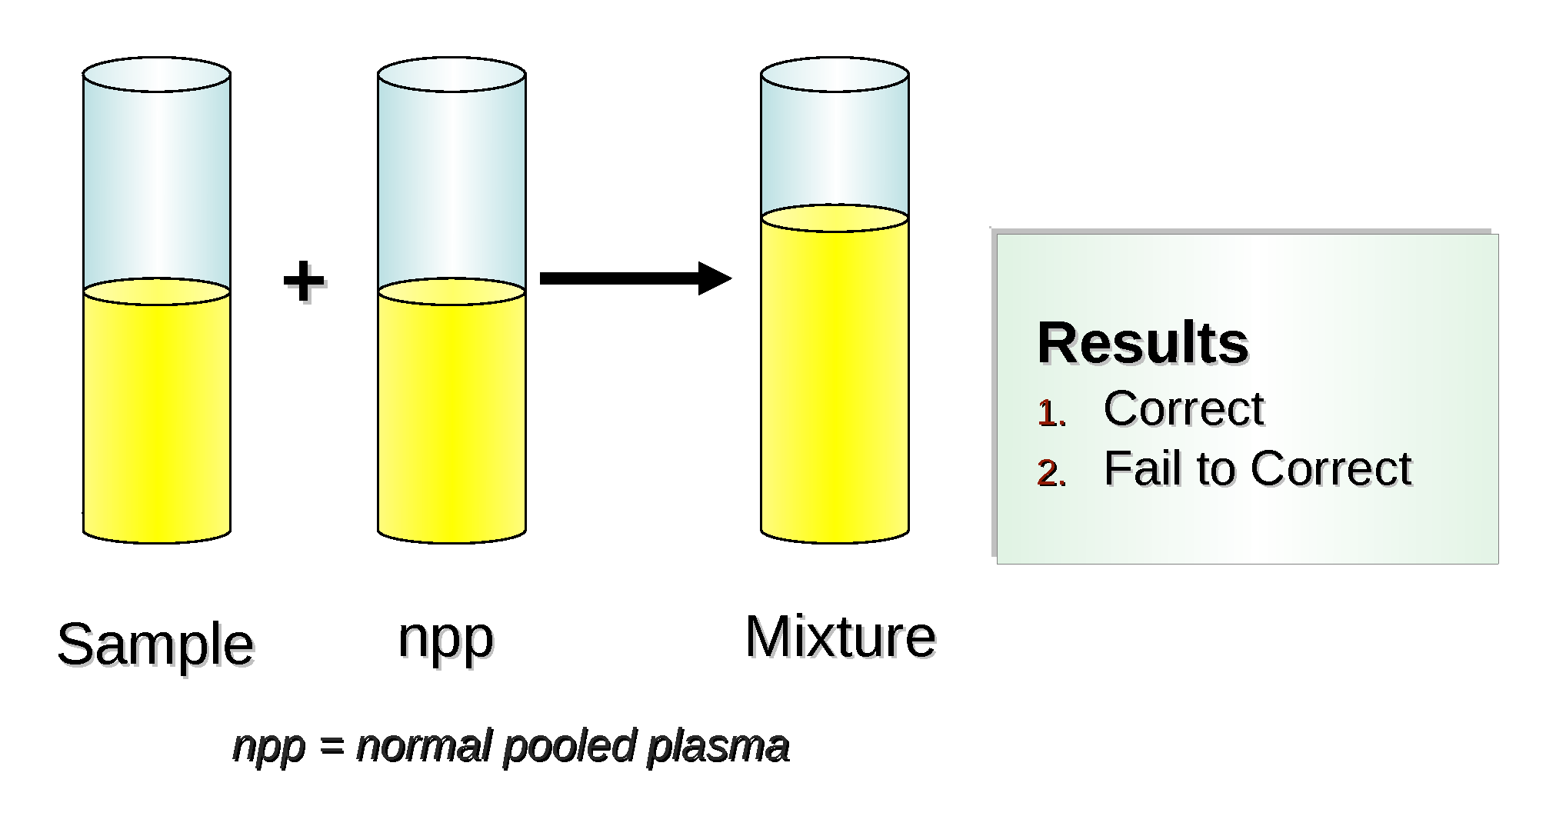
Hemophilia : Diagnosis
Screening tests
  Normal PT , Raised APTT.
Mixing studies
Definitive diagnosis specific factor VIII or IX by assays
F VIII deficient plasma
F IX deficient plasma
Notes:
Mixing studies: With control plasma- confirms factor deficiency and not circulating inhibitors as cause of APTT prolongation.
With FVIII deficient plasma (from known patients) - suggests FIX deficiency.
With FIX deficient plasma (from known patients) - suggests FVIII deficiency

Slide 37
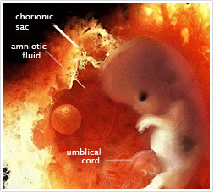
Carrier state and Genetic testing
Three approaches:
Patient and family history
Coagulation-based assays: unreliable
DNA testing: GOLD standard
Prenatal diagnosis
Notes:
A woman is a definite carrier if (i)her father has hemophilia, (ii)she has one son with hemophilia and a 1st degree male relative with hemophilia, (iii)she has two sons with hemophilia.
- A possible carrier if (i)she has one or more maternal relatives with hemophilia, (ii)she has one son with hemophilia & no other affected relative.

Slide 38
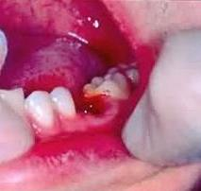
Case
6yr boy is brought to the OPD with complaints of recurrent painful swelling of the Lt Knee joint since 2yr of age. He also has a history of prolonged bleeding from cut sites.
O/E, Lt Knee joint swollen, tender
Investigations ???
PT- Normal, APTT – 90sec (Control – 25sec)
Mixing study: Corrected with factor IX deficient plasma
Factor VIII assay: < 1% activity
Went to a dentist for tooth extraction. Developed uncontrolled bleeding following the procedure. How will you manage ?

Slide 39
Hemophilia: Management
Issues to be considered
Lifestyle modifications
Available therapeutic options
Inhibitors complicating Hemophilia
Prophylactic factor therapy
Transfusion transmitted infections

Slide 40


Hemophilia: Management
Lifestyle modifications: Goal - Prevention of bleeding.
- Avoid drugs that affect platelet function -NSAIDs
- paracetamol - safe for analgesia.
- Regular exercise to promote strong muscles, protect joints, and
improve fitness.
- Avoid contact sports ; swimming and cycling encouraged.
- Recognize early signs of bleeding - a tingling sensation or “aura”.
- trained to seek treatment at this stage.
- Carry identification indicating the diagnosis, severity, and contact information .

Slide 41
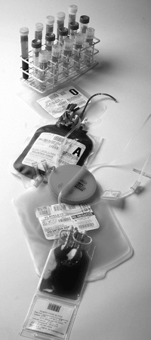
Hemophilia: Management
Available pharmacological agents
Factor concentrates
Cryoprecipitate
Fresh Frozen Plasma and Cryo-Poor Plasma
Adjuvant Pharmacological Options
  Desmopressin (DDAVP)
  Tranexamic acid
  Epsilon aminocaproic acid (EACA)

Slide 42
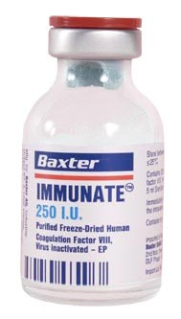
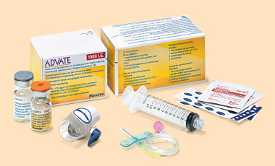
Hemophilia: Management
Factor concentrates
Factor VIII | Factor IX
Half-life – approx. 8–12 hours. | About 18-24 hours.
Each FVIII unit/ per kg i.v. will raise plasma FVIII level approximately 2%. | Each FIX unit per kg i.v. will raise plasma FIX level approx. 0.7 to 1.0%.
Dose of factor VIII= desired % rise x body wt (kg) x 0.5 | Dose of factor IX= desired % rise x body wt (kg) x 1.4

Slide 43
Type of Hemorrhage | Desired factor level |  | Duration (days) (longer if indicated)
 | Hemophilia A | Hemophilia B
Joint | 10%–20% | 10%–20% | 1–2
Muscle (except iliopsoas) | 10%–20% | 10%–20% | 2–3
Iliopsoas • initial maintenance | 20%–40% 10%–20% | 15%–30% 10%–20% | 1-2 3-5
CNS/head initial maintenance | 50%–80% 30%–50% 20%–40% | 50%–80% 30%–50% 20%–40% | 1-3 4-7 8-14
Throat and neck • initial maintenance | 30%–50% 10%–20% | 30%–50% 10%–20% | 1-3 4-7
Gastrointestinal • initial • maintenance | 30%–50% 10%–20% | 30%–50% 10%–20% | 1–3 4–7
Renal | 20%–40% | 15%–30% | 3–5
Deep laceration | 20%–40% | 15%–30% | 5-7
Surgery (major) • Pre-op • Post-op | 60%–80% 30%–40% 20%–30% 10%–20% | 50%–70% 30%–40% 20%–30% 10%–20% | 1–3 4–6 7–14
WHF Recommendations for target factor levels

Slide 44
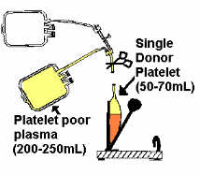
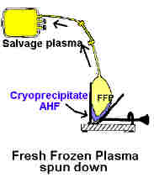
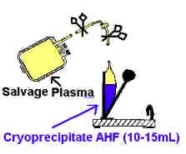
Hemophilia: Management
Cryoprecipitate
- Prepared by slow thawing of FFP at 4°C for 10–24 hours.
- Contains – FVIII, vWF, fibrinogen, & FXIII (not FIX or XI).
- supernatant - cryo-poor plasma and contains other coagulation factors VII, IX, X, and XI.
- FVIII /bag of cryoppt is 60-100 units (avg-80 units) in a 30-40 ml vol.
-does not contain factor IX, so no use in Haemophilia B
Concerns :
  - factor content of individual packs variable.
  - not subjected to viral inactivation procedures

Slide 45
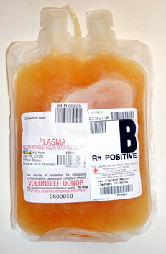
Hemophilia: Management
Fresh Frozen Plasma
FFP can be used to treat both hemophilia A &B
1 U FFP contains about 160-250ml plasma with activity of ~80%.
Rate and total dose limited by the risk of acute or chronic circulatory overload.
How to use
  Thaw.
  Transfuse over how many minutes.
  Reusing after thawing
Disadvantages:
  No viral inactivation
  F level >20-25% difficult to achieve

Slide 46
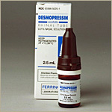
Hemophilia: Management
Desmopressin
Only effective in mild hemophilia A - single i.v. infusion of 0.3 μg/kg expected to boost FVIII level 3-6 fold
Ineffective in severe hemophilia A
No value in hemophilia B - does not affect FIX levels
Nasal spray available - useful for home treatment of minor bleeding problems.

Slide 47
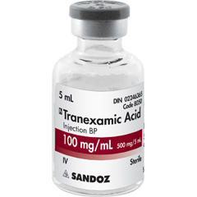
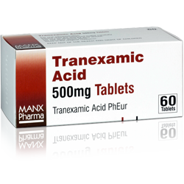
Hemophilia: Management
Tranexamic acid / EACA
Antifibrinolytic agent, competitively inhibits activation of plasminogen to plasmin.
Valuable in controlling bleeding from mucosal surfaces (e.g.,
oral bleeding, epistaxis, menorrhagia)
- dental surgery
- eruption of teeth
Tranexa dose for children - 25 mg/kg up to three times daily
- 500 mg tablet can be crushed, dissolved in water for
topical use on bleeding mucosal lesions.

Slide 48

Management of Hemophilic arthropathy
Analgesics, ice packs ( 5 minutes on, 10 minutes off, for as long as the joint feels hot), avoidance of weight bearing and immobilisation.
Factor replacement- most important
Physiotherapy

Slide 49
Hemophilia: Management
Inhibitors:
Suspected - when no / inadequate response to factor replacement.
Detected by:
  Measuring factor levels after factor replacement
  Mixing studies
Treatment:
  low-responders - specific factor at a much higher dose
  High responders - alternative agents like bypassing agents : as recombinant factor VIIa and prothrombin complex concentrates.

Slide 50
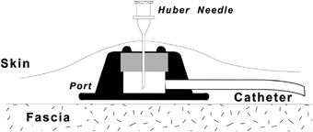
Hemophilia: Management
Prophylactic Therapy
Administration of clotting factors at regular intervals to prevent bleeding
- Patients with clotting factor level > 1% seldom have
spontaneous bleeding
25-40 IU/kg of clotting factor concentrates
- 3 times/week for hemophilia A
- twice a week for hemophilia B
Expensive but preservation of joint function & improved QOL
Administered by subcutaneous access port of central line

Slide 51
Comprehensive care
Comprehensive team including hemophilia specialist, nurse coordinator, social worker, psychologist, physiotherapist, orthopaedic surgeon, primary care physician, financial counsellor and sometimes infectious disease specialist
Provided primarily through comprehensive hemophilia treatment centres

Slide 52
Case
6yr boy is brought to the OPD with complaints of recurrent painful swelling of the Lt Knee joint since 2yr of age. He also has a history of prolonged bleeding from cut sites.
O/E, Lt Knee joint swollen, tender
Investigations ???
PT- Normal, APTT – 90sec (Control – 25sec)
Mixing study: Corrected with factor IX deficient plasma
Factor VIII assay: < 1% activity
Went to a dentist for tooth extraction. Developed uncontrolled bleeding following the procedure. How will you manage ?

Slide 53
Classification of bleeding disorders
Primary Hemostatic defect
  Platelet disorder
    Qualitative
    Quantitative
  Von Willebrand Disease
Coagulation Disorders (Clotting factor deficiency)
  Acquired
  Inherited
Vascular

Slide 54
Classification of bleeding disorders
Primary Hemostatic defect
  Platelet disorder
    Qualitative
    Quantitative
BERNARD- SOULIER SYNDROME
Diagnosis
BT
Platelet counts
Failure to agglutinate by Ristocetin
PFA
Flowcytometry
Genetic testing
GLANZMANN’s Thrombasthenia
Notes:
Platelet count is normal in GT but may be reduced in BSS.
Acquired qualitative defect: NSAIDs, Uremia.
Failure to agglutinate by Ristocetin seen in BSS

Slide 55
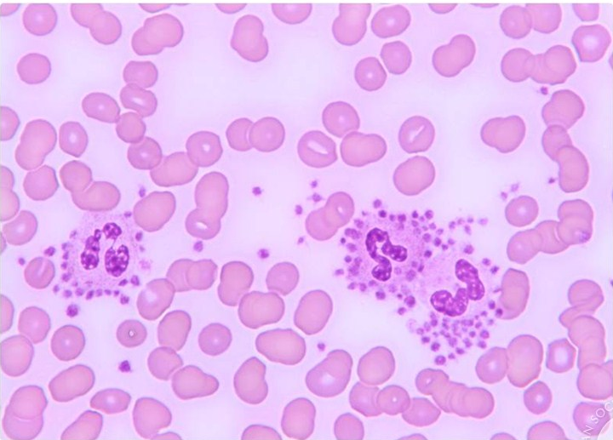
Classification of bleeding disorders
Primary Hemostatic defect
  Platelet disorder
    Qualitative
    Quantitative (Thrombocytopenia)
Impaired production
Aplastic anemia
Leukemia
MDS
B12/Folate deficiency
Hereditary (TAR)
Increased destruction
ITP
SLE
Thrombotic microangiopathy (HUS)
Sequestration
Hyperspenism
SPURIOUS THROMBOCYTOPENIA
Notes:
Spurious thrombocytopenia: If history and examination are normal, a low plt count may just be a lab artifact. Causes include: platelet activation during blood collection, in vitro agglutination by EDTA dependent antibodies etc. On smear examination in such cases, large clumps of agglutinated platelets may be found at the periphery of blood film, or platelets may be adherent to leucocytes and form platelet “satellites”

Slide 56
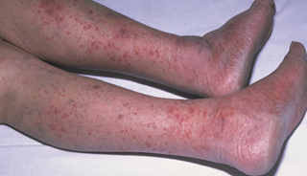
Case
2 yr girl is brought to the ER with complaints of red colored spots over entire body for last 3 days.
H/O, URI 2wk back.
O/E, Afebrile. No Pallor
Spleen : just palpable
DDx ?
Investigations ?
Platelet count: 12000/mm³
Notes:
Why not Hemophilia? Aplastic anemia? Leukemia?
Peak age of ITP: 2-6yr; Splenomegaly present in 10% children with ITP; Anemia in proportion to the blood loss.

Slide 57
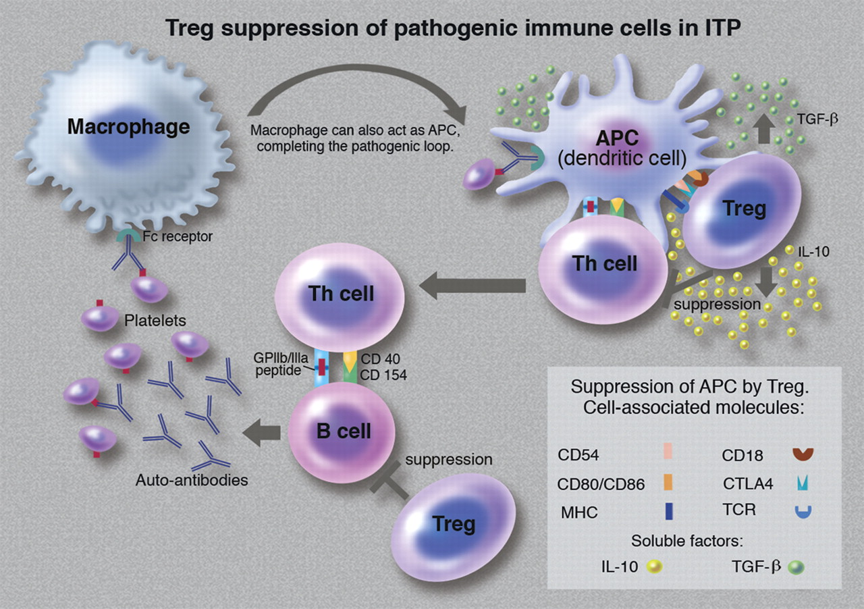
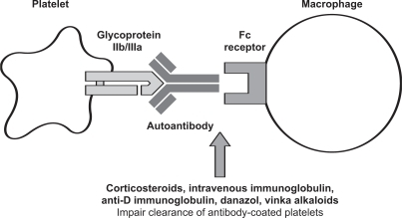
Pathogenesis of ITP
Notes:
Factors that trigger platelet autoantibody formation in ITP is not well understood.

Slide 58
Definitions
Immune Thrombocytopenia (ITP)
Platelet count less than 100 × 10⁹/L in absence of other causes or disorders that may be associated with thrombocytopenia
Newly diagnosed ITP: diagnosis to 3 months
Persistent ITP: 3 to 12 months from diagnosis
Chronic ITP: lasting for more than 12 months
Source: The American Society of Hematology 2011 evidence-based practice guideline for immune thrombocytopenia

Slide 59
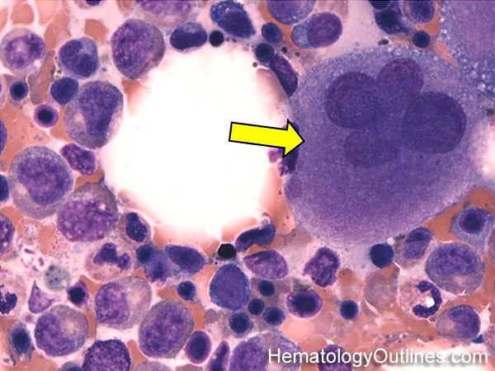
Investigations
Complete blood count
Peripheral smear
Bone marrow aspiration ???
Notes:
BM reveals normal or increased megakaryocytes in bone marrow.
Bone marrow examination is unnecessary in patients with the typical features of ITP outlined above, irrespective of the age of the patient.
The presence of abnormalities in the history, physical examination, or the complete blood count and peripheral blood smear should be further investigated, e.g. with a bone marrow
examination or other appropriate investigations, before the diagnosis of ITP is made.

Slide 60
Treatment of Newly diagnosed ITP
General Tt
  Education
  Activity limitation
  No NSAIDs
  Careful follow up
Observation only
Pharmacological Tt
Vs
Notes:
In adults, all cases with plt count <30000 are treated with pharmacological Tt. But in children most cases resolve on its own, so Tt reserved for severe cases only.

Slide 61
Case
2 yr girl is brought to the ER with complaints of red colored spots over entire body for last 3 days.
H/O, URI 2wk back.
O/E, Afebrile. No Pallor
Spleen : just palpable
Observation only
Daily follow up advised.
Comes next day with Epistaxis and gum bleeding.
What next???
Notes:
Why not Hemophilia? Aplastic anemia? Leukemia?
Peak age of ITP: 2-6yr; Splenomegaly present in 10% children with ITP; Anemia in proportion to the blood loss.

Slide 62
Treatment of Newly diagnosed ITP
General Tt
  Education
  Activity limitation
  No NSAIDs
  Careful follow up
Observation only
1st line Pharmacological Tt
Corticosteroids
IVIG
Anti D
Vs

Slide 63
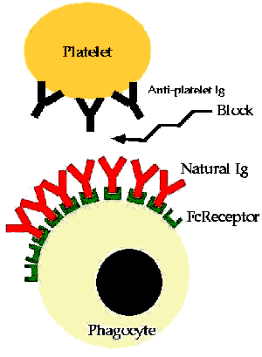
1st line Medical Therapies in ITP
RBC
Y
Y
Anti D
IVIG
Anti D
Notes:
Prerequisites for use of Anti D: Rh +, Not Anemic, Non-splenectomized
Quickest response with IVIG : (response starts in 1-3 days and peaks in 2-7 days)
Anti D: (response starts in 1-3 days and peaks in 3-7 days)
Corticosteroids: (response starts in 4-14 days and peaks in 7-28 days)

Slide 64
1st line Medical Therapies in ITP
Corticosteroids
Notes:
Glucocorticoids act by several mechanisms, including inhibition of phagocytosis and antibody synthesis, improved platelet production and increased microvascular stability.

Slide 65
2nd line Treatment options
Rituximab
High dose Dexamethasone
Other immunosuppressants
Splenectomy

Slide 66
Classification of bleeding disorders
Primary Hemostatic defect
  Platelet disorder
    Qualitative
    Quantitative
  von Willebrand Disease
Coagulation Disorders (Clotting factor deficiency)
  Acquired
  Inherited
Vascular

Slide 67
von Willebrand Disease
Pathophysiology
Types
Manifestations
Treatment
Notes:
Manifestations: mucocutaneous bleeding, menorrhagia
Type I treated with desmopressin. Type 2: variable Tt. Type 3: FFP or vWF concentrates.

Slide 68
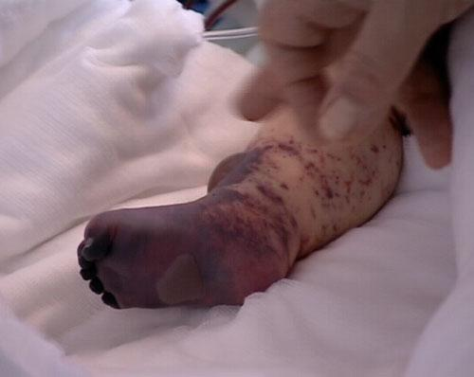
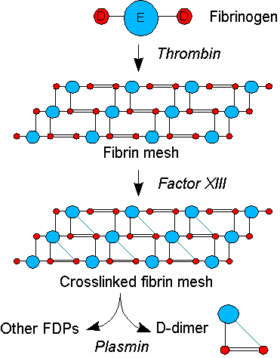
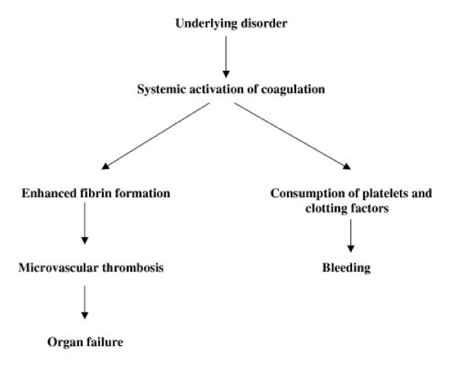
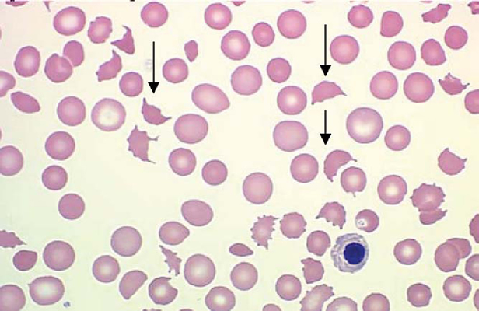
DIC
Activation of
coagulation
cascade
Causes
Manifestations
Diagnosis
Treatment
Notes:
Schistocytes in P/S.

Slide 69
Thank You

