Slide 1
NORMAL PERIODONTIUM AND GINGIVAL DISEASES IN CHILDREN

Slide 2
INTRODUCTION
ORAL MUCOSA consists of 3 zones:
1. Masticatory mucosa-gingiva plus over hard palate
2. Specialized mucosa- over tongue
3. Oral mucous membrane- in remaining oral cavity

Slide 3
GINGIVA
It is that part of oral mucosa that covers the alveolar process of jaws and surrounds the necks of teeth.

Slide 4
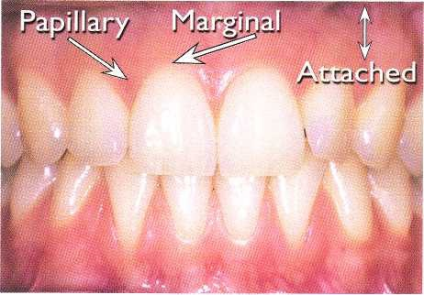
GINGIVA
It is divided into: Marginal , interdental, and attached.

Slide 5
HOW IS A CHILD’S GINGIVA DIFFERENT FROM THAT OF AN ADULT

Slide 6
MARGINAL GINGIVA
It is the margin of gingiva surrounding the tooth in a collar like fashion.
1 mm wide
Separated from attached gingiva by “free gingival groove”
Marginal gingiva of child has rolled edges in primary dentition
In children it is flaccid and retractable due to immature connective tissue and gingival fibers and increased vascularization

Slide 7
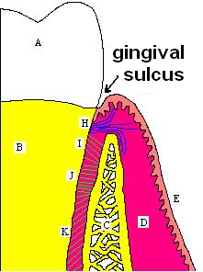
GINGIVAL SULCUS
Gingival sulcus is the space or crevice surrounding the tooth and bounded by tooth on one side and epithelium lining the free end of marginal gingiva on the other side.
The histological depth is less than clinical probing depth.
The mean gingival sulcus depth in primary dentition is 2.1mm+/-0.2mm.
In adults it may be 2 to 3 mm.

Slide 8
ATTACHED GINGIVA
It is firm, resilient and tightly bound to underlying periosteum of alveolar bone.
Separated from loose alveolar mucosa by mucogingival junction.
Width increases with age.

Slide 9
ATTACHED GINGIVA
WIDTH:
Primary dentition: greatest in incisor region, decreases in cuspids, and increases again in primary molars region.
Permanent dentition: Greatest in incisor region and less posteriorly with least in premolar region.
STIPPLING:
Stippling of attached gingiva is absent in infancy, increases in some children by five years of age.
Stippling is present in healthy attached gingiva in adult and disappears in old age

Slide 10
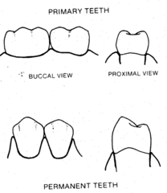
INTERDENTAL GINGIVA
It is pyramidal or “col” shaped
Occupies gingival embrasure beneath tooth contact.
Consists of a facial and lingual papilla connecting together.
Becasue the contact points are broad, flat and low the papillae are shorter and rounder than those in permanent teeth

Slide 11
HISTOLOGIC PICTURE
In child, connective tissue of gingiva contains less abundant collagen fibers than adult
COLOUR
The gingival color of the young child may
be more reddish due to increased vascularity and
thinner epithelium

Slide 12
Summary of gingival tissue characteristics in children
- Less stippled, thicker and rounded margins - Flaccid and less keratinized - Increased vascularity - Interdental col formation and saddle areas - translucent

Slide 13
PHYSIOLOGIC CHANGES IN GINGIVA ASSOCIATED WITH TOOTH ERUPTION

Slide 14
Pre-eruption bulge
It is present over the crown of the tooth which is about to erupt.
May be slightly blanched.

Slide 15
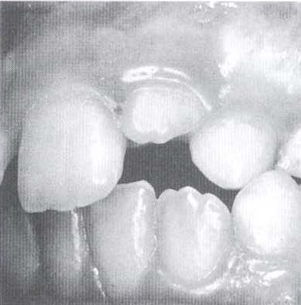
Formation of gingival margin
As the crown penetrates oral mucosa, marginal gingiva and sulcus develop.
Usually edematous, rounded and slightly reddened.

Slide 16
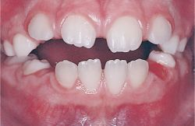
Normal prominence of gingival margin
Prominence of gingival margin especially over maxillary anteriors is normal till the teeth are fully erupted.

Slide 17
CHRONIC GINGIVAL DISEASES IN CHILDHOOD

Slide 18
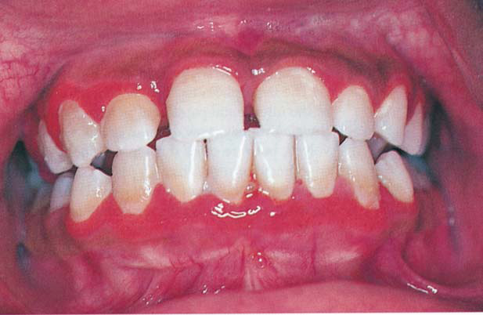
CHRONIC MARGINAL GINGIVITIS
Numerous studies indicate that marginal gingivitis is the
most common form of periodontal disease and starts in
early childhood.
Severe gingivitis is relatively uncommon in children

Slide 19
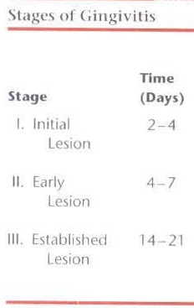
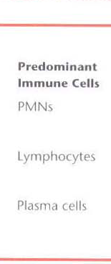
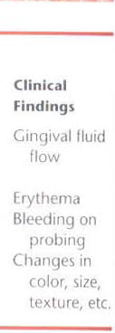
CHRONIC MARGINAL GINGIVITIS

Slide 20
CHRONIC MARGINAL GINGIVITIS
Gingiva exhibits all characters of chronic inflammation.
Color change and swelling are more common in children than bleeding or increase in pocket depth.
ETIOLOGY: uncalcified and calcified bacterial plaque.
Bacterial plaque is composed of soft bacterial
deposits that adhere firmly to the teeth. It is considered to
be a complex, metabolically interconnected, highly
organized bacterial system consisting of dense masses
of microorganisms embedded in an intermicrobial
matrix. In sufficient concentration it can disturb the
host-parasite relationship and cause dental caries and
periodontal disease.

Slide 21
CHRONIC MARGINAL GINGIVITIS
The response to bacterial plaque is less severe in preschool children than in adults.
Plaque forms more rapidly in children between 8 to 12 years than adults.
.

Slide 22
CHRONIC GINGIVITIS ASSOCIATED WITH ERUPTION
A temporary type of gingivitis.
Often observed in young children when primary teeth are erupting.
Subsides after the teeth emerge into the oral cavity.
Related to accumulated dental plaque associated with erupting tooth.

Slide 23
CHRONIC GINGIVITIS ASSOCIATED WITH ERUPTION
The greatest increase in the incidence of eruption gingivitis in children is often seen in the 6- to 7-year age group when the permanent teeth begin to erupt because the gingival margin receives no protection from the coronal contour of the tooth during the early stage of active eruption, and the continual impingement of food on the gingiva causes the inflammatory process.

Slide 24
ALLERGY AND GINGIVAL INFLAMMATION
Seasonal variation of gingival inflammation is seen in children with allergies to birch pollen.
Patients with complex allergies who have symptoms for longer periods may be at higher risk for more significant adverse periodontal changes.

Slide 25
OTHER CAUSES
GINGIVAL INFLAMMATION ASSOCIATED WITH MALPOSED TEETH
Malposed teeth have increased tendency of accumulating plaque.
Mouth breathing habit and nasal obstruction.
Excessive overjet and overbite
Malposed teeth have increased tendency of accumulating plaque.

Slide 26
ACUTE GINGIVAL DISEASES IN CHILDHOOD

Slide 27
HERPES SIMPLEX VIRUS INFECTION
The primary infection usually occurs in a child under 6 years of age who has had no contact with the type 1 herpes simplex virus (HSV-1).
99% of all primary infections are of the subclinical type.
In some preschool children the primary infection may be characterized by only one or two mild sores which may go unnoticed.

Slide 28
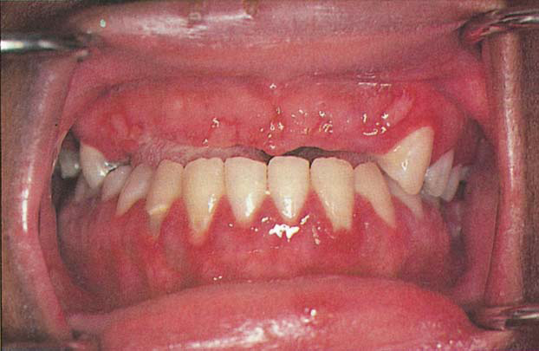
HERPES SIMPLEX VIRUS INFECTION
In other children, the primary infection may be manifested by acute symptoms (acute herpetic gingivostomatitis).
Acute disease can occur in children with clean mouths and healthy oral tissues.
symptoms of the disease develop suddenly and include:
Fiery red gingival tissues,
Malaise,
Irritability,
Headache,
and
Pain associated with intake
of food and liquids of acid content.
DIFFUSE ERYTHEMA

Slide 29
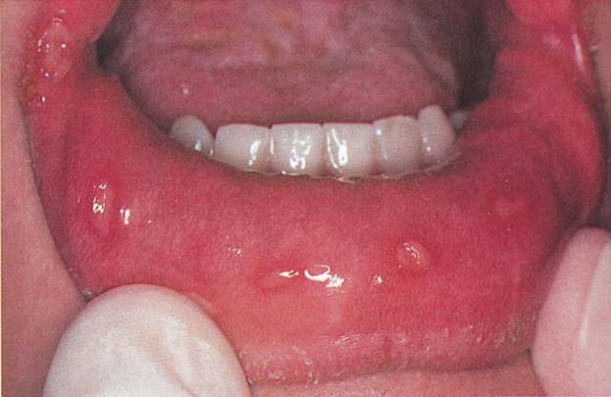
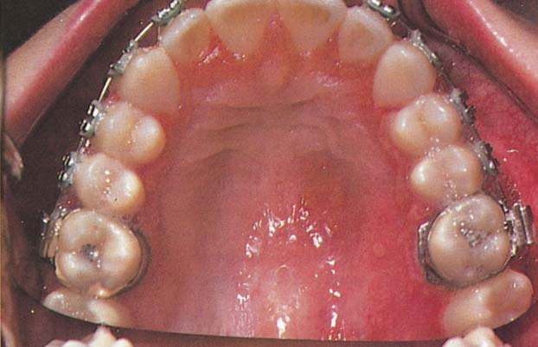
HERPES SIMPLEX VIRUS INFECTION
characteristic oral finding in the acute primary disease is presence of yellow or white liquid filled vesicles that rupture in few days and form painful ulcers, 1 to 3 mm in diameter, which are covered with a whitish gray membrane and have a circumscribed area of inflammation
ulcers may be observed on any area of the mucous membrane
MULTIPLE LESIONS ON LABIAL MUCOSA
CLUSTERS OF VESICLES

Slide 30
HERPES SIMPLEX VIRUS INFECTION
Diagnostic investigations:
four fold rise of serum antibodies to HSV-1
lesion culture will also show positive results for HSV-1.

Slide 31
HERPES SIMPLEX VIRUS INFECTION
TREATMENT:
relief of the acute symptoms so that fluid and nutritional intake can be maintained
The application of a mild topical anesthetic, such as dyclonine hydrochloride (0.5%) before mealtime.
an alternative to the anesthetic is mixture of equal parts of diphenhydramine elixir and Kaopectate. The diphenhydramine has mild analgesic and antiinflammatory properties, whereas the kaolin-pectin compound coats the lesions.

Slide 32
HERPES SIMPLEX VIRUS INFECTION
The antiviral medications currently prescribed are acyclovir, famciclovir, and valacyclovir.
Acyclovir should be administered in 5 daily doses to equal 1000 mg per day for 10 days.
Bed rest and isolation from other children in the family are also recommended.

Slide 33
HERPES SIMPLEX VIRUS INFECTION
After initial primary attack during early childhood, the herpes simplex virus becomes inactive and resides in sensory nerve ganglia.
The virus will often reappear later as the familiar cold sore or fever blister, usually on outside of the lips . It is commonly referred to as recurrent herpes labialis (RHL).
The recurrence of the disease has been related to:
conditions of emotional stress and lowered tissue resistance
Excessive exposure to sunlight

Slide 34
HERPES SIMPLEX VIRUS INFECTION
The most effective treatment for these recurrences is the use of the specific systemic antiviral medications. The daily dosages are the same as those for the primary infection, but the course of treatment is usually 5 days.
topical antiviral agent, penciclovir cream may be applied to perioral lesions(approved for use in children 12 years of age and older)

Slide 35
HERPES SIMPLEX VIRUS INFECTION
Other remedies for herpes simplex infection also include the amino acid lysine. The oral therapy is based on lysine's antagonistic effect on another amino acid, arginine. L-Lysine monohydrochloride is available commercially in capsule form or tablet.
L-Lysine monohydrochloride is available commercially in capsule form or tablets containing 100 or 300 mg of L-Lysine
Ingestion of cereals, seeds, nuts, and chocolate should be avoided.
Foods with adequate lysine, such as dairy products and yeast to be encouraged.

Slide 36
RECURRENT APHTHOUS ULCER/STOMATITIS (CANKER SORE)
Occurs in school-aged children.
Painful ulceration on the unattached mucous membrane.
Lesions persist for 4 to 12 days and heal uneventfully, leaving scars only rarely.
May appear as attacks of minor or single, major or multiple ulcers.
The major form (RAS) is less common and has been referred to as periadenitis mucosa necrotica recurrens and Sutton disease.

Slide 37
RECURRENT APHTHOUS ULCER/STOMATITIS (CANKER SORE)
RAS has been associated with other systemic diseases:
Pharyngitis,
Behcet disease,
Crohn disease,
Ulcerative colitis,
Neutropenia,
Immunodeficiency syndromes,
Systemic lupus erythematosus

Slide 38
RECURRENT APHTHOUS ULCER/STOMATITIS (CANKER SORE)
Cause of RAU is unknown.
Suggested etiology is:
1. Local factors like-
Trauma,
Allergy to toothpaste constituents (sodium lauryl sulfate),
and Salivary gland dysfunction.
2. Deficiencies of iron, vitamin B12, and folic acid
3. It is also possible that the lesions are caused by an
autoimmune reaction of the oral epithelium
4. Infectious microbial factors

Slide 39
RECURRENT APHTHOUS ULCER/STOMATITIS (CANKER SORE)
TREATMENT: variety of treatments have been recommended for RAU/RAS, but a completely successful therapy has not been found.
Topical anti inflammatory and analgesics
Immunosuppression agents like triamcinolone acetonide, amlexanox ( an anti allergic immunomodulator)
Aloe vera freeze-dried gel extract adheres and forms an occlusive protective patch.
The topical application of tetracyclines to the ulcers is often helpful in reducing the pain and in shortening the course of the disease.
Topical rinses have also been helpful- dexamethasone elixir, Chlorhexidine mouthwash.
Treatment with acyclovir may respond favorably

Slide 40
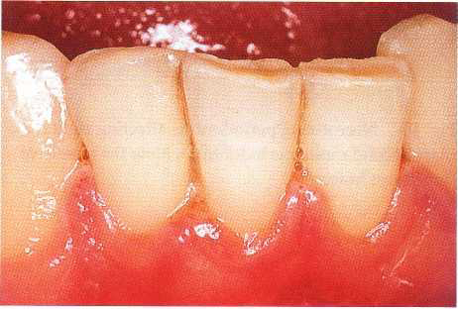
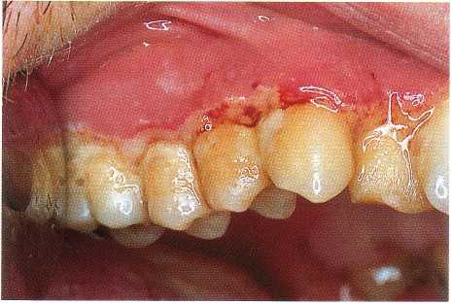
ACUTE NECROTIZING ULCERATIVE GINGIVITIS (VINCENT INFECTION)
Rare among preschool children, occurs occasionally in children from 6 to 12 years old
ANUG can be easily diagnosed because of the involvement of the interproximal papillae and the presence of a gray pseudomembranous necrotic covering of the marginal tissue.
Two microorganisms, Borrelia vincentii and fusiform bacilli, referred to as spirochetal organisms, are generally believed to be responsible for the disease.
ADVANCED STAGE OF NECROSIS
INITIAL PUNCHED OUT LESIONS

Slide 41
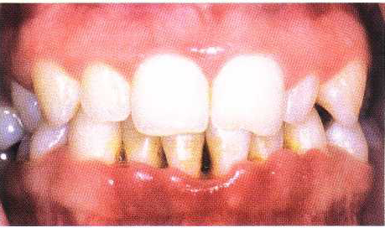
ACUTE NECROTIZING ULCERATIVE GINGIVITIS (VINCENT INFECTION)
Characteristics lesion are punched out crater like lesions at the crests of the inter dental papillae extending to marginal gingiva, and rarely to attached gingiva.
The clinical manifestations of the disease include inflamed, painful, bleeding gingival tissue, poor appetite, fever as high as 40° C (104° F), general malaise, and a fetid odor.
CRATERING

Slide 42
ACUTE NECROTIZING ULCERATIVE GINGIVITIS (VINCENT INFECTION)
TREATMENT :
Subgingival curettage, debridement, and the use of mild oxidizing solutions
If the gingival tissues are acutely and extensively inflamed when the patient is first seen, antibiotic therapy is indicated
Improved oral hygiene, the use of mild oxidizing mouthrinses after each meal, and twice-daily rinsing with chlorhexidine will aid in overcoming the infection.

Slide 43
ACUTE NECROTIZING ULCERATIVE GINGIVITIS (VINCENT INFECTION)
Distinguishing ANUG from acute herpetic gingivostomatitis
Therapeutic prophylaxis and debridement will bring about a favorable response in cases of ANUG but not in acute herpetic gingivostomatitis.
A therapeutic trial of antibiotics will reduce the acute symptoms in ANUG but not in the viral infection.
Acute herpetic gingivostomatitis is most frequently seen in preschool children, and its onset is rapid. ANUG rarely occurs in the preschool-aged group and develops over a longer period, usually in a mouth in which irritants and poor oral hygiene are present.
Clinical picture
Biopsy of specimen.

Slide 44
ACUTE CANDIDIASIS (THRUSH, CANDIDOSIS, MONILIASIS)
Candida (Monilia) albicans is a common inhabitant of the oral cavity that multiply rapidly and cause a pathogenic state when tissue resistance is lowered.
Young children sometimes develop thrush after local antibiotic therapy, which allows the fungus to proliferate.
lesions of the oral disease appear as raised, furry, white patches, which can be removed easily to produce a bleeding underlying surface
Antifungal antibiotics are available to control thrush.

Slide 45
GINGIVAL DISEASES MODIFIED BY SYSTEMIC FACTORS

Slide 46
GINGIVAL DISEASES ASSOCIATED WITH THE ENDOCRINE SYSTEM
Puberty gingivitis is a distinctive type of gingivitis that occasionally develops in children in the prepubertal and pubertal period.
11- to 14-year age group.
The enlargement of the gingival tissues is confined to the anterior segment and may be present in only one arch.
The gingival enlargement was marginal in distribution and, in the presence of local irritants, was characterized by prominent bulbous interproximal papillae

Slide 47
GINGIVAL DISEASES ASSOCIATED WITH THE ENDOCRINE SYSTEM
Treatment of puberty gingivitis should be directed toward improved oral hygiene, removal of all local irritants, adequate nutritional status
Severe cases of hyperplastic gingivitis that do not respond to local or systemic therapy should be treated by gingivoplasty

Slide 48
GINGIVAL LESIONS OF GENETIC ORIGIN
Hereditary gingival fibromatosis (HGF) is characterized by a slow, progressive, benign enlargement of the gingivae
usually has an autosomal dominant mode of inheritance .
elephantiasis gingivae or hereditary hyperplasia of the gums.
The gingival tissues appear normal at birth but begin to enlarge with the eruption of the primary teeth.
continue to enlarge with eruption of the permanent teeth until the tissues essentially cover the clinical crowns of the teeth

Slide 49
GINGIVAL LESIONS OF GENETIC ORIGIN
Dense fibrous tissue often causes displacement of the teeth and malocclusion
The condition is not painful until the tissue enlarges to the extent that it partially covers the occlusal surface of the molars and becomes traumatized during mastication.
Treatment: Surgical removal of the hyperplastic tissue
can recur within a few months after the surgical procedure

Slide 50
PHENYTOIN-INDUCED GINGIVAL OVERGROWTH(PIGO)
Phenytoin is a major anticonvulsant agent used in the treatment of epilepsy.
Varying degrees of gingival hyperplasia is one of the most common side effects of phenytoin therapy.
Incidence has been reported as ranging between 0% and 95%.
true hyperplasia not to exist.
Most investigators agree on the existence of a close relationship between oral hygiene and PIGO rather than dose of phenytoin.
The relationship between plaque, local irritants, and PIGO is also supported by the observation that patients without teeth almost never develop PIGO.

Slide 51
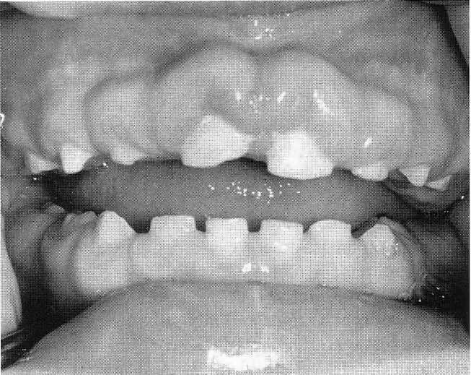
PHENYTOIN-INDUCED GINGIVAL OVERGROWTH
appear as early as 2 to 3 weeks after initiation of phenytoin therapy
The initial clinical appearance is painless enlargement of the interproximal gingiva.
become more generalized later.
These lesions may remain purely
fibrotic in nature or may be
combined with a noticeable
inflammatory component.
In some cases, the entire occlusal
surface of the teeth becomes covered.

Slide 52
PHENYTOIN-INDUCED GINGIVAL OVERGROWTH
Problems include: esthetics, difficulty in mastication, delayed tooth eruption,and secondary inflammation leading to periodontal disease
TREATMENT:
Unfortunately, no cure exists and treatment is often symptomatic in nature
Patients with mild PIGO (i.e., less than one third of the clinical crown is covered) require daily meticulous oral hygiene
For patients with moderate PIGO (i.e., one third to two thirds of the clinical crown is covered) meticulous oral home care and the judicious use of an irrigating device may be needed

Slide 53
PHENYTOIN-INDUCED GINGIVAL OVERGROWTH
Phenytoin levels should be checked after four prophylaxis visits (4 weeks).
If there has been no change, consultation with the patient's physician concerning the possibility of using a different anticonvulsant drug may be helpful
Severe PIGO (i.e., more than two thirds of the tooth is covered) : surgical removal and good oral hygiene after surgery are generally considered to be the most effective treatment.
Recurrence may occur.

Slide 54
Other drugs that have been reported to induce gingival
overgrowth in some patients include cyclosporin,
calcium channel blockers, valproic acid, and phenobarbital.

Slide 55
ASCORBIC ACID DEFICIENCY GINGIVITIS
differs from the type of gingivitis related to poor oral hygiene
The involvement is usually limited to the marginal tissues and papillae
severe pain, and spontaneous hemorrhage will be evident.
Complete dental care, improved oral hygiene, and supplementation with vitamin C and other water soluble vitamins will greatly improve the gingival condition.

Slide 56
PERIODONTAL DISEASES IN CHILDHOOD

Slide 57
PERIODONTAL DISEASES IN CHILDHOOD
Periodontitis is an inflammatory disease of the gingiva and deeper tissues of the periodontium
It is characterized by pocket formation and destruction of the supporting alveolar bone.
Bone loss in children can be detected in bite-wing radiographs by comparing the height of the alveolar bone to the cementoenamel junction.
Distances between 2 and 3 mm can be defined as questionable bone loss and distances greater than 3 mm indicate definite bone loss.

Slide 58
Children vs Adults
Greater metabolic activity in children offers periodontium greater resistance to breakdown and enhances repairs.
Oral flora is different (spirochetes and B melaninogenicus are established late)
Composition and metabolsim of plaque different (lower irritation potential)
Preschoolers with 4x plaque have 1/4 gingival index

Slide 59
EARLY-ONSET PERIODONTITIS
EOP is used to describe a heterogeneous group of periodontal diseases occurring in young individuals who are otherwise healthy
EOP consists of three categories of periodontitis that may have overlapping etiologies and clinical presentations:
(1) a localized form (localized juvenile periodontitis [LJP]),
(2)a generalized form (generalized juvenile periodontitis [GJP)
(3) a prepubertal category that may have both localized and generalized forms (localized and generalized prepubertal periodontitis)

Slide 60
EARLY-ONSET PERIODONTITIS
American Academy of Periodontology has recategorized the early-onset form under Aggressive Periodontitis and has recommended that its sub-classifications be discarded.
The old categorization has been retained because the new classification is not as widely used.

Slide 61
1. LOCALIZED EARLY-ONSET PERIODONTITIS ( LOCALIZED JUVENILE PERIODONTITIS)
LJP occurs in otherwise healthy children and adolescents without clinical evidence of systemic disease.
It is characterized by the rapid and severe loss of alveolar bone around more than one permanent tooth, usually the first molars and incisors
bone loss around the primary teeth can be an early finding in this disease.

Slide 62
patients have little or no tissue inflammation and very little supragingival dental plaque or calculus
Micro-organisms predominating in the gingival pockets include Actinobacillus actinomycetemcomitans (Aa)or Aa in combination with Bacteroides-like species
variety of neutrophil defects have been reported in patients with LJP.
Some suspect a hereditary basis for LJP

Slide 63
2. GENERALIZED EARLY-ONSET PERIODONTITIS (GENERALIZED JUVENILE PERIODONTITIS)
The generalized form of EOP occurs at or around puberty in older juveniles and young adults.
It often affects the entire periodontium of the dentition
known by the terms generalized juvenile periodontitis (GJP), severe periodontitis, and rapidly progressive periodontitis.
Affected teeth harbor more nonmotile, facultative, anaerobic, gram-negative rods (especially Porphyromonas gingivalis)
Individuals with GJP exhibit marked periodontal inflammation and have heavy accumulations of plaque and calculus.

Slide 64
TREATMENT OF LOCALISED AND GENERALIZED EARLY-ONSET PERIODONTITIS
Treatment of EOP, both the localized and generalized types (LIP and GJP), includes surgery and the use of tetracyclines (sometimes in combination with metronidazole)
FOR LJP:
Surgical removal of infected crevicular epithelium and debridement of root surfaces during surgery while the patient is on a 14-day course of doxycycline hyclate (1 g per day) is considered the best effective treatment modality.

Slide 65
a DNA test kit for periodontal pathogens. The test involves collecting a plaque specimen by inserting a paper point provided in the kit into a periodontal pocket for 10 seconds. The paper point is placed into a test vial and returned for the microbial test.
Retesting in 4 to 6 weeks after the completion of antibiotic therapy will determine the patient's response to the treatment.

Slide 66
Treatment of GJP:
is often less predictable.
Alternative antibiotics directed at the specific pathogenic flora may be required

Slide 67
3. PREPUBERTAL PERIODONTITIS
LOCALIZED FORM:
Localized prepubertal periodontitis (LPP) is localized attachment loss and alveolar bone loss only in the primary dentition in an otherwise healthy child.
appears to arise around or before 4 years of age
the bone loss is usually seen on radiographs around the primary molars and/or incisors

Slide 68
Affected sites may present with:
Abnormal probing depths with minor gingival inflammation,
rapid bone loss, and,
minimal to varying amounts of plaque.
Abnormalities in host defenses (e.g., leukocyte chemotaxis), extensive proximal caries facilitating plaque retention and bone loss, and a family history of periodontitis have been associated with LPP in children
Micro-organisms predominating in the gingival pockets include Actinobacillus actinomycetemcomitans (Aa), Porphyromonas (Bacteroides) gingivalis.

Slide 69
GENERALIZED FORM:
onset of generalized prepubertal periodontitis (GPP) is during or soon after the eruption of the primary teeth.
results in severe gingival inflammation and generalized attachment loss, tooth mobility, and rapid alveolar bone loss with premature exfoliation of the teeth
The gingival tissue may initially demonstrate only minor inflammation with a minimum of plaque material
the primary teeth may be lost by 3 years of age.
Abnormalities in host defenses may be associated.
Micro-organisms predominating in the gingival pockets include Actinobacillus actinomycetemcomitans (Aa), Porphyromonas (Bacteroides) gingivalis.

Slide 70
TREATMENT OF BOTH FORMS:
Consultation with a pediatrician is needed to rule out systemic diseases.
Use of antimicrobial rinses (chlorhexidine) and therapy with broad-spectrum antibiotics are effective in eliminating the periodontal pathogens.(Amoxicillin, tetracycline)
The child's parents should be made aware of the potential for pigmentation change in the developing permanent teeth and an increased susceptibility to oral candidiasis as a result of tetracycline therapy.
Treatment of GPP is less successful overall and sometimes requires extraction of all primary teeth.

Slide 71
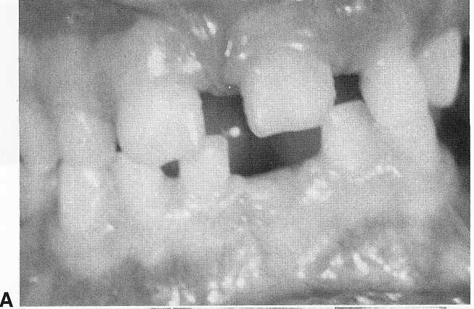
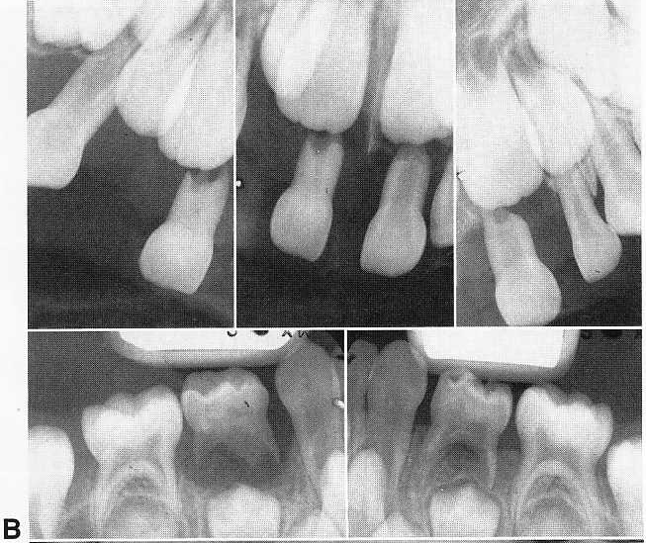
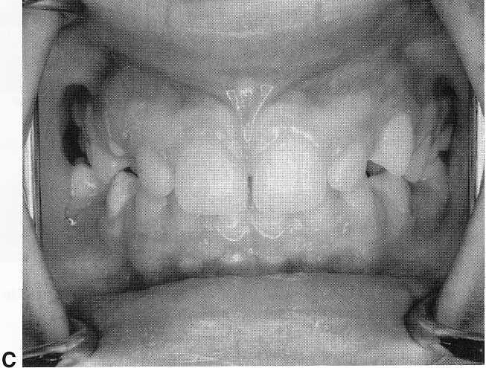
A, Prepubertal periodontitis in a 41/2-year-old girl. Loosening, migration, and spontaneous loss of the primary teeth occurred.
B, A generalized loss of alveolar bone can be
seen in the radiographs.
C, Eight years after the initial observation of an involvement of the supporting tissues, there is evidence of normal gingival tissues. It is believed that dietary counseling and excellent oral hygiene contributed to the success of the treatment.

Slide 72
PERIODONTITIS AS A MANIFESTATION OF SYSTEMIC DISEASE
In the primary dentition, this is rare.
Local factors account for the majority of cases of premature bone loss.
bony destruction in the primary dentition in the absence of local factors is highly suggestive of systemic diseases like-
hypophosphatasia, Papillon-Lefevre syndrome,
histiocytosis X, agranulocytosis,
Leukocyte adherence deficiency, neutropenias, leukemias
Diabetes mellitus ,Down syndrome, and
Chediak-Higashi syndrome.

Slide 73
Most of them have a genetic origin
The defect in immune and neutrophil cell function associated with these diseases is thought to increase patient susceptibility to infectious periodontitis causing alveolar bone loss and to other infections

Slide 74
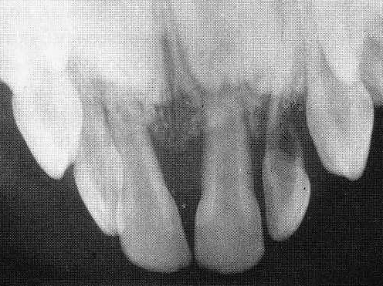
Papillon-Lefevre syndrome
The syndrome is rare and the cause unknown
an autosomal recessive mode of inheritance has been identified
The primary teeth erupt at the normal time.
The primary teeth may show looseness, severe horizontal
bone resorption in full-mouth radiographs
Hyperkeratosis of the palms and soles is present
Previous reports have indicated
that the permanent dentition will
also be affected, however, rarely
the permanent dentition, including the
supporting tissues may appear normal

Slide 75
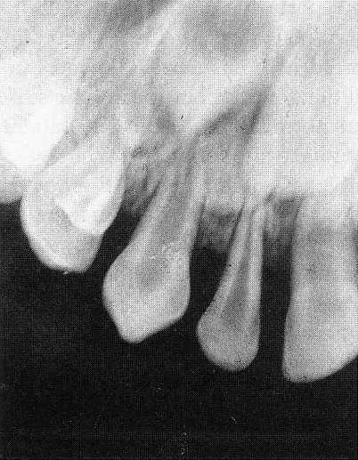
Attempts at conventional therapy prove unsuccessful in preventing tooth loss.
periodontal treatment for these young children includes identification of specific pathogens, specific antibiotic therapy against these organisms, and fullmouth extractions early enough to provide an edentulous period before permanent tooth eruption.

Slide 76
Down Syndrome:
Caused by trisomy of ch no. 21
Characterized by mental deficiency and mental retardation.
Prevalence of periodontal diseases in these patients is very high.(100%in patients less than 30 yrs of age)
Cause of periodontal disease:
T-cell defect and defective chemotaxis.
poor circulation in gingival tissue.
Presents with deep periodontal pockets,substantial plaque formation, and moderate gingivitis.

Slide 77
Hypophosphatasia:
Caused by low levels in blood of alkaline phosphatase
Teeth are lost with no signs of gingival inflammation
Cemenum formation is defective
Primary teeth may be lost prematurely
Involves skeletal system as well

Slide 78
Leucocyte adhesion deficiency:
Rare
Extremely acute inflammation of gingiva and rapid destruction of bone surrounding the teeth
Permanent dentition may not be affected.

Slide 79
GINGIVAL RECESSION
Several factors predispose patients to gingival recession:
presence of a narrow band of attached or keratinized gingiva
Toothbrush trauma,
tooth prominence,
impinging frenum attachment,
soft tissue impingement by opposing occlusion,
orthodontic tooth movement,
use of impression techniques including subgingival tissue retraction,
Oral habits,
periodontitis, and
pseudorecession (extrusion of teeth)

Slide 80
Recession is dealt by elimination of the stimulus if possible, while excellent oral hygiene is maintained in the affected areas.
If the recession has progressed after a 4- to 8-week period of observation, other periodontal procedures may be required based on the identified predisposing factor.

Slide 81
MCQs
Q. 1 Mean Gingival sulcus depth in primary dentition is
1. 2.1 mm
2. 1.2 mm
3. 3.1 mm
4. 2-3 mm

Slide 82
2. What is not true about gingiva in primary dentition
1. Marginal gingiva has rolled edges in primary dentition
2. It is flaccid and retractible
3. It is less reddish
4. It has less abundant collagen fibres

Slide 83
3. The cells in the initial lesion of Chronic Marginal Gingivitis are predominantly
1. PMNs
2. Plasma cells
3. Lymphocytes
4. Plasma cells and lymphocytes

Slide 84
Q. 4 Prevalence of HSV-1 infection is more common under
1. 6 years of age
2. 9 years of age
3. 12 years of age
4. Between 6- 12 years of age

Slide 85
Q. 5 In HSV-1 infection Lysine antagonizes the effect of
1. Arginine
2. Methionine
3. Histidine
4. Glycine

Slide 86
Q. 6 Major form of Recurrent Aphthous Stomatitis is also known as
1. Crohn’s Disease
2. Sutton’s Disease
3. Behcet’s Disease
4. Gardner’s Disease

Slide 87
7. ANUG is caused by
1. Spirocaetes
2. Viruses
3. Fungi
4. None of the above

Slide 88
Q. 8 Thrush is caused by
1. Candida
2. Borrelia vincenti
3. Fusiforms
4. Viruses

Slide 89
Q. 9 Which one is not a feature of Localized early-onset periodontitis (Localized juvenile periodontitis)
1. patients have pronounced tissue inflammation.
2. rapid and severe loss of alveolar bone
3. Micro-organisms predominating in the gingival pockets are Actinobacillus and Bacteroides-like species
4. variety of neutrophil defects may be seen in patients
with LJP.

Slide 90
Q. 10 Down’ s Syndromes is caused by
1. Monosomy of Chromosome no. 21
2. Trisomy of Chromosome no. 21
3. Monosomy of Chromosome no 17
4. Trisomy of Chromosome no. 17

