Slide 1
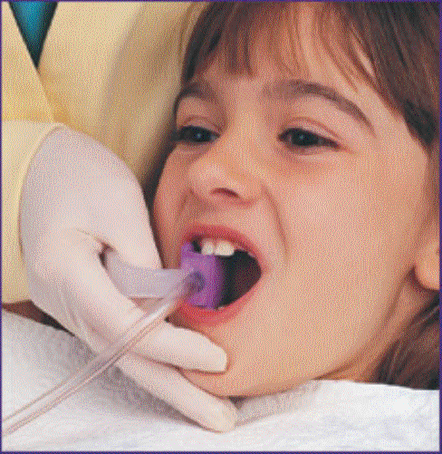
INTRODUCTION TO PEDODONTICS
Presented By: Dr. Rajeev Kumar Singh

Slide 2
Pedodontics ??
Pedo
Pais (Greek)
child
+
Dontics
study of the tooth
Pedodontics or Pediatric dentistry is synonymous with dentistry for children

Slide 3
DEFINITION
American Academy of Pediatric Dentistry (1999):
Pediatric Dentistry is an age-defined specialty that provides both primary and comprehensive, preventive and therapeutic oral health care for infants and children through adolescence, including those with special health care needs.

Slide 4
HISTORICAL PERSPECTIVE
1737 GERAULDY
Writes about theories of tooth eruption and exfoliation
1763 JOSEPH HURLOCK
Published first book on children’s dentistry
1764 ROBERT BUNON (FATHER OF PEDODONTICS)
Reiterates the importance of deciduous dentition

Slide 5
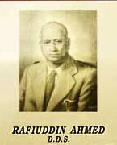
EVOLUTION OF PEDODONTICS IN INDIA
In India 1st dental college was started by the name of “Calcutta Dental College & Hospital” in the year 1920 by Dr. Rafiuddin Ahmed.
Known as “Father of dentistry in India”
Also known as “Grand old man of dentistry”.

Slide 6
EVOLUTION OF PEDODONTICS IN INDIA Cont.….
1950- Pedodontics was first introduced in Government College, Amritsar
1967- KGMC, Lucknow was the second institute to introduce the specialty
1978- Introduced in the undergraduate curriculum in
1979- Indian Society of Pedodontics & Preventive Dentistry was formed

Slide 7
THE NEED FOR PEDIATRIC DENTISTRY
Hippocrates in the 5th B.C talked about the differences between the child and the adult.
In the 4th Century A.D. Celsius recognized that the child must be treated differently from an adult.

Slide 8
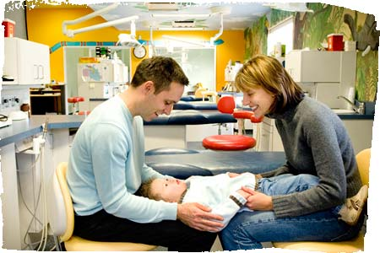
A child differs from an adult in various ways :
Physical
Emotional and psychological
Consideration of behavior
Type of treatment
Dentist patient relationship
Parent dentist relationship

Slide 9
Objectives of Pedodontics
Maintain functioning, esthetics and arch integrity of the primary dentition.
Treatment and prevention of dental caries in primary and young permanent teeth.
Child dental health care education to parents.
Providing for patients' immediate dental needs and initiating good attitudes towards dental health

Slide 10
Importance of Pedodontics
Special importance in preventing tooth decay.
Maintenance of primary teeth (baby teeth) until they are naturally lost.
Serves as an educational resource for parents.

Slide 11
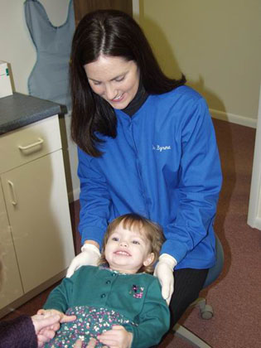
DENTIST PATIENT RELATIONSHIP
The dentist must be able to handle children well.
Perform to the best of his ability

Slide 12
PARENT DENTIST RELATIONSHIP
Dentist should be able to convince the parents that good dentistry for children is an investment in future health
Good dentistry does not begin at dental chair, it begins at home in
Proper oral hygiene
Adequate diet
Carbohydrate restriction
Participating in community programs

Slide 13
CONSIDERATION OF BEHAVIOR
BEHAVIOR MANAGEMENT
The means by which dental health team effectively and efficiently performs treatment for a child and simultaneously instills a positive dental attitude in the child (Wright, 1975)
It can also be considered as an attempt to alter the child’s behavior and emotion in a beneficial manner according to the laws of society

Slide 14
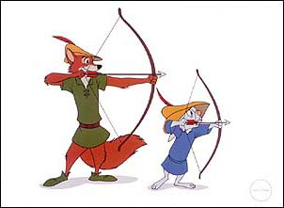
AIMS AND OBJECTIVES
When rendering services of any kind to Children one has to determine :
What is best for the Child at that moment?
What is best for the Adult into whom the Child will eventually grow?
Health of the Child as a whole
Prevention of Oral diseases
Restoring the mouth to good health

Slide 15
RATIONALE OF PEDODONTICS
Maintenance of proper dental health in child. Children are the key to the future. The future adult dental health depends on the dental healthcare of childhood.
Children require special dental care at all ages because they are unique physically and psychologically.

Slide 16
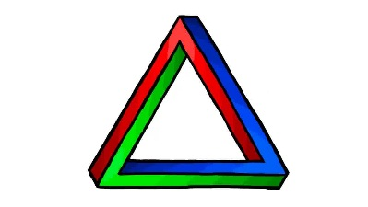
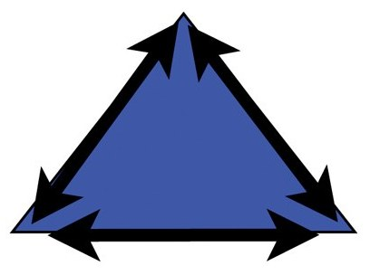
PEDODONTIC TRIANGLE

Slide 17
MODIFIED PEDODONTIC TRIANGLE
Society

Slide 18
MCQs

Slide 19
MCQ 1
BR Vacher
Robert Bunon
R Ahmed
Joseph Herlock
Who is known as Father of Pedodontics:

Slide 20
MCQ 2
Father of Pedodontics in India is:
BR Vacher
Robert Bunon
R Ahmed
A Tewari

Slide 21
MCQ 3
Samuel D Harris
Gerauldy
Joseph Herlock
Pierre Fauchard
Who published first book on children’s dentistry:

Slide 22
MCQ 4
Pediatric Treatment triangle was given by:
HG White
GZ Wright
ZG Whiltz
GH Whither

Slide 23
MCQ 5
Which of the following is true regarding Pediatric dentistry:
It is an age defined specialty
It is an gender defined specialty
Manage only primary dentition
Do not treat infants and special children

Slide 24
MCQ 6
Who is known as “Grand old man of Dentistry”:
Dr. B R Vacher
Dr. Robert Bunon
Dr. Joseph Hurlock
Dr. R Ahmed

Slide 25
MCQ 7
Pedodontics was included in the UG curriculum in:
1976
1978
1980
1982

Slide 26
MCQ 8
Who is the focus of attention in Pedodontic triangle:
Dentist
Child
Parents
Society

Slide 27
MCQ 9
Which of the following parameter was added in modified Pedodontic triangle:
Child
Parents
Society
Dentist

Slide 28
MCQ 10
What is the position of the child in the Pedodontic triangle:
Center
Apex
Base
All of the above

Slide 29
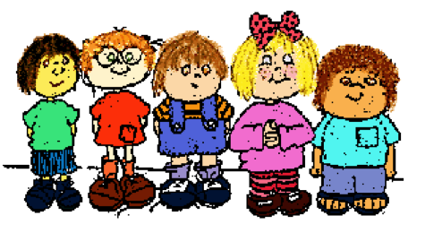
Thank You

