Slide 1
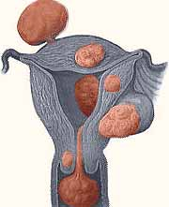
Uterine Fibroids

Slide 2
Quiz 1
To start with all fibroids are:
Interstitial
Submucous
Subserous
Ovarian

Slide 3
Quiz 2
Uterine fibromyoma is associated with:
Endometriosis
Pelvic inflammatory ds
Ovarian carcinoma
Tamoxifen

Slide 4
Quiz 3
In fibroids which of the following is not seen:
Amenorrhoea
Pelvic mass
Menstrual abnormality
Infertility

Slide 5
Quiz 4
What is a St. Paul’s lantern?
Submucous fibroid polyp
Pseudocervical fibroid
Wandering fibroid
Cervical fibroid

Slide 6
Quiz 5
  Treatment of red degeneration of fibroid is
  Analgesics
  Laparotomy
  Termination of pregnancy
  Removal at cesarean section

Slide 7
Fibroids
Synonyms : Myoma, Leiomyoma, Fibromyoma
Most common benign neoplasm in uterus and female pelvis
Incidence : 20 to 40% of reproductive age women

Slide 8
Epidemiological risk factors
Increased risk
Decreased risk
Age 35 to 45 years
Nulliparous or low parity
Black women
Family history
Obesity
Early Menarche
Diabetes
Hypertension
↑↑ parity
Exercise
↑↑intake of green vegetables
Progesterone only contraceptives
Cigarette smoking

Slide 9
Etiology
It arises from smooth muscle cells of myometrium.
Suggested causes include:
Monoclonal origin ( arising from single cell) confirmed by G6PD studies
Genetic basis confirmed by family studies
Various growth factors like TGFβ , EGF, IGF-1, IGF-2, BFGF are recently implicated

Slide 10
Role of Estrogen in development of Fibroids?
Estrogen although not proved for causing myoma, is definitely implicated in its growth
Uncommon before puberty & regress after menopause
Higher incidence in nulliparous women
Common in obese women
May increase during pregnancy
Studies show high concentrations of estrogen receptors in leiomyoma than myometrium
Common in fifth decade due to anovulatory cycles with high or unopposed estrogen

Slide 11
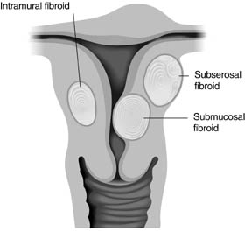
Types of Fibroids
More common in uterine corpus, less in cervix
All fibroids are interstitial to begin with and then enlarge
May remain intramural, become subserosal or submucosal
Subserosal may become pedunculated &
occasionally parasitic receiving blood
from other organs usually omentum
Submucous fibroid may become
pedunculated and present in the vagina
through the cervix as a fibroid polyp
Large submucous fibroid may pull down the
cervix resulting in chronic inversion

Slide 12
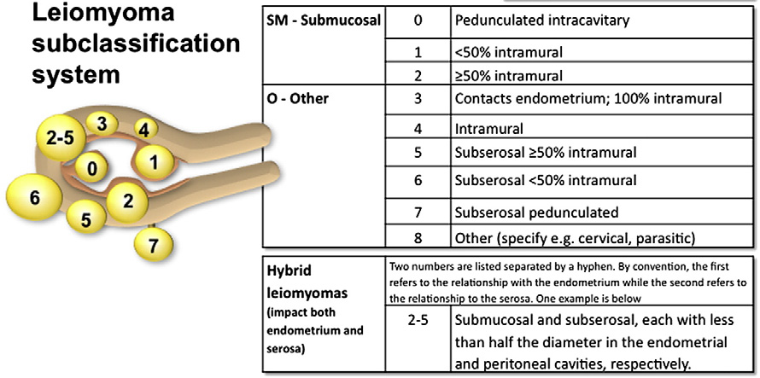
Classification of Fibroids (May know)

Slide 13
Fibroid Pathology
Gross appearance- Multiple, discrete, spherical, pinkish white, firm capsulated masses protruding from surrounding myometrium. Pseudo capsule is made up of compressed myometrium giving it a distinct outline
Microscopy- non-striated muscle fibres are arranged in interlacing bundles of varying size arranged in whorled pattern. Varying amount of connective tissue is intermixed with smooth muscle fibres

Slide 14
Fibroid Pathological variants
Intravenous leiomyomatosis
LPD – leiomyomatosis peritonealis dissemination
Secondary changes- Hyaline, calcific, necrosis, red degeneration during pregnancy, fatty degeneration
Leiomyosarcoma- 0.49-0.79%, more common in the 5th decade, diagnosed with presence of mitotic figures

Slide 15
Clinical presentation
- Commonly asymptomatic
- Abnormal uterine bleeding – 30-50% , more common with submucous fibrouids but may occur with all types due to
- ↑↑ surface area
- ↑↑vascularity, thinning and ulceration of overlying endometrium
- endometrial hyperplasia
- venous obstruction
- interference with contractions

Slide 16
Clinical presentation (contd.)
Anemia due to excessive blood loss
Pelvic pain - 1/3rd patients
- backache
- Acute pain due to torsion, infection, expulsion, red degeneration, vascular complication
- Dysmenorrhoea – Spasmodic as well as congestive

Slide 17
Clinical presentation (contd.)
- Pressure symptoms
- Lump in abdomen
- Urinary symptoms- urgency, frequency, incontinence, rarely urethral obstruction
- Bowel symptoms- constipation, intermittent intestinal obstruction
- Abdominal distention- large fibroids
Rapid growth- pregnancy and malignancy
Infertility – 2 to 10 % cases- due to irregular cavity interfering with sperm transport, endometrial changes
* Rare symptoms : Ascites, polycythemia

Slide 18
Effects of fibroid on pregnancy/ labor/ puerperium
Pregnancy : Abortion
Pressure symptoms
Malpresentation
Retrodisplacement of uterus
Labour : Preterm labour Uterine inertia PPH
Dystocia MRP
Puerperium : Subinvolution
Sec. PPH
Puerperal sepsis
Inversion

Slide 19
Effects of pregnancy on fibroid
Increase in size & softening
Red degeneration
- Commonly in 2nd trimester
- due to rapid growth there is congestion with interstitial hemorrhage & venous thrombosis
Impaction in pelvis
Torsion
Infection
Injury- Pressure necrosis during delivery
Rupture of subserous vein → Internal hemorrhage

Slide 20
Fibroid – Examination findings
General examination– Anemia due to prolonged heavy bleeding
P/A – If > 12 weeks size , firm, nodular, arising from
pelvis, lower limit can’t be reached, relatively well
defined, mobile from side to side, nontender, dull
on percussion, no free fluid in abdomen
P/S – Cervix pulled higher up
P/V – Uterus enlarged, nodular
D/D from ovarian tumour → Uterus not separately
felt , transmitted movement present, notch not felt
P/R – May help in difficult cases

Slide 21
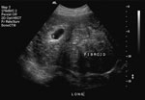
Fibroid – Confirmation of Diagnosis
USG :
- Well defined hypoechoic lesions
- Peripheral calcification with distal shadowing
Hysteroscopy : Submucous fibroids
Saline infusion sonography- help differentiate submucous from intramural fibroids

Slide 22
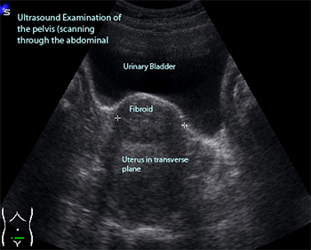
Fibroid USG

Slide 23
Diagnosis of Fibroid (contd.)
MRI :
- Most accurate imaging modality for diagnosis of fibroid
- Precise fibroid mapping & characterization possible
→ D/D from adenomyosis
→ D/D from adnexal pathology
→ Detects small myomas(0.5 cm)
H S G : Done for infertility evaluation . Coincidental finding of filling defects may be seen

Slide 24
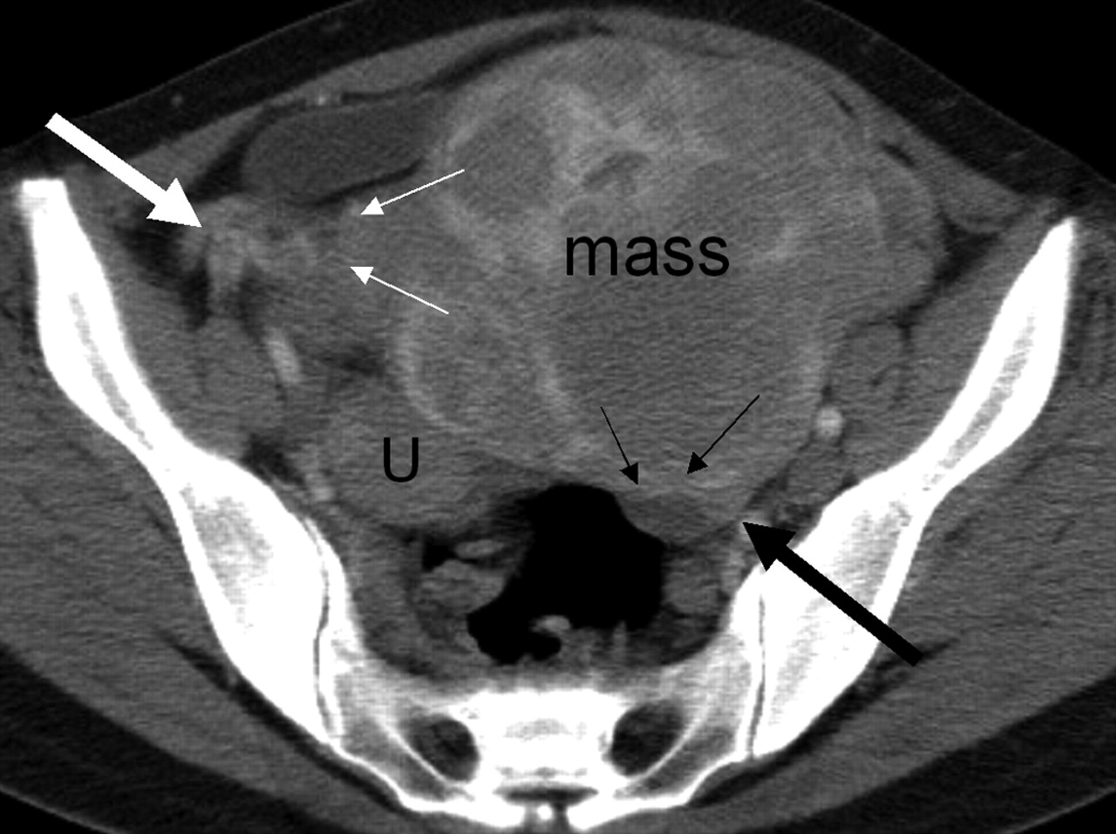
Fibroid MRI

Slide 25
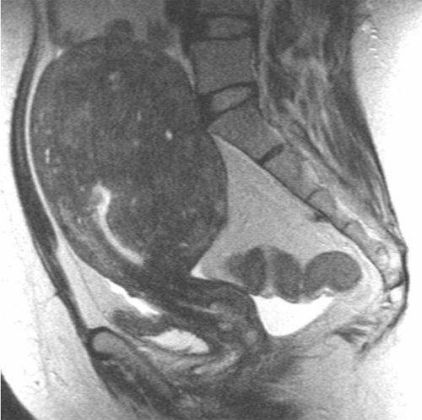
Fibroid MRI

Slide 26
Differential Diagnosis of Fibroid
Pregnancy
Adenomyosis
Ovarian tumour
Ectopic pregnancy
Endometriosis
T O mass

Slide 27
Case study
A 26 yr old P0+0 presents with menorrhagia. P/V examination shows a bulky uterus. The patient is worried about her bleeding & also wishes to conceive.
What could be the differential diagnosis?
How will you confirm the diagnosis?

Slide 28
Expectant management of Fibroid
Indications :
asymptomatic incidental fibroids
Size < 12 weeks
nearing menopause
Prerequisites:
- Regular follow up every 6 months
- Routine pelvic examination
- Baseline imaging to compare regression

Slide 29
Medical Management
Not a definitive treatment
For symptomatic relief from pain- NSAIDs
Decrease menstrual blood loss
Preoperatively to decrease the size of fibroid
Drugs used:
- Progestogens : Oral/ IUCD
- Antiprogestogens (Mifepristone)
- Androgens ( Danazol, Gestrinone)
- GnRH analogues
- SERMS & SPRM
- Aromatase inhibitors

Slide 30
Progesterone
Medroxy progesterone acetate
Norethisterone acetate
D5 X 21 days X 3-6 cycles
Indication: To delay surgery

Slide 31
Progesterone releasing IUD- LNG-IUD
Fibroids with uterus <12 weeks size with menorrhagia
Expulsion rates higher in presence of fibroids
Contains Progesteron LNG 60 mg releasing 20 ug /day
Fibroids decreases in size 6 – 12 mths of use
May have variable effects on uterine myomas depending upon balance of growth factors
Few studies have shown beneficial results

Slide 32
Mifepristone
5 – 10 mg is tried
No loss of bone density
Promising results
Decrease in myoma volume by 26-74 %.
No effect on bone density
Endometrial hyperplasia may limit its longterm use.

Slide 33
GnRH analogues
GnRH Agonists:
Triptorelin (Decapeptyl) 3.75 mg I/M once a month X 3 months
Leuprolide depot 3.75 mg I/M once a month X 3 months
Goseraline (Zoladex) 3.6 mg SC once a month X 3 months
Advantages : Decrease in size of myoma by 20 to 50 %
Decrease in bleeding→ increases Hb level
Decreases blood loss during surgery
Helps to convert hysterectomy into myomectomy
Helps to converts Abd. hyst into vag. hysterectomy

Slide 34
GnRH analogues
Disadvantages : High cost
Hypoestrogenic side effects- medical menopause
Effect is reversible
Rarely ↑↑ bleeding due to degeneration
Occasionally difficulty in enucleation during myomectomy
GnRH Antagonist
Cetrorelix is used
60 mg I/M repeated after 3-4 months if necessary
Initial flare up does not occur
Decrease volume of fibroid

Slide 35
SERM – Raloxifen
60 mg /day is tried for 6 to 12 mths
Higher doses ( 180 mg) are required for effective decrease in size
Better if combined with GnRH analogs

Slide 36
SPRM (Selective Progesterone Receptor Modulator) – Asoprisnil
5 to 25 mg/day is used
Mechanism of inhibitory action is not known
Possible risk of endometrial hyperplasia is not studied

Slide 37
Aromatase inhibitors
Directly inhibit estrogen synthesis & rapidly produce hypoestrogenic state
Fadrozole/ Letrozole is tried in couple of studies
71 % reduction occurred in 8 weeks
Appears to be promising therapy

Slide 38
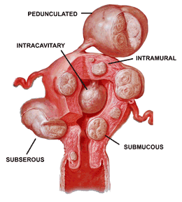
Surgical Management
* Hysterectomy → Abdominal
→ Vaginal
→ LAVH, TLH
* Myomectomy → Abdominal
→ Vaginal
→ Hysteroscopic
→ Laproscopic

Slide 39
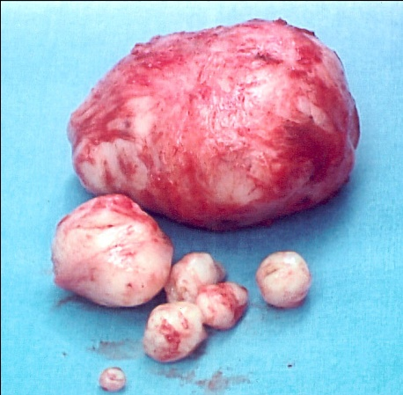
Surgical Management
Myomectomy is preferred in
Infertility
Recurrent pregnancy loss when no other
cause can be found for it
Young patients
Patients who wish to preserve their uterus

Slide 40
Abdominal myomectomy
- Other factors for infertility should be ruled out
- Consent for hysterectomy
- Blood matched & handy
- Pap’s smear & endometrial sampling to rule out malignancy
Medical or mechanical means to control blood loss
- Bonney’s Myomectomy clamp
- Rubber tourniquet
- Manual ( finger compression) pressure at isthmic region
- Vasopressin 10 – 20 units diluted in 100ml saline infiltrated before putting the incision

Slide 41
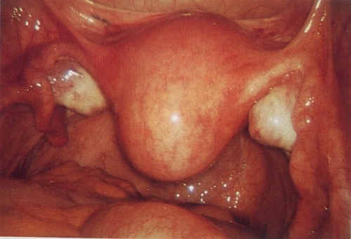
Abdominal myomectomy
Minimum incisions are kept – preferably single midline vertical, lower, anterior wall
Removal of as many fibroids as possible through one incision & secondary tunnelling incisions
Meticulous closure of all dead space
Proper haemostasis
Measures for adhesion prvention should be taken

Slide 42
Bonney’s Hood Operation
For large posterior fundal fibroid
Transverse fundal incision made posterior to tubal insertion
After enucleation uterine wall is sutured anteriorly covering the fundus as a hood

Slide 43
Laproscopic myomectomy
Includes:
- In 3 phases → excision of myoma, repair of myometrium & extraction of myoma
Suitable for subserous & intramural fibroids upto 10 cm size
Fibroid excised are remoyed by electronic morcellators or through posterior colpotomy incision vaginally.

Slide 44
Hysteroscopic myomectomy
For submucous myoma causing infertility, RPL, AUB or pain
Criteria :- < 5 cm in size
< 50 % intramural component
< 12 cm uterine size
Gn RH analogue may be given preoperatively to decrease size of myoma
Malignancy, infection & excessive mural component is a contraindication
Advantages- short procedure, rapid recovery & all disadvantages of laprotomy avoided

Slide 45
Vaginal myomectomy
Submucous pedunculated or small sessile cervical fibroids are removed vaginally
Ligation of pedicle if accessible
Twisting off the fibroids if pedicle not accessible in case of small & medium size fibroids
To gain access to pedicle of higher & big fibroid incision on the cervix can be made

Slide 46
Factors favouring vaginal hysterectomy
Uterus < 16 wks, preferably < 14 wks
No associated pathology like endometriosis , PID, adhesions
Uterus mobile & adequate lateral space in pelvis
Experienced vaginal surgeon

Slide 47
Newer modalities of treatment
Laparoscopic myolysis
Uterine artery embolization
MRGFUS

Slide 48
Laproscopic myolysis
By ND-YAG laser or long bipolar needle electrode blood supply of myoma coagulated
Results in atrophy of myoma
Applicable if myoma 3 -10 cm size & < 4 in number

Slide 49
Uterine artery embolization
By interventional radiologist
Catheter is passed retrograde through Right femoral artery to bifurcation of aorta & then negotiated down to opposite uterine artery first
Polyvinyl alcohol ( PVA ) particles ( 500-700 um) or gelfoam are used for embolization
60 – 65 % reduction in size of fibroid
80 – 90 % have improvements in menorrhagia & pressure symptoms

Slide 50
Uterine artery embolization
High vascularity & solitary fibroid are associated with greater chance of longterm success
Pregnancy, active infection, desire for fertility & suspicion of malignancy are absolute contraindications
Risk of ovarian failure must be counselled
Post embolization syndrome ( fever ,vomiting, pain) can occur

Slide 51
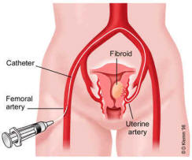
Uterine artery embolization

Slide 52
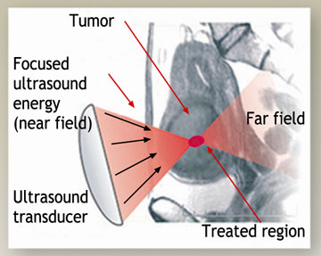
MRGFUS (Magnetic resonance guided focussed ultrasound)
Permitted by FDA since 2004
MRI guidance is used to direct ultrasound to tissues to elicit coagulative necrosis via thermal ablation

Slide 53
Case study
A 26 yr old P0+0 presents with menorrhagia. P/V examination shows a bulky uterus. The patient is worried about her bleeding & also wishes to conceive.
How will you manage this patient?

Slide 54
MCQs
1. A pregnant woman with fibroid uterus develops acute pain in abdomen with low grade fever & mild leucocytosis at 28 week. The most likely diagnosis is
Preterm labor
Torsion of fibroid
Red degeneration of fibroid
Infection in fibroid

Slide 55
2. Least common complication in fibroid is
Menstrual disorder
Malignancy
Urinary retention
Degeneration

Slide 56
3. Submucosal fibroid is diagnosed by all except
Hysteroscopy
Hysterosalpingography
Transabdominal USG
Laparoscopy

Slide 57
4. The drug which has no effect on the size of fibroids is
GnRH agonist
Danazol
Progesterone
Mifepristone

Slide 58
5. all of the following are indications for myomectomy except
Associated infertility
Recurrent pregnancy loss
Pressure symptoms
Red degeneration

Slide 59
6. A 29 yr old nulliparous woman complains of severe menorrhagia & lower abdominal pain since 3 months. On examination there was a 14 weeks size uterus with fundal fibroid. The treatment of choice is
Wait & watch
GnRH analogue
Myomectomy
Hysterectomy

Slide 60
7. pressure symptom is usually seen in which type of fibroid?
Submucous
Subserous
Intramural
All

Slide 61
8. Treatment of choice in a 39 yr old with bleeding P/V due to multiple fibroids is
TAH with BSO
TAH
Myomectomy
Vaginal hystertectomy

Slide 62
9. Malignant prevalence in a fibroid is
0.5%
1%
2%
5%

Slide 63
10. Interstitial myomas predispose to menorrhagia by
Inhibiting uterine contractility
Degeneration
Erosion of endometrium
Cause not known

Slide 64
Answers Quiz
A
A
A
D
A

Slide 65
MCQs
C
B
D
C
D
C
B
B
A
A

