Slide 1
IMPORTANCE &SKILLS OF GIVING FEEDBACK Dr. A.K.Pathak ELMC ,Lucknow

Slide 2
Objectives
♦♦ Define feedback
♦♦ Recognize importance of feedback
♦♦ Identify barriers to feedback
♦♦ Knowledge about characteristics & skills of effective feedback

Slide 3
Feedback
“Specific information about the comparison between a trainee’s observed performance and a standard, given with the intent to improve the trainee’s performance.”
“Feedback is an assessment for learning rather than an assessment of learning.”
Notes:
What makes this definition novel?
Focus is on observed performance: many tasks are suitable for observation: history taking, physical exam, handoffs, interpersonal skills with team, clinical reasoning when performed outloud
Goal of feedback highlights that the goal of feedback is to help the trainee acquire the knowledge, skills, attitudes to become a superb practitioner
Content of the feedback is the difference in performance between the content of the feedback and a standard
Aim of feedback is trainee improvement- it’s a learning catalyst

Slide 4
Feedback vs. Evaluation
Feedback
♦♦ Conveys information
♦♦ Formative
♦♦ Current performance
♦♦ Neutral
(verbs & nouns)
♦♦ Foster learning
Evaluation
♦♦ Conveys judgment
♦♦ Summative
♦♦ Past performance
♦♦ Normative statements
(adjectives and adverbs)
♦♦ Certification

Slide 5
Feedback – Why is it important?
♦♦ promotes learning
♦♦ Ensures learner clear about learning outcomes expected
♦♦ ensures that standards are met
♦♦ Provides Student/resident with an accurate perception of their own performance
♦♦ Enhances student/resident’s self awareness

Slide 6
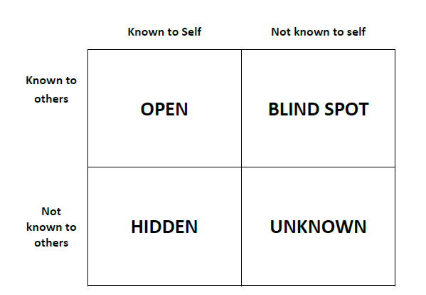
How feedback works

Slide 7
Characteristics of Good Feedback
♦♦ Feedback should be part of the assessment design
♦♦ Feedback should be constructive
♦♦ Feedback should be timely- helps students use it for subsequent learning.
♦♦ Feedback should be prompt students can recall what they did and thought at the time.
♦♦ Feedback should be justified, by being based on clear and explicit explanations of performance against stated criteria and standards.
……………CONTD.

Slide 8
Characteristics of Good Feedback
.CONTD.
♦♦ Feedback should be focused, on achievement, not effort; and on the work, not the student.
♦♦ Feedback should be expressed in terms of the learning outcomes, so that students can relate their assessment to the learning outcomes-- seeing how they can close the gap between their current and their desired achievement of these outcomes.
♦♦ Feedback should be consequential, so that it engages students by requiring them to attend to the feedback as part of the grading.

Slide 9
Obstacles for Teachers
♦♦ It can be uncomfortable giving negative feedback
♦♦ Concerns about consequences of negative feedback
♦♦ Time constraints
♦♦ Poor feedback skills
♦♦ Limited knowledge about the performance

Slide 10
Snapshots
Inpatient
♦♦ Pre-rounds
♦♦ Post-rounds counseling
♦♦ Discharge instructions
♦♦ ED encounters
♦♦ Part of admission
♦♦ Family meeting
♦♦ OR/procedures
Outpatient
♦♦ First 5 minutes of encounter
♦♦ Part of physical exam
♦♦ Counseling
Notes:
As I mentioned, faculty will need to brainstorm about strategies to increase observation. It will therefore be helpful to have them think about situations during inpatient and outpatient encounters conducive to direct observation, remembering that observation can occur as a snapshot focusing on just interview, or exam, or counseling.
Frequent “snapshots”
Pre-rounds
First 5 minutes of the outpatient encounter
Post-rounds counseling/discharge instructions
Observe exam
Observation in OR
Team interactions

Slide 11
Some methods of feedback
♦♦ Sandwich method
♦♦ Pendleton's rules
♦♦ ALOBA
♦♦ SCOPME model
♦♦ Chicago model

Slide 12
The ‘Feedback Sandwich
The ‘Feedback Sandwich’ maintains a trust environment
State (based on observation):
What was done well…(positive comment )
What could be changed or improved… (area of improvement)
How improvement be achieved…(another positive comment)

Slide 13
Set the Stage
Establish goals upfront: yours & the learners
Establish expectation of continuous feedback
Create environment conducive to feedback
Private, quiet, close to event, not post-call
Start session by telling learner: “This is your feedback”

Slide 14
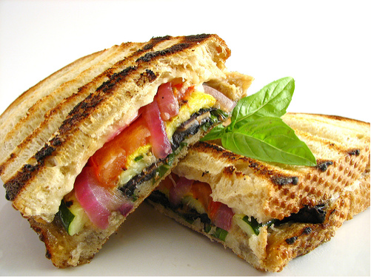
The New Feedback Sandwich
Ask
Tell
Ask

Slide 15
Ask
♦♦ Ask learner to assess own performance
♦♦ Begins a conversation – an interactive process
♦♦ Assesses learner’s level of insight and stage of learning
♦♦ Promotes reflective practice
Notes:
Feedback should first start by asking the learner to assess their own performance
These can be questions like: how do you think that went? How did you feel during that encounter? What might you consider doing differently the next time?
The value in starting by asking the learner how they believe it went allows the feedback to turn into a conversation or dialogue rather than having the faculty do all of the speaking. It makes the feedback interactive and learner centered.
It is also very helpful because it allows you to assess the learners level of insight into their clinical skills
It seems to make feedback less threatending by helping to separate out behaviors from an evuations self.
And importantly – it promotes reflective practice- which we discussed earlier is important for the development of clinical skills expertise.
I think as well for many of us- given that most trainees provide at least in part an accurate self-assessment – trainees with offer and earea of weakness- in doing so- for many faculty- it makes providing constructive efeedback easier.

Slide 16
Tell
♦♦ Tell what you observed
♦♦ Include both positive and corrective elements
“I observed….”
♦♦ React to the learner’s observation
♦♦ Feedback on self-assessment
♦♦ Provide action plan (suggestions for how to improve)
** Remember: limit constructive feedback to no more than 2-3 (max 4)
Notes:
After asking the trainee for their self-assessment, you can then say or tell what it is that you observed. You can also give the learner feedback on their self-assessment (insert example).
It is very important that this includes specific positive and specific constructive- remembering from earlier to priorize

Slide 17
Ask (again)
♦♦ Ask about recipients understanding and strategies for improvement (action plan)
♦♦ What could you do differently?
♦♦ Give own suggestions
♦♦ Commit to monitoring improvement together

Slide 18
Pendleton’s Rules
♦♦ Clarification of matters of fact
♦♦ Trainee identifies what went well
♦♦ Trainer identifies what went well
♦♦ Trainee discusses what did not do well and how to improve
♦♦ Trainer identifies areas for improvement
♦♦ Agreement on areas for improvement and formulation of action plan
Notes:
18

Slide 19
Difficulties with Pendleton ?
♦♦ The strict format may inhibit spontaneous discussion.
♦♦ Opening comments may seem predictable.
♦♦ Holding four separate conversations covering the same performance can be time consuming and inefficient.
Notes:
19

Slide 20
ALOBA 1 of 2
♦♦ Start with the learner’s agenda.
♦♦ Look at the outcomes the learner and the patient are trying to achieve.
♦♦ Encourage self-assessment and self-problem solving first.
♦♦ Involve the whole group in problem-solving.
♦♦ Use descriptive feedback to encourage a non-judgemental approach.
♦♦ Provide balanced feedback.

Slide 21
ALOBA 2 of 2
♦♦ Make offers and suggestions: generate alternatives.
♦♦ Be well-intentioned, valuing and supportive.
♦♦ Rehearse suggestions.
♦♦ Opportunistically introduce theory, research evidence and wider discussion.
♦♦ Structure and summarise learning to reach a constructive end-point.

Slide 22
SCOPME Standing Committee on Postgraduate Medical and Dental Education
♦♦ Listen
♦♦ Reflect back
♦♦ Support
♦♦ Counsel
♦♦ Treat information in confidence
♦♦ Inform without censuring

Slide 23
Chicago
♦♦ Review aims and objectives of the job at the start.
♦♦ Give interim feedback of a positive nature.
♦♦ Ask the learner to give a self-assessment of their progress.
♦♦ Give feedback on behaviours rather than personality.
♦♦ Give specific examples to illustrate your views.
♦♦ Suggest specific strategies to the learner to improve performance.
Notes:
23

Slide 24
Think about the following questions after giving feedback
♦♦ Did you address the issues and performance as planned?
♦♦ How did you feel when giving the feedback?
♦♦ Did you focus on performance not the person, and did you use appropriate language?
♦♦ Do you feel you could have delivered the feedback more effectively?
♦♦ If so, how will you do it differently next time?
♦♦ How did the student react to the feedback?
♦♦ How did you handle their reaction?
♦♦ What was the outcome/action plan?

Slide 25
Don’ts
♦♦ Don’t email feedback (esp. negative)
♦♦ No opportunity for orientation, elicitation
♦♦ No opportunity to clarify the facts
♦♦ Impersonal
♦♦ No way to control tone or modify conversation
♦♦ Try not to give feedback when angry
♦♦ Think about the timing of your feedback
♦♦ Don’t be accusatory, demeaning or sarcastic
♦♦ Avoid negative feedback in front of peers/patients

Slide 26
Take Home Points
♦♦ Tell the person that you are going to give them feedback
♦♦ Engage the learner in the process – self assessment
♦♦ Focus on behaviors – what needs to be changed
♦♦ Develop an action plan

Slide 27
THANK YOU

