Slide 1

INGUINAL BUBO AND GENITAL ULCER: SYNDROMIC APPROACH
TOPIC
Dr. Rohit Kumar Singh
Resident, MD Dermatology
Base Hospital

Slide 2
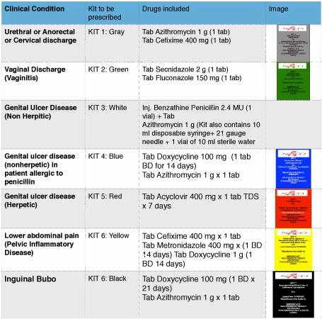

Slide 3
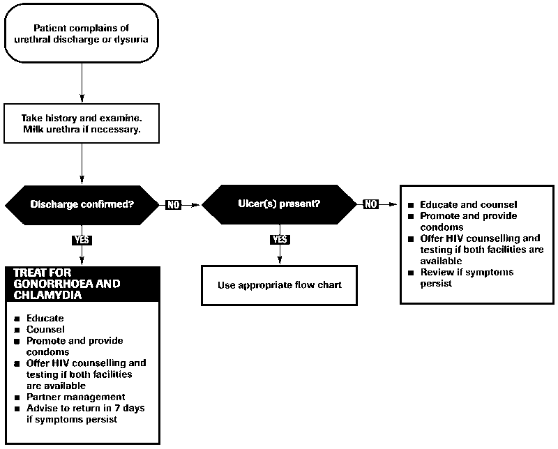
URETHRAL DISCHARGE

Slide 4
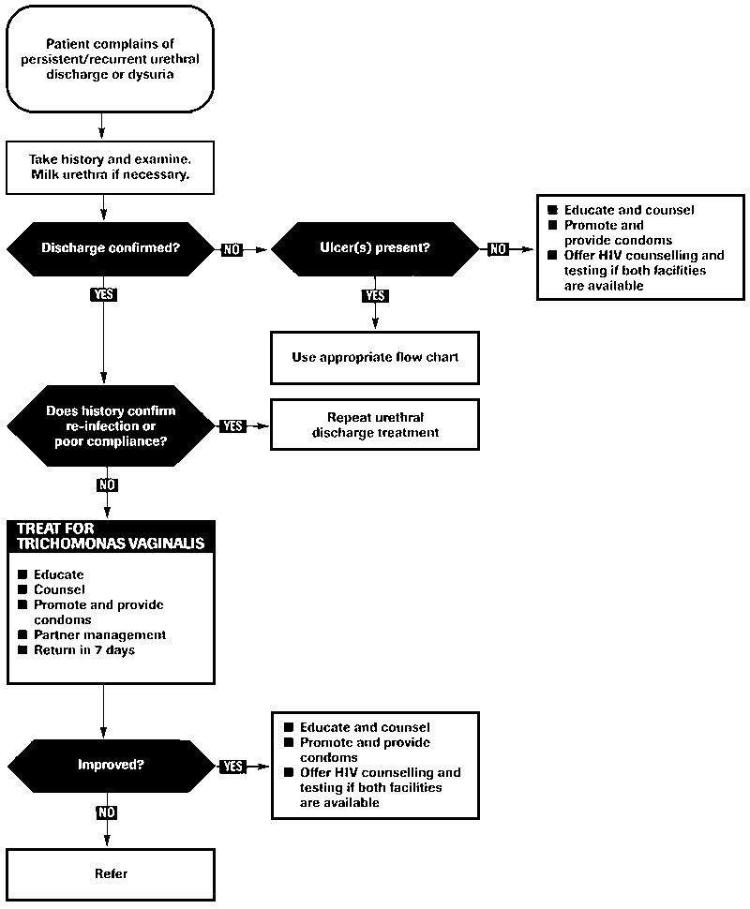
PERSISTANT UETHRAL DISCHARGE

Slide 5
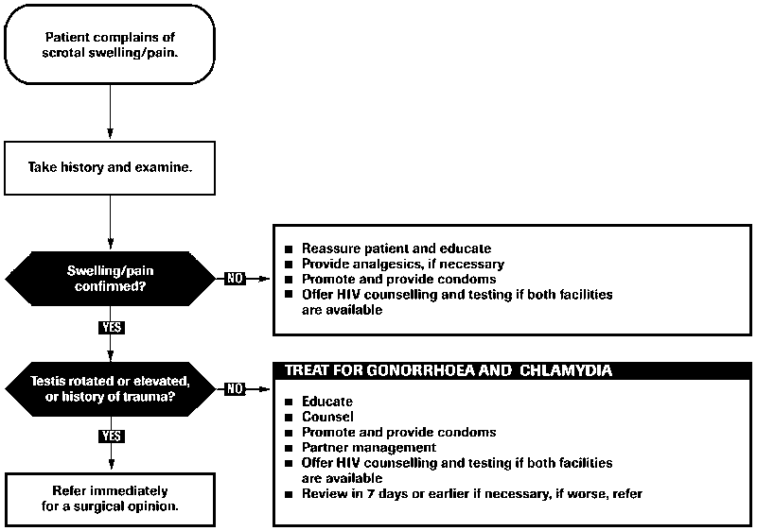
SCROTAL SWELLING

Slide 6
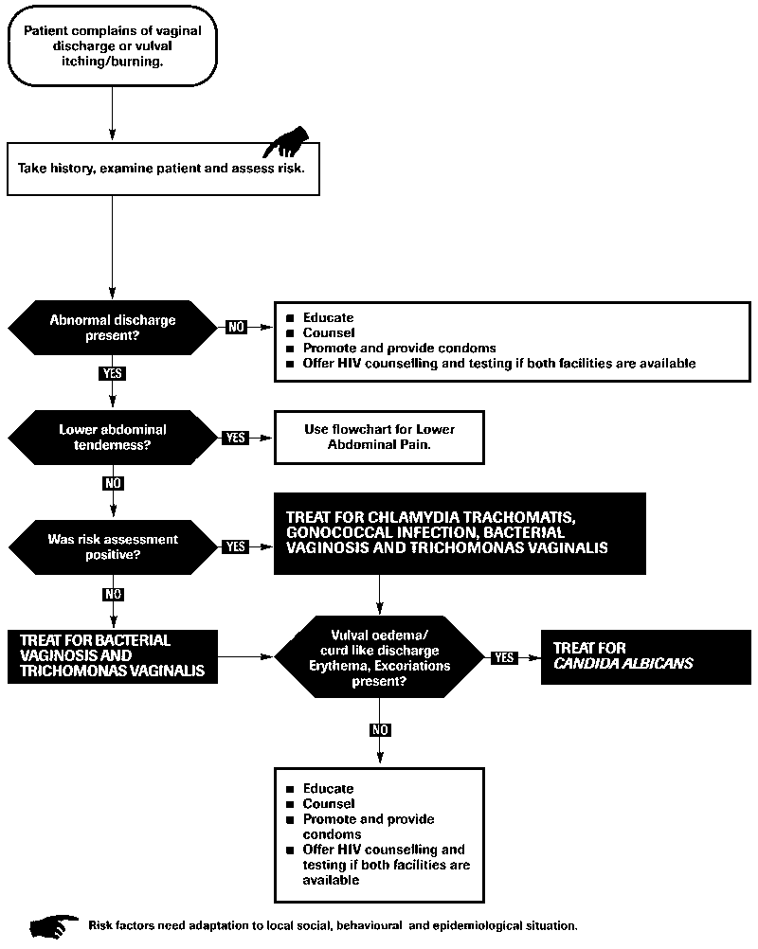
VAGINAL DISCHARGE

Slide 7
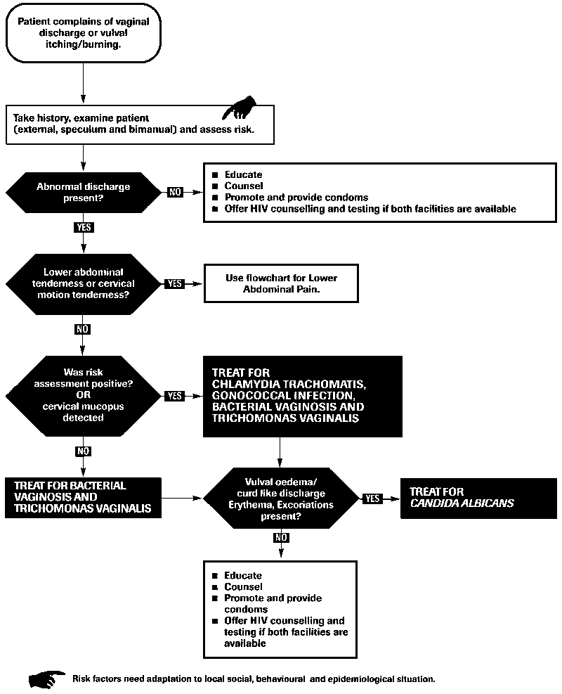
VAGINAL DISCHARGE (SPECULUM AND BlMANUAL)

Slide 8
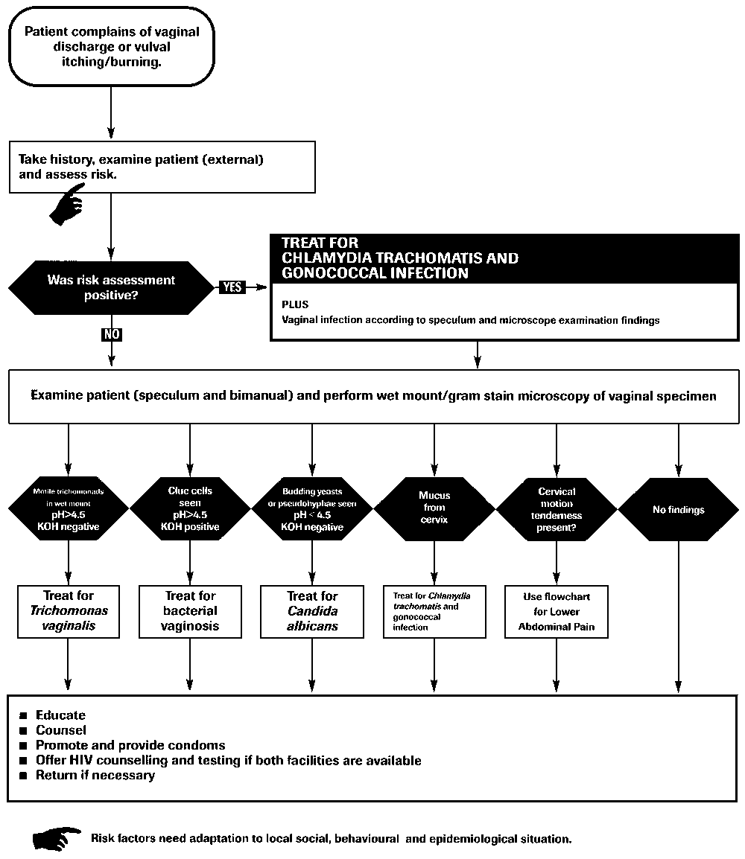
VAGINAL DISCHARGE (SPECULUM AND MICROSCOPE)

Slide 9
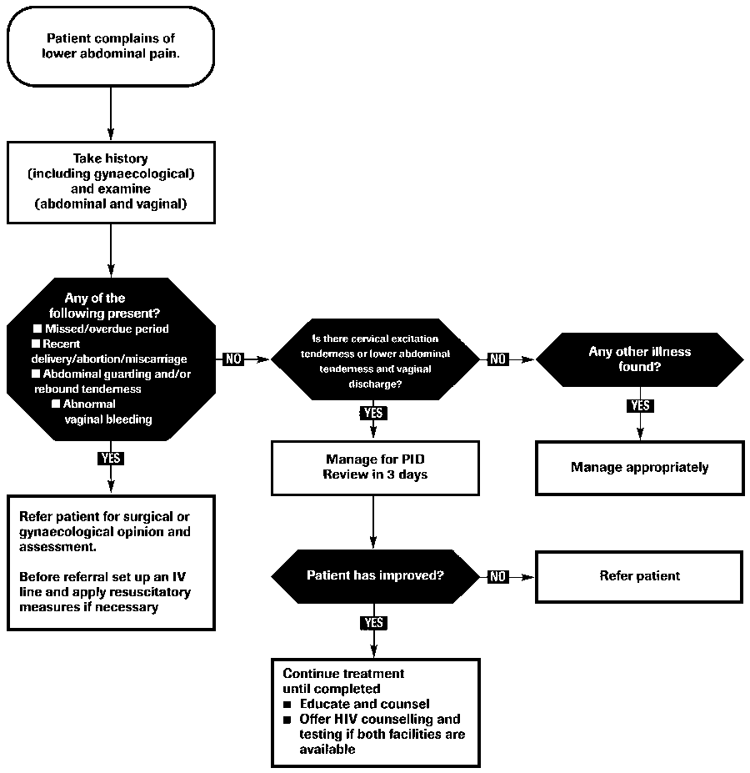
LOWER ABDOMINAL PAIN

Slide 10
LOWER ABDOMINAL PAIN
Recommended syndromic treatment
1. ceftriaxone, 250mg by intramuscular injection, once daily
PLUS
• doxycycline, 100mg orally or by intravenous injection, twice daily, or tetracycline, 500mg orally 4 times daily
PLUS
• metronidazole, 400-500mg orally or by intravenous injection, twice daily, or chloramphenicol, 500mg orally
or by intravenous injection, 4 times daily.
2. clindamycin, 900mg by intravenous injection, every 8 hours
PLUS
• gentamicin, 1.5 mg/kg by intravenous injection every 8 hours.
3. ciprofloxacin, 500mg orally, twice daily, or spectinomycin 1g by intramuscular injection, 4 times daily
PLUS
• doxycycline, 100mg orally or by intravenous injection, twice daily, or tetracycline, 500mg orally, 4 times daily
PLUS
• metronidazole 400-500mg orally or by intravenous injection, twice daily, or chloramphenicol, 500mg orally or by
intravenous injection, 4 times daily.
Note
• For all three regimens, therapy should be continued until at least 2 days after the patient has improved and should then
be followed by either doxycycline, 100mg orally, twice daily for 14 days, or tetracycline, 500mg orally, 4 times daily, for 14 days.
Patients taking metronidazole should be cautioned to avoid alcohol. Tetracyclines are contraindicated in pregnancy.

Slide 11
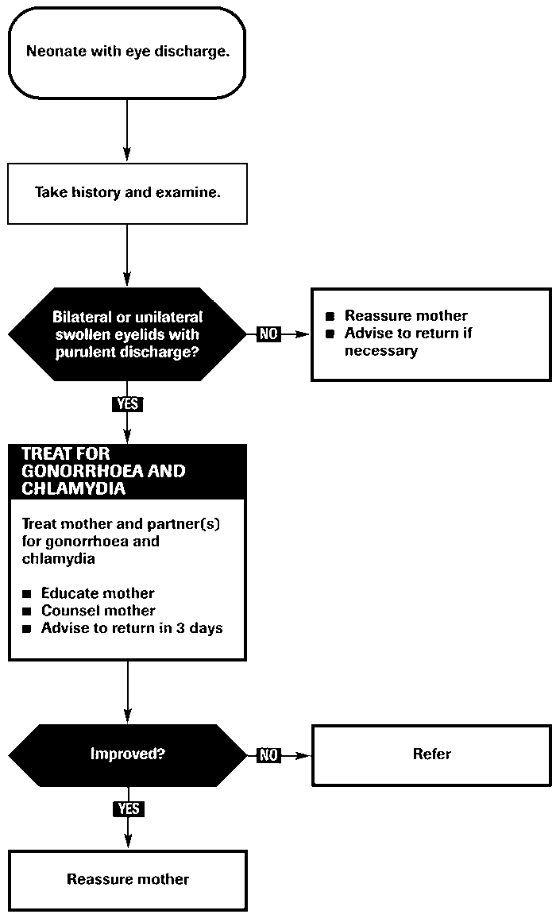
NEONATAL CONJUNCTIVITIS

Slide 12
NEONATAL CONJUNCTIVITIS
Neonatal conjunctivitis (ophthalmia neonatorum) can lead to blindness when caused by N. gonorrhoeae.
The most important sexually transmitted pathogens which cause ophthalmia neonatorum are
N. gonorrhoeae and C. trachomatis. In developing countries, N. gonorrhoeae accounts for 20-75% and
C. trachomatis for 15-35% of cases brought to medical attention.
Other common causes are Staphylococcus aureus, Streptococcus pneumoniae, Haemophilus spp. and
Pseudomonas spp. Newborn babies are generally presented because of redness and
swelling of the eyelids or "sticky eyes", or because of discharge from the eye(s).
As the clinical manifestations and possible complications of gonococcal and chlamydial infections are similar,
In settings where it is impossible to differentiate the two infections, treatment should be provided to cover
both infections.
This would include single dose therapy for gonorrhoea and multiple dose therapy for chlamydia.
Drug options for gonorrhoea | Drug options for chlamydia
Ceftriaxone | Erythromycin
Alternatives | Alternatives
Kanamycin | Trimethoprim/Sulfamethoxazole
Spectinomycin

Slide 13
INTRODUCTION
The term sexually transmitted diseases (STDs) is used to refer to a variety of clinical syndromes caused by pathogens that can be acquired and transmitted through sexual activity
Sexually transmitted infections (STIs) are among the most common causes of illness in the world and have far-reaching health, social and economic consequences for many countries.

Slide 14
STI vs STD
STI – Infections acquired through sexual intercourse (may be symptomatic or asymptomatic)
STD – Symptomatic disease acquired through sexual intercourse
STI is most commonly used because it applies to both symptomatic and asymptomatic infections
Notes:
Step 2: Overview of STIs (Slides 3-13) – 15 minutes
Some people use the terms STI and STD interchangeably but they actually have different meaning.

Slide 15

How Symptomatic are STIs?
Source: WHO HIV/AIDS/STI Initiative
Notes:
Males are generally more symptomatic than females.
Most STIs are asymptomatic! Think about it: if everyone with a STI had pain, discharge, etc., most people would seek treatment and the amount of STIs in the general population would drop dramatically. Asymptomatic infection exists as a large “reservoir” that perpetuates STI.
This emphasizes the need to screen, diagnose, and treat asymptomatic cases.
Source: http://www.gfmer.ch/Endo/Lectures_11/Pdf/STI-HIV.pdf

Slide 16
IMPACT OF STIs
Considerable morbidity
High rate of complications
Facilitate HIV transmission and acquisition
May cause infertility
Treatment can be a high financial burden
May cause problems in relationships—divorce, abandonment, beatings.

Slide 17
INTERACTION BETWEEN HIV AND STIs
Significant interaction exists b/w HIV and STIs
  Affect similar populations
  Have a similar route of transmission
The interaction is bidirectional
  HIV influences conventional STIs
  STIs influence HIV

Slide 18
INFLUENCE OF HIV INFECTION ON STIs
HIV alters the clinical features of STIs
  Syphilis: Neurosyphilis develops more frequently and rapidly
  HSV: Ulcers are more severe, chronic, and possibly disseminate throughout body
Response to treatment may be reduced
  High rates of treatment failure for neurosyphilis
Complications may increase and occur more quickly

Slide 19
HOW DO STIs INCREASE HIV TRANSMISSION?
Reducing physical/mechanical barriers (disruption of epithelium)
Increasing HIV in genital lesions, semen or both
Evoking a more infectious HIV variant
Increasing the number of receptor cells or the density of receptors per cell

Slide 20
THREE APPROACHES TO
DIAGNOSIS OF RTI / STI
Clinical approach
Etiological approach
Syndromic approach

Slide 21
SYNDROMIC APPROACH
Syndromic management is based on the identification of consistent groups of symptoms and easily recognized signs (syndromes), and the provision of treatment that will deal with the majority or most serious organisms responsible for producing a syndrome.
WHO developed a simplified tool (a flowchart or algorithm) to guide
health workers in the implementation of syndromic management.

Slide 22
COMPONENTS OF SYNDROMIC APPROACH
Classification by Syndrome:
Classifying the main causal pathogens by the syndromes they produce
Use of Algorithms:
Using flowcharts to guide the management of a given syndrome
Treatment and Counseling:
Using often more than one treatment that addresses all the pathogens with potential to cause a given syndrome
Treatment of Partners:
Promoting treatment of sex partners

Slide 23
MAIN SYNDROMES
Urethral discharge
Genital ulcer
Scrotal swelling
Vaginal discharge
Lower abdominal pain
Neonatal conjunctivitis
Inguinal bubo

Slide 24
SYNDROMIC CASE MANAGEMENT
ADVANTAGES:
Identifies and treats by signs & symptoms
Syndromes easily recognised clinically
Small number of clinical syndromes
Treatment given for majority of organisms
Simple and cost-effective
Valid, feasible, immediate treatment

Slide 25
SYNDROMIC CASE MANAGEMENT
DISADVANTAGES:
Tendency to overtreat – justifiable in high prevalence settings (>20%)
Decreased specificity
Overuse of expensive drugs
Asymptomatic cases not fully addressed even with risk assessment
Management of cervical infections problematic
Vaginal discharge algorithm performs poorly in low prevalence settings e.g., ANC, FP

Slide 26
Patient complaining of
inguinal swelling
INGUINAL BUBO SYNDROME
Take history
and examine
Educate
Counsel
Offer VCT
Promote and provide condoms
Inguinal/femoral
bubo present?
Any other STI present
No
No
Yes
Use appropriate flow chart
Ulcers
present
Yes
Use genital ulcer flow chart
No
Treat for LGV AND CHANCROID
  Aspirate if fluctuant
  Educate on treatment compliance
  Counsel on risk reduction
  Promote and provide condoms
  Partner management
  Offer VCT if available
  Advise to return in 07 days
  Refer if no improvement

Slide 27
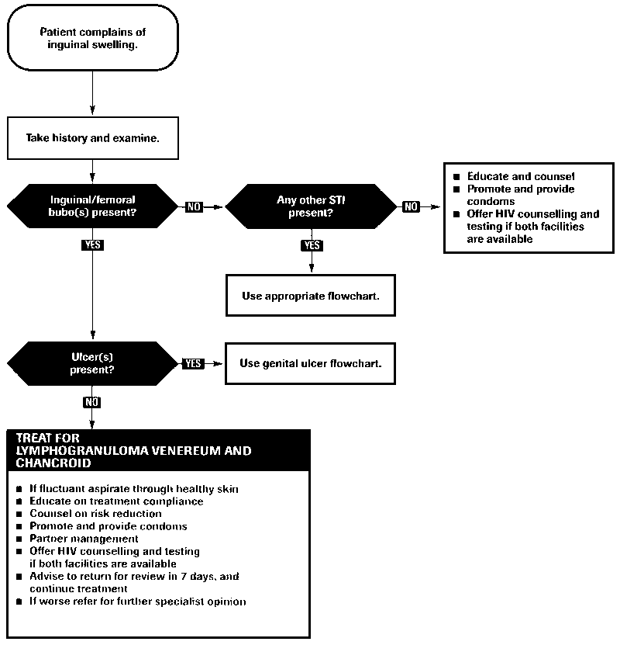
INGUINAL BUBO SYNDROME

Slide 28
INGUINAL BUBO
Swelling of inguinal lymph nodes as a result of STIs (or other causes)
Common causes:
  Treponema pallidum (syphilis)
  Chlamydia trachomatis L1, L2,L3 (LGV)
  Hemophilus ducreyi (chancroid)
  Calymmatobacterium granulomatis
  (granuloma inguinale)

Slide 29
LYMPHOGRANULOMA VENEREUM
Tropical or Climatic bubo
Durand-Nicholas-Favre disease
Lymphogranuloma inguinale
Poradenitis inguinalis
Strumous bubo

Slide 30
EPIDEMIOLOGY
6% Prevalence Rate in Clinics
Endemic to India
20 - 40 yrs.
Male : female = 5 :1
Urban, sexual promiscuity, low socio- economic status.

Slide 31
AETIOLOGY
Chlamydia Serovar L1/L2/L3
Obligate intracellular, Gram negative bacillus with humans as Natural Hosts by Sexual Transmission / Perinatal infection
Intracytoplasmic inclusion bodies
Controls the organelles of host cells for own growth and protein synthesis
Cell cycle – 48 to 72 hrs

Slide 32
PATHOGENESIS
Entry into cell as Metabolically inactive elementary body (Eb) by receptor mediated endocytosis.
Conversion to Active Reticulate Bodies which multiply , condense and form Eb → burst out of host cells
Lymphangitis, perilymphangitis, necrosis of lymph nodes
PMN stellate abscess- bubo
Healing by fibrosis - esthiomene, adhesions
Dissemination rare

Slide 33
CLINICAL FEATURES
Primary stage
Incubation period : 5 – 21 days.
Single, painless, evanescent, inconspicuous
Papule / vesicle / Erosion / Ulcer
Male – coronal sulcus, prepuce, glans, urethra
Female - endocervix, post vaginal wall
Oral / Rectal localization
NSU
BUBONULUS – Lymphangitic nodules over
dorsal penis → Chord-like swelling
Constitutional symptoms

Slide 34
SECONDARY ‘INGUINAL’ STAGE
10 – 30 days after primary lesion
Inflammatory swelling of Inguinal nodes in males
perirectal and iliac nodes in females → ‘BUBOES’ → Fluctuant if untreated → Multilocular Suppuration (70%)
Unilateral 2/3rd cases
Constitutional symptoms with bubo
Blue ball sign / Livid colour of overlying skin over
Bubo predicts rupture
Groove sign of Greenblat (20%)

Slide 35
SECONDARY STAGE
Dissemination (Rare, hematogenous)
Arthritis
Ocular inflammatory disease
Pneumonitis
Hepatitis
EN / EM / EAC

Slide 36
TERTIARY STAGE
Develops in 25% of untreated
GENITO-ANO-RECTAL syndrome, more common in women / MSM
Clinical features
Hyperplastic Ulcerative lesions
Proctocolitis
  Bloody purulent discharge
  Pruritis Ani
  Tenessemus

Slide 37
TERTIARY STAGE
Lymphatic tissue hyperplasia
(LYMPHORROIDS / PERI-ANAL CONDYLOMAS)
Chronic Ulceration / Scarring
Fistulae / Strictures (Urethral syndrome)
Saxophone penis
Esthiomene
Mechanisms
Anal Intercourse
Posterior Urethral spread
Direct Spread from Vaginal Secretions
Lymphatic Dissemination by Cx

Slide 38
COMPLICATIONS
Ca rectum (2-5%)
Epididymo-orchitis
Prostatitis
Seminal vesiculitis
Malignant change in esthiomene

Slide 39
EXTRAGENITAL MANIFESTATIONS
Ocular manifestations
Can occur at any stage
Common with L2
Conjunctivitis, Episcleritis, Keratitis, Iritis
Submaxillary, post auricular LN
Cutaneous manifestations
Id eruptions (photodermatitis)
Ilio-Psoas Abscess

Slide 40
INVESTIGATIONS
Microscopy / Identification
Gram stain, Giemsa stain, Warthin Starry, Machiavello
Isolation
Culture on McCoy / HeLa Cell Line (Brown Inclusion bodies)
Histopathology – Stellate Abscesses / PMNs granulomatous reaction
Serological tests: CFT, PCR, NAAT, immunofluorescence
CT / MRI, Lymphography
Skin (Frei) test

Slide 41
TREATMENT OF LGV
Recommended syndromic treatment
■ Doxycycline, 100 mg orally, twice daily for 21 days
OR
■ Erythromycin, 500 mg orally, four times daily for 21 days

Slide 42
GENITAL ULCER SYNDROME
OR PAINFL OR PAINLESS LN +/-
DO VDRL OR RPR

Slide 43
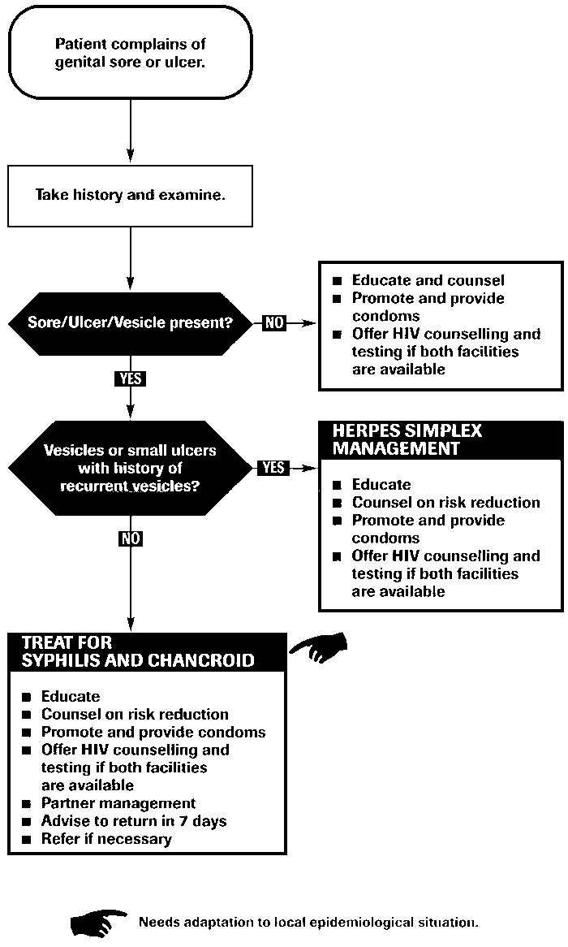
GENITAL ULCER SYNDROME

Slide 44
CHANCROID
SOFT CHANCRE
Haemophilus ducreyi
Small coccobacillus
Gram – negative
IP – 3 – 5 days

Slide 45
CHANCROID PRESENTATION
Genital ulcers
  Often Multiple, saucer shaped ulcers with erythematous halo
  With Sharply Defined, undermined edges
  Painful
  Non - indurated
  Exudative Base
  Bleed When traumatized
  (grey membrane)
Inguinal lymph nodes
  Tender
  Unilateral (> ⅔ )
  Unilocular abscess
  ( BUBO)
  Suppurative
  Drain spontaneously
  with single sinus formation

Slide 46
CLINICAL VARIANTS
Giant
Dwarf
Large serpiginous ulcer(ulcus molle serpiginous)
Pagedaemic ( ulcus molle gangrenosum)
Transient ( ulcus molle volant)
Follicular
Pseudo grranuloma inguinale
Mixed
Chancroidal chancroid

Slide 47
COMPLICATIONS
Painful adenitis
Abscess and fistula – inguinal
Kissing ulcer – extragenital spread
Esophageal lesion in HIV pt
Acute conjunctivitis
Bacterial superinfection
Scarring leads to phimosis
Erythema nodosum / EM
Enhance HIV transmission ( 3- 10 fold increase)

Slide 48
CHANCROID DIAGNOSIS
Smear examination
  Gram, Giemsa and Wright’s stains
  Rail – track appearance
Culture
  Own clotted blood, fetal calves
  Shoals of fish
Serology
  CFT
Skin test ( Ito-Reenstierna reaction)
Biopsy is seldom helpful

Slide 49
CHANCROID TREATMENT
Recommended regimen
■ Ciproﬂoxacin, 500 mg orally, twice daily for 3 days
OR
■ Erythromycin base, 500 mg orally, 4 times daily for 7 days
OR
■ Azithromycin, 1 g orally, as a single dose
Alternative regimen
■ Ceftriaxone, 250 mg by intramuscular injection, as a single dose

Slide 50
GRANULOMA INGUINALE
DONOVANOSIS
1st described by McLeod(1882) in Madras, India.
Etiology
  Klebsiella granulomatis
  Pleomorphic, Gram negative rod
  Safety pin appearance
  99% phylogenetic homology with K. pneumoniae
  Difficult to grow in culture

Slide 51
GRANULOMA INGUINALE(Donovanosis)
IP – 1 to 12 wks
Early lesion – vesicle or button like papule
Ulcer characteristics
      Sharply defined edges
      Serpiginous border
      Beefy red granulation
      tissues
      - Firm base
      Bleeds on touch
      Painless
      Pseudo bubo(subcut. granulomas )

Slide 52
GRANULOMA INGUINALE
Complications
  Phagedemic ulcerations
  Keloid scarring
  Elephantoid enlargement of penis and scrotum
  Stenosis of urethral, vaginal and anal orifices
  Metastatic spread to bones (vertebrae)

Slide 53
GRANULOMA INGUINALE: DIAGNOSIS
Tissue smears
  Most effective
  From edge of lesions
  Giemsa, Wright, Leishman or Gram stain
  CELLS OF GREEBLATS
  Silver stains
Culture
  Tissue and egg culture
Serum tests
  CFT
Biopsy
  Pseudo-epithelial hyperplasia of marginal epithelium
  Plasma cell infiltration of corium

Slide 54
GRANULOMA INGUINALE(DONOVANOSIS): TREATMENT
Recommended Regimen
Doxycycline 100 mg orally twice a day for at least 3 weeks and until all lesions have completely healed
Alternative Regimens
Azithromycin 1 g orally once per week for at least 3 weeks and until all lesions have completely healed
OR
Ciprofloxacin 750 mg orally twice a day for at least 3 weeks and until all lesions have completely healed
OR
Erythromycin base 500 mg orally four times a day for at least 3 weeks and until all lesions have completely healed
OR
Trimethoprim-sulfamethoxazole one double-strength (160 mg/800 mg) tablet orally twice a day for at least 3 weeks
and until all lesions have completely healed

Slide 55
HERPES GENITALIS
  DNA double stranded virus, linear
  125-250 Kb long, relatively big
  Enveloped
  Virion size 200 nm, relatively big
  9 HSVs, Ex. Varicella, EBV, CMV
  Diseases: Chickenbox, Mononucleosis, Hepatitis, Encephalitis
  Recurrent eye, mouth
  and genital lesions

Slide 56
FIRST EPISODE PRIMARY INFECTION
Clinical Manifestations
Characterized by multiple lesions that are more severe, last longer, and have higher titers of virus than recurrent infections
Typical lesion progression:
  papules → vesicles → pustules → ulcers → crusts → healed
Often associated with systemic symptoms including fever, headache, malaise, and myalgia
Illness lasts 2-4 weeks

Slide 57
HERPES GENITALIS
Multiple grouped vesicles
Erythematous sharp margin
Painful
Firm tender B/L lymph node

Slide 58
FIRST EPISODE PRIMARY INFECTION: WITHOUT TREATMENT
Clinical Manifestations
Numerous, bilateral painful genital lesions; last an average of 11-12 days
Local symptoms include pain, itching, dysuria, vaginal or urethral discharge, and tender inguinal adenopathy
Median duration of viral shedding detected by culture (from the onset of lesions to the last positive culture) is ~12 days
HSV cervicitis occurs in most primary HSV-2 (70-90%) and primary HSV-1 (~70%) infections

Slide 59
RECURRENT INFECTION
Clinical Manifestations
Prodromal symptoms are common (localized tingling, irritation) - begin 12-24 hours before lesions
Illness lasts 5-10 days
Symptoms tend to be less severe than in primary infection
Generally no lymphadenopathy
Usually no systemic symptoms
HSV-2 primary infection more prone to recur than
HSV-1

Slide 60
VIROLOGIC TESTS
Diagnosis
Viral culture (gold standard)
    Preferred test if genital ulcers or other mucocutaneous lesions are present
    Highly specific (>99%)
    Sensitivity depends on stage of lesion; declines rapidly as lesions begin to heal
    Positive more often in primary infection (80%–90%) than with recurrences (30%)
    Cultures should be typed
Polymerase Chain Reaction (PCR)
    More sensitive than viral culture
    Preferred test for detecting HSV in spinal fluid

Slide 61
VIROLOGIC TESTS
Diagnosis
Antigen detection (DFA or EIA)
    Fairly sensitive (>85%) in symptomatic shedders
    Rapid (2-12 hours)
    May be better than culture for detecting HSV in healing lesions
Cytology (Tzanck smear)
    Insensitive and nonspecific and should not be relied on for HSV diagnosis

Slide 62
TYPE-SPECIFIC SEROLOGIC TESTS
Diagnosis
Type-specific and nonspecific antibodies to HSV
IgM – acute infection
Ig G – chronic infection, persists for life long
HSV-2 antibody indicates anogenital infection
HSV-1 does not distinguish anogenital from orolabial infection

Slide 63
HERPES GENITALIS : TREATMENT
Recommended regimen for ﬁrst clinical episode
■ Acyclovir, 200 mg orally, 5 times daily for 7 days
OR
■ Acyclovir, 400 mg orally, 3 times daily for 7 days
OR
■ Valaciclovir, 1 g orally, twice daily for 7 days
OR
■ Famciclovir, 250 mg orally, 3 times daily for 7 days

Slide 64
HERPES GENITALIS : TREATMENT
Recommended regimen for recurrent infection
■ Acyclovir, 200 mg orally, 5 times daily for 5 days
OR
■ Acyclovir, 400 mg orally, 3 times daily for 5 days
OR
■ Acyclovir, 800 mg orally, twice daily for 5 days
OR
■ Valaciclovir, 500 mg orally, twice daily for 5 days
OR
■ Valaciclovir, 1000 mg orally, once daily for 5 days
OR
■ Famciclovir, 125 mg orally, twice daily for 5 days

Slide 65
HERPES GENITALIS : TREATMENT
Recommended regimen for suppressive therapy
■ Acyclovir, 400 mg orally, twice daily, continuously
OR
■ Valaciclovir, 500 mg orally, once daily
OR
■ Valaciclovir, 1000 mg orally, once daily
OR
■ Famciclovir, 250 mg orally, twice daily

Slide 66
HERPES GENITALIS : TREATMENT
Recommended regimen for severe disease
■ Acyclovir, 5–10 mg/kg IV, every 8 hours for 5–7 days or until clinical resolution is attained
Recommended regimen in severe herpes simplex lesions with coinfection with HIV
■ Acyclovir, 400 mg orally, 3–5 times daily until clinical resolution is attained
Recommended regimen for neonates
■ Acyclovir, 10 mg/kg intravenously, 3 times a day for 10–21 days

Slide 67
PRIMARY SYPHILIS
(The Chancre)
IP- 9-90 days, usually ~21 days.
Develops at site of contact/inoculation.
Ulcer ( HARD CHANCRE/HUNTARIAN CHANCRE/EROSIVE CHANCRE)
  single, painless, clean-based, indurated ulcer, with firm, raised borders. Atypical presentations may occur.
Site:
  Mostly anogenital, but may occur at any site (tongue, pharynx, lips, fingers, nipples.
Non-tender regional adenopathy
Very infectious.
May be darkfield positive but serologically negative.
Untreated, heals in several weeks, leaving a faint scar.

Slide 68
PRIMARY SYPHILITIC CHANCRE
Sharply demarcated
Elevated
Round/oval
Smooth clean looking floor
Indurated base
Painless
Firm discrete B/L LN

Slide 69
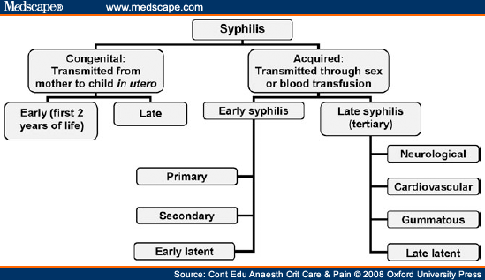

Slide 70
DIAGNOSIS OF SYPHILIS
Evaluation based on three factors:
  Clinical findings.
  Demonstration of spirochetes in clinical specimen.
  Present of antibodies in blood or cerebrospinal fluid.
More than one test should be performed.
No serological test can distinguish between other Treponemal infections.

Slide 71
LABORATORY TESTING
Direct examination of clinical specimen by dark-field microscopy or fluorescent antibody testing of sample.
Non-specific or non-treponemal serological test to detect reagin, utilized as screening test only.
Specific Treponemal antibody tests are used as a confirmatory test for a positive reagin test.

Slide 72
SERUM TEST FOR SYPHILIS
ANTIBODY | ANTIGEN | PRINCIPLE | TESTS
Non – specific ( anti- lipoidal) | Cardiolipin Cardiolipin coated particles | Complement fixation flocculation | CWR VDRL RPR ART
Group – specific ( all treponemes) | Extract of non – pathogenic trep. | Complement fixation | Reiter protein CFT
Specific (pathogenic treponemes) | Live trep. Dead trep. Disrupted trep. Disrupted trep. Coated RBCs | Immobilization Immunofluorescence Enzyme linked assays Haemagglutination | TPI FTA-Abs ELISA TPHA

Slide 73
SYPHILIS : TREATMENT
Recommended regimen
■ Benzathine benzylpenicillin,2.4 million IU by intramuscular injection, at a single session. Because of the volume involved, this dose is usually given as two injections at separate sites
Alternative regimen
■ Procaine benzylpenicillin,1.2 million IU by intramuscular injection, daily for 10 consecutive days

Slide 74
SYPHILIS : TREATMENT
Alternative regimen for penicillin-allergic non-pregnant patients
■ Doxycycline, 100 mg orally, twice daily for 14 days
OR
■ Tetracycline, 500 mg orally, 4 times daily for 14 days
Alternative regimen for penicillin-allergic pregnant patients
■ Erythromycin, 500 mg orally, 4 times daily for 14 days

Slide 75
 | Syphilitic chancre | Herpes genitalis | Chancroid | LGV | Donovanosis
IP | 9 – 90 days | 2-7 days | 1-5 days | 3 d- 6 wks | 1-4 wks
Initial lesion | Papule | Vesicle | Papule/ pustule | Papule , pustle/ Vesicle | Papule Subcutaneous nodule
Number | One | Multiple | Multiple | One | Variable
Size (mm) | 5-15 | 1-2 | 2-20 | 2-10 | Variable
Edge/margin | Sharply Demarcated, Round/oval | Erythematous Sharp | Undermined Ragged Irregular | Elevated Round Oval | Elevated Irregular
Depth | Superficial/ Deep | Superficial | Excavated and Deep | Superficial | Elevated Irregular
Floor | Smooth, Clean looking | Serous Erythematous | Purulent Necrotic | Variable | Beefy red granulation
Base | Indurated | None | Soft | Firm | Firm
Tenderness | Painless | Common | Very tender | Variable | Uncommon
LNpathy | Firm , discrete Shotty, Bilateral | Firm tender Bilateral | Tender, unilocular U/L, single sinus | Tender , Multiloculated rupture from multiple sinuses | Pseudobubo Unilateral

Slide 76
CHILDREN, ADOLESCENTS AND SEXUALLY TRANSMITTED INFECTIONS
Sexual abuse of children and adolescents has come to be recognized as a serious social problem.
Infection may be asymptomatic.
If remains undiagnosed and untreated may result in an unanticipated complication at a later stage and may be transmitted to others.
The identification of a sexually transmissible agent in a child beyond the neonatal period, in the vast majority of cases, is suggestive of sexual abuse
Most cases of sexual abuse involve relatives, friends and other adults in close and legitimate contact with the child or adolescent.

Slide 77

THANK YOU

Slide 78

SYNDROMIC APPROACH OF
URETHRAL DISCHARGE IN MALES
Dr AMRITA KUMARI
RESIDENT,DERMATOLOGY
BASE HOSPITAL,LKO

Slide 79
Objectives
To review the facts: STIs enhances the acquisition and transmission of HIV
To review the syndromic approach to management
To demonstrate the use of the algorithms

Slide 80
How do STIs increase HIV transmission?
Reducing physical/mechanical barriers (disruption of epithelium)
Increasing HIV in genital lesions, semen or both ( even if VL is undetectable)
Evoking a more infectious HIV variant
Increasing the number of receptor cells or the density of receptors per cell

Slide 81
STI Case Management
AETIOLOGIC:
  Lab isolation of the causative organism
CLINICAL ASSESSMENT:
  “Aetiology” based on clinical appearance
SYNDROMIC:
  Syndromes – clinical symptoms, signs, risk assessment, rapid and cost-effective tests
MIXED:
  All of the above; but which give immediate results for “point of first contact” management

Slide 82
STI – Syndromic Case Management
ADVANTAGES:
Identifies and treats by signs & symptoms
Syndromes easily recognised clinically
Small number of clinical syndromes
Treatment given for majority of organisms
Simple and cost-effective
Valid, feasible, immediate Treatment
Risk assessment increases performance

Slide 83
STI – Syndromic Case Management
DISADVANTAGES:
Tendency to overtreat – justifiable in high prevalence settings (>20%)
Decreased specificity
Overuse of expensive drugs
Asymptomatic cases not fully addressed even with risk assessment
Management of cervical infections problematic
Vaginal discharge algorithm performs poorly in low prevalence settings e.g., ANC, FP

Slide 84
STI – Syndromic Case Management
REQUIREMENTS:
Adequate medical history
Good sexual history
Complete STI clinical examination
Management guidelines
Good supply of effective drugs

Slide 85
Essential Steps In STI Care Management*
Syndrome
Assessment
Contact tracing
Compliance
Confidentiality
Condom use
Counseling
(diagnostic tools)
Diagnosis
Treatment
5Cs
(screening tests)
Risk
Assessment
* Adapted from Holmes & Ryan
Notes:
An Integrated Approach to SCM begins with:
RA & SA [sexual behaviours, specific exposures, sociodemographic and other markers of high risk]. History of RH and past STIs.
Depending on Resources for Testing results may lead to:
Confirmatory diagnostic tests (in symptomatic patients).
Screening tests (in asymptomatic patients at high risk).
In most settings, Tx of symptomatic patients is started on a syndromic presumptive basis:
Industrialised countries: while waiting on test results.
Or on basis of rapid tests: Gram, WP, TRUST, etc.
After Tx, SCM concludes with the 4 Cs (5 if confidentiality is added).
THE RULE OF 5s:
See: 5 risk factors; 5 steps; 5 prevention messages; 5 PID referrals; 5 PID treatment indicators.

Slide 86
Risk Assessment Include:
Sexual behaviour
Specific exposures
Socio demographics/other high risk markers:
  young age
  marital status: not living with steady partner
  partner problems
History of reproductive health
History of past STI

Slide 87
STI Control Program
Basic activities of STI prevention activities
(for primary and secondary prevention strategies)
  Primary infection: prevent new infection
  Secondary prevention: prevent complication

Slide 88
WHO recommendation for STI control Program
Primary prevention measures
1. Health education and promotion of safer sex and risk reduction
2. Promotion of condoms
(Wide spread availability and affordability of Condom)
3. Information campaigns on the association between HIV and STI

Slide 89
Secondary prevention
1. Promotion of early health care seeking behavior
2. Accessible, effective and acceptable care -Integration of STD care into all basic health care facilities
3. Promotion of early use of health care services
( STD patients and their partners)
4.Early detection and treatment of asymptomatic infections through case finding
Screening for asymptomatic patients
eg, SY serology in pregnant women, CT tests in CSWs

Slide 90
Basic model for the reproductive rate of new infection in a population
R0 = βDc
Basic reproductive rate (Ro):
Average of likelihood of transmission of the disease pathogen (β)
Average rate of exposure of susceptible to infectious people in the population (C)
Average duration of infectiousness (D)

Slide 91
Intervention points according to the determinants of STI transmission
Exposure of a susceptible person
C
β
Intervention point
Acquisition of infection
Persistence and infectivity of infection
D

Slide 92
Intervention that reduce exposure to STI (C)
Target on determinants of Sexual behavior
Potential activities:
  Promotion of delayed initiation of sex among youth adolescents, abstinence, monogamy, reduce rates of sex partner change, avoidance of concurrent sexual partnerships
  Clinic level Health education for risk reduction
  Community-level interventions to modify community norms toward less acceptance of specific, high-risk behaviors.
  School Health education program

Slide 93
Intervention that could shorten duration of infectivity (D)
Active case finding through widespread access to acceptable and good quality clinical care, screening, and contact tracing
Prompt and effective diagnosis and treatment for symptomatic persons
Clinical practice guideline (emphasis on syndromic or rapid test)
Screening practices for asymptomatic infection
Promoting awareness among potentially infected persons (having symptom of STI)
“Epidemiologic treatment” selective mass treatment
Outbreak investigation (rare disease)

Slide 94
Intervention that reduce efficacy of STI transmission during sexual exposure (β)
Increase consistence and correct use of barrier contraceptive methods
  (eg, condom, spermicides)
Decrease specific risky sexual practices
  (eg, penetrative sex)
Vaccine
  Hepatitis B
  HPV

Slide 95
Vertical program and horizontal program
Advantage
Vertical (STI Clinic) Horizontal (general care)
-Well equipped clinic
-Well train staff
-Good diagnostic services
-More accessible
-Used more by women
-Less stigmatizing

Slide 96
Disadvantage
Vertical Horizontal
- Access often restricted for much of population
- Stigmatizing
- Expensive
- Quality of patient care can be variable
- Overwork and poorly trained staff
Poor diagnostic services
Limited drugs

Slide 97
Good quality care and management
- appropriated drug (efficacy, low cost)
- education
- counseling
- treatment of sexual partners
Treatment: rely on
- efficacy
- acceptability
- low cost
- antibiotic resistance considerations

Slide 98
Partner notification
Partner management
- epidemiology treatment
- Laboratory diagnosis
(if available)
- education and counseling

Slide 99
Targeted interventions
Sex workers, MSM and injecting drug users.
STI services for these and other high-risk population groups need to be scaled up universally, making them a regular component of primary and sexual and reproductive health care.

Slide 100
Intervention in Commercial Sex workers

Slide 101
STI services for CSW
Periodic health checkup
  Clinic (government, private)
  Mobile Clinic
Effective treatment ( MININUM OR FREE OF CHARGE)
  Individual
  Mass treatment

Slide 102
URETHRAL DISCHARGE
URETHRAL DISCHARGE OR DYSURIA
HISTORY,EXAMINATION
MILK URETHRA IF REQUIRED
EDUCATE AND COUNSEL
PROMOTE & PROVIDE CONDOMS
OFFER HIV COUNSELING AND TESTING IF BOTH FACILITIES ARE AVAILABLE
REVIEW IF SYMPTOMS PERSIST
NO
NO
DISCHARGE
ANY OTHER
GENITALDISEASE
YES
YES
TREAT FOR GONORRHOEA & CHLAMYDIA
EDUCATE AND COUNSEL
PROMOTE AND PROVIDE CONDOMS
OFFER HIV COUNSELLING & TESTING IF BOTH FACILITIES ARE AVAILABLE
PARTNER MANAGEMENT
ADVISE TO RETURN IN SEVEN DAYS IF SYMPTOMS PERSIST
USE APPROPIRATE FLOW CHART

Slide 103
PERSISTENT OR RECURRENT URETHRAL DISCHARGE
PERSISTENT OR RECURRENT URETHRAL DISCHARGE OR DYSURIA
EDUCATE AND COUNSEL
PROMOTE & PROVIDE CONDOMS
OFFER HIV COUNSELING AND TESTING IF BOTH ARE AVAILABLE
HISTORY,EXAMINATION
MILK URETHRA IF REQUIRED
NO
ANY OTHER
GENITALDISEASE
DISCHARGE CONFIRMED
NO
DOSE Hx CONFIRM RE-INFECTION
YES
REPEAT
URETHRAL
DISCHARGE
TREATMENT
USE
APPROPIRATE
FLOW
CHART
TREAT FOR TRICHOMONAS VAGINALIS
EDUCATE AND COUNSEL
PROMOTE AND PROVIDE CONDOMS
MANAGE AND TREAT PARTNER
ADVISE TO RETURN IN SEVEN DAYS IF SYMPTOMS PERSIST
YES
IMPROVED
EDUCATE AND COUNSEL
PROMOTE & PROVIDE CONDOMS
OFFER HIV COUNSELING AND TESTING IF BOTH ARE AVAILABLE
NO
REFER

Slide 104
Urethritis
SYMPTOMS
Urethral discharge
Dysuria
Itching at end of urethra
Urethral discharge
Increased number of PMNL on Gram stain of a urethral smear or in the sediment of the first-voided urine
SIGNS
LABORATORY
Notes:
- This may be less of a problem with the single dose extended release
microsphere formulation which bypass motilin receptors in the upper GIT
and releases azithromycin in the lower GIT
104

Slide 105
Epidemiology of urethritis
Common STI syndrome among men – 60% among STI clinic.
NGU cases exceed gonococcal urethritis
For both GU and NGU, peak age range is 20-24 years, followed by 15-1 and then 25-29
Notes:
- This may be less of a problem with the single dose extended release
microsphere formulation which bypass motilin receptors in the upper GIT
and releases azithromycin in the lower GIT
105

Slide 106
Aetiology of urethritis
Gonococcal
Neisseria gonorrhoeae
Chlamydia trachomatis (15-40%)
Mycoplasma genitalium (15-25%)
Trichomonas vaginalis (5-15%)
Ureaplasm urealyticum (<15%)
Herpes simplex (2-3%)
Adenovirus (2-4%)
Haemophilus spp. (rare)
Unknown
Non-gonococcal
Notes:
- This may be less of a problem with the single dose extended release
microsphere formulation which bypass motilin receptors in the upper GIT
and releases azithromycin in the lower GIT
106

Slide 107
Male Genital Infections
ETIOLOGY OF NGU
  INITIAL, NON-RECURRENT, DOCUMENTED URETHRITIS
  Chlamydia trachomatis 20-40%
  Mycoplasma genitalium 10-20%
  Other and unknown 30-50%
  Ureaplasma urealyticum? 10-30%?
  Normal flora (oral, vaginal)? 10-20%?
  U. parvum 0
  Trichomonas vaginalis 0-5%
  Adenovirus 0-5%
  Herpes simplex virus 0-5%
  See Bradshaw et al, JID 2006;193:336-45

Slide 108
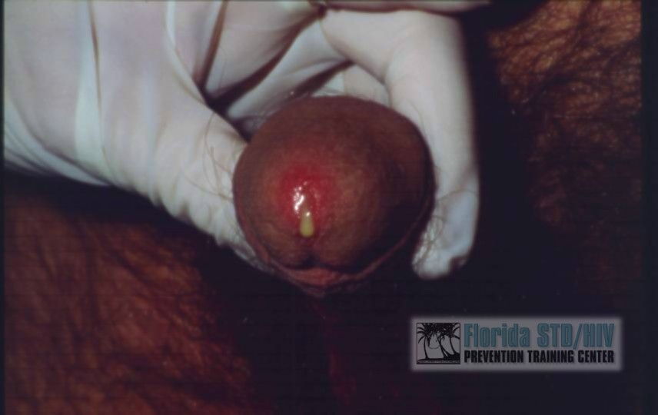
Neisseria gonorrhoeae
Gram negative diplococcus
Asymptomatic and minimally symptomatic infections occur in the community – may be associated with AHU auxotrophs (US studies)
Increasing antimicrobial resistance
Concurrent C. trachomatis infection common
Notes:
- This may be less of a problem with the single dose extended release
microsphere formulation which bypass motilin receptors in the upper GIT
and releases azithromycin in the lower GIT
108

Slide 109
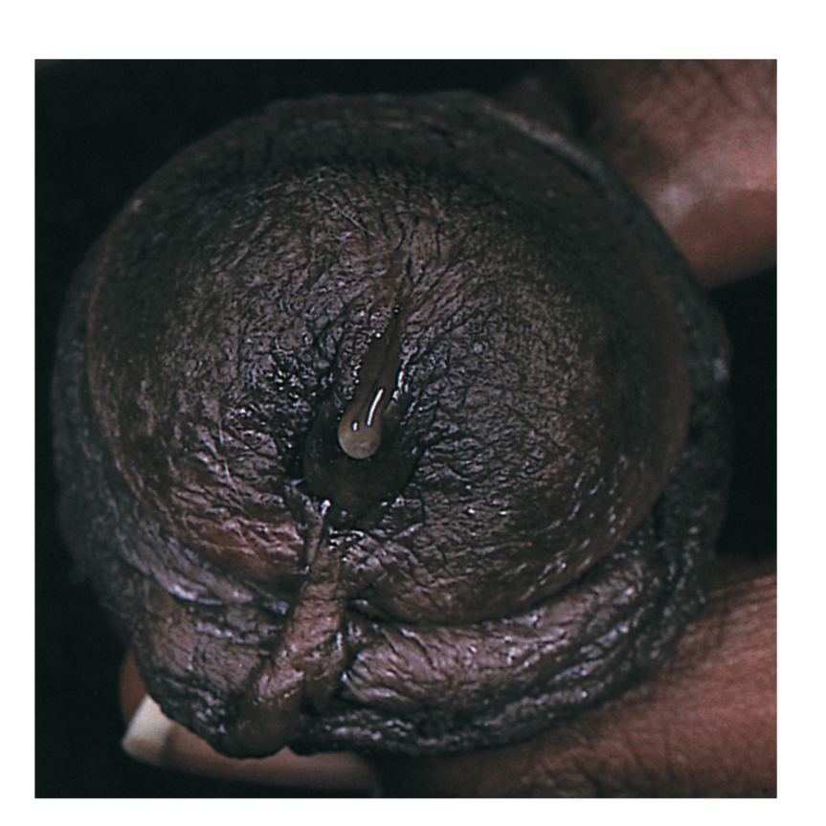
Chlamydia trachomatis
Gram negative obligate intracellular bacterium
Common cause of post-gonococcal urethritis
Less common among MSM
Isolated from urethras of:
- 25-60% (usually 30-40%) NGU cases
- 4-35% (usually 15-25%) GC cases
- 0-7% of men without urethritis
Notes:
- This may be less of a problem with the single dose extended release
microsphere formulation which bypass motilin receptors in the upper GIT
and releases azithromycin in the lower GIT
109

Slide 110
Mycoplasma genitalium
Intracellular bacterium without a cell wall
Pooled data from 19 studies:
NGU (21.1%) vs. normal men (6.7%);
OR 3.8 (95% CI: 3.0 - 4.9)
CT negative NGU (21.7%) vs. normal men (6.0%); OR 5.15 (95% CI: 3.6 – 7.4)
Genotyping analyses of concurrently infected couples supports sexual transmission
Notes:
- This may be less of a problem with the single dose extended release
microsphere formulation which bypass motilin receptors in the upper GIT
and releases azithromycin in the lower GIT
110

Slide 111
Trichomonas vaginalis
Flagellated protozoon
Initial studies using microscopy +/- culture showed an association of T. vaginalis with NGU
Organism frequently found in urethra of both symptomatic and asymptomatic men by NAAT – association of T. vaginalis with NGU vs. colonisation less clear
T. vaginalis more important as a cause of NGU among African men as high prevalence of trichomoniasis
Notes:
- This may be less of a problem with the single dose extended release
microsphere formulation which bypass motilin receptors in the upper GIT
and releases azithromycin in the lower GIT
111

Slide 112
Ureaplasma species
Higher isolation rates from men with C. trachomatis negative NGU than among C. trachomatis positive NGU/no urethritis cases
Isolated more often from men with first episode NGU than those with a history of previous NGU episodes or men without urethritis
Intraurethral inoculation of Ureaplasma sp. into non-human primates associated with increased numbers of PMNL in endourethral smears (some animals)
Limited studies suggest U. urealyticum, rather than U. parvum, is associated with NGU
Notes:
- This may be less of a problem with the single dose extended release
microsphere formulation which bypass motilin receptors in the upper GIT
and releases azithromycin in the lower GIT
112

Slide 113
Other bacterial causes of NGU
Most studies have not revealed differences in aerobic and anaerobic urethral flora between CT+/CT- NGU cases
Haemophilus influenzae and Haemophilus parainfluenzae are rare causes of NGU
Neisseria meningitidis may cause NGU – transmission by orogenital sex supported by PFGE in one case study
Association between NGU in males and BV in females – further research required to identify responsible bacteria
Notes:
- This may be less of a problem with the single dose extended release
microsphere formulation which bypass motilin receptors in the upper GIT
and releases azithromycin in the lower GIT
113

Slide 114
Viral causes of NGU
Urethritis occurs in 30% of men with primary HSV (less common in recurrent HSV)
Recent PCR-based studies suggest HSV detected in 2-3% of cases
In Australia, Bradshaw et al. (2006) demonstrated:
- significantly more HSV detected in 329 NGU cases compared to 307 controls
- HSV-1 was more commonly detected than HSV-2
- unprotected oral sex was a risk factor
Adenoviruses reported among men with urethritis in Australia and USA – seasonal, associated with receptive oral sex, may see co-existent conjunctivitis
Notes:
- This may be less of a problem with the single dose extended release
microsphere formulation which bypass motilin receptors in the upper GIT
and releases azithromycin in the lower GIT
114

Slide 115
Non-STI causes of NGU
Urinary tract infection
Bacterial prostatitis
Urethral stricture (catheterisation/instrumentation)
Phimosis
Congenital abnormalities
Chemical irritation
Tumours
Stevens Johnson syndrome
Role of masturbation, “milking” urethra, frequency of sexual activity, coffee, alcohol, foods unclear
Notes:
- This may be less of a problem with the single dose extended release
microsphere formulation which bypass motilin receptors in the upper GIT
and releases azithromycin in the lower GIT
115

Slide 116
Asymptomatic STIs - The hidden epidemic
INFECTION | SYMPTOMATIC FOR STIs (n = 27) |  | ASYMPTOMATIC FOR STIs (n = 274) |  | OVERALL (n = 301)
 | No. | % | No. | % | No. | %
Neisseria gonorrhoeae infection | 6 | 22.2% | 13 | 4.7% | 19 | 6.3%
Chlamydia trachomatis infection | 1 | 3.7% | 25 | 9.1% | 26 | 8.6%
Trichomonas vaginalis infection | 6 | 22.2% | 37 | 13.5% | 43 | 14.3%
Mycoplasma genitalium infection | 2 | 7.4% | 18 | 6.6% | 20 | 6.6%
Only 9% of men were symptomatic for STIs

Slide 117
Clinical presentation
Characteristic | Gonorrhoea | NGU
Discharge | Profuse and purulent | Scant and muco-purulent, may be absent
Dysuria | +++ | + (+++ with HSV/adenovirus)
Incubation period | 2-6 days | 1-5 weeks
Health seeking behaviour | early | late
Asymptomatic cases | +/- | ++
Notes:
- This may be less of a problem with the single dose extended release
microsphere formulation which bypass motilin receptors in the upper GIT
and releases azithromycin in the lower GIT
117

Slide 118
Urethral discharge

Slide 119
Bacterial verus Viral NGU
 |  | CT | MG | Adeno | HSV
Mod/severe dysuria |  | 28% | 20% | 69% | 78%
Meatal erythema |  | 33% | 26% | 92% | 89%
Concider acyclovir in patients with proiment dysuria and meatal inflammation?
Bradshaw C et al. JID 2006;193:336-45

Slide 120
Syndromic management approach
Syndromic management approach for all STI syndromes decreased HIV incidence by 38%
Works well for male urethral discharge syndrome
Avoids lab tests but regular microbiological surveillance is part of the syndromic approach
Treatment must cover gonorrhoea and chlamydial infection – now also important to consider M. genitalium and T. vaginalis infection.
Notes:
- This may be less of a problem with the single dose extended release
microsphere formulation which bypass motilin receptors in the upper GIT
and releases azithromycin in the lower GIT
120

Slide 121
Syndromic management approach
Educate, ensure compliance and counsel
Promote abstinence during the course of treatment
Promote and demonstrate condom use, provide condoms
Stress importance of partner treatment and issue one notification slip for each sexual partner, follow up partner treatment during review visit
Offer HIV counselling and testing, repeat HIV test after 3 months (HIV negative paitients)
Notes:
- This may be less of a problem with the single dose extended release
microsphere formulation which bypass motilin receptors in the upper GIT
and releases azithromycin in the lower GIT
121

Slide 122
Diagnosis of urethritis
Gram stain microscopy (GC, NGU) [≥ 5 PMNL/hpf x 5]
Rapid tests (CT, TV – issues with current GC assays)
Culture (GC CT, TV, Ureaplasmas, HSV, adenovirus)
ELISA (CT)
Monoclonal antibody tests (GC, CT)
Nucleic acid amplification tests (GC, CT, TV, MG, HSV, Ureaplasma urealyticum)
- PCR (Roche + others), SDA (Abbott) and TMA (GenProbe)
commercial assays
- in-house multiplex assays
Notes:
- This may be less of a problem with the single dose extended release
microsphere formulation which bypass motilin receptors in the upper GIT
and releases azithromycin in the lower GIT
122

Slide 123
Specimen collection
Gram
staining Transport media(Amies/Stuart)
Mod.Thayre martin media
(5% co2, 35⁰C ,24-48hr)

Slide 124
Diagnosis
Non-culture tests
  Amplified tests (NAATs)
    Polymerase chain reaction (PCR) (Roche Amplicor)
    Transcription-mediated amplification (TMA) (Gen-Probe Aptima)
    Strand displacement amplification (SDA) (Becton-Dickinson BD ProbeTec ET)
  Non-amplified tests
    DNA probe (Gen-Probe PACE 2, Digene Hybrid Capture II)

Slide 125
Laboratory Tests for Chlamydia
Drips
Tissue culture has been the standard
  Specificity approaching 100%
  Sensitivity ranges from 60% to 90%
Non-amplified tests
  Enzyme Immunoassay (EIA), e.g. Chlamydiazyme
    sensitivity and specificity of 85% and 97% respectively
    useful for high volume screening
    false positives
  Nucleic Acid Hybridization (NA Probe), e.g. Gen-Probe Pace-2
    sensitivities ranging from 75% to 100%; specificities greater than 95%
    detects chlamydial ribosomal RNA
    able to detect gonorrhea and chlamydia from one swab
    need for large amounts of sample DNA

Slide 126
Laboratory Tests for Chlamydia (continued)
Drips
DNA amplification assays
  polymerase chain reaction (PCR)
  ligase chain reaction (LCR)
Sensitivities with PCR and LCR 95% and 85-98% respectively; specificity approaches 100%
LCR ability to detect chlamydia in first void urine

Slide 127
Treatment of Uncomplicated Gonorrhea
RECOMMENDED
Ceftriaxone 125-250 mg IM
Cefixime 400 mg PO
Cefpodoxime 400 mg PO
Ciprofloxacin 500 mg PO
Ofloxacin 400 mg PO
Levofloxacin 250 mg PO
PLUS
Azithromycin
or
Doxycycline
No longer recommended
Include as syndromic
management of urethritis

Slide 128
Gonococcal Isolate Surveillance Project (GISP) — Percent of Neisseria gonorrhoeae isolates with resistance or intermediate resistance to ciprofloxacin, 1990–2003
Note: Resistant isolates have ciprofloxacin MICs ≥ µg/ml. Isolates with intermediate resistance have ciprofloxacin MICs of 0.125 - 0.5 µg/ml. Susceptibility to ciprofloxacin was first measured in GISP in 1990.

Slide 129
Co-treatment for
Chlamydia trachomatis
Management
If chlamydial infection is not ruled out:
Azithromycin | 1 g | Orally | Once or
Doxycycline | 100 mg | Orally | Twice a day for 7 days

Slide 130
Treatment of NGU
Azithromycin 1.0 g, single dose
  Chlamydia efficacy 90-95%
  Clinical efficacy ~90%
  M. genitalium: Usually effective but apparent risk of inducible resistance
Doxycycline 100 mg po BID x 7 days
  Chlamydia efficacy >98%
  Clinical efficacy ~90%
  M. genitalium Not effective
Alternatives: Other tetracyclines, erythromycin, fluoroquinolones

Slide 131
Management of Sex Partners of Men with NGU
Goals
  Treat/prevent chlamydia
  Prevent reinfection
Treat with same regimen as index case
Examine for other STDs, if practical
Partner treatment of unknown benefit in recurrent or persistent NGU

Slide 132
Recurrent and Persistent NGU
Symptoms may take 10-14 days to completely resolve
Symptoms persist or recur within 4-6 weeks in 10-15%
Evaluation
  Document urethritis
  Otherwise, no treatment
Treatment
  Retreat with opposite drug (AZM or doxy)
  Metronidazole or tinidazole
No documented need to retreat partners

Slide 133
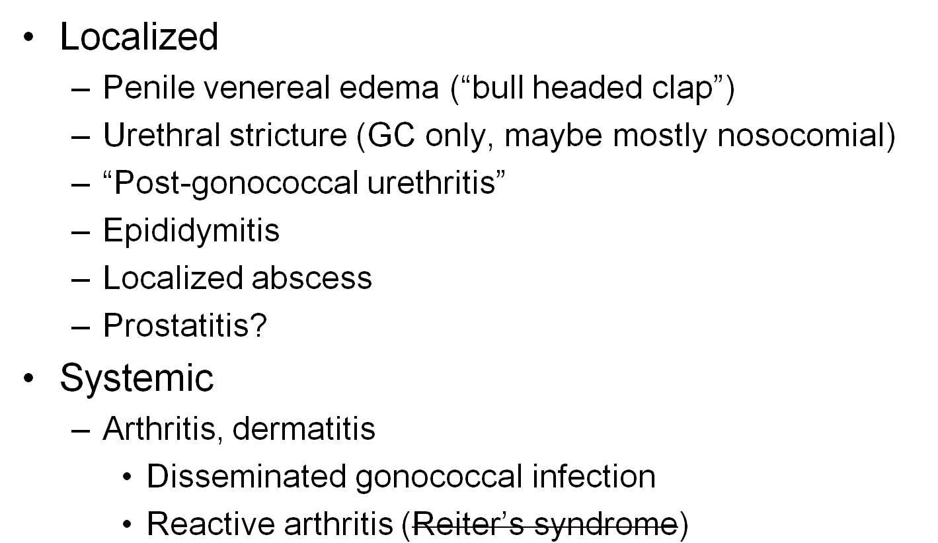
Complications of Male Urethritis

Slide 134
Management of epididymo-orchitis
STI-related:
Ceftriaxone 250mg imi stat
Doxycycline 100mg po 12 hourly x 14 days
UTI-related:
Ciprofloxacin 500mg po 12 hourly x 10 days
or
Ofloxacin 400mg po 12 hourly x 10 days
Consider IV antibiotics if systemic illness
No improvement or clinical progression:
Review lab tests and susceptibility data
Assess for complications (ultrasound &/or surgery)
Consider alternative diagnosis, e.g. TB
Scrotal support enhances lymphatic and venous drainage
Notes:
- This may be less of a problem with the single dose extended release
microsphere formulation which bypass motilin receptors in the upper GIT
and releases azithromycin in the lower GIT
134

Slide 135
Special Considerations:
Pregnancy
Management
Pregnant women should NOT be treated with quinolones or tetracyclines
Treat with alternate cephalosporin
If cephalosporin is not tolerated, treat with spectinomycin 2 g IM once

Slide 136
Alternative Regimens
Management
Spectinomycin 2 g in a single IM dose
Single-dose cephalosporin regimens
  Ceftizoxime 500 mg IM
  Cefoxitin 2 g IM with Probenecid 1 g orally

Slide 137
Follow-Up
Management
A test of cure is not recommended if a recommended regimen is administered.
If symptoms persist, perform culture for N. gonorrhoeae.
  Any gonococci isolated should be tested for antimicrobial susceptibility.

Slide 138
Screening
Prevention
Pregnancy
  A test for N. gonorrhoeae should be performed at the first prenatal visit for women at risk or those living in an area in which the prevalence of N. gonorrhoeae is high.
  Repeat test during the 3rd trimester for those at continued risk.
Other populations can be screened based on local disease prevalence and patient’s risk behaviors.

Slide 139
Partner Management
Prevention
Evaluate and treat all sex partners for N. gonorrhoeae and C. trachomatis infections if contact was within 60 days of symptoms or diagnosis.
If a patient’s last sexual intercourse was >60 days before onset of symptoms or diagnosis, the patient’s most recent sex partner should be treated.
Avoid sexual intercourse until therapy is completed and both partners no longer have symptoms.

Slide 140
Reporting
Prevention
Laws and regulations in all states require that persons diagnosed with gonorrhea are reported to public health authorities by clinicians, labs, or both.

Slide 141
Patient Counseling/Education
Prevention
Nature of disease
  Usually symptomatic in males and asymptomatic in females
  Untreated infections can result in PID, infertility, and ectopic pregnancy in women and epididymitis in men
Transmission issues
  Efficiently transmitted
Risk reduction
  Utilize prevention strategies

Slide 142

CONCLUSION

Slide 143

THANK
YOU

