Slide 1
Sexually transmitted infections-our experience
Dr Swastika Suvirya Assistant Professor
Dermatology, Venereology & Leprosy KGMU

Slide 2
Approaches to STI Case Management
Traditional clinical approach
Laboratory assisted approach
Syndromic approach

Slide 3
Comparison of Approaches
Traditional clinical approach | Laboratory-assisted approach | Syndromic approach
Interviews patient for symptoms | Interviews patient for symptoms | Interviews patient for symptoms Picks the relevant flowchart
Does a clinical examination | Does a clinical examination | Does a clinical examination for finding signs Uses flowcharts as tools
Uses clinical experience to identify symptoms and signs of a specific STI | Collects samples for testing/ refers to laboratory for tests | Syndrome identification
Treats for the specific STI | Treats for STIs identified by the results of the laboratory tests | Treats patients for the most common organisms responsible for that syndrome (usually 2-3 STIs)
Educates patients for compliance and prevention, promotes condoms and emphasizes the importance of partner management | Educates patients for compliance and prevention, promotes condoms and emphasizes the importance of partner management | Educates patients for compliance and prevention, promotes condoms and emphasizes the importance of partner management

Slide 4
Syndromic Approach
Diagnosis is based on the identification of syndromes, which are combinations of the symptoms the patient reports and the signs the health care provider observes.
The recommended treatments are effective for all the diseases that could cause the identified syndrome.
Provides single dose treatment
Comprehensive -patient education, counseling

Slide 5
Syndromic Management- Advantages
Fast—one visit.
Highly effective for selected syndromes.
Relatively inexpensive
No need for patient to return for lab results.
Scientifically tested
Easy for health workers to learn & practice.
Integrated into other primary health care services easily.
Can be used by providers at all levels

Slide 6
Syndromic Management- Limitations
Not useful in asymptomatic.
Over-treatment
Financial cost
Increases antibiotic resistance
Not effective in some cases

Slide 8
Key Achievements of National AIDS Control Programme during 2013-2014
Targeted Interventions for High Risk Groups:
OBJECTIVE: to improve health seeking behaviour of High Risk Groups (HRG) & reduce their risk of acquiring STI and HIV.
HRGs include Female Sex Workers (FSW) Men who have Sex with Men (MSM) Transgenders (TG)/ Hijras Injecting Drug Users (IDU) http://naco.gov.in/NACO/Divisions/STI__RTI_Services2. Accessed on 6th May 2015.

Slide 9
Bridge populations include High risk behaviour Migrants Long Distance Truckers.
TI provides services such as behaviour change communication, condom promotion, safe needles and syringes (for people who inject drugs), STI care, referrals for HIV testing, Syphilis testing and Referral for ART.
Sexually transmitted infections (STI) rank among the top five conditions for which sexually active adults seek health care in the developing countries.
http://naco.gov.in/NACO/Divisions/STI__RTI_Services2. Accessed on 6th May 2015.

Slide 10
STI/RTI prevalence (2003), ≥6% of population in India annually+.
Early diagnosis, treatment and management of STI/RTI including education will reduce transmission of STI/RTI and HIV*.
NACP III -15 million STI/RTI episodes annually.
NACO 1131 designated STI/RTI clinics -free standardized STI/RTI services.
“Suraksha Clinics” +http://naco.gov.in/NACO/Divisions/STI__RTI_Services2. Accessed on 6th May 2015. *Lancet 1995; 346:530-536

Slide 11
STI/RTI Control and Prevention Programme
A total of 67.68 lakh STI/RTI cases have been managed against the target of 68 lakh during 2013- 2014.
Of the 23 lakh DSRC attendees screened for Syphilis, 14,507 (0.62%) were found to be sero-reactive.
Of the 15 lakh DSRC attendees referred to Integrated Counseling and Testing Centres, 18,959 (1.25%) tested positive for HIV infection. http://naco.gov.in/NACO/Divisions/STI__RTI_Services2. Accessed on 6th May 2015.

Slide 12
Failure to diagnose and treat STI/RTI in women of reproductive age group may result in infertility, fetal wastage, ectopic pregnancy, ano-genital cancer and premature death, as well as neonatal and infant infections.
STIs and HIV have same routes of transmission and occur in individuals practicing similar type of high risk behaviour i.e. unsafe sexual intercourse.
http://naco.gov.in/NACO/Divisions/STI__RTI_Services2. Accessed on 6th May 2015.

Slide 13
Presence of a STI/RTI in the sexual partner increases the risk of acquisition of HIV from an infected partner by 8-10 fold.
The presence of HIV affects the clinical presentation, course, diagnosis as well as management of STI/RTI.
Integration with the RCH-II programme.
Private sector has been involved http://naco.gov.in/NACO/Divisions/STI__RTI_Services2. Accessed on 6th May 2015.

Slide 14
Statistics:
A total of 1,234 patients attended the Suraksha Clinic in Dermatology OPD from April 2014-March 2015.
Out of these, 243 patients were diagnosed with an STI.
Out of these, 13(5.34%) were sero-positive for HIV-1.

Slide 15
Statistics:
S.no. | Diagnosis | No. of patients | %
1. | Genital warts | 35 | 14.40
2. | Herpes genitalis | 28 | 11.52
3. | Vaginal discharge | 23 | 9.46
4. | Urethral discharge | 21 | 8.64
5. | Genital Ulcer Disease | 13 | 5.34
6. | Lower abdominal pain | 9 | 3.70
7. | Syphilis | 7 | 2.88
8. | Others | 107 | 44.03

Slide 17
KITS AVAILABLE IN STI CLINIC
http://naco.gov.in/NACO/Divisions/STI__RTI_Services2. Accessed on 6th May 2015.

Slide 19
What is special here?
A lab technician being provided by the department of Microbiology, who collects the samples on the spot and personally takes them to so that the patient’s investigations are done in the department itself and etiological diagnosis is possible in maximum cases.
In cases of urethral discharge, the specific media is brought in the Department of Dermatology and samples taken there itself.

Slide 20
CASE series
We report 5 cases of purulent urethral discharge and pain during micturition.
There was history of paid sexual contact, unprotected, within the period of previous 10 days in all patients. All were bisexual.
On examination, purulent discharge was seen at the tip of the urethral meatus.
Gram staining of the discharge showed gram negative intracellular diplococci.

Slide 22
Swabs taken from the discharge were directly inoculated in chocolate agar(Biomerieux)and incubated in a candle jar at 35°C.
Culture from the discharge showed growth of N.gonorroea. Bacterial isolates were then lyophilized and sent to apex laboratory for confirmation and antimicrobial sensitivity by calibrated dichotomous sensitivity test( CDS) method recommended by WHO

Slide 23
http://www.popsci.com/science/article/2011-07. Accessed on Jun 7 2015

Slide 24
DISC | CONCENTRATION (μg) | CATEGORY |  |  |  |  | MIC
 |  | P1 | P2 | P3 | P4 | P5 | P1 | P2 | P3 | P4 | P5
Penicillin | 0.5 | R-PPNG | R-PPNG | LS | LS |  | 24 | 32 | 0.125 | 0.5
Ceftriaxone | 0.5 | S | S | S | S |  | 0.008 | 0.004 | 0.002 | <1.016
Spectinomycin | 100 | S | S | S | S |  | 16 | 06 | 04 | 8
Tetracycline | 10 | TRNG | TRNG | LS(TRNG) | TRNG |  | 24 | 12 | 0.5 | 16
Ciprofloxacin | 01 | HLR | HLR | HLR | R |  | 04 | 08 | >32 | 4
Nalidixic acid | 30 | R | R | R | R |  | - | - | - | -
Cefopodoxime | 10 | S | S | S | S |  | 0.016 | 0.016 | 0.016 | 0.032
Cefexime & other cephalosporins | 5 | S | S | S | S |  | <0.016 | <0.016 | <0.016 | <0.016
Azithromycin | 15 | S | S | S | S |  | 0.125 | 0.094 | 0.125 | 0.125

Slide 25
Based on the culture and sensitivity reports, all the patients were treated with azithromycin 1 gm stat and cefixime 400 mg stat. (KIT 1),
Patients were counseled regarding safer sexual practices.
Partner notification and contact tracing was done.
Patients reported with improvement at next follow up visit.

Slide 26
CASE 2
A 27 yr old female presented with foul smelling vaginal discharge, burning micturition and dyspareunia.
On examination, frothy profuse vaginal disharge was seen.
Speculum examination showed classic “strawberry cervix”
Wet mount film of the discharge showed motile Trichomonas vagialis

Slide 29
The patient was managed with secnidazole 2g and fluconazole 150 mg single dose (KIT 2)
Partner notification and management was done by giving KIT 2 to husband as well.
The patient was counseled about safe sex practices.
The patient reported one week later with marked improvement in symptoms.

Slide 30
Case 3
A 25 year old male from oral medicine being treated for oropharyngeal candidiasis was referred to Dermatology for skin lesions.
Few violaceous plaques were seen on the thighs, chest (2-3 cm) and the scrotal area about (1-2 cm) in diameter

Slide 32
He had scaly lesions on the palms and soles which was diagnosed as Tinea manuum and was treated for the same by a private practitioner.
Oral examination of the patient revealed diffuse loss and atrophy of the filiform papillae on the dorsum of tongue with insignificant changes of the oral mucosa

Slide 35
There was history of painless genital ulcer 2 months ago, which healed on its own.
The patient was investigated keeping a provisional diagnosis of secondary syphilis and erythematous oropharyngeal candidiasis in mind.
He showed positivity for HIV 1 and a negative VDRL test. The VDRL was negative on repeated testing. However, TPHA was positive. *Samaranayake, Lakshman P. "Oral mycoses in HIV infection." Oral surgery, oral medicine, oral pathology 73.2 (1992): 171-180.

Slide 36
After consultation with the Microbiology department, VDRL was repeated in higher dilution and came out to be positive at 1:64 dilution.
Prozone phenomenon*.
*Taniguchi S, Osato K, Hamada T. The prozone phenomenon in secondary syphilis.ActaDermVenereol1995; 75: 153–54.

Slide 37
Skin biopsy from a plaque on the chest showed a moderately dense superficial and deep perivascular and periappendageal infiltrate of lymphocytes, histiocytes and plasma cells. The infiltrate in the upper dermis was present close to the epidermis in a patchy lichenoid pattern. The epidermis showed mild hyperplasia, spongiosis with neutrophils and focal parakeratosis.

Slide 39
Patient was treated with 3 weekly intramuscular injections of Benzathine Penicillin in dose of 2.4 million units after sensitivity test.* (KIT 3)
He was also administered Ketoconazole 200mg OD for 15 days for the management of oral lesions.
*Lynn, W. A., and S. Lightman. "Syphilis and HIV: a dangerous combination." The Lancet infectious diseases 4.7 (2004): 456-66.

Slide 40
Patient was counseled regarding safer sexual practice.
Partner notification and contact tracing was done for the patient.
He was also referred to the ART (Anti Retroviral Therapy) centre.
Patient was followed weekly and then monthly with significant resolution of clinical lesions at the end of 2 weeks
Titers of VDRL declined to 1:4 at the end of 6 months

Slide 41
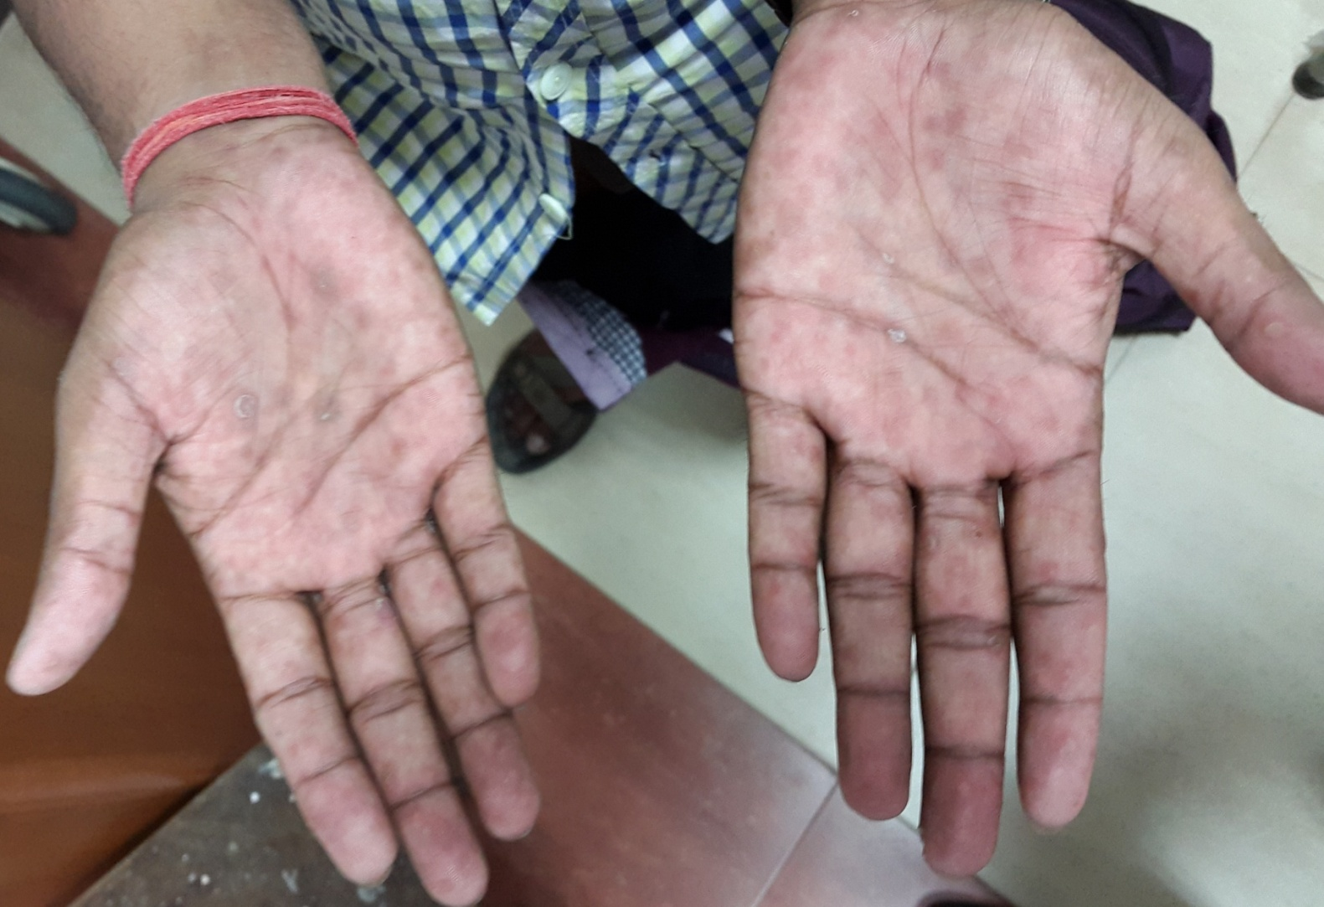
The patient of Secondary syphilis was being mistreated as Tinea manuum.

Slide 42
CASE 4
An 18 yr old unmarried female presented with painful genital ulceration since 10 days and painful nodular lesions on both shins since 5 days.
There was history of unprotected sexual contact 1 year ago.
On examination, multiple erythematous nodules were present on bilateral shins, which were tender on palpation.
Genital examination revealed multiple superficial ulcers over the labia minora with polycyclic margins*
*Corey L, Wald A. Genital Herpes. In: Homes KK, Mardh PA, Sparling PF. Textbook of sexually transmitted disease. 3rd ed. New York: McGraw Hill; 1999. p. 285-312.

Slide 45
A biopsy was taken from the lesions on the legs and showed changes of panniculitis consistent with EN.
A tissue sample from the genital lesion was sent for PCR, and was positive for HSV-2.

Slide 46
Patient was prescribed acyclovir 400 mg TDS (KIT 5) along with NSAIDs for EN.
Patient was counseled regarding safer sexual practices.
Partner notification and contact tracing was done for the patient.
Patient showed marked improvement after 4 weeks, with complete healing of the genital ulcer and resolution of the lesions over the legs.

Slide 47
Among the various sexually transmitted infections, EN has been reported with Gonorrhoea, Syphilis and Lymphogranuloma venereum and chancroid*.
Erythema nodosum occurring with genital herpes is rare+.
*Requena L, Sánchez Yus E. Erythema nodosum. Semin Cutan Med Surg 2007; 26:114–25.
+Tojo M, Zheng X et al. Detection of Herpes Virus Genomes in Skin Lesions from Patients with Behcet’s Disease and Other Related Inflammatory Diseases. Acta Derm Venereol 2003; 83: 124–7.

Slide 48
CASE 5
A 28 year old male presented with multiple asymptomatic papules over the genitalia.
There was history of multiple sexual contacts with unprotected exposure.
On examination, multiple umbilicated papules and verrucous growths over the glans and shaft of the penis.

Slide 50
Patient was counseled regarding safer sexual practice.
Partner notification and contact tracing was done for the patient.
The patient was managed with chemical cauterization+ of the molluscum contagiosum and destruction of the warts by podophyllin application*.
*Androphy EJ, Lowy DR. Warts. In: Wolff K, Goldsmith LA, Katz SI, Gilchrest BA, Paller AS, Leffell DJ, editors. Fitzpatrick’s Dermatology in General Medicine. 7th ed. New Delhi: McGraw Hill Medical; 2008. p 1914-18. +Tom W, Friedlander SF. Poxvirus Infections. In: Wolff K, Goldsmith LA, Katz SI, Gilchrest BA, Paller AS, Leffell DJ, editors. Fitzpatrick’s Dermatology in General Medicine. 7th ed. New Delhi: McGraw Hill Medical; 2008. p1899-1913.

Slide 51
Case 6
A 40 year old male presented with c/o multiple papular lesions over perianal area.
He was homosexual
There was history of multiple unprotected exposures in the last 5 years, with different partners.

Slide 53
Patient was counseled regarding safer sexual practice.
Partner notification and contact tracing was done for the patient.
The patient was treated with podophyllin application* over the lesions, which resulted in complete clearance of the lesions over a period of 4 weeks.
MSM is a high risk group for HIV/AIDS+.
*Androphy EJ, Lowy DR. Warts. In: Wolff K, Goldsmith LA, Katz SI, Gilchrest BA, Paller AS, Leffell DJ, editors. Fitzpatrick’s Dermatology in General Medicine. 7th ed. New Delhi: McGraw Hill Medical; 2008. p 1914-18. +http://naco.gov.in/NACO/Divisions/STI__RTI_Services2. Accessed on 6th May 2015.

Slide 54
CASE 7
An 11 year old girl presented with multiple asymptomatic papular lesions over the perianal area since 1 month.
On examination multiple umbilicated papules were seen on the perianal area.
On careful questioning, the girl admitted to being sexually abused by an uncle.

Slide 56
The patient was treated with radiofrequency ablation*.
The lesions responded well to treatment.
The parents were alerted about the cause of the disease and counseled.
Although genital and perianal lesions can develop in the pediatric population*, a possibility of sexual abuse must be ruled out by detailed history in these patients.
*Tom W, Friedlander SF. Poxvirus Infections. In: Wolff K, Goldsmith LA, Katz SI, Gilchrest BA, Paller AS, Leffell DJ, editors. Fitzpatrick’s Dermatology in General Medicine. 7th ed. New Delhi: McGraw Hill Medical; 2008. p1899-913.

Slide 57
CASE 8
A 23 year old unmarried male presented to the OPD with c/o genital ulceration since 5 days.
The lesion was asymptomatic and was noted by the patient while bathing.
There was history of multiple contacts, both paid and unpaid; protected and unprotected in the last one year.

Slide 60
On examination, the ulcers were clean, painless, well defined and with indurated base.
Inguinal lymph nodes were enlarged, 1.5-2 cm in size, firm and shotty.
The patient was investigated keeping in mind the diagnosis of primary syphilis.
The VDRL was positive in 1:16 dilution.
ELISA for HIV 1 was negative.
The Dark ground illumination microscopy showed motile Treponema pallidum.

Slide 61
The patient was managed by intramuscular injection of Benzathine Penicillin in dose of 2.4 million units after sensitivity test.
The patient improved and the lesions cleared completely 2 weeks after therapy. Misra RS, Kumar J. Syphilis: Clinical Features and Natural Course. In: Sharma VK, editor .Sexually Transmitted Diseases and HIV/ AIDS. 2nd ed. New Delhi: Viva Books p262-326.

