Slide 1
DIAGNOSIS & TREATMENT PLANNING Dr. Vijay Kumar Shakya

Slide 2
INTRODUCTION
Many diagnostic aids available which makes diagnosis simple
Utilizing skills ,experience & knowledge in obtaining the history, any related information & in performing the clinical tests in order to establish a diagnosis
Depending on one clinical test solely as it may be misleading

Slide 3
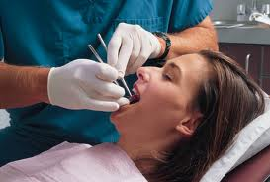
DEFINITION
Diagnostic process -as an act of determining a patients health status & evaluating the factors influencing that status
Art or act of identifying a disease from its signs & symptoms
(MERRIAM-WEBSTER ,2003)
Various types of diagnosis-
Provisional diagnosis
Differential diagnosis
Investigative diagnosis
Histo -pathological diagnosis
Radiographic diagnosis
Final diagnosis

Slide 4
CLINICAL DIAGNOSIS
“The determination of the nature of a disease made from a study of the sign and symptoms of a disease.”

Slide 5
Art and Science of diagnosis
Chief Complaint
Medical history
Dental history
History of Present Dental problem
Dental History Interview

Slide 6
Clinical Examination and Testing
Extraoral Exam
Intraoral Exam

Slide 7
Radiographic Exam and interpretation
Diagnosis

Slide 8
Chief Complaint (CC)
Record symptoms or problems expressed by the patient in his or her own words
When the patient is unaware of any problem or has been referred for diagnosis or treatment, these fact should also be recorded” no chief complaint” for future reference

Slide 9
Medical History
1. Take a complete medical history for each new patient.
2. Update the medical history of each patient of record at each Treatment (Tx) visit and determine any changes in the Pt’s medical Hx or medication
3.A medical problem could confuse and complicate the Dx of dental pathosis

Slide 10
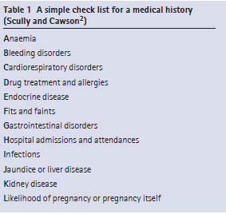

Slide 11
Medical Conditions That Warrant Modification of Dental Care or Treatment
Cardiovascular: High- and moderate-risk categories of endocarditis, pathologic heart murmurs, hypertension, unstable angina pectoris, recent myocardial infarction, cardiac arrhythmias, poorly managed congestive heart failure.
Pulmonary: Chronic obstructive pulmonary disease, asthma,
Tuberculosis.
Gastrointestinal and renal: End-stage renal disease; hemodialysis;

Slide 12
viral hepatitis (types B, C, D, and E); alcoholic liverdisease; peptic ulcer disease; inflammatory bowel disease;
pseudomembranous colitis.
Hematologic: Sexually transmitted diseases, HIV and AIDS,
diabetes mellitus, adrenal insufficiency, hyperthyroidism and hypothyroidism, pregnancy, bleeding disorders, cancer and leukemia, osteoarthritis and rheumatoid arthritis, systemic lupus erythematosus.
Neurologic: Cerebrovascular accident, seizure disorders, anxiety, depression and bipolar disorders, presence or history of drug or alcohol abuse, Alzheimer’s disease,
schizophrenia, eating disorders, neuralgias, multiple sclerosis, Parkinson’s disease

Slide 13
Dental history
- Should include any past and present symptoms, as well as any procedures or trauma that might have evoked the CC
- use a premade form to record the pertinent information obtained during the dental Hx interview and diagnostic examination
- Attitudes toward dental health and treatment may affect treatment planning.

Slide 14
Present illness
Onset:sudden or insidious onset
Location: diffused, localized, referred, or radiated
Quality: throbbing/dull, sharp or lingering
Intensity: mild,moderate,severe
Frequency: constant, intermittent, momentary or occasionally
Initiated/related/relieved by….

Slide 15
Dental History interview
5 basic direction of questioning
1. Location-”Can you point to the offending tooth? In some cases the patient may be able to identify
2. Commencement: When did the symptoms first occur?
3. Intensity-How intense is the pain?

Slide 16
4. Provocation and relief of pain: What produces or reduces the symptoms?
5 Duration-Do the symptoms subside shortly, or do they linger after they are provoked ?

Slide 17
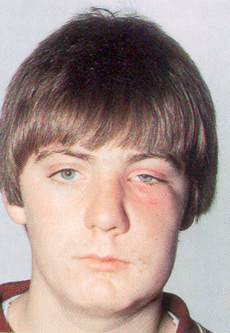
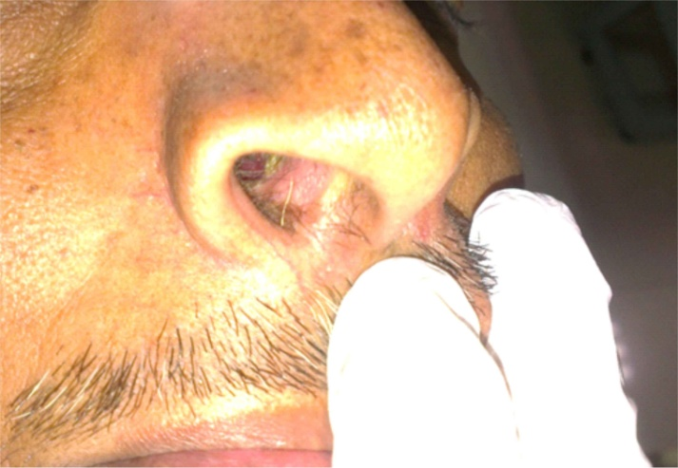
Clinical Examination and testing
Extraoral Examination
a. Check general appearance, skin tone, and facial asymmetry
b.Note any swelling, redness, sinus tracts, tender or enlarged lymph nodes, or tenderness or discomfort upon palpation or movement of the TMJ.

Slide 18
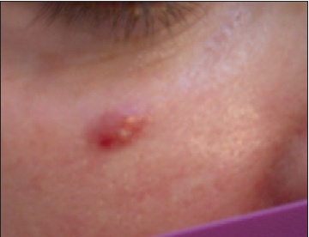

Slide 19
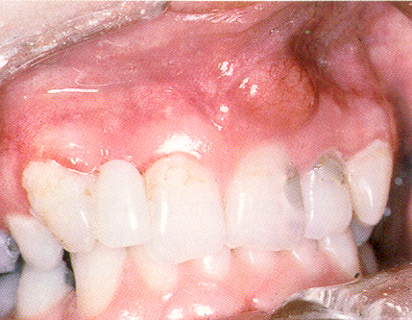
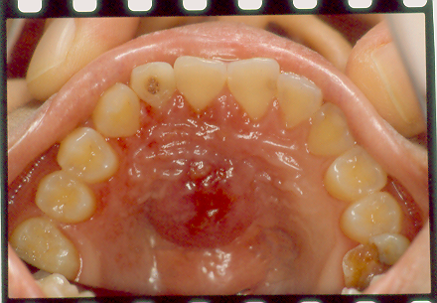
Intraoral Exam
Soft Tissue -Examine the mucosa and gingival visually and digitally for discoloration, inflammation, ulceration, swelling, and sinus tract formation

Slide 20
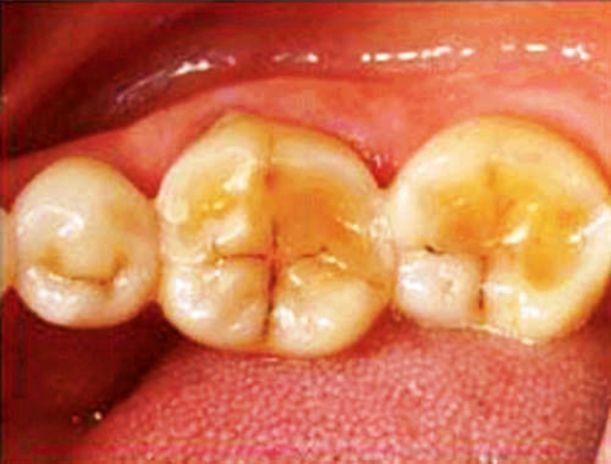
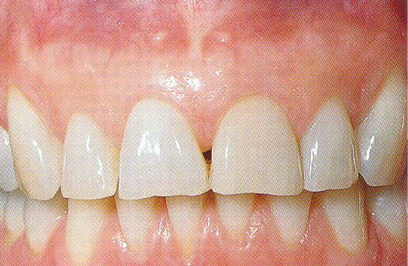
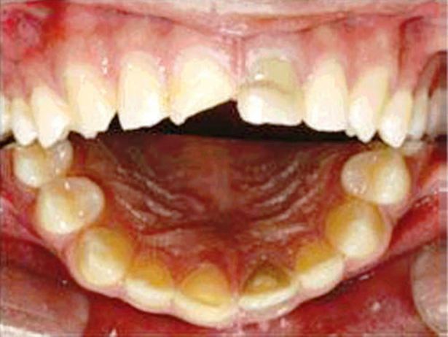
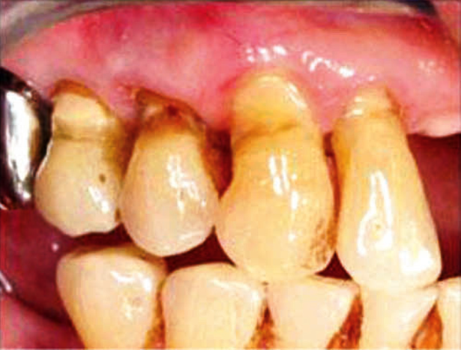
Dentition-Examine teeth for discoloration, fracture, abrasion, erosion, caries, large restorations, discoloration or other abnormalities

Slide 21
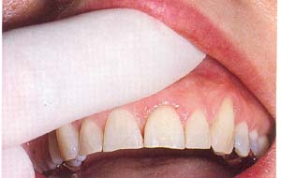
Palpation
Bilateral palpation
Note how it compares with and relates to the adjacent and contralateral tissues
Question the Pt on any areas that feel unusually sensitive during this palpation part of the Exam

Slide 22
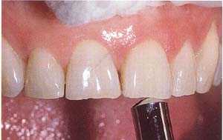
Percussion
Digital pressure
Tapping with instrument handle
-using the back end of a mirror handle
Occlusal / Buccal/ Lingual

Slide 23
CLASSIFICATION OF DIAGNOSTIC AIDS
CONVENTIONAL
VISUAL
TACTILE
RADIOGRAPHS-IOPA & BITEWING
CARIES ACTIVITY TESTS
NEWER DIAGNOSTIC AIDS
BASED ON DIGITAL RADIOGRAPHY
BASED ON VISIBLE LIGHT
BASED ON LASER LIGHT
MAGNIFICATION

Slide 24
CLASSIFICATION
FUTURE TRENDS IN DIAGNOSIS
MULTI PHOTON IMAGING
INFRA RED THERMOGRAPHY
INFRARED FLUORESENCE
OPTICAL COHERENCE TOMOGRAPHY
ULTRASOUND
TERAHERTZ IMAGING

Slide 25
CONVENTIONAL DIAGNOSTIC AIDS

Slide 26
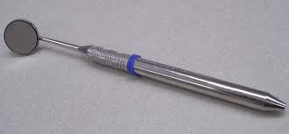
MOUTH MIRROR
Various sizes & types No. 2 to No. 5 (0.75 -1 inch dia)
No. 2 dental mirror provides greater freedom for rotary or hand instrumentation. Especially in posterior segment
The dental mirror is used
As an operating light deflecting device
Means of visualizing the examining area

Slide 27
MOUTH MIRROR
The reflective surface of the mirror may be Plain or Magnifying
It may reflect from either the front or rear surface
Early lesion appear as chalky white , yellow , brown or black discoloration
The front surface types are advantageous as the visual distortions are minimized

Slide 28
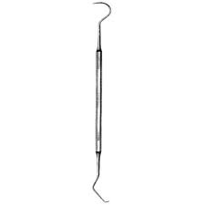
DENTAL EXPLORER
A delicate pointed instrument used for the digital examination of the tooth
Restoration surfaces and their margin juncture
To enhance tactile discrimination
Types-straight explorer, sickle shaped explorer

Slide 29
DENTAL EXPLORER
There are three operational factors which are to be considered when selecting an explorer:
1) Sharpness of the point
2) Resilience and stiffness
3) Design of the shank, handle
The explorer enables the operator to probe enamel surfaces with some vigour in diagnosing caries

Slide 30
ICDAS
A-Preliminary Preparation
B- Assessment

Slide 31
Caries Severity
0-Sound Tooth Structure.
1-First Visual Change in Enamel
2-Distict Visual Change in Enamel.
3-Enamel breakdown, no dentine visible.
4-Dentinal shadow, no cavitations.
5-Distict Cavity with visible dentine.
6-Extensive distinct cavity with visible dentine.

Slide 32
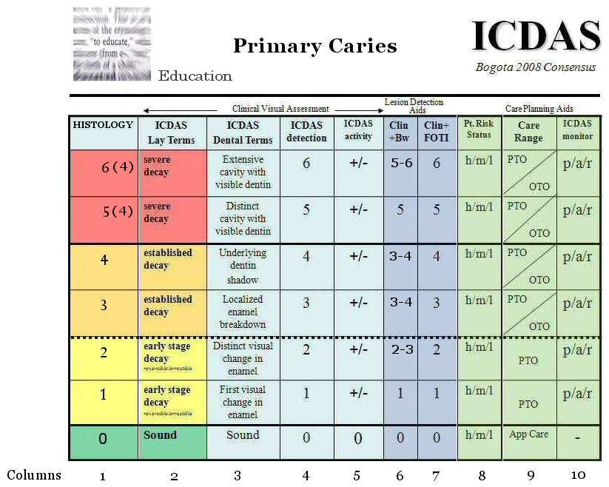

Slide 33
Restorative Status
0-Not Sealed or restored.
1-Sealent, partial.
2-Sealent, Full tooth colored restoration.
3-Amalgam restoration.
4-Stainless steel restoration.
5-Ceramic,Gold,PFM.
6-Lost broken restoration.
7-Temporary restoration.

Slide 34
SEPARATORS
Orthodontic elastic separators applied for 2-3 days around contact areas of surfaces
Tooth separation have detected more non cavitated enamel lesions than visual tactile examination
Established relationship- radiographic lesion depth & presence or absence of cavity formation on contacting approximal surfaces
Disadvantages
Accessibility for inspection after tooth separation is not always improved as much as needed
Use of this technique may cause discomfort
Requires an extra visit

Slide 35
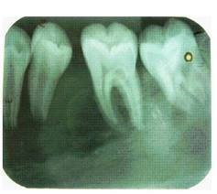
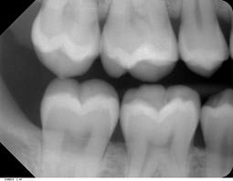
RADIOGRAPHS
Radiographs are a valuable supplement to a thorough clinical examination of the teeth for detecting caries
IOPAR- useful primarily for detecting changes in periapical bone
BITE WING-most useful for detecting caries

Slide 36
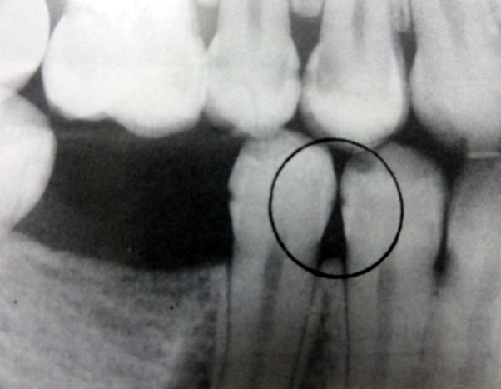
RADIOGRAPHIC DETECTION OF LESION
PROXIMAL SURFACE
Early radiolucent lesion in enamel- triangle with broad base at tooth surface
At DEJ – spreads along the junction second triangle with apex towards the pulp chamber

Slide 37
Wider base than at enamel , progressing towards pulp along direction of dentinal tubules
Lesion commonly found between contact point & free gingival margin
Lesion confined to enamel are not evident till 30- 40% demineralization

Slide 38
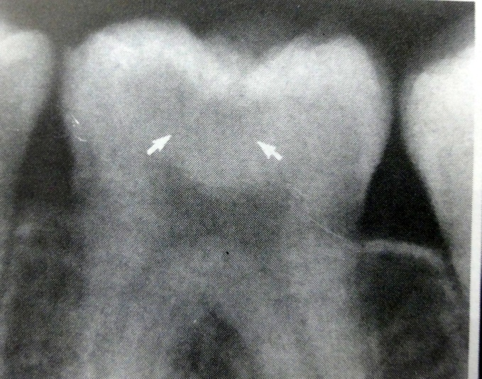
OCCLUSAL SURFACE
Originates at enamel pits & fissures walls , spreads along enamel rods , penetrates to DEJ perpendicularly(radiolucent line)
Occlusal caries in dentin – broad based radiolucent zone ,often beneath a fissure ,with little or no changes in enamel
In dentin the margin between carious & non carious dentin is diffuse & may obscure the radiolucent line at DEJ

Slide 39
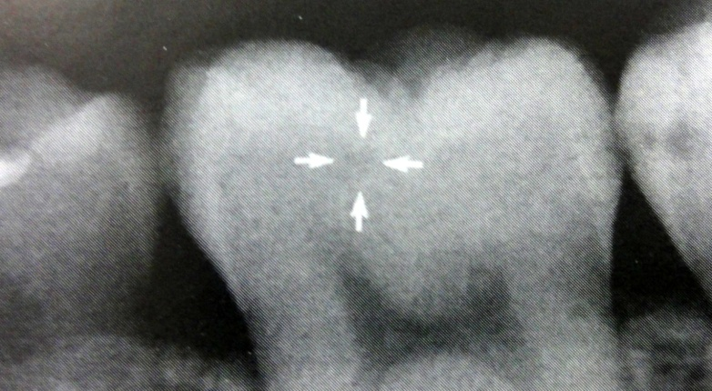
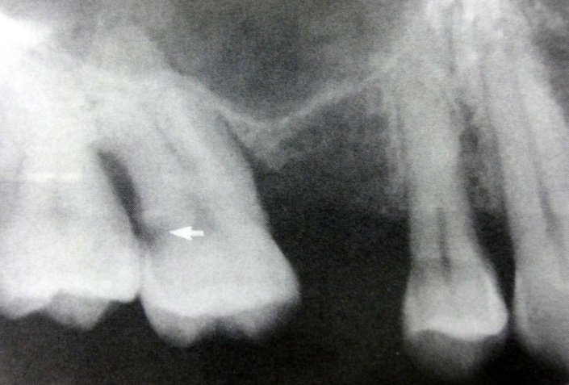
BUCCAL & LINGUAL SURFACE
These lesion occur in enamel pits & fissures
Small- round , they enlarge , they are elliptical or semilunar with sharp well defined borders
ROOT SURFACE
Involve both cementum & dentin , gingival recession
Differ from intact surface- absence of an image of root edge & appearance of diffused rounded inner borders

Slide 40
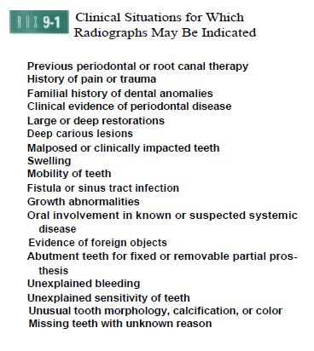

Slide 41
CARIES ACTIVITY TEST
Caries susceptibility tests
Status of micro- organisms in oral cavity
SNYDER’S TEST
Basis- amount of acid produced in a medium no. of acid producing lactobacilli present
pH -5
For indication of change in pH ,evaluation of rapidity & extent of acid production –Bromocresol green

Slide 42
SALIVARY REDUCTACE TEST/ TREATEX TEST
Rate at which Diazo Resorcinol color changes from blue- red , red – pink or white or colorless shows caries activity
Saliva taken in collection tube till 5 ml calibration mark
Mixed with Diazo Resorcinol (reductace enzyme reacts)
Color changes in 30 sec & 15 min indicates caries activity
Color | Time | Score | Caries activity
Blue | 15 min | 1 | Non-conducive
Orchid | 15 min | 2 | Slightly conducive
Red | 15 min | 3 | Moderately conducive
Red | Immediately (30 sec) | 4 | Highly conducive
Pink or white | Immediately (30 sec) | 5 | Extremely conducive

Slide 43
NEWER DIAGNOSTIC AIDS

Slide 44
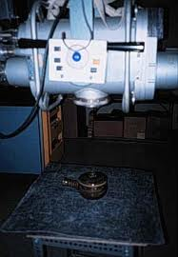
XERO RADIOGRAPHY
Imaging method was discovered by an American physicist, Chester Carlson in 1937
Pogorzelska-Stronczak the first to use xeroradiograph to produce dental images
An electrostatic process which uses- to form a plate
Amorphous selenium photoconductor material
Vacuum deposited on an aluminium substrate
The plate, enclosed in light tight cassette

Slide 45
ADVANTAGES
Elimination of accidental film exposure
High resolution
Simultaneous evaluation of multiple tissues
Ease of reviewing
Higher latitude of exposure factors
Better ease & speed of production
Reduced exposure to radiation hazards
Wide application

Slide 46
DISADVANTAGES
Technical difficulties
Fragile selenium coat
Transient image retention
Slower speed
Technical limitations

Slide 47
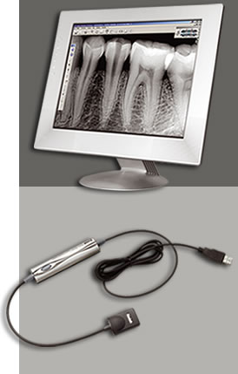
RADIO VISIO GRAPHY
Dr.Francis Mouyen , 1987
A rapid low dose digital imaging system
Components-
Electronic sensor or detector
Analog digital convertor
Computer/monitor
Printer

Slide 48
The “radio” component- high resolution sensor with an active area
The “visio” component- video monitor& display processing unit
The “graphy” component-high resolution printer that provides a hard copy of screen image

Slide 49
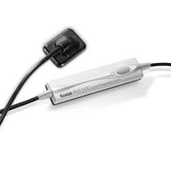
INTRA ORAL SENSOR
A sensor is a small detector placed in the mouth to capture radiographic image
Wired
Sensor linked by fiber optic cable to computer to record generated signals
Cable length- 8 -35 ft
Wireless
Image sensor phosphor coated plate not linked
3 direct sensor technologies
Charge coupled device
Complementary metal oxide semi conductor /active pixel sensor
Charged injection device

Slide 50
TYPES OF DIGITAL READINGS
Direct digital readings
Includes x ray machine
Intra oral sensor
Computer monitor
Sensor captures the image & then transmits to monitor
CCD is used for direct reading

Slide 51
ADVANTAGES
Immediate viewing of image
Allows change in contrast ,image enhancement
Maintenance of developing & fixing solution ,dark room not required
Teleradiology
Reduction in radiation exposure by 70 -90 %
Chemical processing takes 4- 6 minutes, whereas, digital systems take – 7 sec

Slide 52
DISADVANTAGES
CCD sensors may be wired /wireless- mastering the use requires some effort & learning period
CCD sensors are rigid & can irritate the oral tissues & cause pain
The receptors is reused indefinitely –cross infection

Slide 53
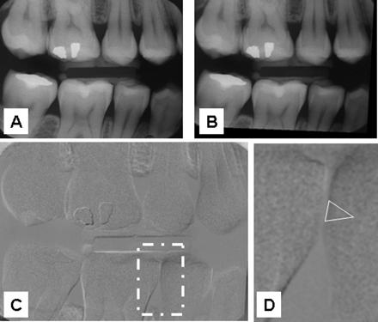
DIGITAL SUBTRACTION RADIOGRAPHY
Subtraction methods – B.G Zeides Des Plantes-1920,in dentistry -1980’s

Slide 54
Greater visualization of radiographic changes between a pair of radiographs by subtracting unchanging background distractions
Images to be compared are brought in software in numeric format the changed images
Images that have not changed are subtracted ,highlighting
Radiographic image pair,& subtracted resultant image are furnished as slide presentation

Slide 55
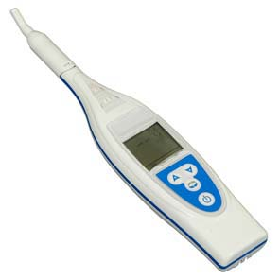
OPTICAL CARIES MONITOR
Comprises of light source ,measuring & reference units & detection part
The light is transported through a fiber bundle to tip of handpiece
The tip is placed against the tooth surface & the reflected light is collected by different fibers of same tip
Disadvantage- used only for smooth surface lesions

Slide 56
FIBER OPTIC TRANSILLUMINATION
Principle-carious lesion has a lowered index of light transmission area of caries appears as a darkened shadow
Initially developed for proximal caries detection
Method-
150 watt halogen lamp & rheostat used to produce a light of variable intensity
Fiber optic probe of 0.5mm diameter is used to place in embrasure area

Slide 57
FIBER OPTIC TRANSILLUMINATION
The marginal ridge is viewed from occlusal surface
Advantages- no hazards , lesions not diagnosed by radiographs
Disadvantages- subject to inter & intra observer variation

Slide 59
DIFOTI
Narrow fiber optic bundle to transmit visible white light through tooth structure, allowing to visualize in a darkened operatory
Resultant light changes in light distribution as light traverses the tooth then recorded as an image for analysis
Instantly creates high resolution digital images of occlusal ,interproximal & smooth surface
Also inspects tooth fractures , decalcification & wear

Slide 60
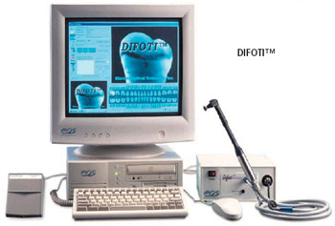
Images from all tooth surfaces can be digitally captured for computer analysis
Teeth are transilluminated ,the areas of demineralized enamel , dentin scatter light & incipient caries appear darker
Different pictures can be compared of same tooth over time

Slide 61
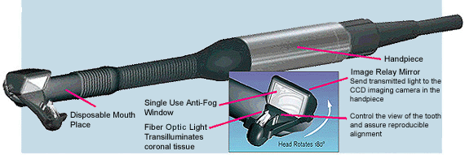
DIFOTI assembly
Two mouthpieces- 1 for occlusal caries detection,1 for smooth surface caries
Disposable mouthpiece
A foot control- selecting the image of concern
Computer

Slide 62
Advantages
Twice more sensitive than conventional radiographs for interproximal ,occlusal caries
No harmful radiations
Helps detect tooth decay before cavity develops
Disadvantages
Does not have the capability to determine the depth of the lesion

Slide 63
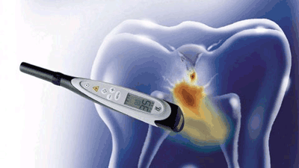
DIAGNODENT
Detection of oral decay
Uses infrared laser fluorescence for detection
Uses a simple laser diode to inspect teeth comparing reflection wavelength against a healthy baseline wavelength to uncover decay
655nm- clean healthy teeth exhibits little or no fluorescence
Carious tooth proportionate to the degree of caries ,resulting in elevated scale reading

Slide 64
Aim laser on healthy enamel tooth surface for bench mark reading ,continue shining laser 2.5mm into all suspected areas
As pulses into grooves ,fissures or cracks , reflects fluorescent light of specific wavelength
Light is measured by receptors converted to acoustic signals , evaluated electronically
Peak surface readings | Clinical interpretation
0-9 | Sound /early enamel caries
10-17 | Enamel caries
18-99 | Dentinal caries

Slide 65
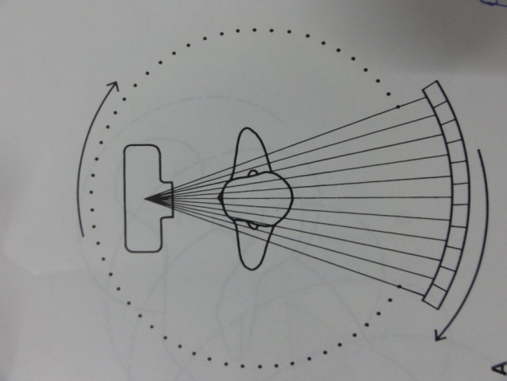
COMPUTED TOMOGRAPHY
Godfrey Hounsfield -1972
Also called
Computerized axial transverse scanning
Computerized axial tomography
Computerized reconstruction tomography
Computed tomographic scanning
Axial tomography
Computerized transaxial tomography

Slide 66
CONE BEAM COMPUTED TOMOGRAPHY
The development of computed tomography in 1972
Arai et al in 1997 created CBCT for dental use
Technique of choice for imaging dental hard tissues
Advantages
More efficient
Economical

Slide 67
DENTAL LOUPES
High powered magnification loupes &headlamps greatly enhance treatment quality
They aid in visualizing
Internal anatomy following access
Inspecting instruments
Managing root-end during surgery and interpreting
Radiographs
Advantages
Better visual acuity
Greater motor control
Improved diagnostic outcomes.
Better treatment outcomes.
Reduces neck and back strain

Slide 68
There are several parameters to be considered & evaluated while selecting a loupe
Power on magnification
Working distance
Field of view
Depth of focus
Magnification describes the increase in size-field of view & depth of focus decreases
Magnification range-2x-3x

Slide 69
WORKING DISTANCE
Distance from the eye to the object when the object is viewed in focus.
This distance is in the middle of the depth of focus
Working distance depends on the height , arm length & seating preferences 13-14’
DEPTH OF FOCUS
Difference between the far & in focus limits of the working distance
Depth of focus decreases as magnification increases

Slide 70
DECLINATION ANGLE
Working posture is directly related to the line of sight & declination angle
Shallower the angle , the greater the need to tilt the neck to view the object being worked on .
Ability to adjust the working angle will permit comfortable viewing during intra oral procedures & other activities

Slide 71
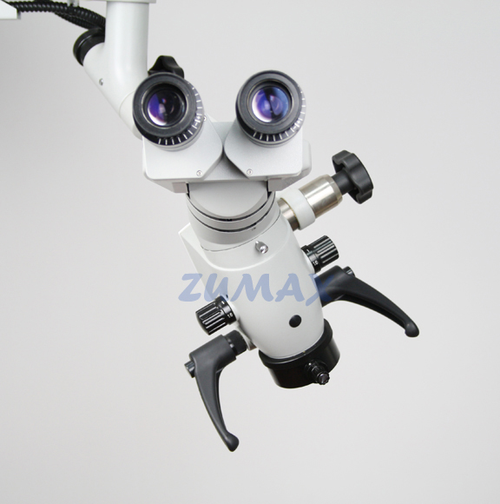
SURGICAL OPERATING MICROSCOPE
Otologists first introduced the operating microscope in early 1940’s
The most important recent development in surgical endodontics is the introduction of surgical operating microscope
Magnifying of 2.5X -8.0X to provide a wide field of view & good depth

Slide 72
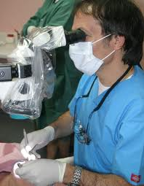
SURGICAL OPERATING MICROSCOPE
Midrange magnifications of 10X -16X are used for root end resection & preparations procedures
High range 18X -30X magnifications are used for observation & evaluating fine details

Slide 73
ADVANTAGES
Visualization of the operating field
Allows to perform surgical procedures on exceptionally small & complex structures
Evaluation of the surgical technique
Improves patient education through video use
Reduces the number of radiographs
Provides reports for reference to dentists & insurance companies

Slide 74
DISADVANTAGES
As magnification increases ,the field of vision & focal depth decreases
Any slight movement of the patient or the operating microscope will result in loss of visual field or focus

Slide 75
Clinical Examination for Caries
(1) visual changes in tooth surface texture or color,
(2) tactile sensation when an explorer is used judiciously,
(3) radiographs,
(4) transillumination.

Slide 76
Clinical Examination of Restorations.
when amalgam restorations are evaluated
(1) amalgam "blues,“
(2) proximal overhangs,
(3) marginal ditching,
(4) voids,
(5) fracture lines,
(6) lines indicating the interface
between abutted restorations,
(7) improper anatomic contours,

Slide 77
(8) marginal ridge incompatibility,
(9) improper proximal contacts,
(10) recurrent caries,
(11) improper occlusal contacts.

Slide 78
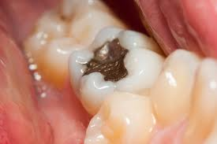

Slide 79
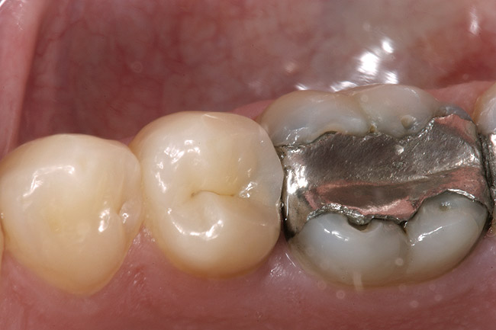
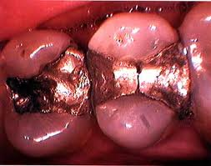

Slide 80
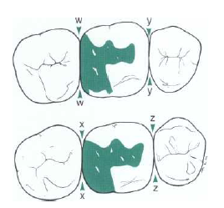
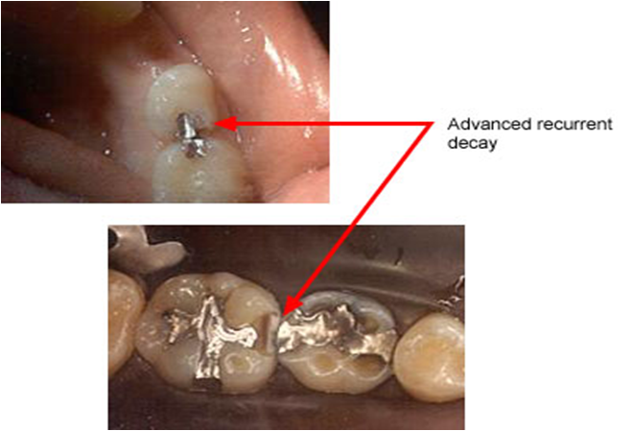

Slide 81
Clinical Examination for Additional Defects
Nonhereditary hypocalcified areas of enamel
Erosion
Abrasion
Attrition
Fracture or craze lines in a tooth

Slide 82
REVIEW OF PERIODONTIUM

Slide 83
EXAMINATION OF OCCLUSION

Slide 84
TREATMENT PLANNING
TREATMENT PLAN SEQUENCING
Urgent Phase.
Control Phase.
Re-evaluation Phase.
Definitive Phase.

Slide 85
Prevention and Management of Caries
Chemical-Use of antimicrobial agents to alter the
oral flora and administration of topical fluoride to
stimulate remineralization.
Surgical-Removal of diseased tooth structure
and replacement of missing tooth structure with
restorative material

Slide 86
Behavioral-Application of appropriate techniques
to help the patient develop the skills, knowledge,
and attitudes to alter deleterious dietary intake
and improve oral hygiene
Mechanical-Mechanical alteration of tooth surfaces at high risk (e.g., sealants), removal of overhangs, reestablishment of proximal contacts, and restoration of defective contours
Dietary-Alteration of the character of the diet

Slide 87
Other-Stimulation of salivary flow through increased chewing, alteration of medications, and use of artificial saliva

Slide 88
Pulp Vitality Tests
Pulp Vitality Tests-These determine response to stimuli and may identify the offending tooth with an abnormal response. Always include stimuli similar to those that provoke the patient’s chief complaint

Slide 89
Cold is the primary pulp testing method for many clinicians today. To be most reliable, cold testing should be used in conjunction with an electric pulp tester so that the results
from one test will verify the findings of the other test

Slide 90
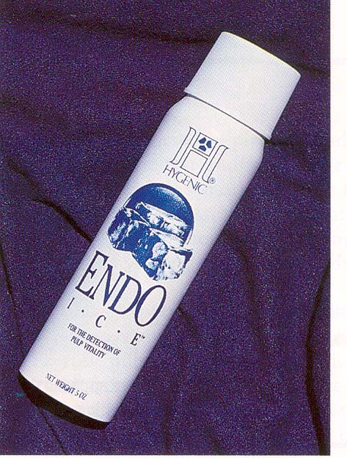
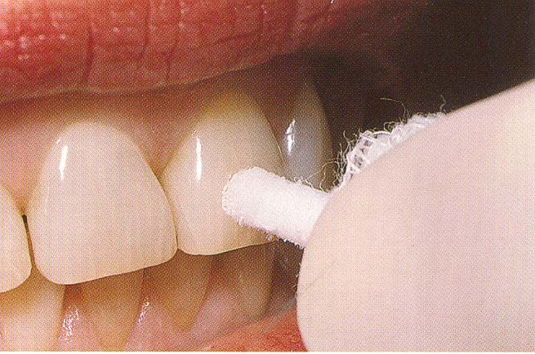
Cold Test
Intense, prolonged pain indicates an irreversible pulpitis.
Necrotic pulps do not respond.
A false-negative response may occur with constricted canals

Slide 91
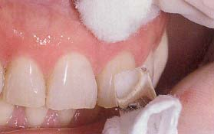
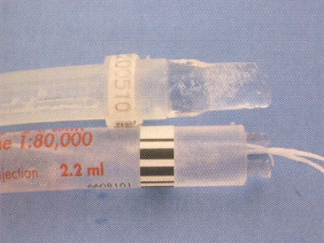
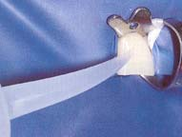
Ice stick
Ice water
Co2 snow (−69° F to −119° F; −56° C to −98° C)
Ethyl chloride spray
Dichlorodifluoromethane = Endo ice( −26.2° C).

Slide 92
However, a multirooted tooth, with at least one root containing vital pulp tissue, may respond to a cold test even if one or more of the roots contain necrotic pulp tissue.

Slide 93
Heat Test
Heat testing is most useful when a patient’s chief complaint is intense dental pain on contact with any hot liquid or food.

Slide 94
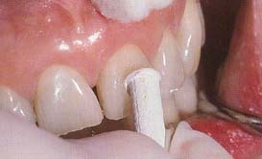
Heated gutta percha stick over 65.5 c
Heat ball burnisher
Burlew wheel/rubber cup
(friction heat)
Tooth isolated w/ RD & Bathed
W/ hot water

Slide 95
Electric Pulp Testing
Contrary to popular opinion and persistent notion, different response levels in electric pulp testing do not indicate different stages of pulp degeneration. Electric pulp testers do not measure the degree of health or disease of a pulp. A “yes or no” response is merely a rough indicator of the presence or absence of vital nerve tissue in the root canal system

Slide 96
Stimulate A delta fiber in the pulp

Slide 97
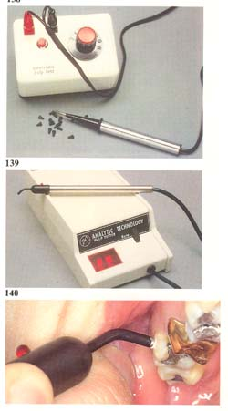

Slide 98
Electric Pulp Testing
(a) Before testing, clean, dry, and isolate the teeth, then place a small amount of tooth-paste or other conductor on the electrode. Be sure to follow your manufacturer’s instructions for establishing a electrical circuit and to ensure accurate measurement with your instrument.
(b) Sensation may be described as tingling, stinging, or a feeling of heat, “fullness”, or pressure

Slide 99
If a mature, untraumatized tooth does not respond to both electric pulp test and cold test, then the pulp should be considered necrotic.

Slide 100
False Positive
Plaque & calculus
Saliva
Partial necrosis
Large restoration
Pt interpret ion

Slide 101
False Negative
Technical errors
Canal calcification
Immature apical development
Traumatic injury
Low battery

Slide 102
Laser Doppler Flowmetry
Use a laser beam to be Doppler-shifted to be back scattered out of the tooth. This reflected light is detected by a photocell on the tooth surface, the output of which is proportional to the number and velocity of the blood cell

Slide 103
Special Tests
if special circumstances prevent making a definitive diagnosis, additional tests may be indicated

Slide 104
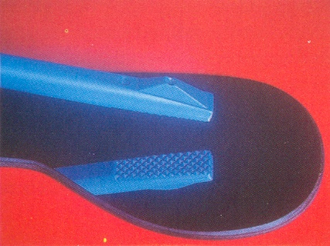
Bite test
Apply pressure to individual cusps or area of the tooth
Cotton applicators, toothpicks, orangewood sticks and rubber finishing wheels
Bite on tooth slooth and Frac Finder

Slide 105
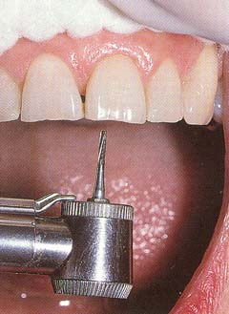
Test cavity
may be helpful, especially for a tooth with a porcelain-fused-to-metal crown (PFM).

Slide 106
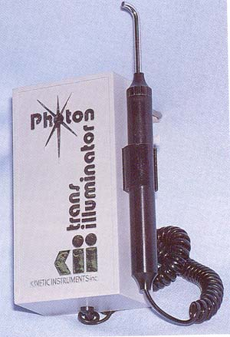
Transillumination-for identification of vertical crown fractures, since fractured segments do not transmit the light similarly. Dark and light shadows appear at the fracture site.

Slide 107
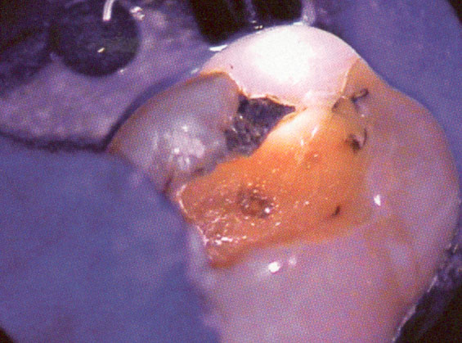

Slide 108
CONCLUSION
Each of the methods measures the result of the caries process. Some methods may have the potential to measure lesion activity indirectly. Large array of potential methods gives causes for optimism that rapid ,non invasive quantifiable methods of caries detection

Slide 109
Q. 1-Which of the following partially or completely disappears visually when the enamel is hydrated?
(A) Incipient caries
(B) hypocalcified enamel
(C) Tetracycline stains
(D) Fluoride stains
Q. 2-Proximal caries can be detected best with?
(A) IOPA Radiographs
(B) Bitewing Radiographs
(C) Occlusal Radiographs
(D) OPG

Slide 110
Q. 3-Diagnosis of small occlusal cavities is most readily made by?
(A) An Explorer and compressed air
(B) Bitewing Radiographs
(C) Intra oral camera
(D) IOPA Radiographs
Q. 4- Digital Imaging Fiber –Optic Transillumunation
(A) Is used to detect Dental caries
(B) Is used to detect enamel fracture
(C) Is used to detect plaque
(D) all of the above

Slide 111
Q. 5-When all the diagnostic procedure fail to detect proximal caries, last resort is?
(A) Mechanical separation
(B) Preparation of test cavity
(C) Trans illumination
(D) Caries activity test
Q. 6-Minimum depth of demineralization of caries lesion to be detected radio graphically is?
(A) 100 µm
(B) 200 µm
(C) 300 µm
(D) 400 µm

Slide 112
Q. 7-The control teeth used during pulp testing?
(A) Adjacent and opposing teeth
(B) Adjacent and contraleteral teeth
(C) Suspected tooth only
(D) Adjacent teeth only
Q. 8-Vitality of pulp commonly determine by?
(A) Radiography
(B) Thermal testing
(C) CT
(D) Percussion &Palpation

Slide 113
Q. 9-Tooth Erosion is?
(A) Chemical dissolution of teeth by acids
(B) Wearing away of hard tissue by abnormal mechanical process
(C) Physiological wearing
(D) Loss of hard structure of tooth due to trauma
Q. 10-Which type of fiber stimulated by Electric Pulp Testing
(A) A δ Fiber
(B) C Fiber
(C) Both
(D) None of the above

Slide 114
Thank you

