Slide 1
DENTAL GRADUATES :JOURNEY AHEAD
Dr. Vishal Nath Saxena

Slide 2
At the ‘X’road ????
Practice
Academics
Unconventional
Notes:
Academics will include : Teaching / Research
Practice can be private / hospitals & clinics / Government Sector.
Unconventional work will be moving to Hospital Administration / Public Health

Slide 3
The Road Map…
Academics
Teaching
Higher Education (Masters/PhD)
Employment
Conventional
Dental Practice in clinics and Hospitals
Unconventional Sectors
Public health
Hospital Administration
Self Employed
Private practice
Notes:
Private practice
Single
Group

Slide 4
Practice
Practice Abroad
Central Government (Defense and Railways
Practice in Hospitals and Clinics
State Medical Services
Private Practice

Slide 5
Government Sector
Army Dental Corps
It has a regular intake every year.
Permanent Commission
Short Service Commission
Result is based on AIPGDEE , Interview and Medical
ECHS
Ex-servicemen contributory health scheme
Various ECHS clinics are running throughout the country.
Each clinic has minimum 2-3 dentists

Slide 6
Railways
Fairly regular intake of Dental Surgeons at their hospitals
To keep tab on job openings – Employment news website
http://employmentnews.gov.in/NewEmp/Home.aspx

Slide 7
UPSC
UPSC has posts for dental surgeons for the CGHS hospitals.
Selection process is usually through
Written Test
Interview
http://www.upsc.gov.in/
State PSC
Each state has openings in respective medical service
For UP : http://uppsc.up.nic.in/Notifications.aspx

Slide 8
Other Jobs via nodal centers like
National Rural Health Mission
Regional Institute of Medical Science
National Institute of Rural Development and Panchayati Raj
Employees State Insurance Corporation (ESIC Hospitals)
Hospital run by local bodies (Municipal Corporations)

Slide 9
Other sectors
Public sector undertakings and Private sector run hospitals in industrial townships.
e.g.
Jagdishpur Industrial Area (around 80KM from lucknow)
Bharat Heavy Electricals Limited (PSU)
Indo gulf Fertilizers (Private Sector)
Private Hospitals
Private Dental Clinics

Slide 10
Practice – Abroad Popular destinations
Notes:
UAE MOH ministry of health exam
Dubai health authority

Slide 11
United States
BDS is classified as
Dental Degree from regionally accredited university
Graduates : Undergo Advanced Standing Program
DDS/DMD
Program duration : 2 to 3 years
(Depends upon the University)
Notes:
European degrees too are regional
Ibt Cost : $170

Slide 12
Examination Required
National Dental Board Examination : Part –I
Valid for 5 years
TOEFL iBT
Test of English as Foreign Language
Score 100 and above (max score: 120)

Slide 13
Contd…
Transcript evaluation
Educational Credential Evaluators
https://www.ece.org/
Course by Course evaluation to obtain Grade Point Average (GPA minimum 2.5)
Letter of recommendation / Statement of Purpose
Yearly expense
USD 90000 to USD 100000
Starting yearly Salary
USD 120000 to 140000
65 schools of dentistry in 36 states in US
Harvard School of Dental Medicine, Boston
Rutgers School of Dental Medicine, Newark NJ

Slide 14
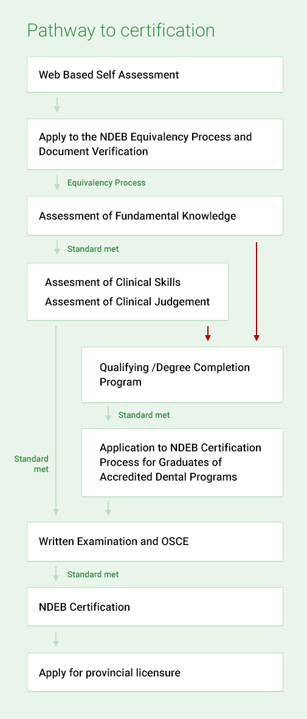
Canada
https://www.ndeb-bned.ca/quiz/
100 Q’s – 120 min
Three Assessments
2 to 3 years
Objective Structured Clinical Examination
Registration possible in New Zealand with certification

Slide 15
Australia
Four Step Process
http://www.adc.org.au/
Initial Document Assessment
English Language Test
Written Examination
Practical Examination (Clinical)

Slide 16
Document Assessment (AUD 610)
Professional Qualification
BDS (4 year dental degree + registration)
Certificates
Work Experience
English Test (Might be required)
IELTS ( International English Language Testing System)

Slide 17
Written Exam (AUD 2000)
MCQ – scenario based – 2 day exam
Tentatively in Mar & Sept (Lucknow is center too)
Examination 27-28 February 2017
Applications from 26 September 2016 to 30 November 2016
Examination 4-5 September 2017
Applications from10 April 2017 to 26 May 2017
Practical Exam (AUD 4500)
Conducted in Australia only
Results valid for three years

Slide 18
UK
Overseas Registration Exam (ORE)
Two parts (I & II)
Basic and Clinical exam
Administered in UK
Requirements
BDS (minimum 55%)
Intership
IELTS / Equivalent (6.5)
1600 hours of clinical experience
During dental degree (and/or)
Post qualification experience
Website:
http://www.gdc-uk.org/dentalprofessionals/ore/Pages/default.aspx

Slide 19
World of Academics
Clinical / Research

Slide 20
Masters/ PhD in clinical work
Masters/PhD in Research
MS
Fellowship
MClinDent
PostDoc

Slide 21
MS (Master in Science)
Clinical subjects
Residency Programs (Orthodontics/Endodontics/Periodontics/ Pediatric Dentistry/ Oral & Maxillofacial Surgery)
Rutgers School of Dental Medicine NJ

Slide 22
Non clinical / Unconventional
Oral Biology (@ UCLA www.ucla.edu)
Dental Sleep Medicine (@ Tufts : http://www.tufts.edu/)
oral appliance therapy to treat sleep-disordered breathing
Biomaterials /Oral Sciences (@ buffalo NY https://dental.buffalo.edu/Education/AdvancedEducation/Biomaterials,MS.aspx)
Dental Public Health (@ Iowa http://www.dentistry.uiowa.edu/preventive-grad-program-requirements)
Average Fees
USD 30000 – 40000 per year

Slide 23
Admission -Requirements
BDS grades evaluation
GRE (Graduate Record Examination) (some courses)
National Dental Board Part (I & II) (some courses – clinical subjects)
TOEFL
Recommendation Letters
Preferably by Dean/ HOD and faculty
Statement of Purpose
Highlight achievements and why do the course.

Slide 24
Job Scope
During MS (Research)
Teaching Assistantship
Stipends (upto USD 30000 are available)
After MS
Post Doctoral Research
Jobs in Research Labs both Private and Governmental
Academics and University posts.

Slide 25
Australia
Courseware offered
DclinDent (Orthodontics / Periodontics /Prosthodontics)
Requisites
BDS
IELTS /TOEFL iBT
MASTER OF PHILOSOPHY (DENTISTRY)
Oral biology / biomaterials / public health
Requisites
BDS / Masters
IELTS / TOELF iBT

Slide 26
Duration
1-2 years full time
Fees
AUD 40000 – AUD 60000 per year
Web reference @ University of Sydney
http://sydney.edu.au/dentistry/study/pg-coursework/index.php

Slide 27
MscDent (Master of Science in Dentistry)
Research oriented program
Craniofacial Biology / Biomechanics and clinical subjects like implantology/endodontics and pediatric oral health
Steps to apply
Important is to contact and identify a supervisor and prepare a research proposal.
IELTS/ TOEFL
Web reference : Univ of Western Australia (Perth)
http://www.dentistry.uwa.edu.au/research

Slide 28
UK
MClinDent (clinical)
Prosthodontics / Periodontics/ Endodontics
MSc (Research)
Maxillofacial and Craniofacial Technology
Dental Public Health
Regenarative Dentistry
Requirements
Graduate – BDS
IELTS
Fees : (£ 22000)
Notes:
egenerative dentistry including dental stem cell culture, iPS and ES cells, tooth bioengineering, the role of stem cells in tooth repair and regeneration.

Slide 29
MJDF /MFDS
Diploma of Membership of the Joint Dental Faculties
Administered by Royal College of Surgeons
Faculty of General Dental Practice
Structure
Part 1
first year after graduation
Multiple choice questions (MCQs) & multiple short answer questions.
Part 2
Second year
Objective structured clinical examination (OSCE)
Structured clinical reasoning (SCR) exercise.

Slide 30
Unraveling the process
GRE
GMAT
TOEFL
IELTS

Slide 31
TOEFL
Test of English as Foreign Language
Test to ascertain English proficiency .
Required in admission for universities in US/Canada/Australia/UK
iBT : Internet based testing
Tests all Four Skills: Listening, Reading, Speaking, and Writing and has these four sections
Fees : $170
Centers : Throughout India including Lucknow
Web Ref :https://www.ets.org/toefl/

Slide 32
GRE
Test required for admission in Masters programs and sometimes in management programs
Structure
Verbal Reasoning : analyze and evaluate words / sentences and recognize relationship
Quantitative Reasoning : Basic Mathematics
Analytical Writing : Measures critical thinking and analytical writing skills
Fees : $205
Test center at Allahabad (nearest for Lucknow)
https://www.ets.org/gre/

Slide 33
IELTS
International English Language Testing System
Similar to TOEFL administered for study in UK/Australia and Canada
Total test time
2 hours and 45 minutes.
Listening / Reading / Writing /Speaking
Test centers : throughout India including Lucknow
Fees : Rs 11300/-
https://www.ielts.org/

Slide 34
GMAT
Required for admission to MBA programs
Good option is MBA in Healthcare
Job Prospects in Health industry and Hospital
Structure
Analytical Writing
Reasoning
Quantitative
Verbal
Fees : $250
http://www.mba.com/global

Slide 35
Healthcare
Healthcare industry
Fast growing industry (India and abroad)
Good Job Prospects and Salary

Slide 36
Course
MBA (Health care specialization)
MHA (Masters in Health Administration)
For US/Canada
GMAT / GRE and TOEFL
Most University offer specialization – MBA
(Harvard/Wharton/UCLA)
India
IIM Calcutta
Healthcare Executive Management Programme (HEMP)
Manipal University
Chitkara University, Chandigarh

Slide 37
MPH
Masters in Public Health
Curriculum involves
Epidemiology
Environmental and Occupational Health

Slide 38
Course offered in India and abroad
India
Institute of Health Management Research University : http://mph.iihmr.edu.in/
(Requires score of GRE/TOEFL but waived for students with medical degree)
Associated with : Johns Hopkins Bloomberg School of Public Health (JHSPH)
Manipal University : http://manipal.edu/doph/programs/program-list/mph-master-of-public-health.html

Slide 39
Job Prospects
WHO
Various Non Governmental Organizations

Slide 40
Planning the Future practice
Basic Requirements for a successful practice
The Three A’s
Ability
Availability
Affability

Slide 41
Ability : Preparation
Dental Practitioner
Should handle most cases at the clinic
Do good work
Skill honing
Bread and Butter in Practice
Endodontics and Prosthodontics
Learn :
Pro Taper System : Improve efficiency and cut down working time
Fixed Prosthodontics : Crown and Bridge work.
Oral Surgery and Periodontics
Proficiency in extractions , scaling and root planing work
Creamy Practice
Orthodontics and Implant
Focus on short term courses to enhance practice

Slide 42
Availability and Affability
Dental practitioner must devote full clinic hours to his practice.
Dentist not available at the time means a patient lost forever.
Courteous dentist will win patients where as a rude dentist will drive the patients away.

Slide 43
Private Practice for Freshers: A Comparison
Satisfaction and increased motivation
High scope of growth
Initial inexperience may lead to some practice errors. Avoided by course correction.
Gain initial experience.
Low pay and stagnation later may lead to low satisfaction levels.
Own Practice
Other’s Clinic

Slide 44
Starting Up a Practice
Location
Visibility and Economics
Space
Area for surgery
Adequate space around the dental chair for free movement of doctor and assistant.
Avoid too many loose wires and pipes (water / air) which will hamper movement
Many Instruments near the chair
Light Cure, Scalar, Micro-motor, Air rotors , 3 way’s
Patient waiting area
Keep compressor as far and enclosed
Minimize noise.

Slide 45
In conclusion
Entry level dentist in US earn an average $115K and one of the top paid professions.
Converse initial expense are high
Research as a career is gratifying both in terms of earnings and professional advancement.
Low initial expense and can be a stepping stone towards doing DDS
With Part I exam in India , Australia is fast becoming a preferred destination too.
Alternative non conforming (MBA/MPH) are good alternative career options too.

