Slide 2
Lecture series Gastrointestinal tract
Professor Shraddha Singh,
Department of Physiology,
KGMU, Lucknow

Slide 3
Learning Objectives:
Understand the composition of protein
Understand the enzymes responsible for digestion of proteins
What are sites for absorption Molecular basis of protein transportation
Learn about diseases related to protein digestion

Slide 4
What are Protiens ?
Proteins are a sequence of amino acids
One amino acids is joined to the next by a PEPTIDE bond
Provide energy substrate for metabolism (4 kcals/g).
Protein load received by the gut is derived from two primary sources: 70-100 g dietary protein, and
35-200 g endogenous protein,

Slide 5
Amino acids
Of the 20 amino acids that exist, 9 are essential amino acids, and 11 are non-essential

Slide 6
AMINO ACID: Sequence
Dipeptide – 2 amino acids
Tripeptide – 3 amino acids
Oligopeptides – 4-10 amino acids
Polypeptide – more than 10 amino acids
Proteins in the body and diet are long polypeptides (100s of amino acids)

Slide 7
AMINO ACID: Sequence
Dipeptide – 2 amino acids
Tripeptide – 3 amino acids
Oligopeptides – 4-10 amino acids
Polypeptide – more than 10 amino acids
Proteins in the body and diet are long polypeptides (100s of amino acids)

Slide 8
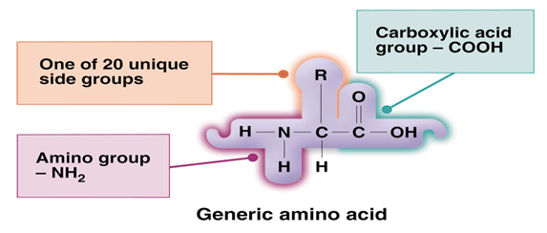
AMINO ACIDS: Structure
Consist of a central carbon atom bonded to: a hydrogen, a carboxylic acid, an amino group, and an additional side group that is unique to each amino acid

Slide 9
Digestion of proteins

Slide 10
Initial digestion of protein in stomach
No digestion of protein takes place in the mouth,
Hydrochloric acid denatures protein and also converts pepsinogen to pepsin
Pepsin breaks the protein down into peptides of various lengths and some amino acids
Pepsin act only at pH 1.6-3.2
Pepsin completes ~ 10-20% of digestion

Slide 11
Denaturing of Proteins
Acid, alkaline, heat and alcohol, can disrupt the chemical forces that stabilize proteins and can cause them to lose their shape (denature)
Denaturing of proteins happens during food preparation (cooking, whipping, adding acids) or digestion (in the stomach with hydrochloric acid)

Slide 12
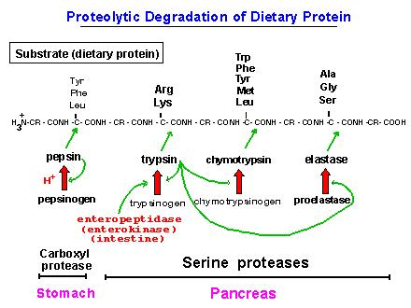
Action of Proteolytic enzymes
Pepsin hydrolyses the bonds between aromatic amino acids(phenylanine or tyrosine) and a second amino acid
So the product of pepsin hydrolysis is polypeptides of diverse sizes

Slide 13
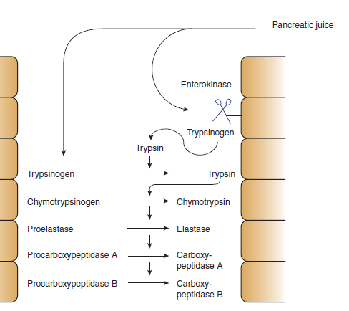
Polypeptidases
Trypsinogen and chymotrypsinogen (proenzymes) are secreted by pancreas in response to protein in the small intestine
They will be activated to trypsin and chymotrypsin (now called proteases)

Slide 14
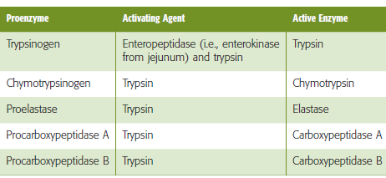

Slide 15
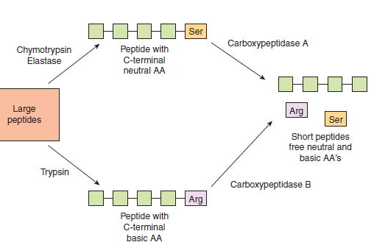
Peptidases hydrolyse proteins
These enzymes can either cleave internal peptide bonds (i.e. endopeptidases)
exopeptidases cleave off one amino acid at a time from either the –COOH or –NH2 terminal of the polypeptide (i.e. they are carboxypeptidases , and aminopeptidases, respectively)

Slide 16
The endopeptidases cleave the large polypeptides to smaller oligopeptides, which can be acted upon by the exopeptidases to produce the final products of protein digestion, amino acids, di- and tripeptides, which are then absorbed by the enterocytes

Slide 17
Further hydrolysis by Peptidases
By the action of endo and exopeptidases some free amino acids are liberated in the intestinal lumen,
But others are liberated at the cell surface by the aminopeptidases, carboxypeptidases, endopeptidases, and dipeptidases in the brush border of the mucosal cells.

Slide 18
Absorption of proteins

Slide 19
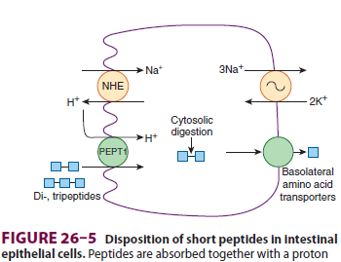
Transport of amino acids and polypeptides in the enterocytes
The di- and tripeptides are actively transported into enterocytes by a system known as peptide transporter 1) that requires H + instead of Na +

Slide 20
At basolateral membrane
The movement of any one amino acid can occur through one or more amino acid transporters.
At least five amino acid transporters are present in the basolateral membrane.
Three amino acid transport processes on the basolateral membrane mediate amino acid exit from the cell into the blood
Two other amino acid transporters mediate uptake from the blood for the purposes of cell nutrition.

Slide 21
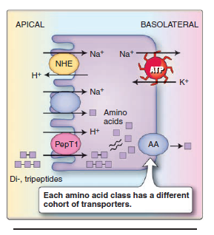
Amino acid transport at basolateral
Individual amino acids are transported across the basolateral membrane without the need for cotransport.
Many different amino acid transporters are located on the basolateral membrane and provide specificity

Slide 22
Further hydrolysis by Peptidases
By the action of endo and exopeptidases some free amino acids are liberated in the intestinal lumen,
But others are liberated at the cell surface by the aminopeptidases, carboxypeptidases, endopeptidases, and dipeptidases in the brush border of the mucosal cells.

Slide 23
Absorption of proteins

Slide 24
Transport of amino acids and polypeptides in the enterocytes
The di- and tripeptides are actively transported into enterocytes by a system known as peptide transporter 1) that requires H + instead of Na +

Slide 25
At basolateral membrane
The movement of any one amino acid can occur through one or more amino acid transporters.
At least five amino acid transporters are present in the basolateral membrane.
Three amino acid transport processes on the basolateral membrane mediate amino acid exit from the cell into the blood
Two other amino acid transporters mediate uptake from the blood for the purposes of cell nutrition.

Slide 26
Amino acid transport at basolateral
Individual amino acids are transported across the basolateral membrane without the need for cotransport.
Many different amino acid transporters are located on the basolateral membrane and provide specificity

Slide 27
Diseases associated with absorption of proteins
Hartnup disease and cystinuria are hereditary disorders of amino acid transport across the apical membrane.
These autosomal recessive disorders are associated with both small intestine and renal tubule abnormalities
the absorption of neutral amino acids in the case of Hartnup disease and of cationic (i.e., basic) amino acids and cystine in the case of cystinuria.

Slide 28
References
Lippincott’s Illustrated Reviews: Physiology (2013)
Medical Physiology, Updated second edition (walter F. Boron, MD, phd)
Berne & levy, physiology, sixth edition, updated edition
Ganong’s Review of Medical Physiology, 26 t h e d i t i o n

