Slide 1
Diabetes in Pregnancy Hyperglycemia in Pregnancy
Prof Vinita Das
Dean Medical Faculty
HOD Ob/Gyn
KGMU, Lucknow

Slide 2
Disclaimer
This presentation and slides are for educational purpose for teaching & training of undergraduate medical students

Slide 3
Objectives of Session
What is GDM?
How to diagnose and monitor during pregnancy in India?
Effect of GDM on pregnancy
Effect of GDM on fetus & neonate
Long term consequences
Management during Labour
Postpartum contraception
Pre-conception counseling

Slide 4
Diabetes a Global Pandemic Prevalence very high in Asians
Global Prevalence is 1-15%
Incidence gradually increasing in younger population
Pregnancy is a Diabetogenic state – Hyperglycemia in pregnancy (HIP) quite common

Slide 5
Diabetes & Pregnancy
Pregnancy in Pre-existing Diabetes
Gestational Diabetes Mellitus (GDM) Prevalence in India 14-17%

Slide 6
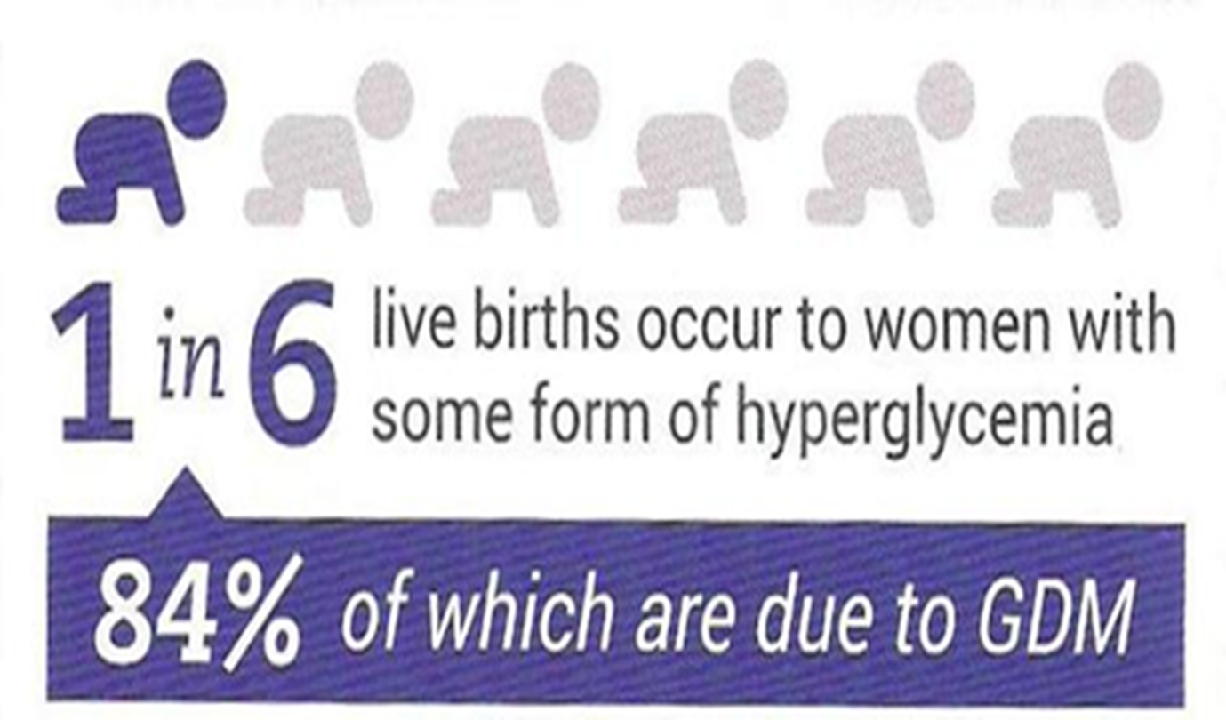

Slide 7
Changes in CHO metabolism during Pregnancy
Pregnancy is a diabetogenic state
There is a state of increasing insulin resistance (due to Cortisol & placental secretion of HPL)
Higher insulin resistance also results into compensatory Hyperglycemia
Higher levels of Estrogen & Progesterone during pregnancy cause pancreatic B cell hyperplasia & hypertrophy resulting into hyperinsulinemia
Glucose diffuses faster across the placenta to be used by fetus
Creating a state of F hypoglycemia (Accelerated starvation & catabolism) and PP hyperglycemia (facilitated anabolism)
State of accelerated starvation leads to higher free fatty acid production to be used by mother for energy
Low renal threshold of glucose & increase GFR leads to glycosuria

Slide 8
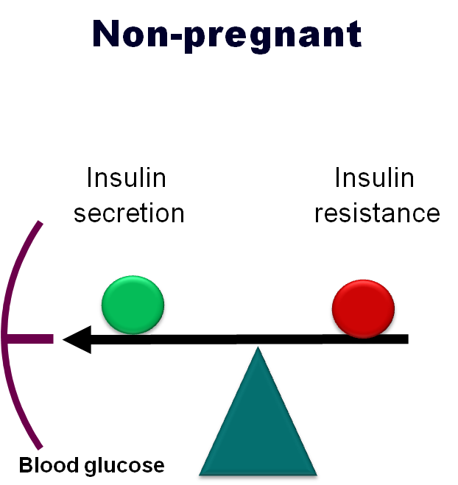
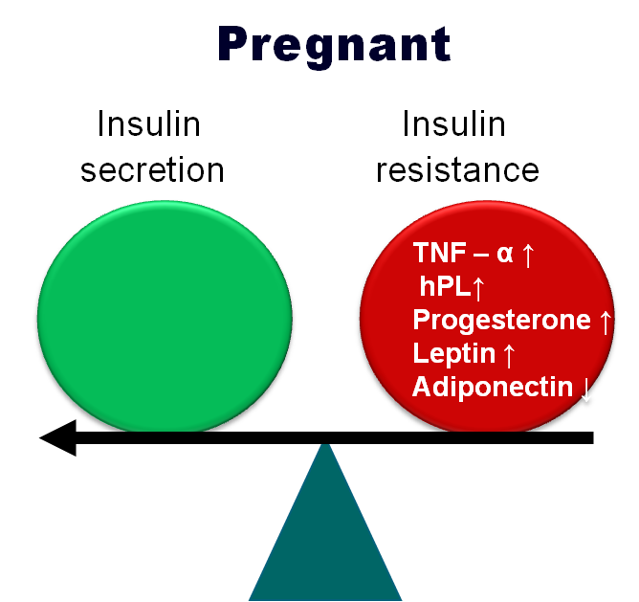
Physiological changes during pregnancy
Notes:
8
#
8
This is a model to explain the relationship between insulin secretion, insulin resistance and glucose tolerance in pregnancy.
Normal glucose tolerance requires a balance between insulin secretion and insulin resistance.
The figure to the left is the situation outside pregnancy in normal women.
In pregnancy, to ensure that adequate nutrients are available all the time for the growing foetus the maternal system as well as the placenta secretes hormones and metabolic mediators that resist the action of insulin creating increased insulin resistance. In normal women, the insulin secretion is correspondingly increased, so the balance is maintained, but at the cost of higher circulating insulin level and glucose levels that are lower than normal because of transfer to the foetus and placenta.

Slide 9
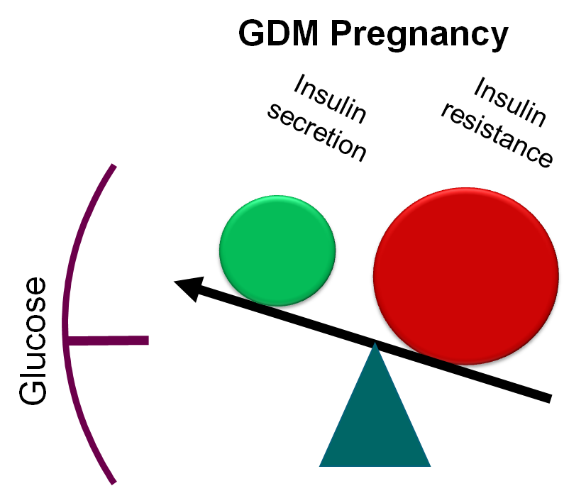
Patho-physiology of GDM
Conditions that enhance IR overweight, obesity, PCOS, excess weight gain, offspring of GDM mother
Conditions compromising ability to increase insulin secretion – low birth weight, poor early life nutrition, stunting
Notes:
As long as the maternal islets are able to cope with rising demand for insulin the balance is maintained. However when the capacity for insulin secretion is not able to cope with rising insulin resistance hyperglycemia occurs. In this context one can understand why women with preexisting insulin resistance (overweight, obesity, foetal programing) or those with lower ability to produce insulin (foetal programing) are more prone to hyperglycemia during preganacy.

Slide 10
Risk factors for GDM
Age > 25
Obesity (BMI ≥ 25) and Metabolic Syndrome
HR ethnicity (South Asians, Mexicans, Blacks etc)
Diabetes in first degree relative
PCOS
Previous GDM/glucose intolerance
Previous macrosomic baby
Previous poly-hydramnios
Previous congenital malformed newborn
Previous unexplained perinatal loss

Slide 11
Gestational Diabetes Mellitus
Glucose intolerance of any severity with onset or first recognition during pregnancy
Recommended in India - Universal screening at first antenatal examination in all pregnant women
If woman comes late in 3rd trimester for the first time, test to be done

Slide 12
DIPSI Test – Single step test
75 gm of glucose in 300 ml of water to be taken irrespective of meal intake
After 2 hour Glucometer sampling done
Blood sugar values ≥ 140 mg% is diagnostic of GDM
If report is negative, test to be repeated between 24-28 weeks gestation
There should be 4 weeks interval between 2 tests

Slide 13
DIPSI Criteria for Diagnosis of GDM/DM
2hr Plasma Glucose after 75 gm Glucose irrespective of meals | In Pregnancy | Outside Pregnancy
>200 mg/dl | Diabetes | Diabetes
>140-199mg/dl | GDM | IGT
120-139mg/dl | GGI (gestational glucose intolerance)
<120 mg/dl | Normal | Normal

Slide 14
Effect of GDM
Maternal
Fetal & Neonatal
Pre-eclampsia 15-20% vs 5-7 % in non GDM
Poly-hydramnios
Preterm delivery
Operative delivery
Perineal trauma
Infections
Keto-acidosis
Risk of future diabetes (60%)
Fetal macrosomia
Prematurity
Birth trauma
Congenital malformations
IUD
RDS
Neonatal metabolic complications (hypoglycemia, hyperbilirubinemia, hypocalcemia, polycythemia)
Obesity & Diabetes in later life (20-30%) 4-8 times higher risk

Slide 15
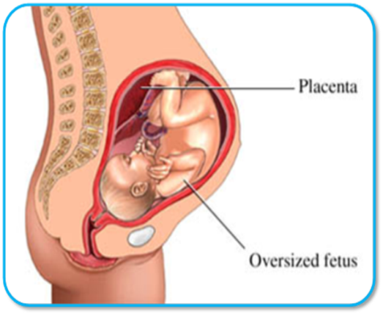
Effect of Hyperglycemia on Maternal morbidity and mortality
Women die during pregnancy and delivery due to:
haemorrhage (25%)
infection (15%)
unsafe abortion (13%)
eclampsia (12%)
obstructed labour (8%)
WHO analysis of causes of maternal death: a systematic review. Lancet 2006; 367 (9516) :1066 –74.
Hyperglycemia increases risk for
Hydroamnios, pre-eclampsia, PIH
Prolonged labor, uterine atony and PPH
Obstructed labor, assisted delivery & C-section
Infections
Progression of retinopathy

Slide 16
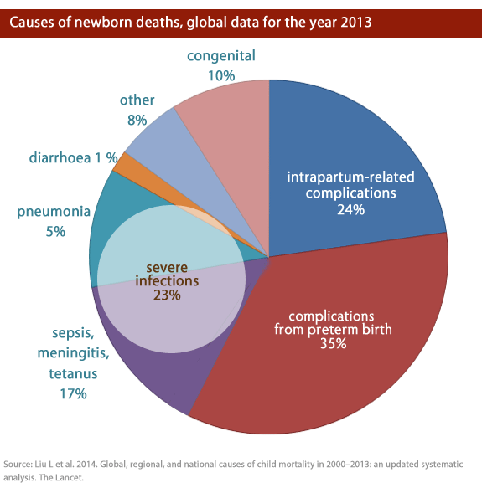
Effect of Maternal Hyperglycemia on Perinatal and Neonatal oucomes
Fetal risks associated with Maternal Hyperglycemia
Spontaneous abortion, IUD and SB
Congenital Malformation
Macrosomia, shoulder dystocia and birth injuries
Neonatal hypoglycemia, RDS,
Low birth weight, Preterm birth

Slide 17
Fetal Complications
Proposed factors associated with teratogenesis in pregnancy with DM
Hyperglycemia
Hypoglycemia
Ketone body excess
Somatomedin inhibition
Arachidonic acid deficiency
Free oxygen radical excess
Factors must act before 7 weeks, so patients with poor peri-conceptional control, long standing diabetes & vascular disease, early 1st trimester GDM
Fetal Macrosomia
Intrauterine fetal death (Hypoxia)
Congenital anomalies

Slide 18
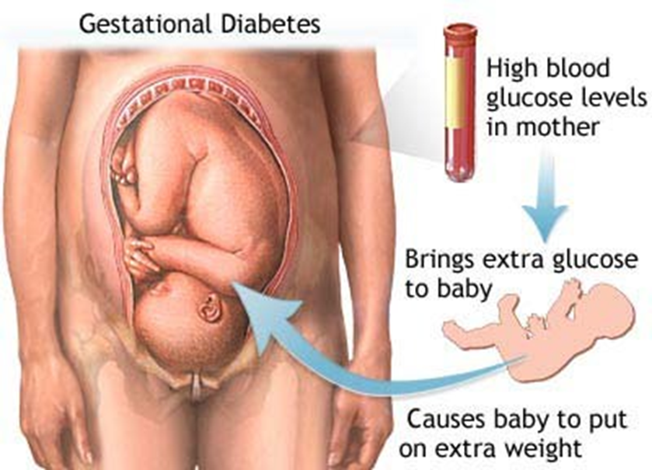
Fetal Macrosomia
Birth weight > 90th percentile
> 4-4.5 Kg
Complicate 50% pregnancies with GDM and 40% with DM type I & II

Slide 19
Congenital Malformations
Congenital malformations - most important cause of perinatal loss in pregnancy associated with DM
2- 6 fold increase in major malformations in DM I & II

Slide 20
Fetal congenital malformations in Diabetes in Pregnancy- Common in preexisting diabetes & GDM diagnosed in 1st trimester
CNS malformations 10%
Anencepahaly
Spina bifida
Holoprosencephaly
Microcephaly
CVS anomalies 38%(most common)
VSD
Transportation of great vessels
ASD
Coarctation of aorta
Cardiomyopathy
Single umbilical artery
Skeletal system anomalies 15%
Caudal regression syndrome
Sacral agenesis – most characteristic
Limb defects
Renal system anomalies
Renal agenesis
Hydronephrosis
Ureteric anomalies
GIT anomalies
Duodenal atresia
Anorectal atresia
Small left colon syndrome

Slide 21
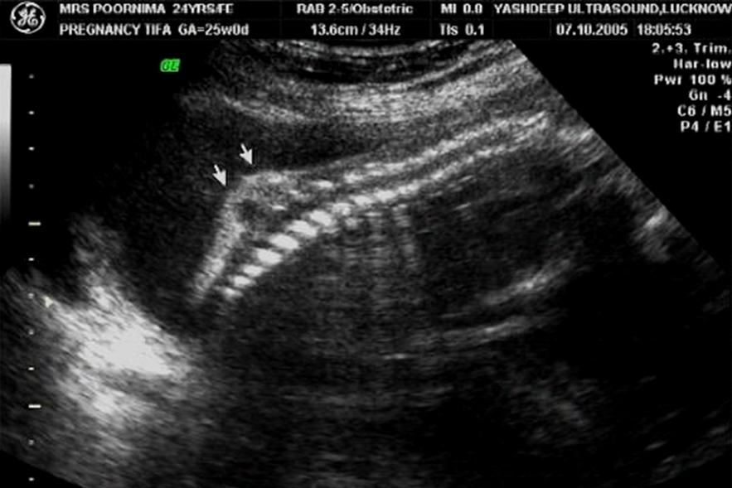
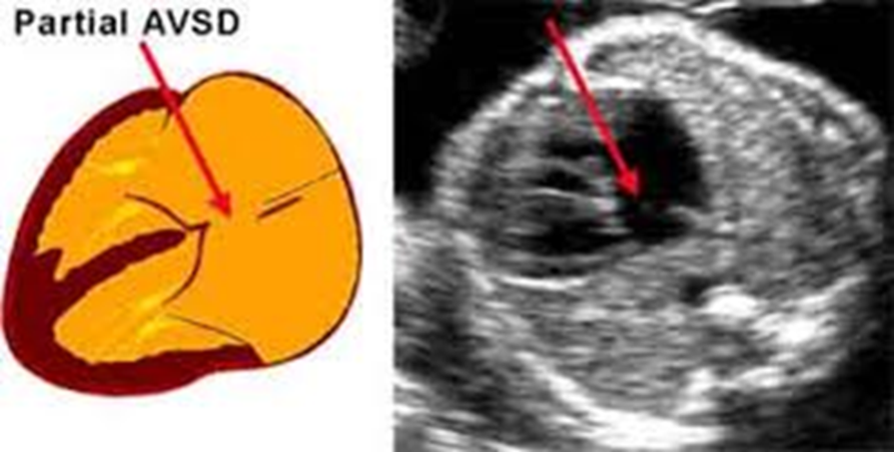
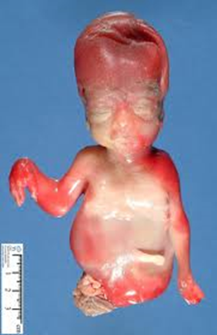
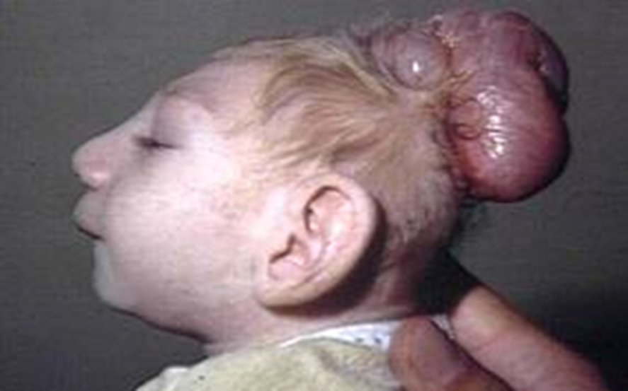
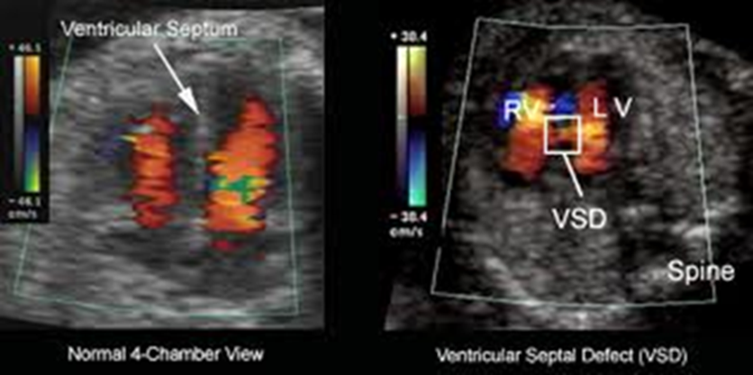

Slide 22
Monitoring and Management of GDM

Slide 23
Maternal Surveillance in GDM
Women education
Monitoring for hyperglycemia
Fetal surveillance
General Obstetric care
Special Obstetric care

Slide 24
Glycemic Control

Slide 25
Target Sugar Values in Pregnancy
F plasma sugar < 95 mg %
2 Hour PP plasma sugar < 120 mg %

Slide 26
Education for glycemic control
Glycemic goals
Need for strict glycemic control
Importance of healthy diet and exercise
Need for regular follow up
How to take metformin/insulin
Symptoms of hypoglycemia and its management
Use of glucometer

Slide 27
Pregnant Woman with GDM
2 hr PPP Glucose < 200 mg%
2 hr PPP Glucose ≥ 200 mg%
Metformin/Insulin + MNT
MNT +
Exercise
2 hr PPPG ≥120mg% start metformin/insulin
2 hr PPPG <120mg% continue MNT
After 2 wks

Slide 28
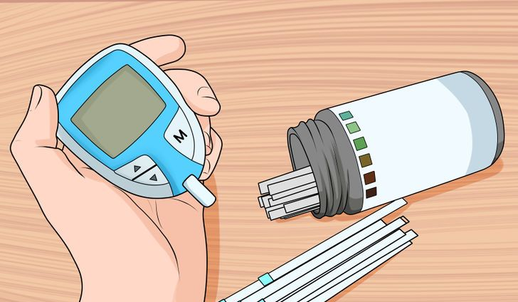
Glycemia Monitoring
On MNT fortnightly till 28 wks ( 2hr PP)
After 28 wks weekly
On metformin / insulin + MNT - 7 times a day ideal or every third day till glycemic goals achieved (F & 2hr PP)
Thereafter every week
HbA1C at 6-8 weeks interval

Slide 29
Diet / MNT for all
Diet plan according to Body Weight – KCal/Kg
Obese women : 25-30
Non-obese : 30-35
Underweight: 35-40
Dietary compliance is evaluated and reinforced during every hospital visits

Slide 30
BMI & Pre-pregnancy weight decides weight gain goals
Pre-pregnancy Weight | Weight Gain during pregnancy in Kg
Normal | 11.5 to 16
Underweight | 12.5 to 18
Overweight | 7 to 11.5
Obese | 5 to 9

Slide 31
Diet Composition
Carb 50 – 60%
Proteins 10 - 20%
Fats 25 – 30%

Slide 32
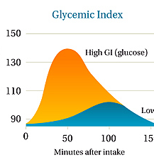
Glycemic index concept to be taught to women
The extent of rise in blood sugar in response to a food in comparison with an equivalent amount of glucose
CHO producing less rise in blood glucose and insulin are low GI foods

Slide 34
Important tips for diet planning
Divide meal into 3 Major meals and 2 – 3 snacks
Eat at same time
Avoid overeating
Avoid fasting

Slide 35
General tips
Avoid fried foods
Recommended steamed, boiled or sauté food
Whole fruits than juices
Fish/chicken over red meat
More fiber, salad and non- starchy veg
Whole grain cereals and pulses
Drink water, buttermilk, soups, soy milk

Slide 36
Exercise
To improve insulin sensitivity
To increase insulin production

Slide 37
What Exercises ?
Start 20 min/day, increase gradually to 45 min/day
Low resistance upper body exercise
Exercise for 15-20 min post meal
Avoid falls

Slide 38
Pharmacotherapy Metformin / Insulin
When target sugars not achieved with MNT & Exercise in 2 weeks- Pharmacotherapy started
FPG > 95mg%
2hr PPBS >120mg%
or
Blood sugar values are high at diagnosis
FPG >120 mg%
2hr PPBS >199 mg%

Slide 39
Word of caution for Hypoglycemia
Blood sugar <70 mg/dL
Drink 3 teaspoons of glucose powder (15-20 grams) or 6 teaspoon sugar dissolved in a glass of water
Take rest and avoid any physical activity

Slide 40
Obstetric monitoring in GDM pregnancy
Routine ANC - Min 4 ANC for GDM well controlled on diet & no complications
More ANC visits or as per need for GDM on insulin, uncontrolled blood glucose or other complication of Pregnancy
Every 2 weeks in second trimester
Every week in third trimester
Monitoring at each ANC
maternal weight gain
Abnormal fetal growth (macrosomia/growth restriction)
Polyhydramnios
BP and Proteinuria
Fundus examination

Slide 41
Role of USG
Early pregnancy scan for MSD & CRL
11-14 weeks scan for NTD
18-20 weeks scan – TIFA (targeted imaging of fetal defects)
Early prediction of PIH & IUGR
24-26 weeks fetal Echocardiography
29 weeks scan - AC for Macrosomia
Follow up scan at 32 & 36 weeks for fetal growth

Slide 42
Antepartum Fetal Surveillance
Daily fetal kick count in third trimester
Fetal NST and/or Biophysical profile as per need
Doppler flow studies specially when associated with PET and IUGR

Slide 43
Role of Antenatal steroids
Delayed fetal Lung Maturity in GDM pregnancy
Woman requiring early delivery needs antenatal steroids
Injection Dexamethasone 6 mg IMI 12 hourly 4 doses
Steroids are hyperglycemic agents
More vigilant monitoring of blood glucose for next 72 hours to one week
Adjustment of insulin done with each meal

Slide 44
Mode & Time of Delivery
Primary goal is to have normal healthy newborn
Concerns –
Risk of Delayed lung maturity
Unexplained IUD & SB more after 36 weeks
Macrosomia
RDS
Vaginal vs cesarean delivery depends on extent of glycemic control and associated obstetrical problems
Women on diet control for spontaneous onset of labour
Elective labour induction is controversial with no proven benefit
Women on insulin should deliver at 38/39 weeks
Cesarean section around 36 weeks for uncontrolled GDM on insulin
Elective LSCS for fetal weight > 4.5 Kg

Slide 45
Intrapartum Considerations
These women are predisposed to infections so strict asepsis
Per vaginal exams to be restricted
CPD to be properly assessed
Early decision of cesarean to be taken in case of prolonged labour
Continuous electronic monitoring is recommended as there is increased risk of fetal distress

Slide 46
Labour management
When patient goes into spontaneous labour or planned for induction or LSCS – F blood sugar to be sent
Morning dose of Long acting insulin to be withheld
Target blood sugar values in Labor is between 70 to 110 mg%
Blood sugar to be checked hourly
Urine sugar and ketone to be checked 2 to 4 hourly
Elective LSCS to be done as first case in morning
Regional anaesthesia is preferred

Slide 47
Glycemic control during Delivery
Goal of intrapartum management is to maintain normoglycemia in order
To prevent neonatal hypoglycemia, capillary hrly monitoring is needed
Target values are 70-110 mg/dl
Blood Glucose | Insulin/IV Fluids
60-90 mg/dl | 5% GNS – 100 ml/hr
90-120 mg/dl | NS or RL – 100 ml/hr
120-140 mg/dl | NS or RL – 100 ml/hr plus 2-4 unit of regular insulin every hr
140-180 mg/dl | NS or RL – 100 ml/hr plus 6 unit of regular insulin every hr
> 180 mg/dl | NS or RL – 100 ml/hr plus 8 unit of regular insulin every hr

Slide 48
Post partum Management
Marked decrease in insulin requirement in first 24-48 hrs post partum
Neonate monitoring for hypoglycemia & respiratory distress ( Blood sugar < 45 mg% cut off for neonatal hypoglycemia)
OGTT done 6 weeks post partum with 75 gm Glucose ( Target values FBG < 100 mg%, 2 hr PP BG < 140 mg%)
Lifestyle modification with diet & exercise and weight reduction
POP, Barrier contraception, IUCD all can be used as post partum contraception
Low dose COC after 6 months

Slide 49
Long term Consequences
Higher chances of (50-60%) early dev of Type II DM & CVD in woman
Higher chances (30-40%) of dev of repeat GDM in subsequent pregnancy
Higher chances (20-30%) of early dev of type II DM and CVD in off springs

Slide 50
Pre-conception counseling
Pre-gestational diabetic becoming pregnant (.2-.3%)
High risk of end organ damage
Higher risk of cong malformation & IUD
Should be a planned pregnancy
Emphasize need for regular follow up and compliance
Evaluation of end organ involvement
Retinopathy requiring laser therapy should be offered MTP
Women with significant impaired renal function (S.creatinine > 3.6 mg%) - should be offered MTP
To be shifted on Insulin if on oral drugs except if on metformin
Dietary advice
HbA1C should be < 6.5 before conception
F plasma Value < 100 mg%, 2 hr PPP glucose < 140 mg%
Folic acid supplementation –peri-conception

Slide 51
Early diagnosis & Proper management & follow up of women has the potential to prevent Diabetes in two generations
Strict glycemic control is key for successful outcome

Slide 52
Thank you

