Slide 1
DEMONSTRATION OF SOFT PARTS OF LOWER LIMB PART 3
BY-
Dr. Amber Rana
JR3
Department of Anatomy
King George’s Medical University

Slide 2
Objective :
To identify and describe the various structures of the following region:-
Lateral compartment of leg
Posterior compartment of leg
Dorsum of foot

Slide 3
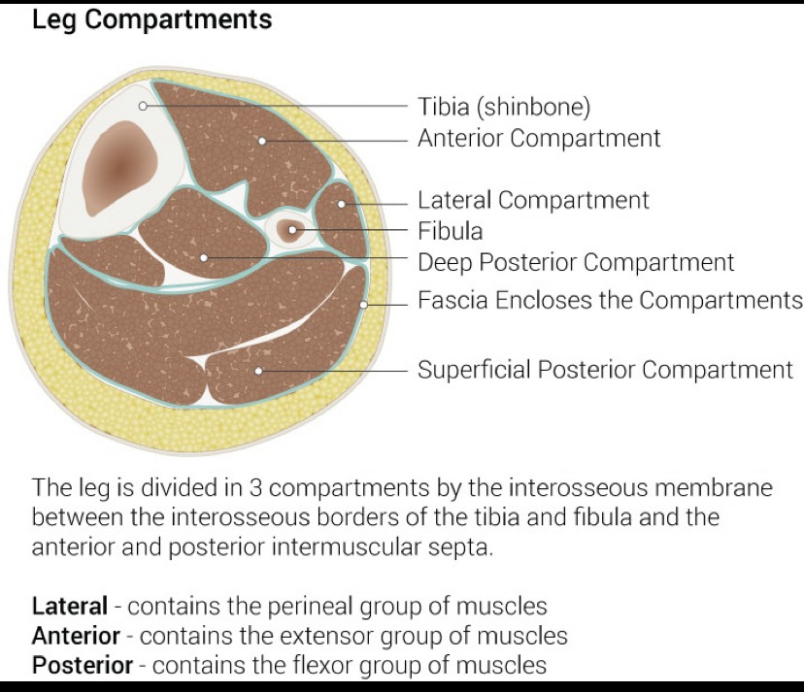
Lateral Compartment of Leg:
Boundaries: -
anteriorly: Anterior intermuscular septum
Posteriorly: Posterior intermuscular septum
Medial: Lateral surface of fibula
Lateral: Deep fascia
Structures present are:-
Muscles: Peroneus longus and Peroneus brevis
Nerves: Superficial peroneal nerve
Vessels: Peroneal artery

Slide 4
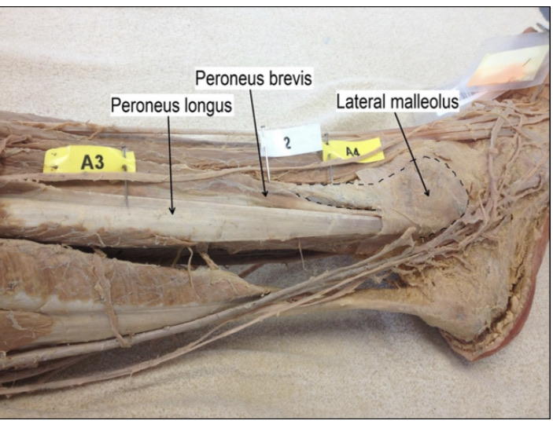
Peroneus brevis
Lateral
malleolus
Peroneus longus

Slide 5
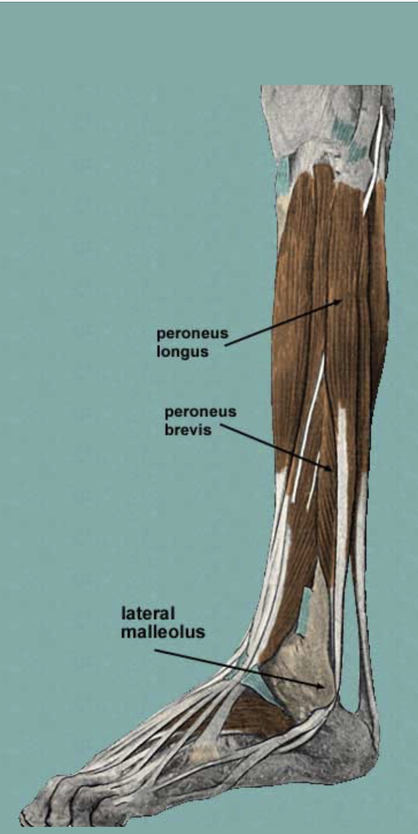
Peroneus Longus
Origin: Head of fibula
upper and middle 1/3rd of the lateral surface of shaft of fibula
Insertion : base of first metatarsal, medial cuneiform.
Nerve: superficial peroneal nerve
Action: Planterflexion, eversion of foot

Slide 6
Peroneus brevis
Origin: Anterior half of middle 1/3rd and whole lower 1/3rd of lateral surface of shaft of fibula, Anterior and posterior intermuscular septum
Insertion : lateral side of the base pf the 5th metatarsal bone
vessel :peroneal artery
Nerves: superficial peroneal (fibular)nerve
Action: Planterflexion, eversion of foot

Slide 7
Posterior Compartment of leg
Aka posterior compartment of leg
Subdivided into 3 compartment : superficial, middle, and deep by 2 strong fascial septa
Muscles of superficial compartment : Gastrocnemius, Soleus and Plantaris
Nerve supply: posterior tibial nerve
Action: planter flexion of foot (Both gastrocnemius and soleus)
flexion at knee joint (gastrocnemius)
Muscles of deep compartment: popliteus,
FDL, FHL, Tibialis posterior

Slide 8
Lateral head
Of gastrocnemius
Medial head of gastrocnemius

Slide 9
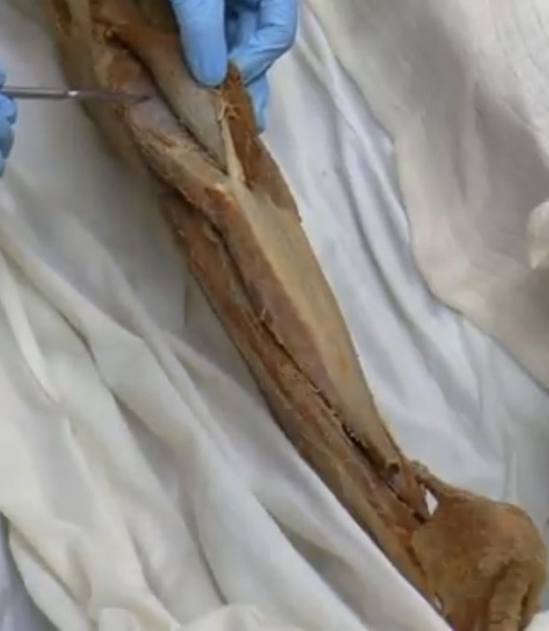
soleus
Proximal
Lateral
Medial
Tendo achellis
Distal

Slide 10
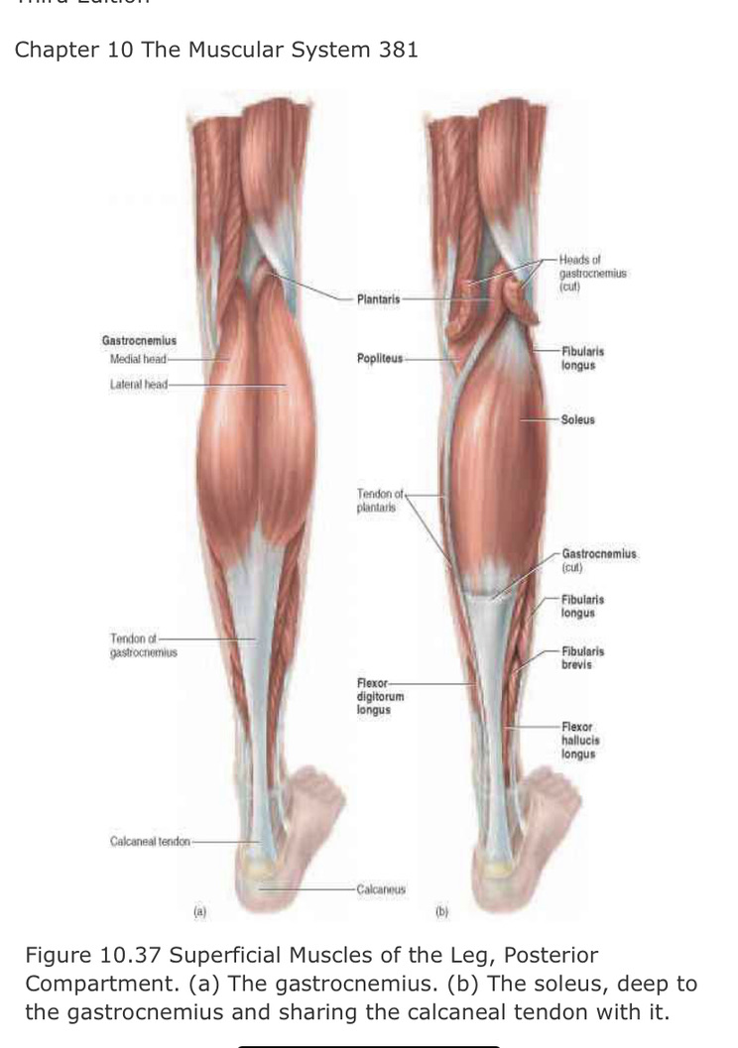

Slide 11
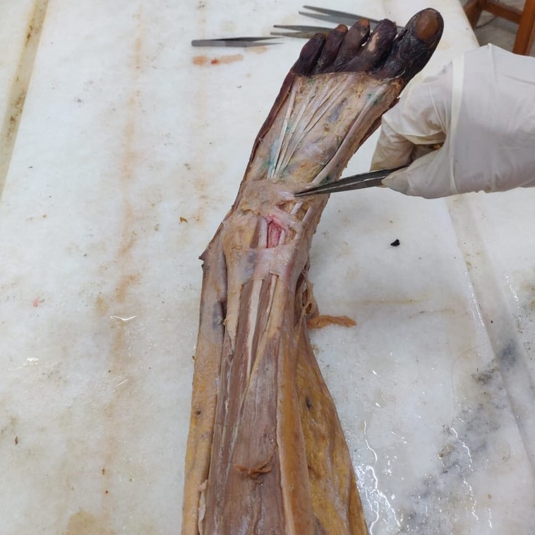
Dorsum of Foot
Small muscle of foot is extensor digitorum brevis present on the dorsal side of foot .Its tendon are deep to the tendons of extensor digitorum longus. Its medial tendon is called extensor hallucis brevis.

Slide 12
Extensor digitorum longus
Inferior
Extensor
retinaculum
Extensor Hallucis Longus
Tibialis Anterior
Superior
Extensor
Retinaculum

Slide 15
Thankyou

