Slide 1
Nasal Cavity-II
Presented by:-
Dr. Sushma Tomar
Associate Professor
Department of Anatomy

Slide 2
Lesson Plan
Lateral Wall of Nasal Cavity:
Formation
Features
Openings
Arterial Supply
Venous Drainage
Lymphatic Drainage
Nerve Supply
Applied Aspects

Slide 3
Lateral Wall of Nasal Cavity

Slide 4
Lateral Wall of Nasal Cavity- Formation
Bones-
Nasal
Maxilla- Frontal process
Lacrimal.
Ethmoid-
-Superior Concha
-Middle Concha
-Labyrinth.
Inferior Nasal Concha.
Palatine- Perpendicular plate.
Sphenoid- Medial Pterygoid Plate.

Slide 5
Lateral Wall of Nasal Cavity- Formation contd…
Cartilages-
Lateral Nasal Cartilage (Lateral process of Septal Cartilage).
Major Alar Cartilage.
Minor Alar Cartilages (3-4 in no.).

Slide 6
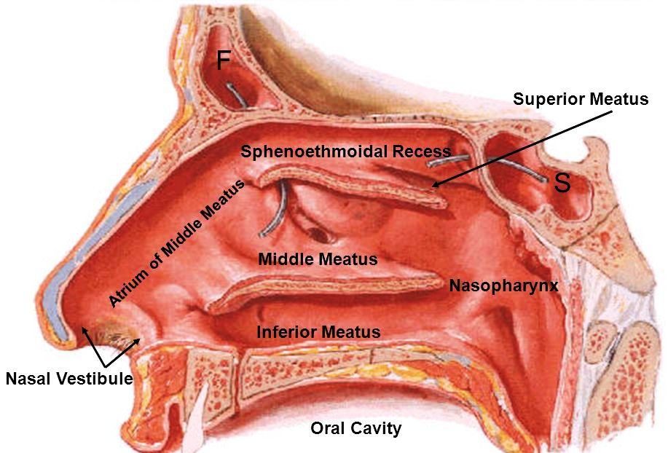
Lateral Wall of Nasal Cavity- Features
Lateral wall of nasal cavity is divided into 3 parts:
Anterior part.
Middle part.
Posterior part.
Anterior part-
Presents a small depressed area, the Vestibule.
It is lined by skin containing short, stiff hair.
Middle part-
It is known as ‘Atrium of Middle Meatus’.
It is limited above by the agger nasi, which is a faint ridge of mucous membrane.
Limen Nasi- Mucocutaneous junction between the vestibule and atrium of middle meatus.
Posterior part-
Presents Conchae (Turbinates) and Meatuses.

Slide 7
Conchae
These are curved bony projections lined by mucosa, directed downwards and medially.
3 in number:
Superior Nasal Concha.
Middle Nasal Concha.
Inferior Nasal Concha.
Superior and middle nasal conchae are projections from medial surface of ethmoidal labyrinth.
Inferior nasal concha is an independent bone.
Superior concha is smallest and Inferior concha is largest in size.

Slide 8
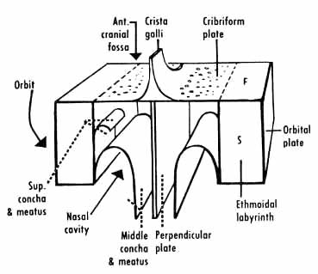
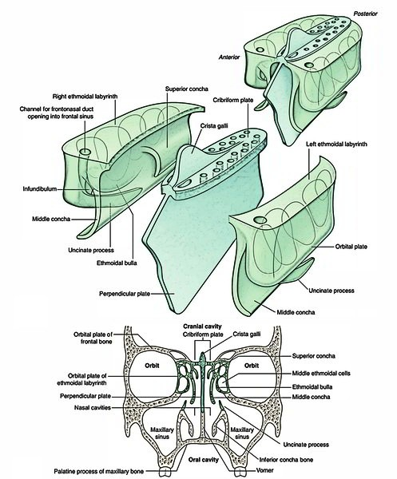

Slide 9
Lateral Wall of Nasal Cavity- Features contd…
Meatuses-
Below and lateral to each concha is a space known as meatus.
3 in number:
Superior meatus.
Middle meatus.
Inferior meatus.
Superior meatus-
It lies underneath the superior concha.
It is smallest.
Middle meatus-
It lies underneath the middle concha.
It presents the following features:
Ethmoidal bulla (Bulla ethmoidalis).
Hiatus semilunaris.
Infundibulum.
Middle concha (cut)
Ethmoidal Bulla
Hiatus Semilunaris
Inferior concha (cut)

Slide 10
Lateral Wall of Nasal Cavity- Features contd…
Ethmoidal bulla-
A round elevation, produced by underlying middle ethmoidal air sinuses.
Hiatus semilunaris-
It is a semicircular sulcus below the ethmoidal bulla.
Infundibulum-
It is a short passage at the anterior end of middle meatus.
Inferior meatus-
It lies underneath the inferior concha.
It is the largest meatus.

Slide 11
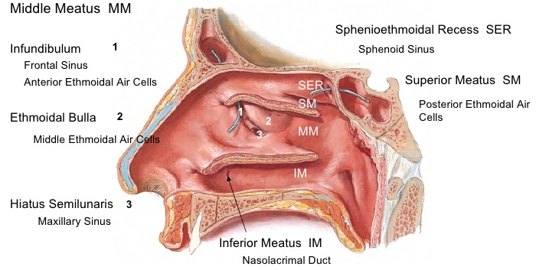
Openings in Lateral Wall of Nasal Cavity
Site | Opening/Openings
Spheno-ethmoidal recess | Sphenoidal air sinus
Superior Meatus | Posterior ethmoidal air sinuses
Middle Meatus
On Ethmoidal Bulla | Middle ethmoidal air sinuses
In Hiatus semilunaris
Anterior part | Frontal air sinus
Middle part | Anterior ethmoidal air sinuses
Posterior part | Maxillary air sinus
Inferior Meatus | Nasolacrimal duct (NLD)

Slide 12
Arterial Supply of Lateral Nasal Wall
Anterosuperior Part-
Anterior Ethmoidal artery (a branch of Ophthalmic artery).
Anteroinferior Part-
Lateral Nasal Artery (a branch of Facial artery).
Greater Palatine Artery ( a branch of Maxillary artery).
Posterosuperior Part-
Sphenopalatine Artery ( a branch of Maxillary artery).
Posteroinferior Part-
Greater Palatine Artery ( a branch of Maxillary artery).

Slide 14
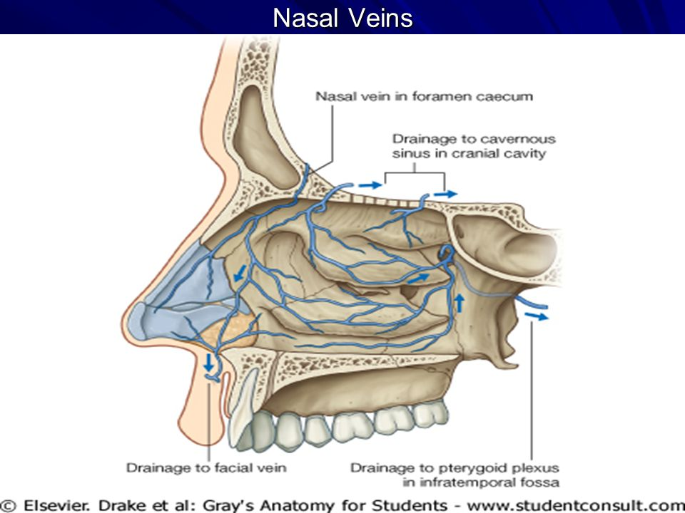
Venous Drainage of Lateral Nasal Wall
In lateral wall of nasal cavity, veins accompany the arteries.
A venous plexus is formed beneath the mucosa.
Veins drain into:
Facial vein.
Pterygoid venous plexus.
Pharyngeal venous plexus.

Slide 15
Lymphatic Drainage of Lateral Nasal Wall
Anterior ½-
Drains into:
Submandibular lymph nodes.
Posterior ½-
Drains into:
Retropharyngeal lymph nodes.

Slide 16
Nerve Supply of Lateral Wall of Nasal Cavity
Anterosuperior Part-
Anterior Ethmoidal Nerve (a branch of Nasociliary nerve).
Anteroinferior Part-
Anterior Superior Alveolar Nerve (a branch of Infraorbital nerve).
Posterosuperior Part-
Posterior superior lateral nasal nerves ( branches of Pterygopalatine ganglion).
Posteroinferior Part-
Nasal branches of Greater Palatine Nerve ( a branch of Pterygopalatine ganglion).
Olfactory Part (upper 1/3rd up to the superior concha)-
Olfactory Nerves.

Slide 17
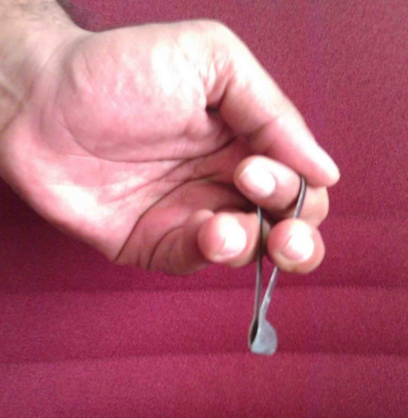
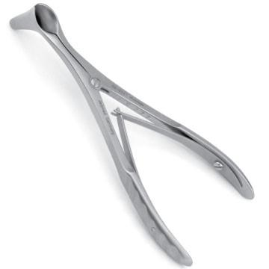
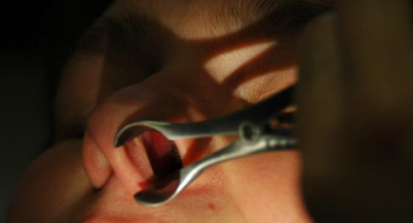
Applied Aspects
Rhinoscopy [ Examination of Nasal Cavity]
Anterior Rhinoscopy
Posterior Rhinoscopy
Anterior Rhinoscopy-
Examination of nasal cavity through the nostril.
It is carried out by inserting a nasal speculum through a nostril.
Nasal Speculum
Nasal Speculum

Slide 18
Structures seen on Anterior Rhinoscopy
Following structures are seen on Anterior Rhinoscopy:
Middle nasal concha (turbinate).
Inferior nasal concha (turbinate).
Superior meatus.
Middle meatus.
Inferior meatus.
Nasal septum.
Floor of nasal cavity.

Slide 19
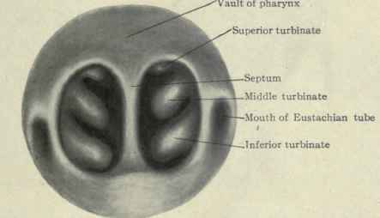
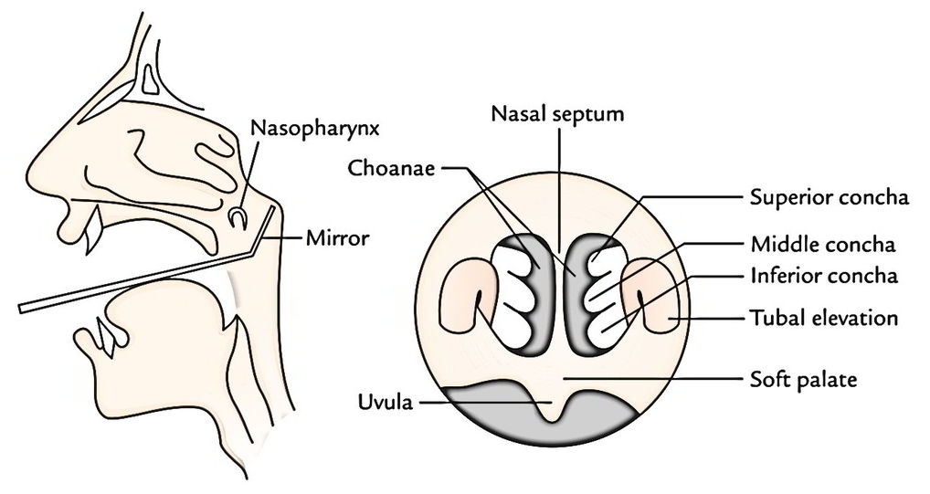
Posterior Rhinoscopy
Examination of nasal cavity through the pharynx.
It is carried out by inserting a mirror into the pharynx.
Structures seen on Posterior Rhinoscopy:
Choanae.
Conchae.
Posterior border of nasal septum.
Posterior Rhinoscopic Mirror

